Slide 1
Cycled HWRF EnKF ensemble hybrid data assimilation system – a potential 2017 HWRF DA Upgrade
Mingjing Tong
Collaborators
Xuguang Wang, Xu Lu, OU, Norman, OK
Henry Winterbottom, Jeff Whitaker, NOAA/ESRL, Boulder, CO
HWRF weekly meeting, July 21, 2016

Slide 2
Outline
Evolution of hybrid DA system for operational HWRF
Challenges for inner-core DA
Cycled HWRF ensemble hybrid DA system
Experiments and results

Slide 3
H215
2013-H214 HWRF hybrid data assimilation system
Conventional data
TDR data
Satellite radiance data
Satellite derived wind
GPS RO banding angle
HS3 dropsonde, Tcvital MSLP data
HWRF one-way hybrid system
GSI hybrid Ens/Var DA d03
Analysis outer, middle, inner
HWRF
3-9hr
forecast
Vortex initialization
GSI hybrid Ens/Var DA d02
Analysis outer, middle, inner
HWRF
forecast
HWRF ensemble forecast
member 1
member 2
……
member 40
Outer domain
analysis
TDR available
TDR
not available
Global EnKF/Var hybrid system
Recenter analysis
Analysis
member 1
member 2
……
member 80
Forecast
member 1
member 2
……
member 80
Analysis
member 1
member 2
……
member 80
Forecast
member 1
member 2
……
member 80
EnKF member
update
high res
analysis
high res
forecast
GSI hybrid Ens/Var
high res
analysis
high res
forecast

Slide 4
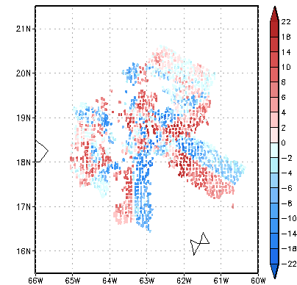
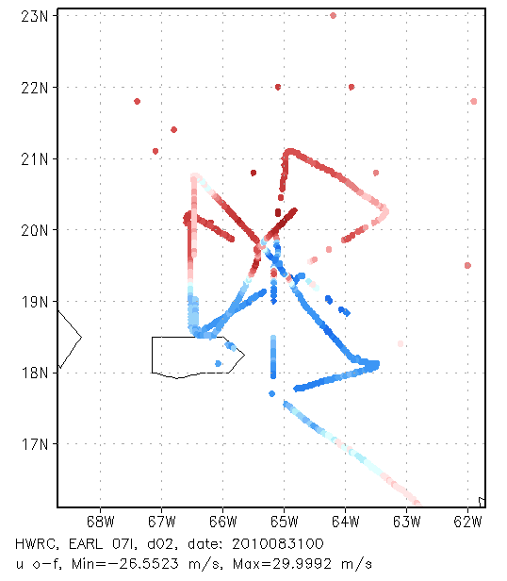
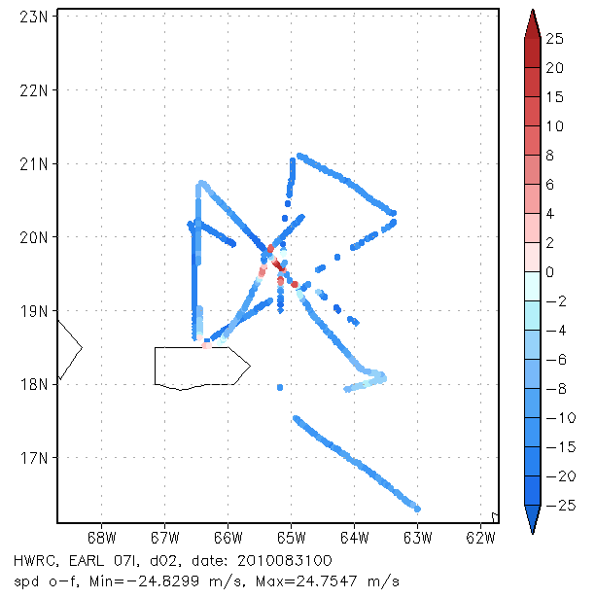
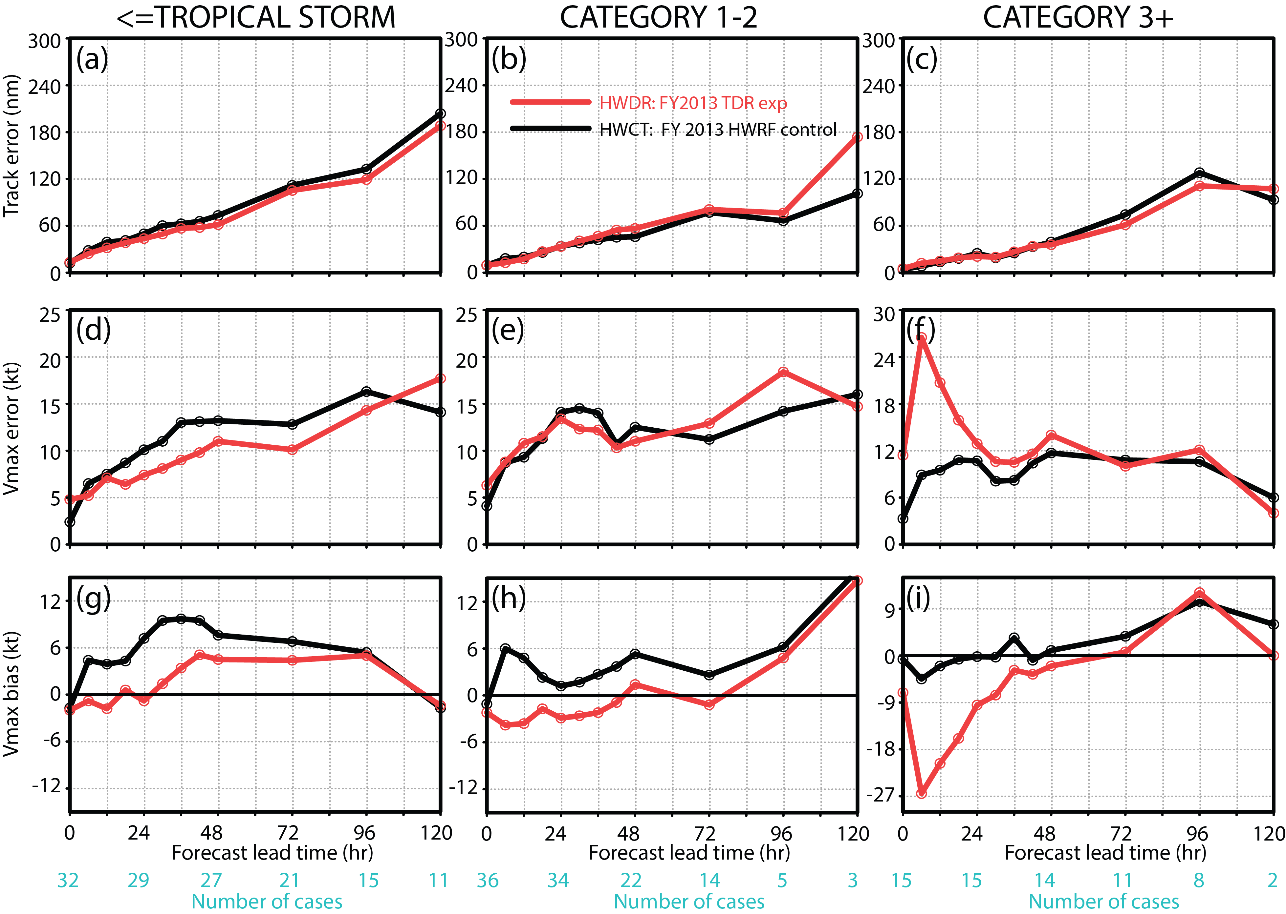
Challenges for hurricane inner-core DA
O-F : TDR radial wind
dropsonde, flight level U
SFMR wind speed
TDR data impact
RECON data impact
TDR + RECON data
RECON from 2008 -2012
Assimilation of aircraft inner observations (TDR, RECON) can improve track and intensity forecast for weak storms, but can degrade intensity forecast for strong storms
Issues for strong storms:
  Initial weak bias
  Imbalance and short-term forecast spin-down

Slide 5
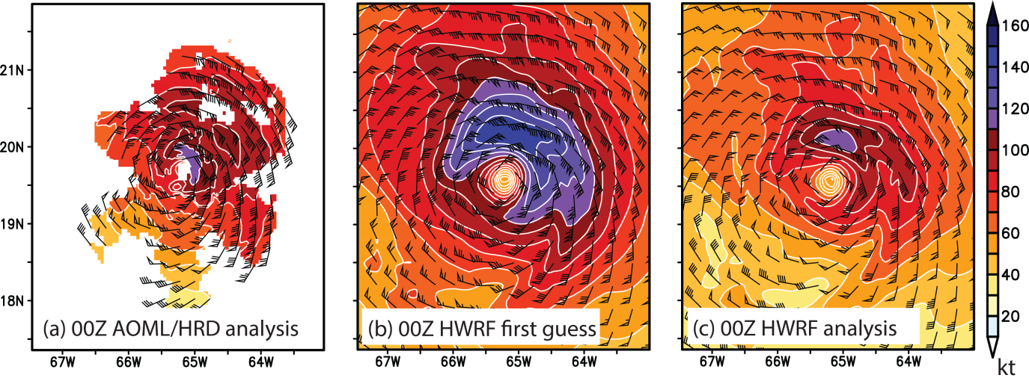
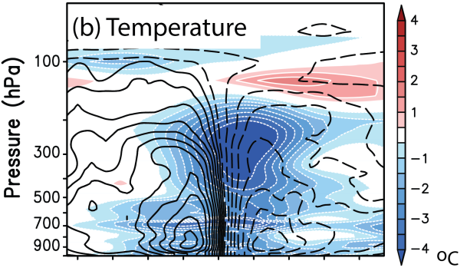

Challenges for hurricane inner-core DA
Reasons for spin-down:
  Systematically larger and stronger bias in background vortex
  Inner-core DA always weakening the storm

Slide 6
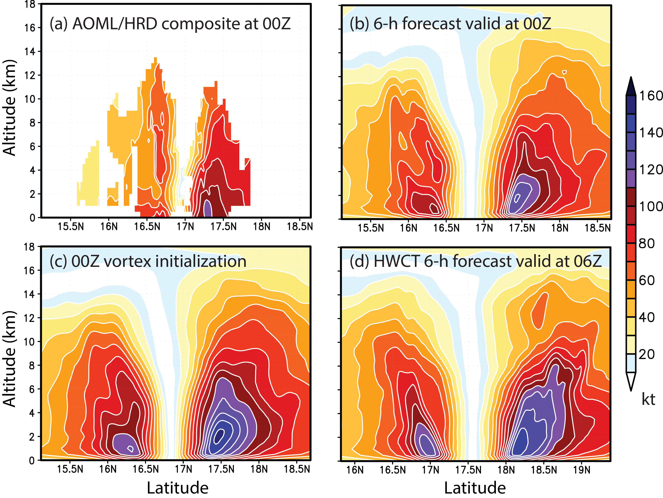
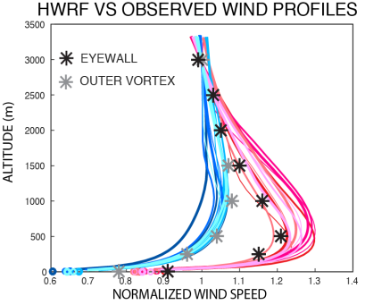
Challenges for hurricane inner-core DA
From Jason Sippel
The strong bias in background vortex come from model and vortex initialization
Model bias - HWRF near-surface winds 10-20% weaker than observation
Vortex initialization matches surface Vmax and applies the same adjustment to the vortex above surface

Slide 7
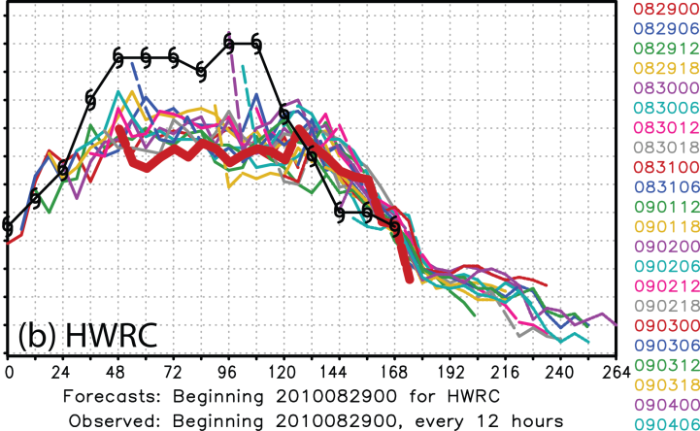
Alleviate spin-down caused by interaction between VI and DA
300km
150km
Current solution to alleviate spin-down: Replace GSI analysis in the inner-core with vortex initialization (VI) – blending. Blending can be turned on based on observed storm intensity (default >50 kts)
Another solution: turn off vortex adjustment (but keep vortex relocation), which can be done for all cycles or triggered by TDR data.
DA
400 hPa
DA
blending
600 hPa
VI

Slide 8
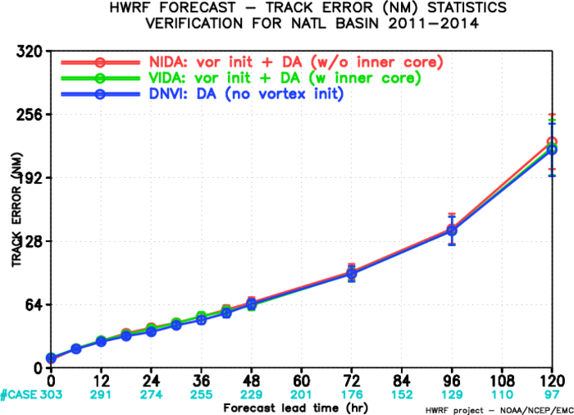
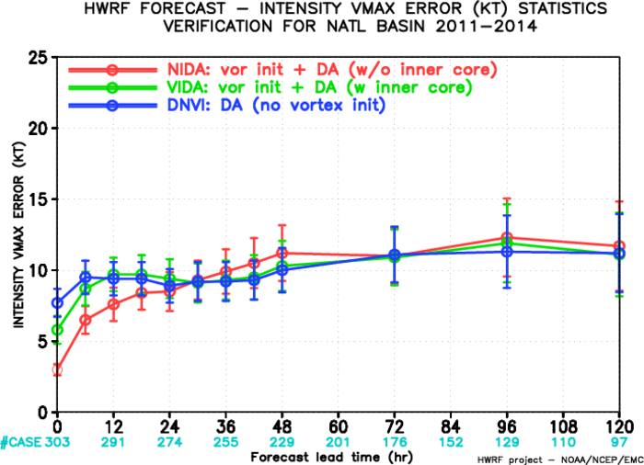
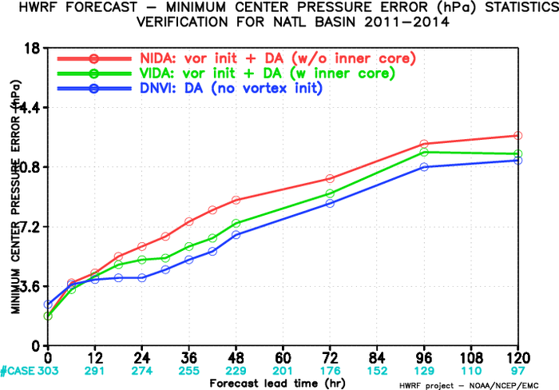
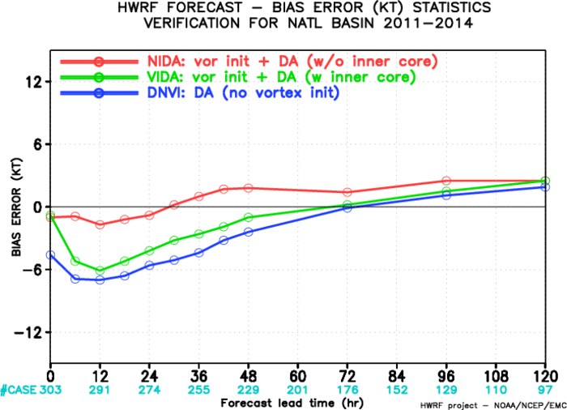
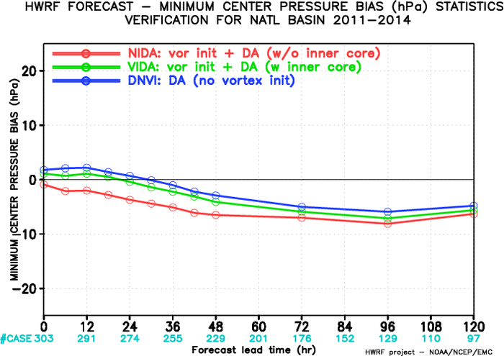
Impact of vortex initialization vs inner-core data assimilation
2015 HWRF 12 AL storms Inner-core data: TDR, dropsonde and MSLP verification for all cycles
NIDA | vortex initialization + inner core DA +blending
VIDA | vortex initialization + inner core DA
DNVI | vortex relocation + inner core DA
Inner core DA: better Vmax forecast after 24 hr and better Pmin forecast
Vortex initialization: better short-term Vmax forecast
* vortex initialization = vortex relocation + size correction + intensity correction
Tong et. al. 27th WAF&23RD NWP conference

Slide 9
Cycled HWRF EnKF ensemble hybrid data assimilation system
Analysis
member 1
member 2
……
member 40
Forecast
member 1
member 2
……
member 40
Vortex relocation
member 1
member 2
……
member 40
Analysis
member 1
member 2
……
member 40
Forecast
member 1
member 2
……
member 40
Recenter
Analysis
EnKF
d01 & d02
EnKF
d02
HWRF EnKF/Var hybrid system
Conventional data
TDR data
Satellite AMVs
HS3 dropsonde
Tcvital MSLP data
Satellite radiance data
GPS RO banding angle
GSI hybrid Ens/Var DA d03
Analysis outer, middle, inner
HWRF
Forecast
(3-9hr)
Vortex initialization
Analysis outer, middle, inner
HWRF
forecast
GSI hybrid Ens/Var DA d02
GDAS
3-9hr
forecast
GDAS/ENKF
ensemble
forecast
mem 001
mem 002
……
GFS analysis
GDAS/ENKF
Analysis
mem 001
mem 002
……

Slide 10
System workflow
launcher
ensda_relocate_pre
GDAS Init
GFS Init
Ocean Init
Relocate ensemble
ens-reloation
mem001
mem002
…
Vortex
Initialization
bufrprep
GSI Meanhx
GSI D03
GSI D02
Merge
GSI Enshx
mem001
mem002
…
MPI
POM-TC
WRF
Coupler
UPP
EnKF
Products
Cycled HWRF ensemble
Ensda_pre
Warm-start HWRF ensemble
Ensda
init-forecast
mem001
mem002
…
post-tracker
to next cycle
GSI D03
GSI D02

Slide 11
Source code changes
EnKF has been added into HWRF building system
hwrf-utilities/tools/hwrf_ensemble
  From Henry Winterbottom
  An independent MPI program to compute ensemble mean
  Modified to perform recentering without interpolation
  namelist parm/hwrf_ensemble.nml
hwrf-utilities/tools/hwrf_interpolate
  A generic MPI program calling GSI modules to perform interpolation between any two NMM grids
  Used for recentering
  The variables to be interpolated are controlled through namelist parm/hwrf_interpolate.nml
  The GSI has to be compiled before hwrf-utilites

Slide 12
Script Changes
Use OU’s branch as a guidance
Scripts written using OOP
Use database to manage products of all new tasks
Rocoto Control workflow and job dependency | Scripts Launch ‘run’ method of each task object | Ush | ush/hwrf define classes for tasks
Added: ensda_relocate_pre.ent enmeanhx.ent enshx.ent enkf.ent Modified: all.ent check_init.ent ensdamemb.ent ensda_relocate.ent | Added: exhwrf_ensda_relocate_pre.py exhwrf_meanhx.py exhwrf_enshx.py exhwrf_enkf.py Modified: exhwrf_bufrprep.py exhwrf_check_init.py exhwrf_ensda_output.py exhwrf_ensda_pre.py exhwrf_ensda_relocate.py | hwrf_expt.py Initialize global variables and instantiate task objects Added instantiation of new task objects | Added: enkf.py Modified/added new classes: ensda.py exceptions.py gsi.py relocate.py

Slide 13
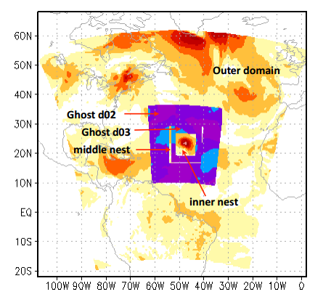
Domain Setup
Ensemble/EnKF d02 is fixed, redefined at each analysis cycle
OU has directed moving nest strategy, but require a big and fixed outer domain, can be leveraged when moving toward basin-scale
HWRF ensemble from 6 km ensemble d02 is used in GSI analysis on 2 km ghost d03
EnKF d02
Ghost d02: 26°x26°, 0.045°
Ghost d03: 13°x13°, 0.015°
EnKF d02 (ensemble forecast d02): 30°x30°, 0.045°

Slide 14
Recenter analysis
EnKF d02 ensemble mean
EnKF d02
members with new ensemble mean
EnKF
GSI hybrid analysis ghost d02 after merged ghost d03 analysis
hwrf_interpolate
EnKF d02 members
ensda – init
GDAS EnKF analysis
The size is determined by the size of the storm
HWRF EnKF analysis

Slide 15
Experiments
EXP | Ensemble (DA d03) | Vortex initialization (VI) | Ensemble relocation | Blend VI and DA
GENS | global | Relocation only when TDR available | No | No
HENS | warm-start HWRF when TDR available | Relocation only when TDR available | No | No
HESB | warm-start HWRF when TDR available | Full VI all cycles | No | Yes
HENR | warm-start HWRF when TDR available | Relocation only when TDR available | Yes | No
HENC | Fully Cycled HWRF ensemble | Relocation only when TDR available | Yes | No
Data usage: all data on DA d02, exclude radiance data on DA d03
Using global ensemble on DA d02

Slide 16
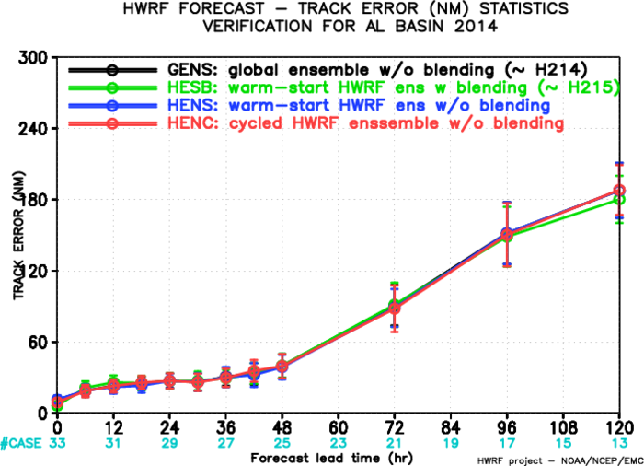
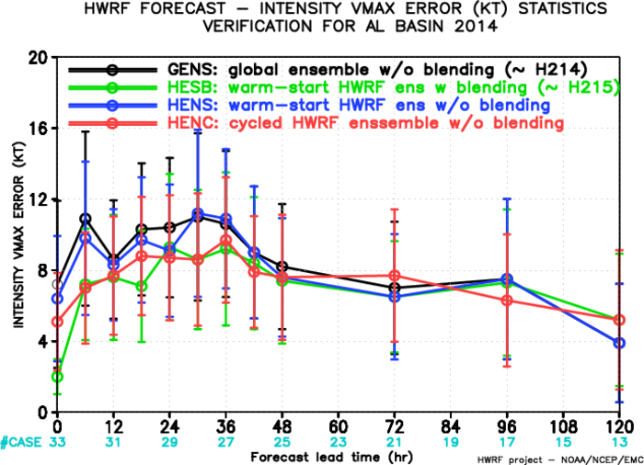
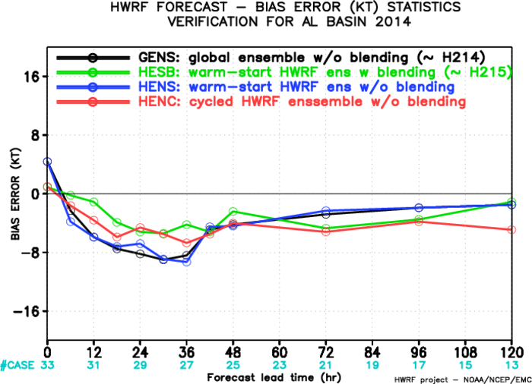
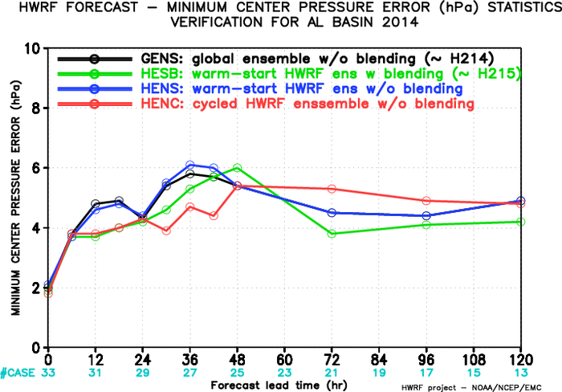
Edouard 06L 2014

Slide 17
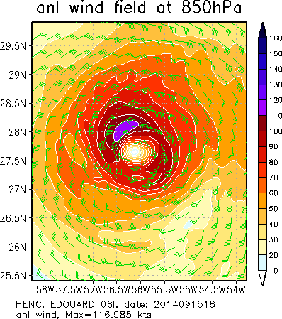
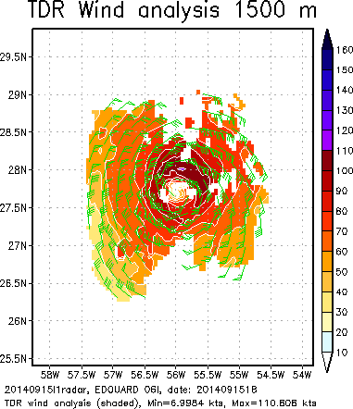
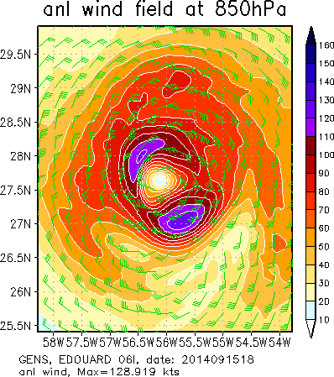
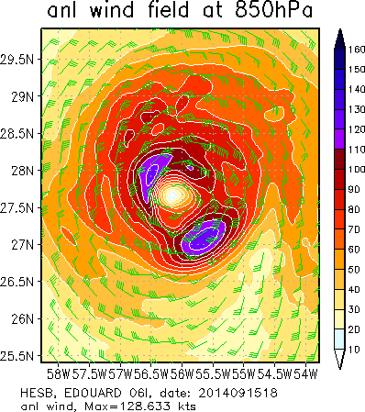
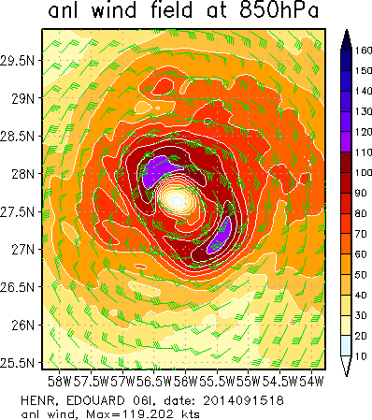
Edouard 06L 2014
2014091518 850 hPa wind analysis
Cycled HWRF ensemble
HENC
warm-start HWRF ensemble
warm-start HWRF ensemble with ensemble relocation
Global ensemble
GENS
HENS
HENR

Slide 18
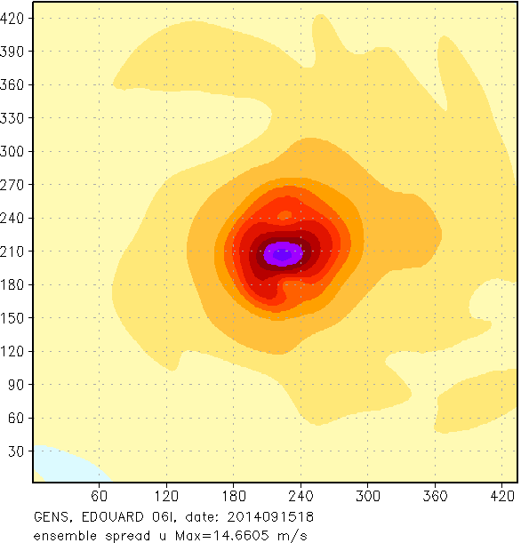
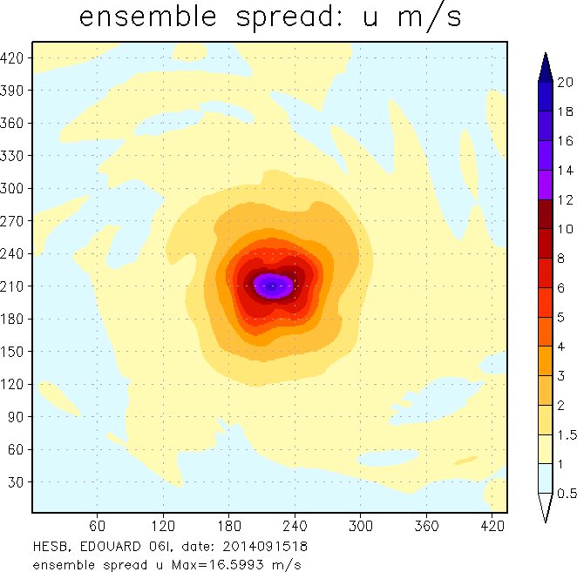
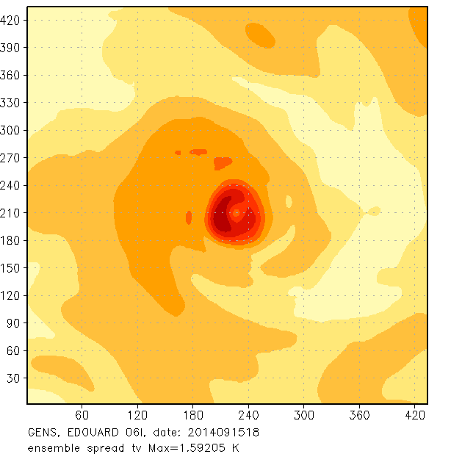
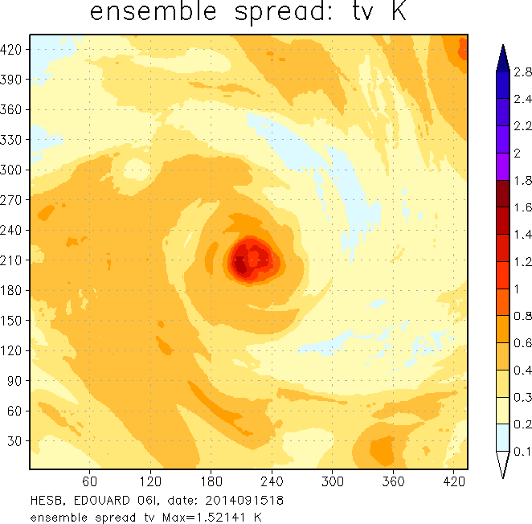
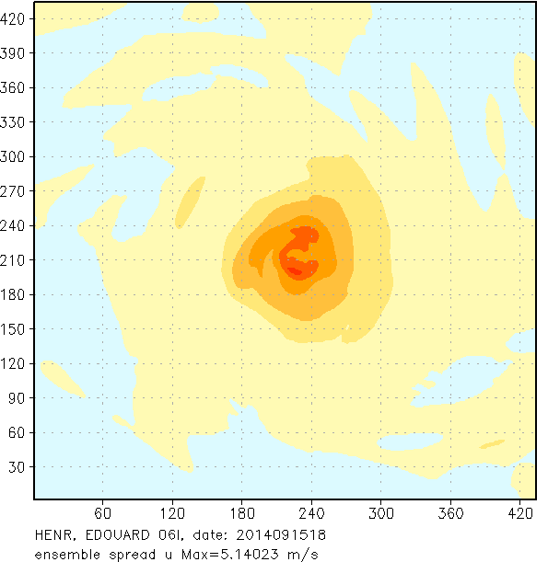
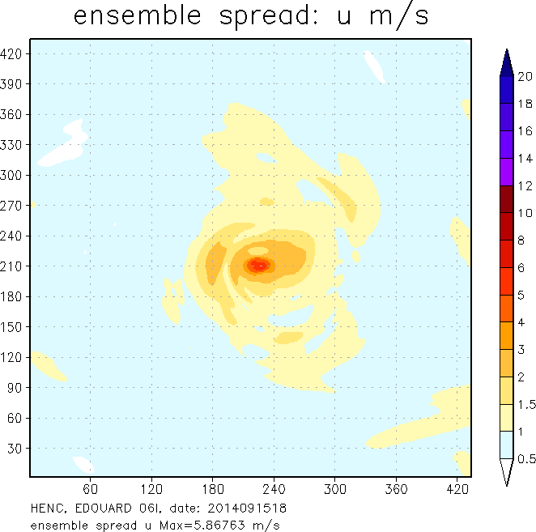
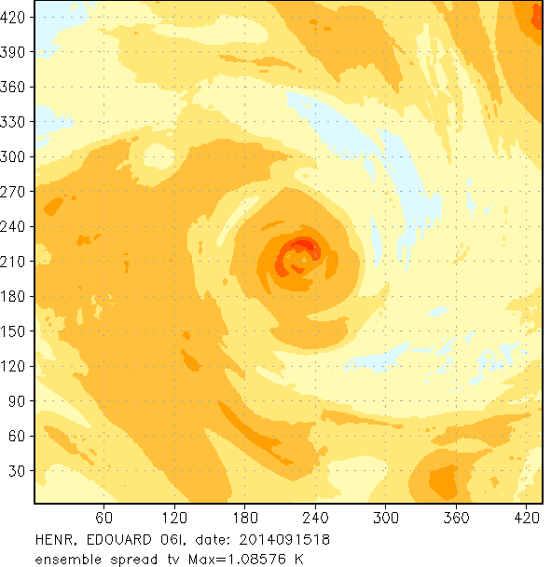
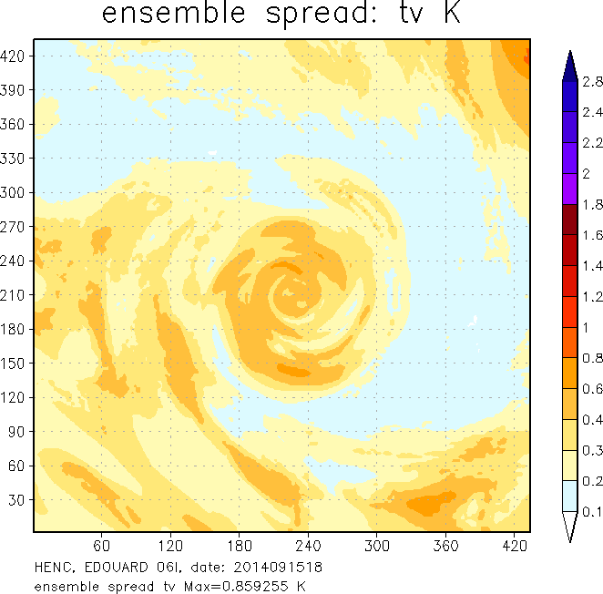
Edouard 06L 2014
2014091518
Ensemble spread U
Ensemble spread T
GENS: global
HENS: warm-start HWRF
GENS
HENS
HENR: warm-start HWRF with ens relocation
HENC: cycled HWRF
HENR
HENC

Slide 19
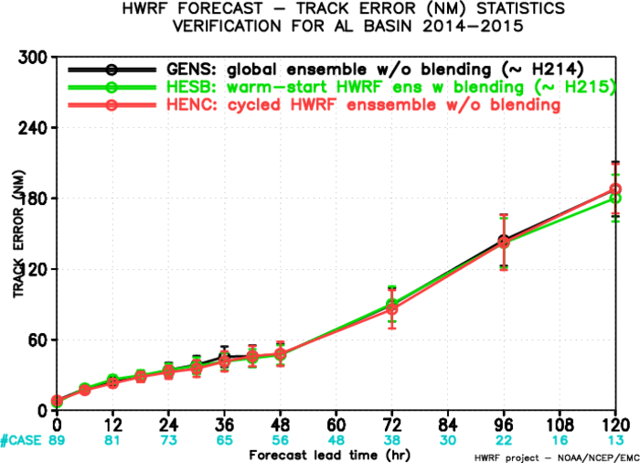
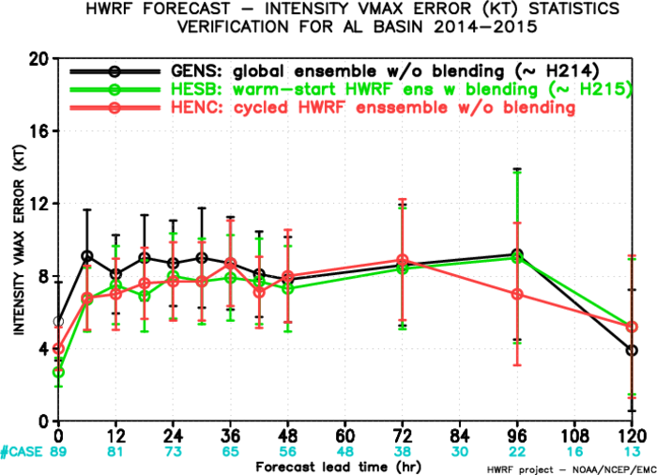
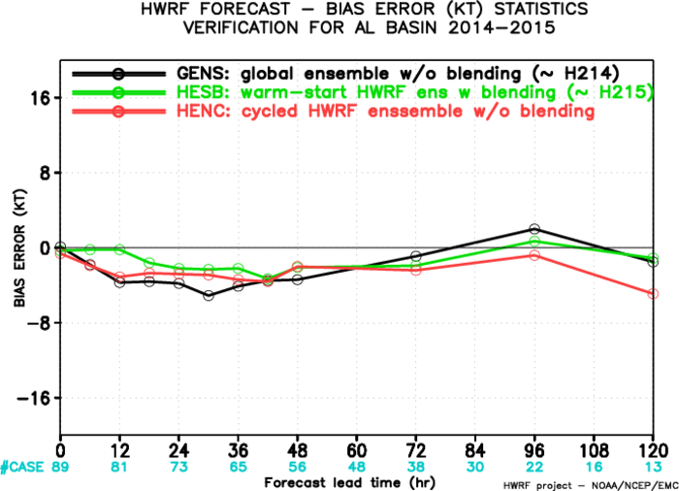
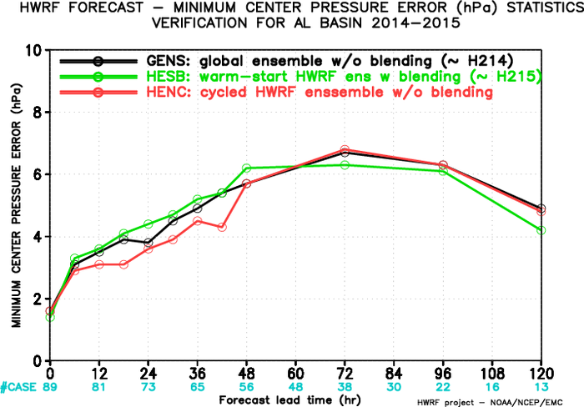
2014-2015 four storms with TDR data available

Slide 20
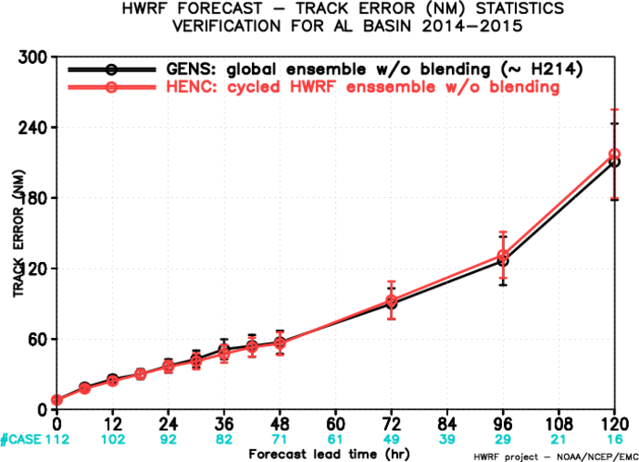
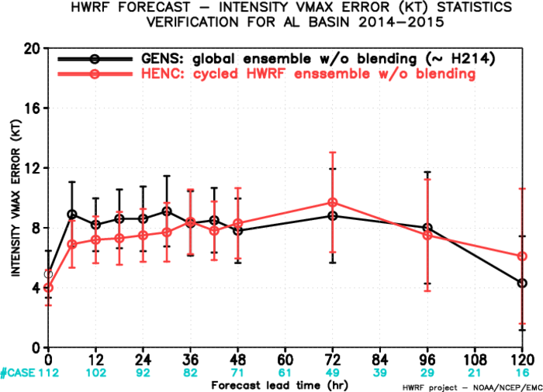
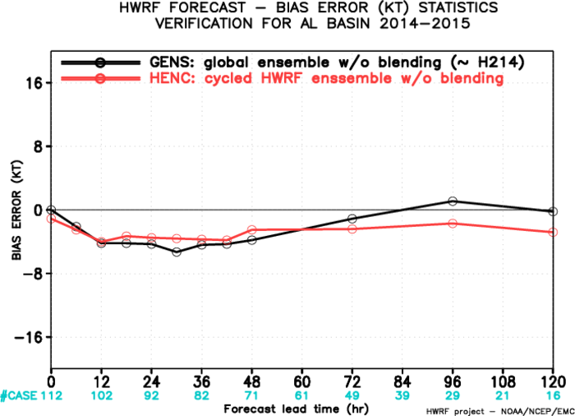
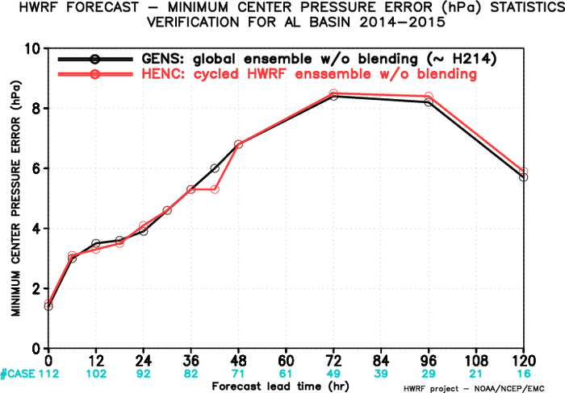
2014-2015 five storms with TDR data available

Slide 21
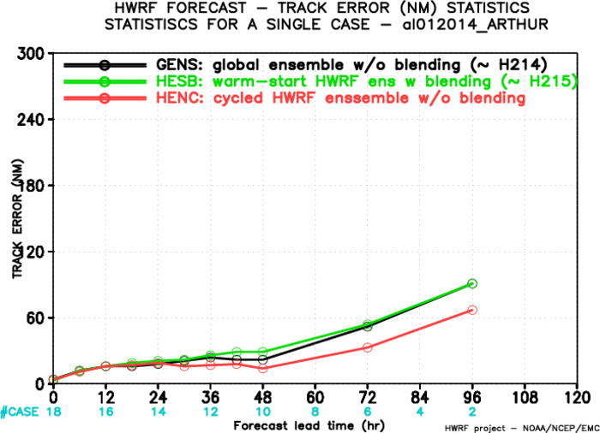
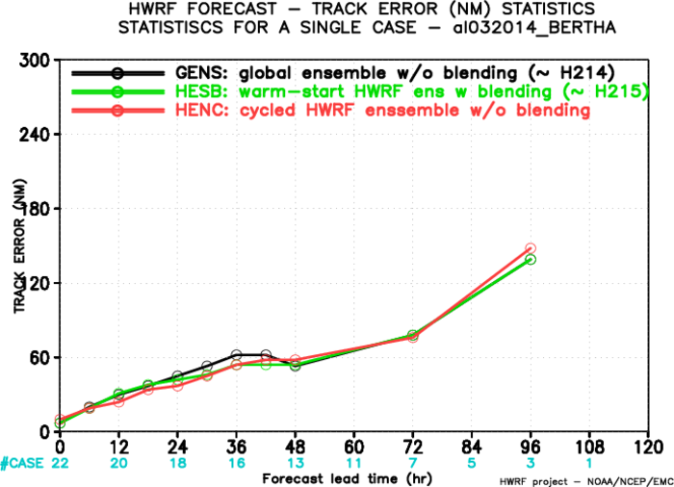
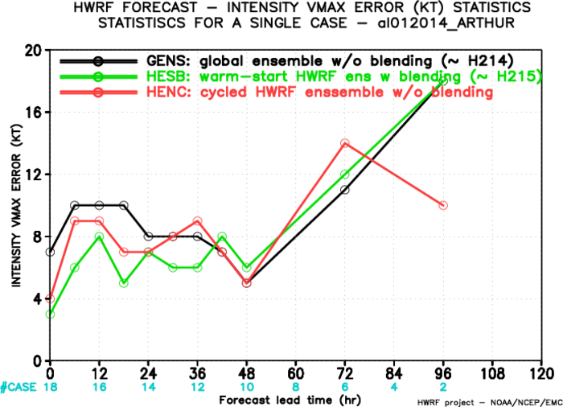
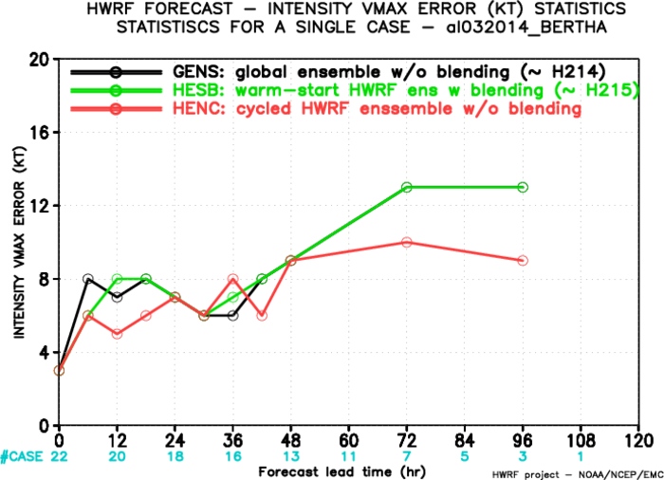
ARTHUR 01L 2014
BERTHA 03L 2014

Slide 22
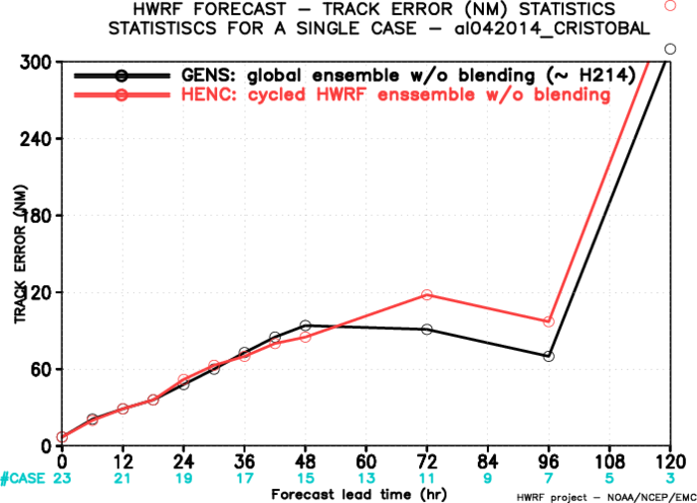
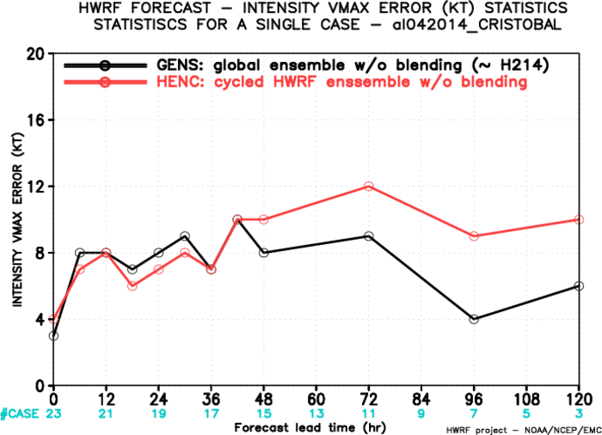
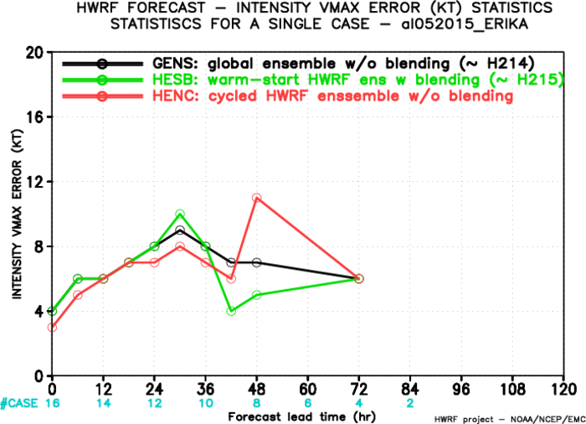
CRISTOBAL 01L 2014
ERIKA 05L 2015

Slide 23
Summary
The cycled HWRF ensemble hybrid DA system improved the estimate of the storm initial intensity compared to hybrid using global ensemble and warm-start HWRF ensemble.
The new hybrid system also improved intensity forecast up to 2 days compared with hybrid using global ensemble and warm-start HWRF ensemble
Compared to the experiment with blending turned on, the new system provided comparable intensity forecast, but the negative intensity bias needs to be improved.
Will run more cases, not limited to TDR cases
Merge H216 and commit the new system to the trunk

