Slide 1
Secondary Eyewalls in Operational HWRF
Federico Di Catarina
Student Meteorologist
NOAA /NCEP /EMC
federico.dicatarina@noaa.gov
Mentors:
Vijay Tallapragada
Weiguo Wang
Sergio Abarca

Slide 2
Importance of Forecasting SEs
Common in Tropical Cyclones (TCs) category 3 or higher
SEs are related to storm intensity change.
-Land falling TCs
-Intensity forecasts
SEs are related to storm growth
-The formation of SEs are related to a radial outward expansion of wind field.
-Land falling TCs

Slide 3
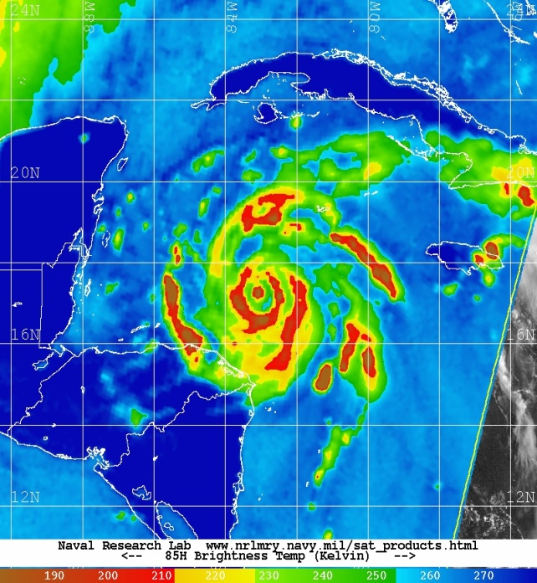
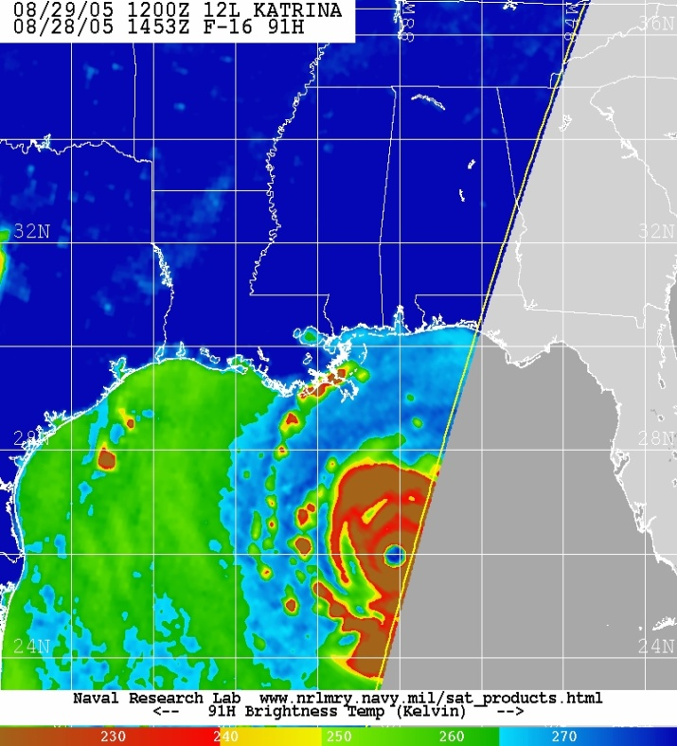
Historic Examples
Hurricane Wilma (2005)
Max. Sustained Wind ~ 160 kt
Hurricane Katrina (2005)
Max. Sustained Wind ~ 150 kt
Weakened to 130 kt
just before making landfall
NHC
Weakened to cat. 3 just before making landfall
NHC

Slide 4
Outline
Objective
SE Identification and Methodology
HWRF Data Availability
Scope of Study
-SE in Nature
-<v> Availability
Edouard 06L 2014
Conclusion
Future Work

Slide 5
Objective
It is known that SE structures are rare in mesoscale integrations.
The following study is to test if 2014 and/or 2015 configurations of HWRF has the ability of simulating SEs.

Slide 6
SE Identification and Methodology
1)Identifying SE in Nature:
➔ TCs that were category 3 or higher were examined for SEs in Microwave imagery. (Navy Research Laboratory).
2)Identifying SE in HWRF Simulations:
➔ Azimuthally averaged tangential <v> wind profile with two distinct local wind maximums
3)Selection of TCs:
➔ When SE identified in both 1 and 2:
4) Further Investigation:
➔ <u>, <v> , and <w> graphs along with Hovmöller diagrams are created to further study these storms

Slide 7
Scope of Study TCs with SE in Nature
 | 2013 | 2014 | 2015
North Atlantic | ---- | 1/2 | ----
West Pacific | 5/6 | 4/4 | 3/3
East Pacific | ---- | 4/9 | 0/2
Others | ---- | 0/4 | ----
Number of TCs that showed signs of SEs in MW imagery/Number cat. 3 or higher TCs surveyed
SE in Nature 56.7%
---- Not Considered in this Study

Slide 8
Scope of Study HWRF <v> Availability
 | 2014 Configuration |  |  | 2015 Configuration
 | 2013 | 2014 | 2015 | 2013 | 2014 | 2015
North Atlantic | ---- | 0/1 | N/A | ---- | 1/1 | No SE
West Pacific | 5/5 | 4/4 | N/A | N/A | N/A | 3/3
East Pacific | ---- | 1/4 | N/A | ---- | 1/4 | No SE
Others | ---- | No SE | N/A | N/A | N/A | ----
Number of TCs that had <v> data available/Nr of TCs that showed SEs in Nature.
---- Not considered in this study
N/A Data not Available

Slide 9
Data Availablity
2014 Configuration |  |  | 2015 Configuration
2013 | 2014 | 2015 | 2013 | 2014 | 2015
Missing Integrations Domain Errors | Missing Integrations Domain Errors | N/A | Available only for N. Atlantic and E. Pacific | Available only for N. Atlantic and E. Pacific | Few Storms to work with so far

Slide 10
TC EDOUARD 06L 2014
Cycle: | Signs of SE <v> Yes/Some/None
2014091406 | Yes
2014091506 | Some
2014091600 | Yes
2014091706 | Yes
Edouard: The only TC to show SE
The table on the right is a list of 4 cycles that had two local <v> maximums at distinct radii
The bold letters indicate cycles with most clear evidence for SE. These will be analyzed in the rest of the presentation

Slide 11
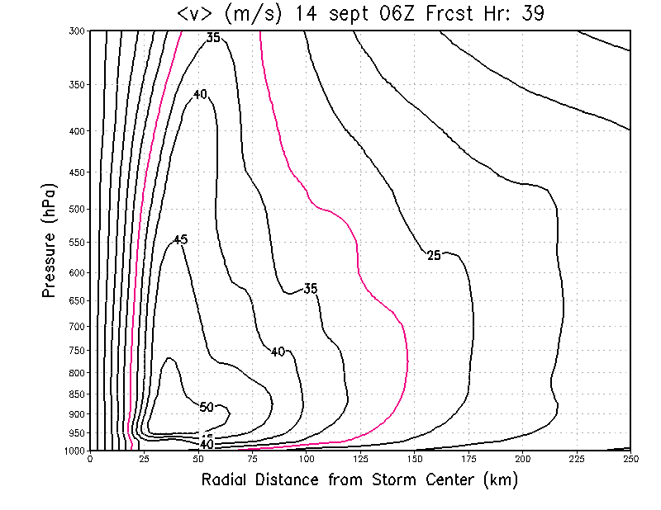
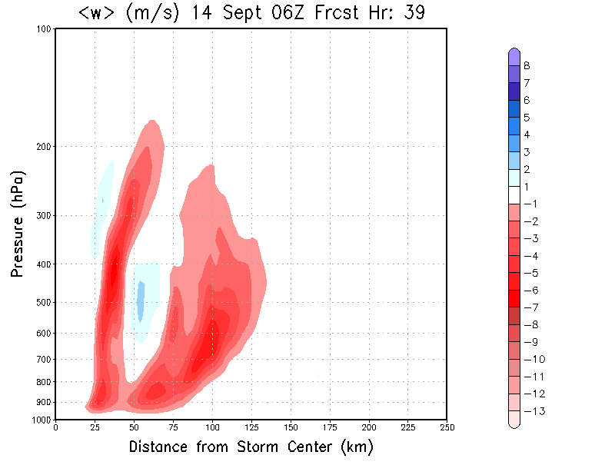
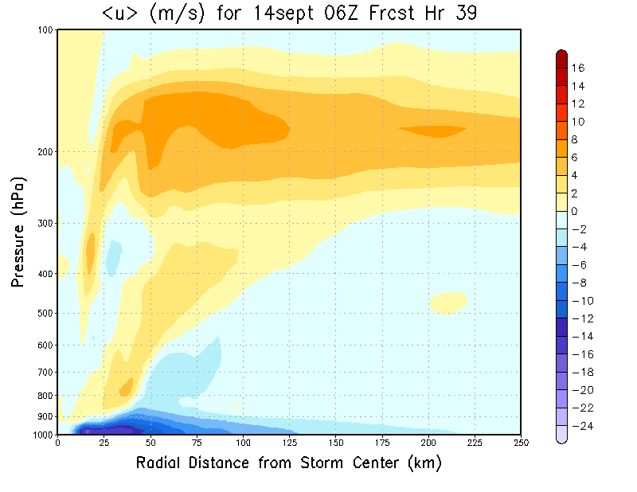
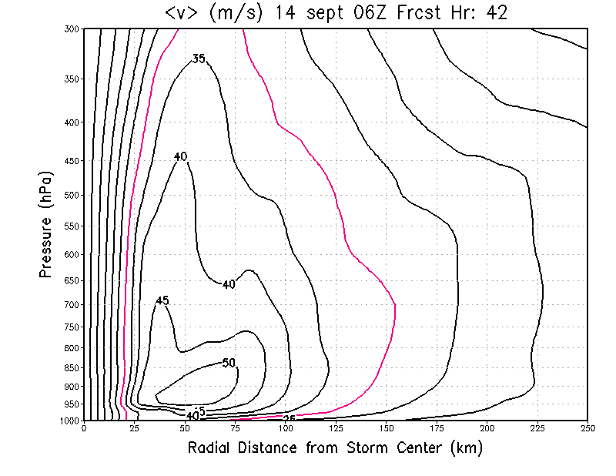
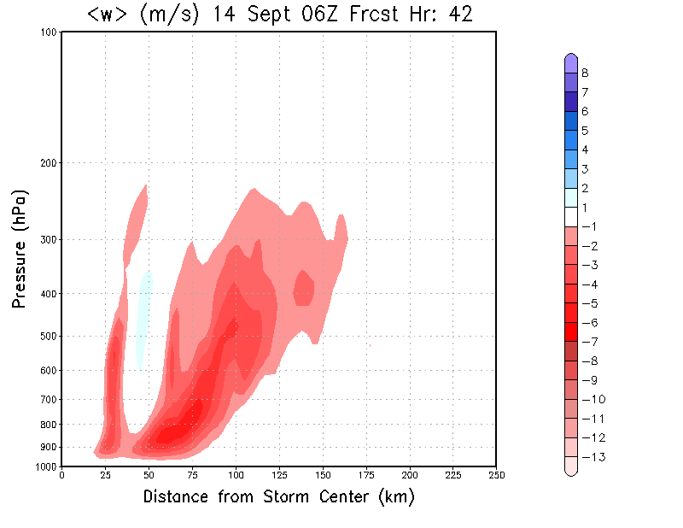
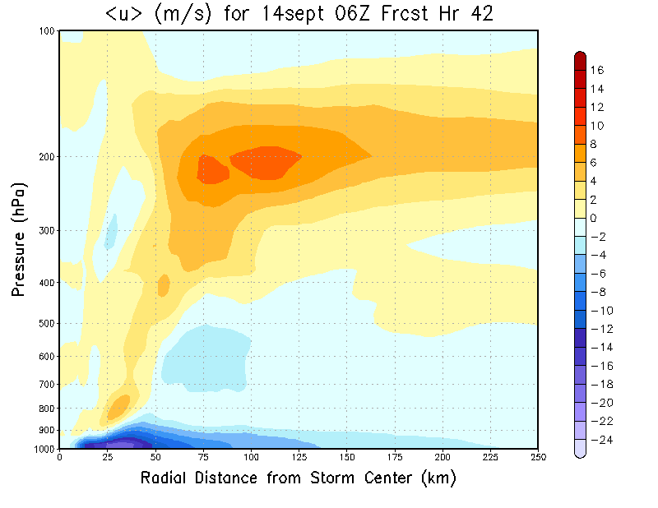
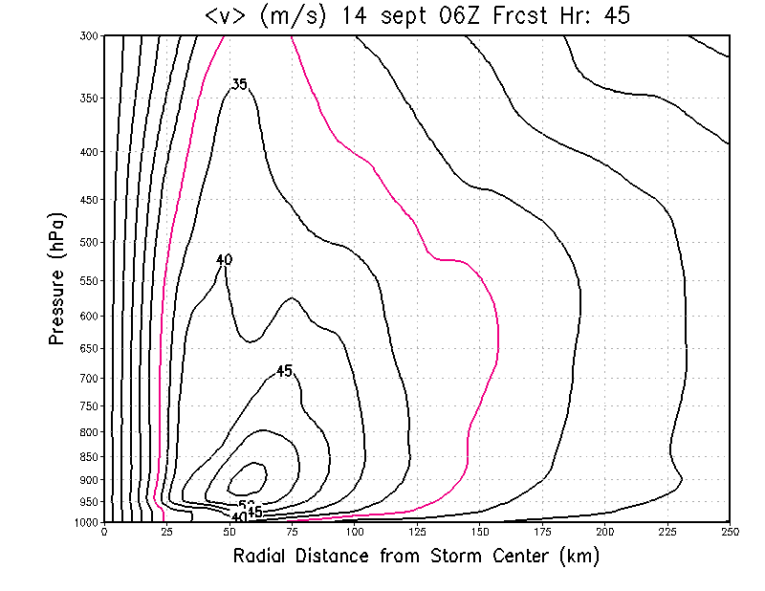
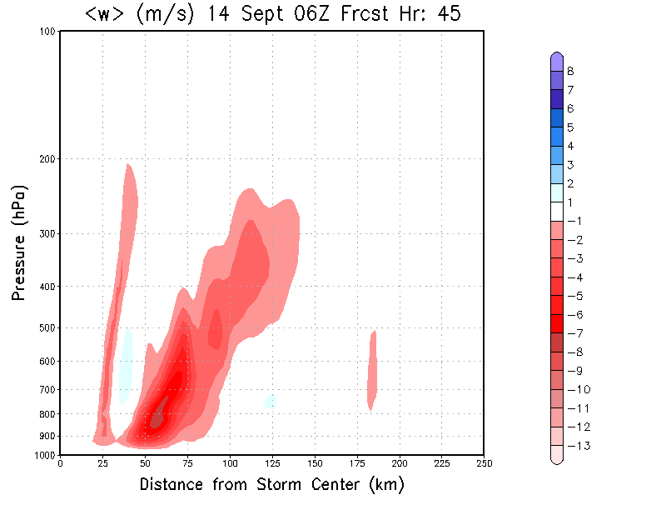
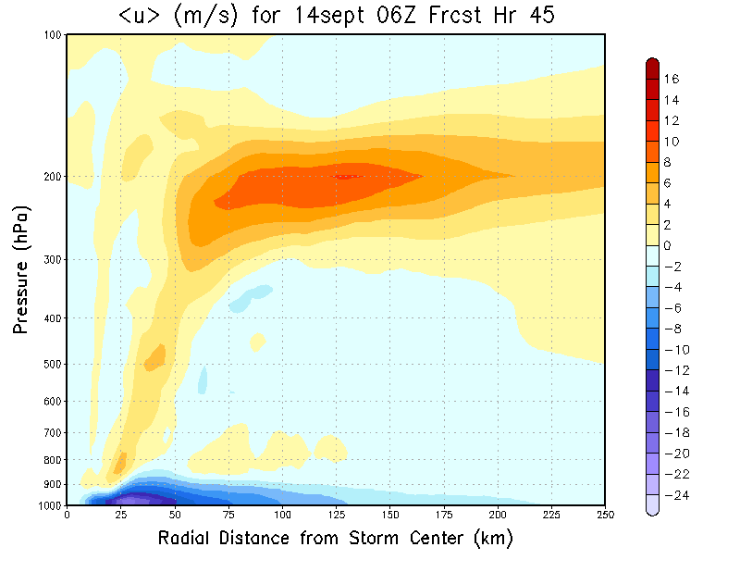
EDOUARD - 2014091406

Slide 12
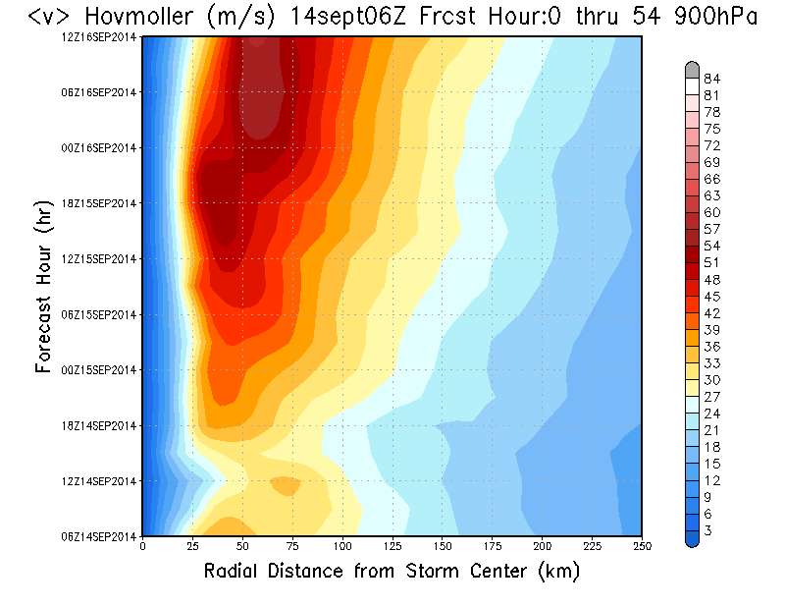
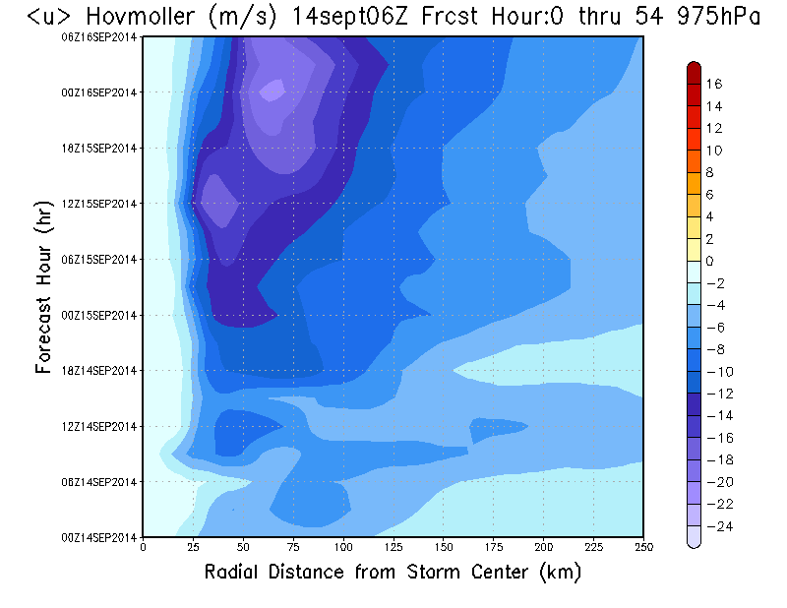
EDOUARD – 2014091406 Hovmöller Diagrams

Slide 13
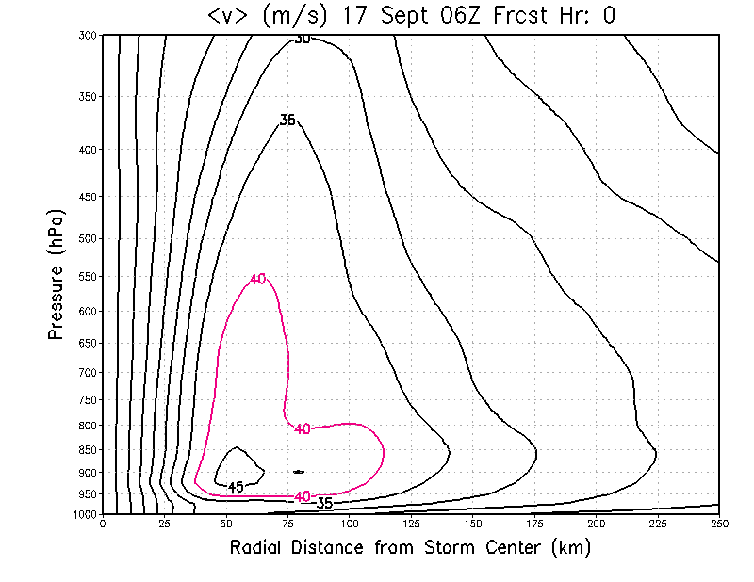
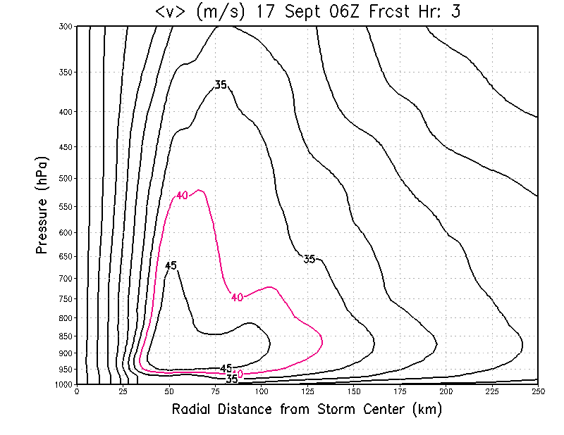
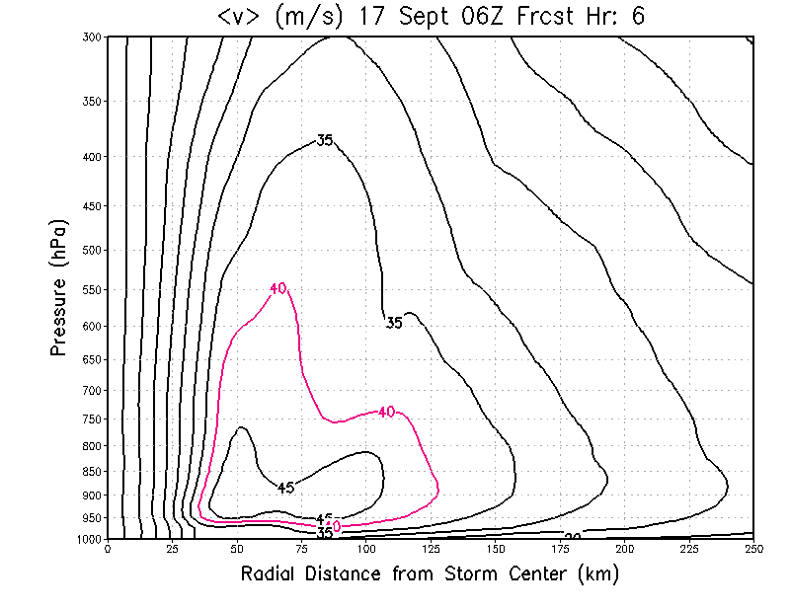
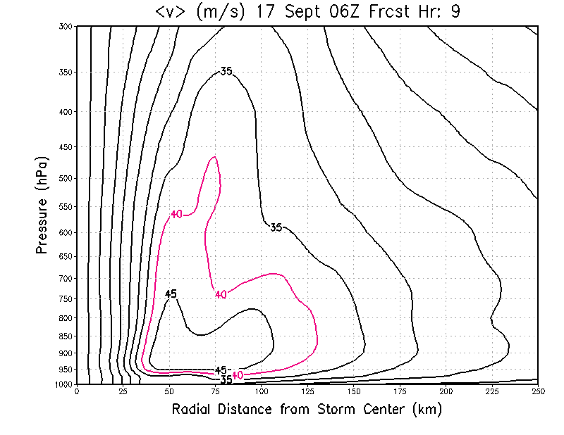
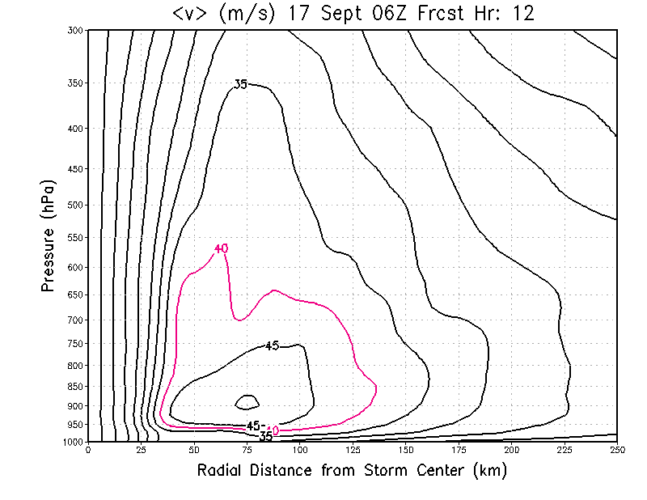
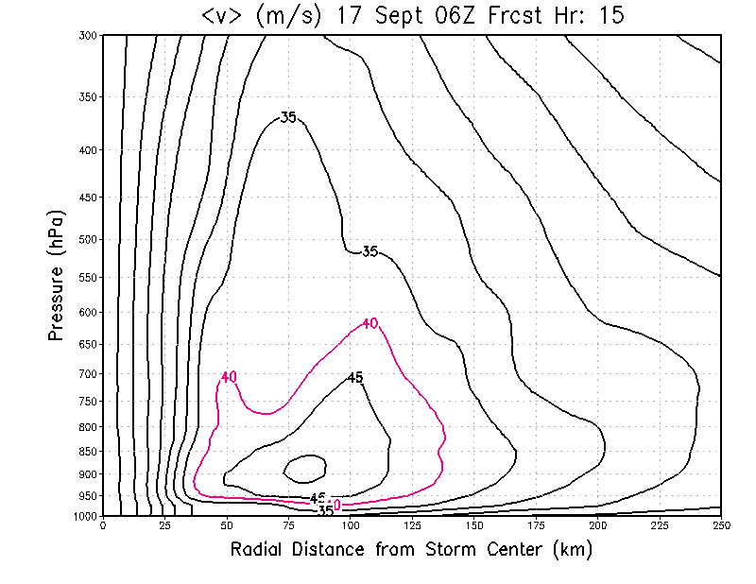
EDOUARD - 2014091706

Slide 14
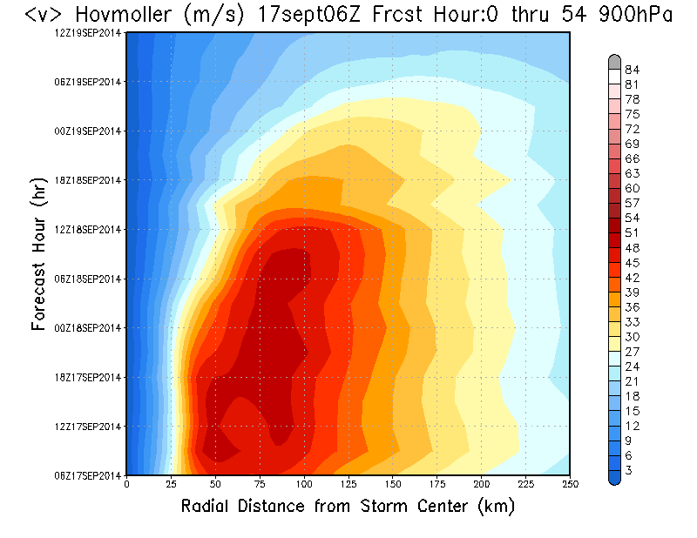
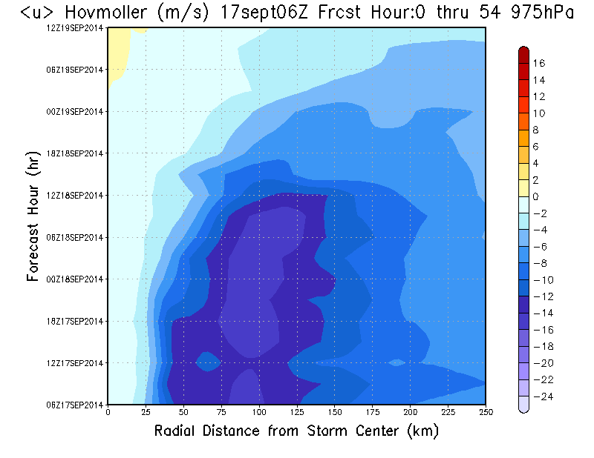
EDOUARD – 2014091706 Hovmöller Diagrams

Slide 15
Conclusion
Operational HWRF can generate realistic SEs

Slide 16
Future Study Topics
What physical and/or dynamical parameterizations made the simulation of SE in Edouard possible.
Why do SEs appear only for Edouard and not in any other TC simulated by 2015 HWRF? In fact, why not in every expected cycle of Edouard?
Is the vortex initialization issue affecting SE forecasts and ultimately intensity forecasts?

Slide 17
Special Thanks To:
Keqin Wu
Hyun-Sook Kim

