Slide 1


Determine the Relationship of Lightning with Intensity Forecast of Tropical cyclones Using the HWRF Model:
Ideal Case
Keren Rosado
Ph.D. Candidate
Howard University
NOAA EDUCATIONAL PARTNERSHIP PROGRAM with MINORITY SERVING INSTITUTIONS (EPP/MSI) GRADUATE RESEARCH & TRAINING SCHOLARSHIP PROGRAM (GRTSP)

Slide 2
Outline
Introduction
  Motivation
  Previous Research
  Objectives: Leading Questions
  Hypothesis
  Strategy

Slide 3
Outline
Methodology and Data
  Lightning Parameterization
    Lightning Potential Index (LPI)
  Global Data Assimilation System (GDAS) data
  World Wide Lightning Location Network data
  National Hurricane Center data

Slide 4
Outline
Experimental Design
  HWRF Configuration
  Experiments
    Idealize HWRF (CTRL)
    Idealize HWRF LPI (LPI)
    Control Experiment Real Case
    Lightning Experiment Real Case

Slide 5
Introduction: Motivation
Every year tropical cyclones affect many countries around the world
  Classification depends on the Ocean Basin
  The forecast of this atmospheric phenomenon can be divided in two parts
    Trajectory (path tropical cyclone will have) forecast
    Intensity (maximum wind strength at the surface) forecast

Slide 6
Introduction: Previous Research
Molinari et al. 1998
  Examined cloud to ground lightning flash locations for nine Atlantic basin hurricanes using data from the National Lightning Detection Network
  Results
    Weak maximum in the eyewall
    Strong maximum outer rainband
    Lightning outbreaks: Beginning of, or during times of intensification
Notes:
Talk about research done to analyze lightning in hurricanes

Slide 7
Introduction: Previous Research
Price et. al 2009
  Analyzed 56 hurricanes terms of lightning, maximum wind speed, and minimum pressure correlations in order to investigate if the lightning can be used as a proxy to forecast hurricanes intensification
  Results
    Correlation coefficient mean r = 0.82 in 90% of the cases
    Lightning peak 30 hours before the hurricanes maximum wind speed
Notes:
Correlation exist !!!!

Slide 8
Price et al. 2009
Notes:
Figure 1. Hurricane Dennis 5-14 July 2005. a. The path of Hurricane Dennis in the Atlantic Ocean, showing the location at 12:00 UTC every day. b. The minimum pressure at the center of the hurricane (dashed curve). c. The maximum sustained winds (solid thin curve) and the observed lightning frequency within a 10° × 10° gridbox centred on the eye of the storm (solid bold curve; Price et al. 2009).

Slide 9
Price et al. 2009
Notes:
Figure 2. The correlation coefficient (r) between maximum sustained winds and lightning activity. Each point represents one hurricane, and the symbols represent the level of statistical significance for a specific hurricane (Price et al. 2009).

Slide 10
Introduction: Leading Questions
Can we predict lightning in HWRF model with some degree of accuracy?
  Space and Time
Does the HWRF with lightning parameterization enhance the forecast of rapid intensification or just steady state intensification?

Slide 11
Introduction: Leading Questions
How well does the HWRF with lighting parameterization model forecast lightning spatial distributions before, during, or after tropical cyclone intensification?
When does the rapid intensification occur: after the HWRF model forecasted lightning peak?
Notes:
Add new question about intensity

Slide 12
Introduction: Leading Questions
How well the HWRF model does with lightning parameterization forecast the wind speed, pressure and outgoing long wave radiation among other variables on tropical cyclones?
What is the functional relationship between tropical cyclone wind speed, minimum pressure, and lightning in the HWRF with lightning parameterization?

Slide 13
Introduction: Hypothesis
We will have the ability to forecast the potential for lightning occurrence in tropical cyclones
  Better understanding of the relationship between lightning and tropical cyclone intensification in terms of wind speeds and minimum pressure
Be able to have a better knowledge of the mechanism behind lightning as a proxy for tropical cyclone steady state intensification and tropical cyclone rapid intensification forecast

Slide 14
Methodology: Lightning Parameterization
Lightning Potential Index (LPI) work done by Yair et al. 2010; Lynn and Yair 2010)
  Measure the potential for charge generation and separation that leads to lightning flashes in a convective thunderstorm between 0°C and -20°C
  Calculated by using simulated grid-scale vertical velocity and simulated hydrometeor mass mixing ratios of liquid water, cloud ice, snow, and graupel
Notes:
Ojo I need to add equations????

Slide 15
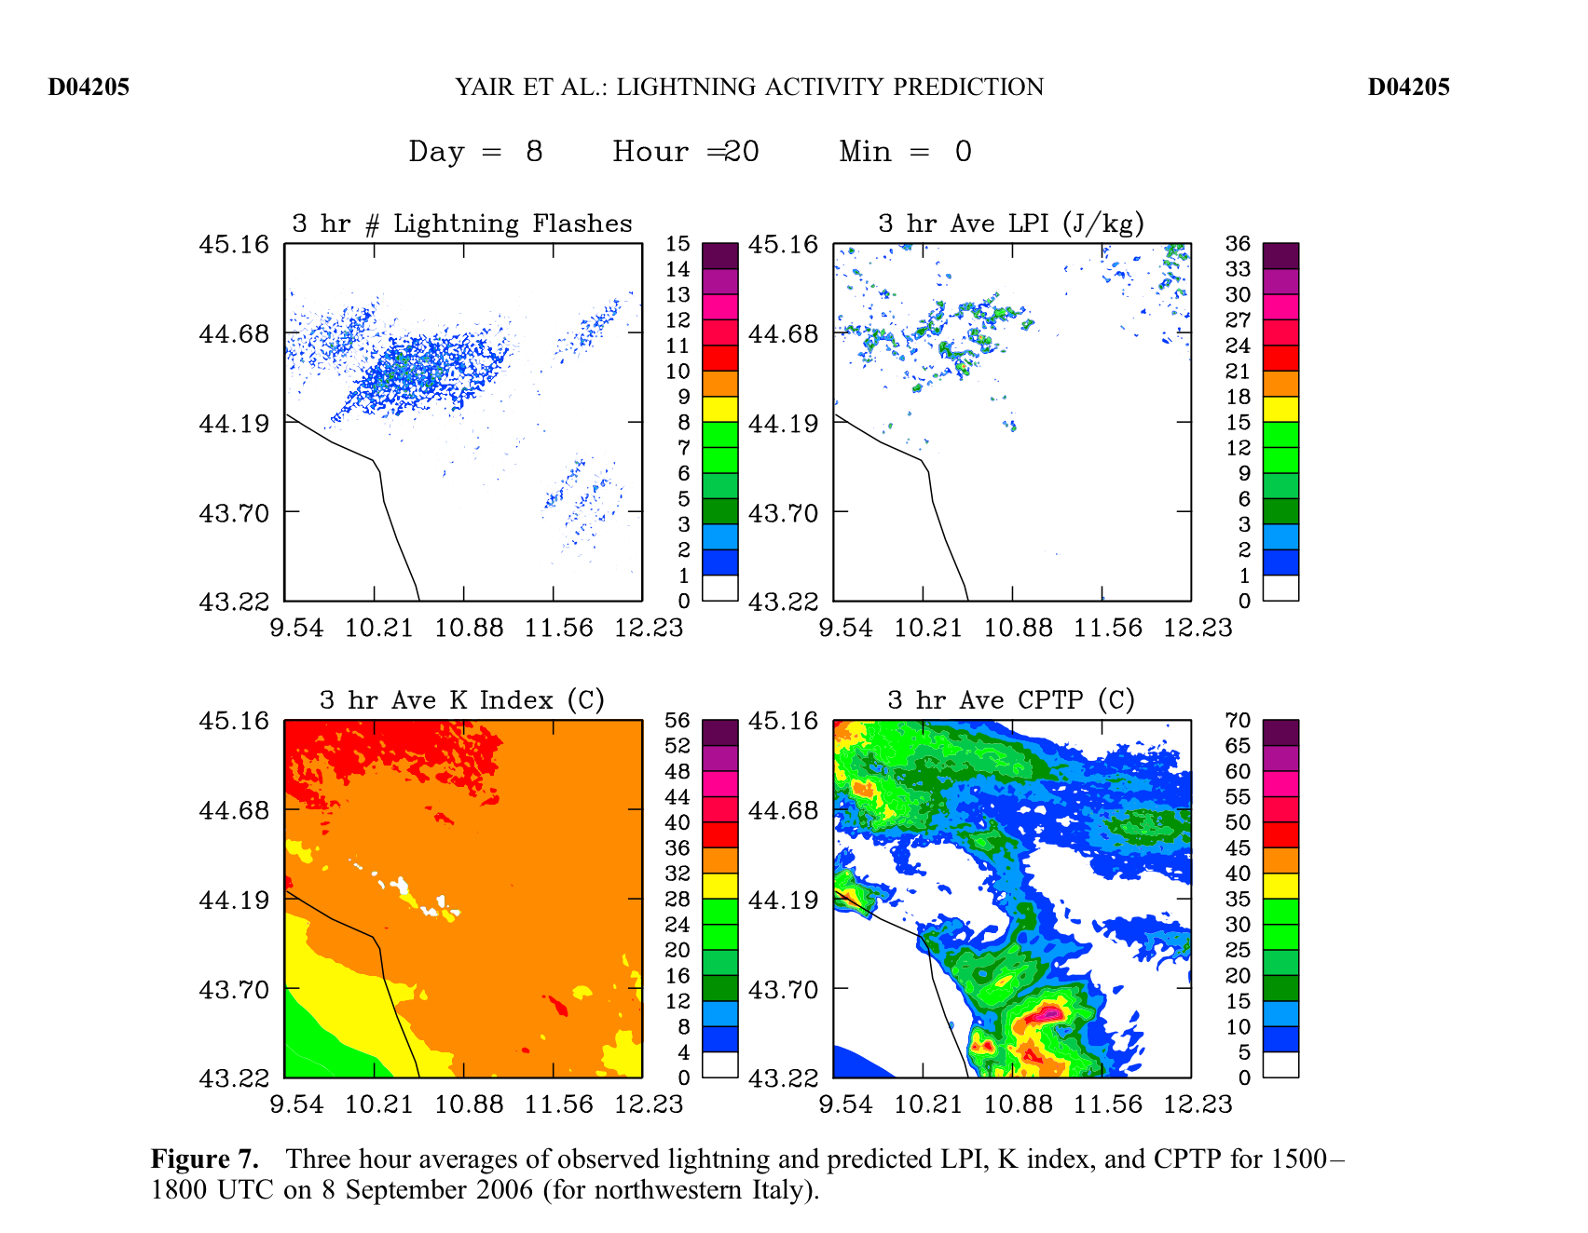
Notes:
Sep 2006

Slide 16
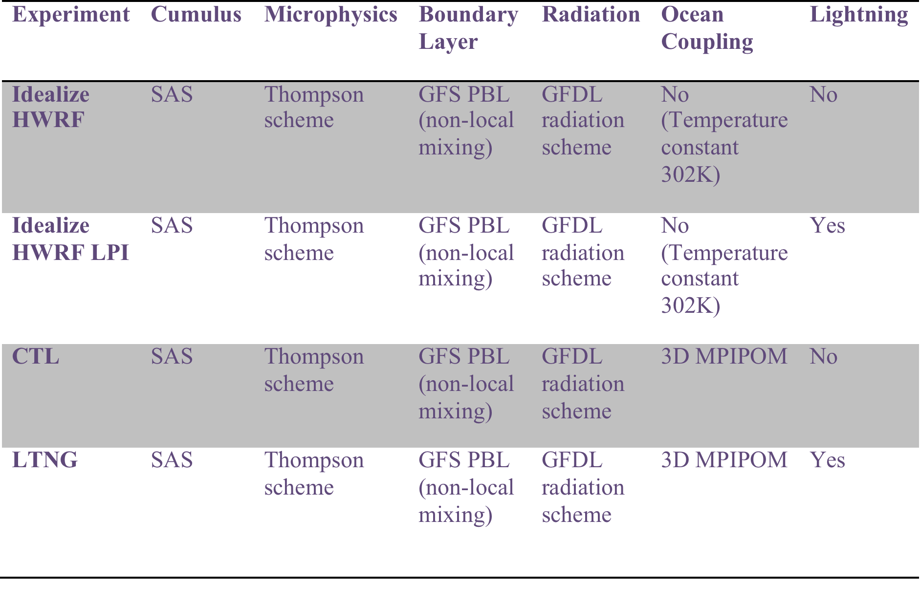
Experimental Design
Notes:
c

Slide 17
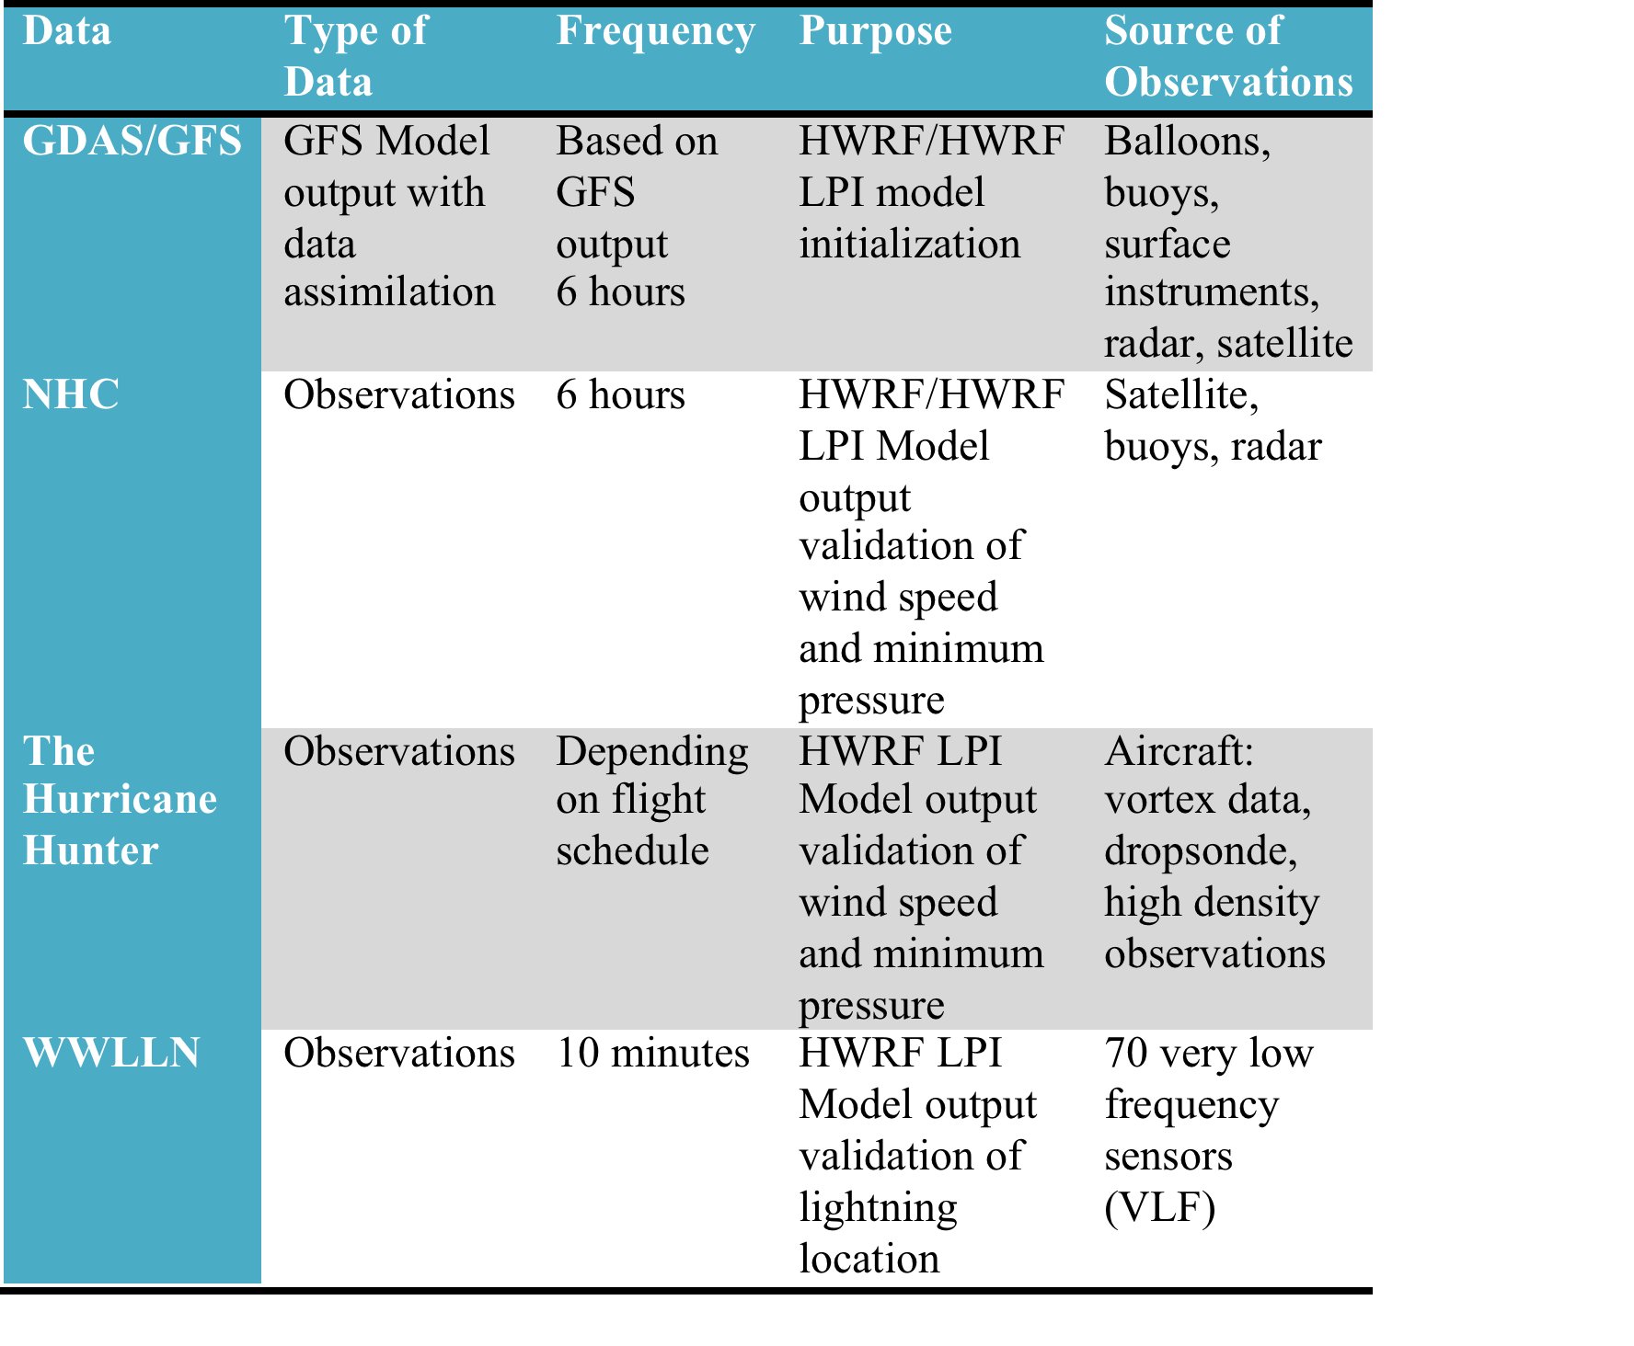

Slide 18
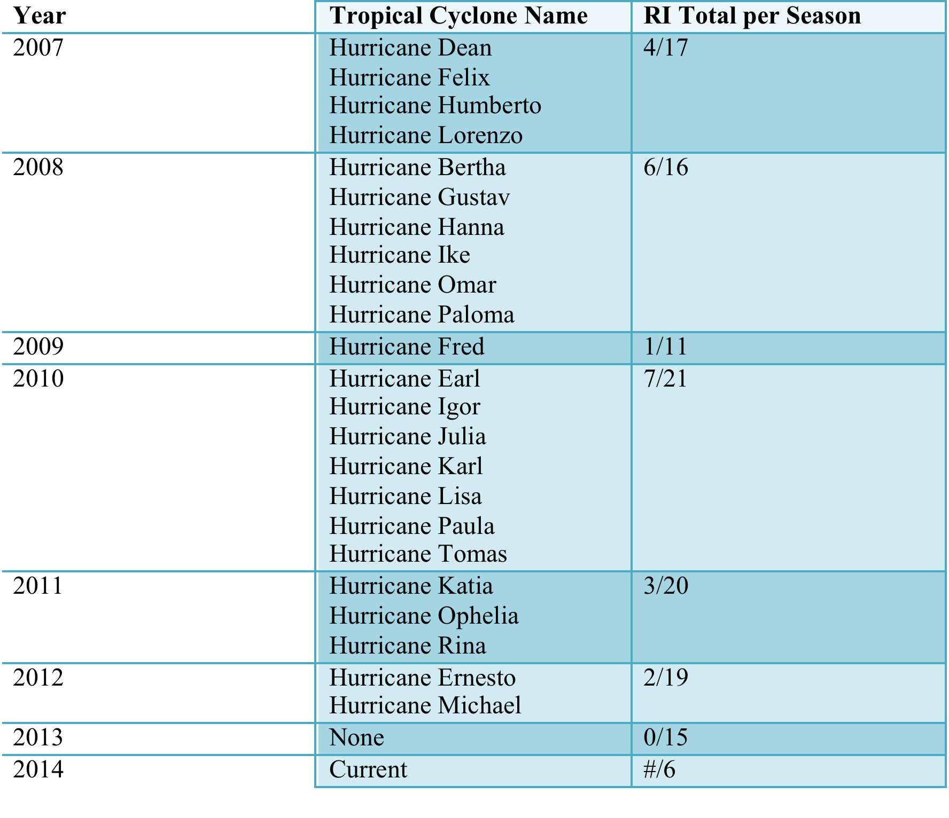

Slide 19
Methodology
Phase 1 ✓
  LPI implement the into the HWRF model
Phase 2 ✓
  HWRF with LPI testing period
    Idealize HWRF with PLI experiment
Phase 3
  HWRF LPI test for real tropical cyclones
    Case #1: Earl 2010
    Case #2?
    Case #3?

Slide 20
Phase 1: LPI Implementation
LPI is a 2D variable implemented into Thompson MP
  Mixing ratios (kg/kg):
    liquid
    ice
    snow
    groupel
  w
  temperature
  height
  z_full
  t_base = 273.15
  t_top = 253.15
Notes:
Red are added to thompson MP

Slide 21
Phase 1: LPI Implementation
Registry
module_michrophysics_driver.F
module_PHYSICS_CALLS.F
solve_nmm.F

Slide 22
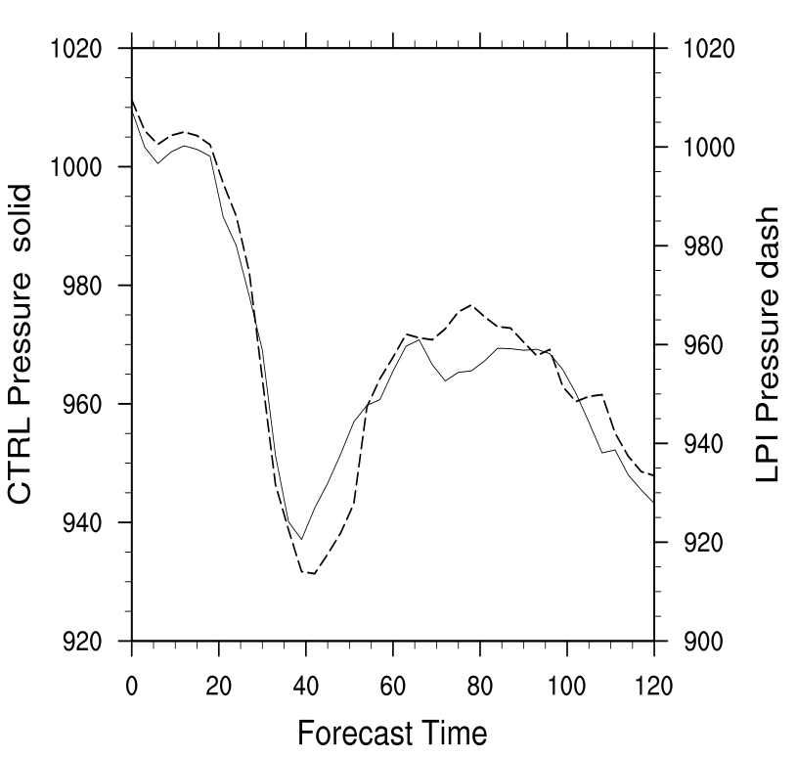
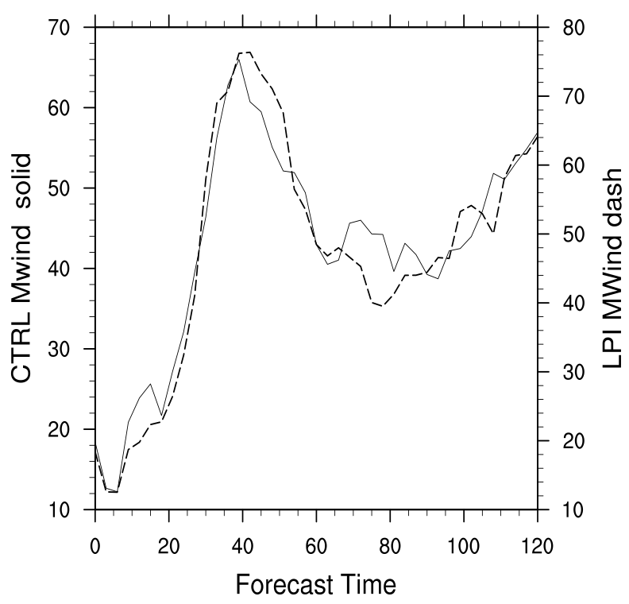
Phase 2: LPI Ideal TC Results

Slide 23
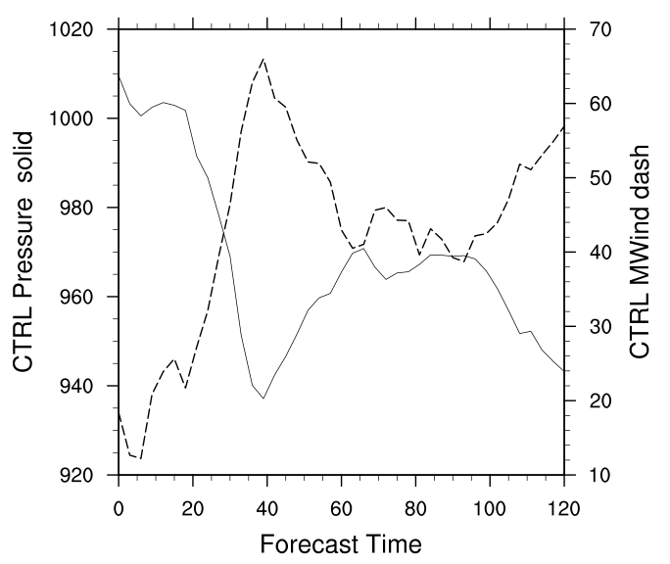
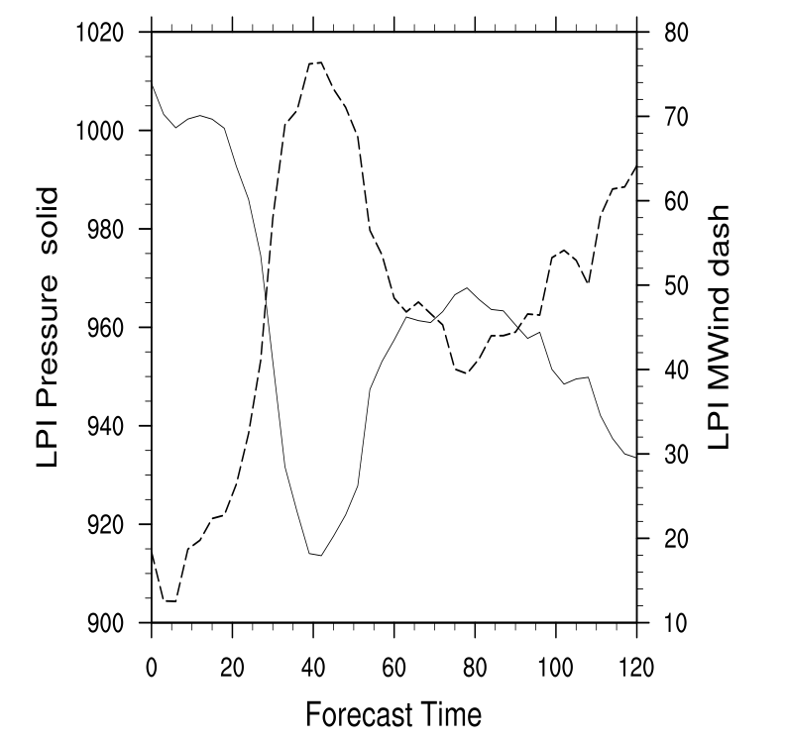
Phase 2: LPI Ideal TC Results

Slide 24
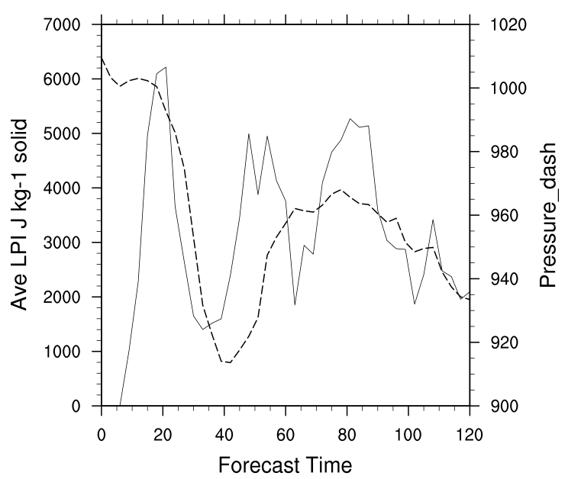
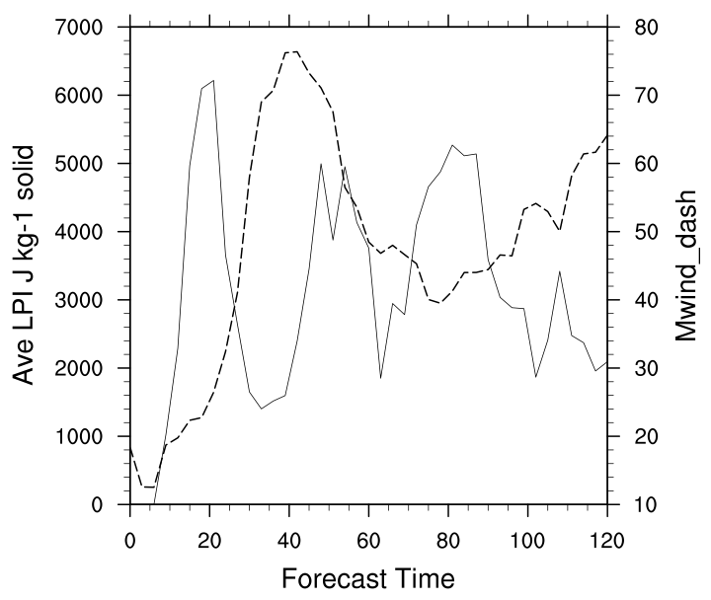
Phase 2: LPI Ideal TC Results

Slide 25
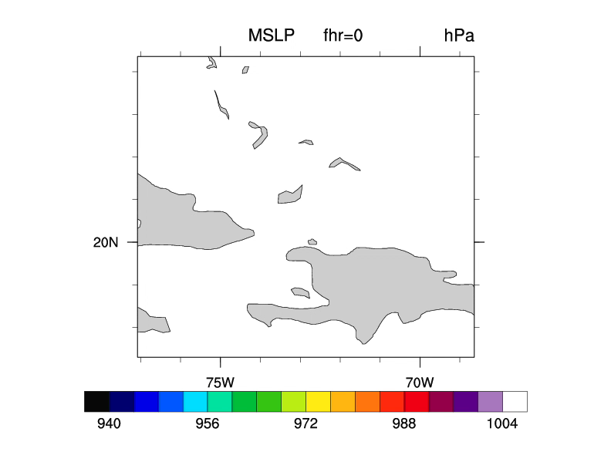
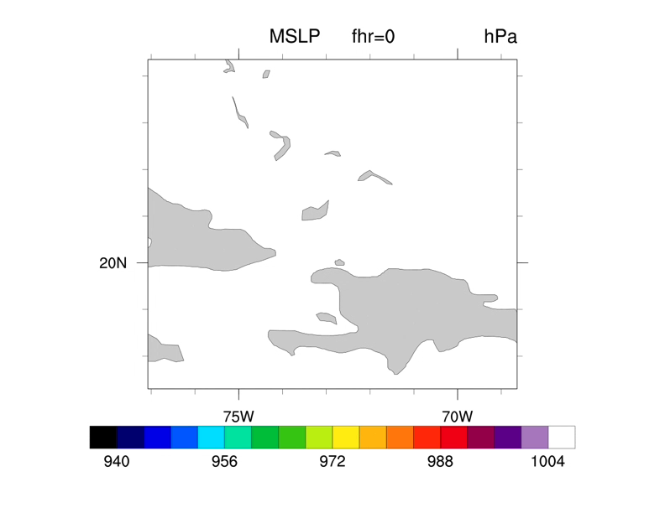
CTRL
LPI
Notes:
SLP CTRL left LPI right

Slide 26
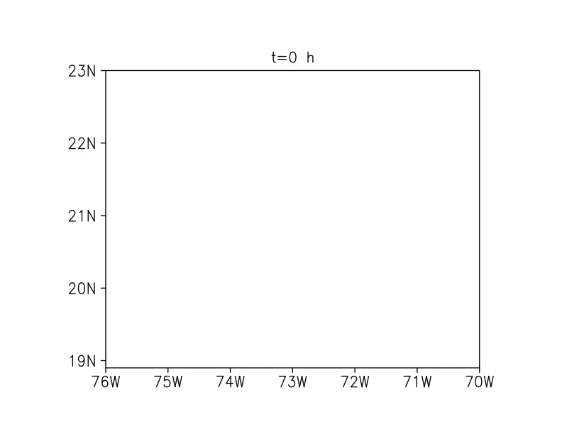
CTRL Refractivity
LPI Refractivity
Notes:
Refractivity left CTRL right LPI

Slide 27
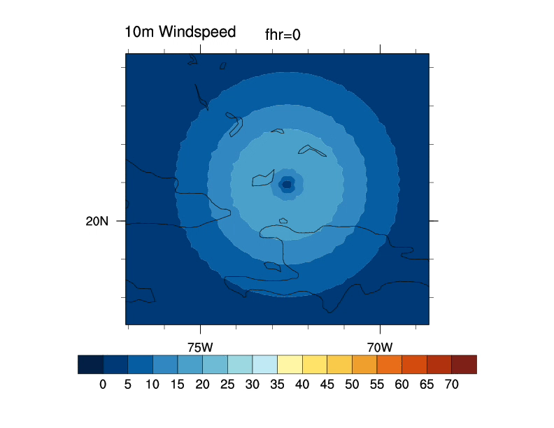
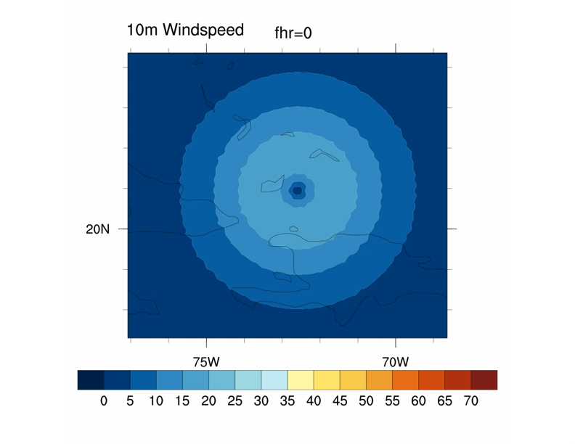
CTRL
LPI
Notes:
Left CTRL right LPI

Slide 28
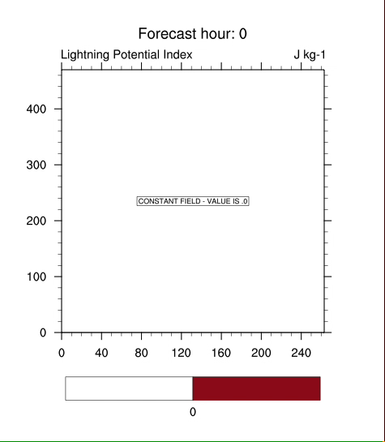
Notes:
Reflactuvity movie

Slide 29
Analysis of Forecast Time: 21h, 45h, 81h

Slide 30
Analysis of Forecast Time: 21h

Slide 31
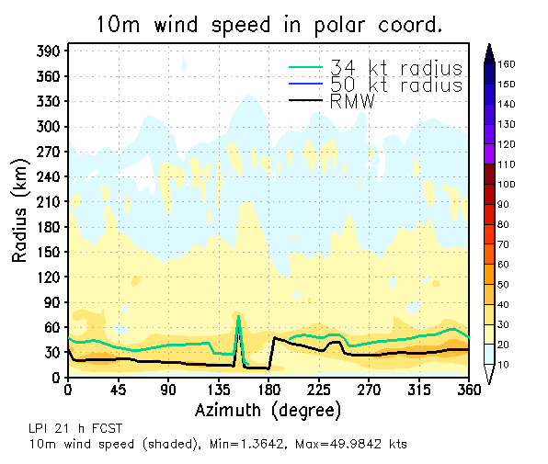
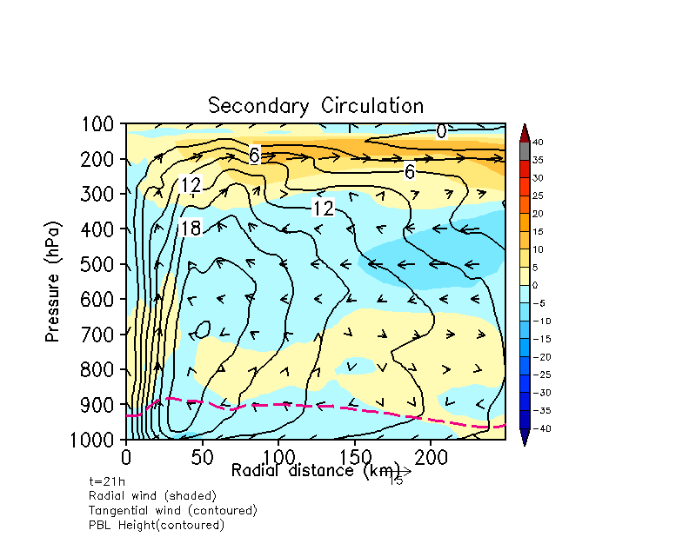
LPI: 21h Forecast
Notes:
21h

Slide 32
Analysis of Forecast Time: 45h

Slide 33
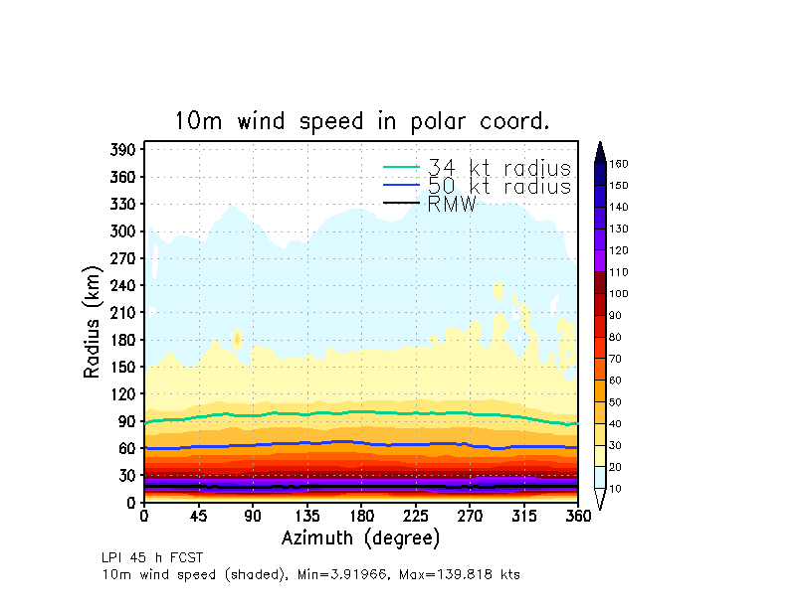
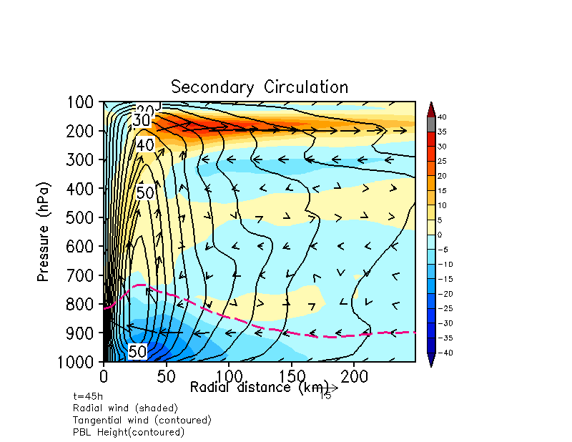
LPI: 45h Forecast
Notes:
45h

Slide 34
Analysis of Forecast Time: 81h

Slide 35
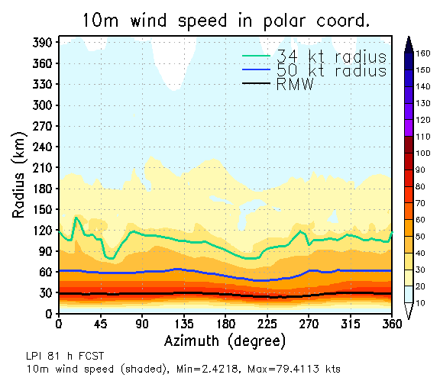
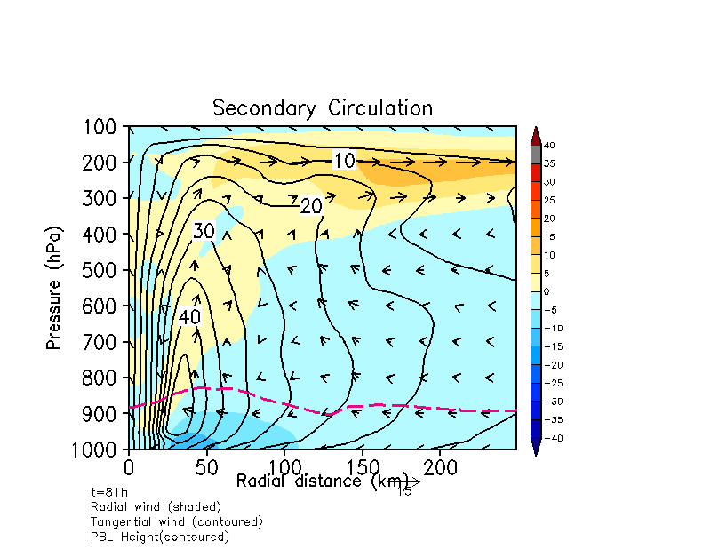
LPI: 81h Forecast
Notes:
81h

