Slide 1
Possible FY16 HWRF Upgrade: HWRF Ensemble Prediction System

Slide 2
Likely Resource Increases Existing 2015 (Phase 2) Resources
Full Node Cores
4152
Forecast
+
Post
1982
1200
DA
Ensemble
GSI
1056
GDAS/GFS
Relocate
Merge
3:00
4:20
5:55
7:10
7:40
Time

Slide 3
Likely Resource Increases New 2016 (Phase 3) Resources
9000
Forecast
+
Post
Full Node Cores
4000
DA
Ensemble
2400
GSI
2200
GDAS/GFS
Relocate
Merge
3:00
4:20
5:55
7:10
8:10
Time

Slide 4
Configuration of 2015 HWRF-based Ensemble Prediction System
Use 2015 operational deterministic HWRF model except for
Less vertical resolution: L43 vs. L61;
Smaller D02, D03 domains, same as H213;
No GSI due to lack of GDAS data;
IC/BC Perturbations (large scale): 20 member GEFS.
TCVital perturbations: storm position, Vmax, Pmin, based on best track uncertainty.
Model Physics Perturbations (storm scale):
Stochastic Convective Trigger in SAS: ±50hPa;
Stochastic boundary layer height perturbations in PBL scheme, ±20%;
Stochastic perturbation on drag coefficient (±20).

Slide 5
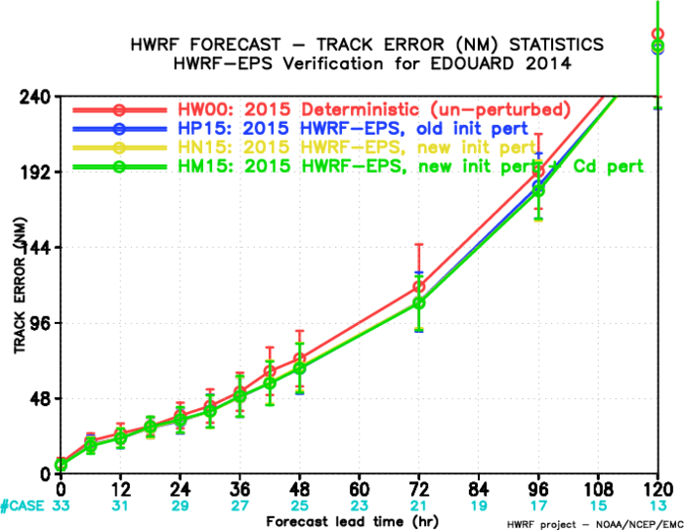
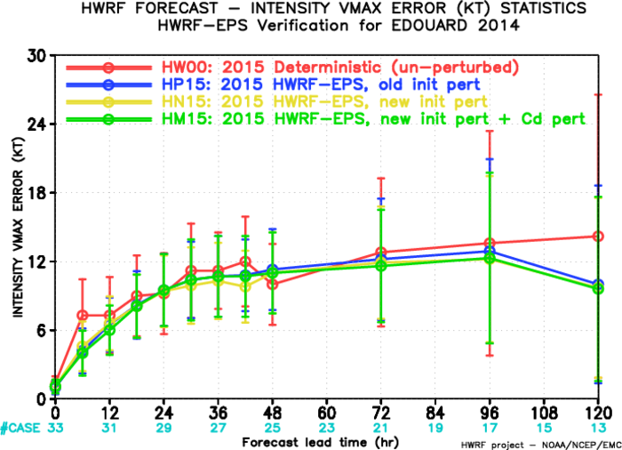
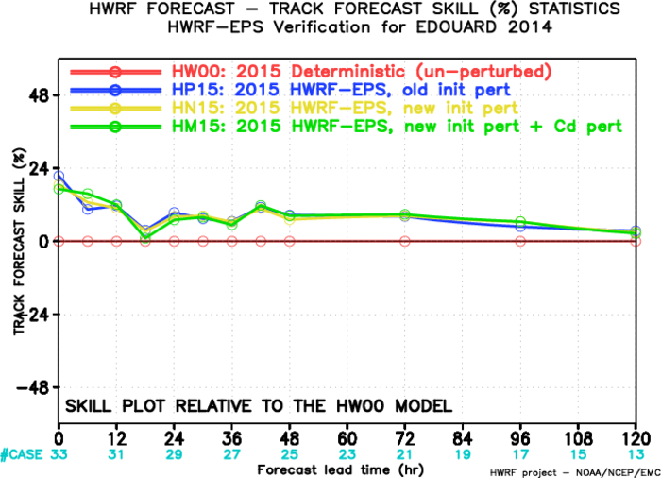
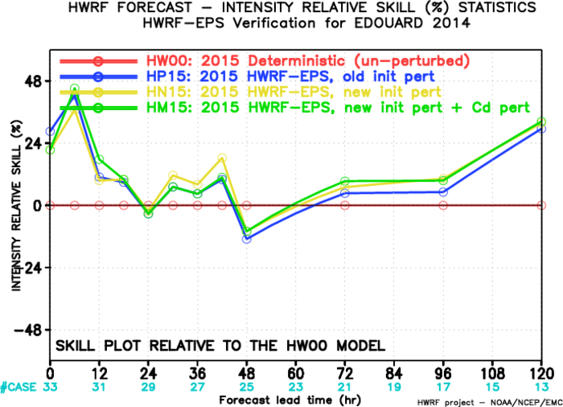
FY15 HWRF Ensemble Verifications

Slide 6
AL03, CP01-02, EP04-07,WP09-12, 08-27 July 2015
Track error(NM)
Forecast hours
CASES 229 210 187 169 149 119 99 80 65 53

Slide 7
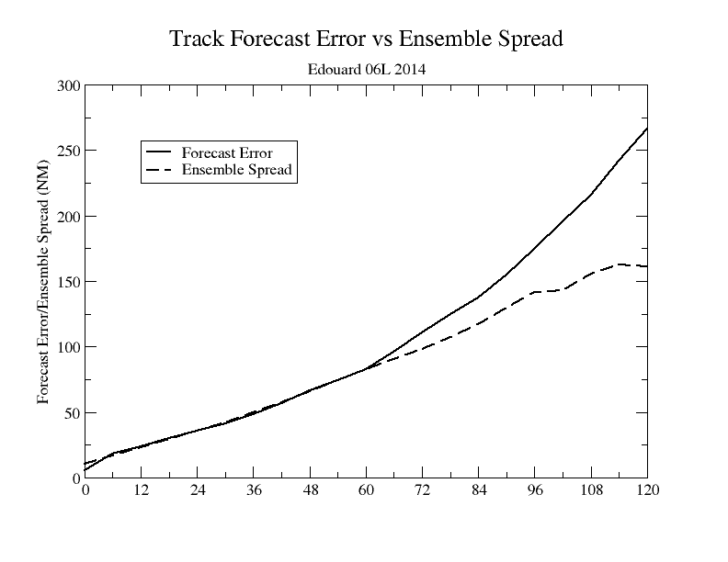
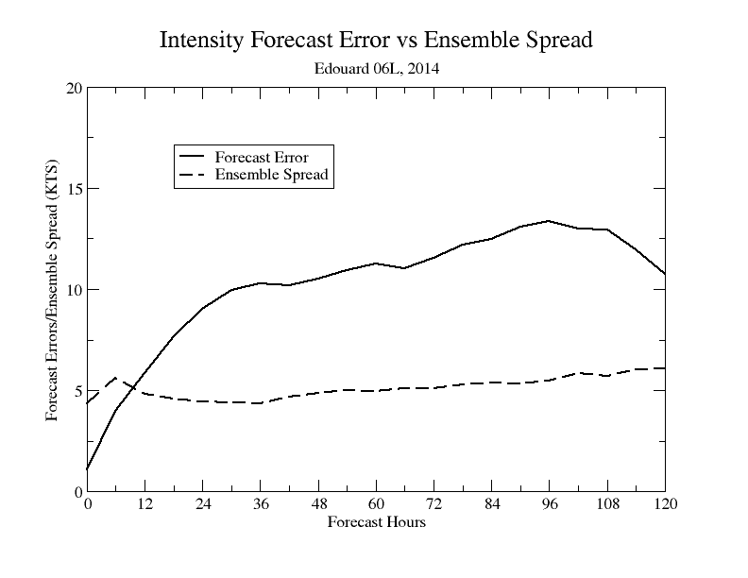
Forecast Error/Ensemble Spread Relationship

Slide 8
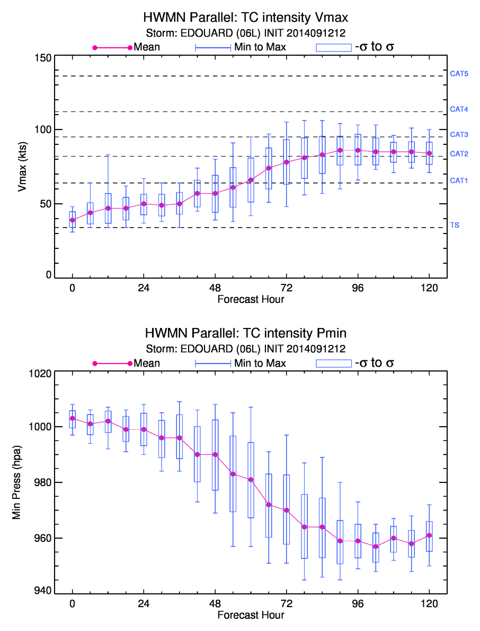
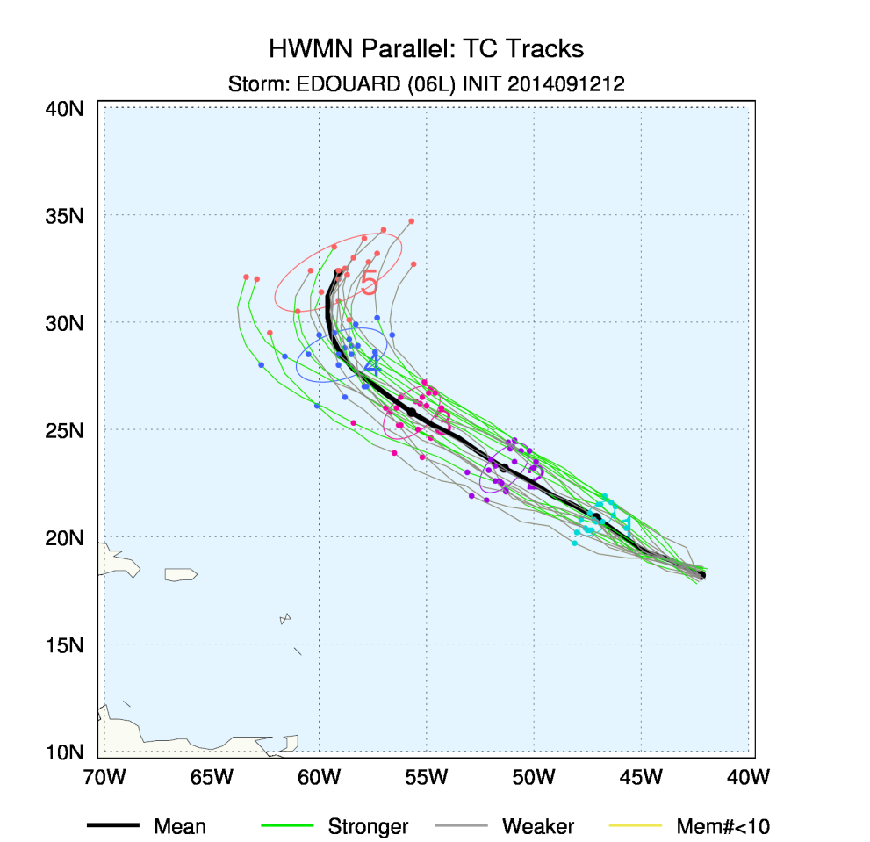
Probabilistic Forecasts

Slide 9
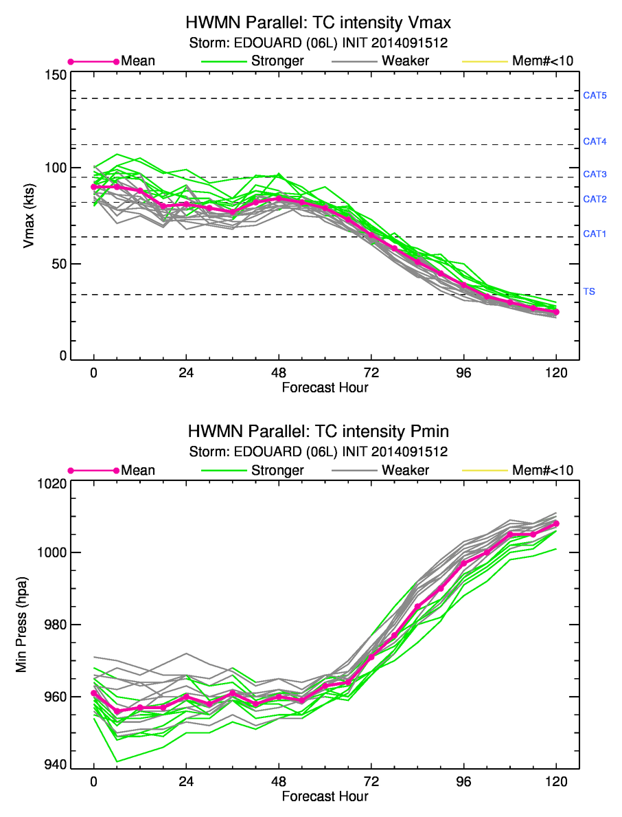
Intensity Forecasts from Individual ensemble members

Slide 10
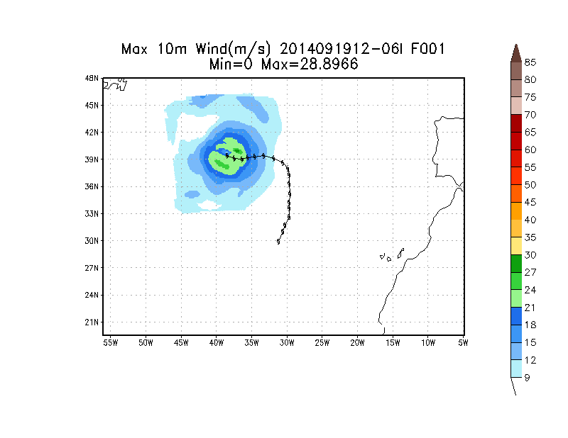
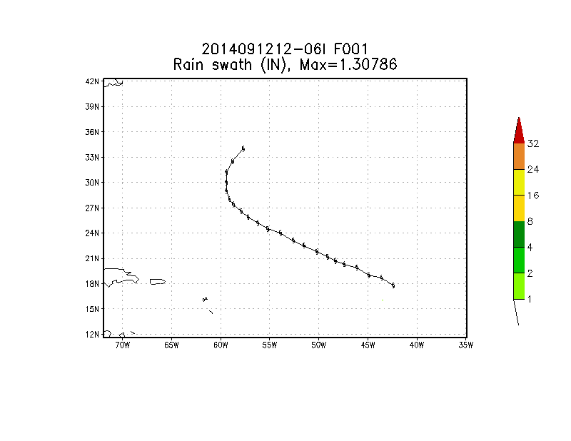
Wind/Rain Swaths from HWRF EPS

Slide 11
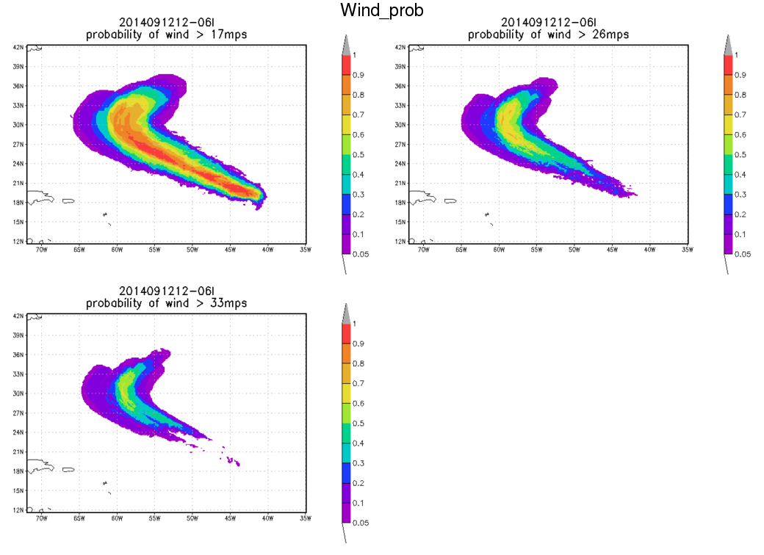
Probabilistic Wind Speed Forecasts

Slide 12
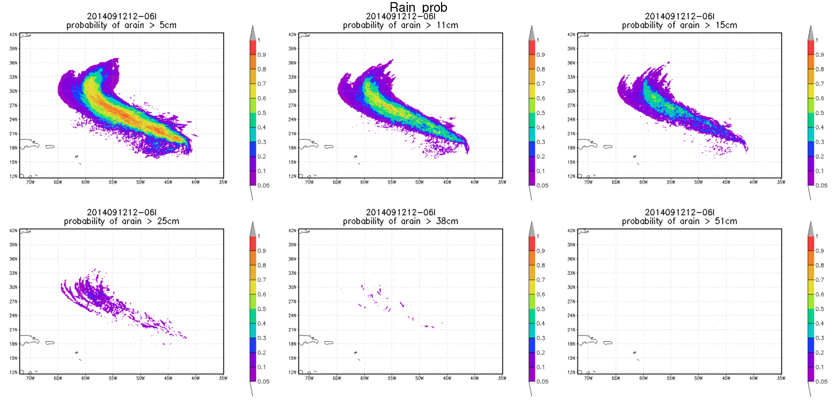
Probabilistic Rainfall Forecasts

Slide 13
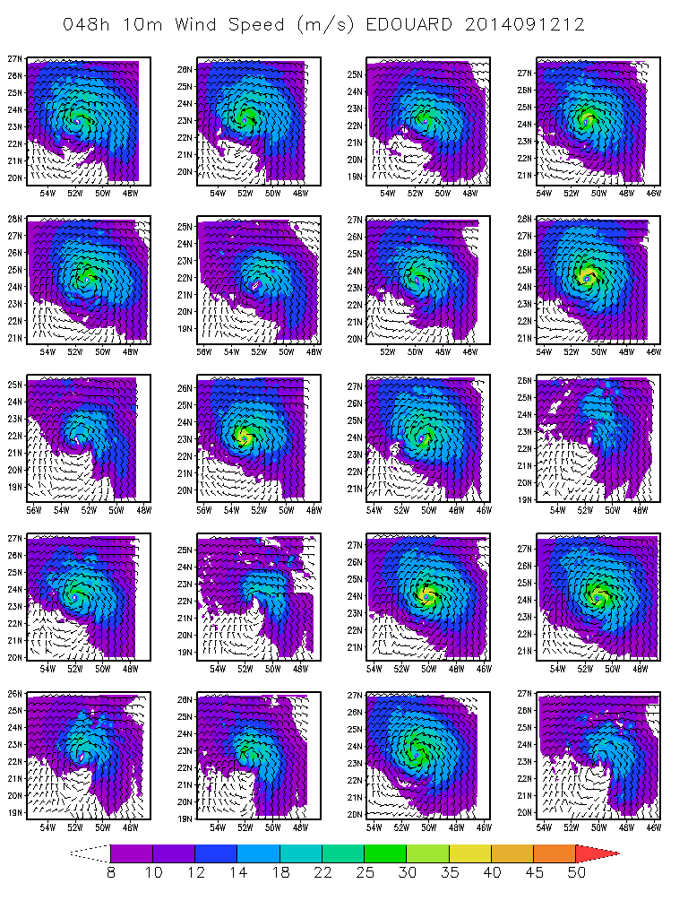
48h 10m Wind Speed Forecasts from individual Ensemble Members

Slide 14
Remarks:
1. The current control (deterministic) system needs to be tuned for lower horizontal and vertical resolution;
2. In general, the track/ intensity forecasts from ensemble predict system are better than that from its deterministic version;
3. The current HWRF EPS is still under-dispersed in terms of both track and intensity, especially intensity spread.

