Slide 1
Preliminary results of all bug-fixes, deep convection tuning and new PBL/shallow convection
Young Kwon

Slide 2
Bug fixes
SAS deep convection
– out of bound in moist static energy
Nest motion
– initialization of fractions of hydrometeo species in start_domain_nmm.f
3. MP bugs
– RHgrd_out setting in vertical levels
– detrainment from convection to MP
CO₂ transmission data
– Lookup table problem. Change to calculate in the model

Slide 3
Deep convection tuning
Modify the momentum mixing
From pgcon=0.55 to pgcon=0.2
2. Uses the original cloud mass fluxes as GFS
** These tunings were done to compensate the degradation of intensity skills caused by the positive bias from SAS convection bug fix

Slide 4
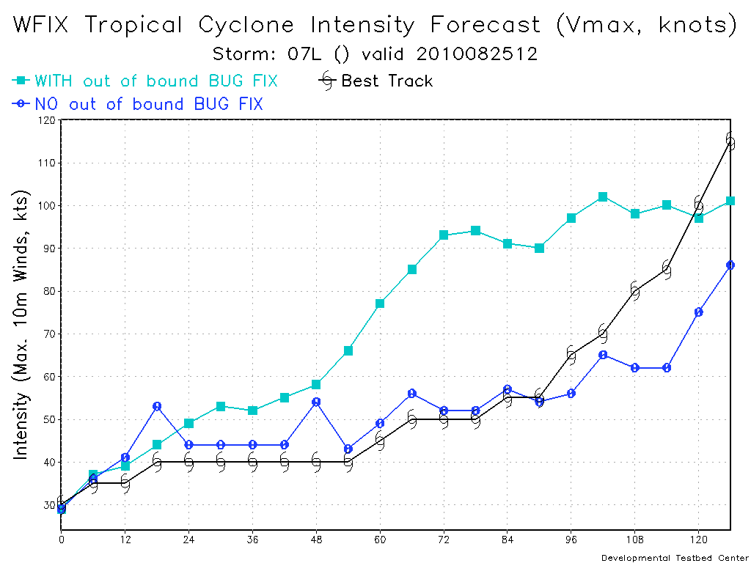
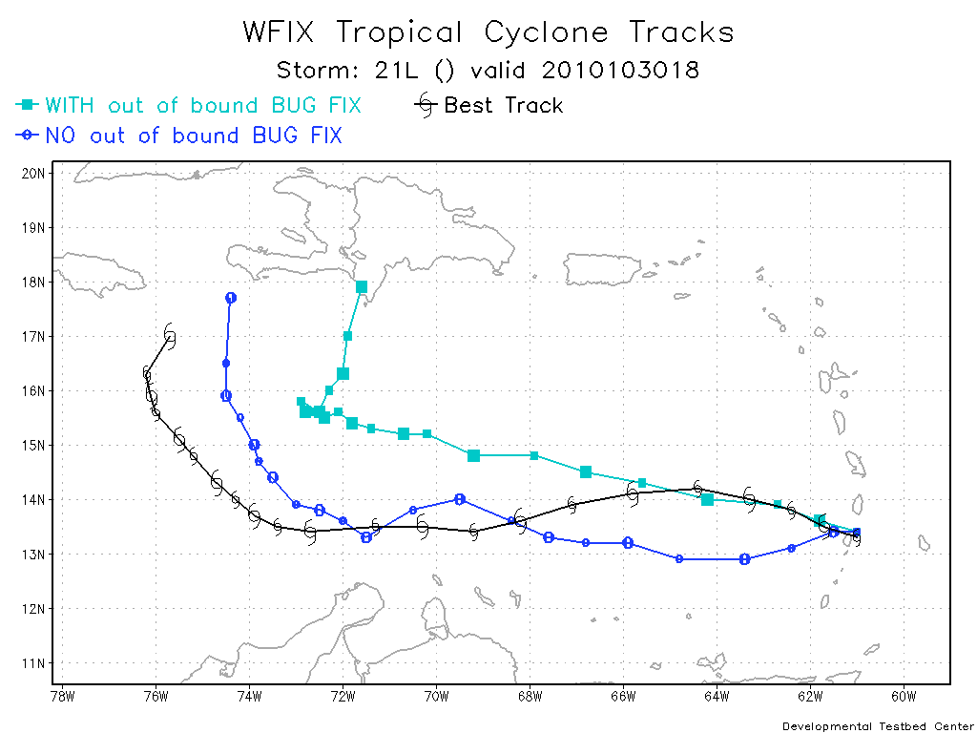

Slide 5
Introducing the new schemes
New GFS PBL scheme
- local mixing when stable conditions
New GFS shallow convection scheme
- important to include when deep convection is working properly (from J. Han)
** These schemes were not included to HWRF model at 2010 for the technical difficulties

Slide 6
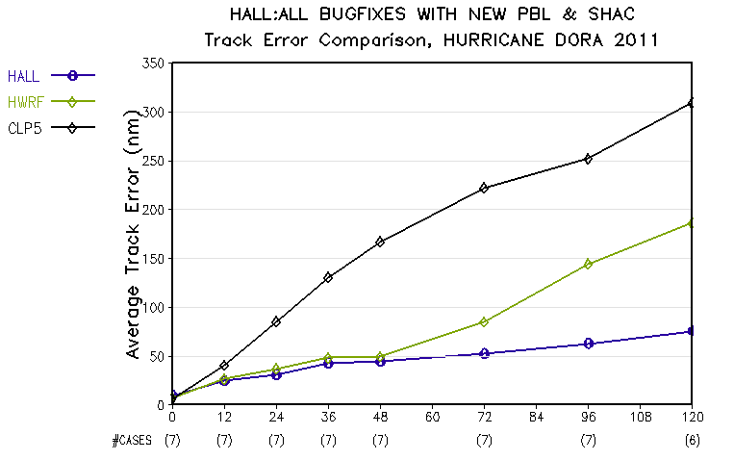

Slide 7
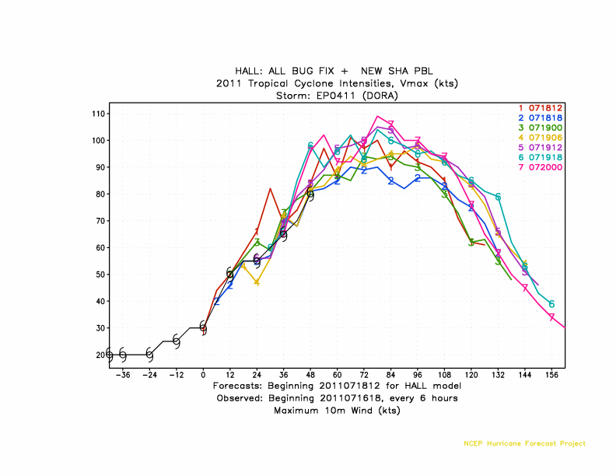
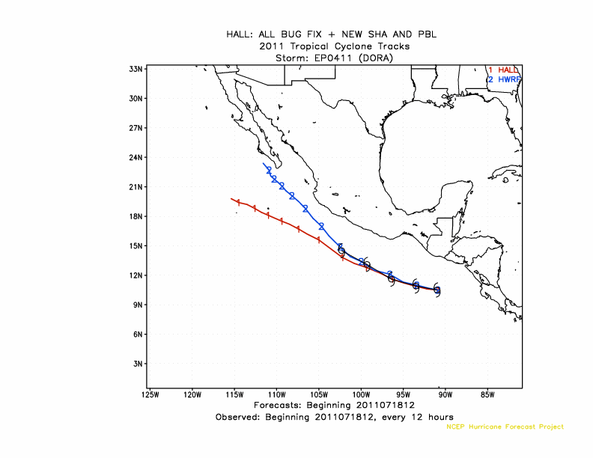

Slide 8
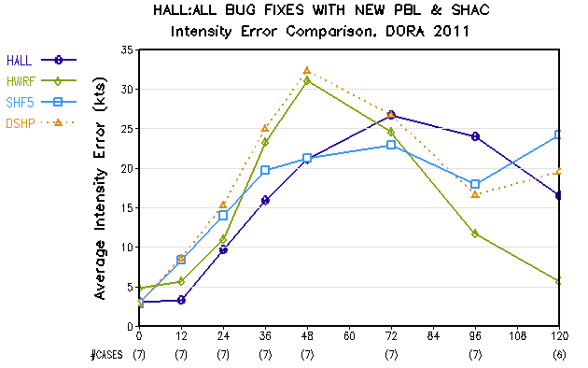

Slide 9
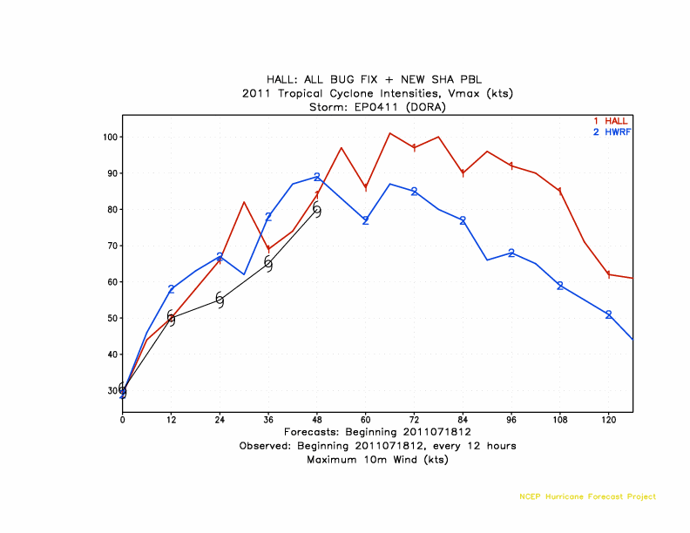

Slide 10
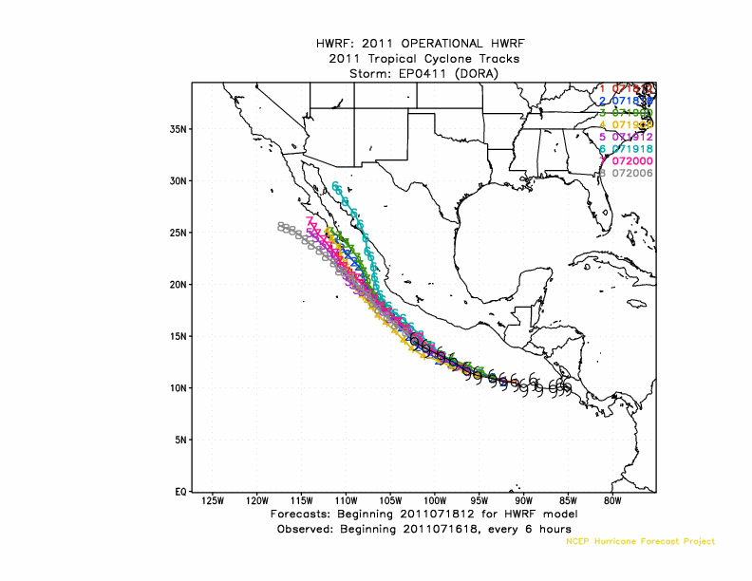

Slide 11
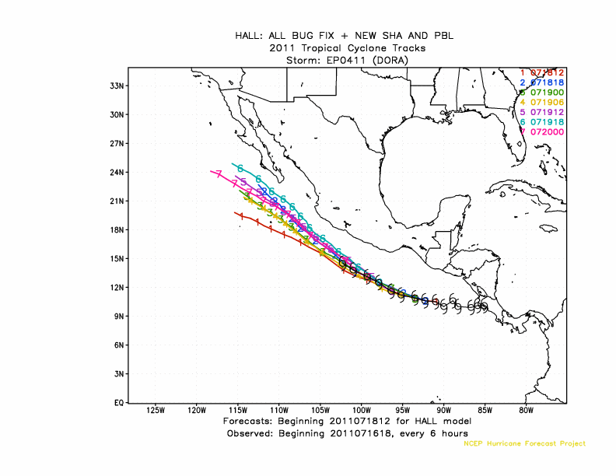

Slide 12
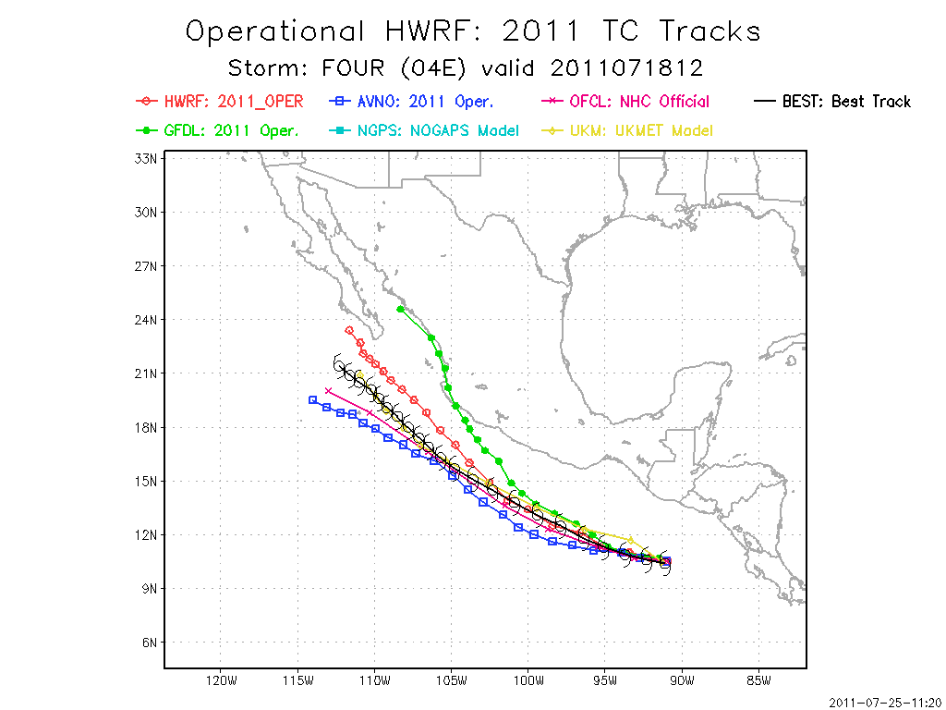

Slide 13
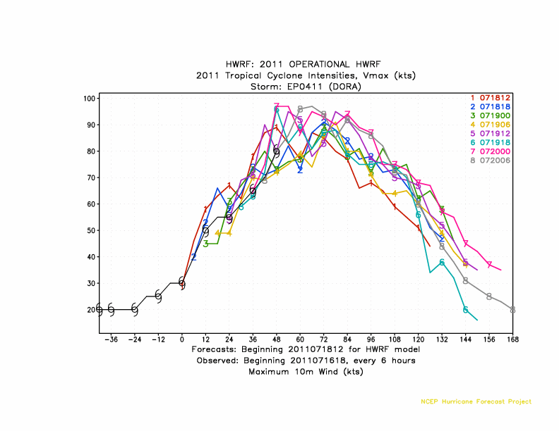

Slide 15
