Slide 1
HWRF Baseline Outlier Analysis (H15B vs H214) Zhan Zhang

Slide 2
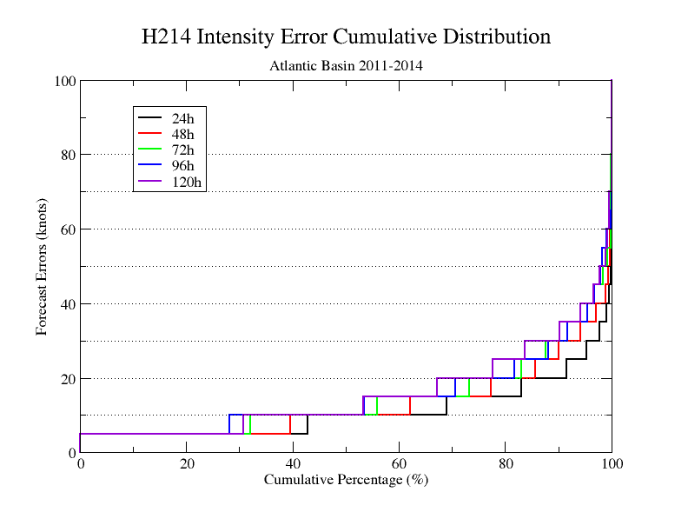
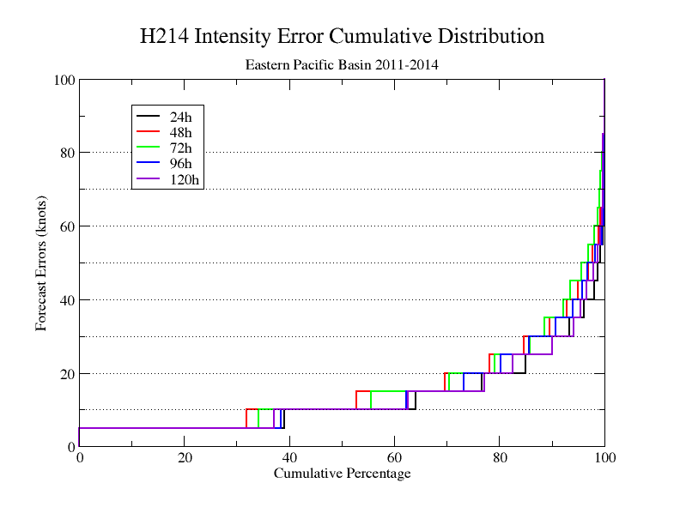
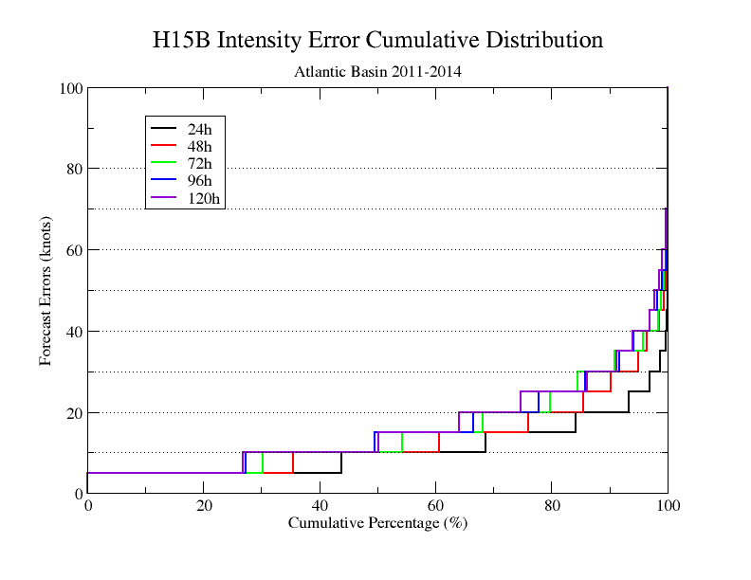
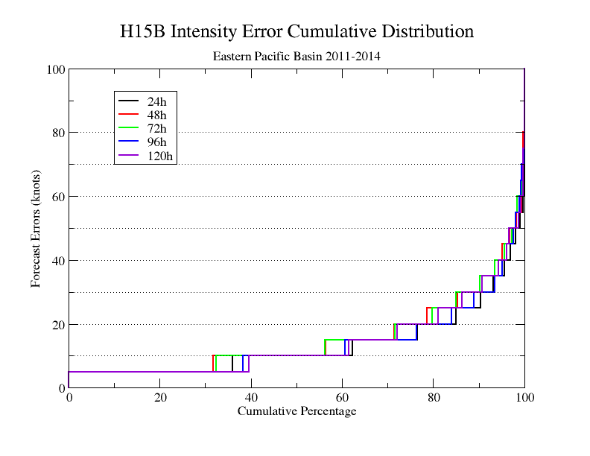
Comparison of Cumulative Distributions between H214 and H15B
H214 AL
H214 EP
H15B AL
H15B EP

Slide 3
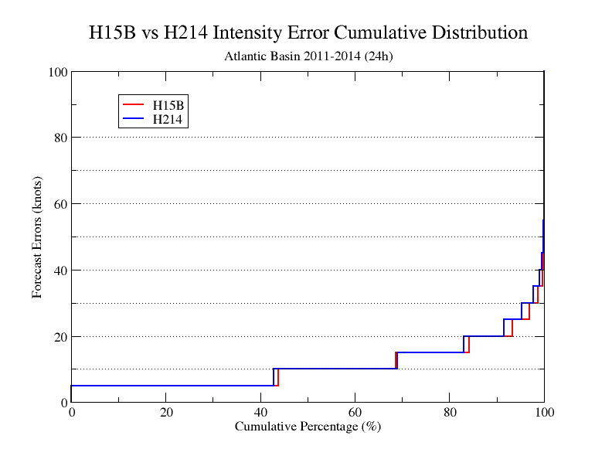
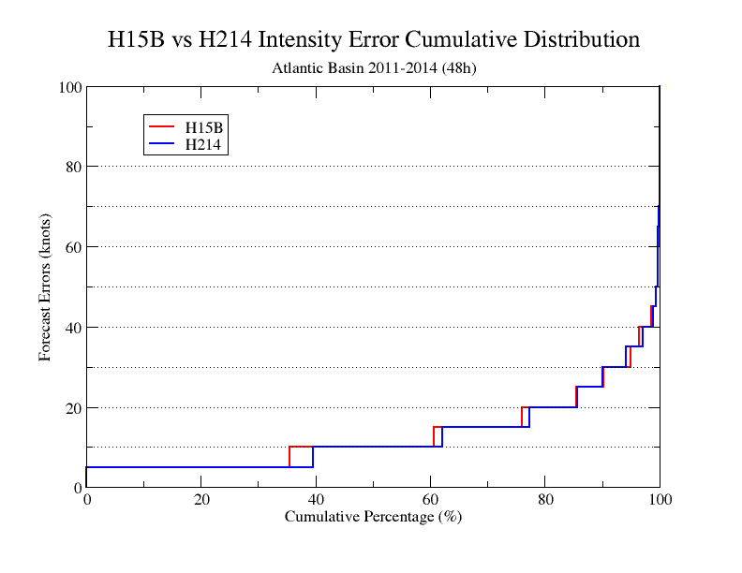
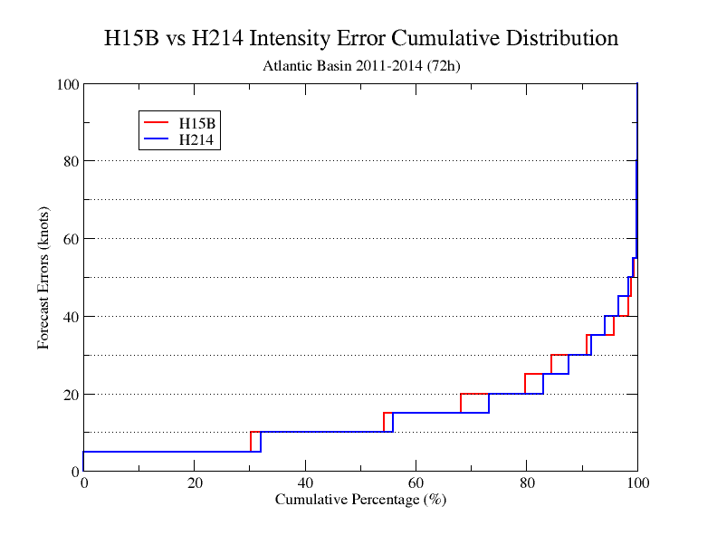
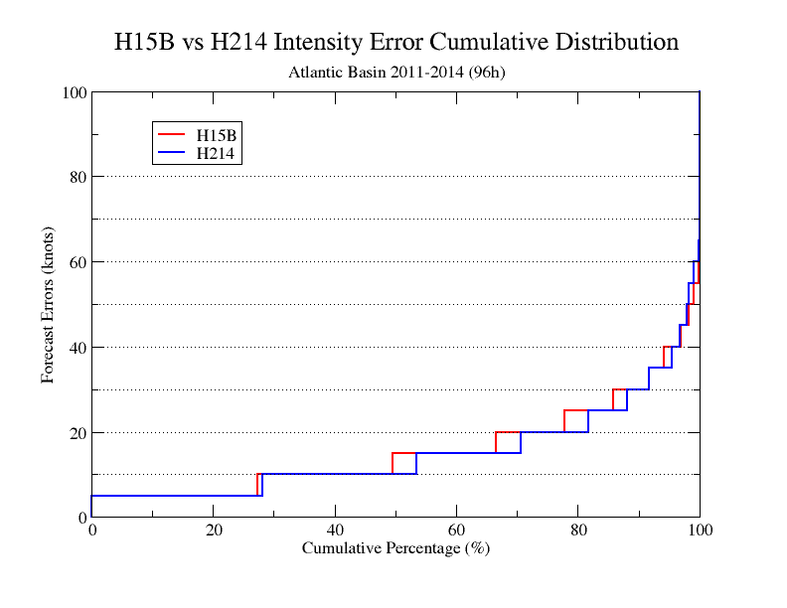
Comparison of Cumulative Distributions between H214 and H15B (AL)
24h
48h
H15B better
H15B similar
96h
72h
H15B worse
H15B worse

Slide 4
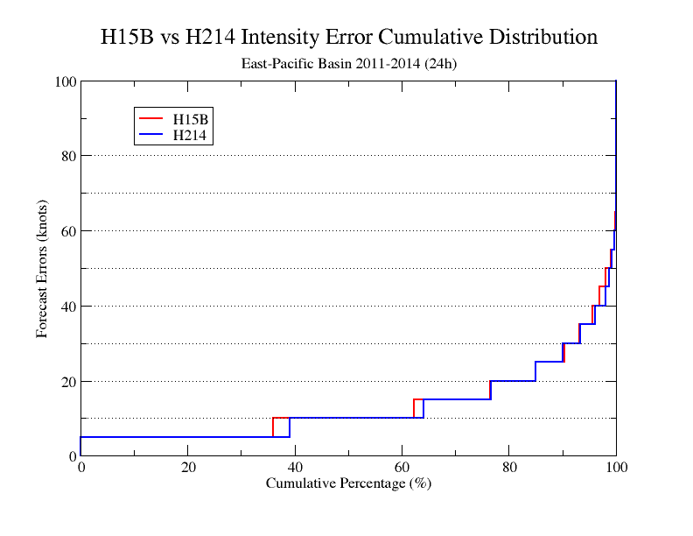
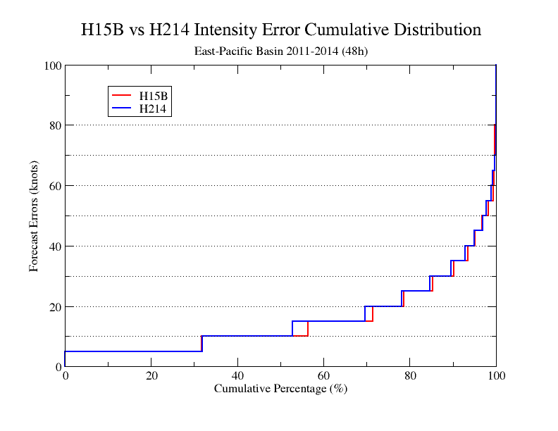
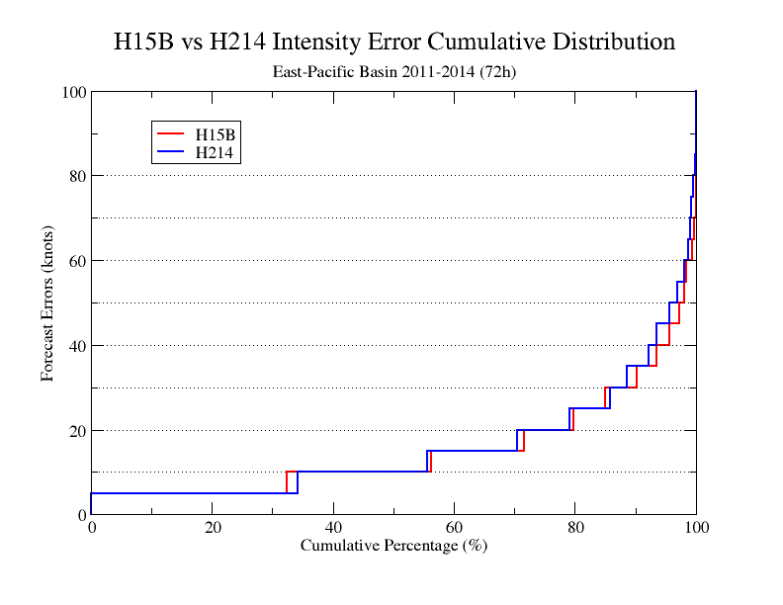
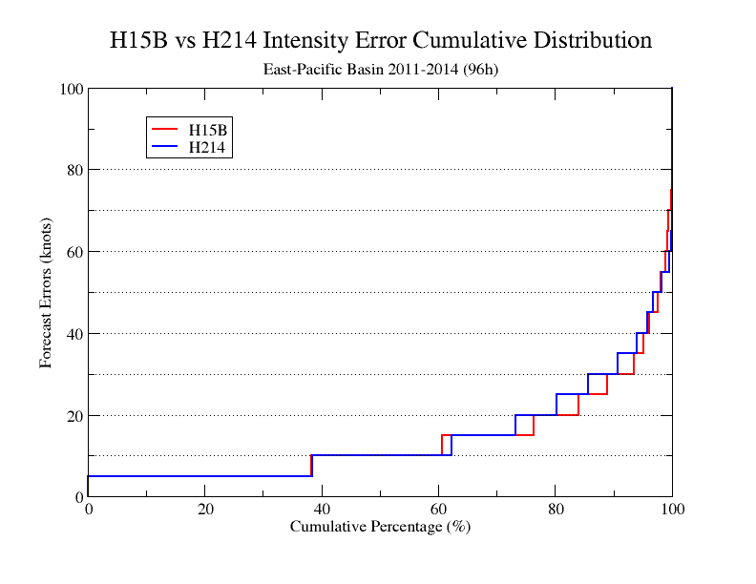
Comparison of Cumulative Distributions between H214 and H15B (EP)
24h
48h
H15B similar
H15B better
72h
96h
H15B better
H15B better

Slide 5
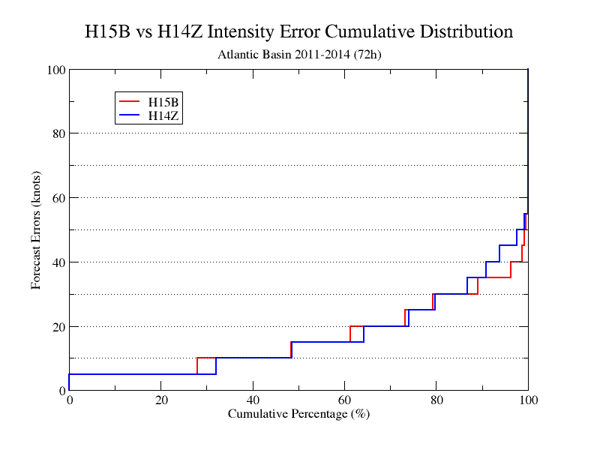
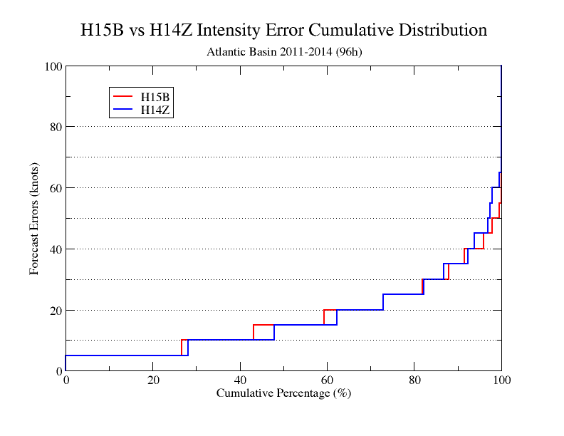
Comparison of Cumulative Distributions between H15B and H14Z(AL)

Slide 6
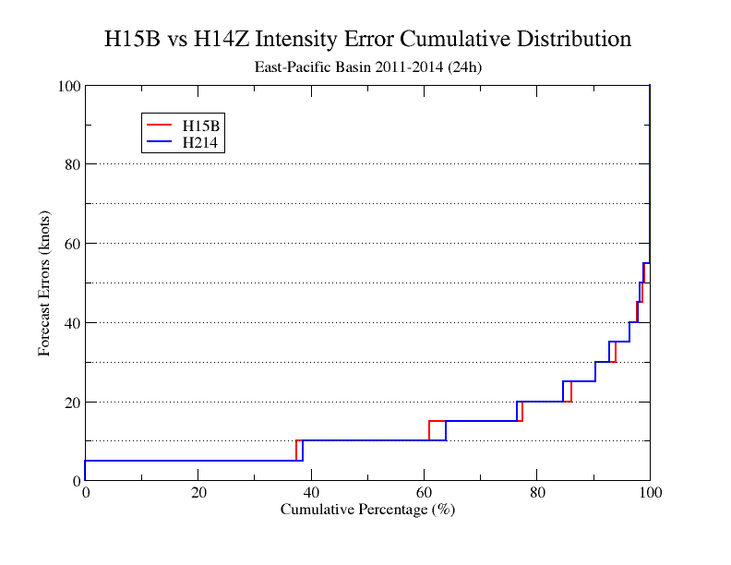
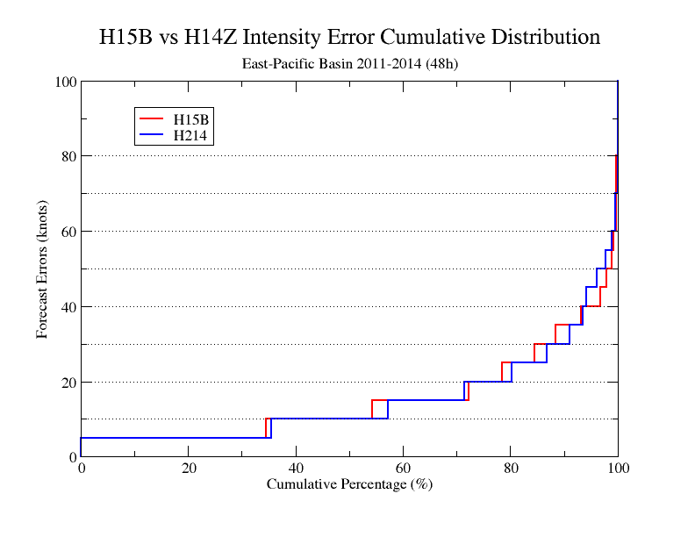
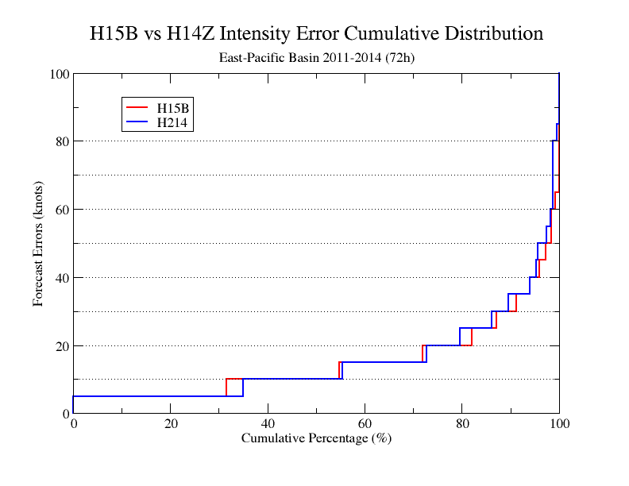
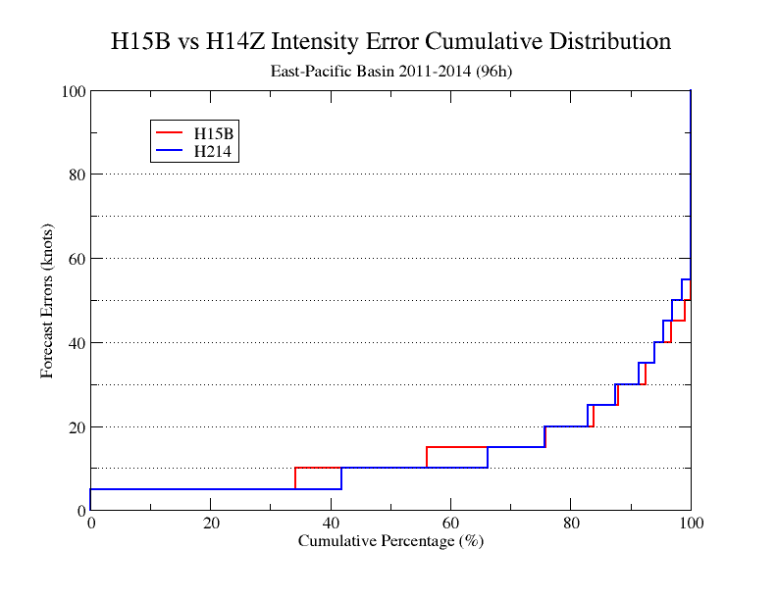
Comparison of Cumulative Distributions between H15B and H14Z (EP)

Slide 7
Intensity Improvement/Degradation of H15B over H214 for AL
4 identified busted storms, 2011, 16L 17L and 2012 12L and 13L are improved
H15B-H214
Improvement: <0
Degradation: >0

Slide 8
Intensity Improvement/Degradation of H15B over H214 for EP
H15B-H214
Improvement: <0
Degradation: >0

Slide 9
Intensity Improvement/Degradation of H15B over H214 for EP
H15B-H214
Improvement: <0
Degradation: >0

Slide 10
Intensity Improvement/Degradation of H15B over H14Z for AL
H15B-H14Z
Improvement: <0
Degradation: >0

Slide 11
Intensity Improvement/Degradation of H15B over H14Z for EP
H15B-H14Z
Improvement: <0
Degradation: >0

Slide 12
Intensity Improvement/Degradation of H15B over H214 for AL
(TDR Storms Only)
H15B-H214
Improvement: <0
Degradation: >0

Slide 13
Track Improvement/Degradation of H15B over H214 for AL
(in Nautical Mile)

Slide 14
Track Improvement/Degradation of H15B over H214 for EP
(in Nautical Miles)

Slide 15
Track Improvement/Degradation of H15B over H14Z for AL
(in Nautical Miles)

Slide 16
Track Improvement/Degradation of H15B over H14Z for EP
(in Nautical Miles)

Slide 17
Intensity Improvement/Degradation of H15B over H214 for AL
Average=0.00710696

Slide 18
Intensity Improvement/Degradation of H15B over H214 for EP
Average=-0.00800047

