Slide 1
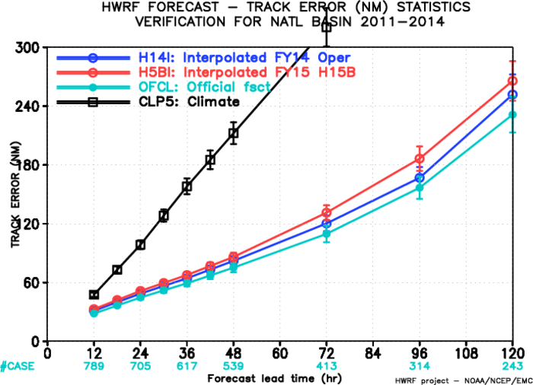
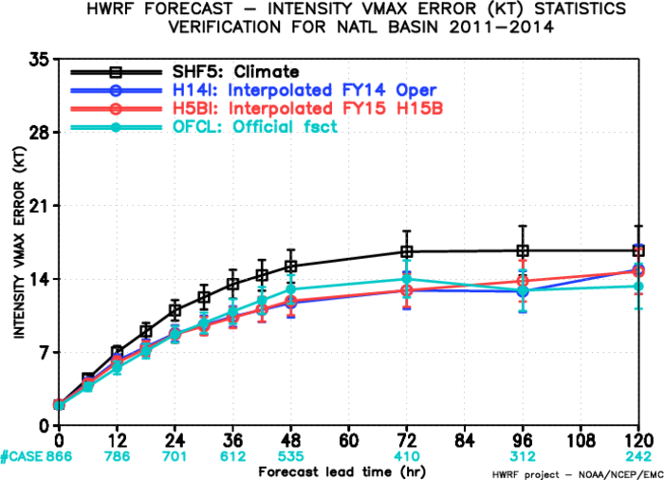
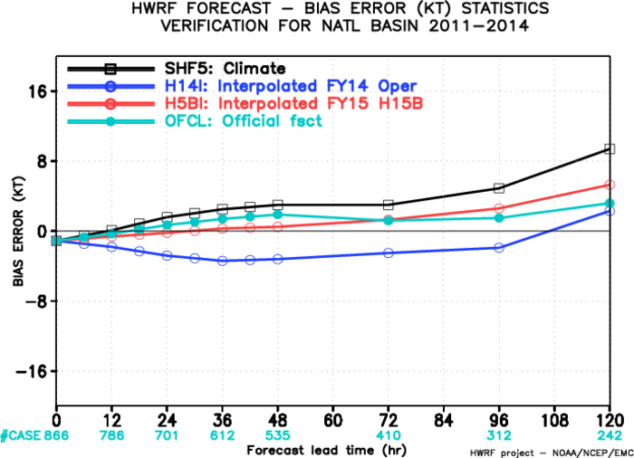
AL Verification (H15B vs. H214)
More plots:
http://www.atmos.umd.edu/~zhang/HWRF/figures_all/AlAL1114/

Slide 2
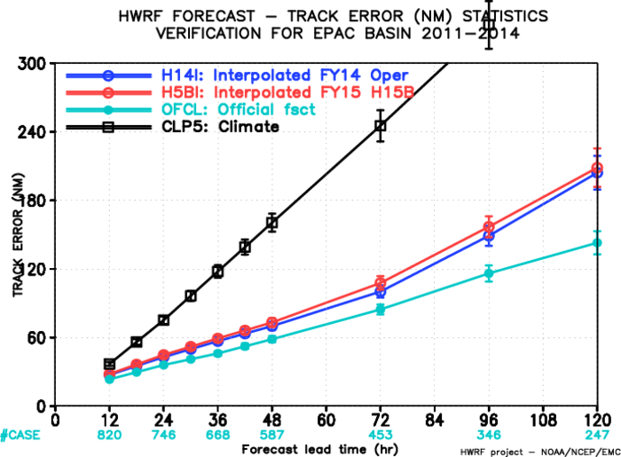
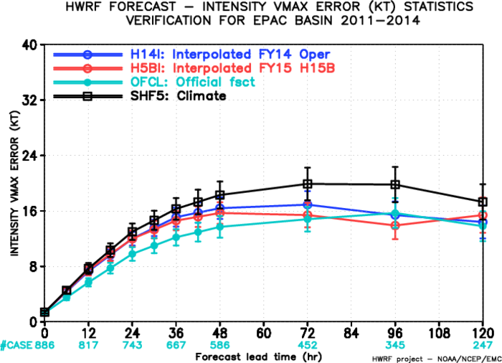
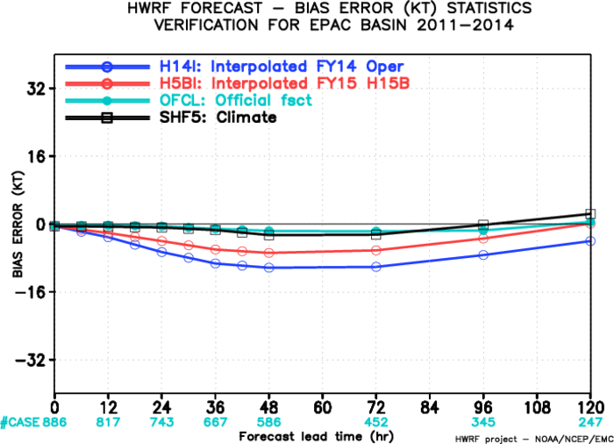
EP Verification (H15B vs. H214)
More plots:
http://www.atmos.umd.edu/~zhang/HWRF/figures_all/EPAL1114/

Slide 3
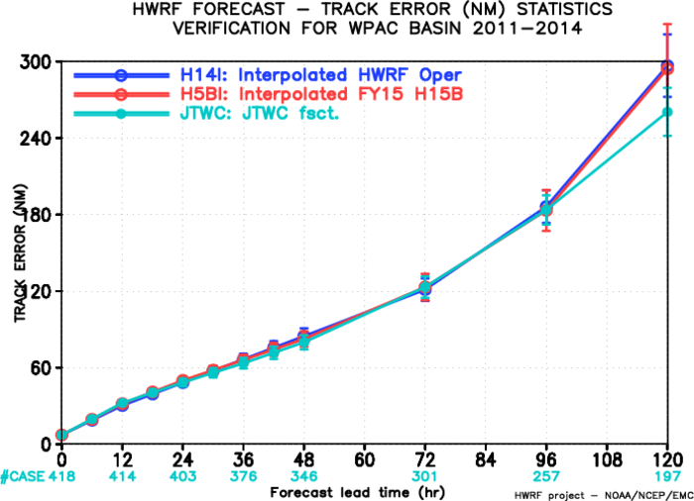
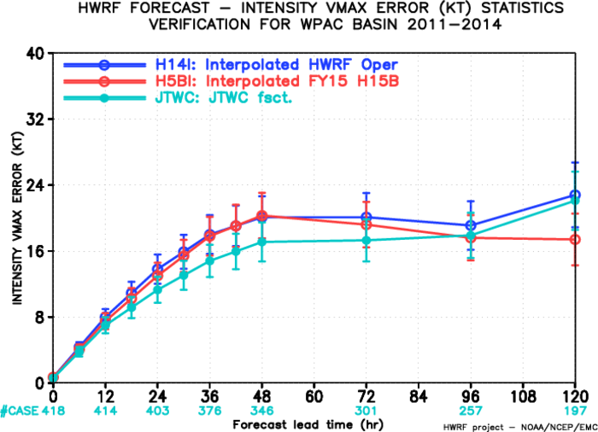
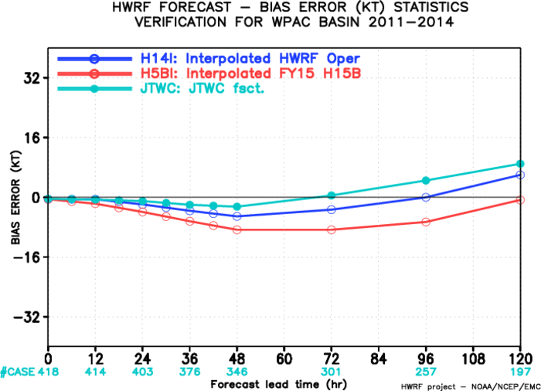
WP Verification (H15B vs. H214)
More plots:
http://www.atmos.umd.edu/~zhang/HWRF/figures_all/WPAL1114/

Slide 4
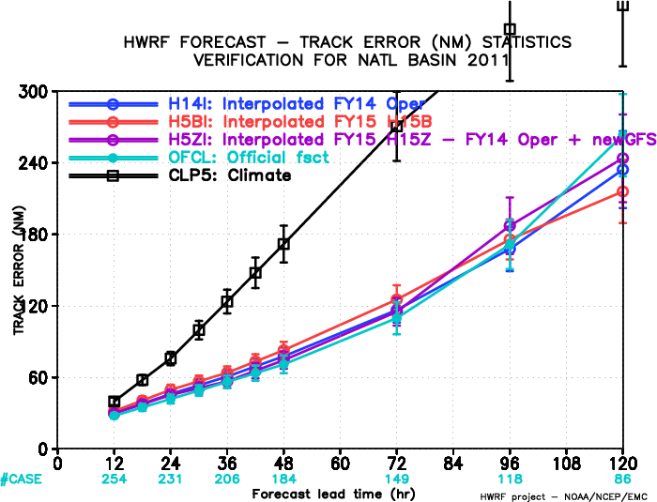
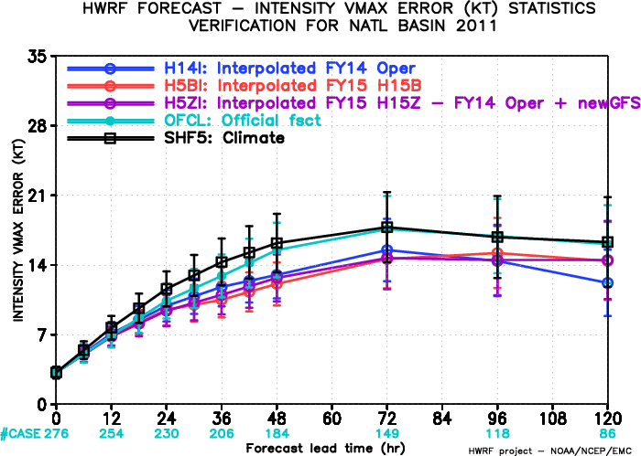
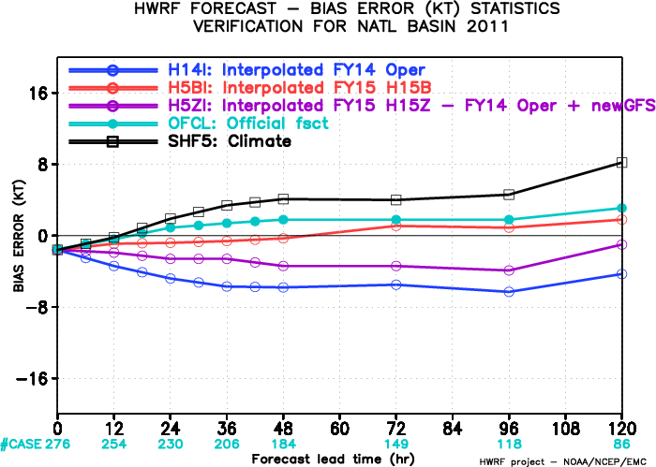
AL Verification (H15B vs. H15Z)
More plots:
http://www.atmos.umd.edu/~zhang/HWRF/figures_all/ALAL1111/

Slide 5
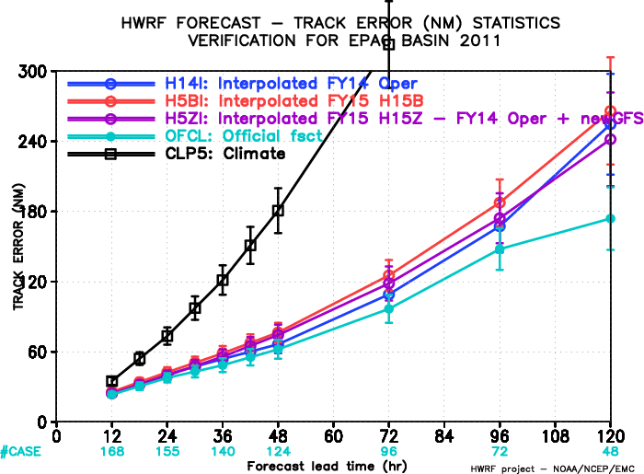
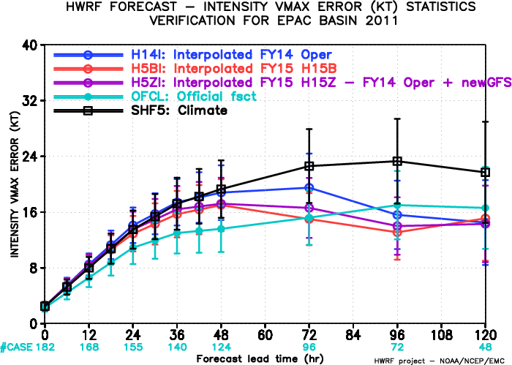
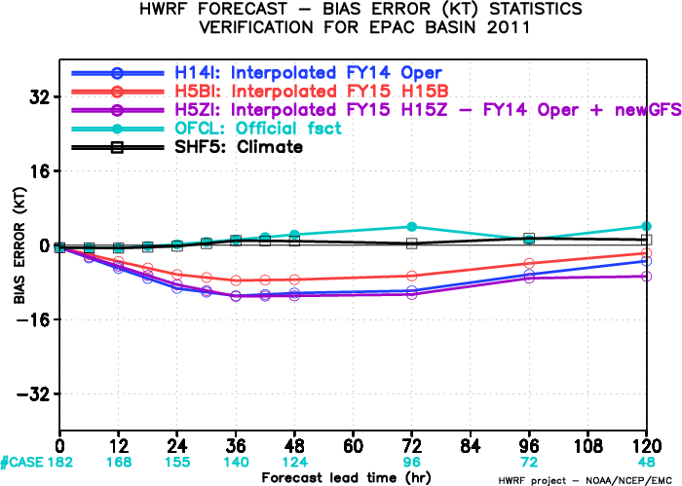
EP Verification (H15B vs. H15Z)
More plots:
http://www.atmos.umd.edu/~zhang/HWRF/figures_all/EPAL1111/

