Slide 1
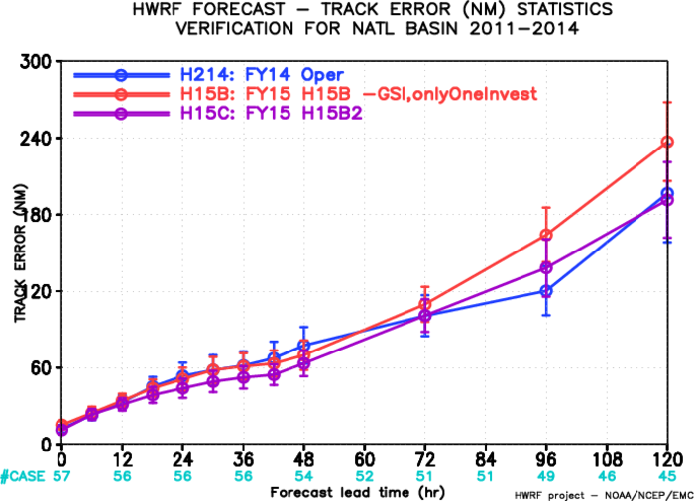
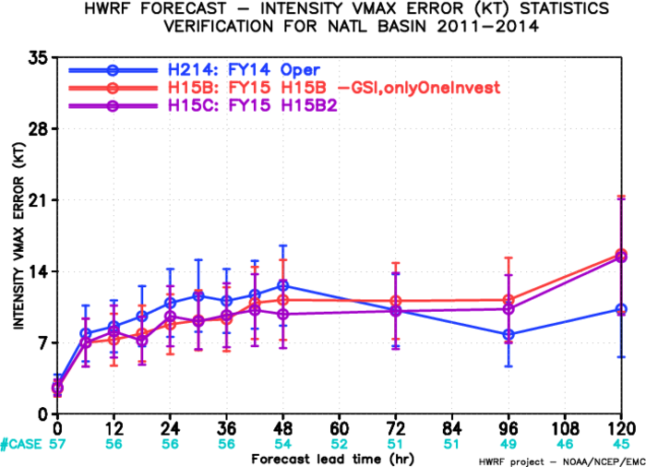
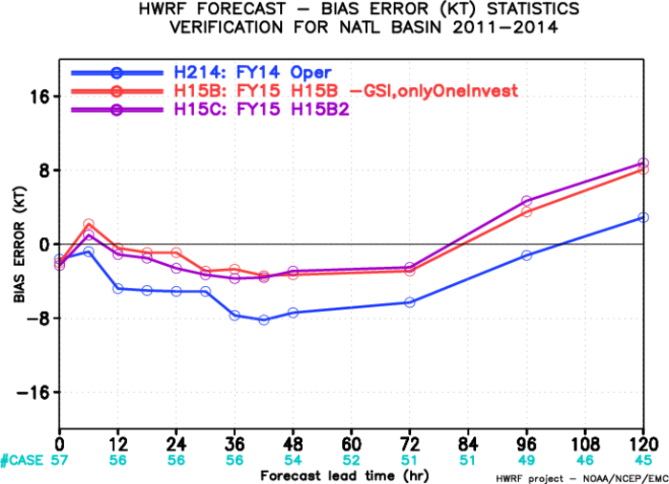
AL Track/Intensity Verification of H15B vs. H15C
H15C track/Intensity is better than H15B/H214 before day 3, and neutral/degraded afterwards.
http://www.atmos.umd.edu/~zhang/HWRF/figures_H15B2

Slide 2
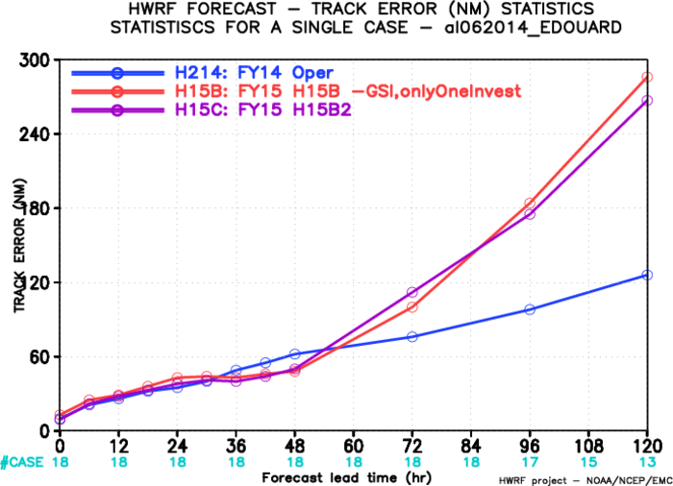
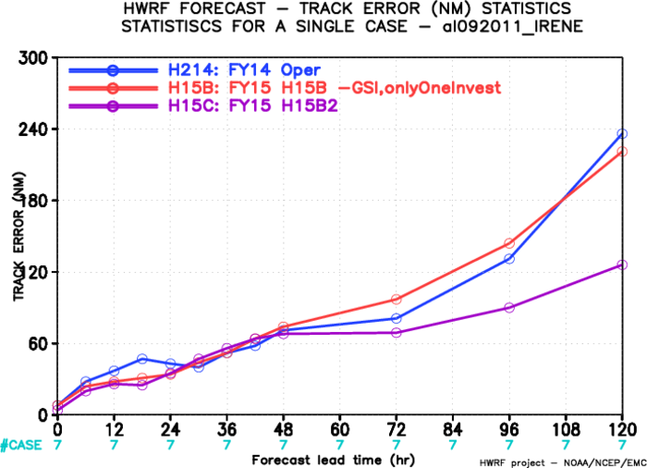
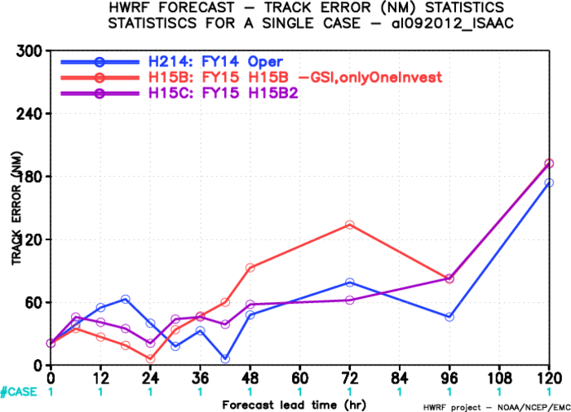
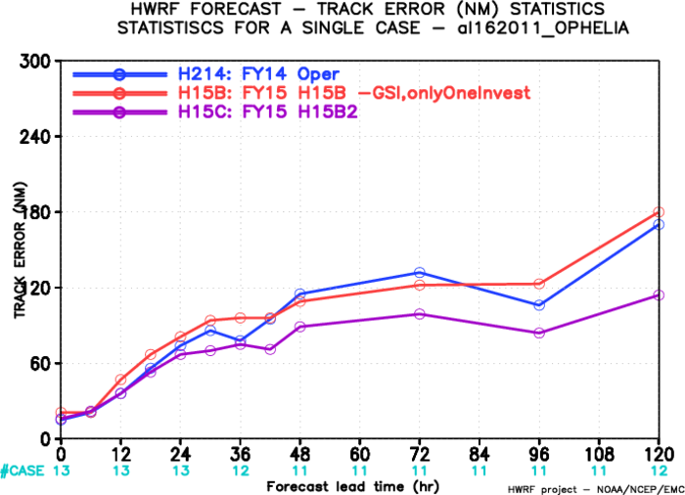
Individual Track Verifications
Edouard, 06L,2014
Irene, 09L,2011
No improvement
Isaac, 09L,2012
Ophelia, 16L,2011

Slide 3
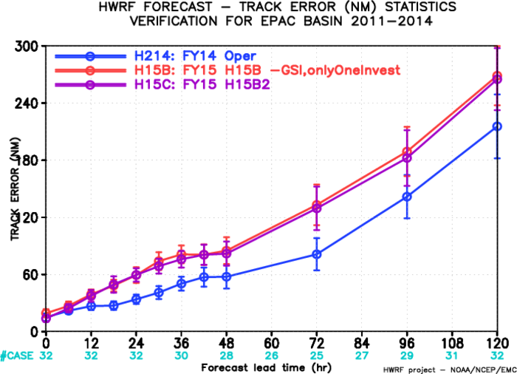
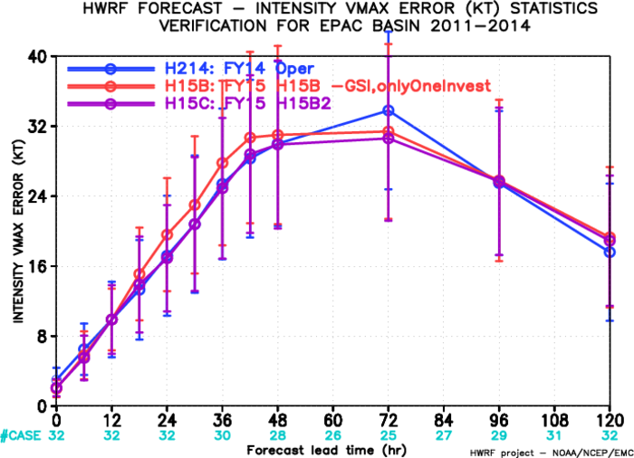
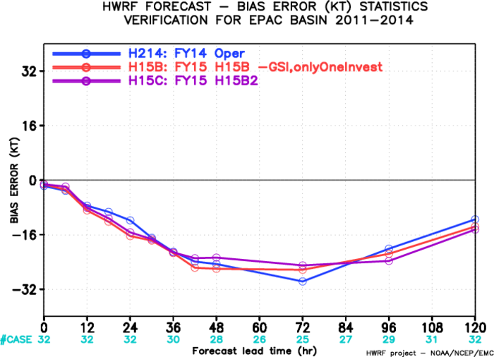
EP Track/Intensity Verification of H15B vs. H15C
No track improvement of H15C over H15B, little intensity improvement?

Slide 4
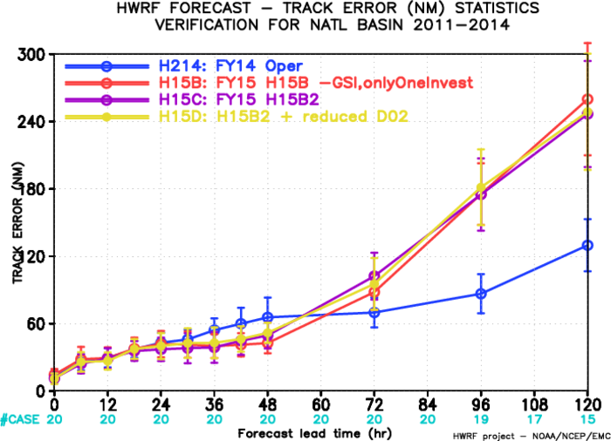
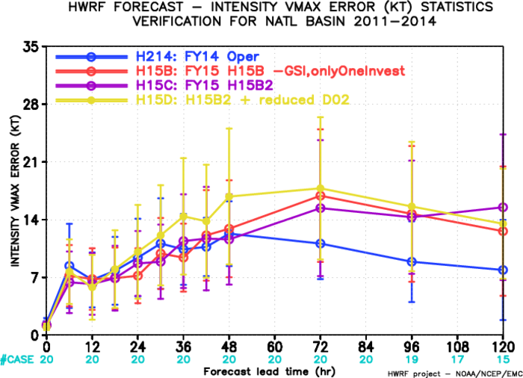
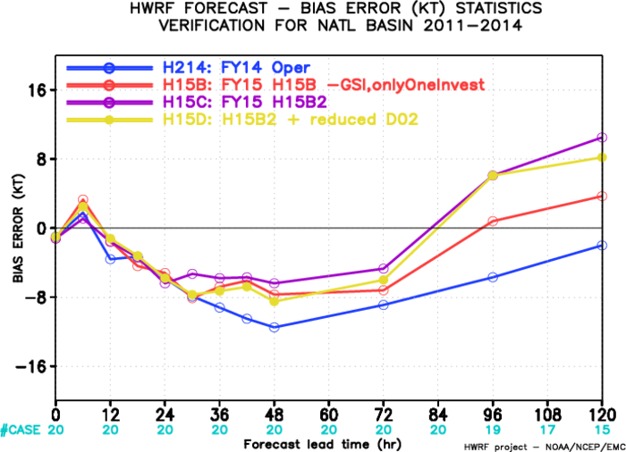
AL Track/Intensity Verification of H15B vs. H15C/H15D
No track improvement of H15C/H15D over H214 due to absence of Irene in H15D.
H15D intensity is degraded over H15C?

Slide 5
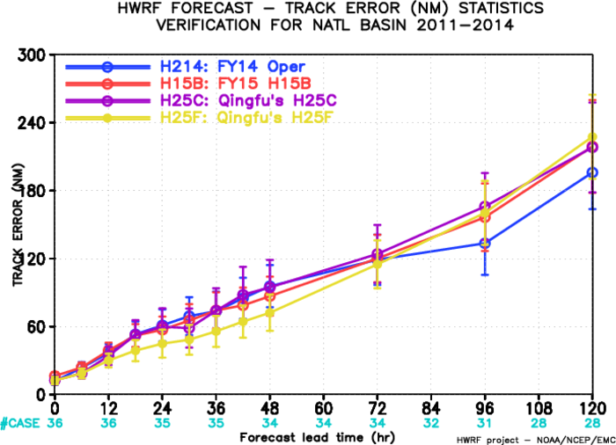
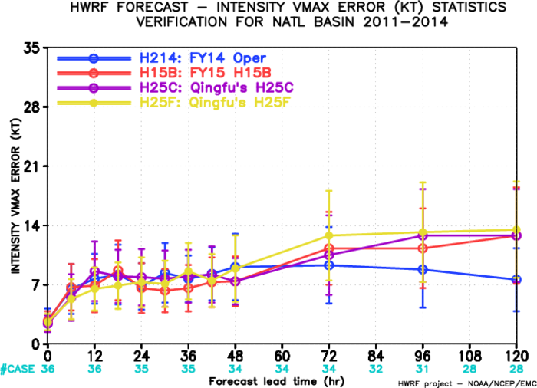
Initialization Experiment

Slide 6
Large Scale Field Analysis for Edouard , 2014
http://ftp.emc.ncep.noaa.gov/mmb/wd20ww/cp-tmp/six06l_2014091112_H214_H15B_H15C_H15D/

