Slide 1



HWRF GSI-Based
TC Vortex Relocation
Henry R. Winterbottom¹ and Jason A. Sippel²
¹I.M. Systems Group, Inc. (IMSG)
National Oceanic and Atmospheric Administration (NOAA)/National Weather Service (NWS)
National Centers for Environmental Prediction (NCEP) Environmental Modeling Center (EMC)
²NOAA Atlantic Oceanographic and Meteorological Laboratory (AOML)
Hurricane Research Division (HRD)

Slide 2
Outline:
Operational HWRF Overview
Motivation
Experiment Configuration
  TC Relocation Algorithm
  TC Relocation Increments
  TC Data Assimilation Analysis
  TC Observations and Analysis Comparison
Considerations

Slide 3
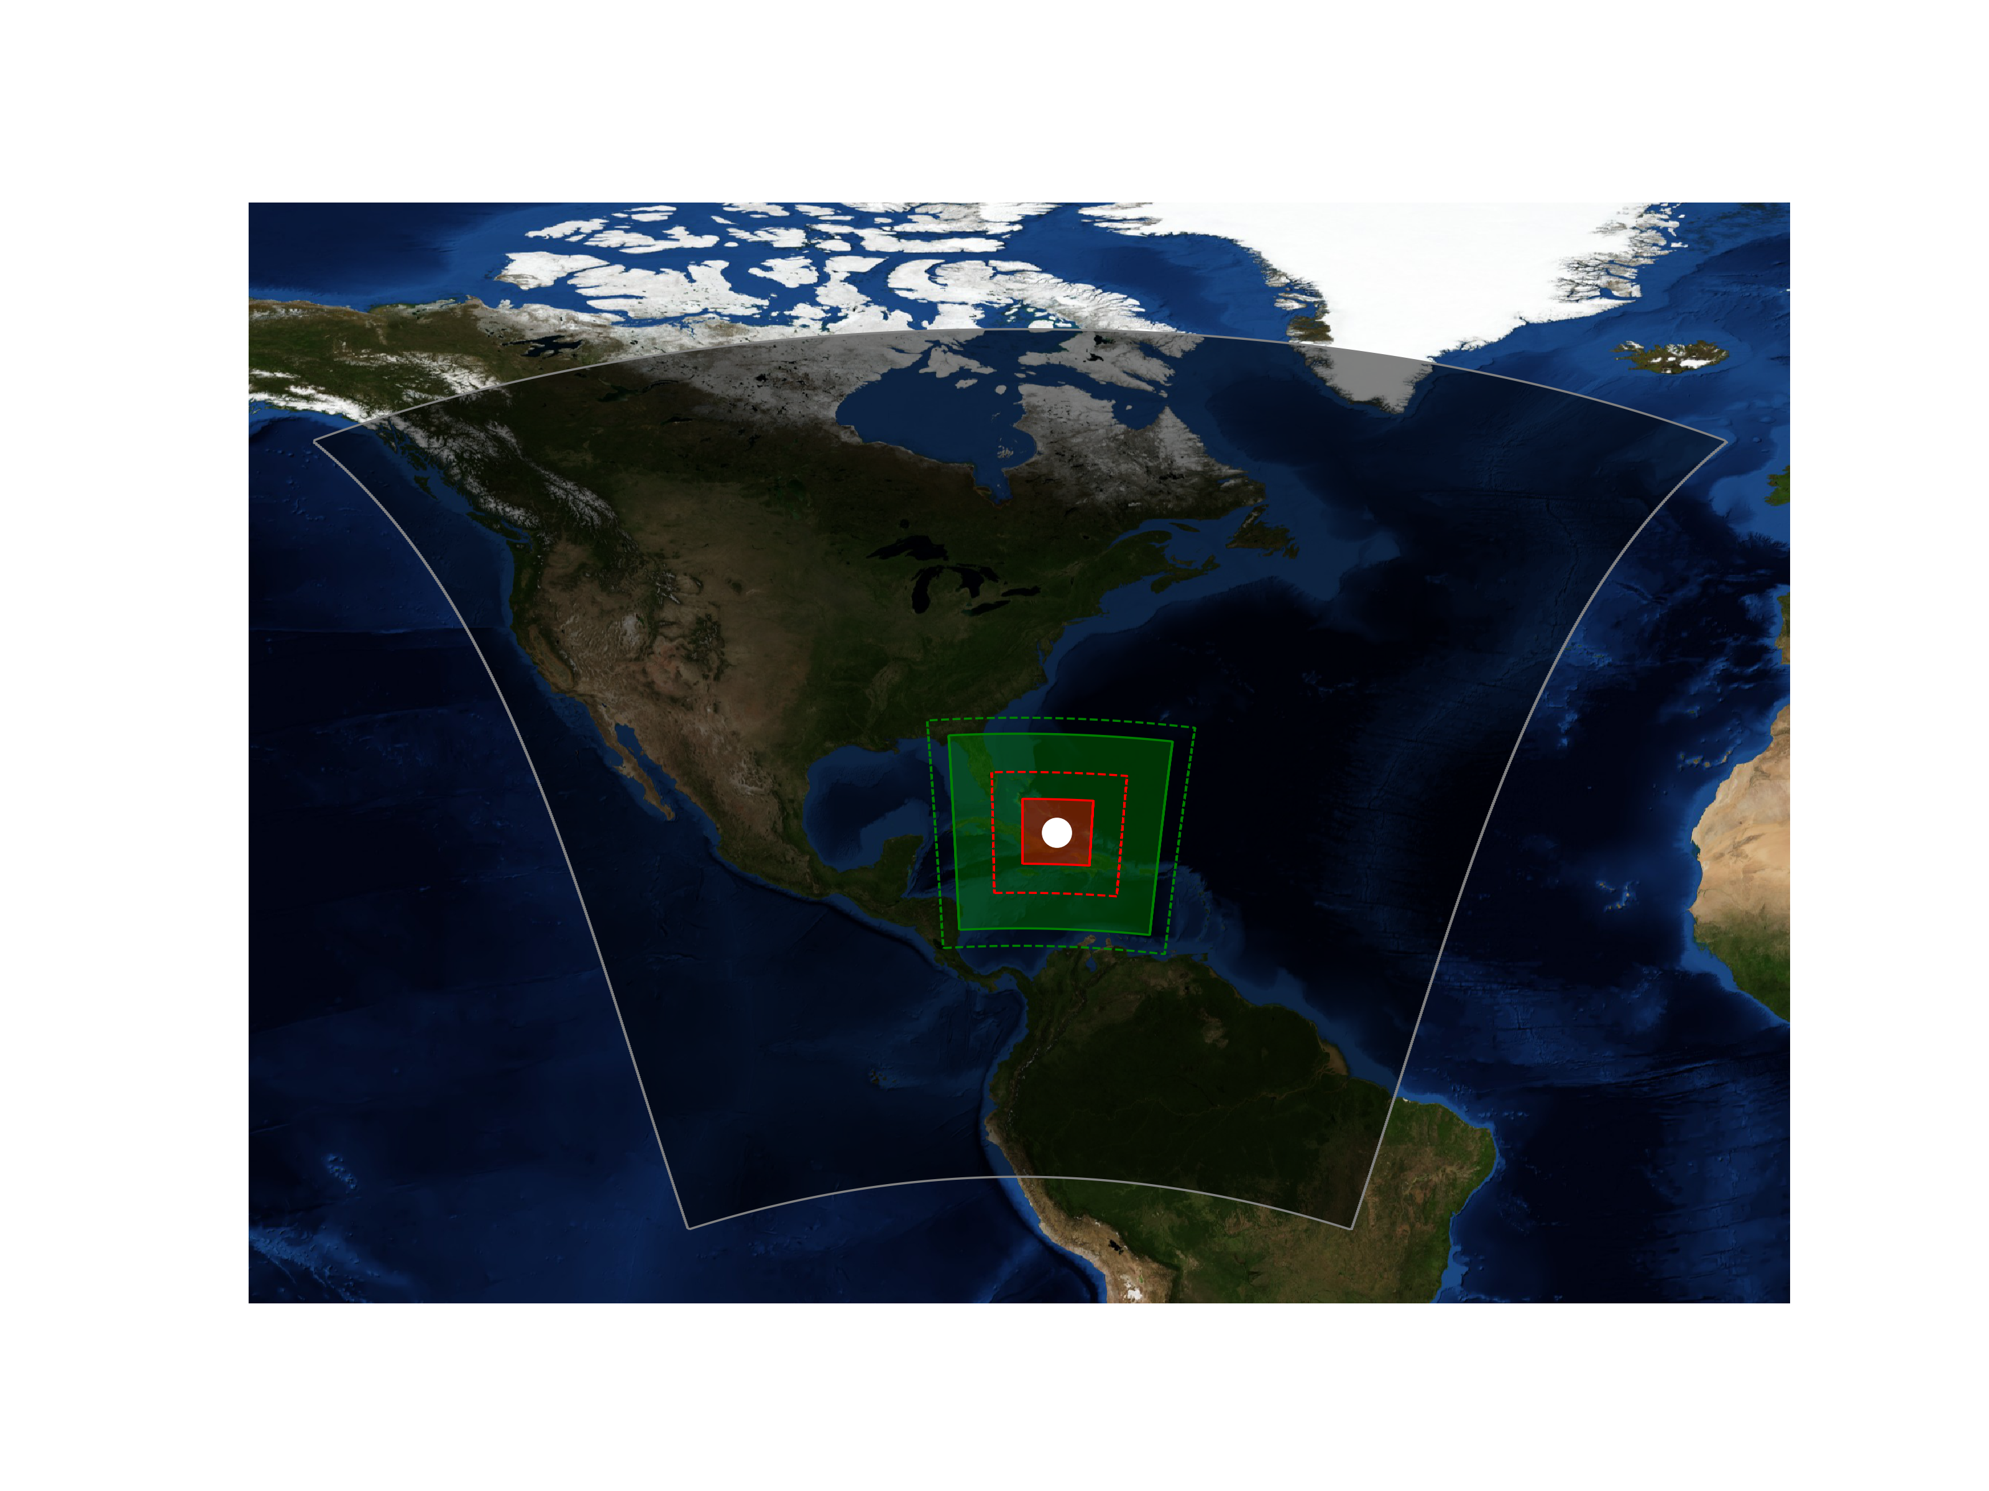
Operational HWRF Overview:
Operational HWRF (H19B) Configuration for
TC Irma (11L 2017) Value 1200 UTC 08 September
HWRF uses a TC-following triply-nested forecast grid configuration
Domain 1 (shaded gray region) does not implement DA and relies entirely on the global model (GFS) initial and boundary conditions
The global model TC positions and intensities are relocated and modified to match the TC-vitals observation prior to the data-assimilation (DA)
DA is performed within the respective domains (illustrated by the dashed lines)
The results of the DA are super-imposed upon the HWRF forecast domains 2 and 3 (illustrated by the shaded green and red regions, respectively)
Domain 1
Domain 2
Domain 3
DA Domain
Forecast Domain

Slide 4
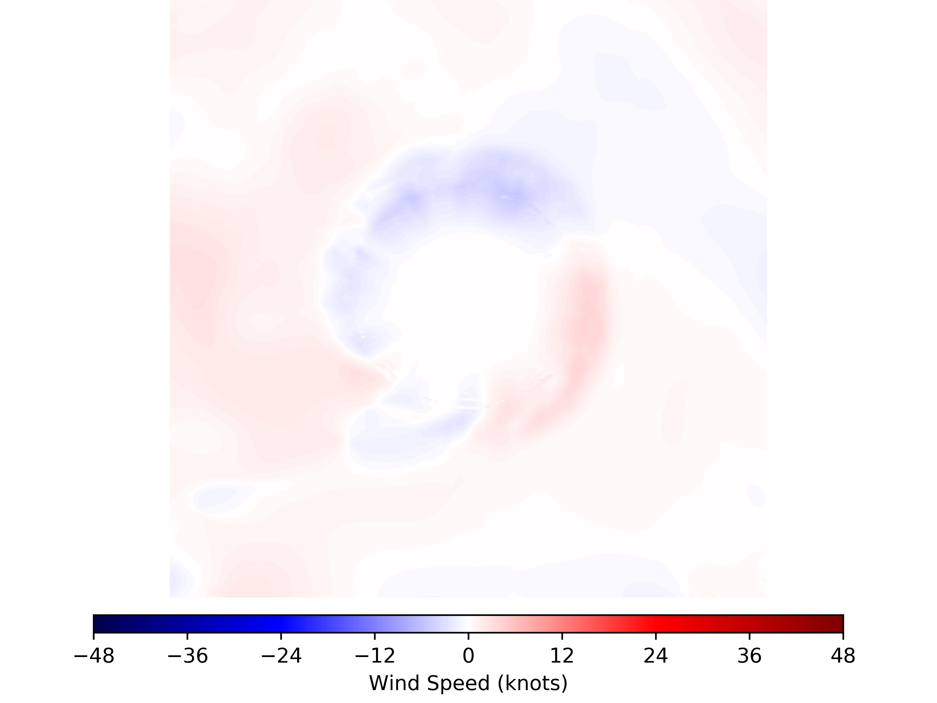
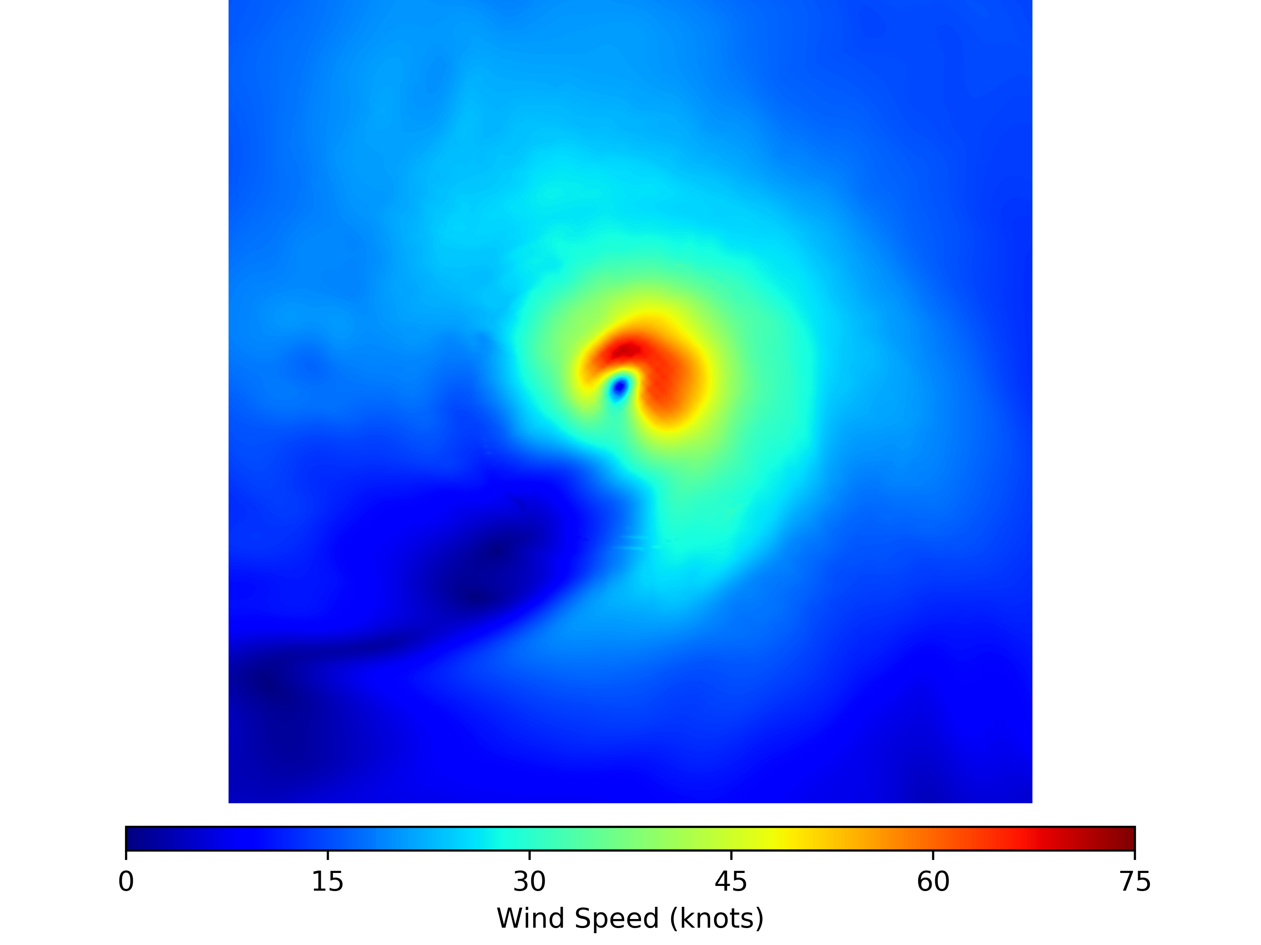
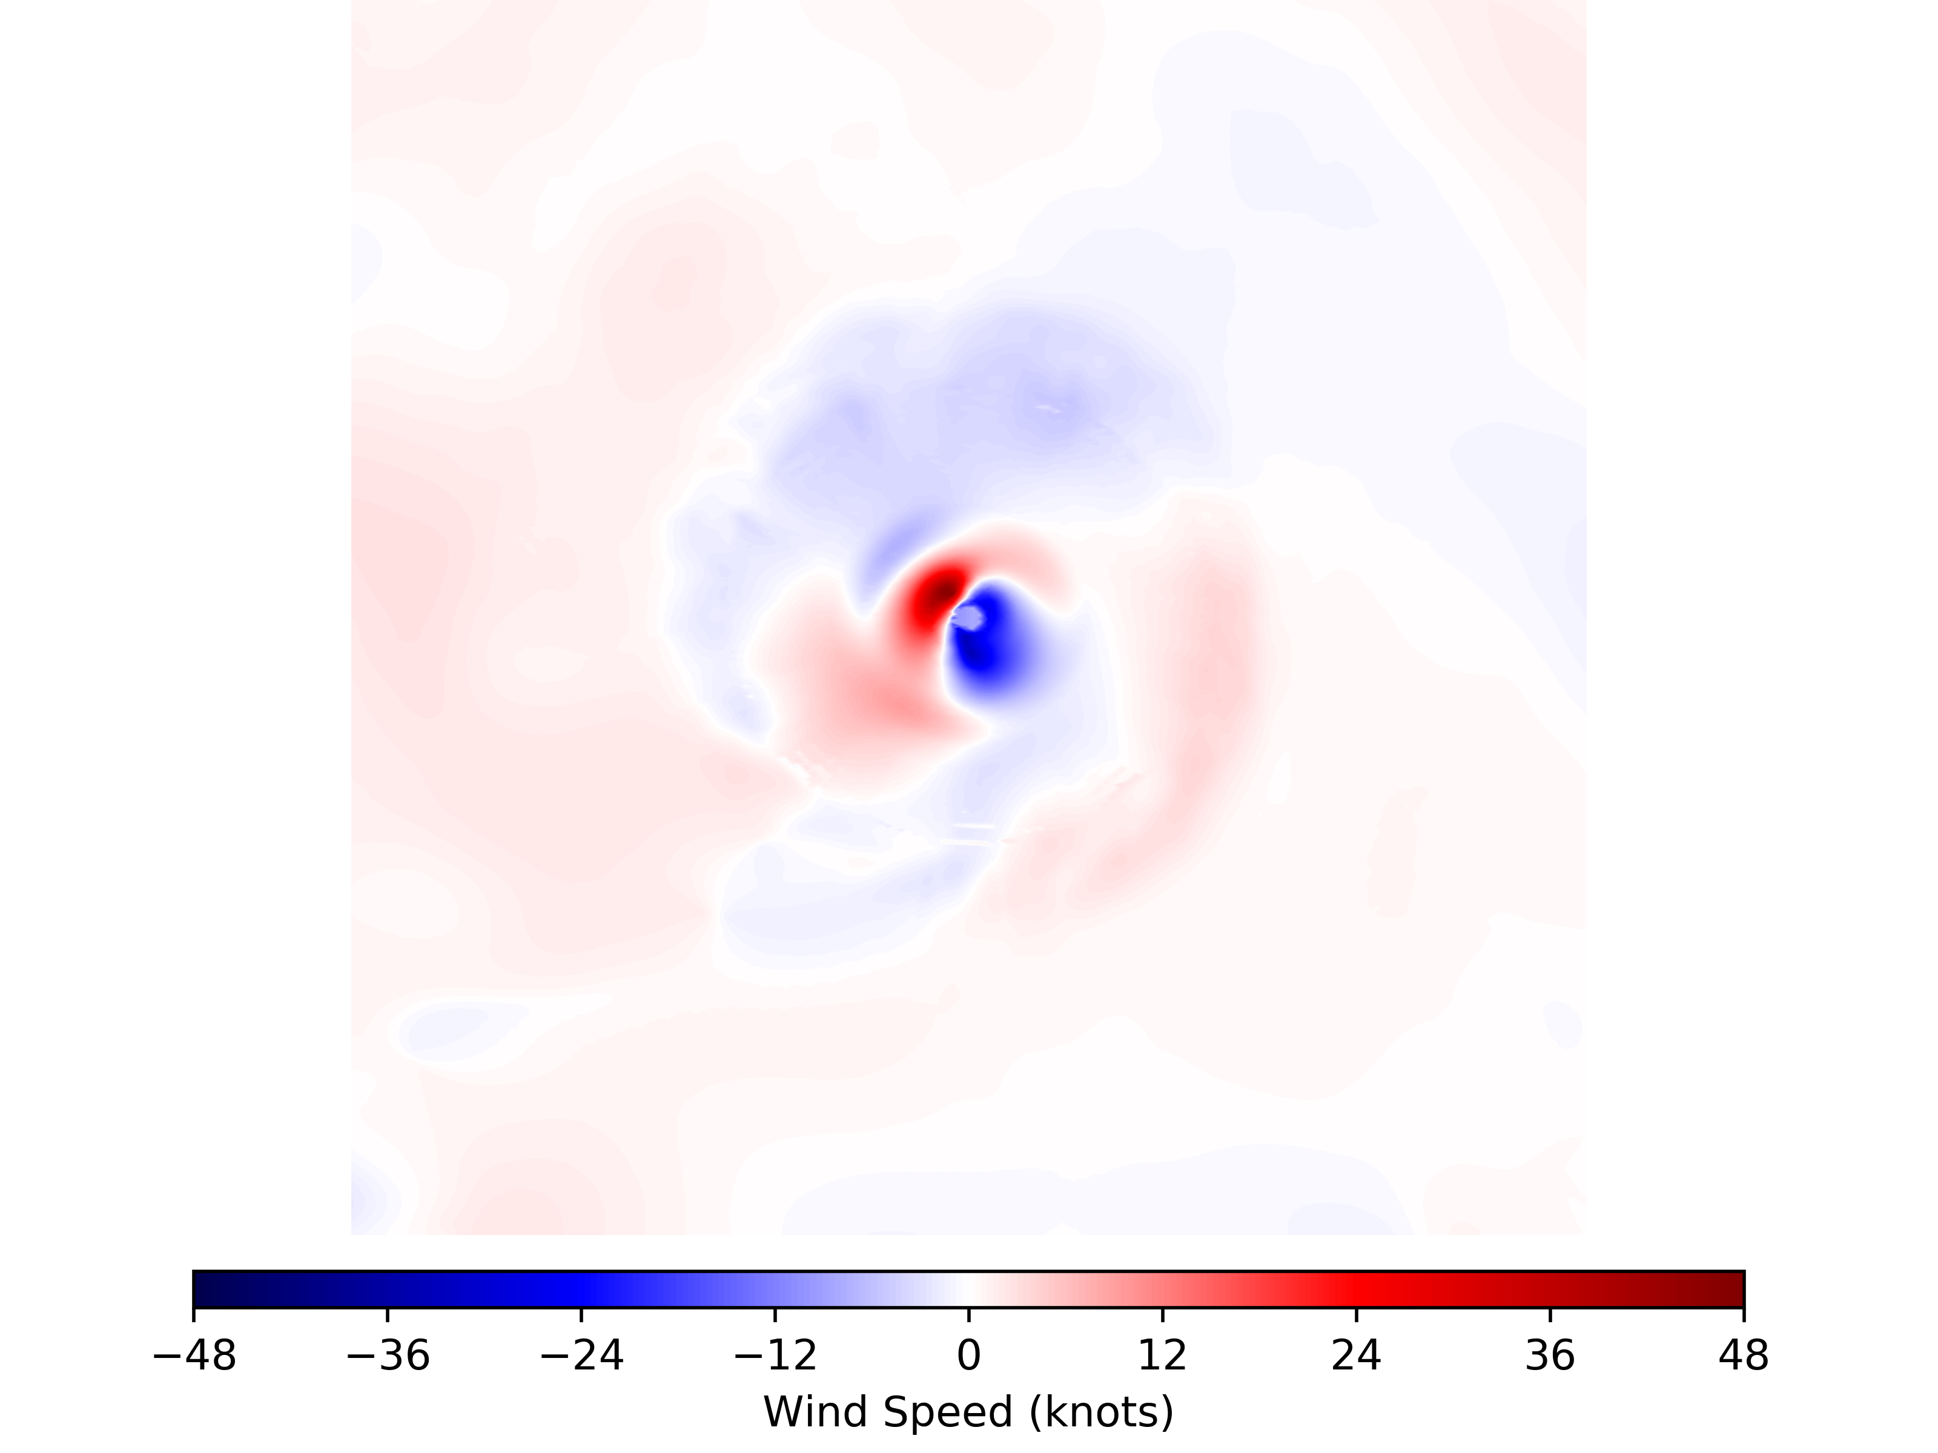
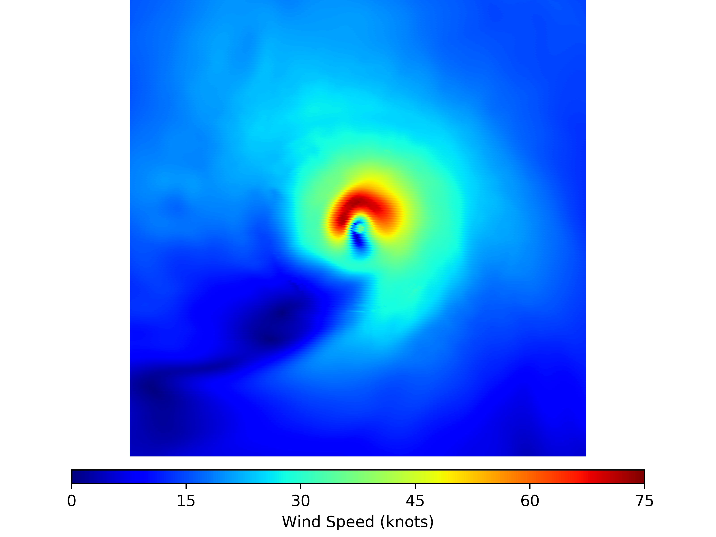
Operational HWRF Overview:
GSI increments Without Modification
HWRF Analysis Without Modification
GSI Analysis Increment Blending Modification:
For hurricane-strength events, we retain only the wavenumber 0 and 1 increments within 150-km of the TC position and relax to the full GSI increment at a distance of 250-km
Inner-core observations (e.g., dropsondes, SFMR, TDR, etc.,) are now more impactful on the TC initial structure and subsequent forecasts
Both the maximum wind-speed MAE and bias are improved
GSI increments With Modification
HWRF Analsysis With Modification
HWRF forecast cycle for TC Gaston (2016) valid 0600 UTC 25 August

Slide 5
Operational HWRF Overview:
Nest to Parent Merging
The operational HWRF system blends the TCs within the HWRF nests as follows:
HWRF d03 DA grid
HWRF d02 DA grid
Only co-located geographical points within the respective domains are updated
HWRF d02 input grid
HWRF d01 input grid

Slide 6
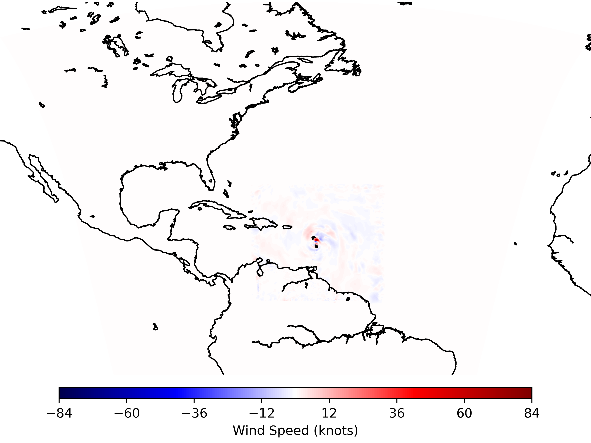
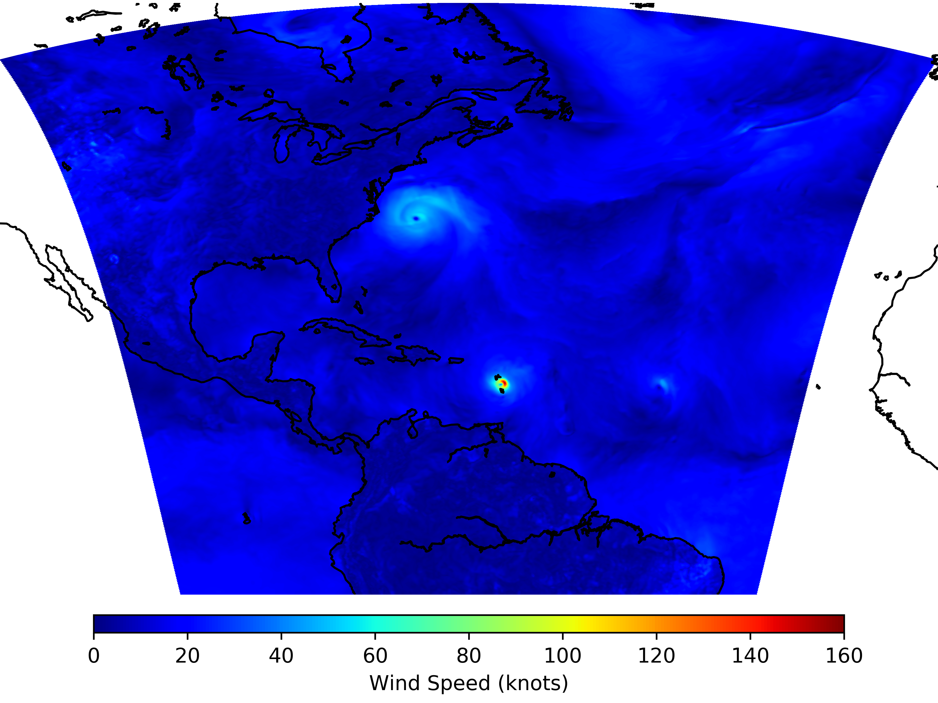
Operational HWRF Overview:
Nest to Parent Merging
HWRF d01 Increment
HWRF d01 Analysis

Slide 7
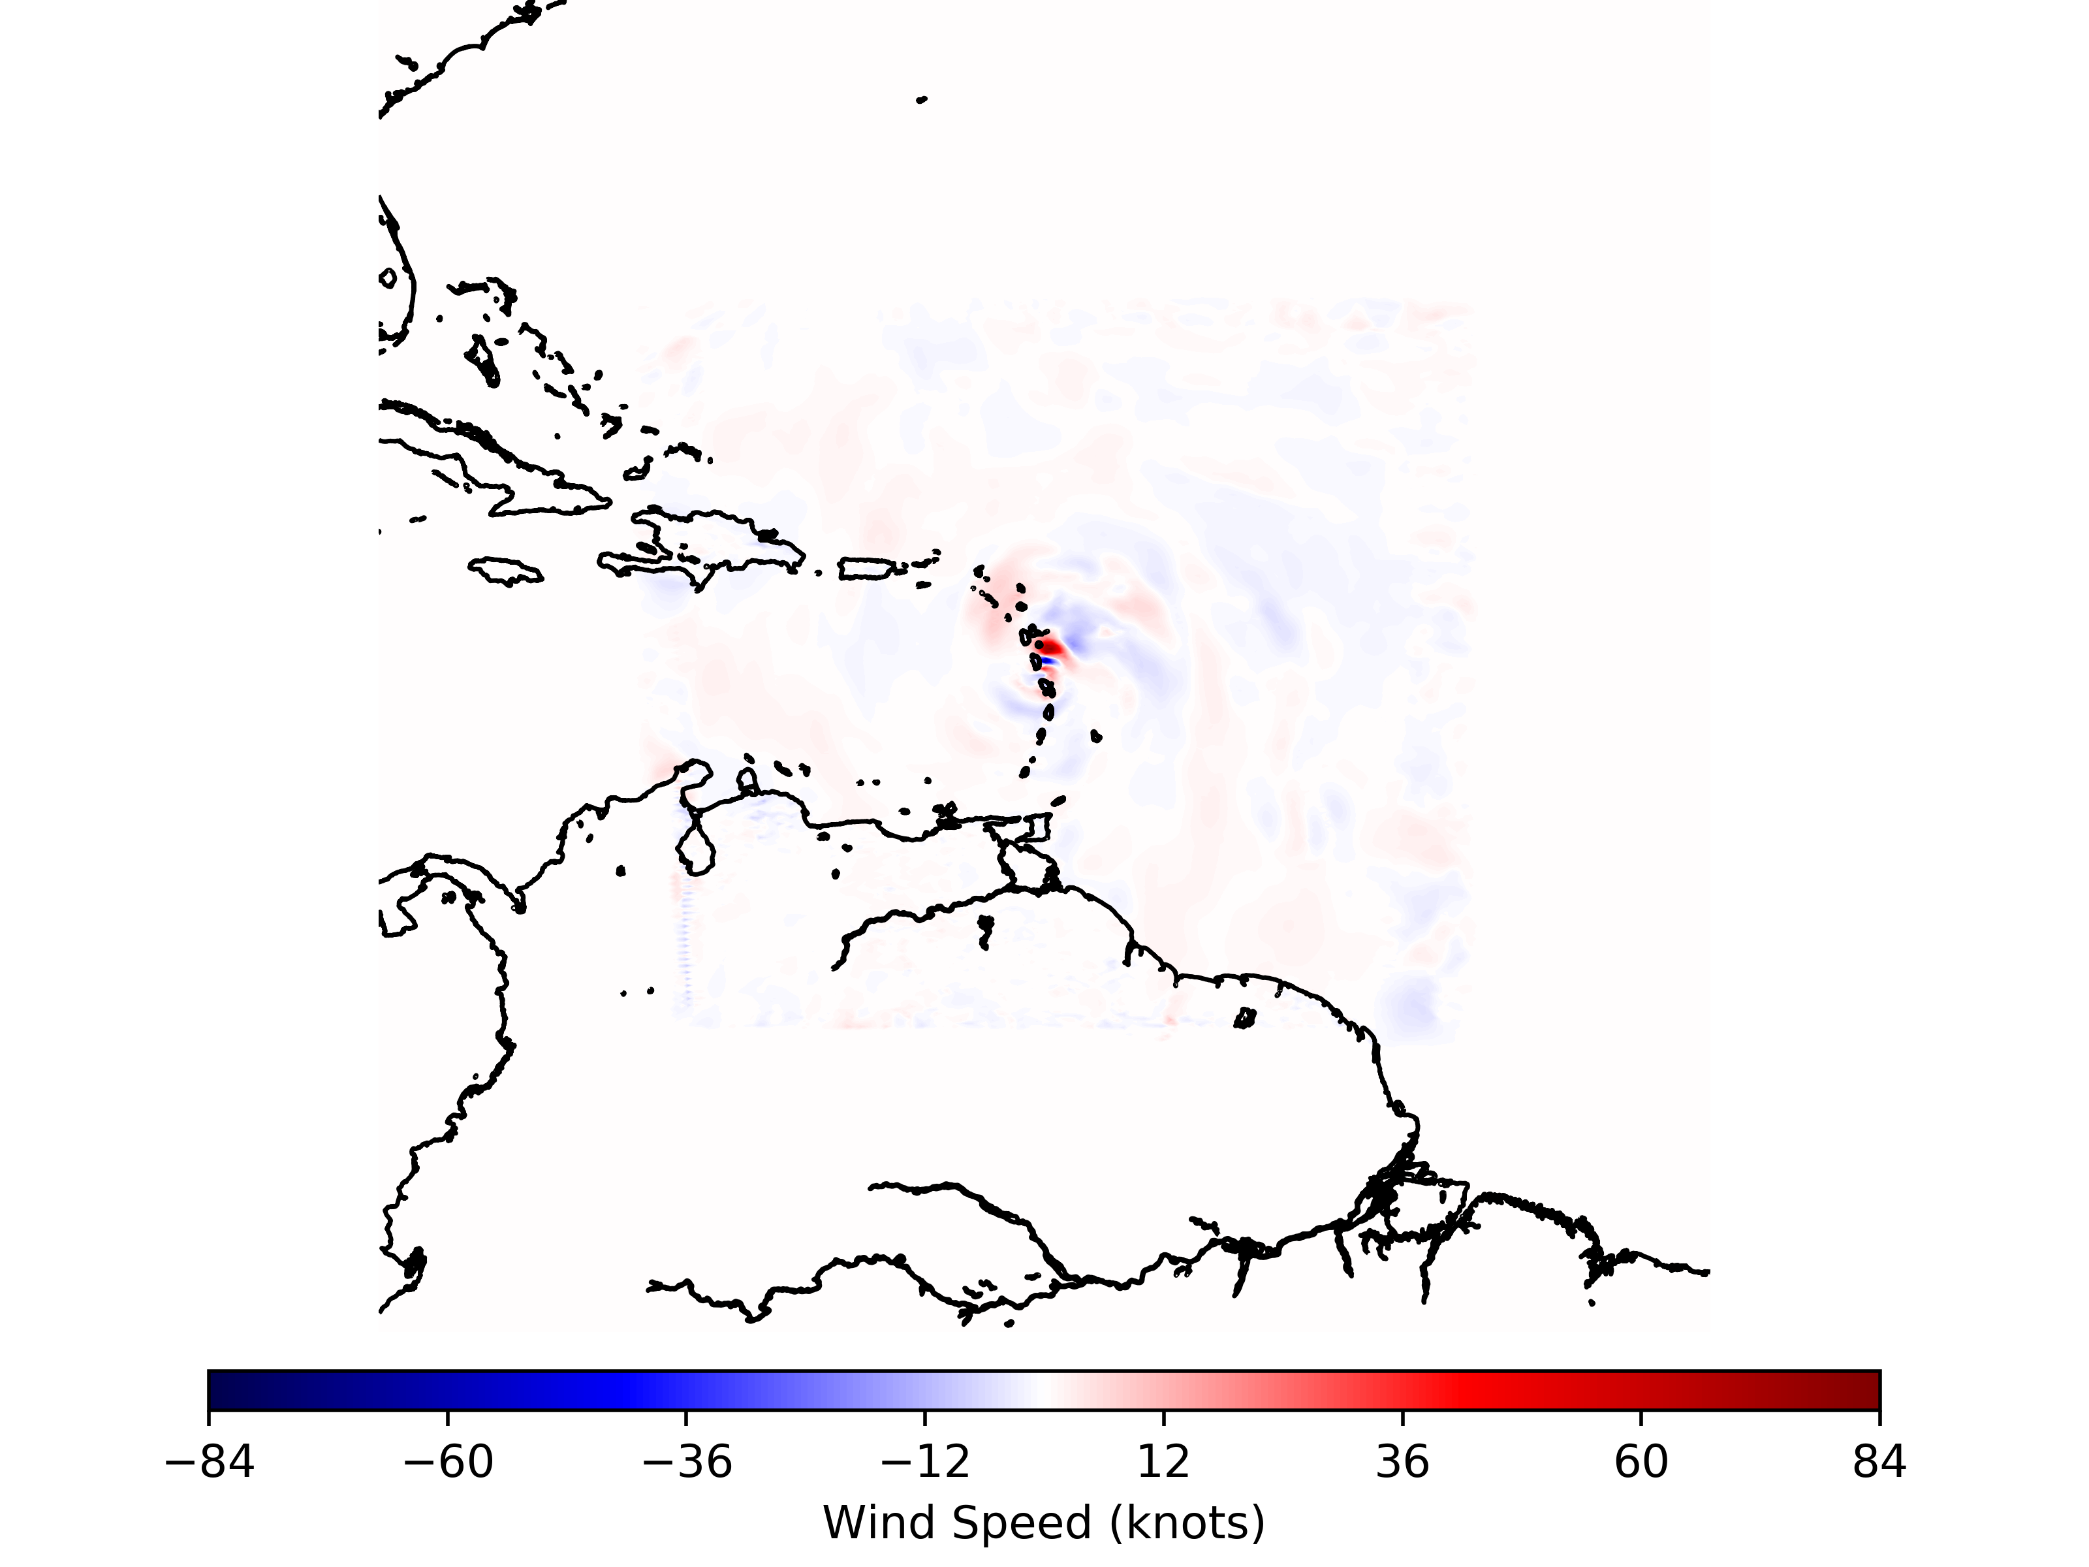
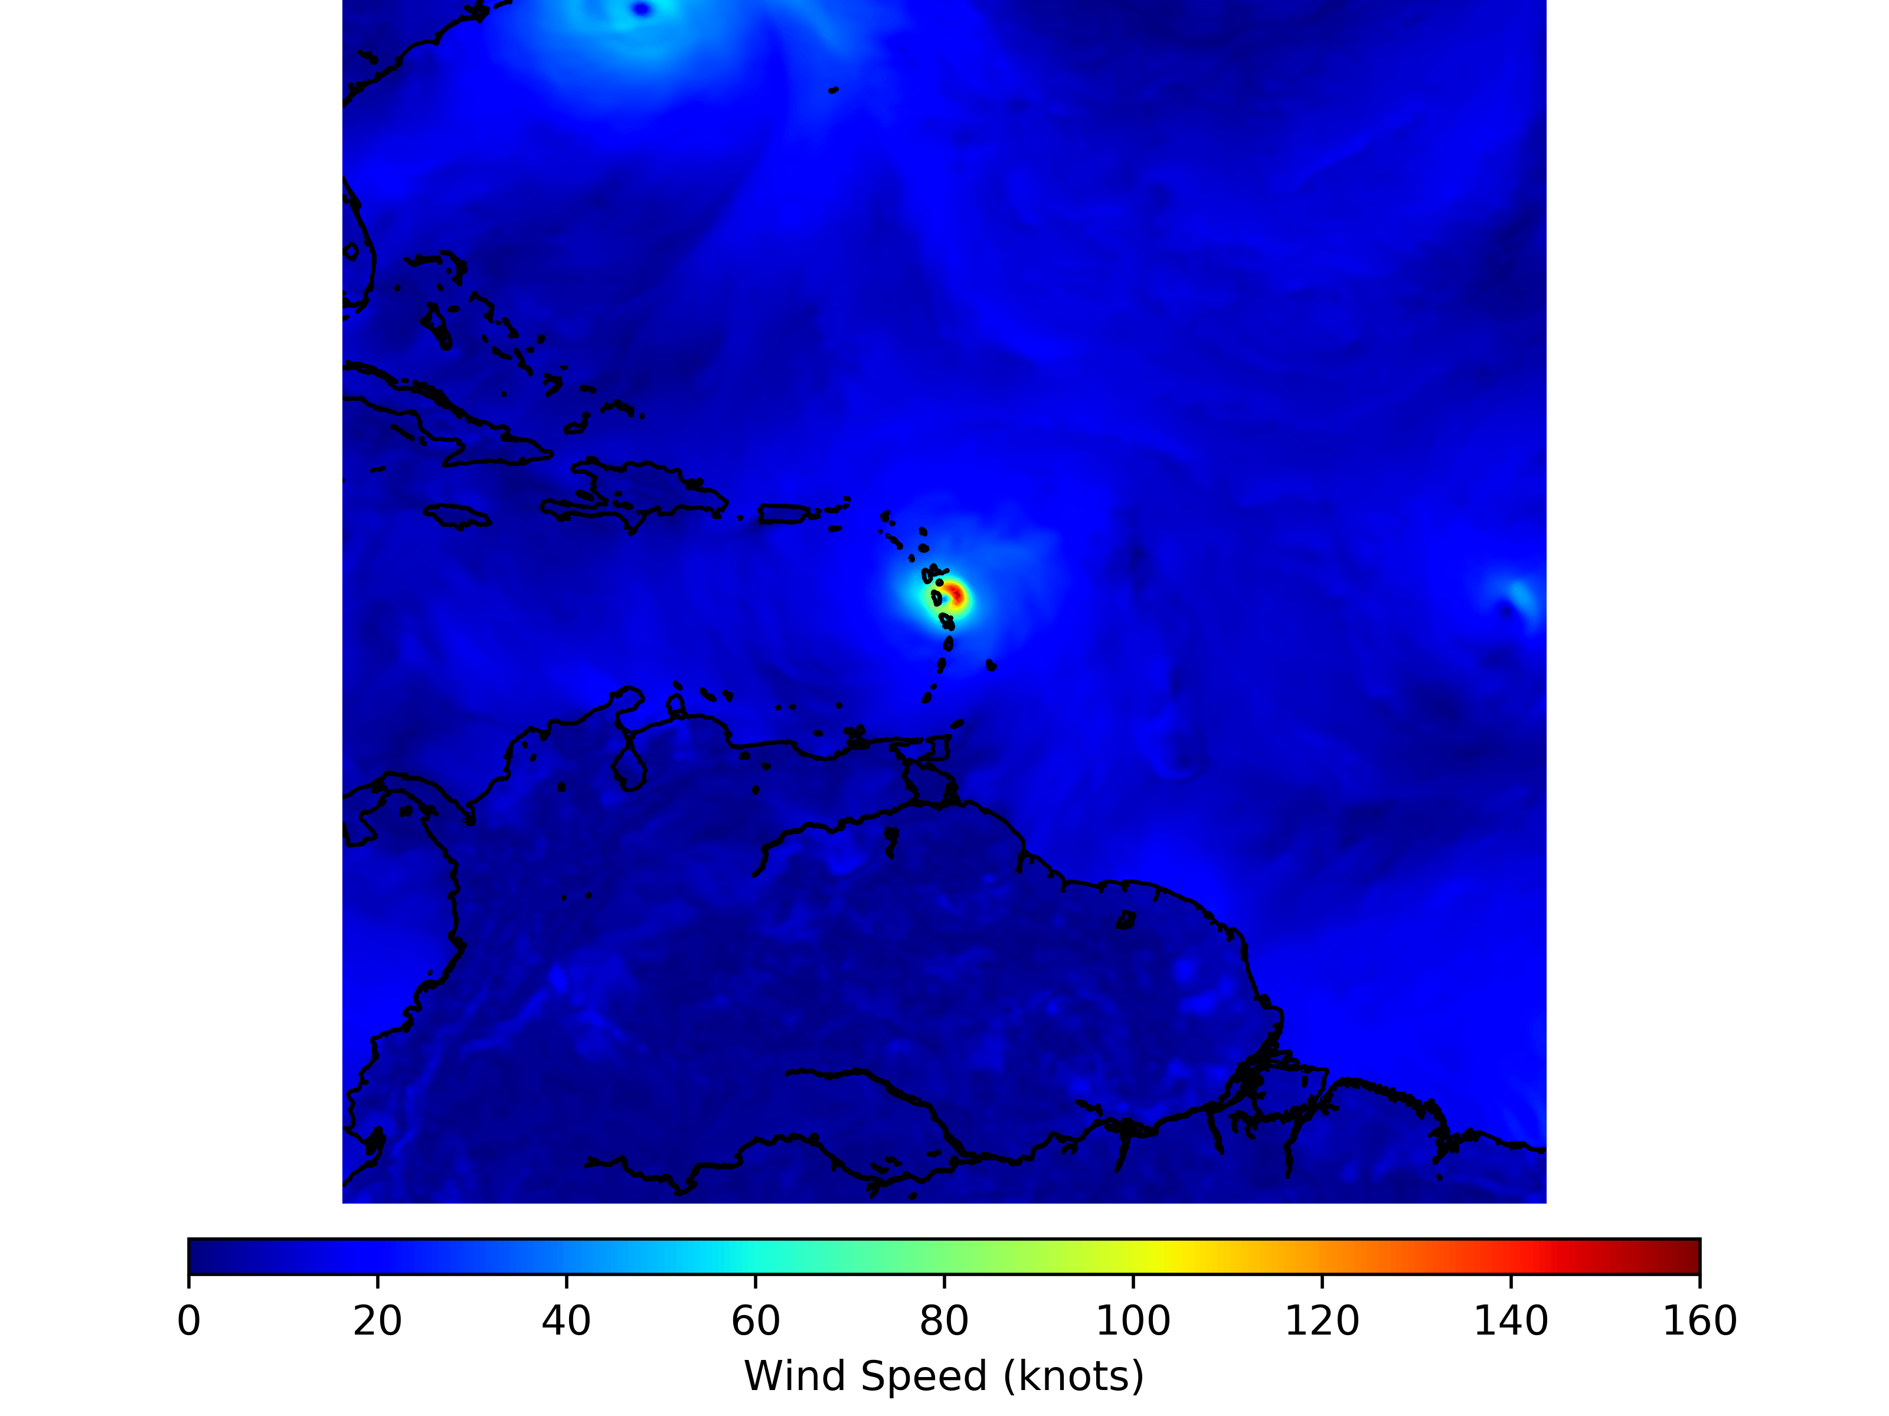
Operational HWRF Overview:
Nest to Parent Merging
HWRF d01 Increment
HWRF d01 Analysis

Slide 8
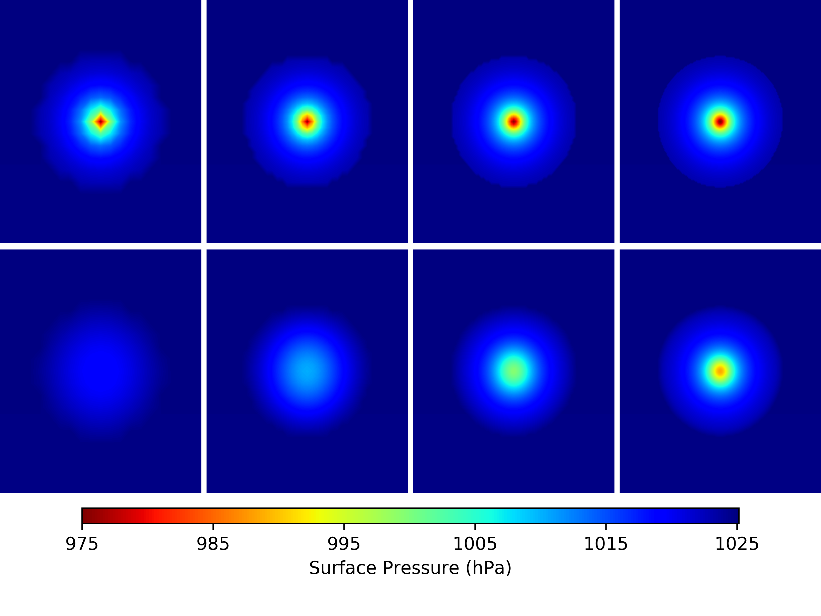
Motivation:
The TC relocation algorithm within HWRF is derived from Kurihara et al., [1993] and Kurihara et al., [1995]
  Performs best at resolutions of 1-degree or greater (i.e., more coarse)
  For higher-resolution forecast analyses, the resolution must be degraded (e.g., coarsened) to at least 1-degree
  Momentum and mass variables are filtered (i.e., the TC is removed) using a wavelength smoothing (e.g., response) function
Initial Field
Final Field

Slide 9
Motivation:
The HWRF TC relocation algorithm is applied to an up-scaled HWRF analysis and uses the HWRF prognostic variables
  Successive and repeated interpolations can result in the loss of small(er)-scale details
  For the purposes of tropical cyclone (TC) inner-core data-assimilation, the maintenance of these features is important
For the purposes of HAFS, TC vortex-relocation capabilities must remain possible
  As grid-length resolutions increase, multiple grid-cell offsets for the TC position can lead to erroneous features caused by inner-core observation data assimilation
  The TC vortex relocation algorithm should not be specific to a given model but applicable to all models

Slide 10
Experiment Configuration:
Control:
HWRF Configuration H19B
Relocation and vortex modification turned on
Experiment:
HWRF Configuration H19B
Relocation accomplished using synthetic observations and the GSI
Vortex modification is turned off
The full GSI increment is used
Analysis Date: 1200 UTC 08 September 2017
TC Irma (11L)
Coincides with available NHC gTCM observations

Slide 11
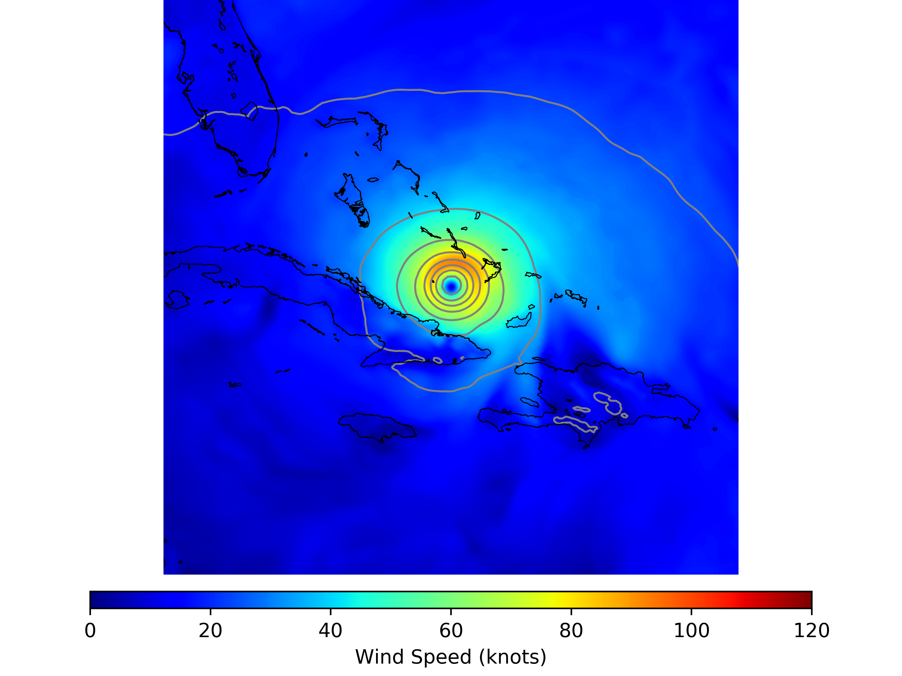
TC Relocation Algorithm:
+3 Hour HWRF d02 FGAT Valid 1500 UTC 08 September 2017 (11L)
 | Observation TC-Vitals | HWRF/FGAT TC-Vitals
Location | 21.9N, 75.4W | 22.0N, 75.2W
Maximum Wind Speed (knots) | 128.4 kts | 93.5 kts
Minimum Pressure (hPa) | 926.0 | 952.9
Radius of Maximum Wind (km) | 52.0 | 79.3
HWRF/FGAT TC-Vitals are estimated using cubic-splines
The offset-distance between the observations and the HWRF FGAT is (approximately) 23.4-km (nominally, 5-grid cells)
The HWRF first-guess (FGAT) is used to create synthetic profile-type observations

Slide 12
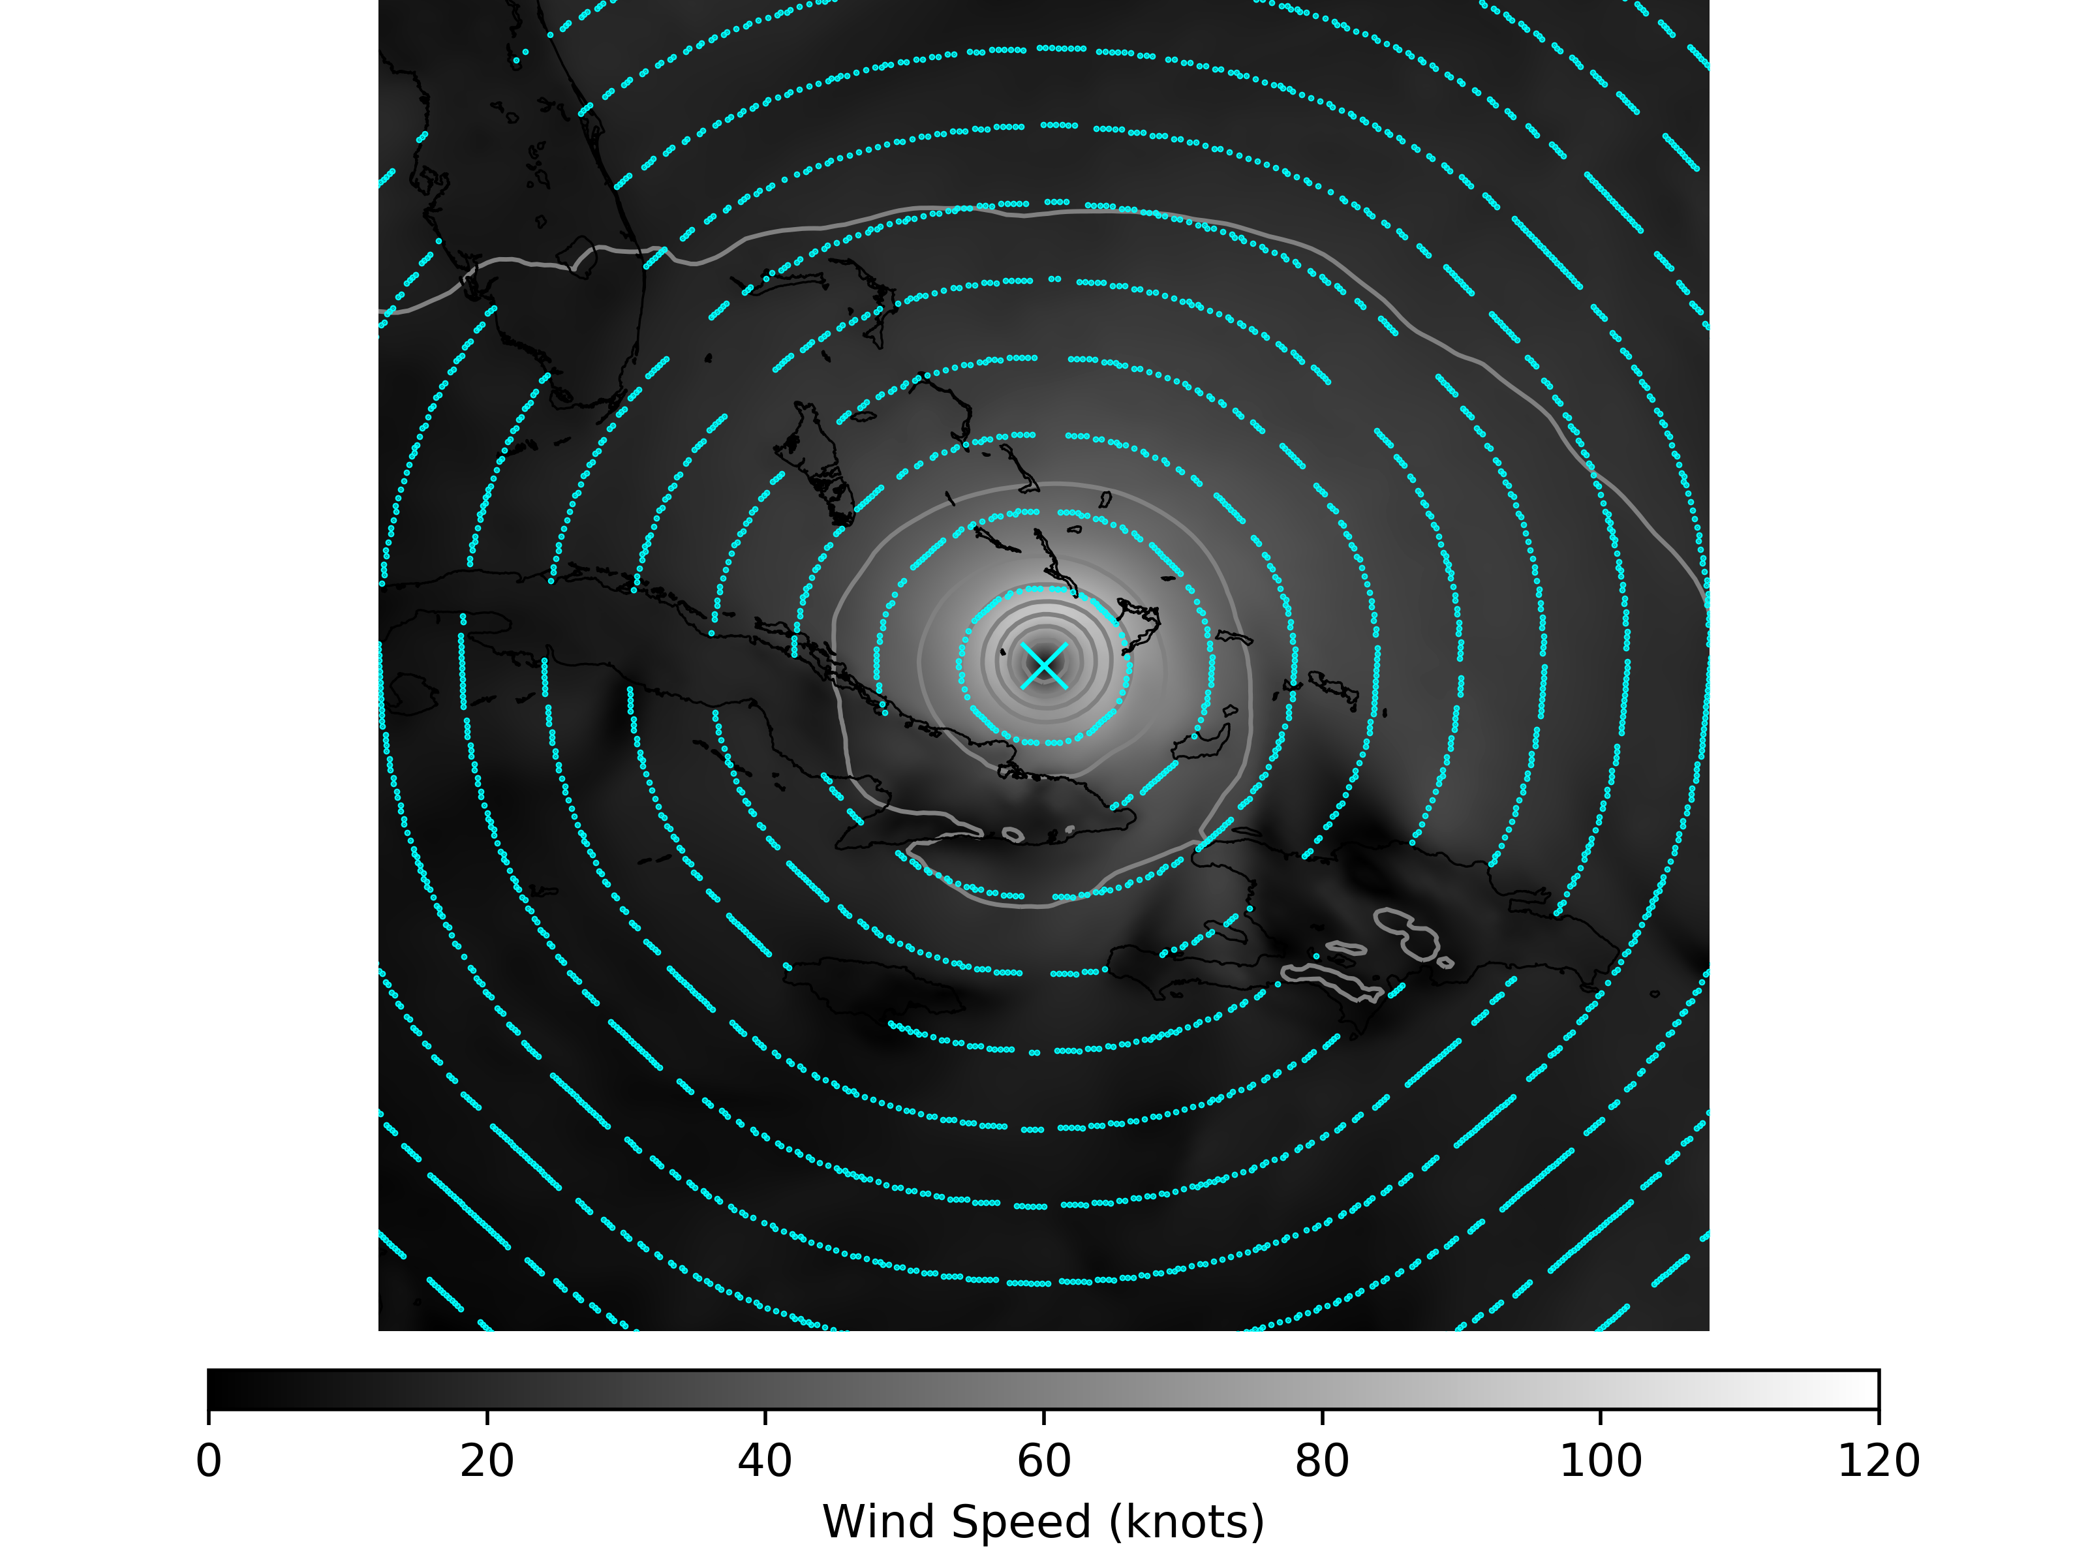
TC Relocation Algorithm:
The HWRF first-guess (FGAT) is used to create synthetic profile-type observations
Ocean-relative observations are collected at radial intervals with respect to the FGAT TC location (cyan points)

Slide 13
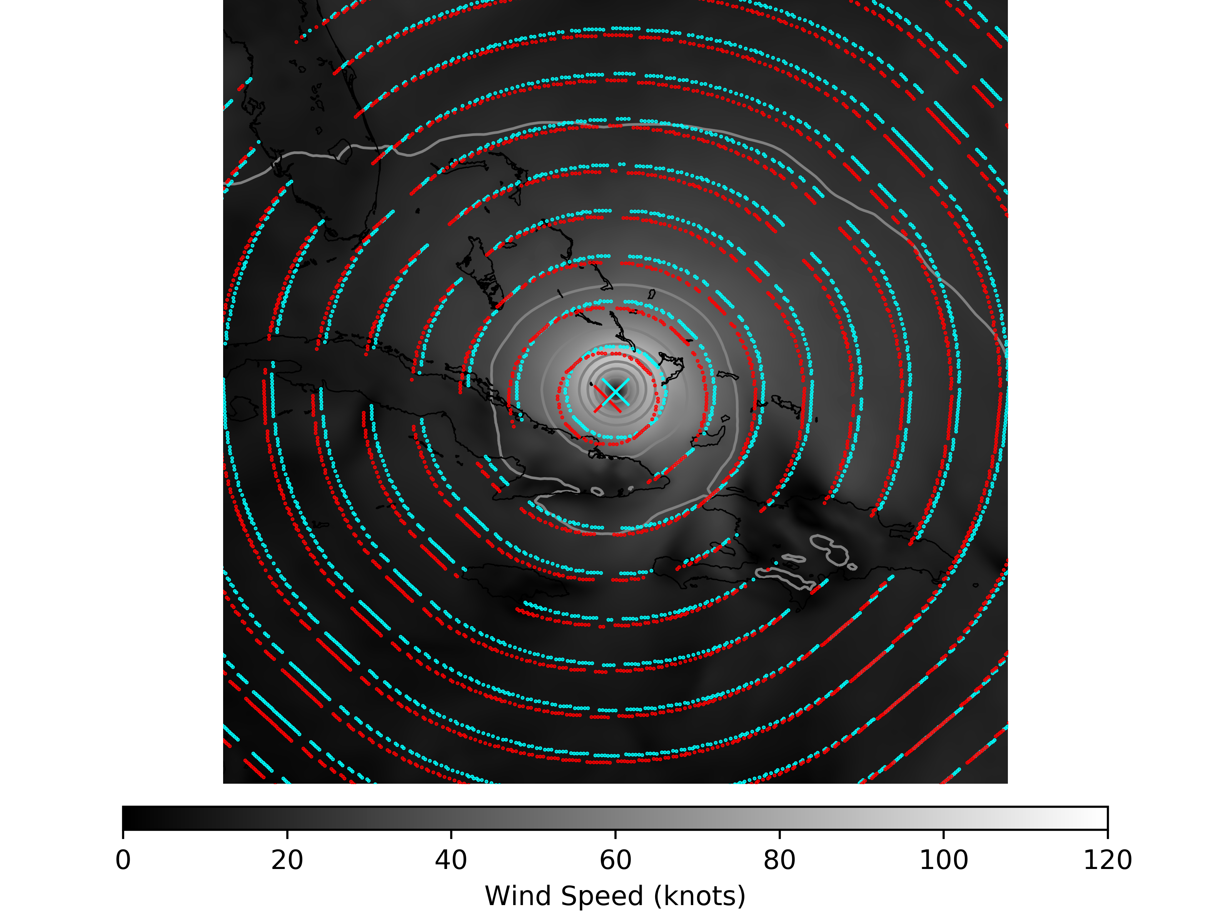
TC Relocation Algorithm:
The HWRF first-guess (FGAT) is used to create synthetic profile-type observations
Ocean-relative observations are collected at radial intervals with respect to the FGAT TC location (cyan points)
The positions for the FGAT observations is updated to reflect their respective locations relative to the observed TCV position (red points)

Slide 14
TC Relocation Algorithm:
The HWRF first-guess (FGAT) is used to create synthetic profile-type observations
Ocean-relative observations are collected at radial intervals with respect to the FGAT TC location (cyan points)
The positions for the FGAT observations is updated to reflect their respective locations relative to the observed TCV position (red points)
The GSI assimilates these observations in order to relocate the TC

Slide 15
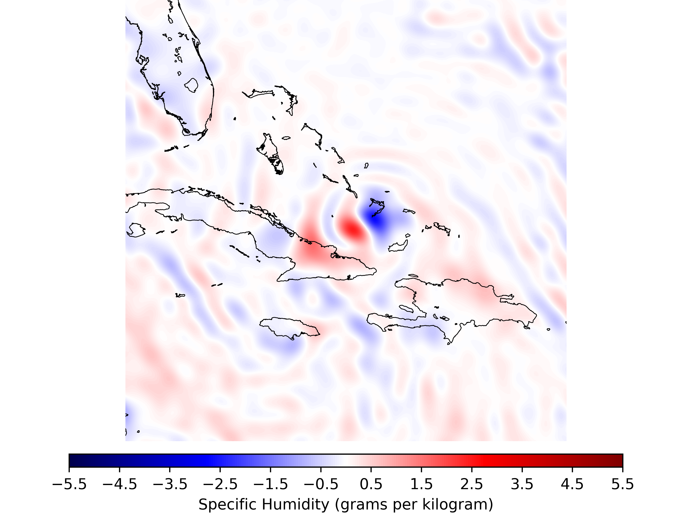
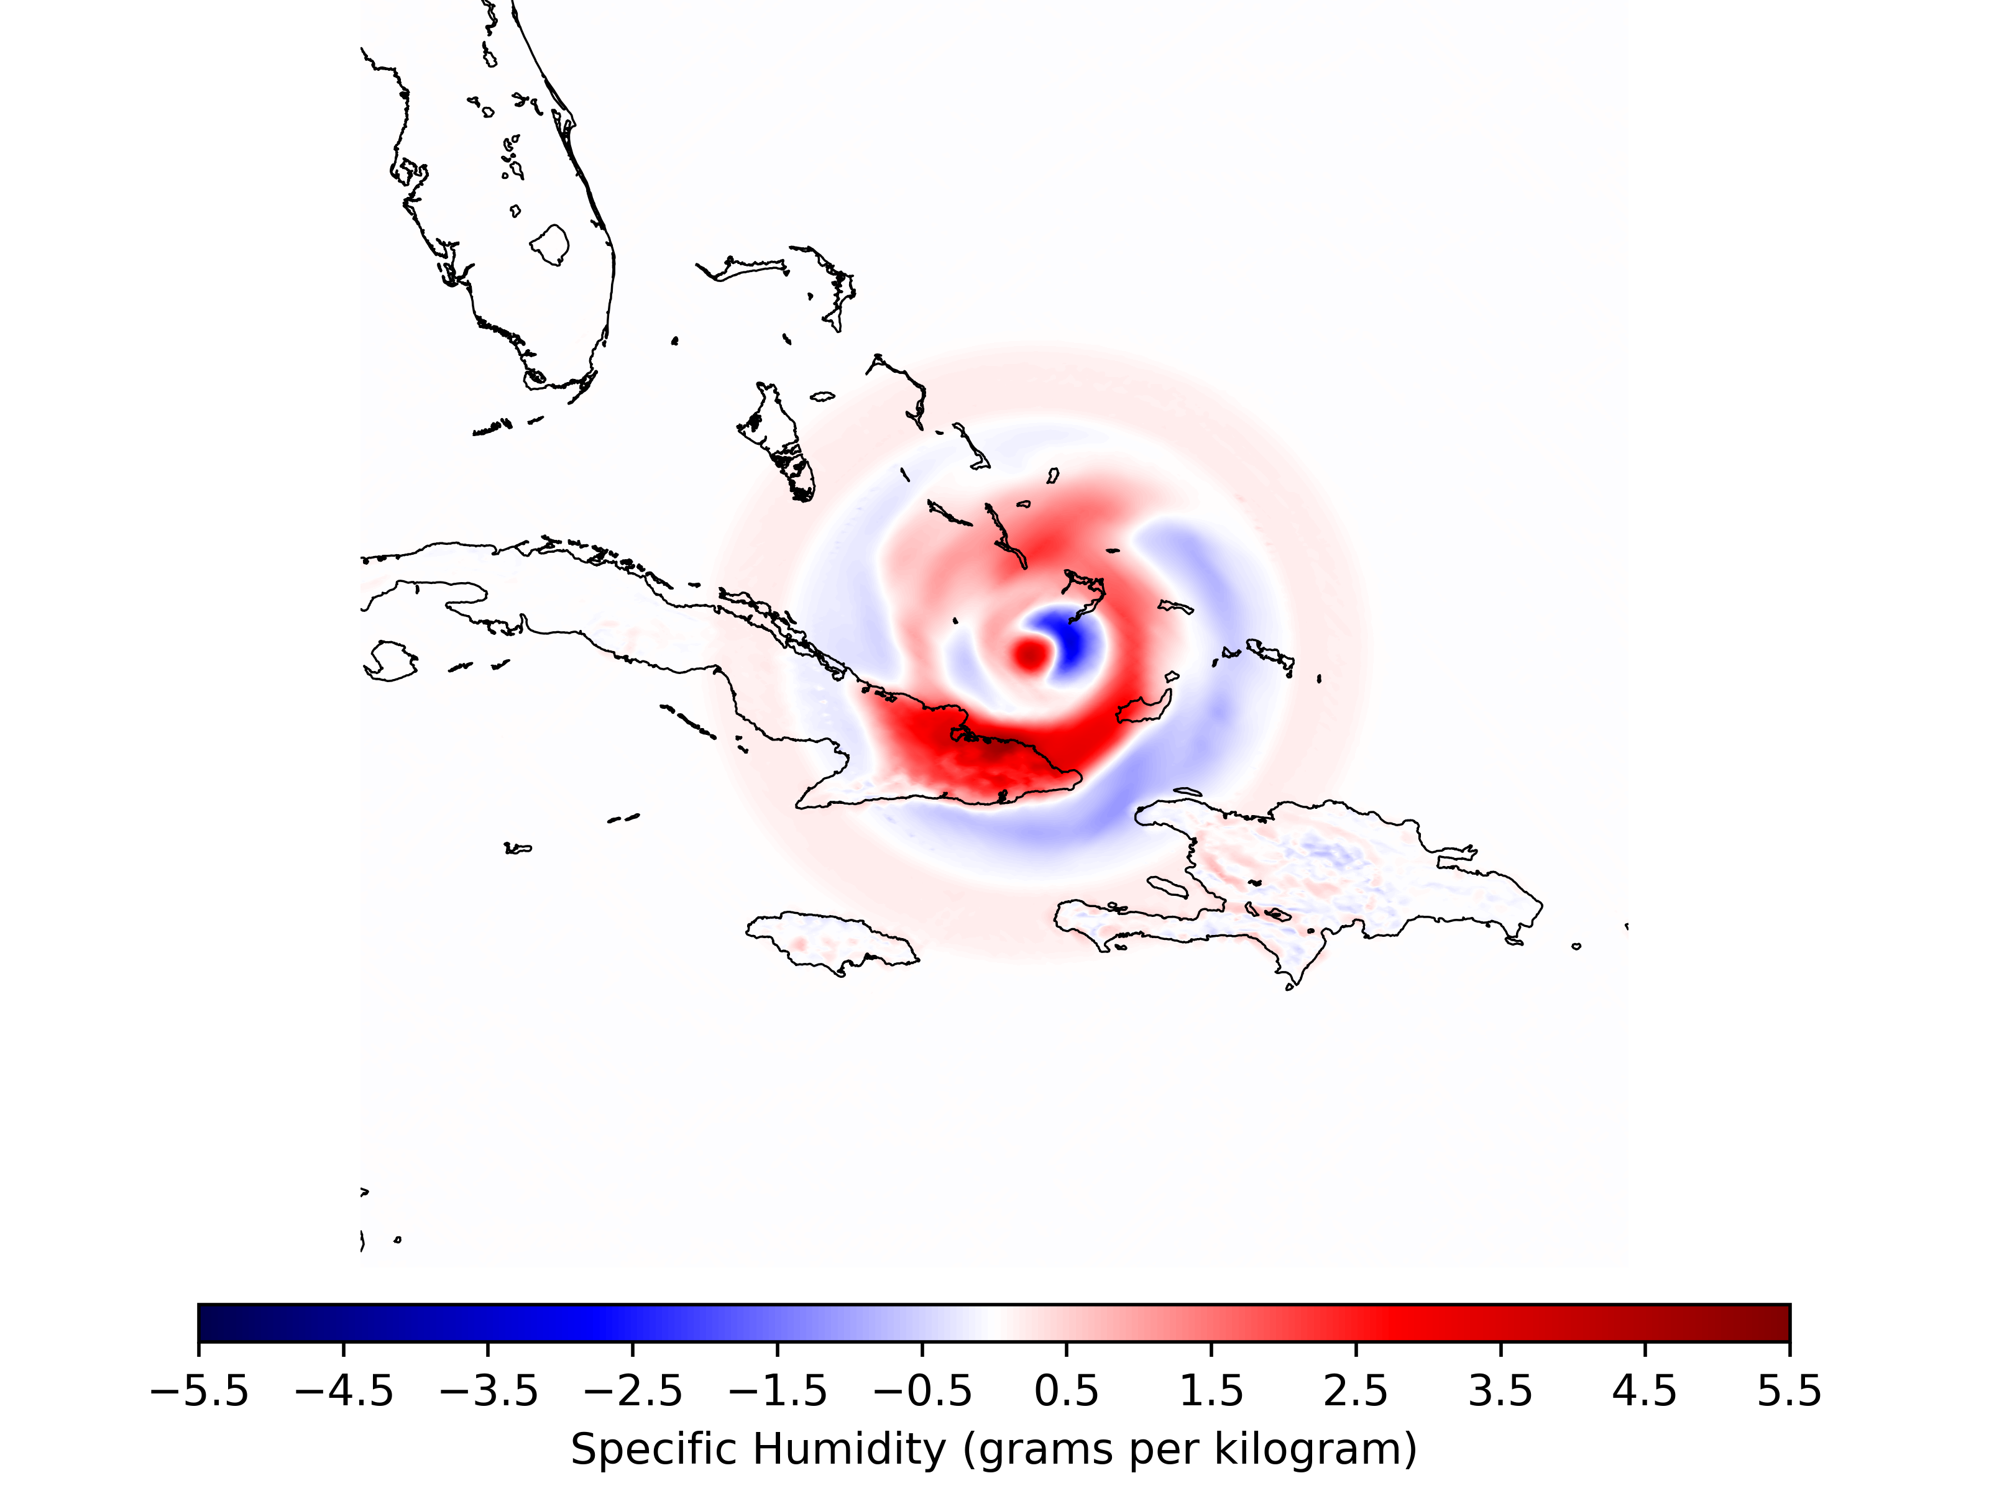
TC Relocation Increments:
TC Relocation Increments Imposed Upon HWRF FGAT
Valid 1200 UTC 08 September 2017 (11L)
HWRF Operational Relocation*
HWRF GSI Relocation
*The operational HWRF relocation step also includes vortex-modification.

Slide 16
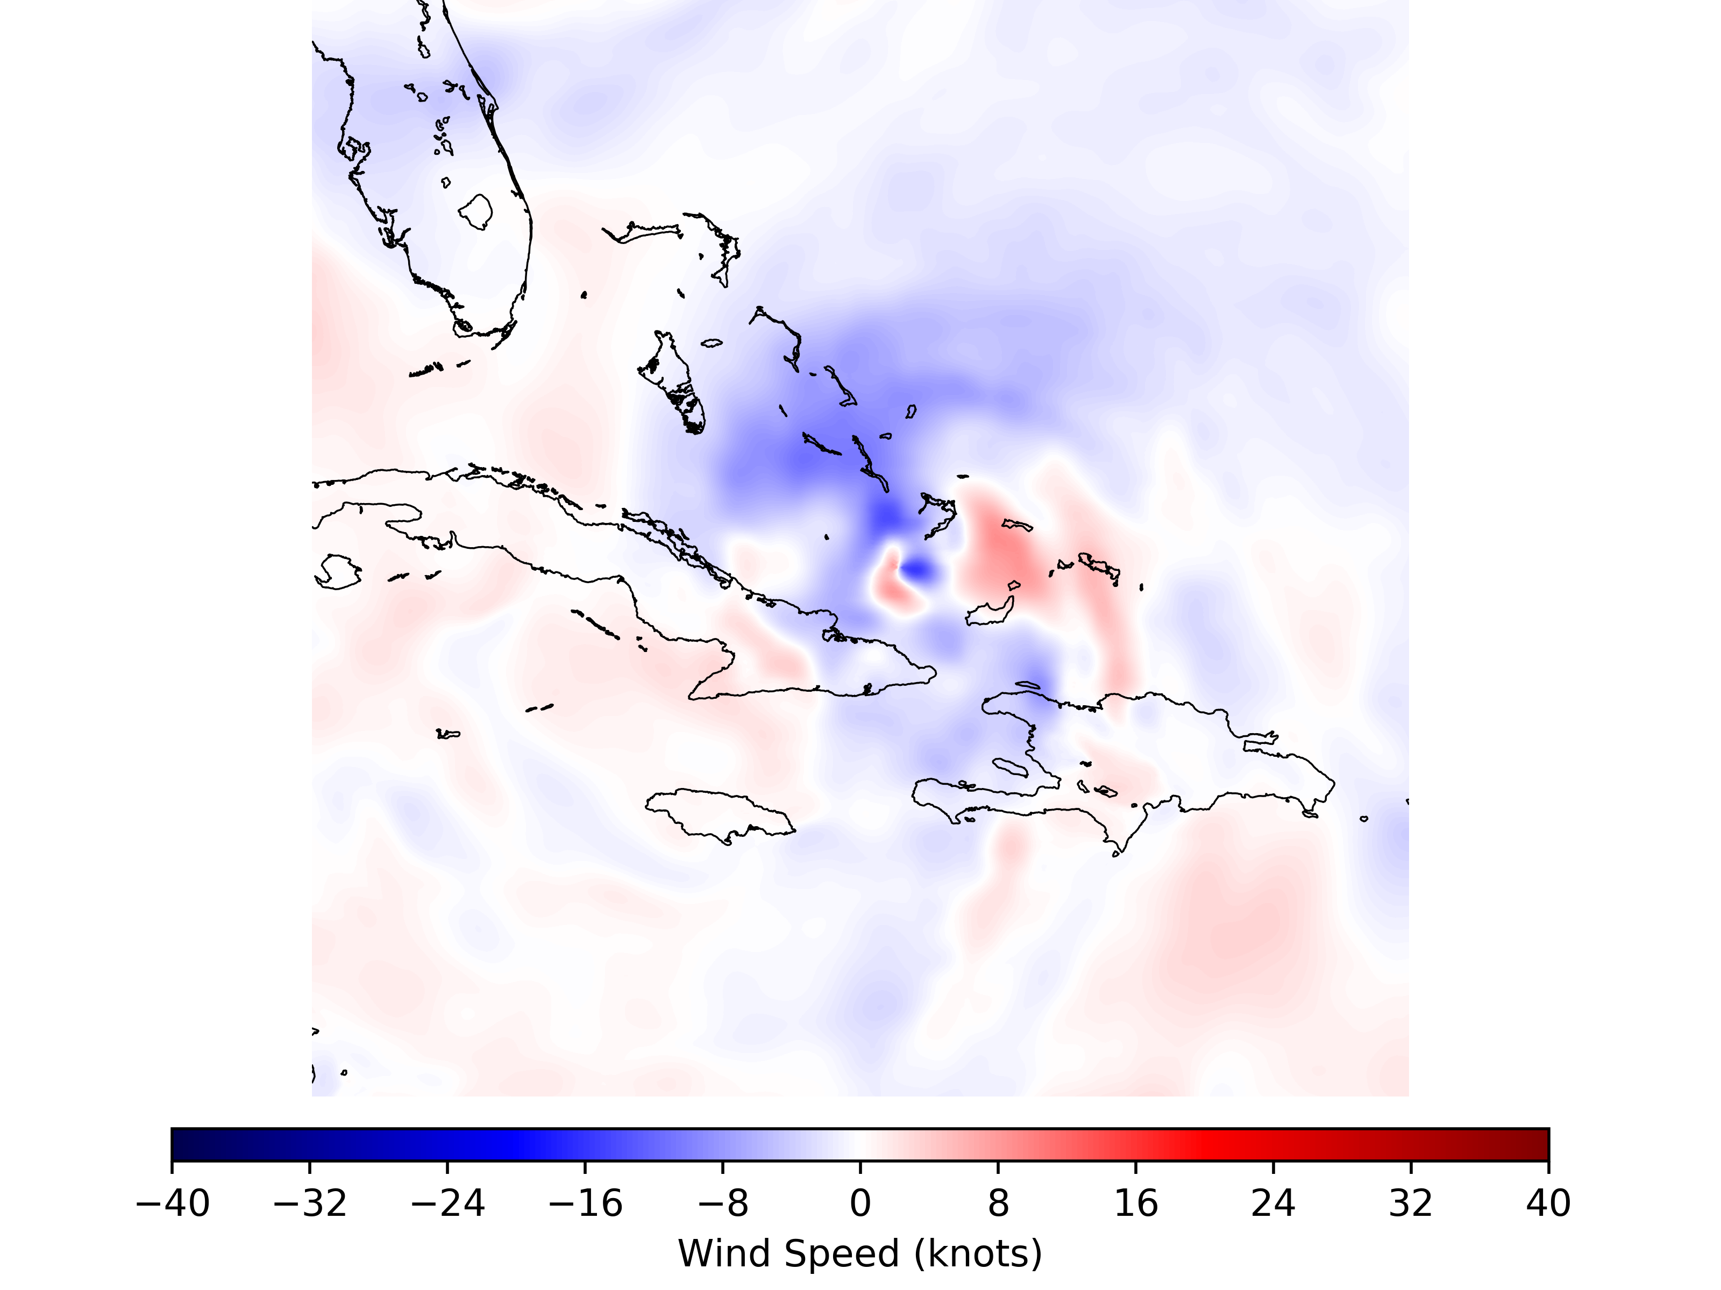
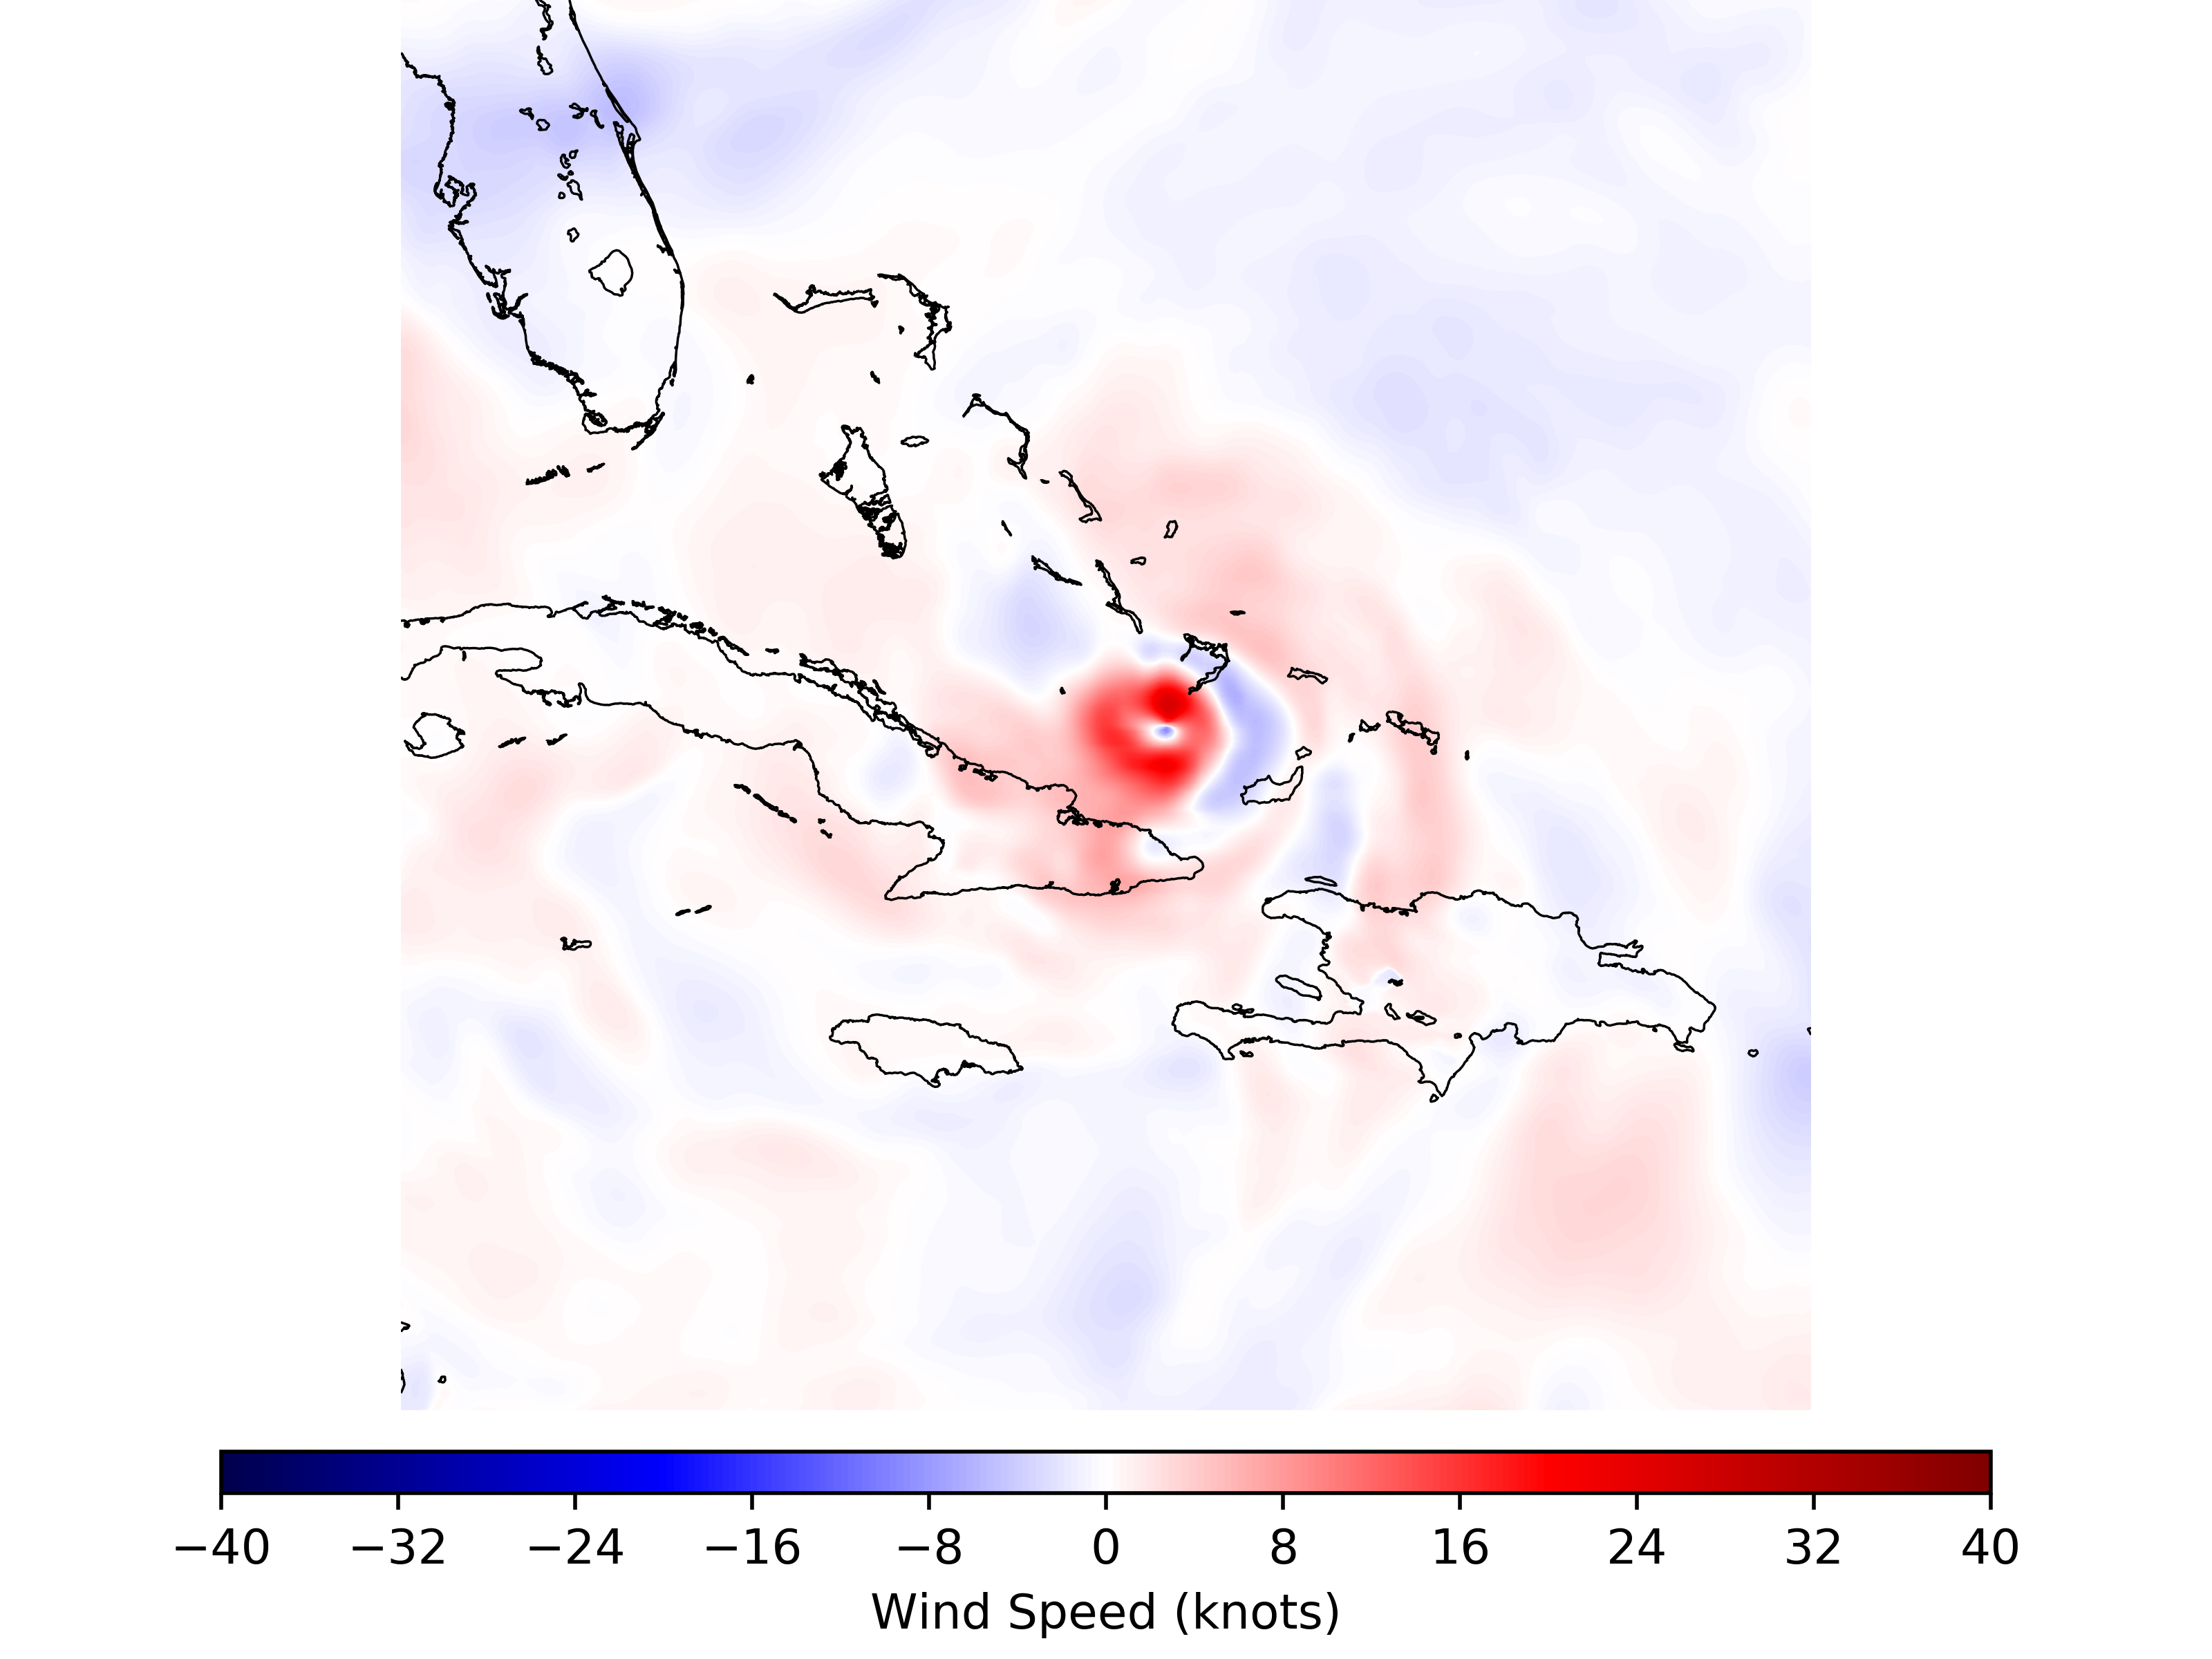
TC Data Assimilation Increments:
Valid 1200 UTC 08 September 2017 (11L)
HWRF Operational Relocation*
HWRF GSI Relocation
*The operational HWRF relocation step also includes vortex-modification.

Slide 17
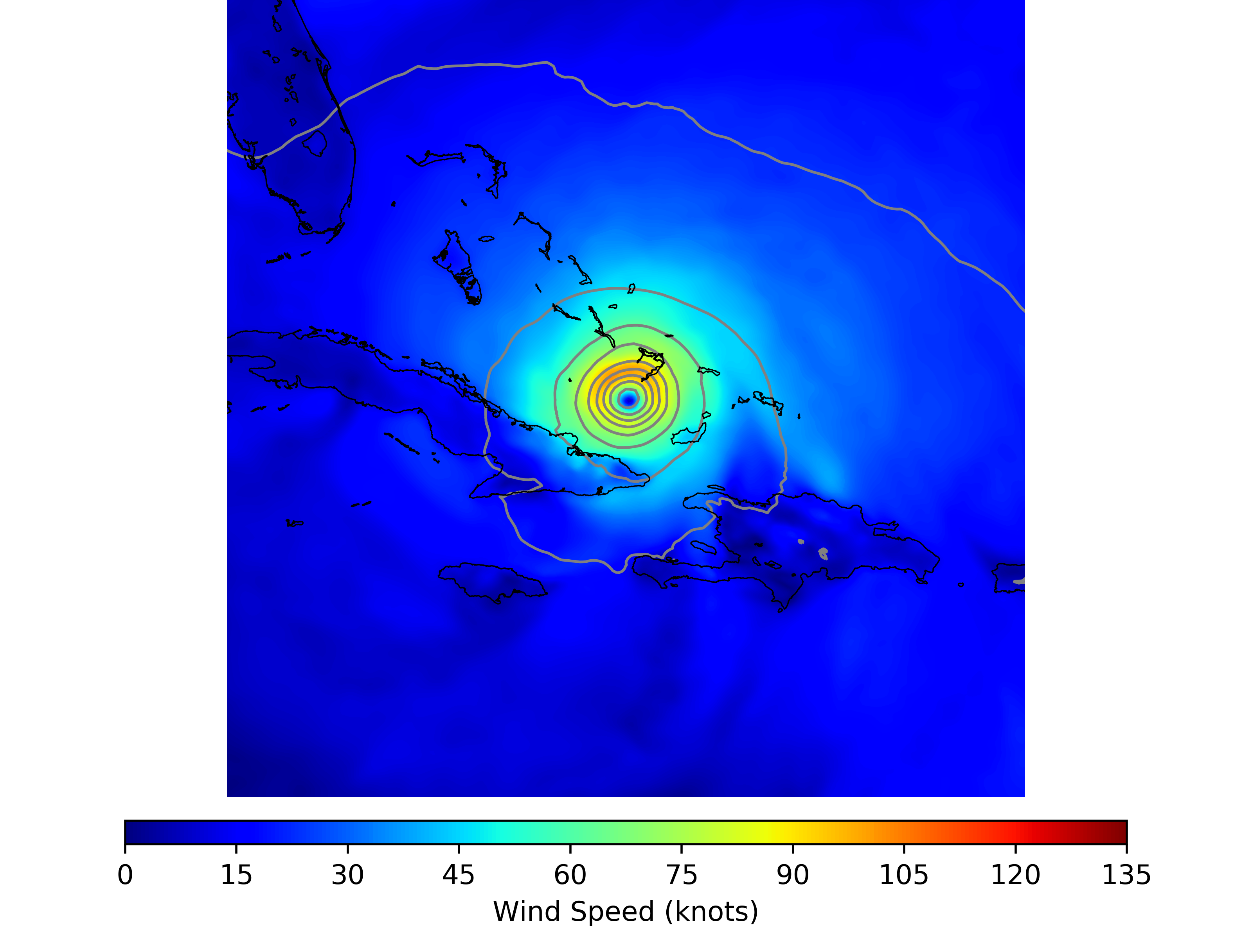
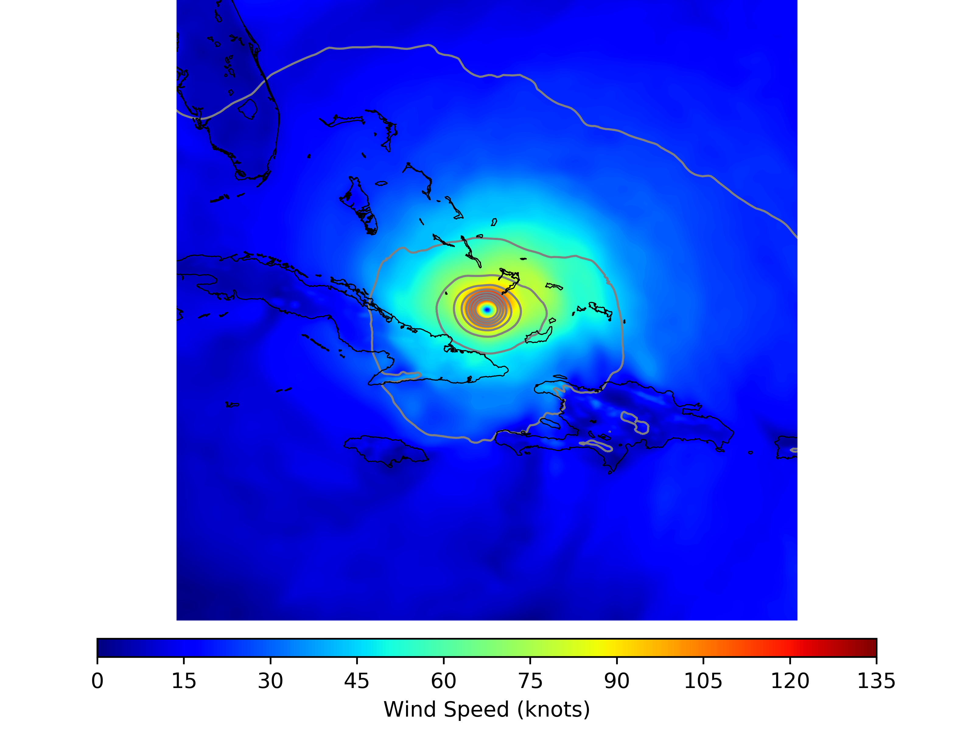
TC Data Assimilation Analysis:
Valid 1200 UTC 08 September 2017 (11L)
HWRF Operational Relocation*
HWRF GSI Relocation
*The operational HWRF relocation step also includes vortex-modification.

Slide 18
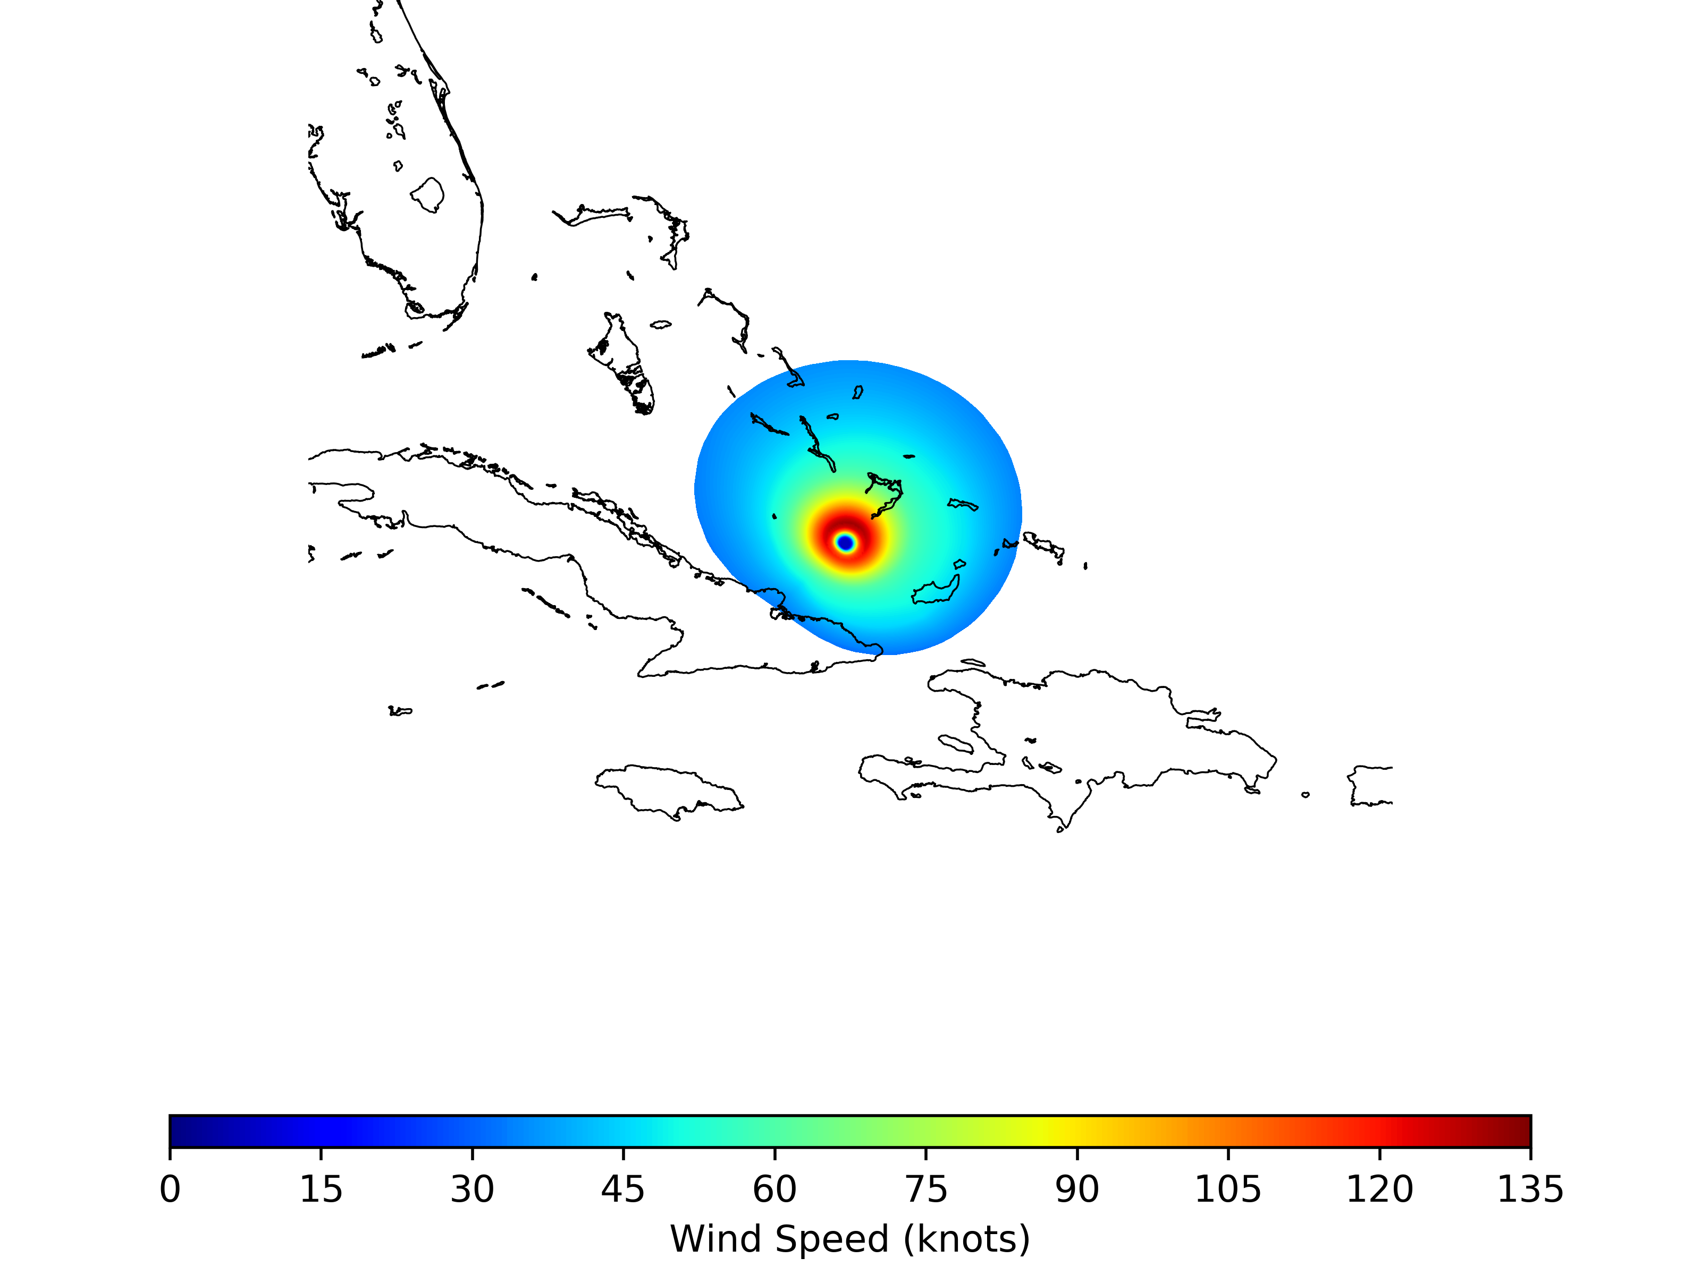
TC Data Assimilation Analysis:
NHC Gridded Tropical Cyclone Model (gTCM)
Experiment Diagnostics
 | Observations (TCV) | Operational | GSI Relocation
MSLP (hPa) | 927.0 | 932.9 | 946.0
V_{max} (kts) | 130.3 | 125.3 | 102.4
RMW (km) | 56.0 | 44.7 | 57.9
Distance (km) |  | 4.89 | 9.57
Valid 1200 UTC 08 September 2017 (11L)

Slide 19
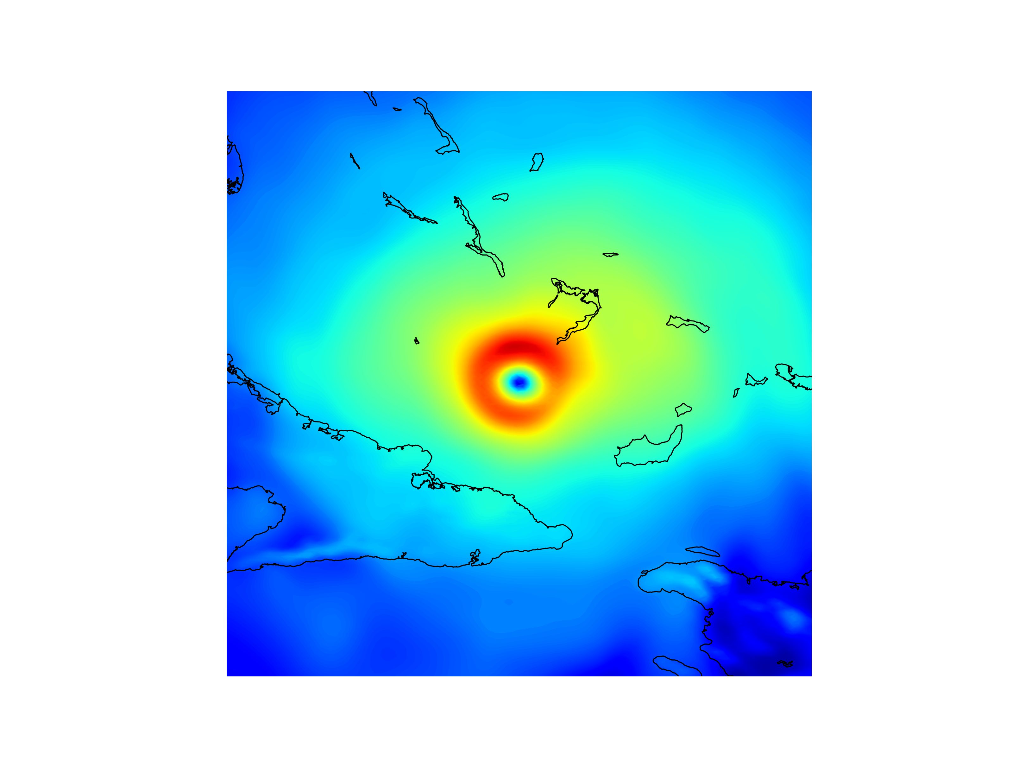
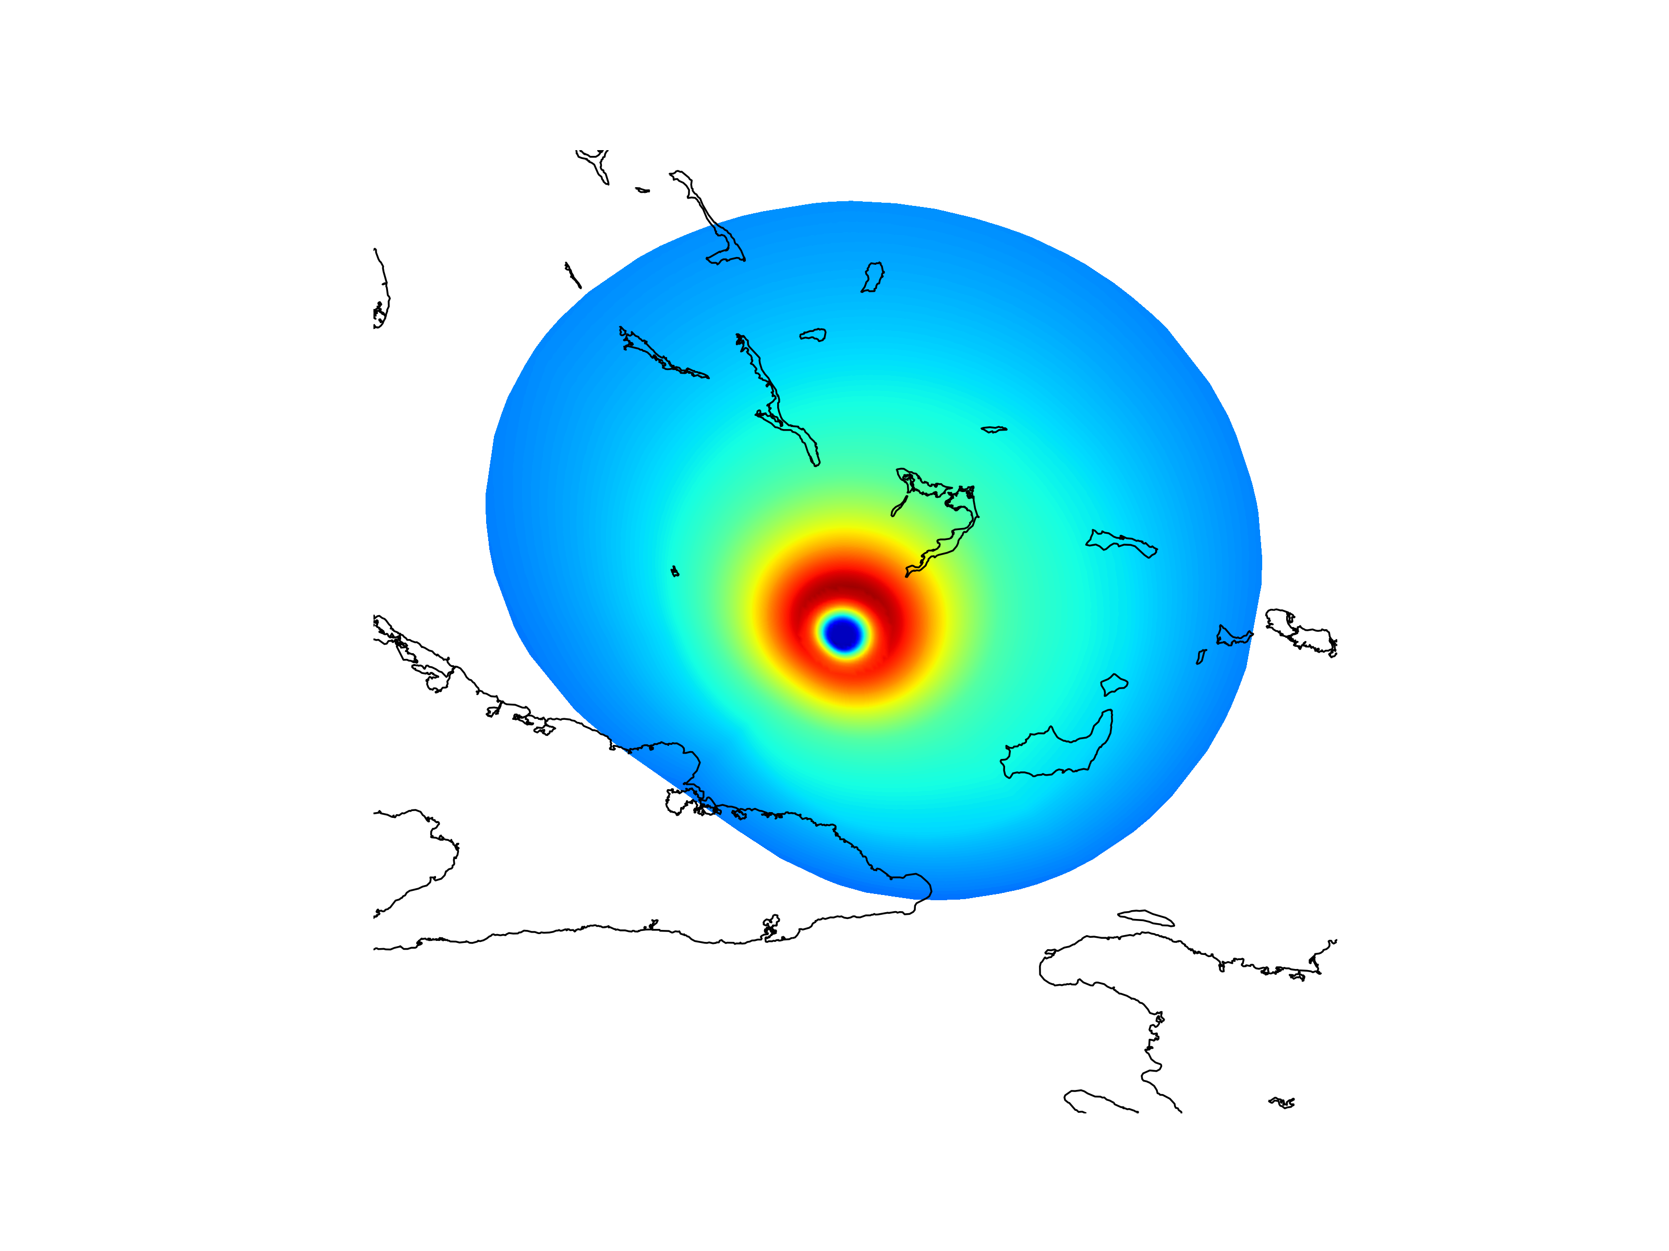
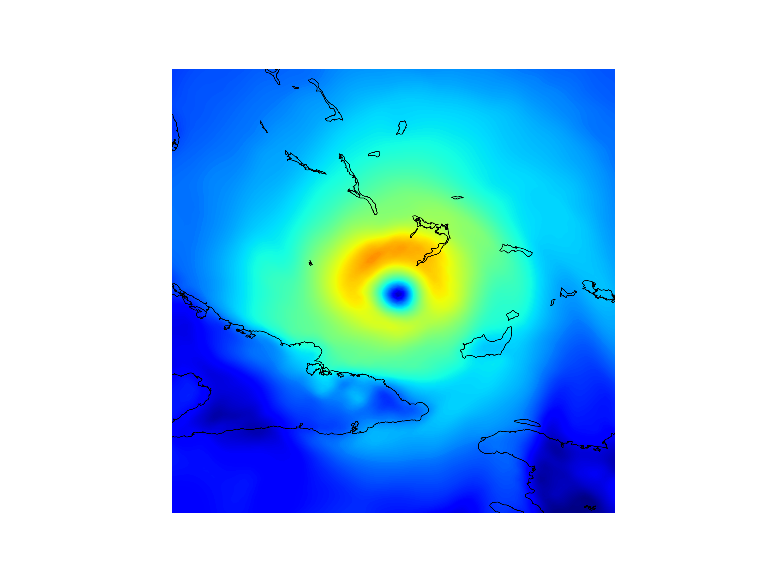
TC Observations and Analysis Comparison:
Valid 1200 UTC 08 September 2017 (11L)
HWRF Operational
Observations
HWRF GSI Relocation

Slide 20
Considerations:
Currently using the location of the minimum sea-level pressure as the location of the analysis TC prior to relocation
  Using more rigorous means (i.e., the NCEP TC tracker, Marchok [2004]) may improve the relocation results
The GSI for relocation is using 3DVAR assumptions
  Having a means of storm-specific background error covariances may improve the relocation results
Currently no tropospheric synthetic observations are rejected by the GSI
  Better synthetic observation error quantifications, specifically for the vector wind components, may improve the analysis results (following relocation)

