Slide 1

DTC Physics Testing Update
Kathryn Newman, DTC
EMC weekly meeting – 2 February 2017

Slide 2
DTC physics testing overview
DTC presented available physics advancements from developer interactions (developer support (including in-house NCAR, NOAA/GSD developers), DTC visitor program PIs) to EMC
Priority given to the following:
Grell-Freitas cumulus parametrization
Cloud overlap methodology change for RRTMG
Partial cloudiness modifications for RRTMG
Developer preference to keep 2&3 separate for initial testing to identify errors of individual modifications
Equal priority: interest in combined impact

Slide 3
Status of runs
Tests still running –available sample used for this snapshot
Storms in sample:
  AL: 06L (Edouard), 08L (Gonzalo), 14L (Matthew), 06L (Fiona)
  EP: 05E (Dolores), 20E (Patricia), 09E (Guillermo) – running
Sample size note: Forecasts are run out to 126 hrs every 18 hrs. (12 hr forecast is run for all initializations for cycling purposes).
  Implemented to increase storm diversity given limited computational resources
 | Control (H216): | Partial Cloudiness: | Cloud Overlap: | G-F cumulus:
AL basin | 128 cases | 109 cases | 109 cases | 128 cases
EP basin | 42 cases | -- | -- | 42 cases
H6CL
H6PC
H6CO
H6GF

Slide 4
RRTMG cloud-radiation enhancements
Alternate cloud overlap methodology and partial cloudiness within RRTMG
  Cloud overlap advancements brought into HWRF through a DTC Visitor Program project (M. Iacono & J. Henderson -AER)
    Project examined the effect of replacing the default maximum-random (MR) cloud overlap assumption with an exponential-random (ER) method
      ER method shown to be more realistic relative to radar measurements within vertically deep clouds
    MR & ER depend on partial cloudiness, operational version used
    Initial results showed promise (in particular for Joaquin case)
  Partial cloud modifications (G. Thompson -NCAR)
    icloud=3
    Operational for HWRF in 2015, bug fix in 2016
    Adjustments to RH threshold methodology
      Reduction in solar radiation biases over CONUS (changes in v3.8.1)
Presentation during EMC weekly meeting Nov 9, 2016

Slide 5
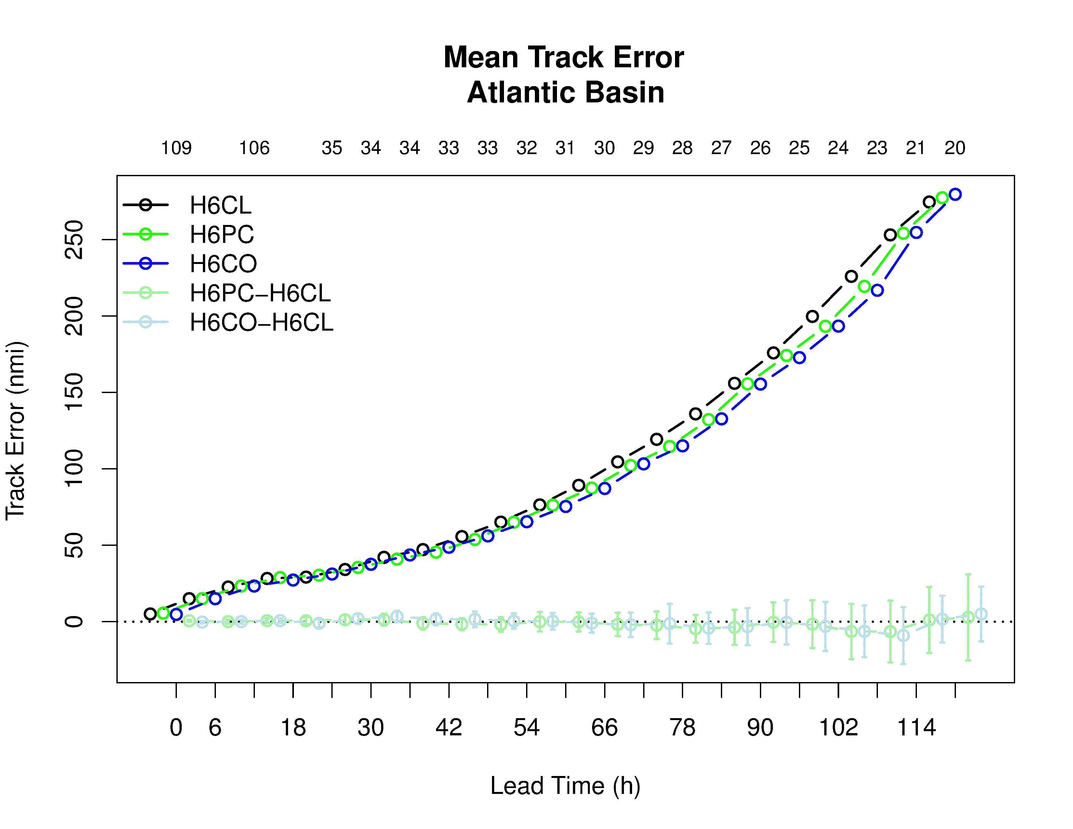
RRTMG cloud overlap & partial clouds
Control
Partial Cloudiness
Cloud Overlap
Consistent reduction in track error for both enhancements (differences are not SS)

Slide 6
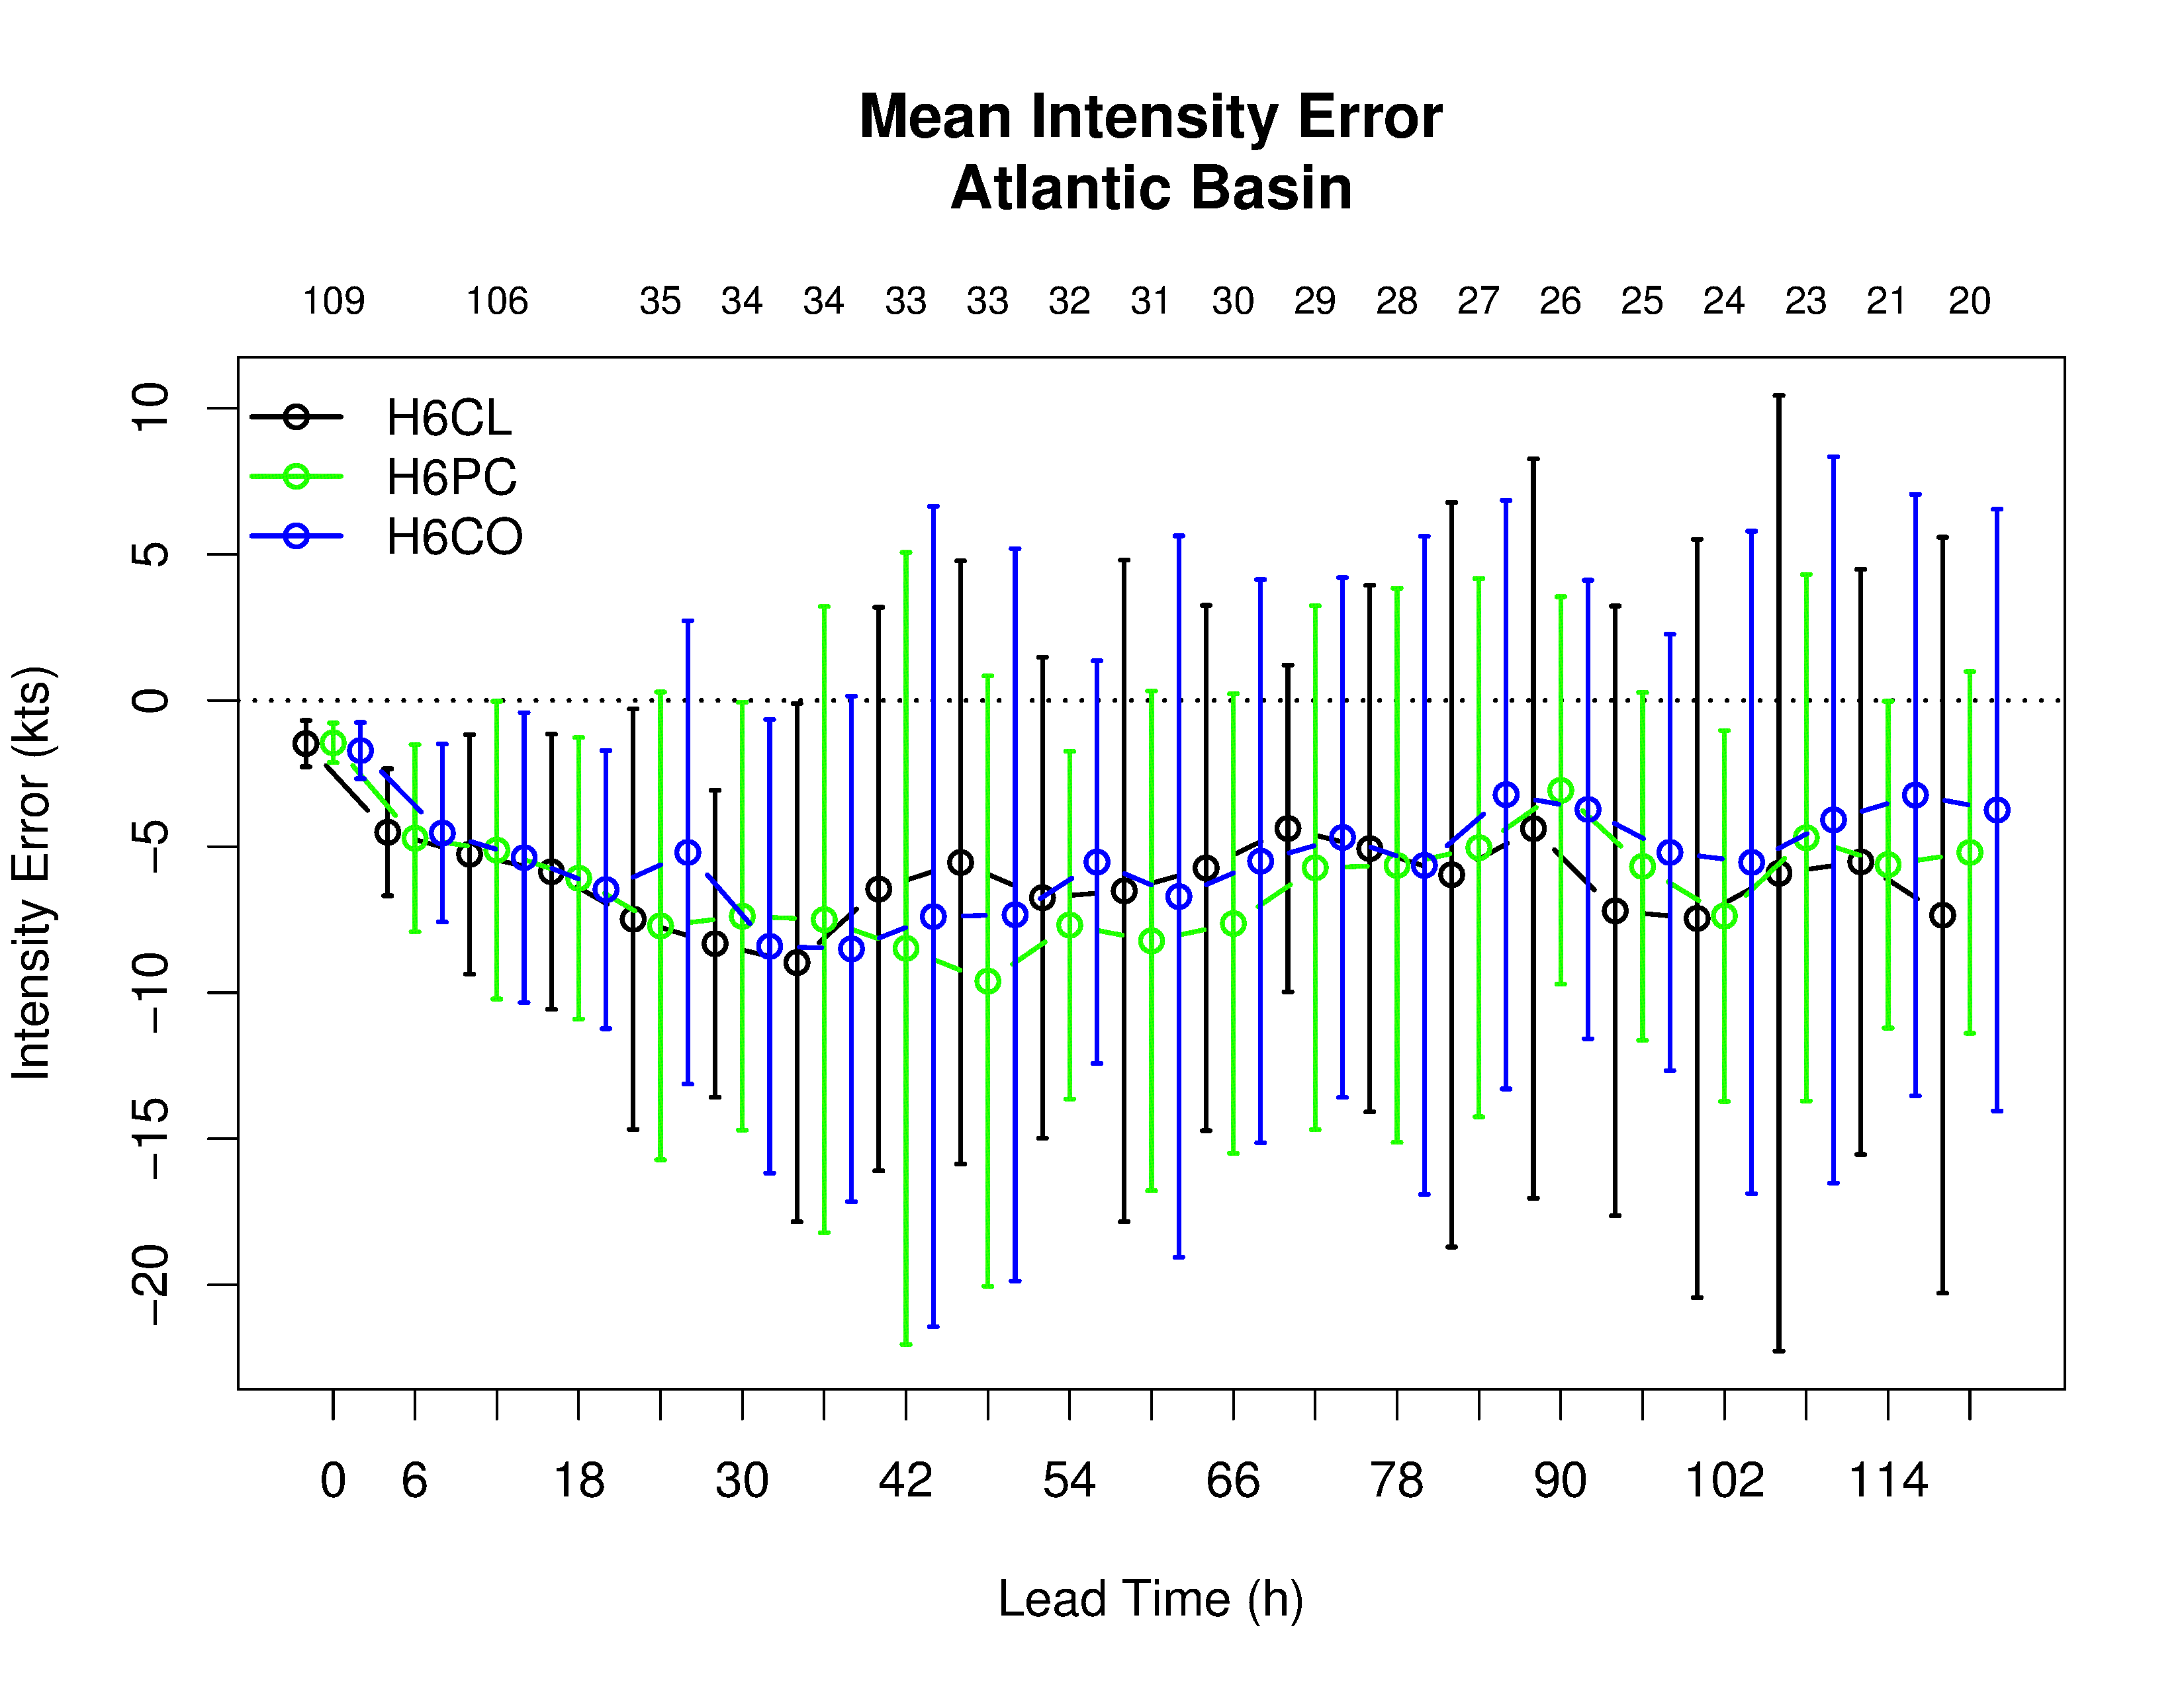
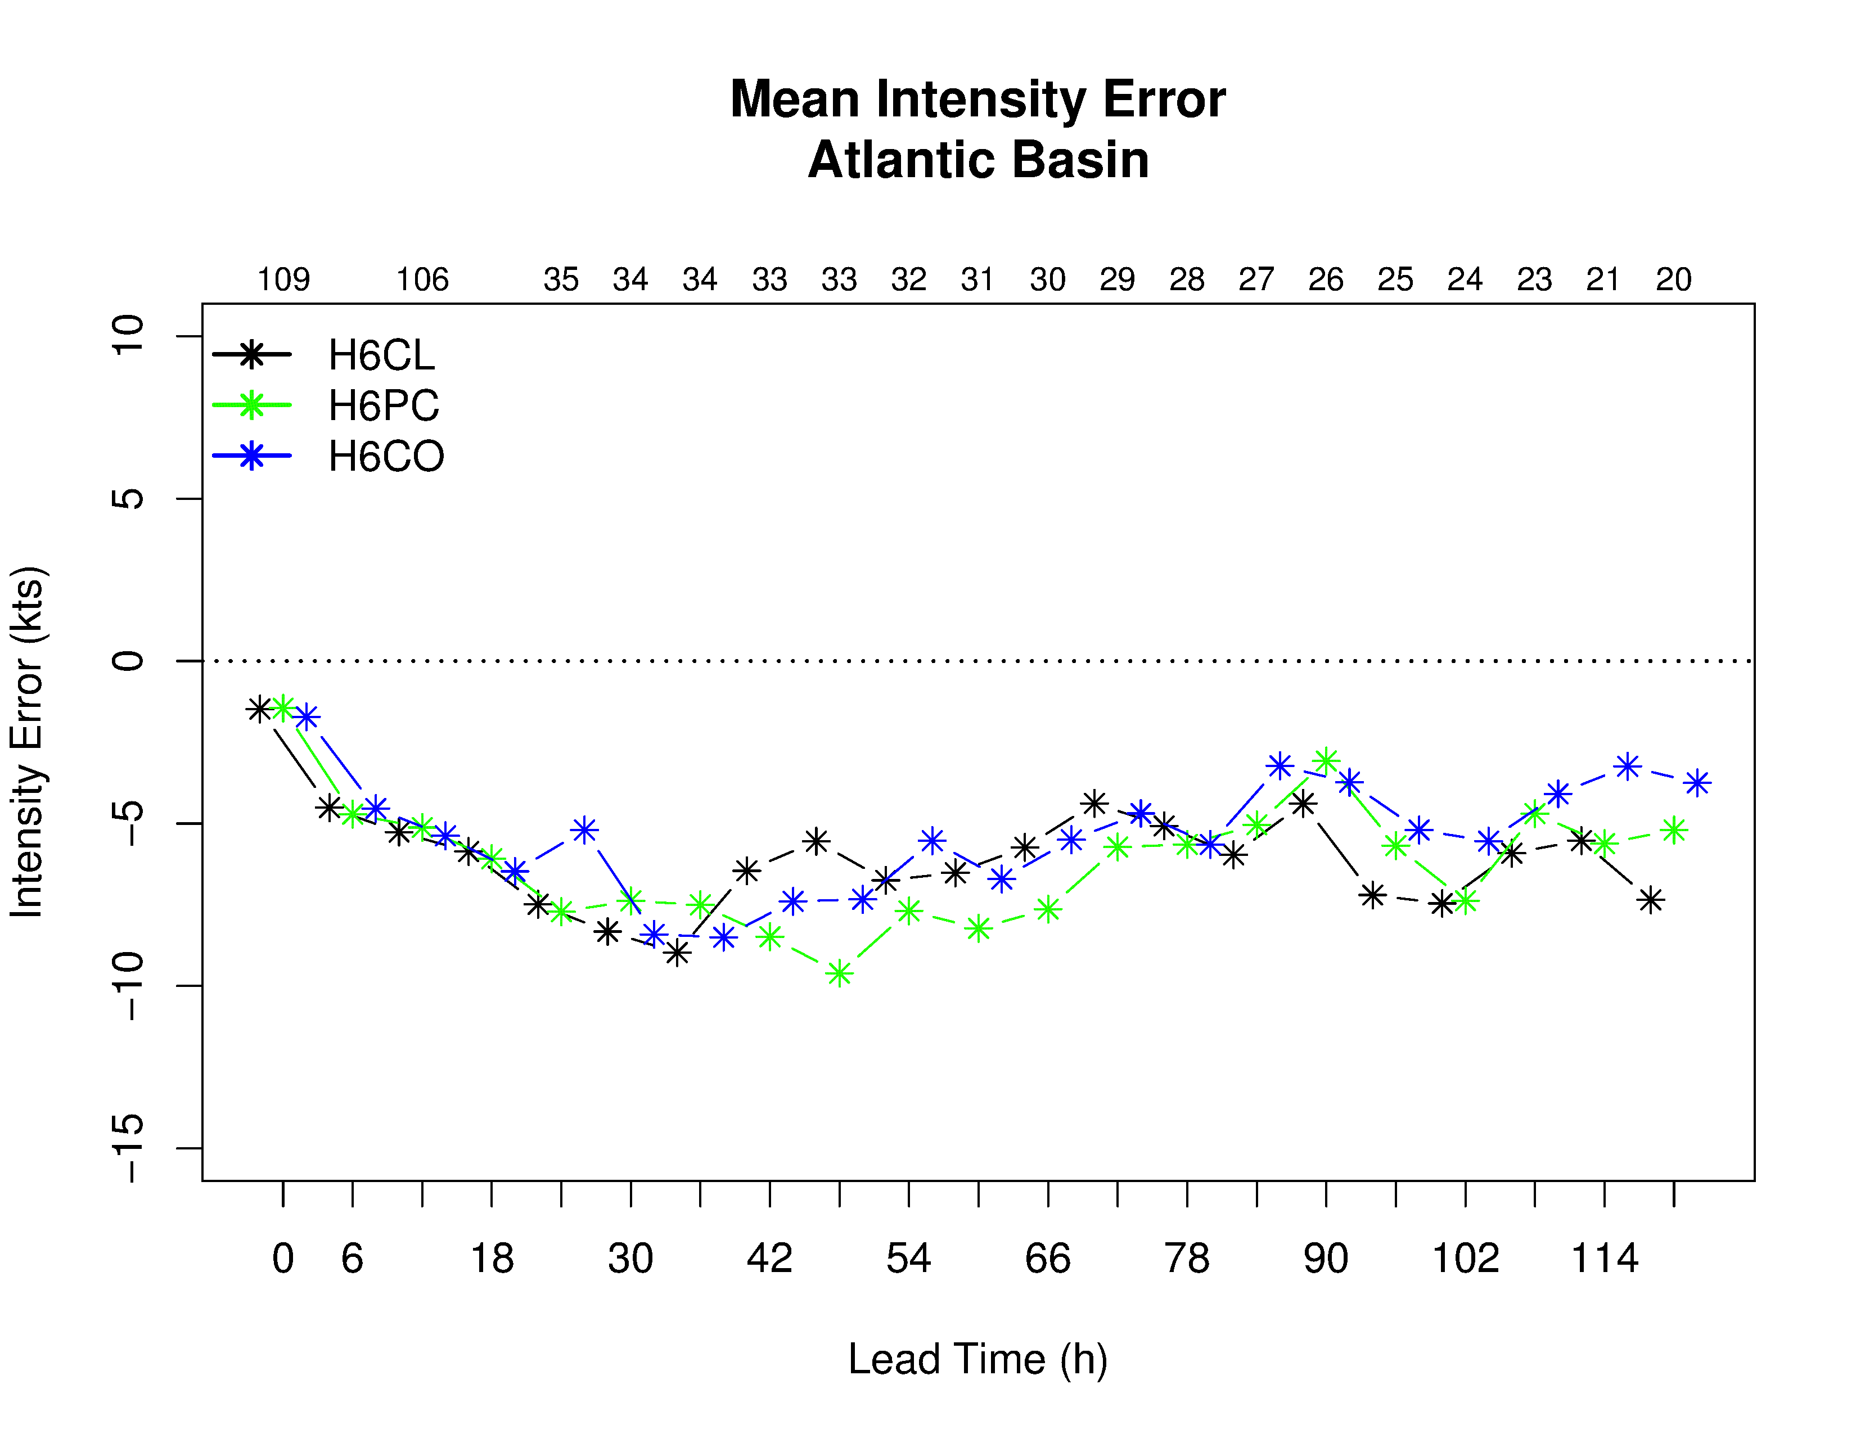
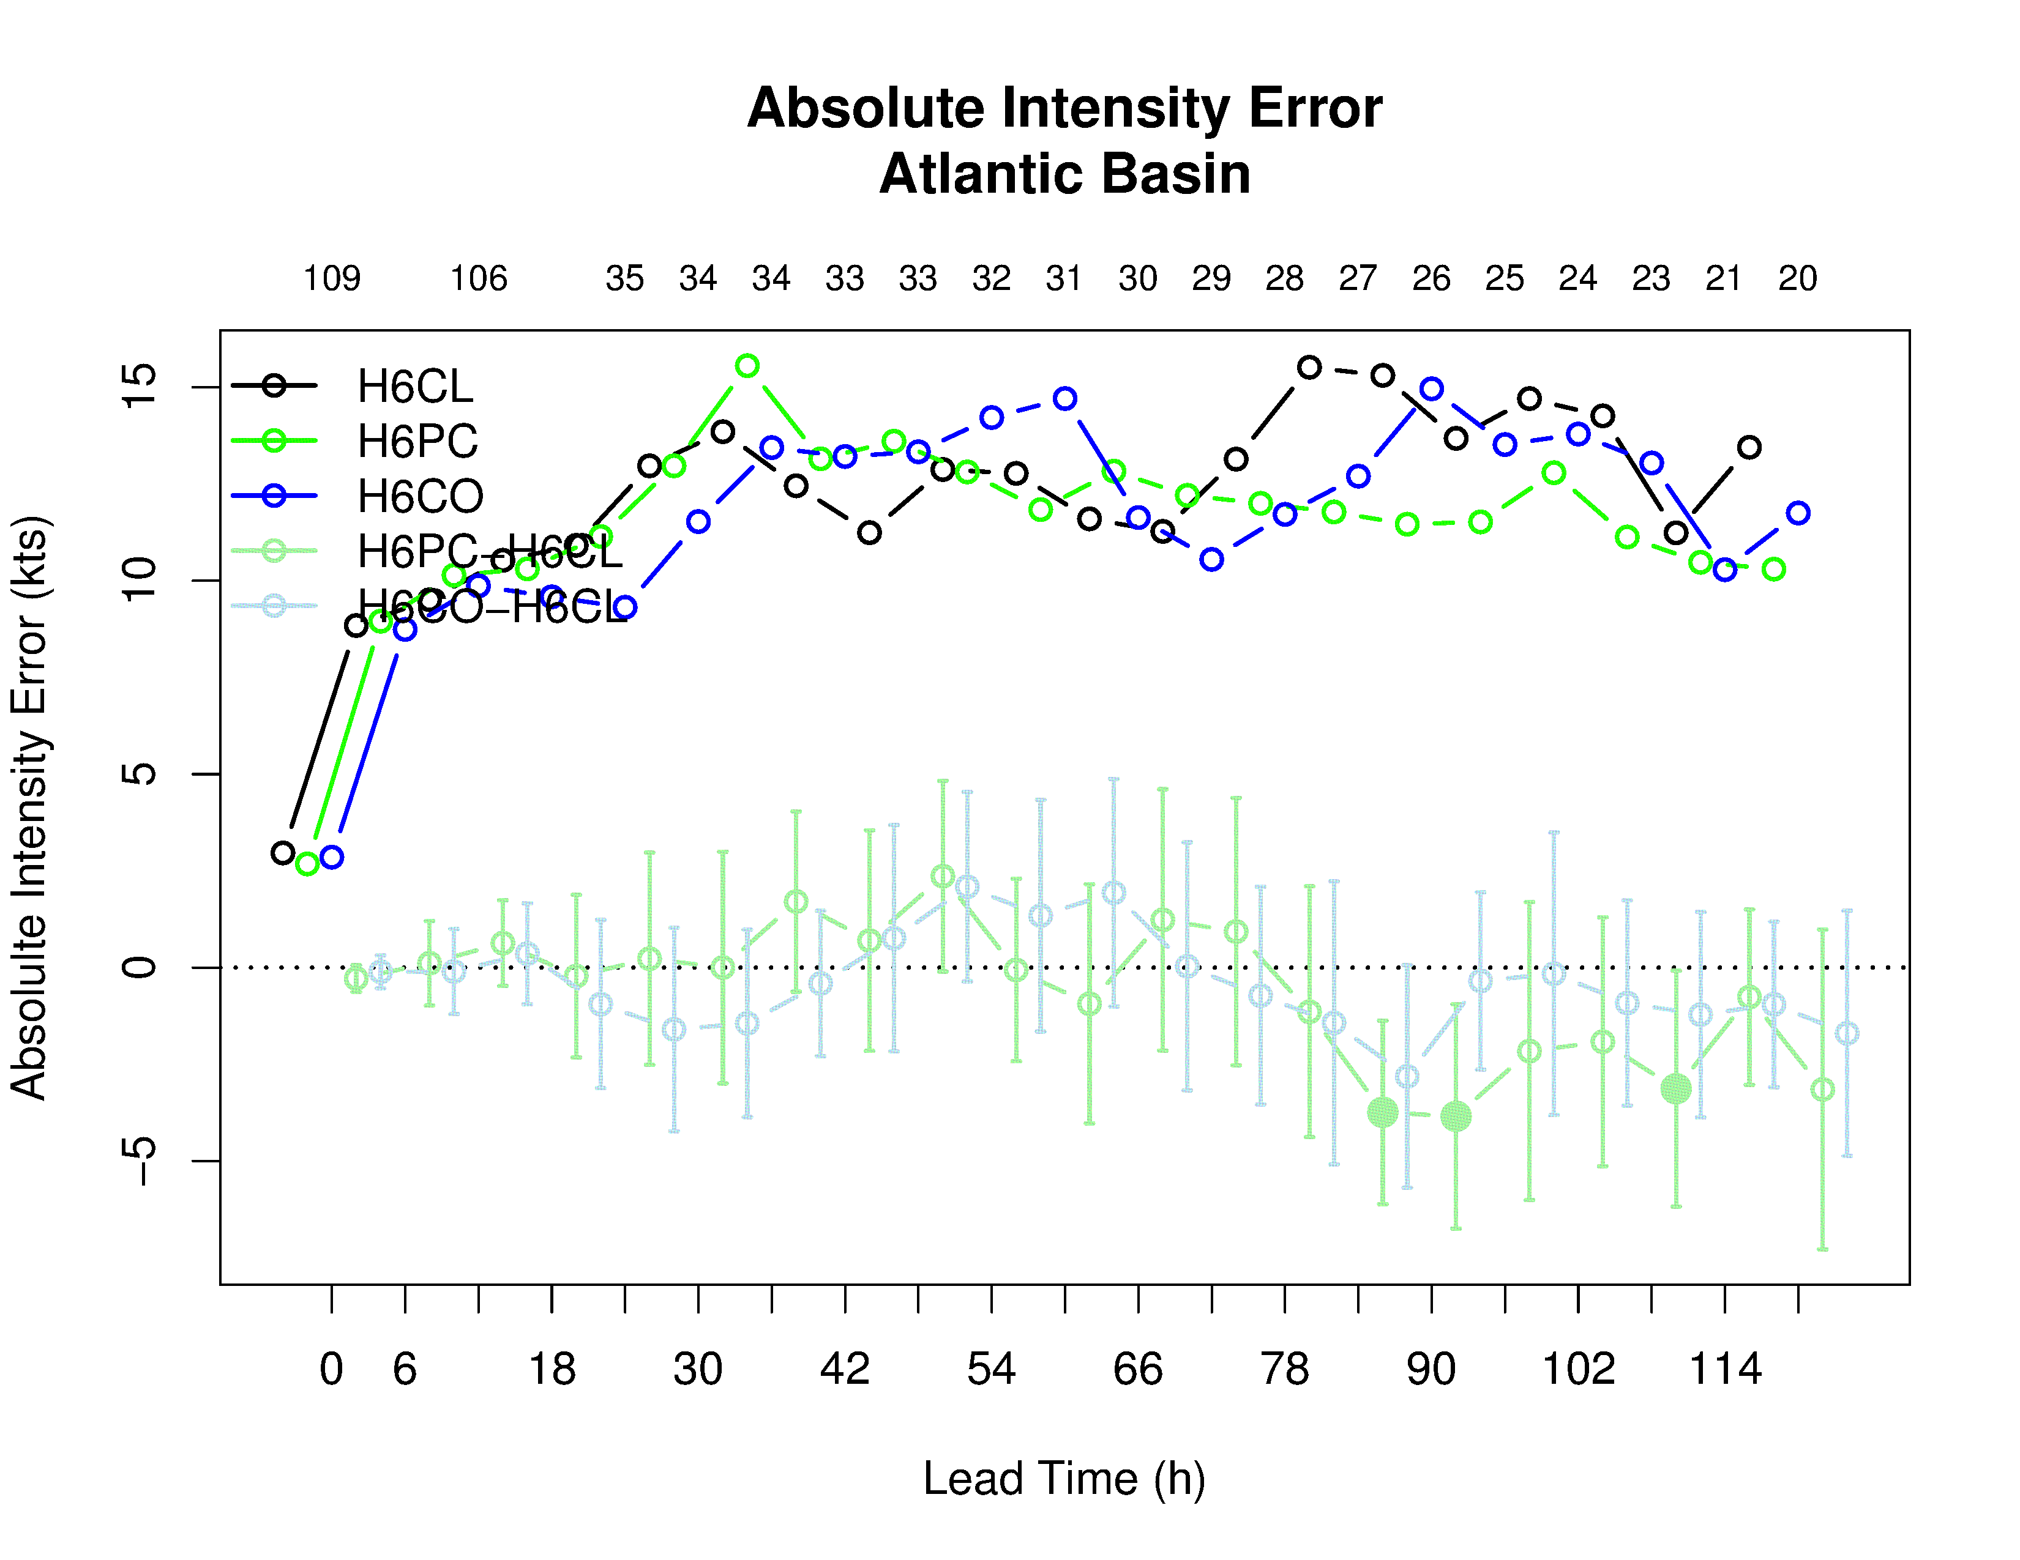
RRTMG cloud overlap & partial clouds
Control
Partial Cloudiness
Cloud Overlap
Intensity: SS improvements at longer lead times

Slide 7
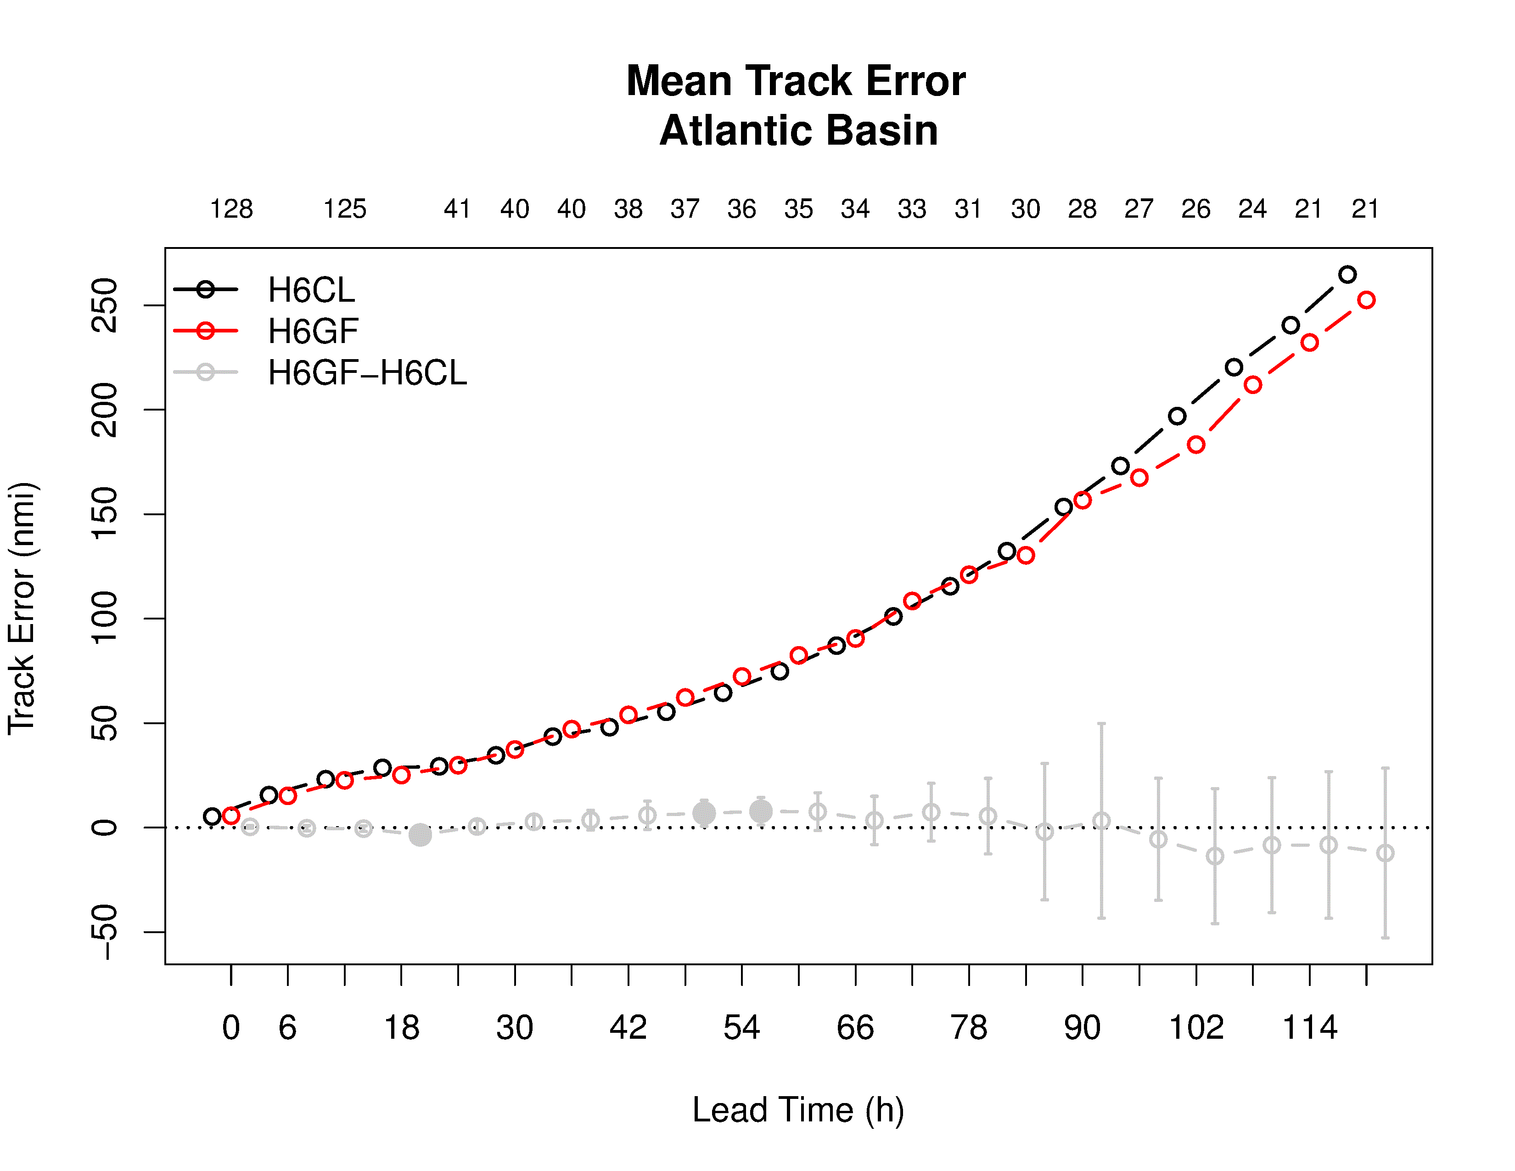
Grell-Freitas convection
G-F cumulus parametrization tested as a replacement candidate for the operational scale-aware SAS cumulus scheme
  Scale aware G-F implemented in HWRF by G. Grell and J.-W. Bao (NGGPS PI)
Control (SASAS)
G-F
Difference

Slide 8
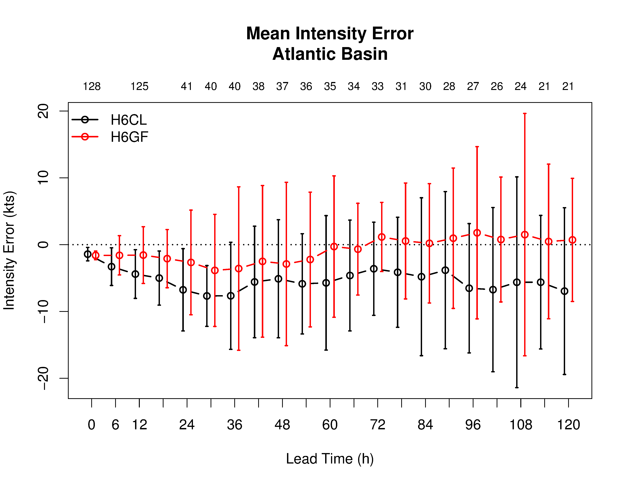
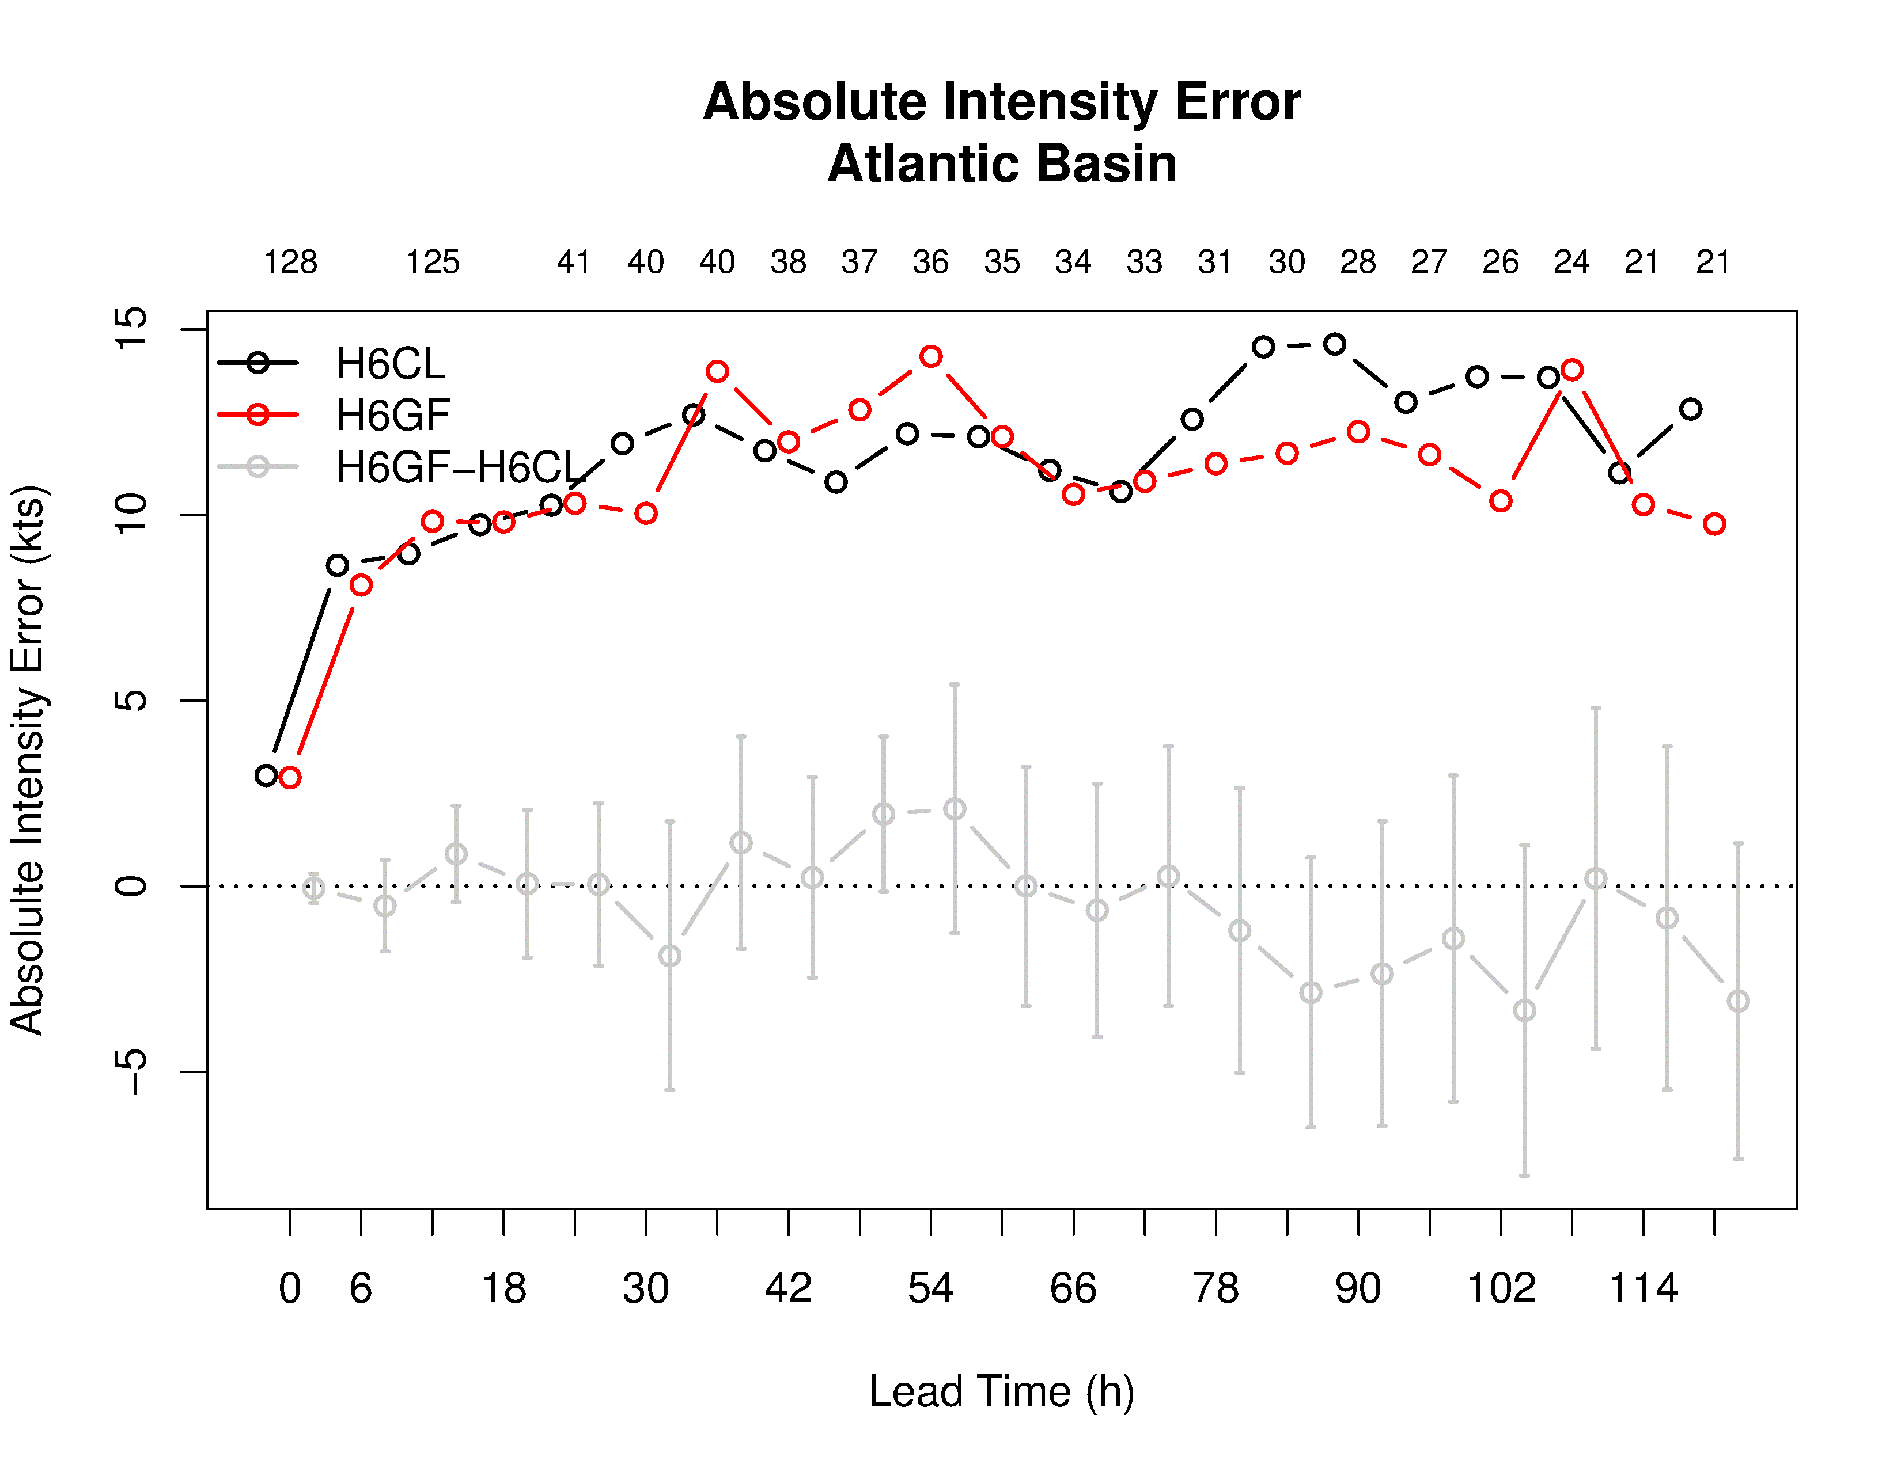
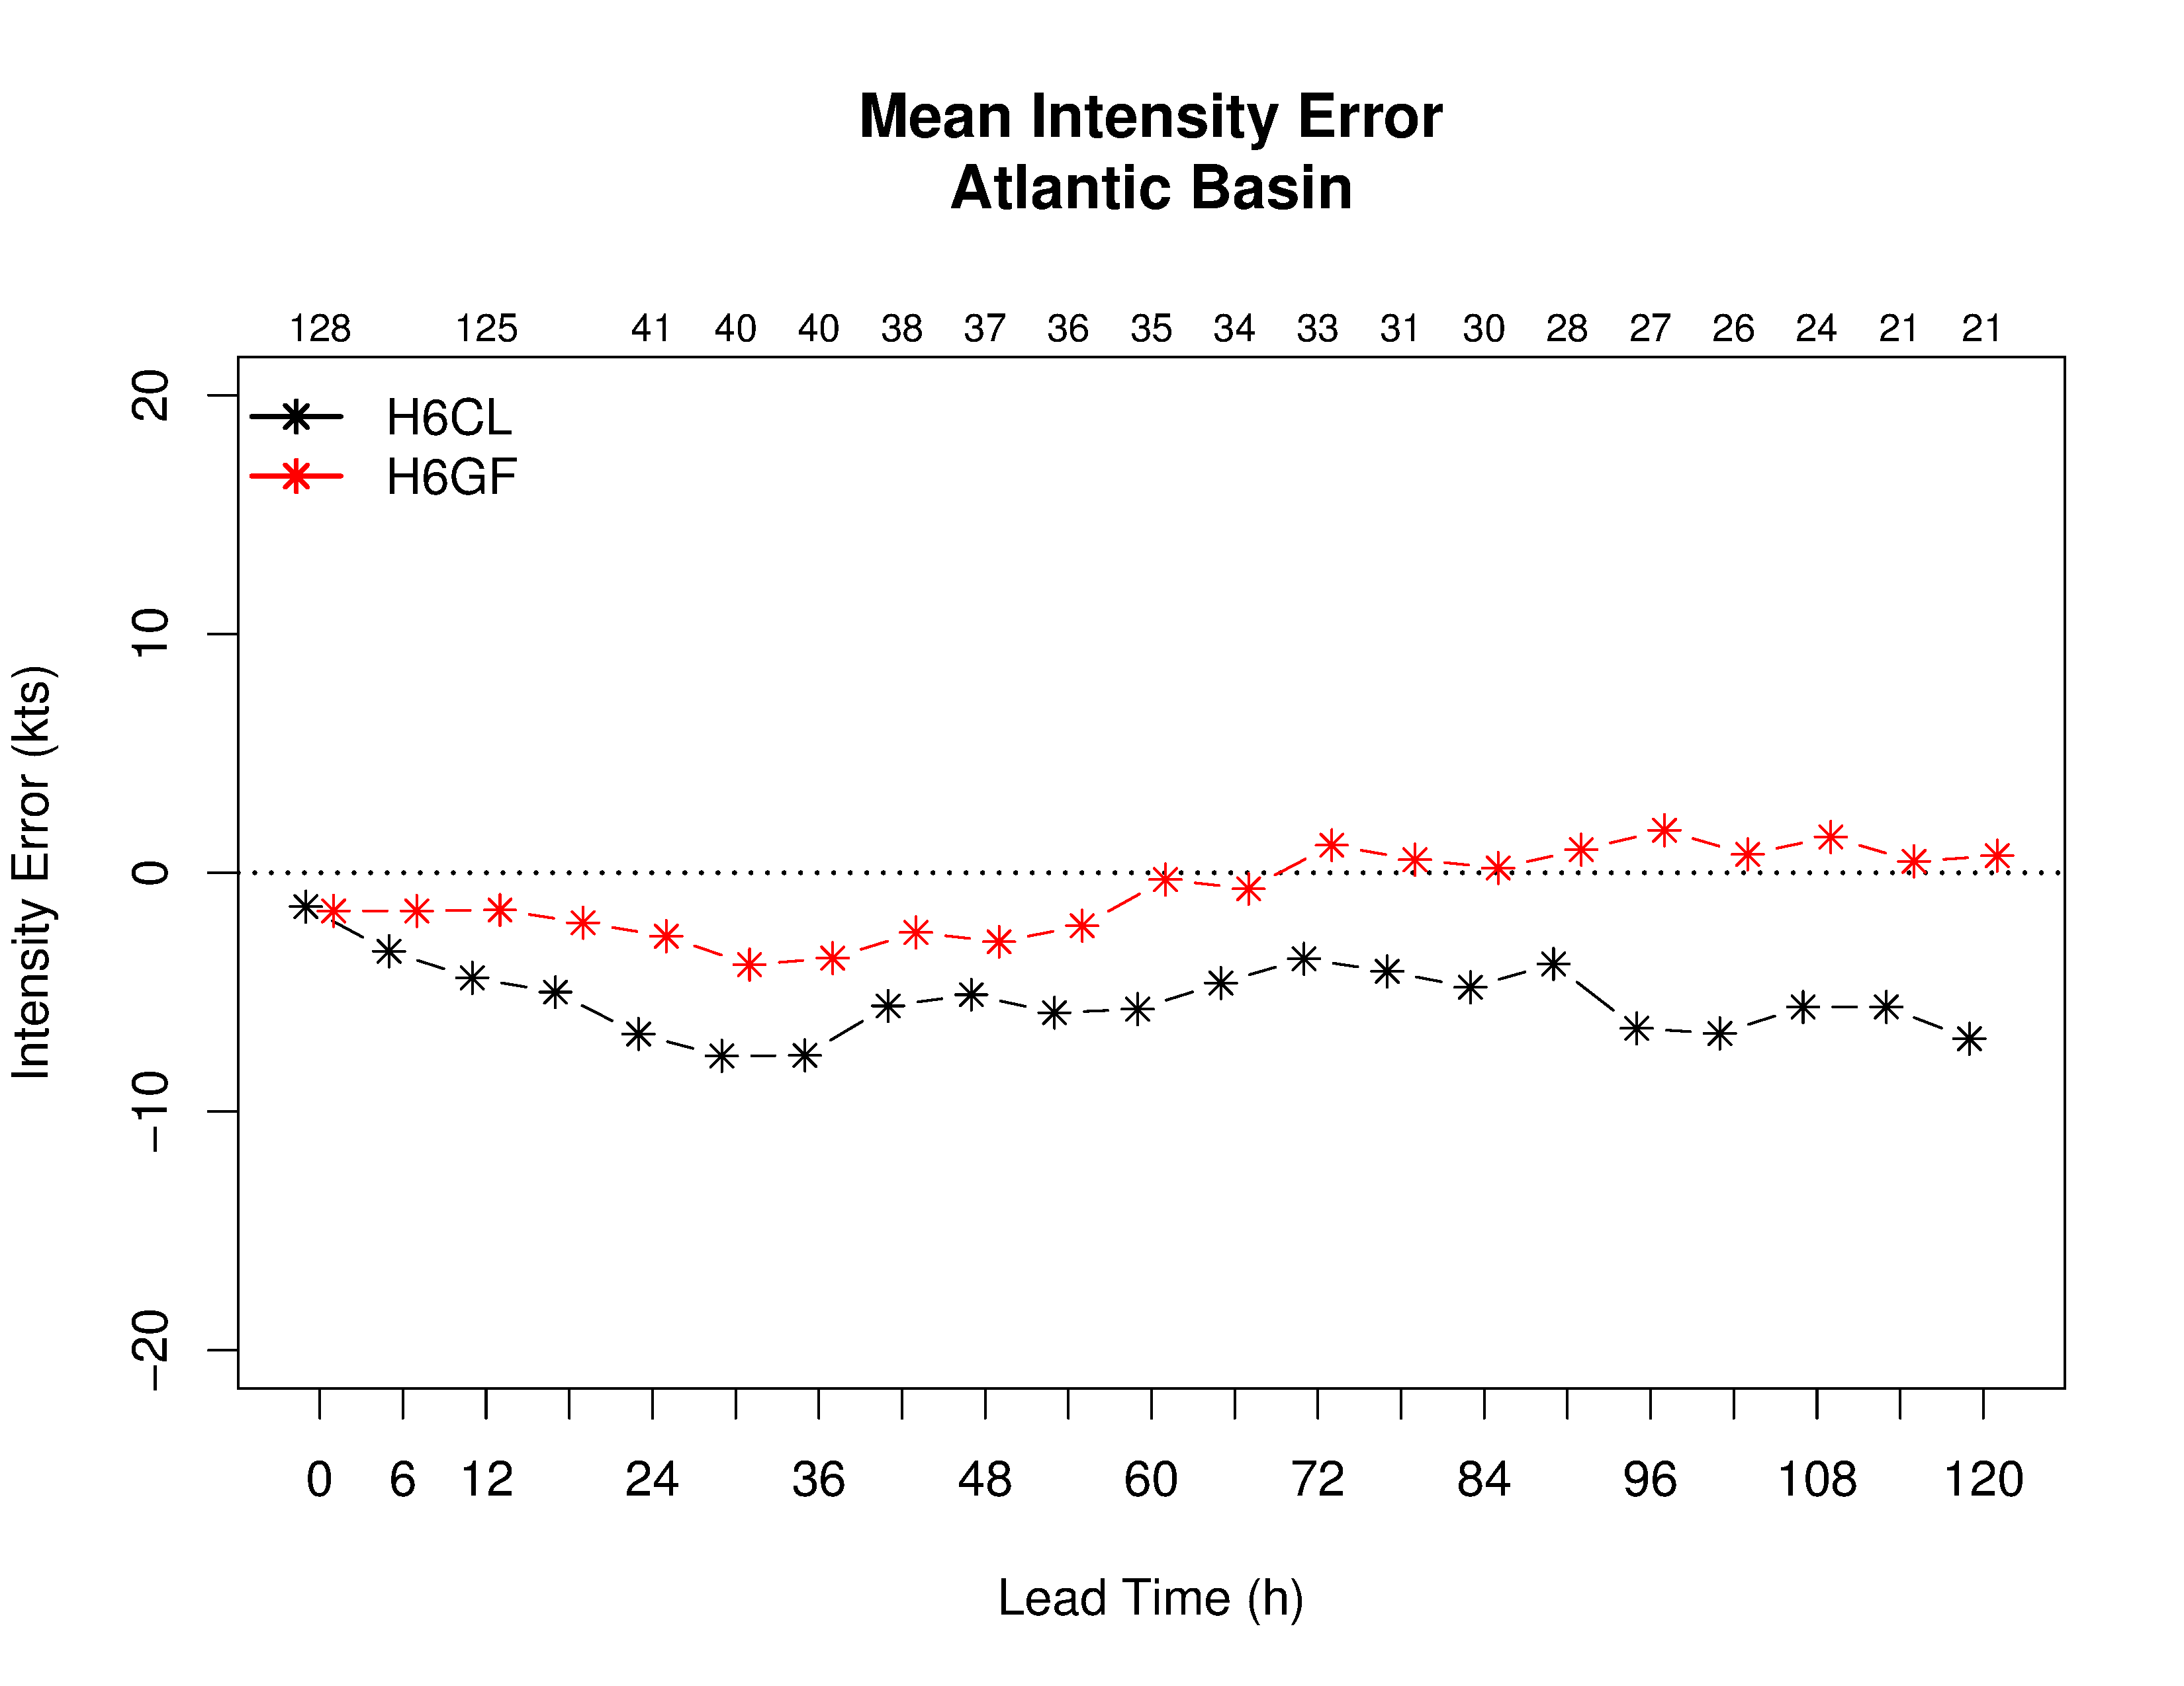
Grell-Freitas convection
Control (SASAS)
G-F
Difference
Largest differences in intensity bias – alleviates low bias for strong storms

Slide 9
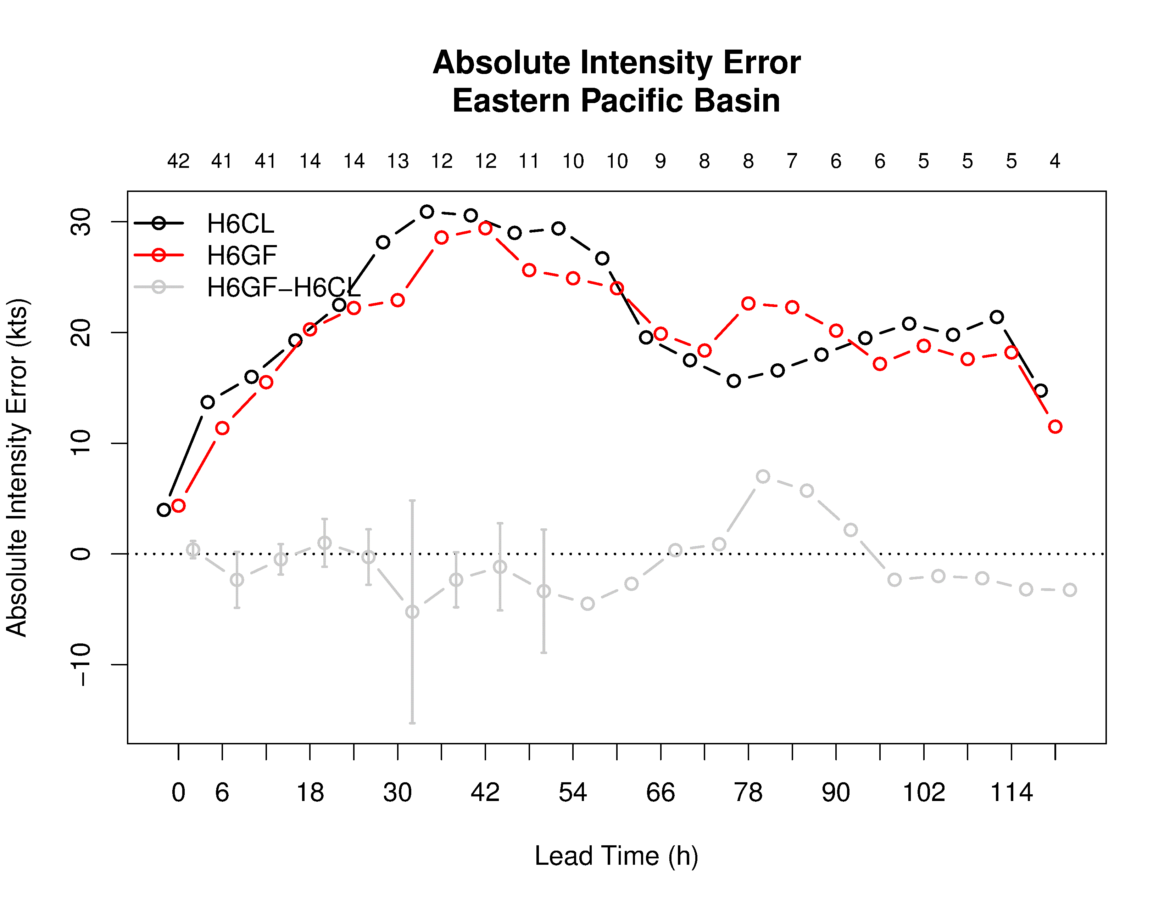
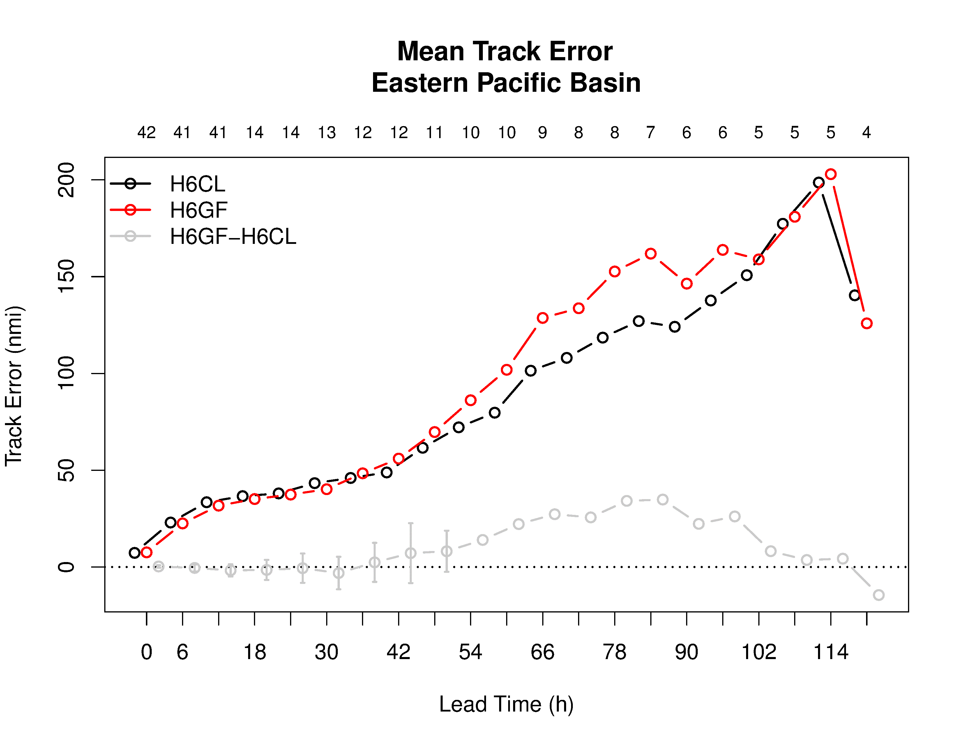
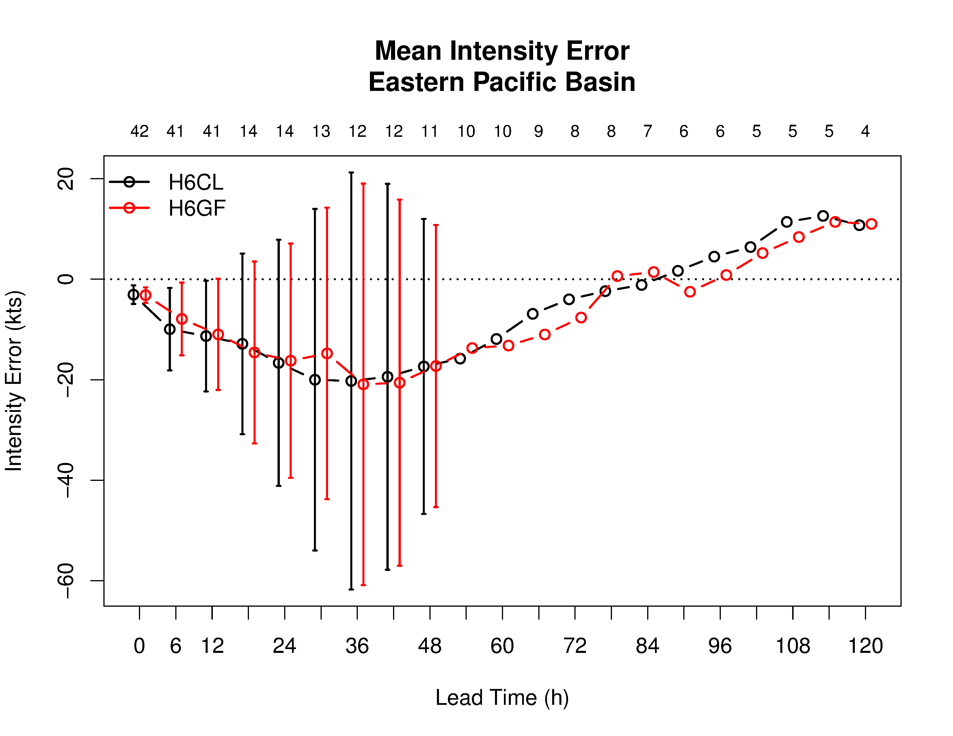
G-F: EP basin
Control (SASAS)
G-F
Difference
EP cases: sample size too low

Slide 10
G-F: Patricia
H6CL
H6GF
H6CL
H6GF

Slide 11
G-F: Dolores
H6CL
H6CL
H6GF
H6GF

Slide 12
Precipitation
Total 24-hr accumulated precipitation
CMORPH
Control
G-F
Convective precipitation
Control
G-F
Differences in SA schemes:
SAS – only explicit precip by 6km
G-F - Shallow convection conversion

Slide 13
Ongoing testing
Alternate cloud overlap methodology, partial cloudiness enhancements for RRTMG and updated G-F code have been added to HWRF repository (in development branches), tested
Preliminary results show promise – sample sizes still quite small
  Additional storms running: Guillermo underway to increase EP sample
Path forward
  Other storms to target?
  Minimum number of cases before decision to pick up code?

