Slide 1
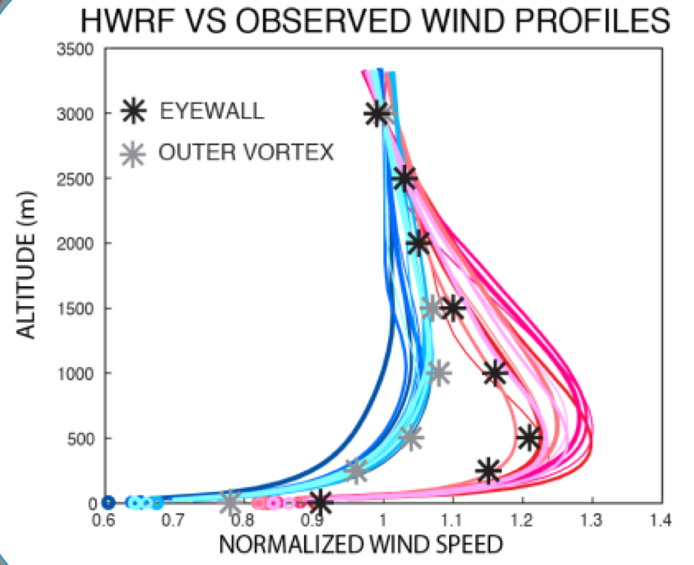
Motivation:
HWRF Wind profile in lower levels: surface wind is a bit too weak
Possible reasons: PBL, surface layer

Slide 2
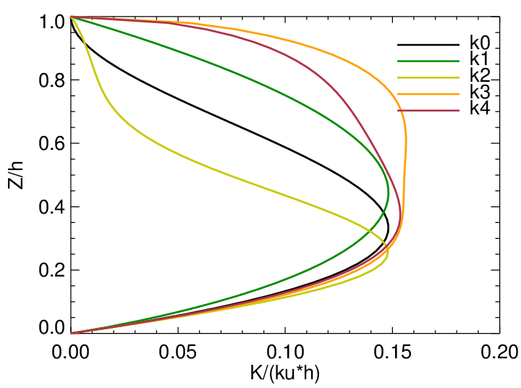
K plays an important role to distribute wind/mass/T in PBL

Slide 4
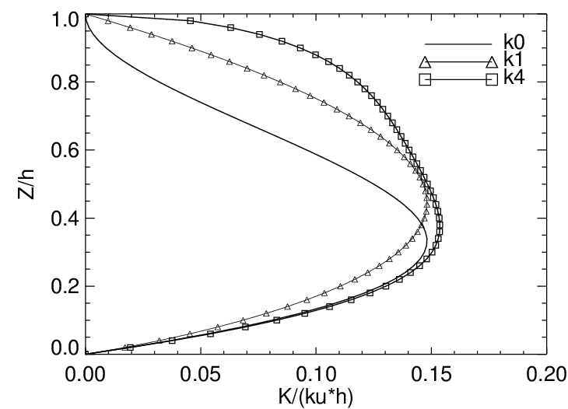

Slide 6
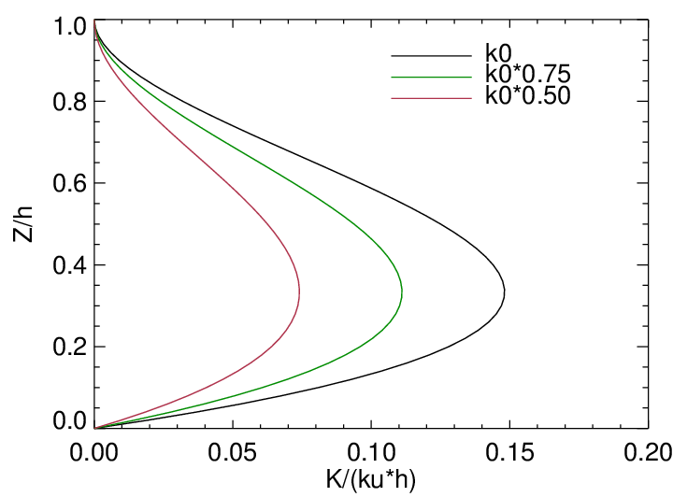
Revisit Alpha adjustment
Sudden/discontinuous changes in K, might damage flux calculation

Slide 7
A Hypothesis
why constant alpha adjustment in HWRF reduces surface wind growing?
Z
Before alpha adjustment
Friction reduced
~ D(uw)/dz
Friction increased
brake
after
kz=1
<uw>
Solution

Slide 8
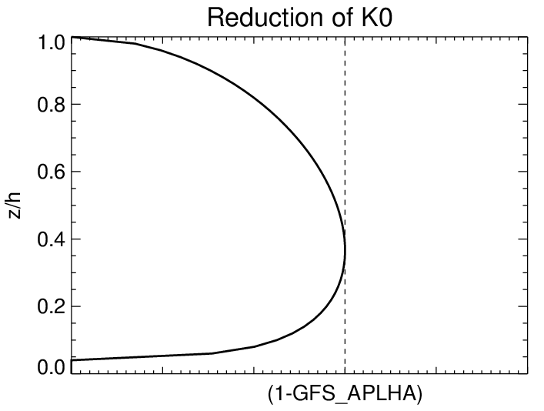

Slide 9
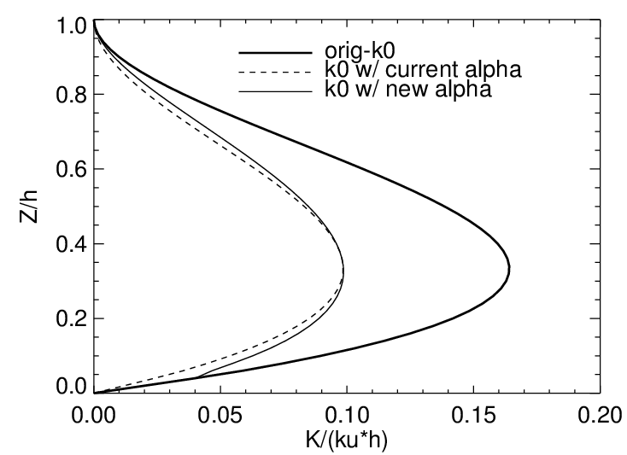

Slide 11
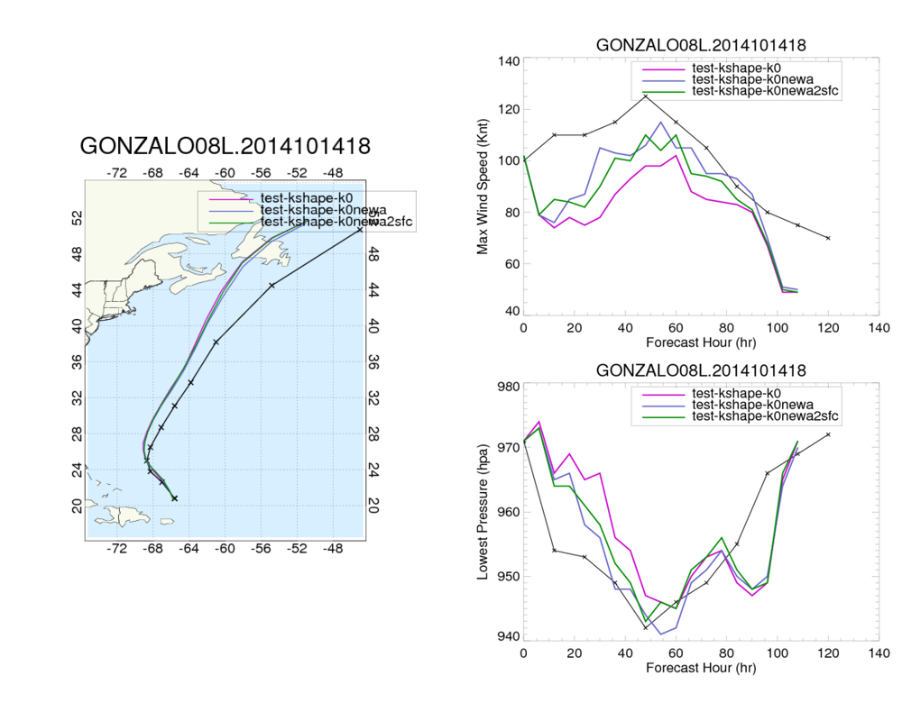

Slide 12
Summary
Be careful when changing K profiles.
Reducing “jump” in K and hence flux benefits surface wind and profiles.

Slide 13
Other tests:
Use newSAS, EDMFPBL, different K profiles
ftp://ftp.emc.ncep.noaa.gov/mmb/wd20ww/cp-tmp/K-sas-noscale-knewa-06L.pdf

Slide 16
Use newSAS with scale-aware, EDMFPBL, different K profiles, new ch
ftp://ftp.emc.ncep.noaa.gov/mmb/wd20ww/cp-tmp/K-sas-scale-knewa-ch-06L.pdf

Slide 17
Scare-aware SAS good for track

Slide 18
New CH

