Slide 1
Agenda:
Update on operational failure investigation;
Update on Thompson MP sensitivity test (DTC); We may drop advected F-A test;
Update on Global RTOFS initialization, HYCOM initialization on POM, and Wave coupling update;
Update on DA experiment;
Update on Cd/Ch investigation.

Slide 2
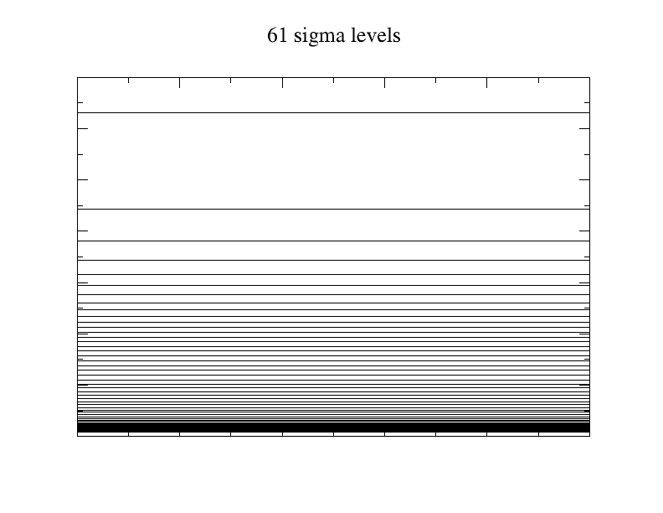
2mb
2mb
10mb
10mb
1000mb
1000mb

Slide 3
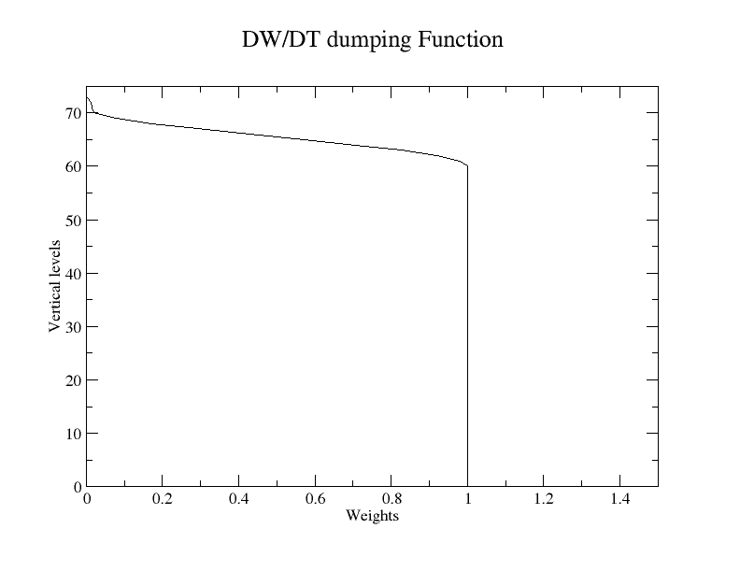
DW/DT Damping, Weights as Function of Vertical Levels

Slide 4
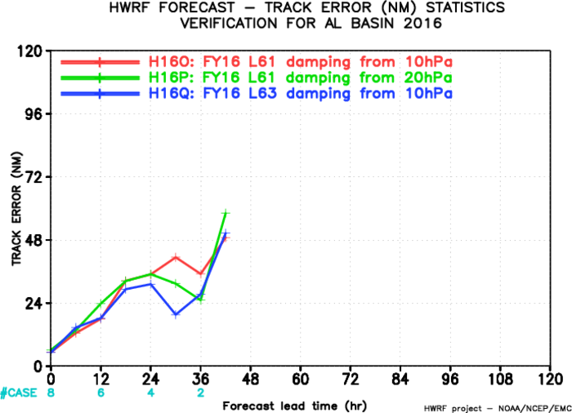
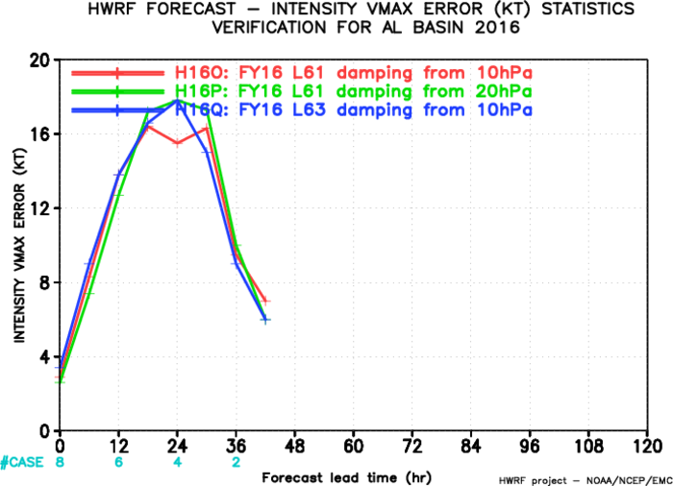
Verification for Hurricane Alex, 2016

