Slide 1
Fixing HWRF wind profiles

Slide 2
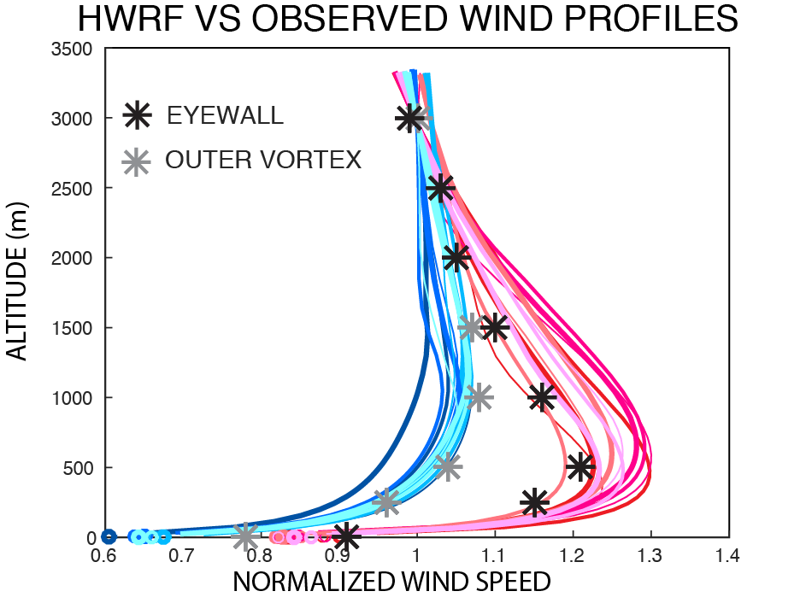
Problem: Near-surface wind speeds are too weak compared to the winds in the PBL

Slide 3
Possible causes
Incorrect vertical diffusion?
Cd too high?
Ck too low?

Slide 4
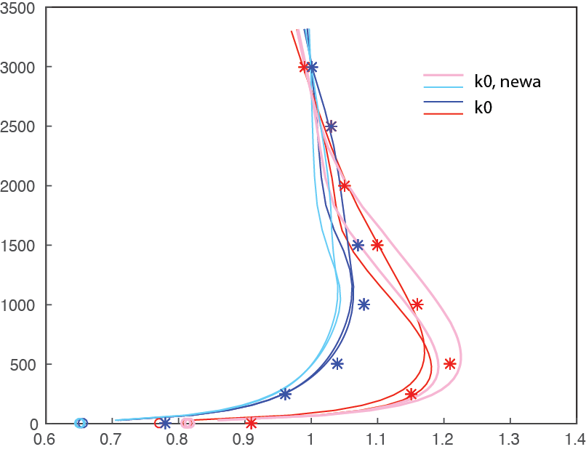
Changing diffusion gives modest improvements in profiles
So let’s look at Ck & Cd

Slide 5
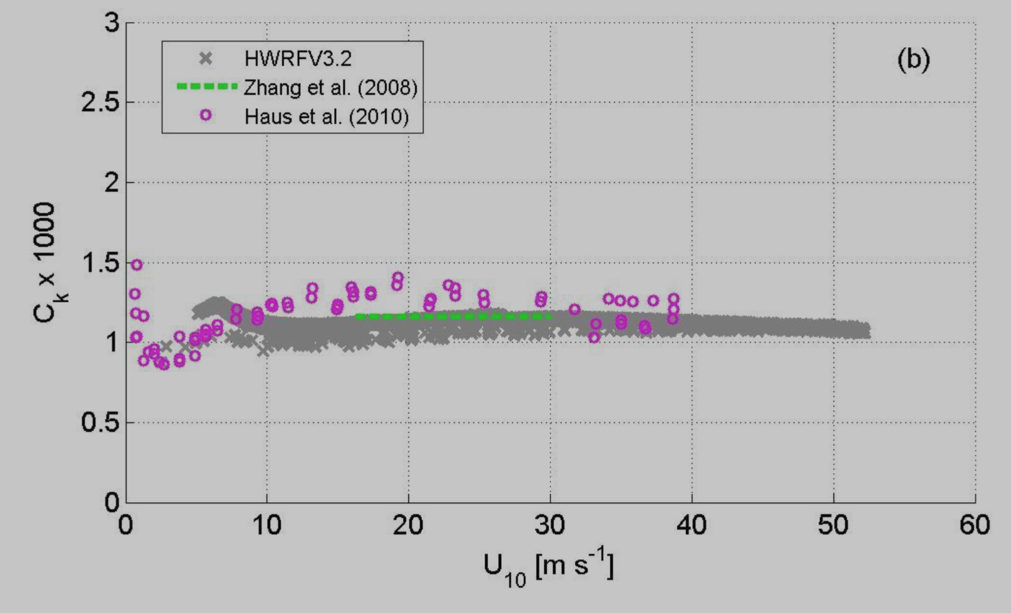
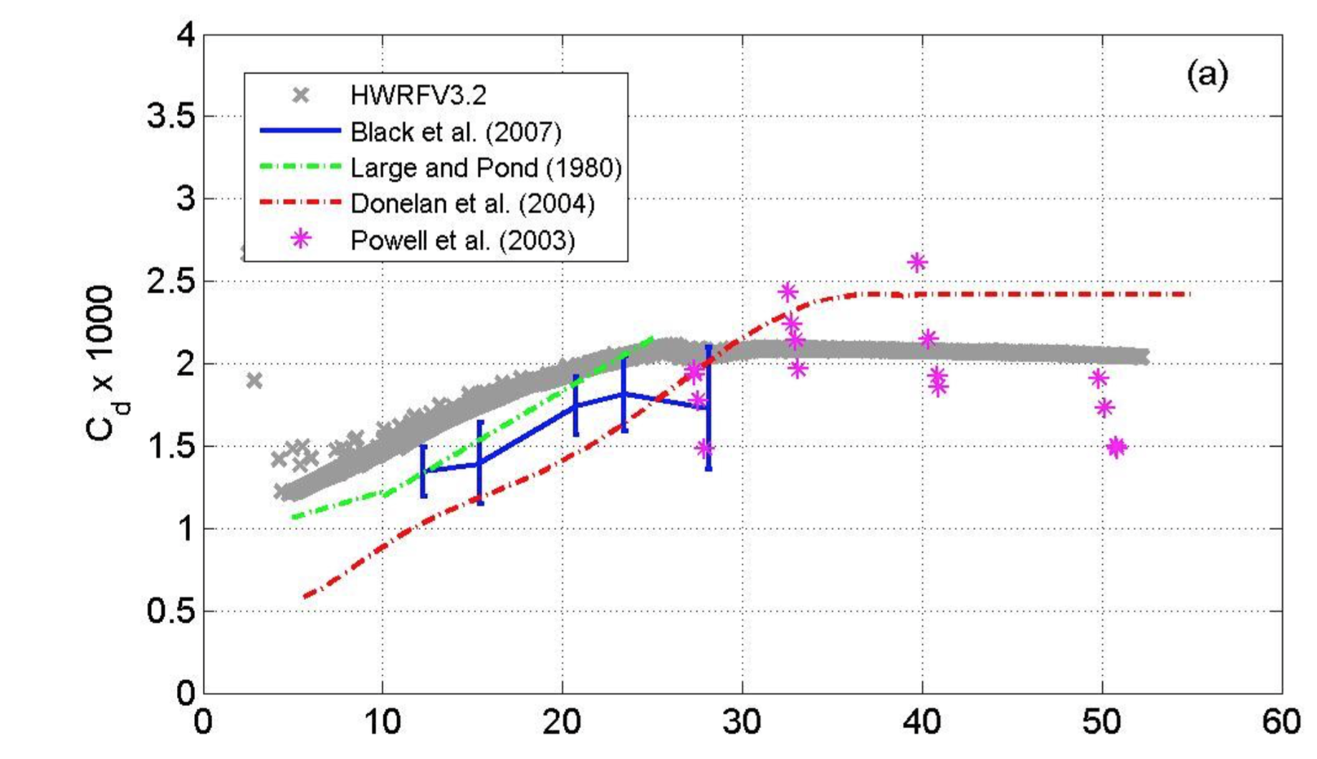
Appropriate Ch & Cd values?
Ck is relatively constant and fairly certain, between 1 and 1.5
Cd varies strongly with wind speed and has large uncertainty

Slide 6
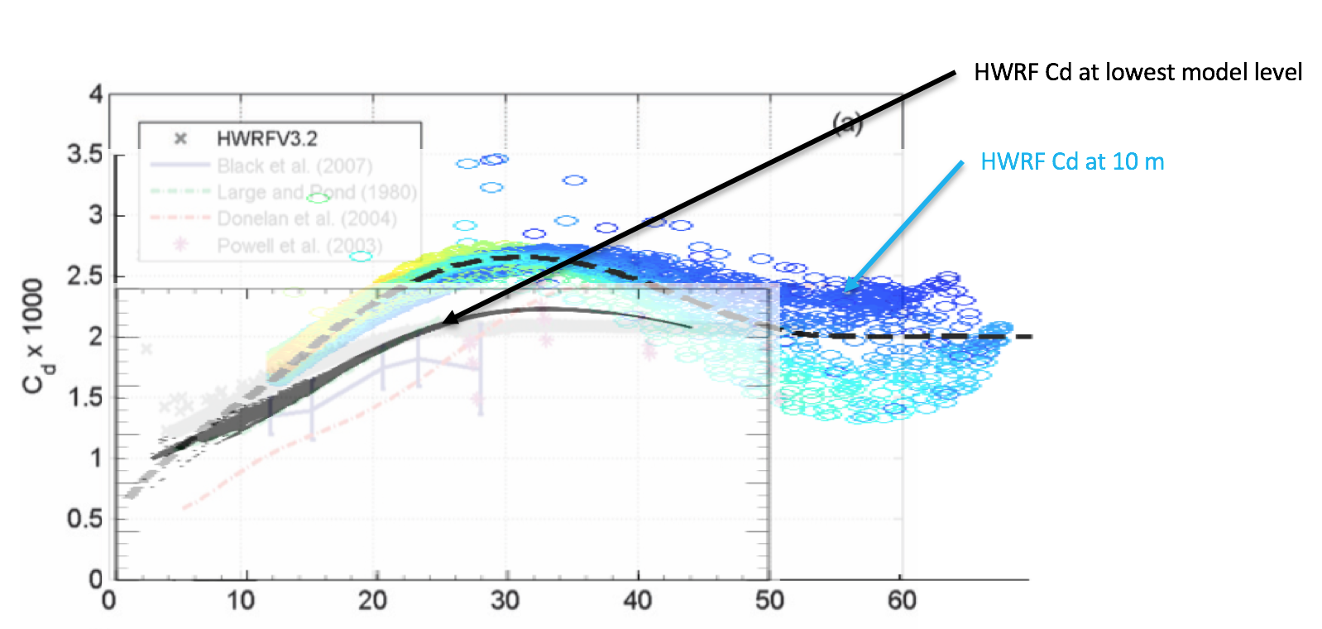
Ck & Cd in HWRF
We discovered that HWRF Ck & Cd have been computed on the lowest model level (30m) but tuned to 10-m obs.
Effectively, Cd in the model has been much higher than previously thought. (what about Ck?)

Slide 7
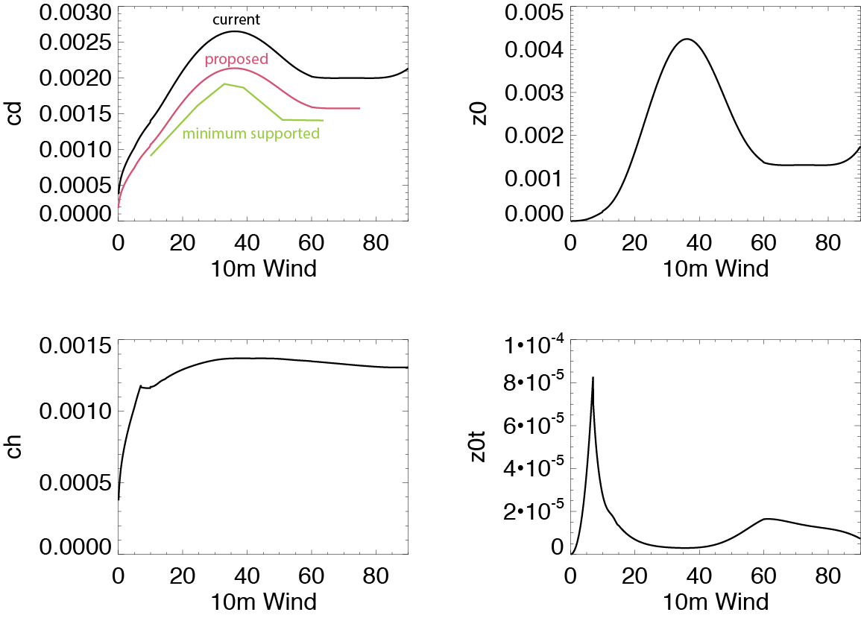
Changing Ck & Cd in HWRF
Ck is as high as it really should be in HWRF, but we have plenty of room to adjust Cd, so we gave it a shot.
Upper limit on Ck

Slide 8
Changing Ck & Cd in HWRF
Ck and Cd are changed through changing Z0 and Z0t, as shown here. We ran an experiment with this configuration

Slide 9
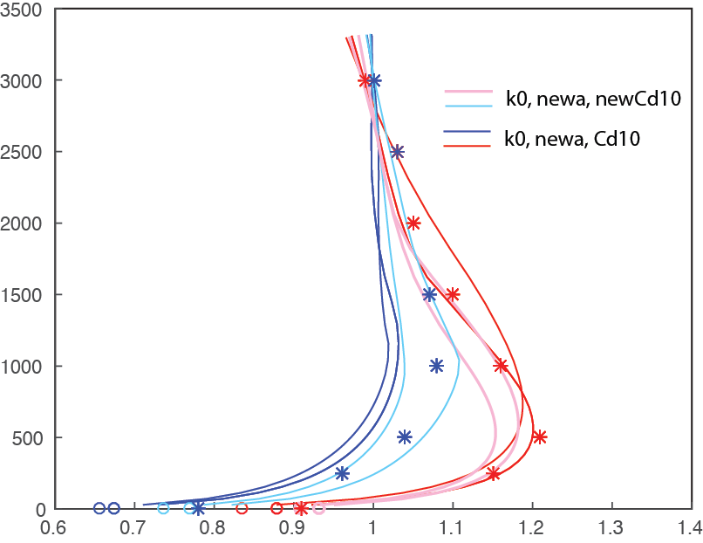
Effect of reducing Cd
10-m winds are now in excellent agreement with observed wind profiles of hurricanes. This is the first time I’ve seen this with HWRF.

Slide 10
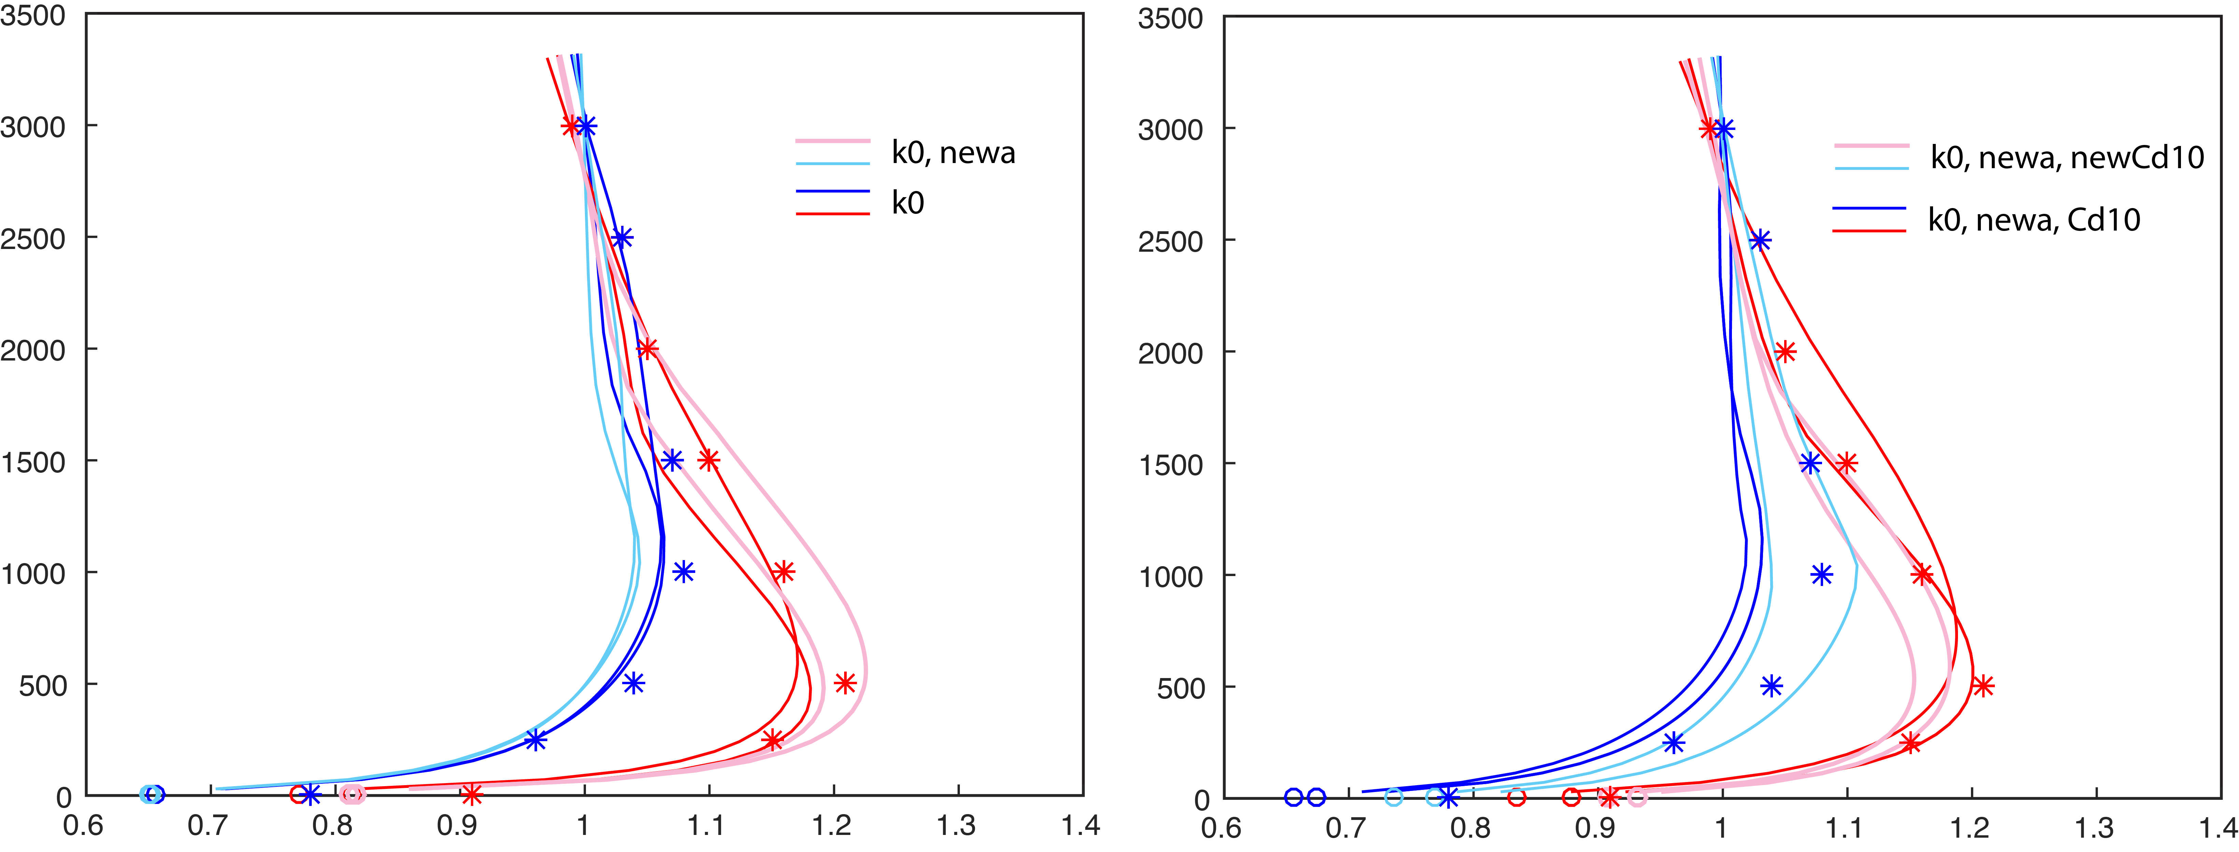
Comparison of all experiments

Slide 11
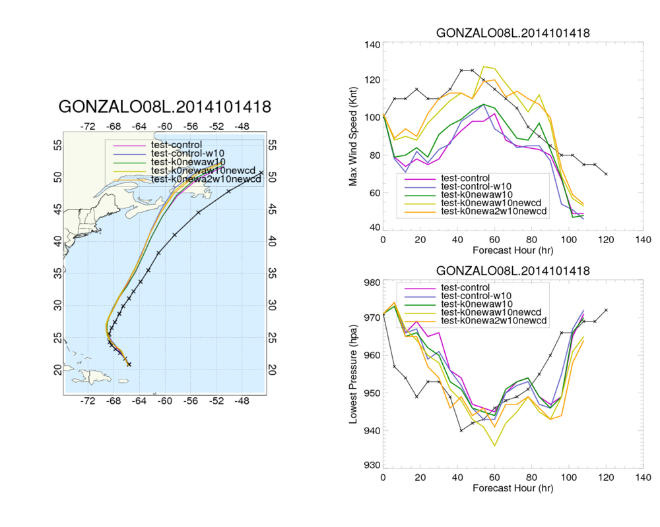
Comparison of all experiments
New cd

