Slide 1
Meeting Agenda
Update on eddy diffusivity experiments.
Update on operational failure investigation.
Thompson MP sensitivity test update (DTC);
Global RTOFS ocean initialization update (URI/EMC), and Wave coupling update
Status of merging H16C and Coupling branch.

Slide 2
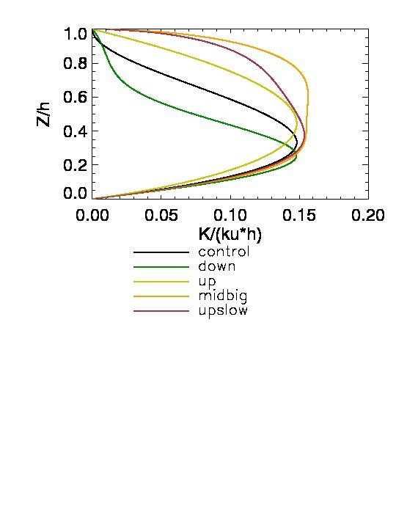
ftp://ftp.emc.ncep.noaa.gov/mmb/wd20ww/cp-tmp/Kshape-intensity.pdf

Slide 3
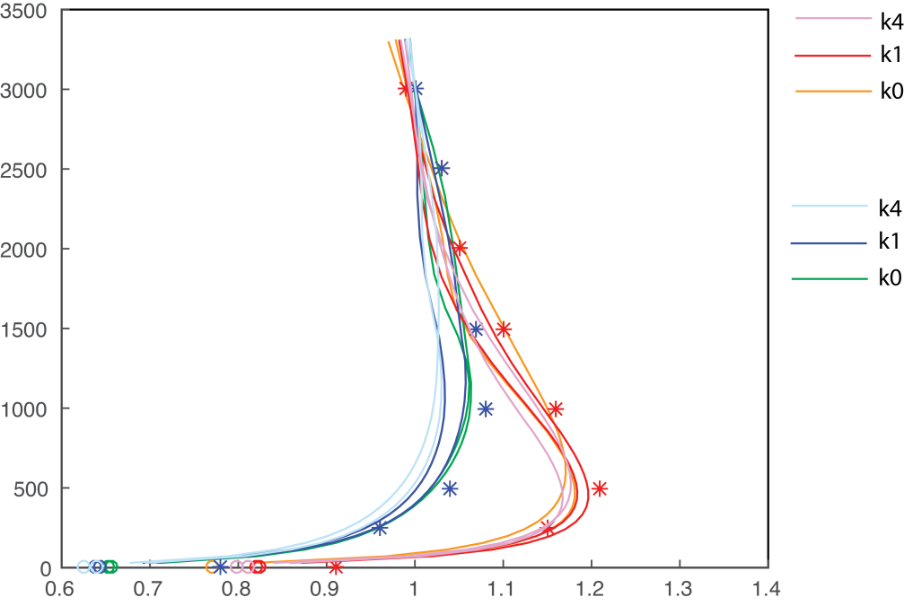
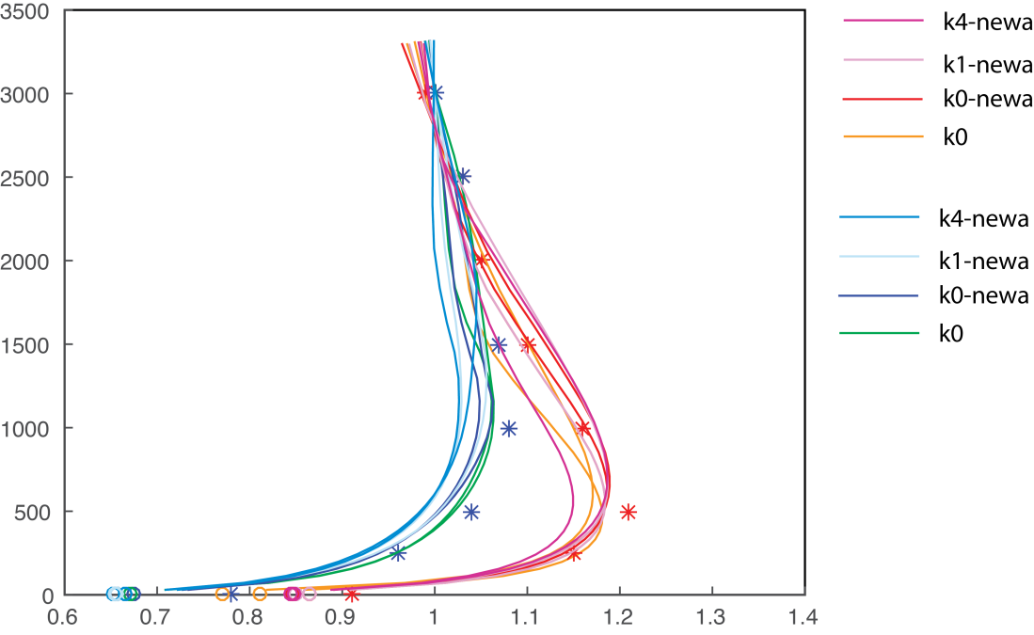
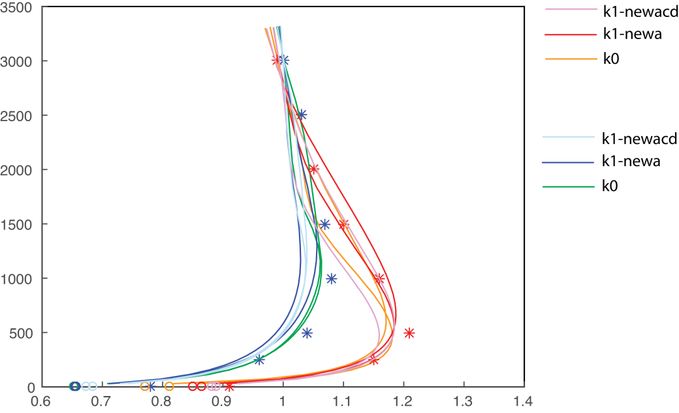

Slide 4
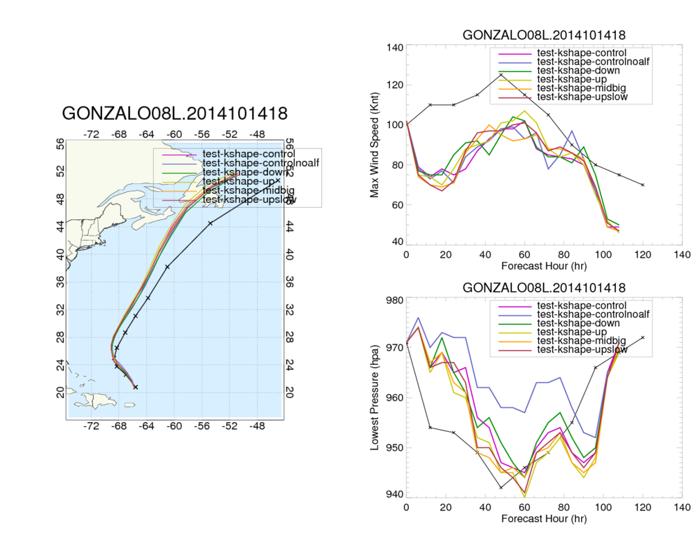

Slide 5
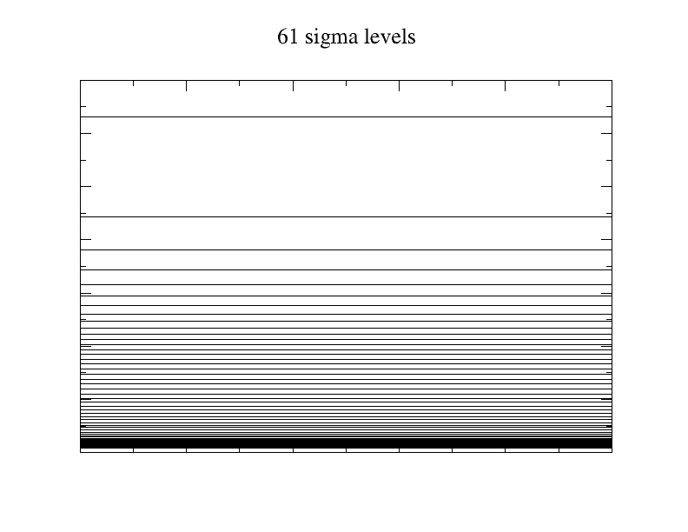
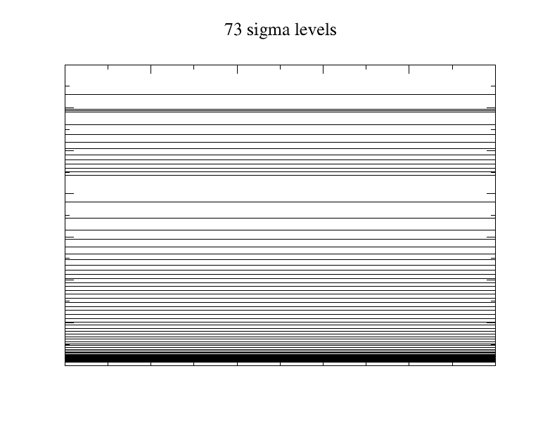
2mb
2mb
10mb
10mb
1000mb
1000mb

Slide 6
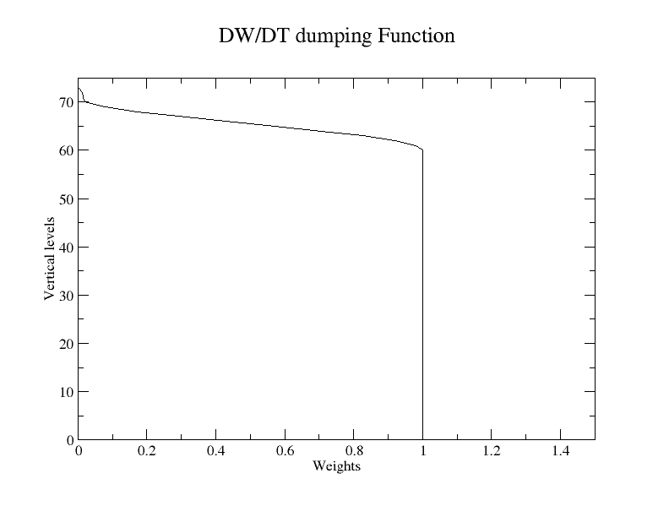
DW/DT Damping, Weights as Function of Vertical Levels

