Slide 1
FY16 baseline (H16C) update
Outlier analysis - H16C vs H16B: Impact of FY16 baseline
- H16C vs H215: Impact of FY16 baseline and new GFS
(#Case AL:242, EP:458)

Slide 2
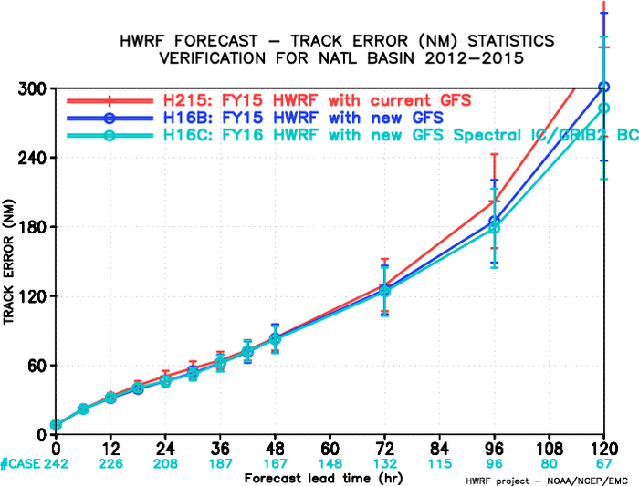
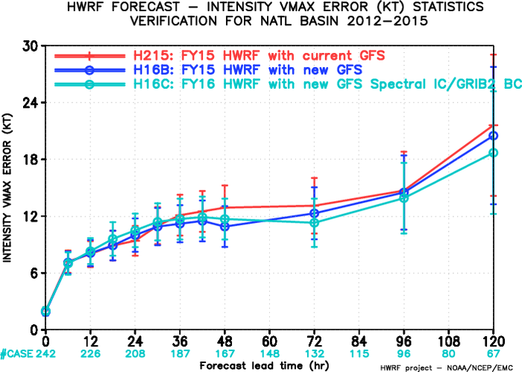
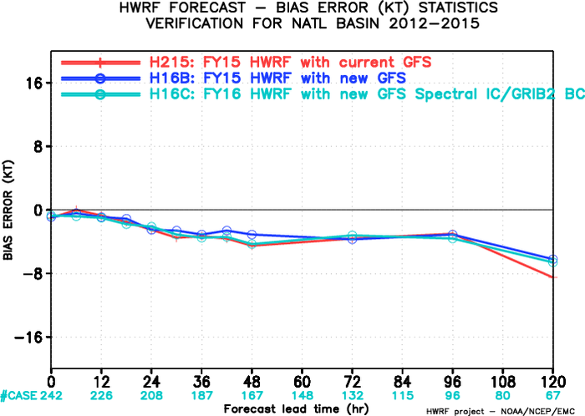
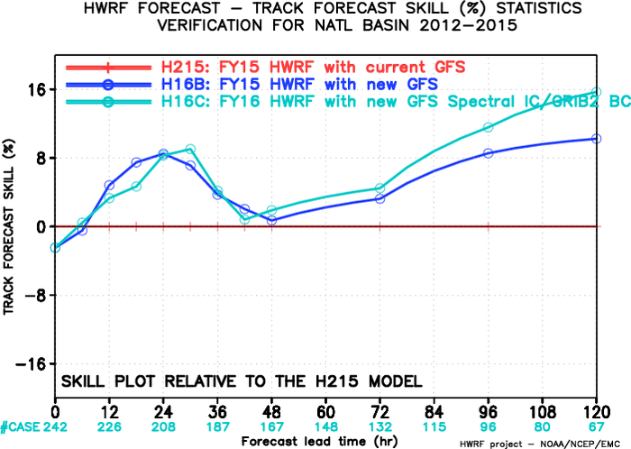
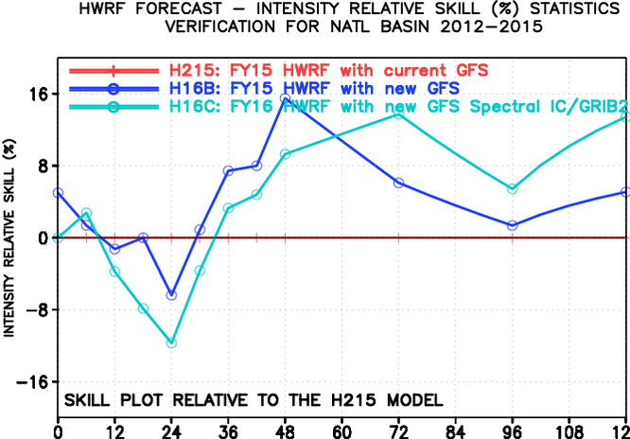
H215/H16B/H16C, NATL, 2012-2015
21.6
20.5
18.7
Compared to H16B, H16C track and intensity forecasts indicated positive impacts beyond day 3.
Compared to H215, H16C track forecasts showed neutral impacts before day 3 but significant improvements at day 4 and 5. H16C intensity forecast indicated a degradation at 24h but significant improvements beyond day 3.
Improvement
Degradation
H16C vs H16B
H16C vs H215

Slide 3
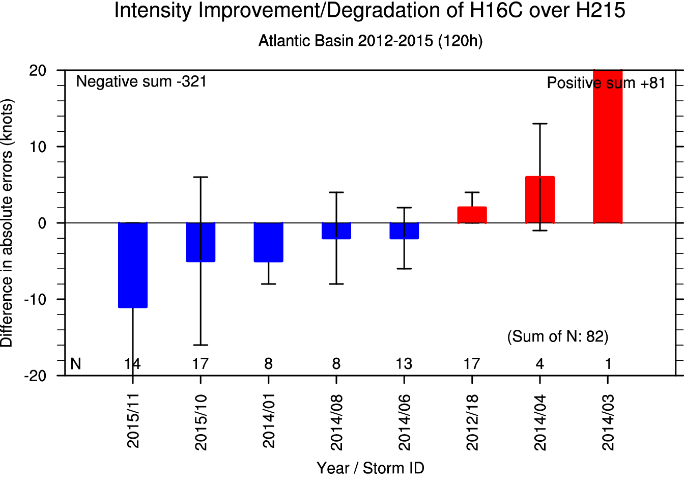
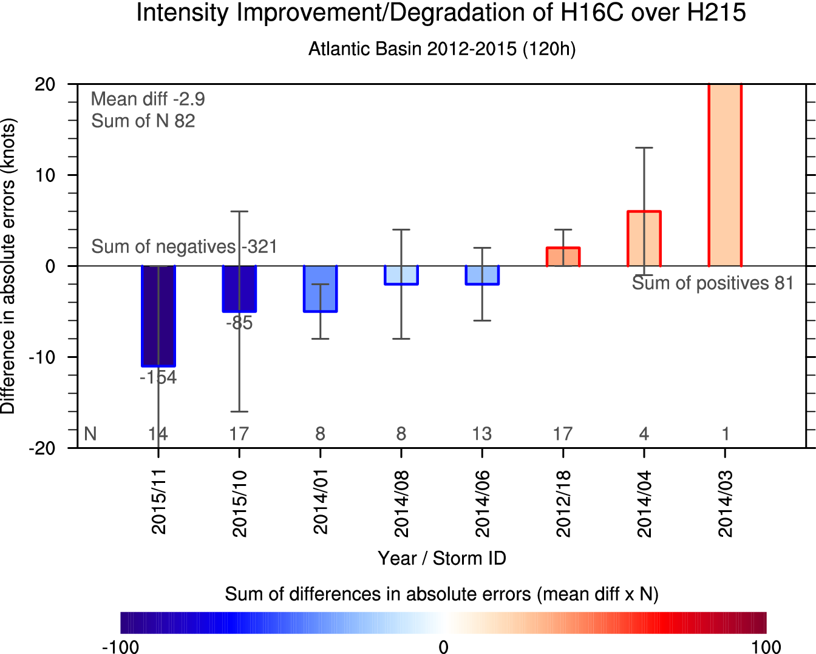
Method: Per-storm evaluation of improve/degrade
21.6
18.7
Previous (y-axis: mean/CI)
Current (y-axis: mean/CI, shaded: sum)
Improvement
2015/11*
2015/10
2015/11*
mean+95% CI
mean
2014/03*
mean-95% CI
Degradation
Bold: significant improvement or degradation
*: notable storm which led the performance
Previous graph shows mean difference in absolute errors between H16C and H215. In terms of mean value, 2015 11L and 2014 03L storms seem to be significant on each side, improvement and degradation. However, 2014 03L has just one sample. This means that 2014 03L is not notable storm which leads the performance because its sum is not larger than other storms. By adding sum values (shaded) to the graph, notable storms with large mean and sum of differences can be easily distinguished from the storms with only large mean differences.

Slide 4
NATL

Slide 5
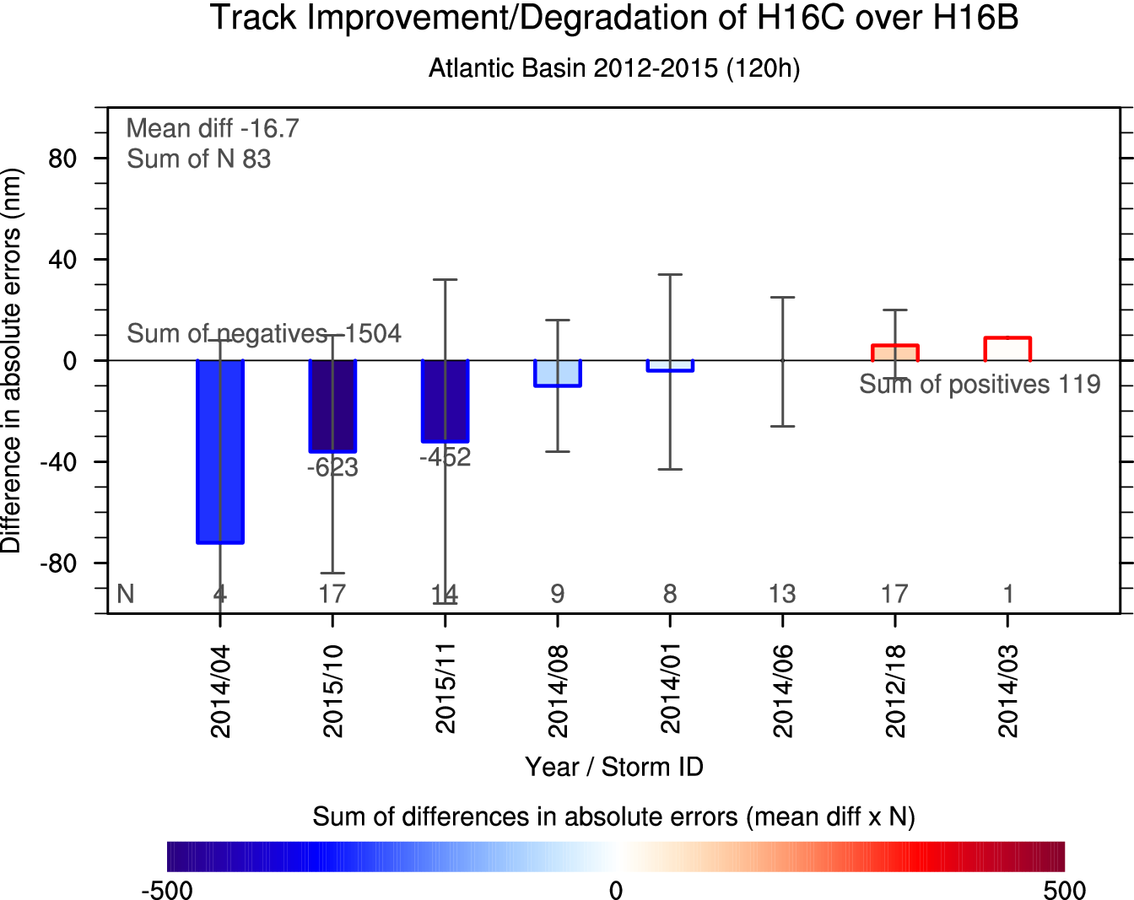
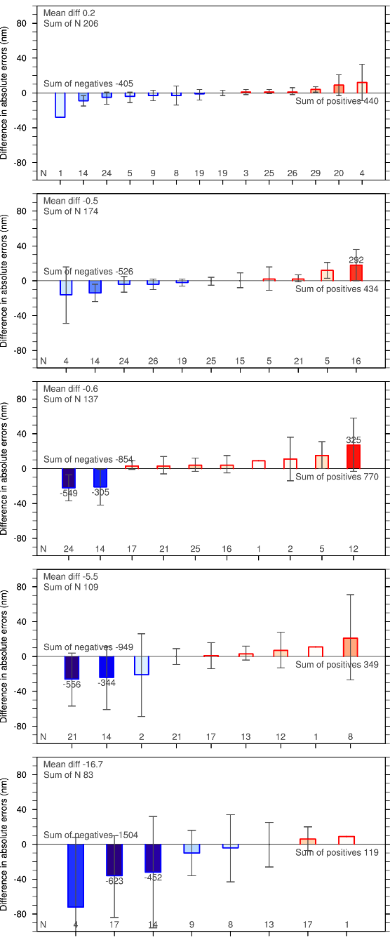
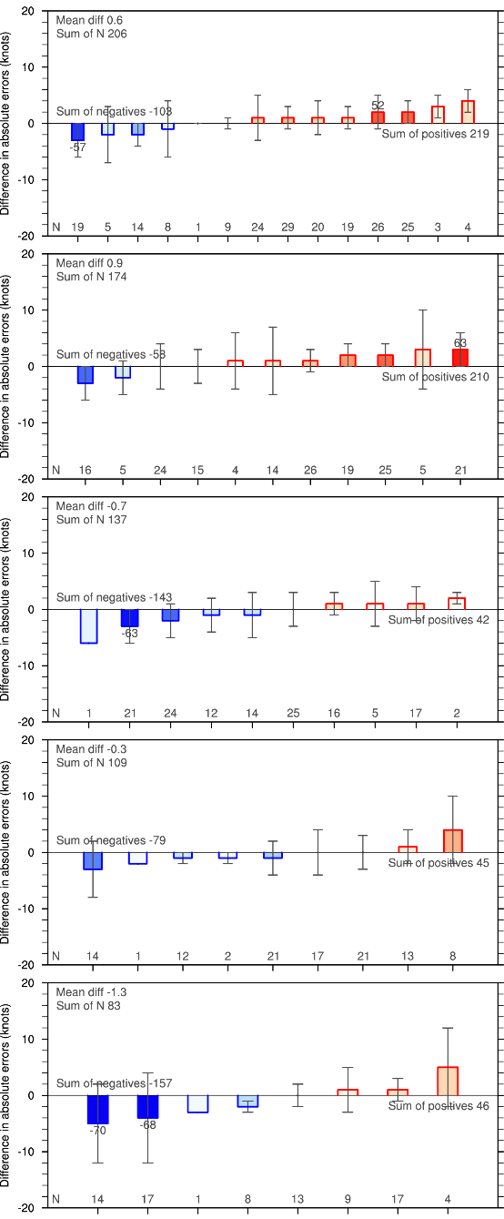
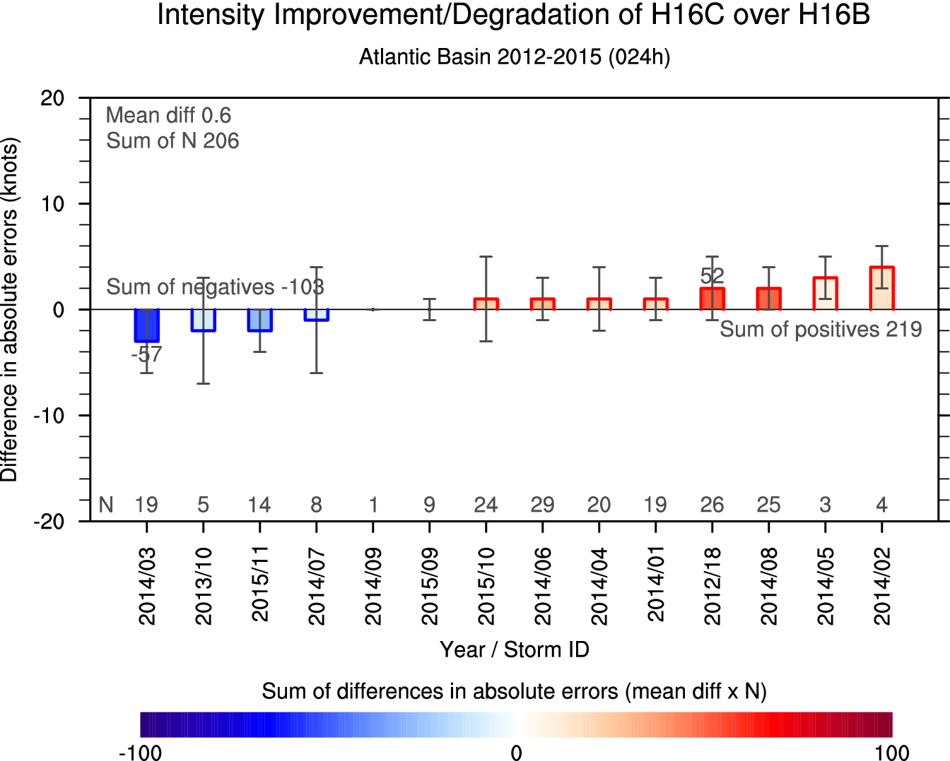
Imprv/Degrd of H16C over H16B
Track
Intensity
Track
Intensity
24h
24h
2014/08*
2012/18
48h
48h
2014/04
2014/08*
2014/06
2015/10*
2015/11*
2014/06
72h
72h
2014/04
2015/10*
2015/11*
96h
96h
2014/04
2015/10*
2015/11*
2015/10*
2015/11*
120h
120h
Although Ida (2015 10L) and Joaquin (2015 11L) cases didn't yet cover their whole lifetimes (60 and 30%, respectively), these two cases have led to significant improvements in track forecasts beyond 72h and intensity forecast at 120h.

Slide 6
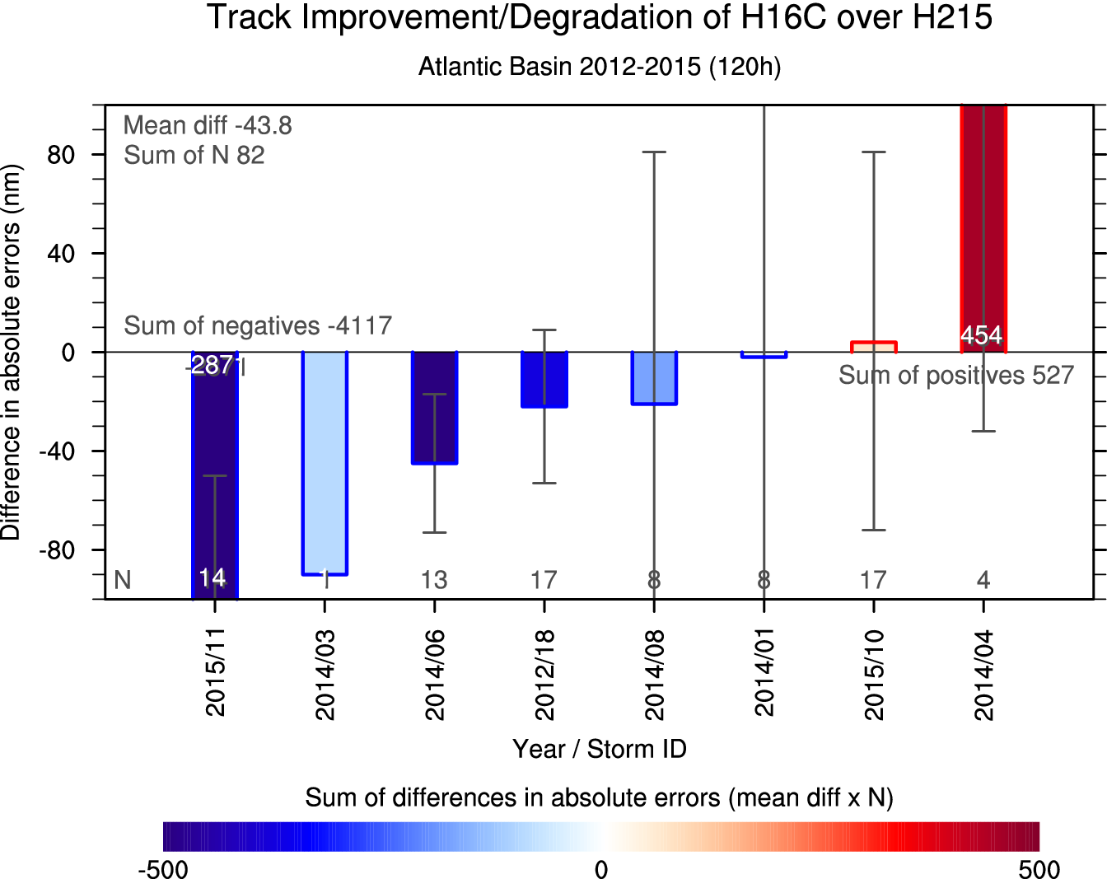
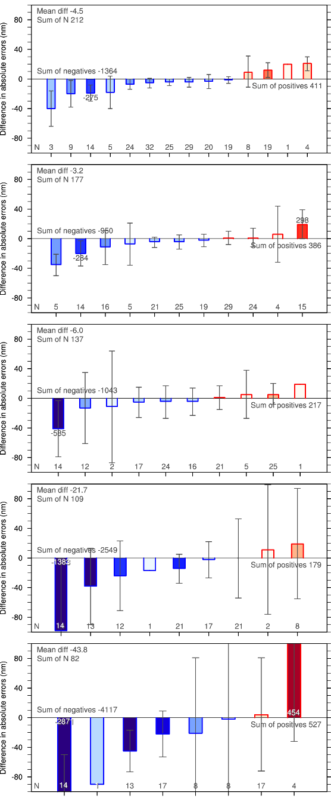
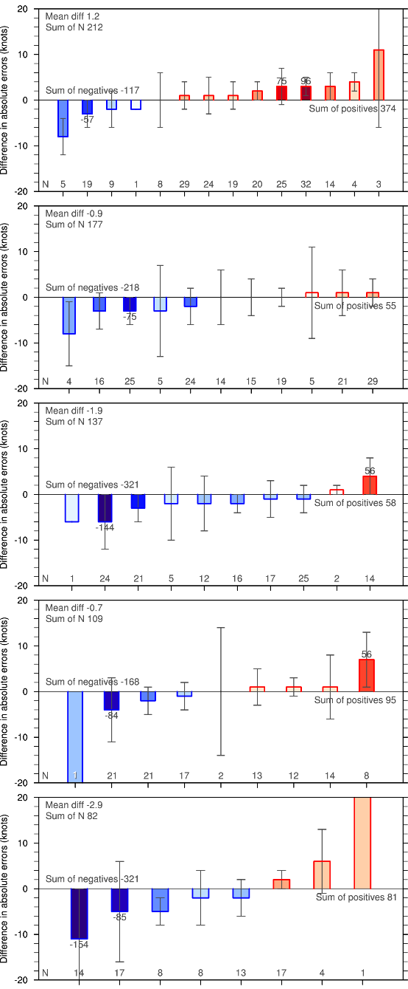
Imprv/Degrd of H16C over H215
Track
Intensity
Track
Intensity
24h
2015/11*
24h
2014/08
2012/18*
48h
2015/11*
2014/06
48h
2014/04
2015/11
2015/11*
2015/10*
2014/06
72h
72h
2015/11
2015/11*
2014/08
96h
2015/10*
96h
2014/04
2015/11*
2014/06
2015/11*
2015/10
120h
120h
2014/04
Joaquin (2015 11L) has led the very significant improvement in track forecast across all lead times (+15% at 120h) and intensity forecast at 120h. Sandy (2012 18L) does not have extensive improvement or degradation (only intensity degradation at 24h).

Slide 7
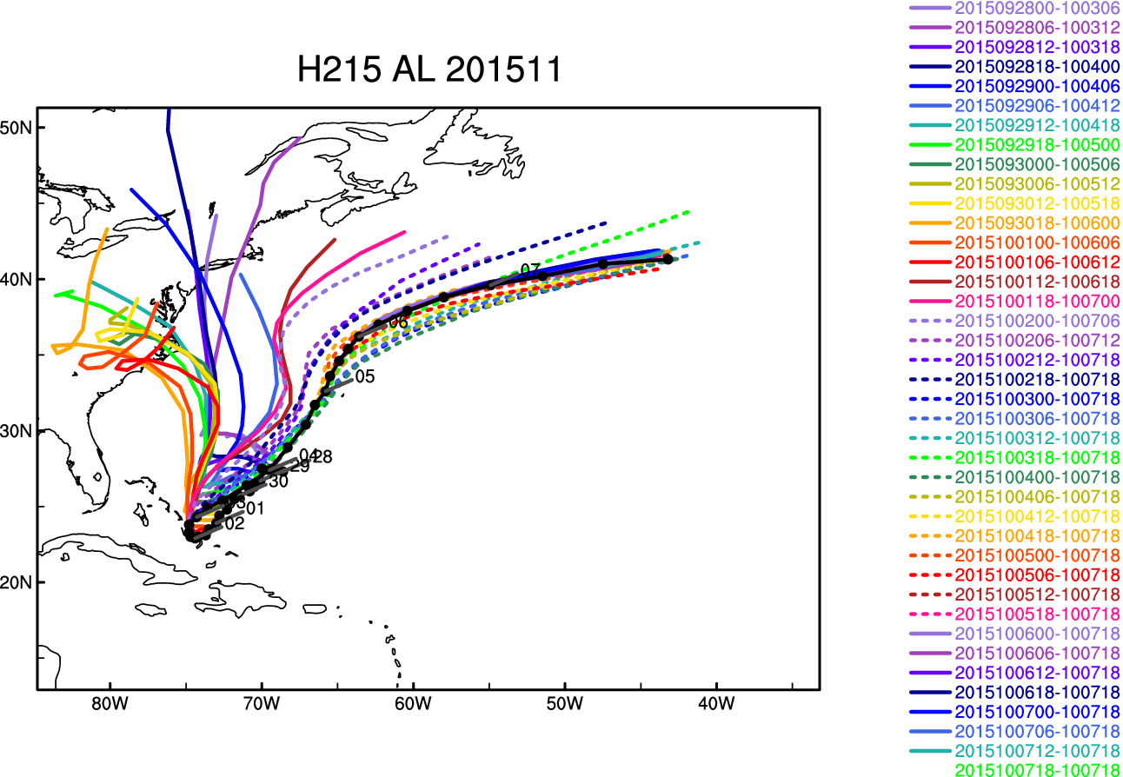
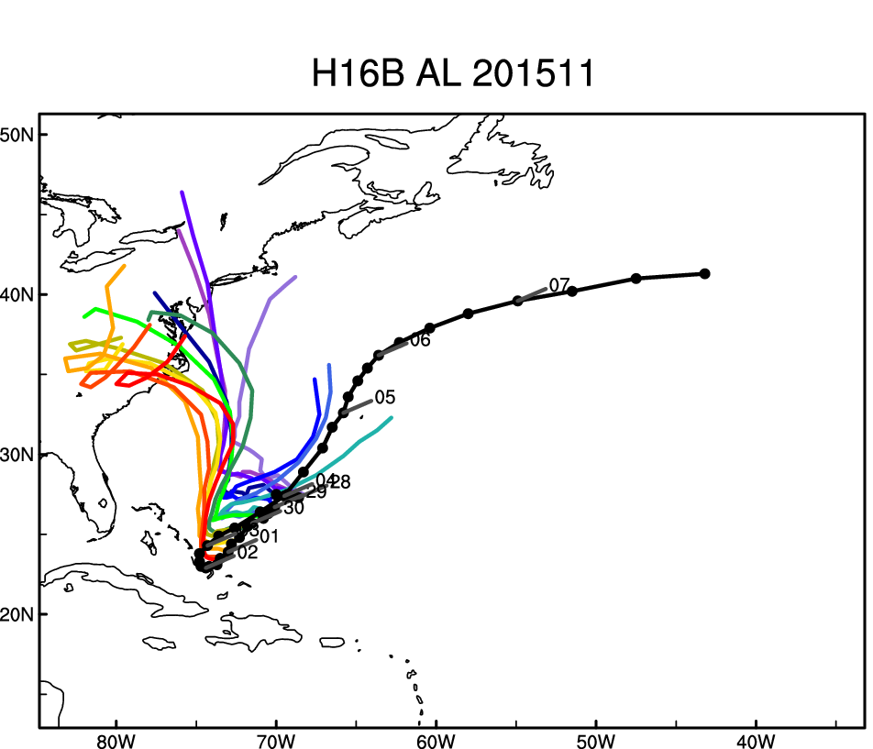
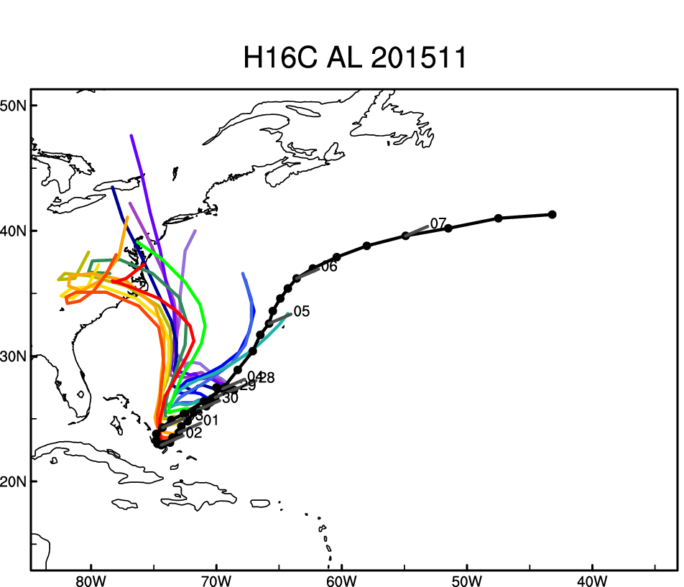
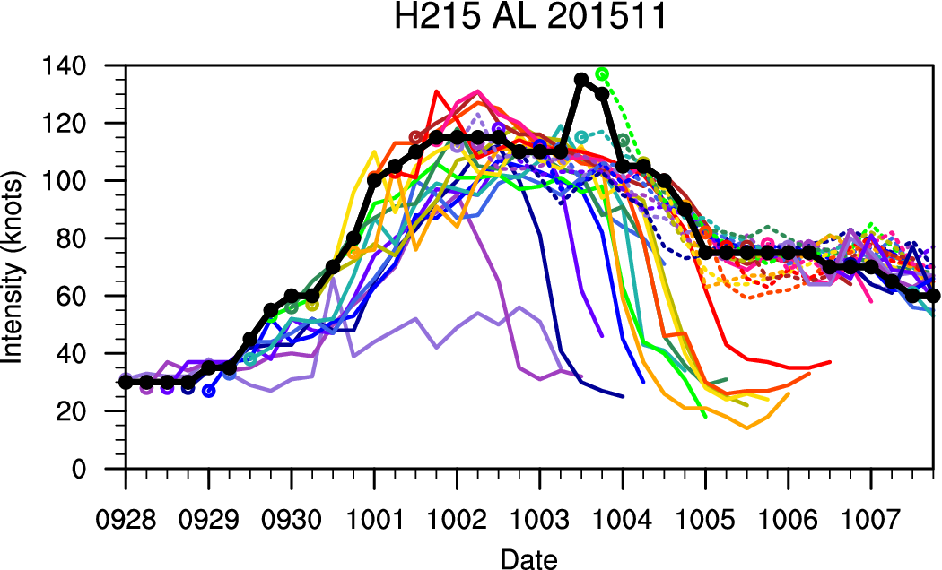
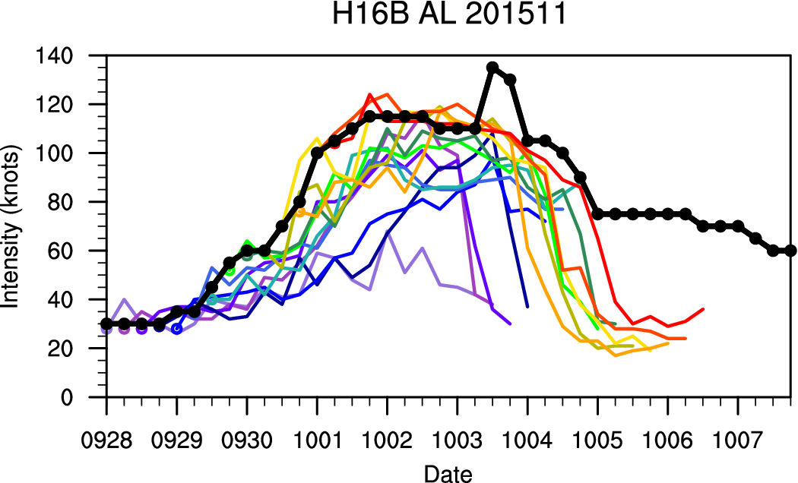
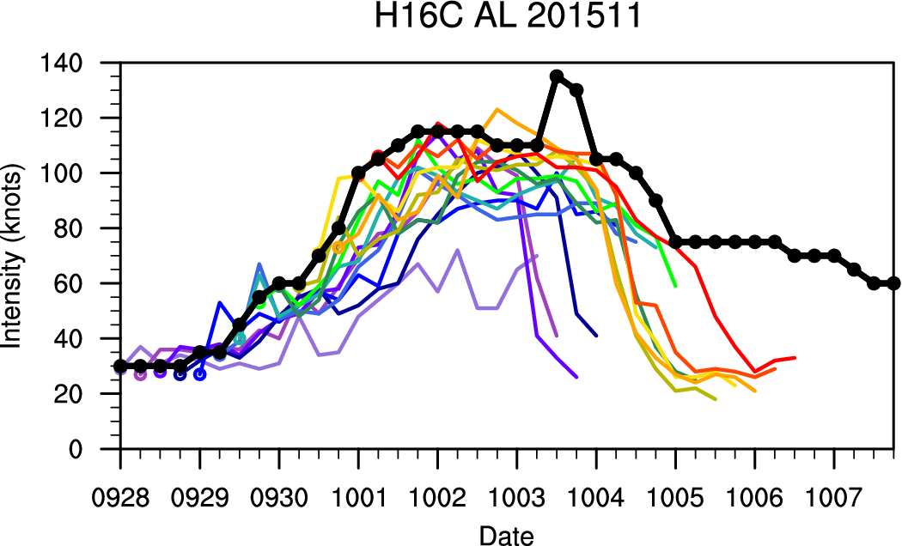
Case: 2015 11L Joaquin
Track fcst (120h)
H16C
– H215
H16C
– H16B
-452
IC: 092800-100718
IC: 092800-100106
IC: 092800-100106
-2871
H16C over H16B: Track forecasts are significantly improved beyond 72h.
H16C over H215: Track forecasts are very significantly improved across all lead times. Especially 120-h track improvement covers 70% of whole negatives (-2871/-4117). Intensity forecast is also improved at 120h.
These two comparisons indicate that the positive impact of new GFS is larger than that of FY16 baseline on track forecast improvement in case of Joaquin.

Slide 8
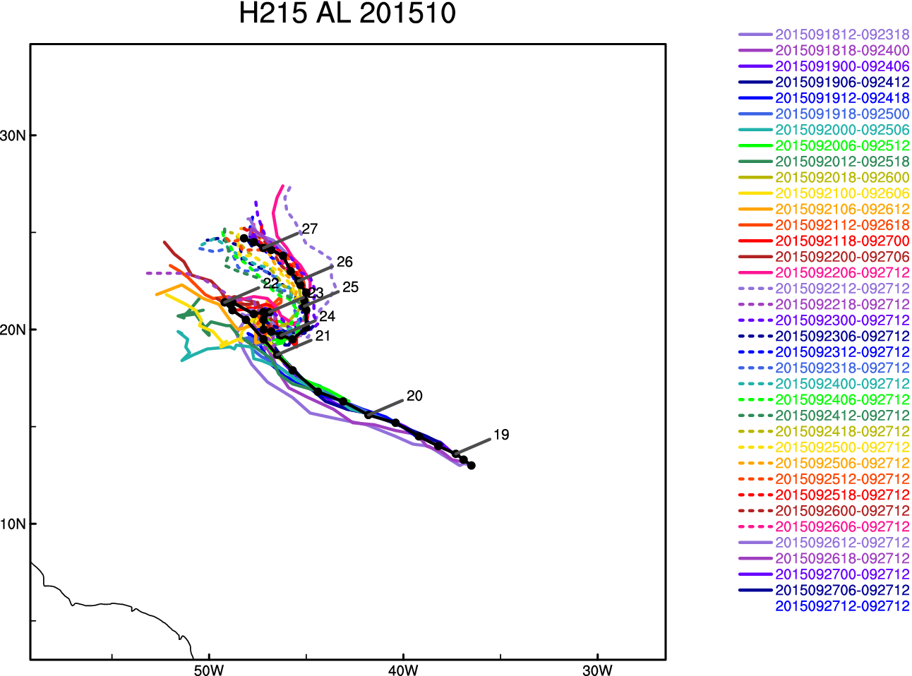
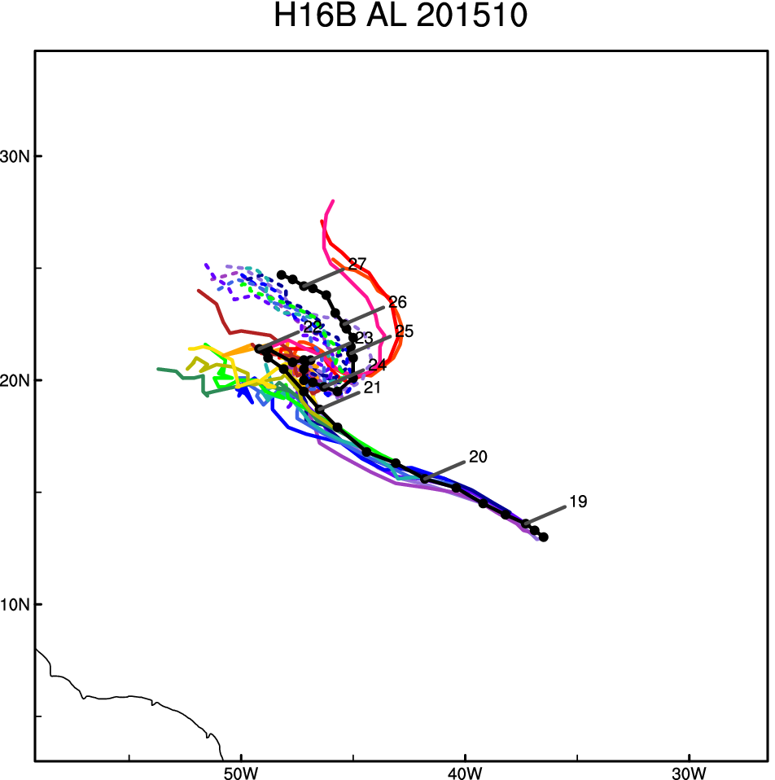
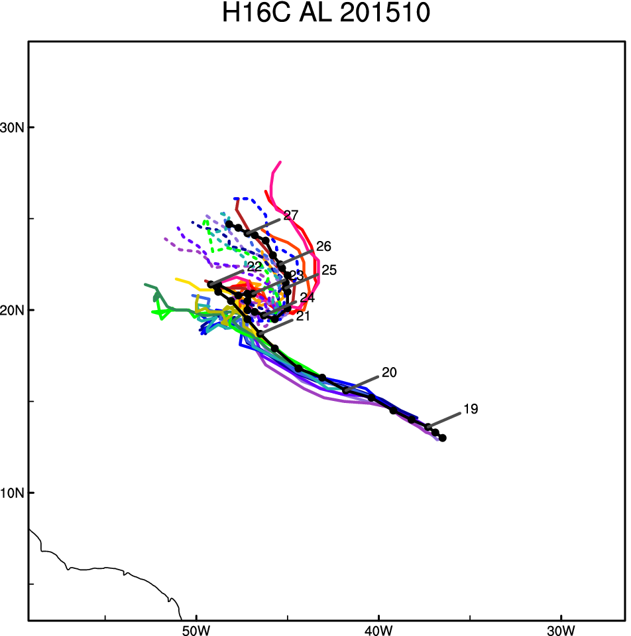
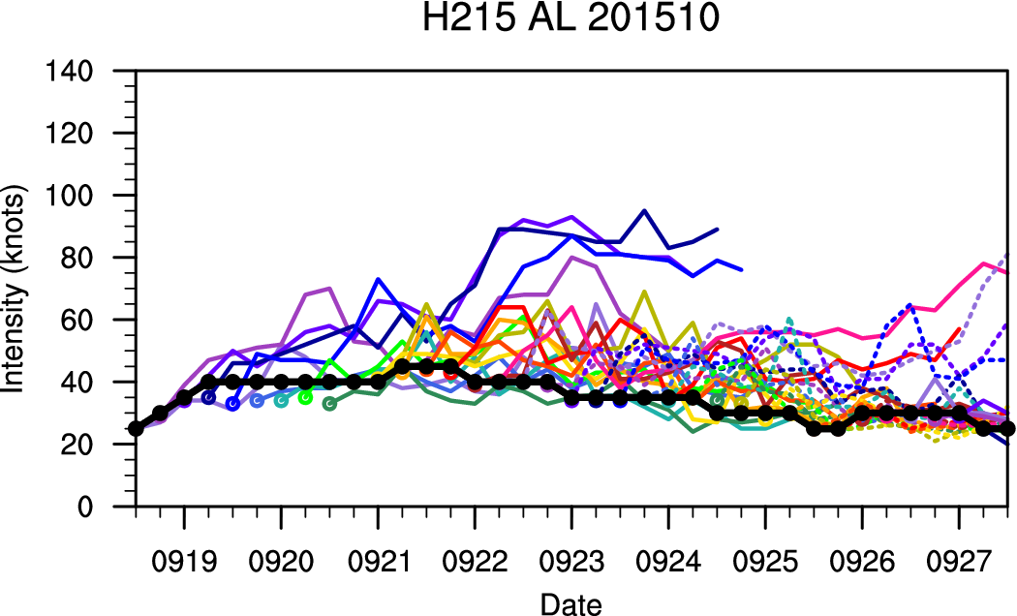
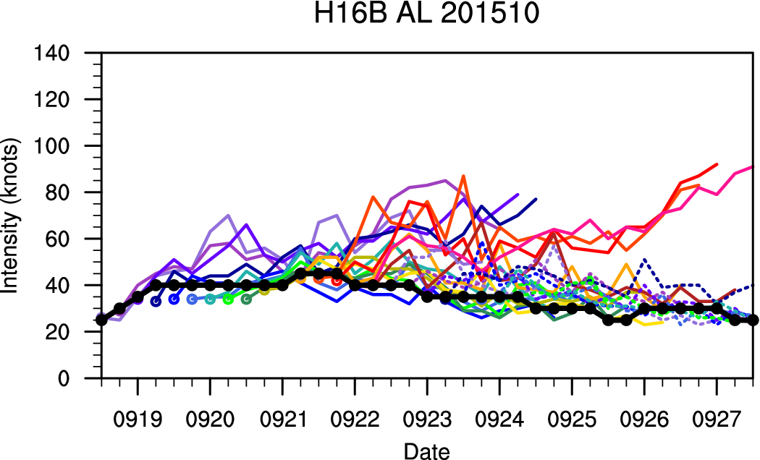
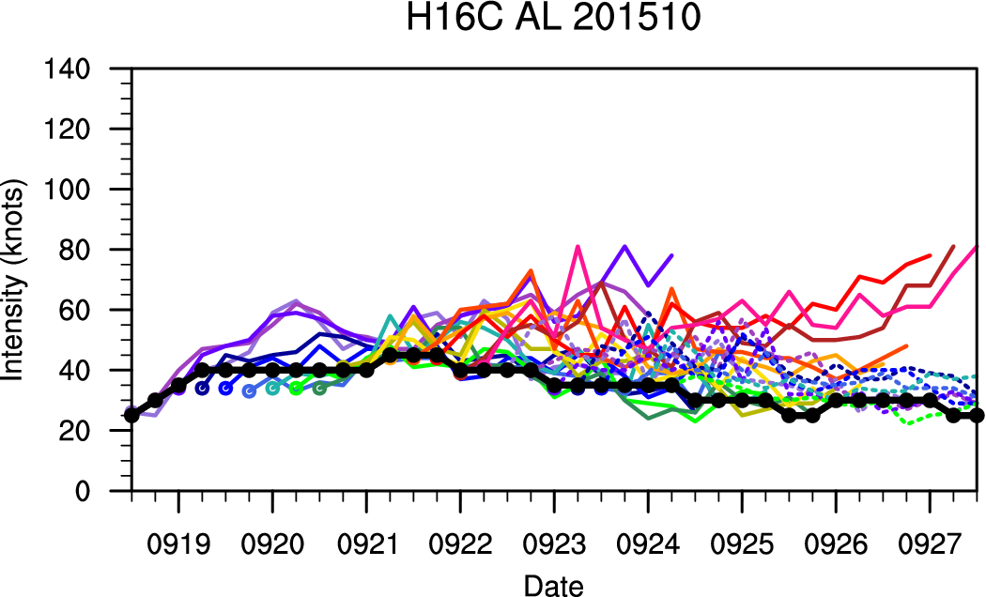
Case: 2015 10L Ida
IC: 091812-092712
IC: 091812-092406
IC: 091812-092406

Slide 9
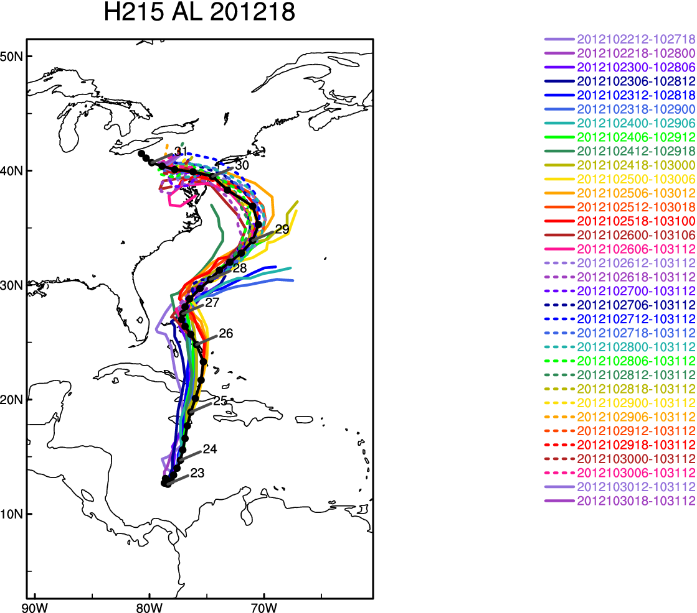
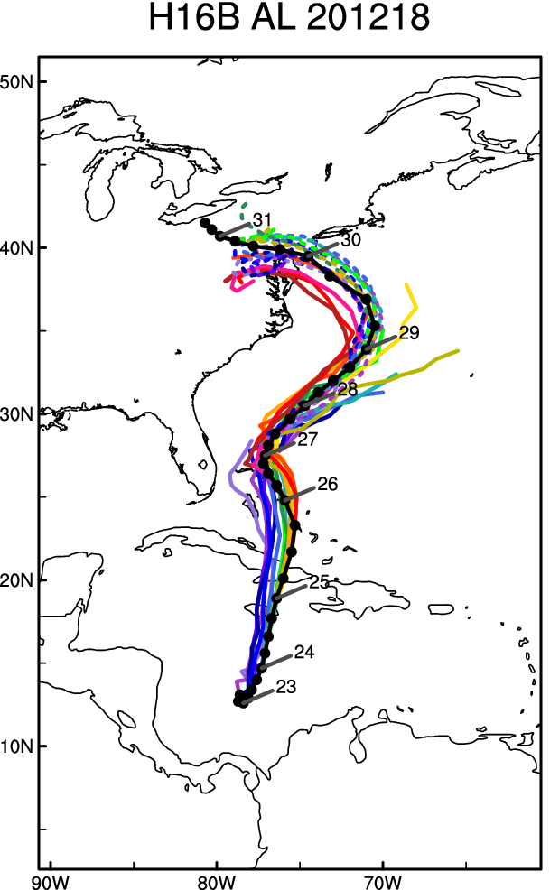
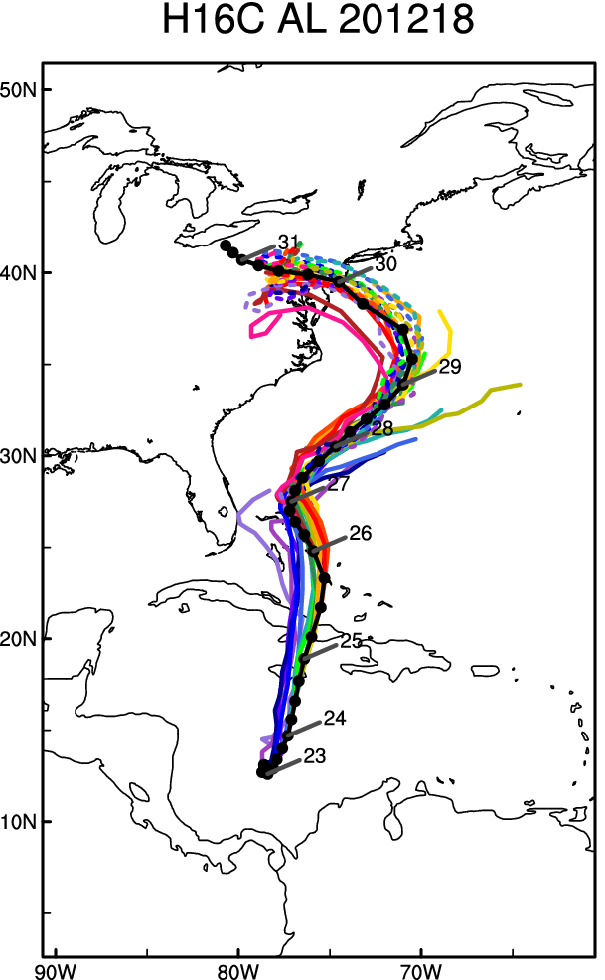
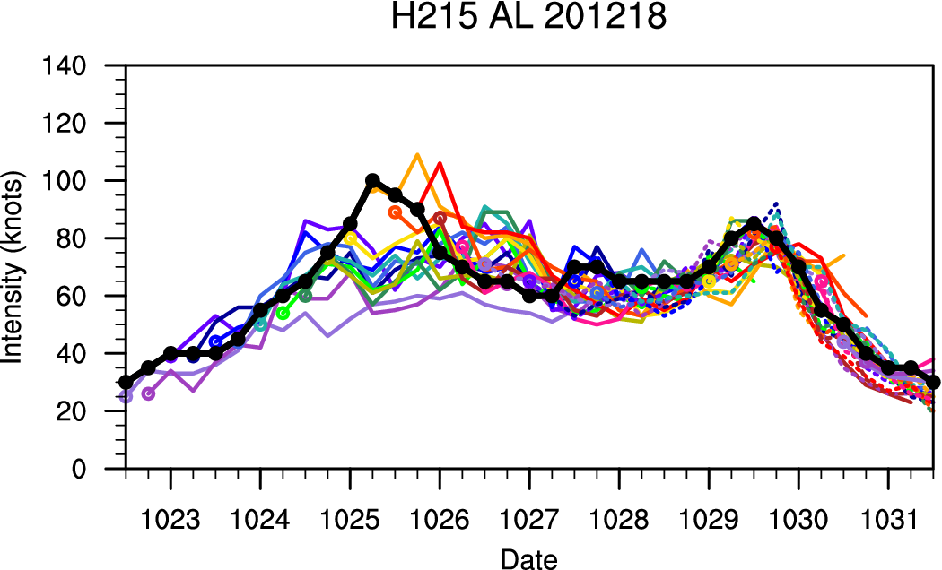
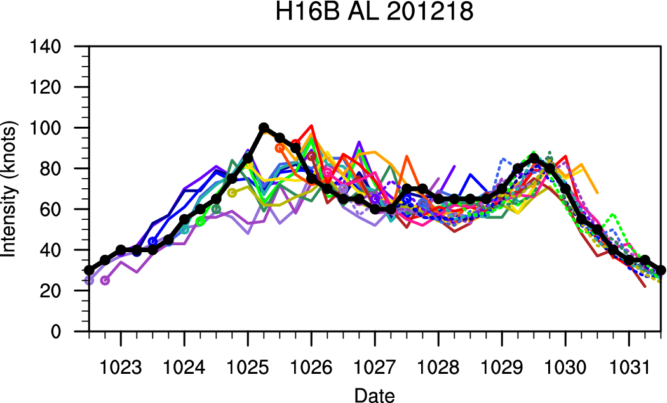
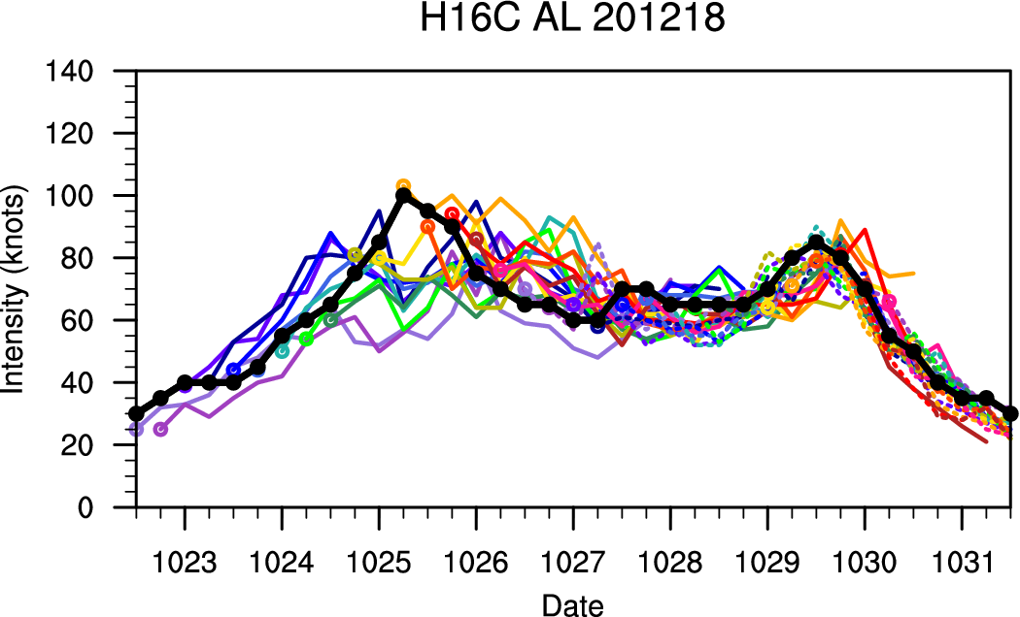
Case: 2012 18L Sandy
IC: 102212-103018
IC: 102212-102818
IC: 102212-103006
Except for the degradation in intensity forecast at 24h, there are no significant differences.

Slide 10
EPAC

Slide 11
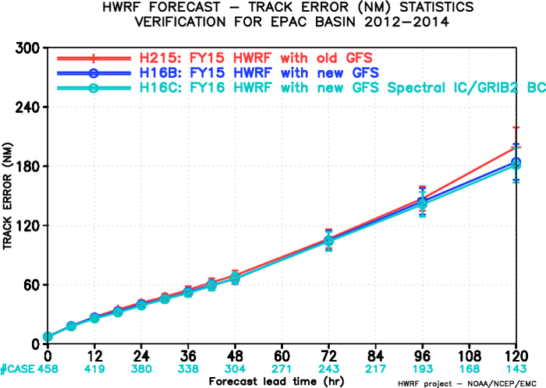
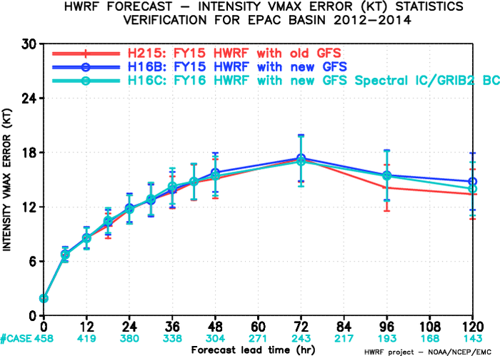
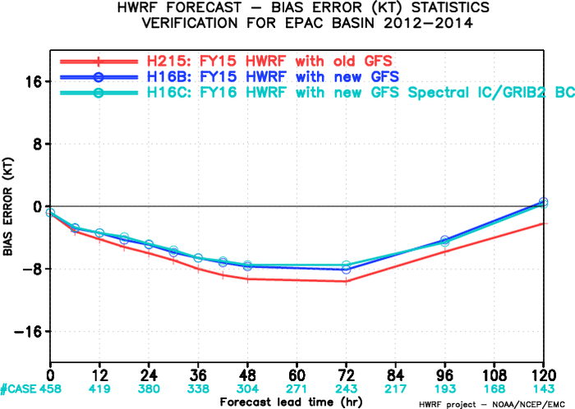
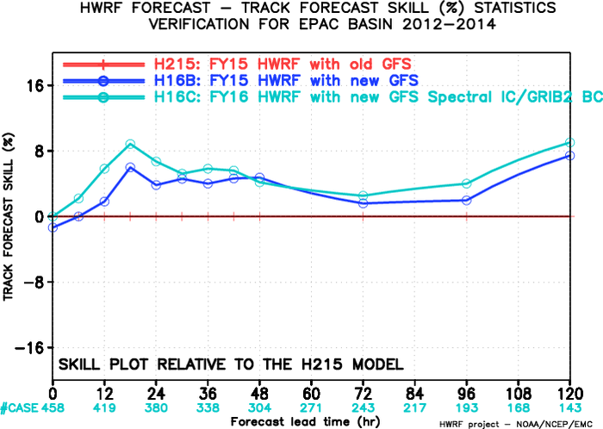
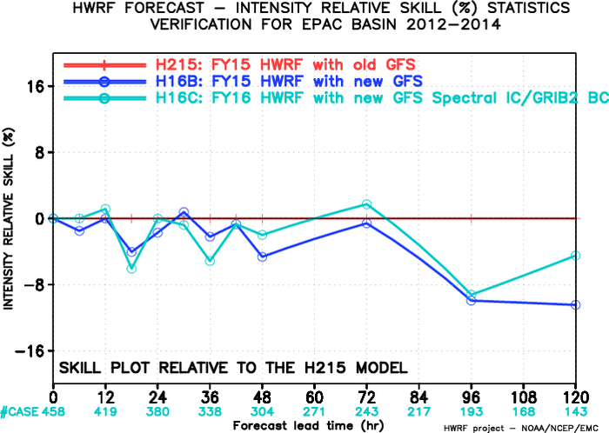
H215/H16B/H16C, EPAC, 2012-2014
H16C track and intensity forecasts indicated positive impacts across forecast lead times.
H16C track forecast showed improvement through all forecast lead times. The impact of H16C on Intensity forecast is somewhat neutral before day 3 but degradation at day 4 and 5.
H16C vs H16B
H16C vs H215

Slide 12
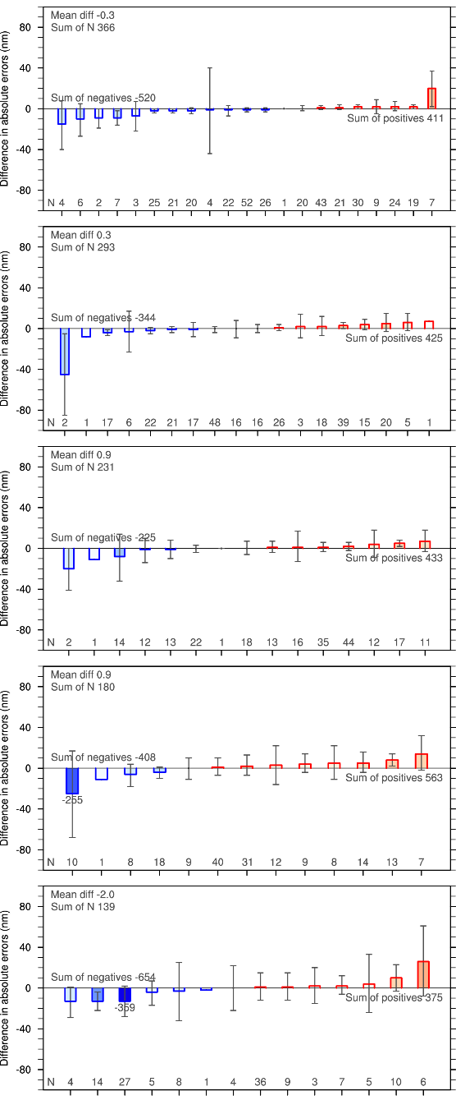
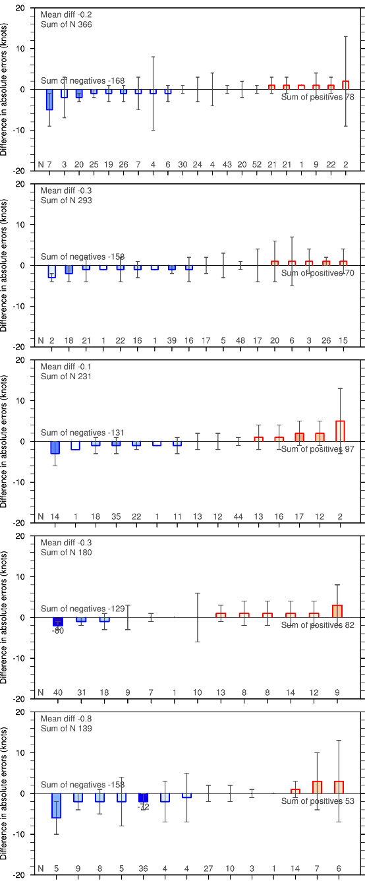
Imprv/Degrd of H16C over H16B
Track
Intensity
Track
Intensity
24h
24h
No notable storm
48h
48h
72h
72h
96h
2014/21
2014/11
96h
No notable storm
120h
2014/10
2014/11
120h
There are no notably improved or degraded storms across all lead times.

Slide 13
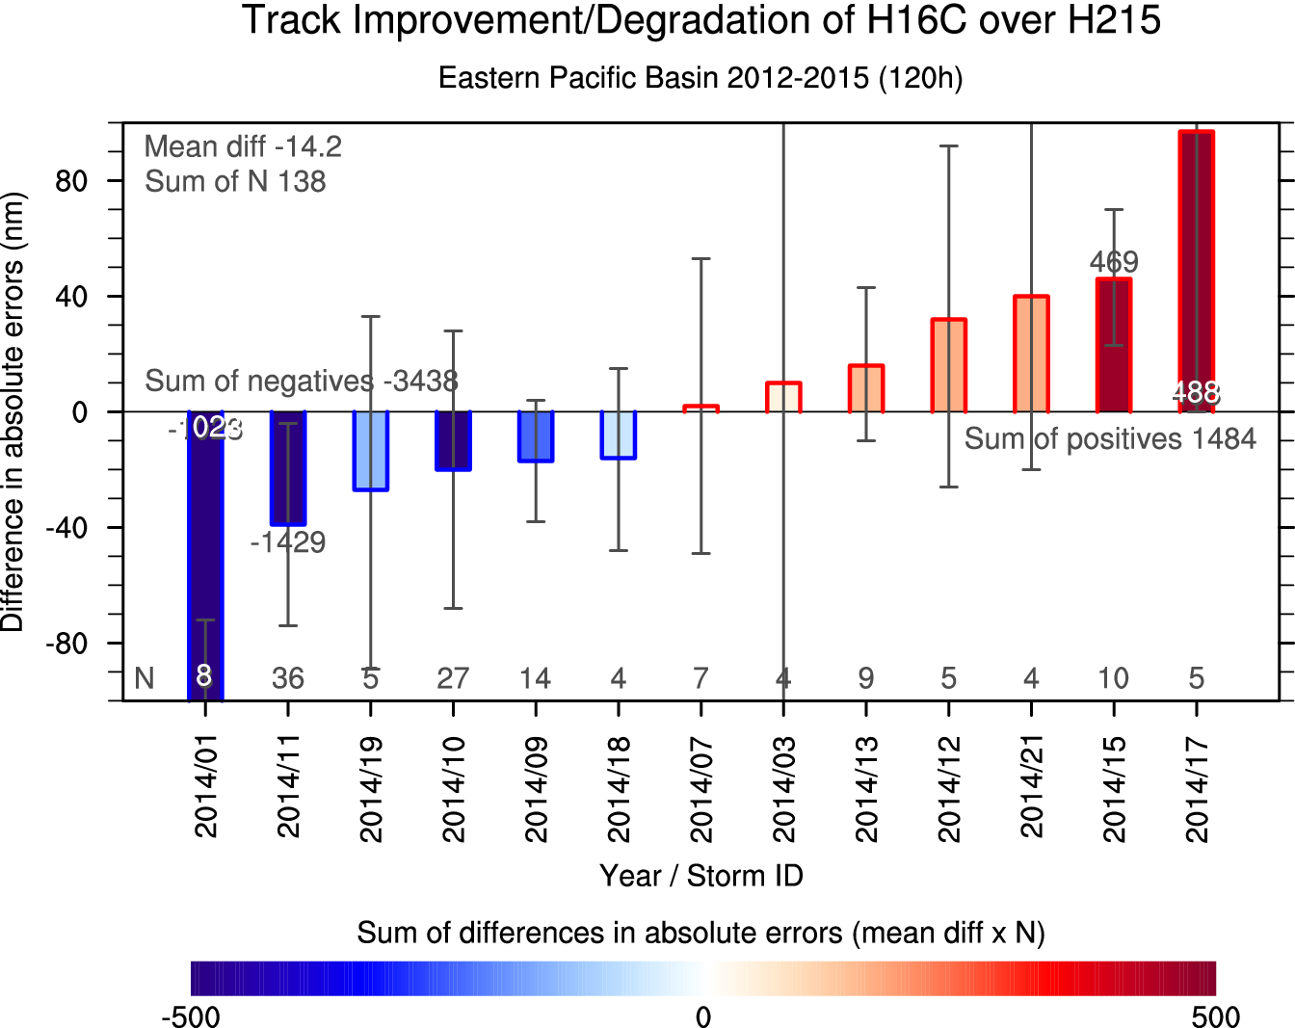
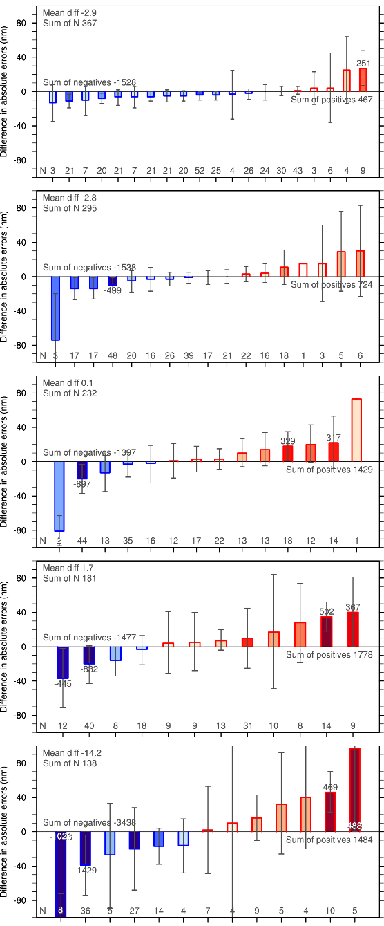
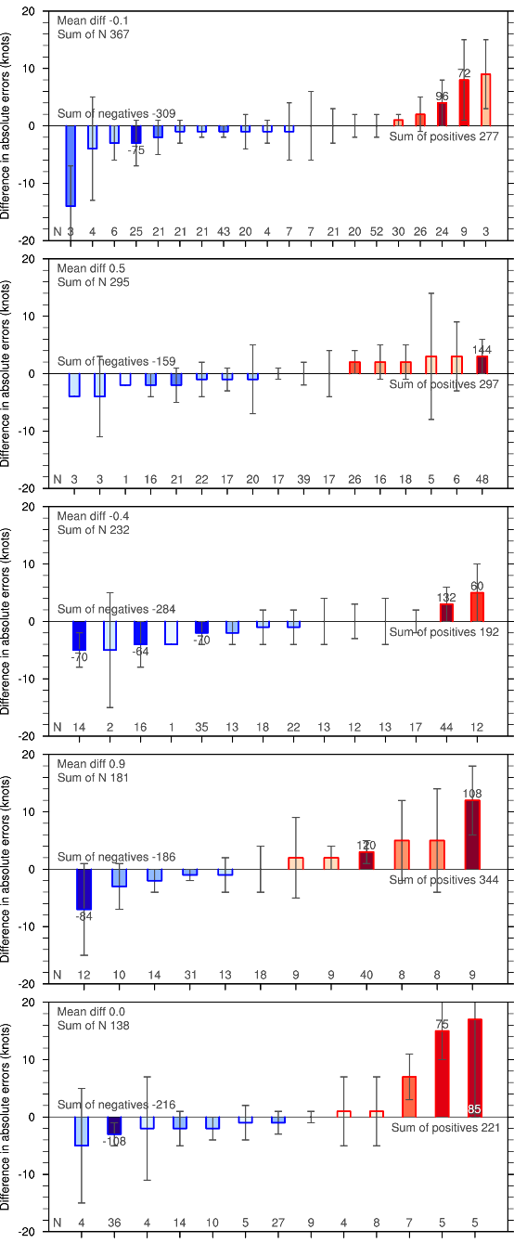
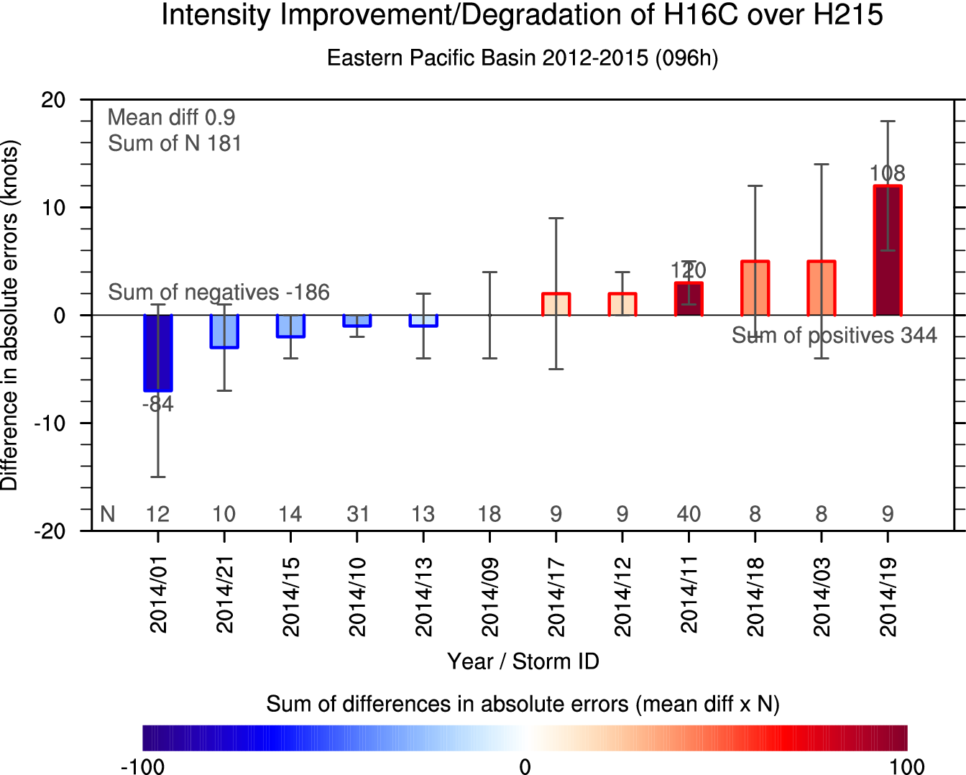
Imprv/Degrd of H16C over H215
Track
Intensity
Track
Intensity
24h
24h
2014/08
2014/01*
48h
2014/11*
48h
2014/11*
2014/11*
2014/21
2014/01*
72h
72h
2014/15
2014/21
2014/03
2014/11*
2014/01*
2014/11*
2014/01*
96h
96h
2014/15
2014/17
2014/19*
2014/11*
2014/01*
2014/11*
120h
2014/11*
120h
2014/17
2014/15
2014/17
2014/19*
Amanda (2014 01E) made a significant contribution to the improvements in the track (96 and 120h) and intensity (72 and 96h) forecasts. Julio (2014 11E) have led the track improvements and intensity degradations beyond 48h.

Slide 14
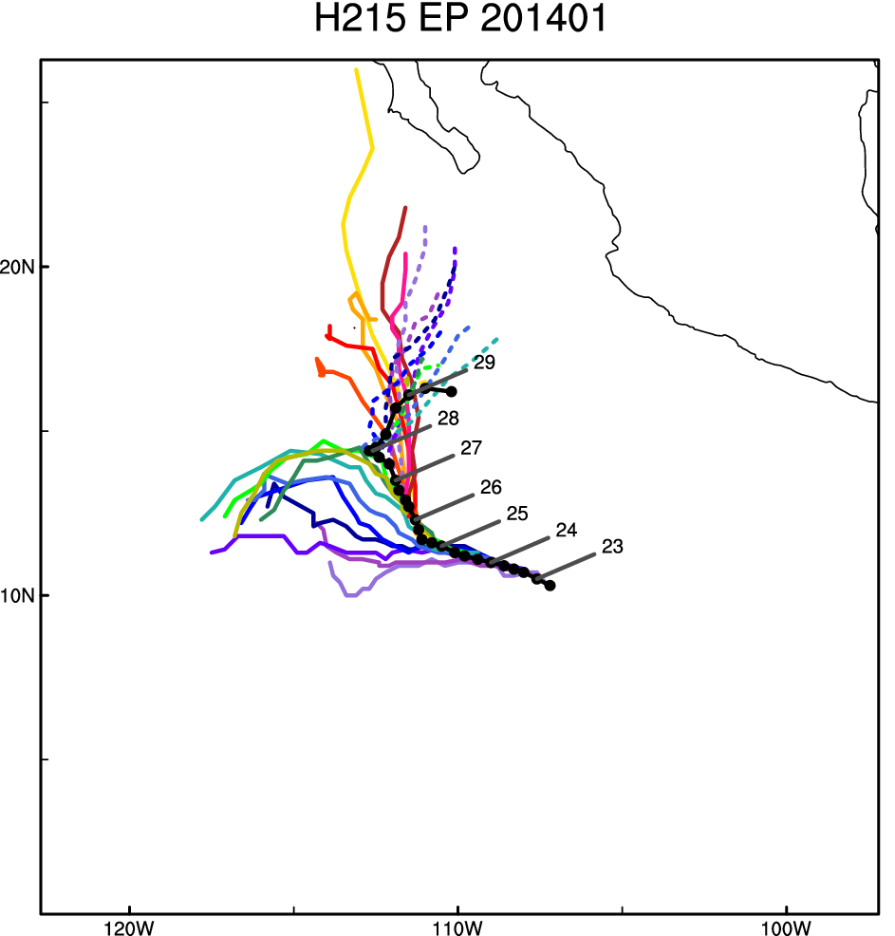
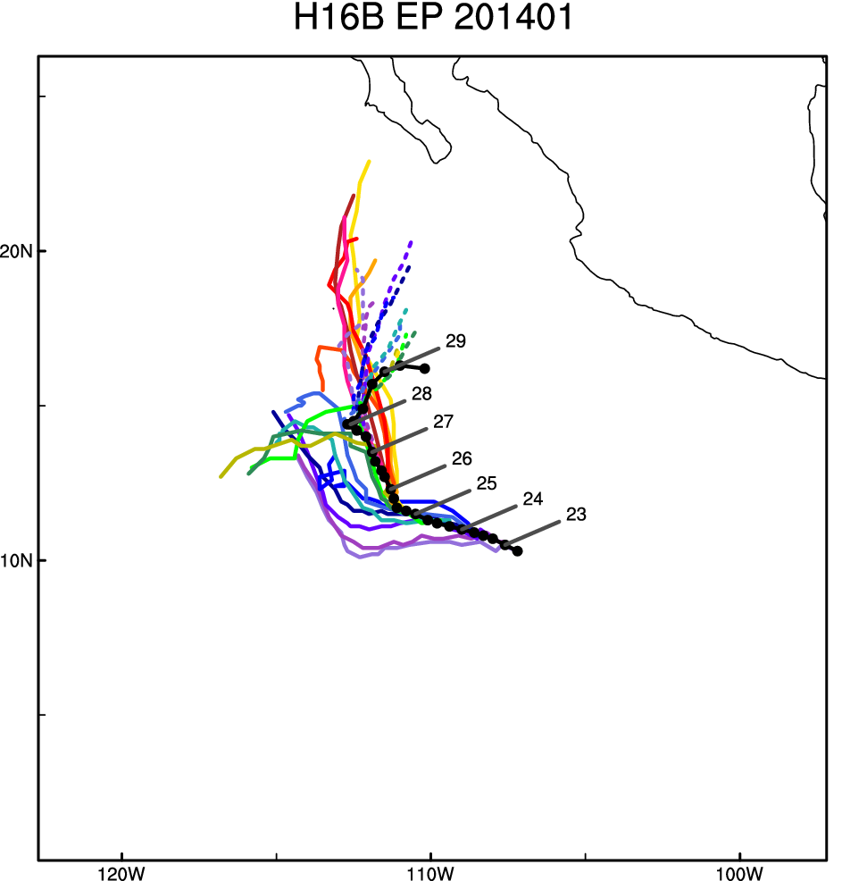
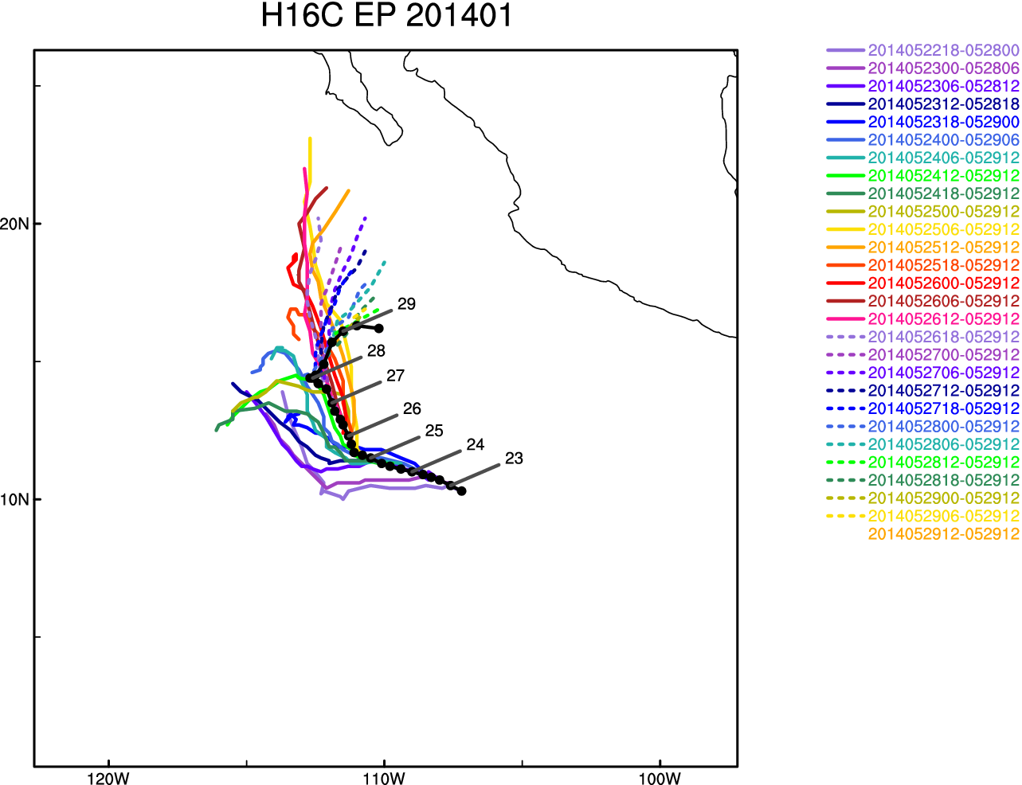
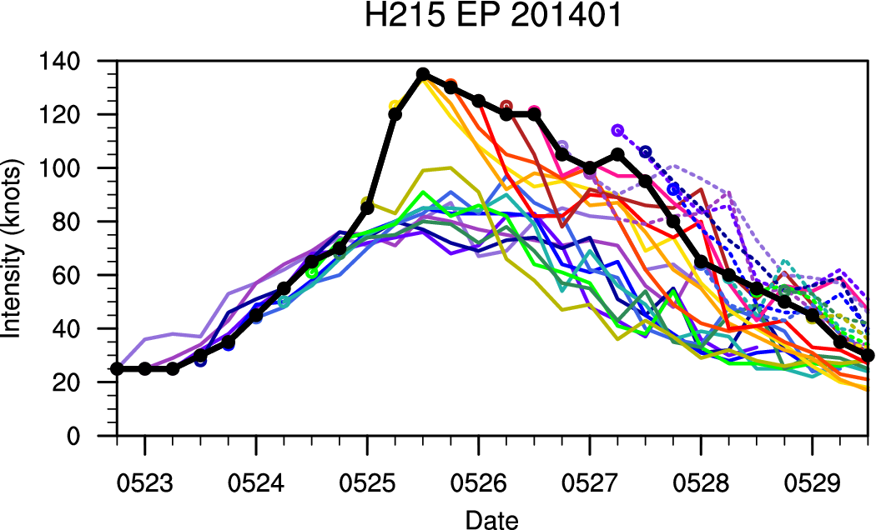
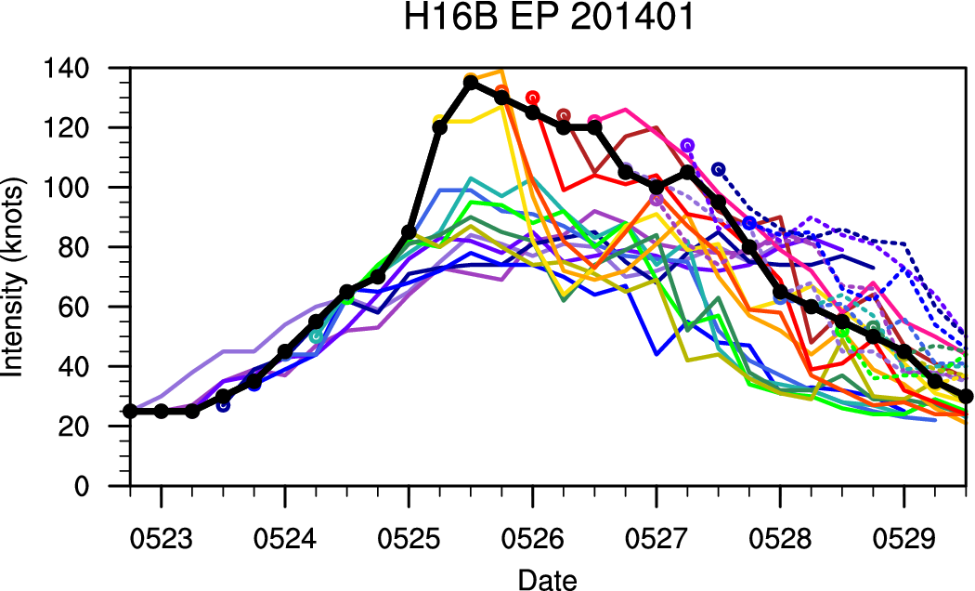
Case: 2014 01E Amanda
H16C over H215: Track forecasts are significantly improved beyond 96h (purple and green lines). In H215, Amanda weakened rapidly due to entering into strong vertical wind shear region and dry air. In H16B and H16C, however, the rapid weakening could be reduced by decrease in westward bias. This indicated that the improvement by new GFS in track forecast could lead to the improvement in intensity forecast.

Slide 15
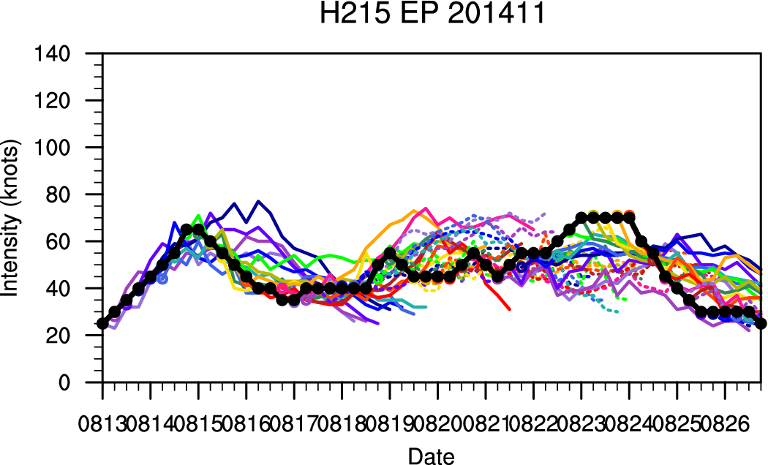
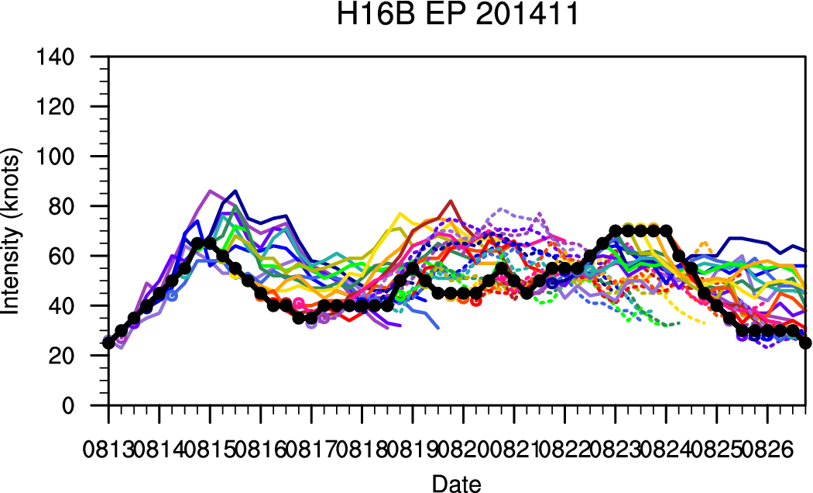
Case: 2014 11E Julio

