Slide 1
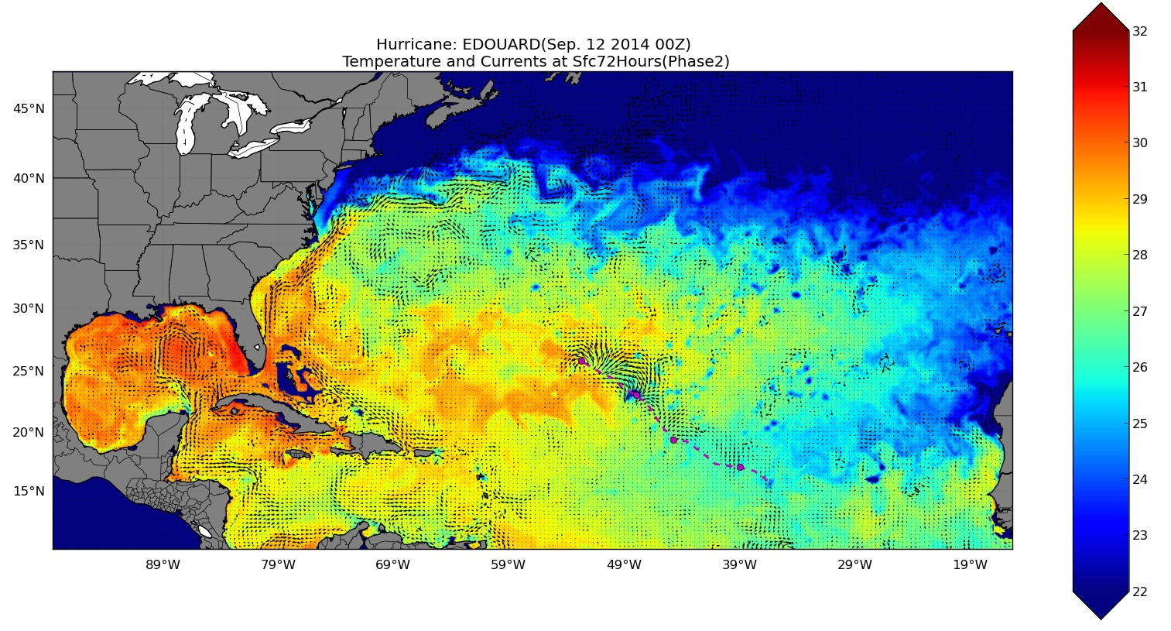
MPIPOM RTOFS Initialization Hurricane Edouard, SST: 72 hrs

Slide 2
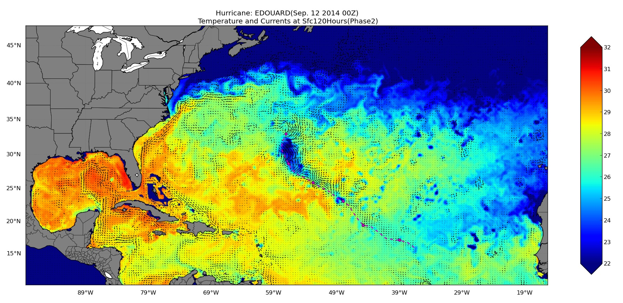
MPIPOM RTOFS Initialization Hurricane Edouard, SST: 120 hrs

Slide 3
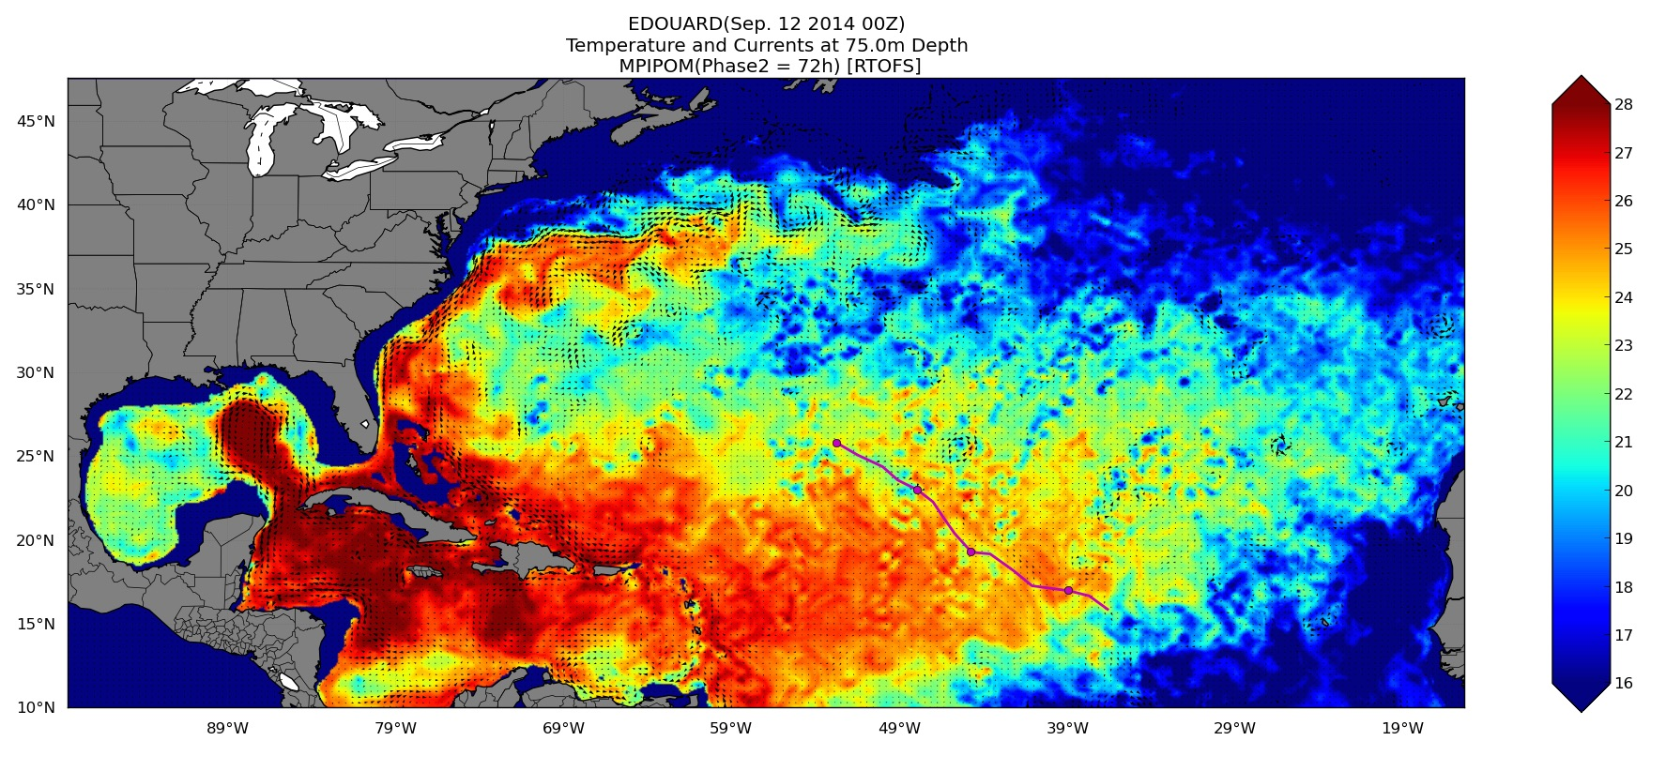
MPIPOM RTOFS Initialization Hurricane Edouard, T at 75 m: 72 hrs

Slide 4
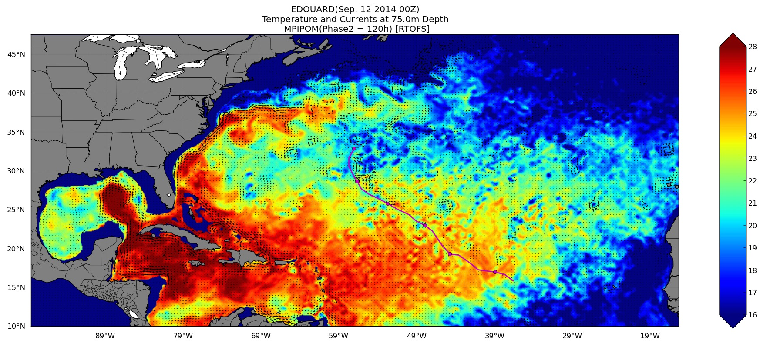
MPIPOM RTOFS Initialization Hurricane Edouard, T at 75 m: 120 hrs

