Slide 1
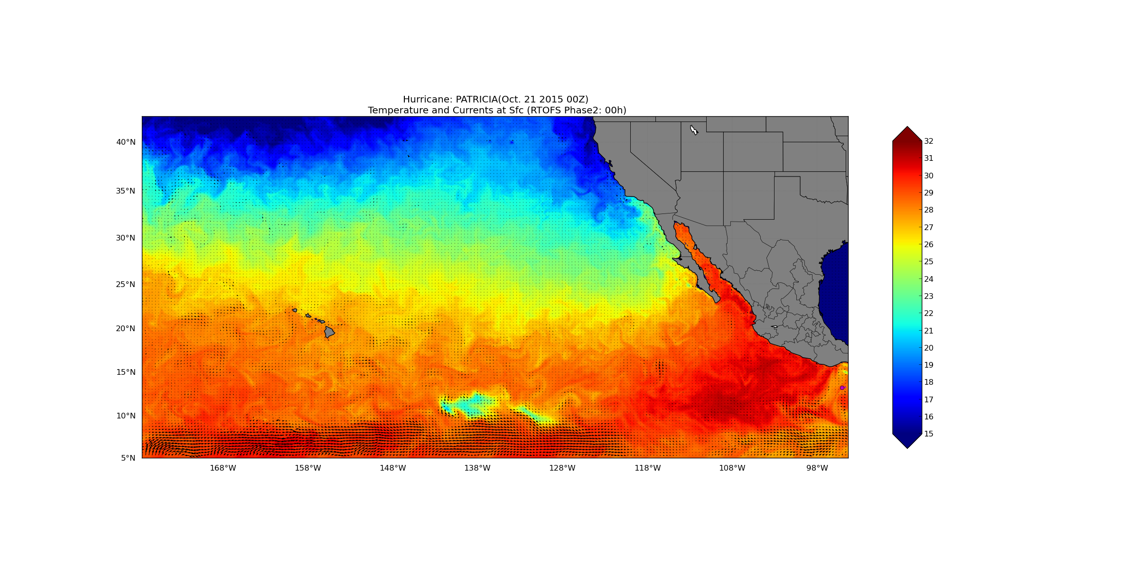
MPIPOM RTOFS Initialization Hurricane Patricia, SST: 0 hrs

Slide 2
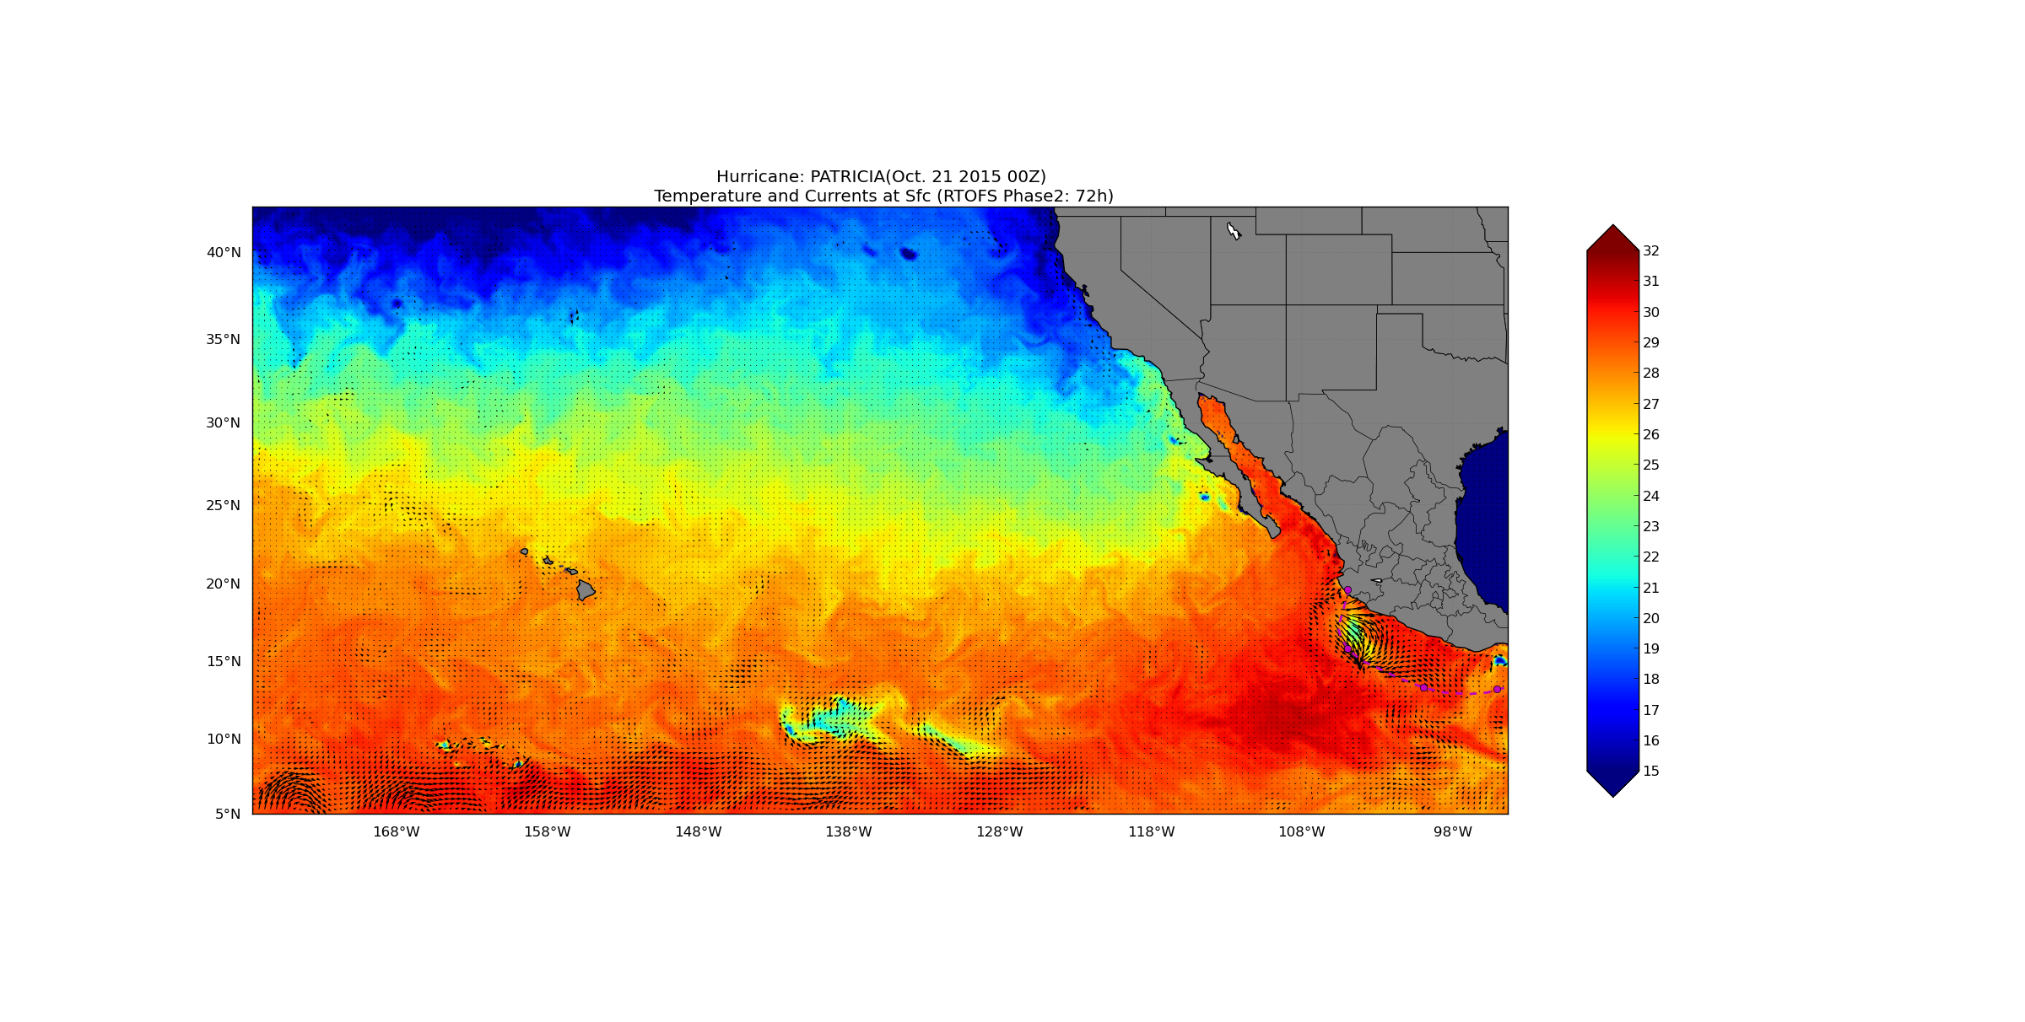
MPIPOM RTOFS Initialization Hurricane Patricia, SST: 72 hrs

Slide 3
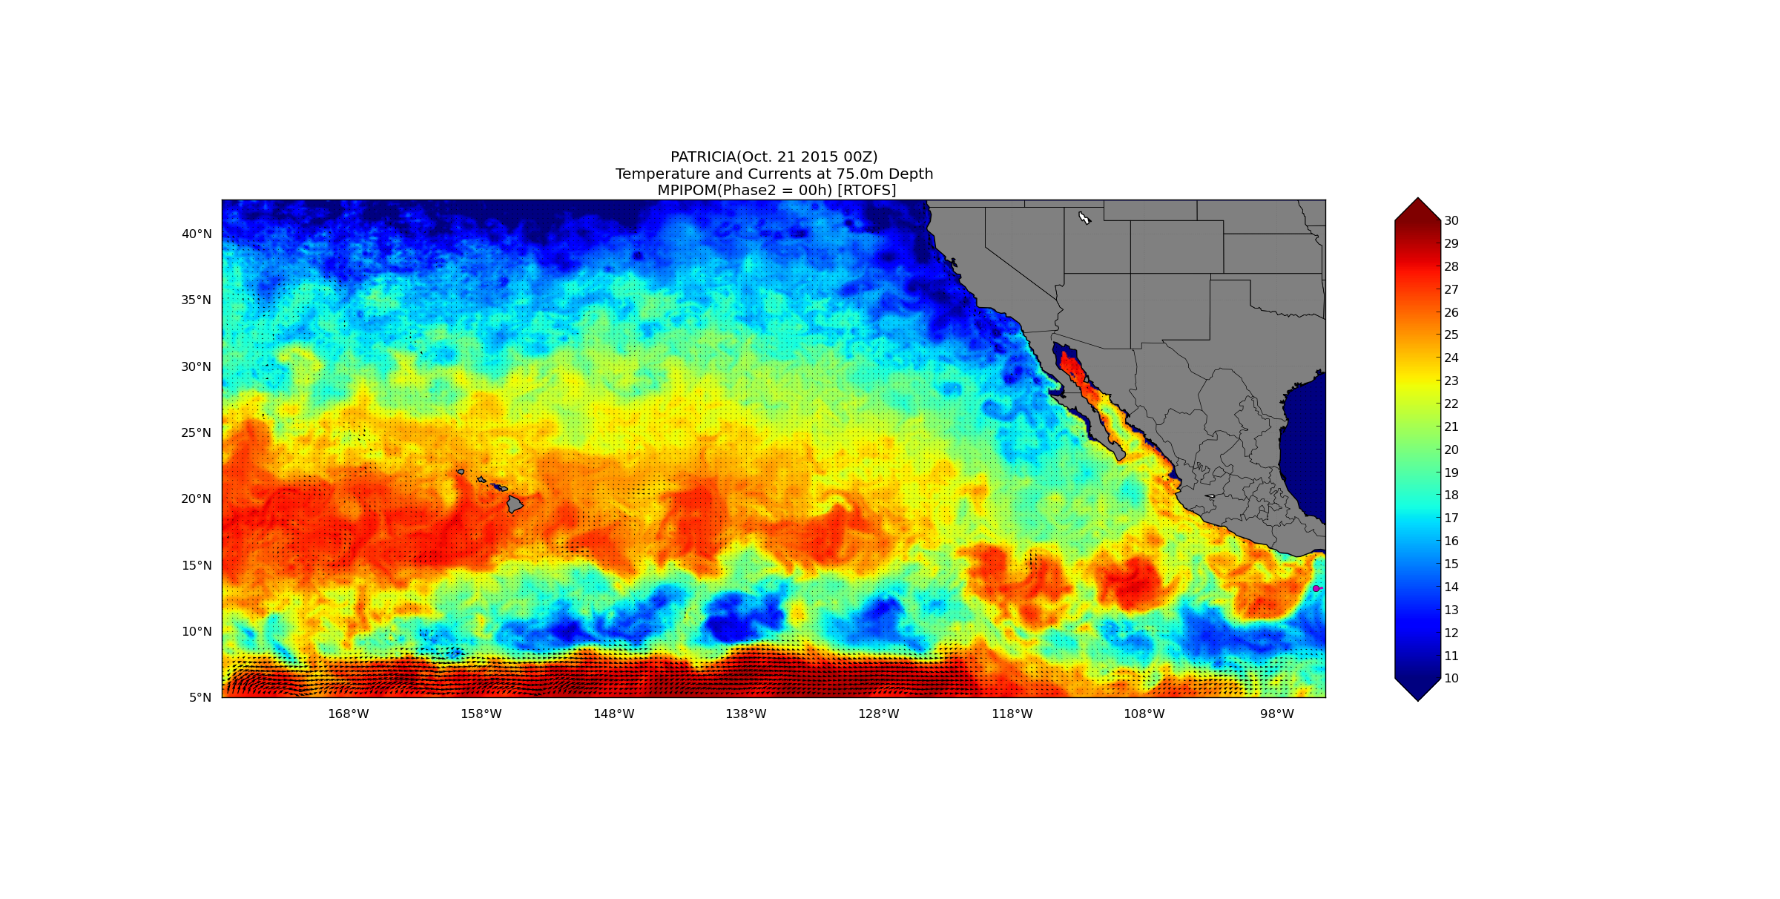
MPIPOM RTOFS Initialization Hurricane Patricia, T at 75 m: 0 hrs

Slide 4
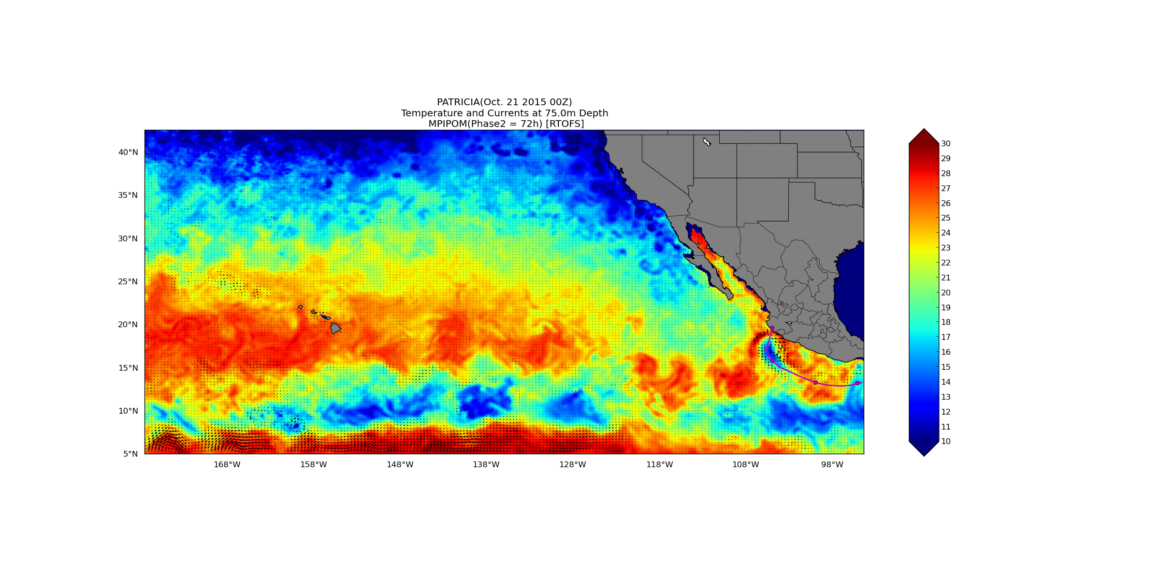
MPIPOM RTOFS Initialization Hurricane Patricia, T at 75 m: 72 hrs

Slide 5
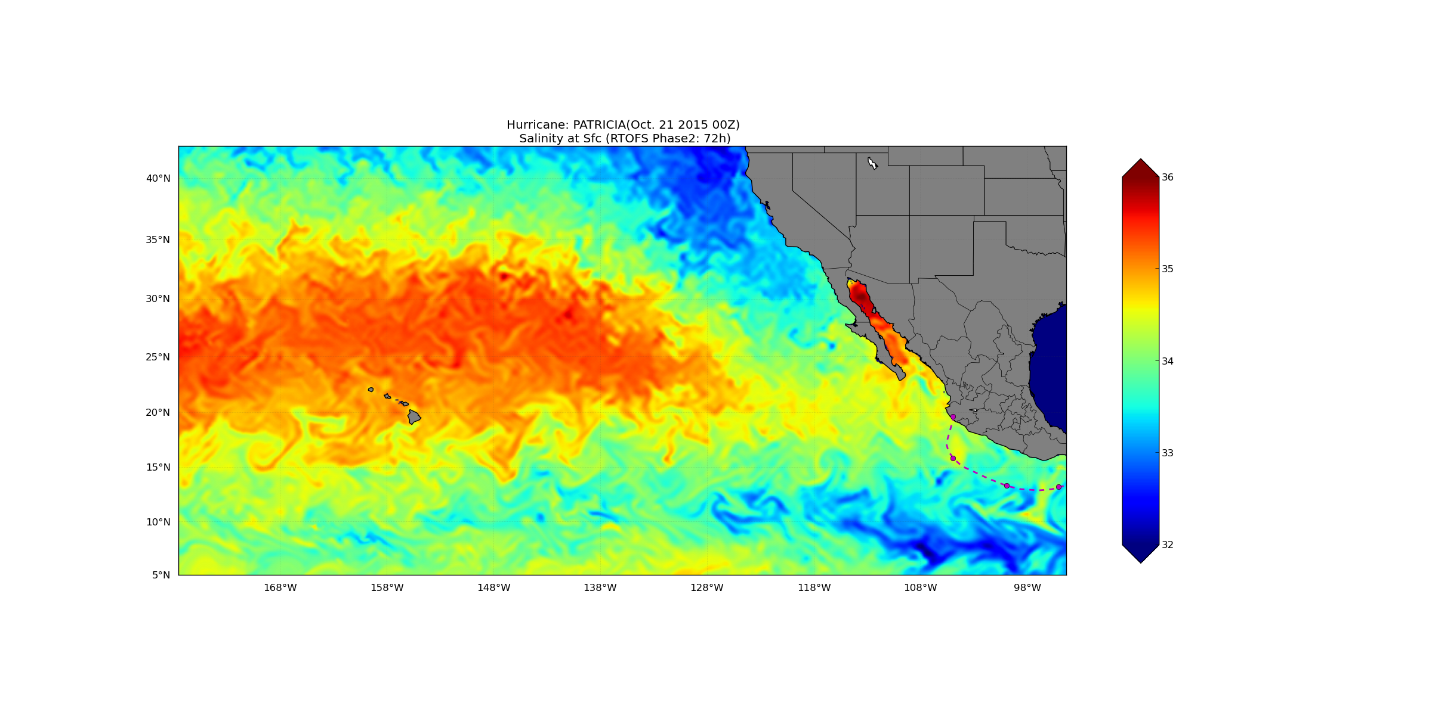
MPIPOM RTOFS Initialization Hurricane Patricia, S at 0 m: 72 hrs

Slide 6
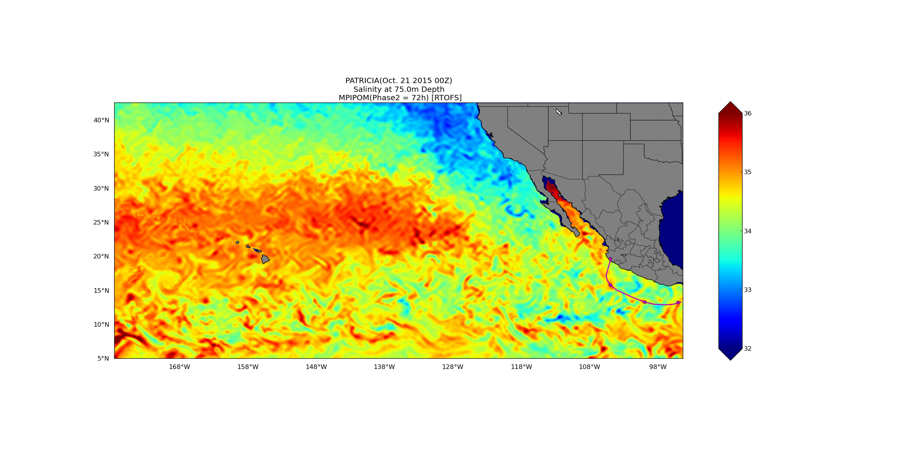
MPIPOM RTOFS Initialization Hurricane Patricia, S at 75 m: 72 hrs

