Slide 1
Status report on Thompson MP tests
DTC
EMC weekly – February 11, 2016

Slide 2
Status of runs
Tests still running – limited sample available for this snapshot
 | AL Storms | EP Storms
HDT6 | 2014: 06, 08 2015: 05, 06, 07 | 2014: 03, 13, 15 2015: 02, 03, 04, 10, 12, 13
HDTB | 2015: 05, 06 | 2015: 02, 10

Slide 3
H16A vs HDT6
H16A – HWRF baseline
HDT6 –
HWRF with Thompson microphysics
nphs=2 for all domains

Slide 4
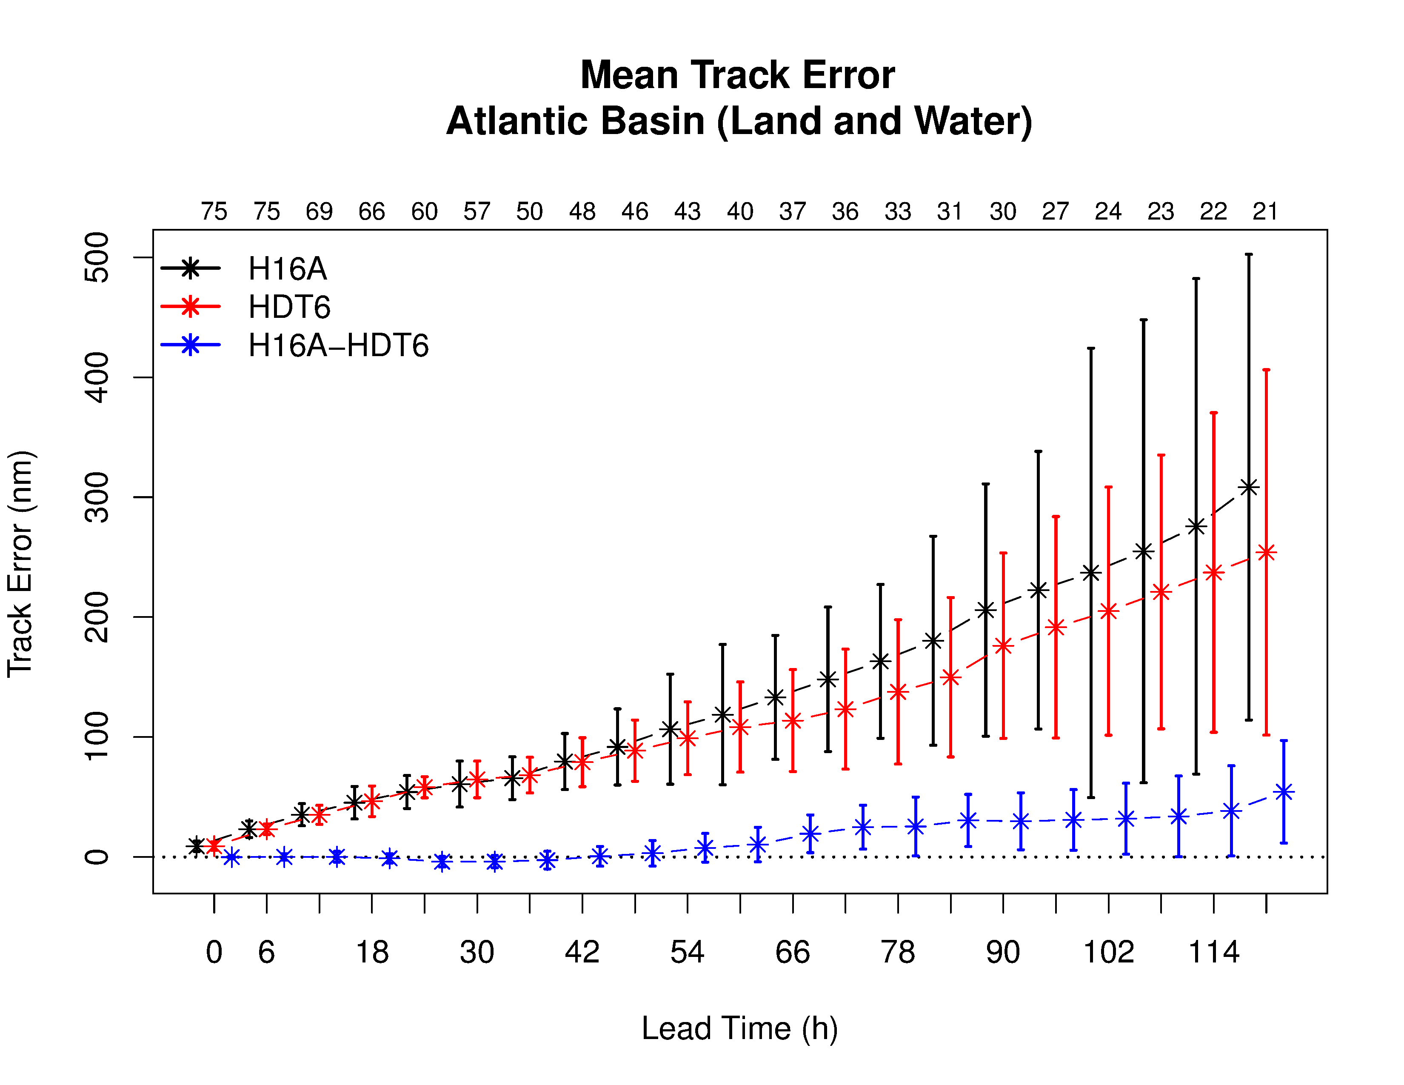
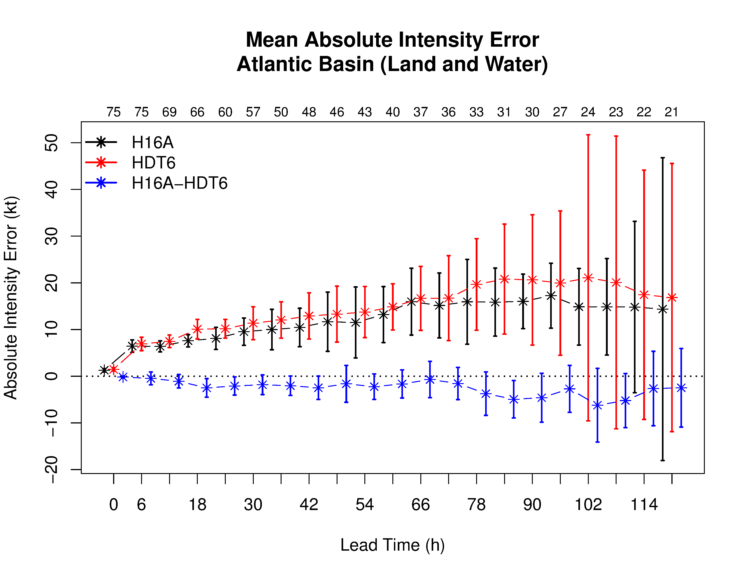
Track and intensity: AL basin
Very limited sample size! Addition storms in progress
Track improvement for HTD6 beyond 48 hrs
Neutral intensity differences; slight degradation HDT6 after 72 h

Slide 5
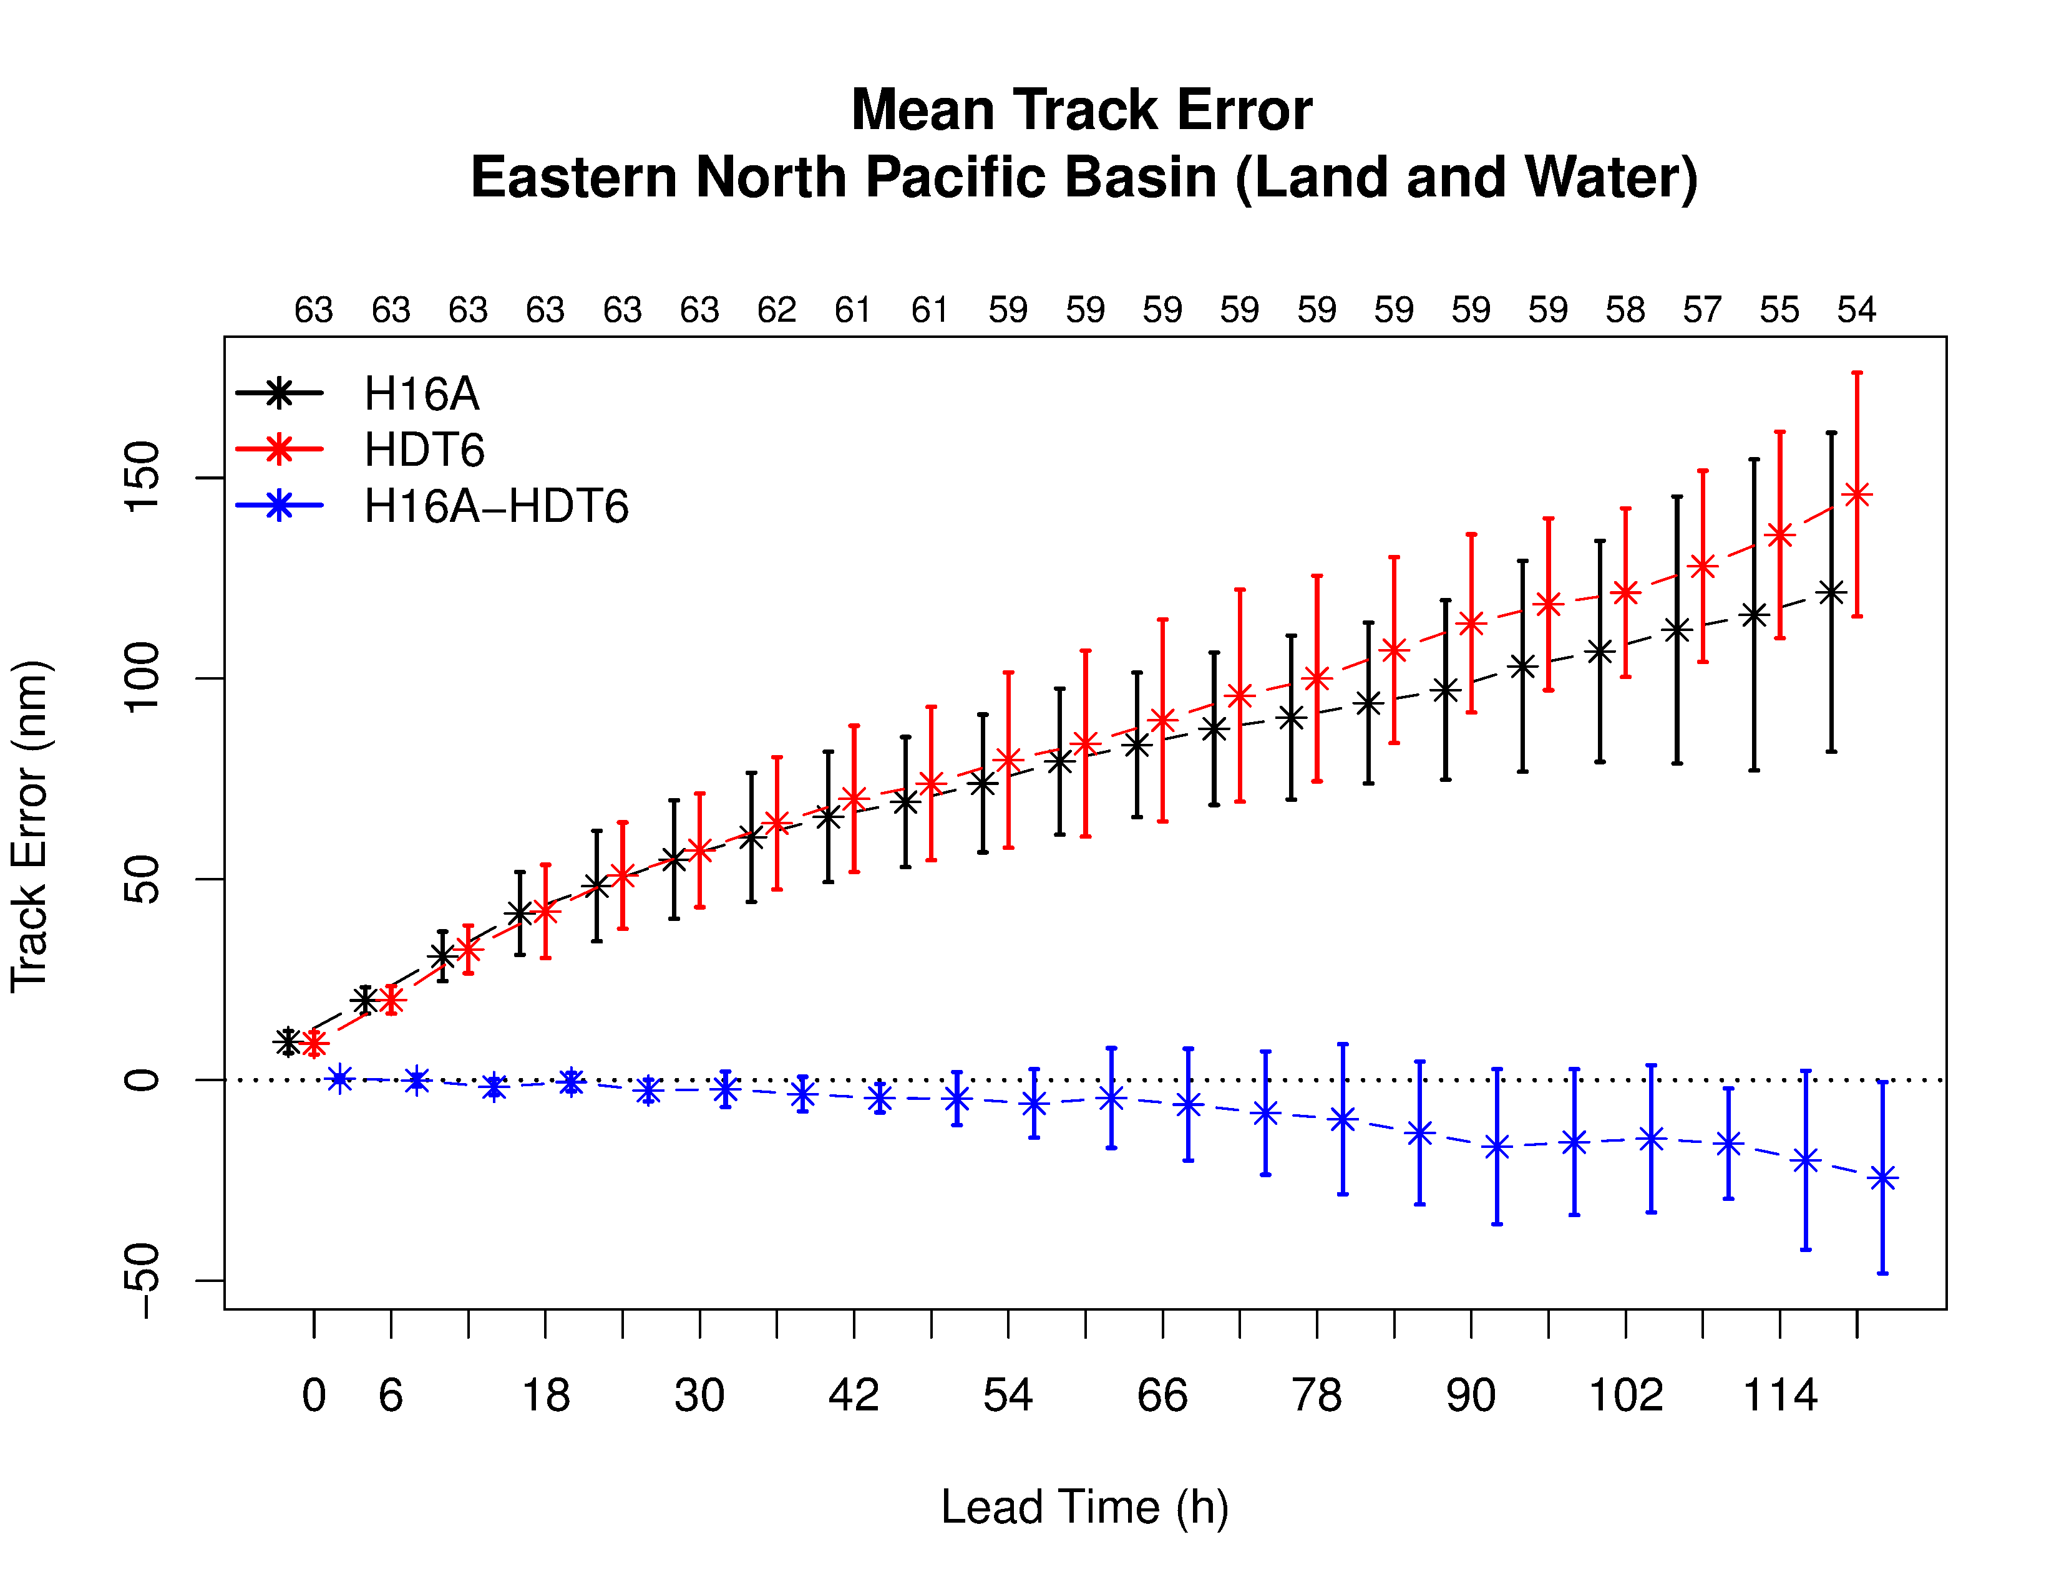
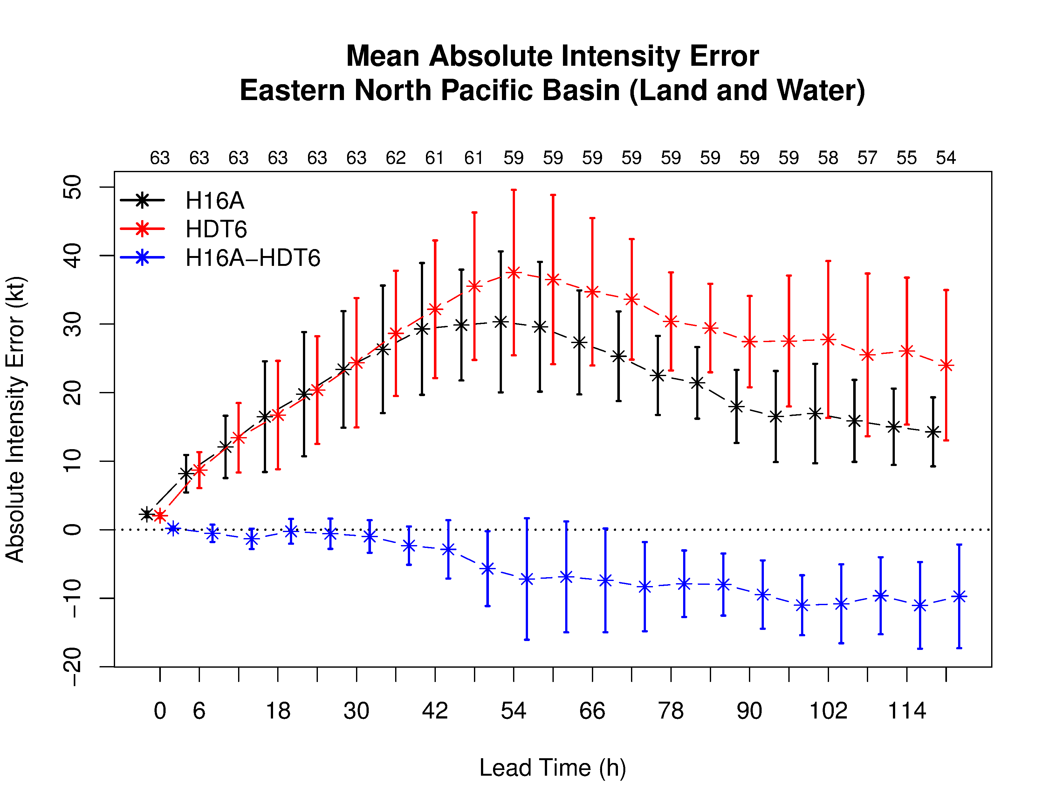
Track and intensity: EP basin
Very limited sample size! Addition storms in progress
Slight track degradation present in HTD6
Large negative intensity bias for both, greater for HTD6
Notes:
Title with figure(s) template

Slide 6
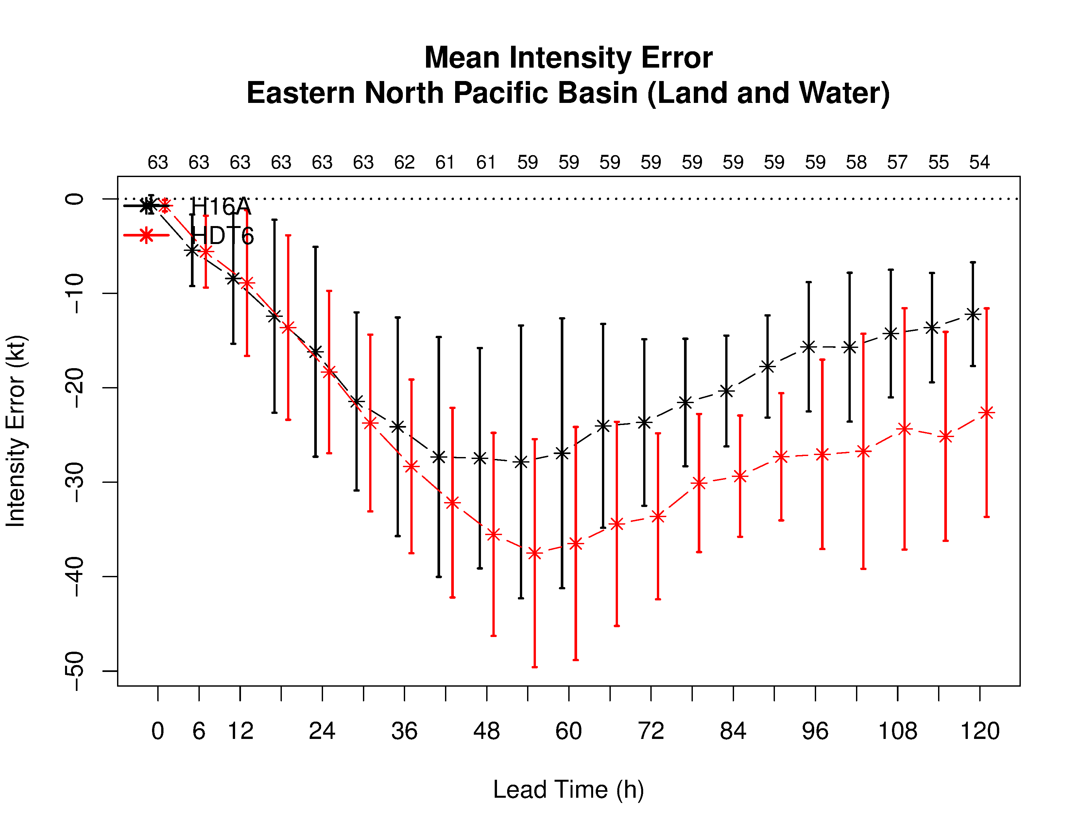
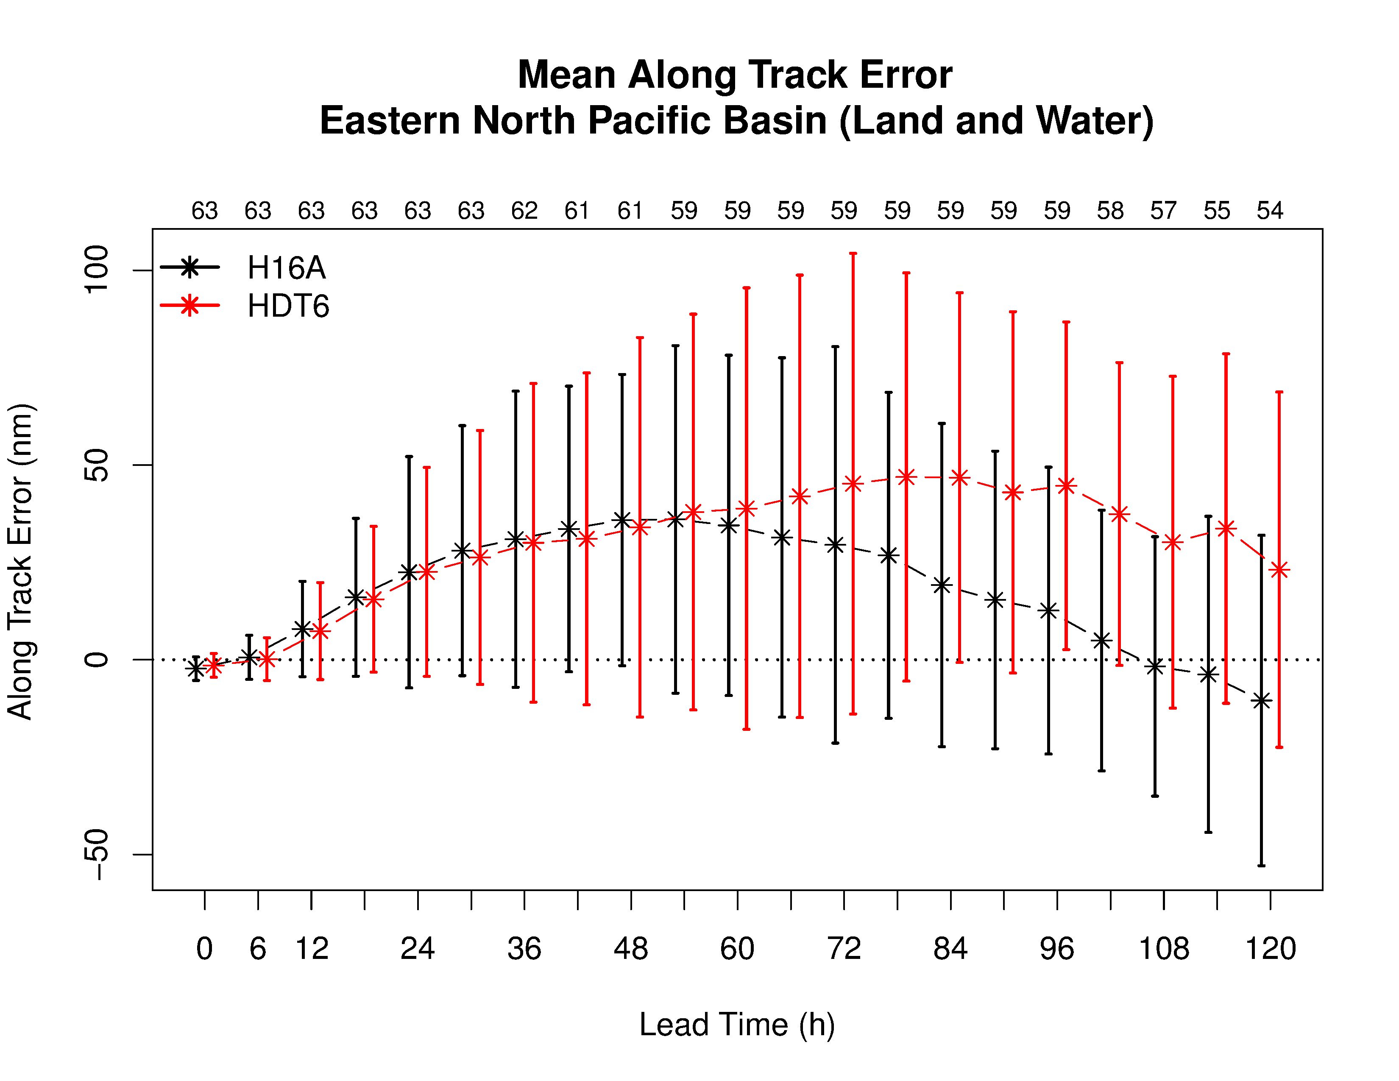
Intensity and along track bias: EP basin
Very limited sample size! Addition storms in progress
Large negative intensity bias for both, greater for HTD6
Positive along track error for HDT6 (storms moving faster)
Notes:
Title with figure(s) template

Slide 7
H16A vs HDT6 vs HDTB
H16A – HWRF baseline
HDT6 –
HWRF with Thompson microphysics
nphs=2 for all domains
HDTB –
HWRF with Thompson microphysics
nphs=6 for all domains
Notes:
Title with figure(s) template

Slide 8
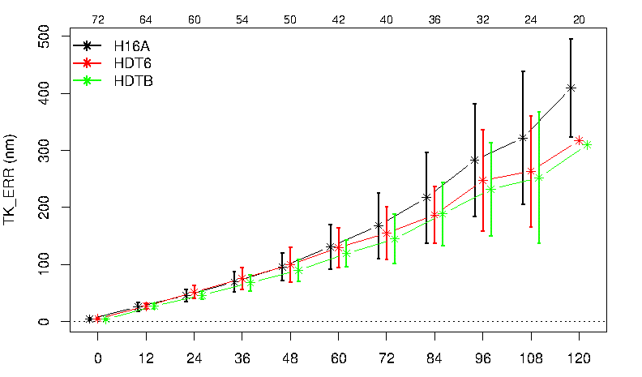
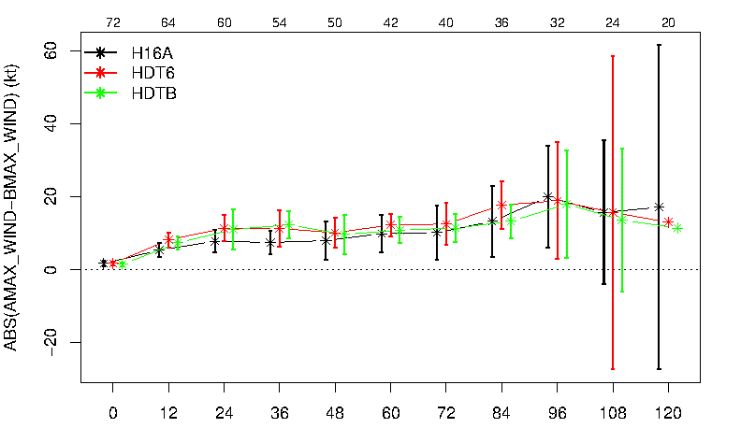
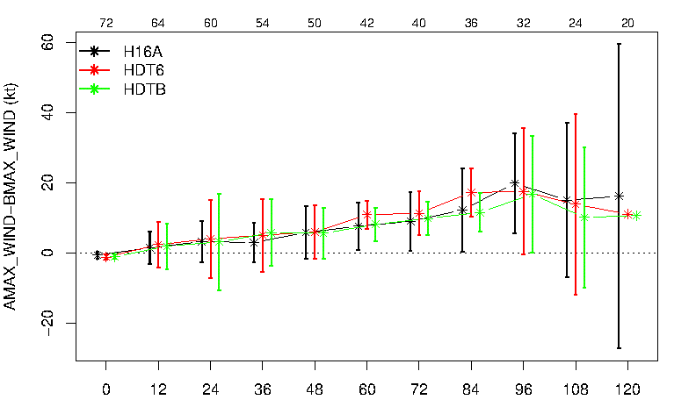
Track and Intensity : AL basin
Track
Absolute Intensity Error
Intensity bias
No Noticeable difference between HDT6 and HDTB
Notes:
Title with figure(s) template

Slide 9
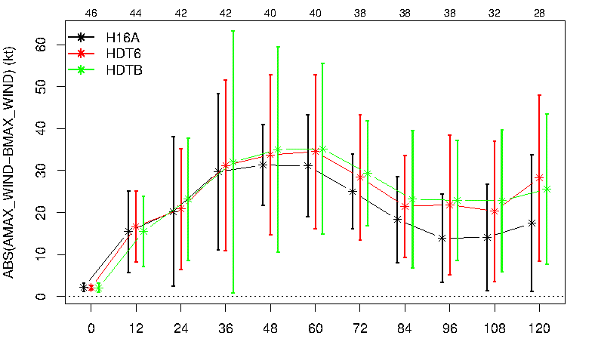
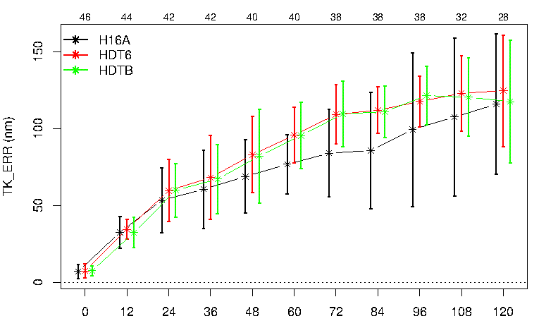
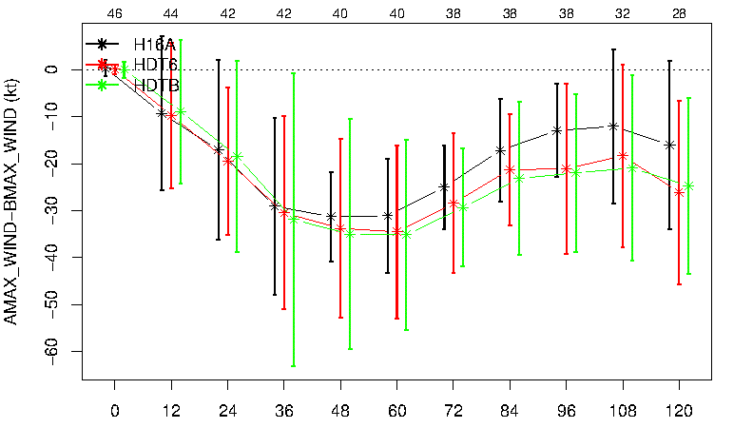
Track and Intensity : EP basin
Absolute Intensity Error
Track
No Noticeable difference between HDT6 and HDTB
Intensity bias
Notes:
Title with figure(s) template

Slide 10
Moving forward
DTC will evaluate the forecasts in greater detail
EP Track and Intensity errors remains an issue
Lower intensity bias related to faster moving storms??
Do we test HWRF with Thompson with nphs=2 or nphs=6?
No noticeable difference in AL and EP cases (sample size small)
Notes:
Title with figure(s) template

