Slide 1
Modified NAM Microphysics for Use in High-Resolution Forecasts
Eric Aligo^{ab}, Brad Ferrier^{ab}, Jacob Carely^{ab}, Matthew Pyle^{b},
Dusan Jovic^{ab}, Eric Rogers^{b} and Geoff DiMego^{b}
ªIMSG, ^{b}NOAA/NWS/NCEP/EMC
Eric.Aligo@noaa.gov
Special thanks also to colleagues at SPC

Slide 2
Ferrier-Aligo version of the NAM microphysics
Changes were designed to better represent deep, intense convection in the operational North American Mesoscale Forecast System (NAM).
Developed from extensive microphysics sensitivity experiments made of the 29-30 June 2012 derecho, and severe weather cases flagged by the Storm Prediction Center at the 2012 NCEP Production Review.
All model sensitivity experiments were made using an upgraded version of the NAM, also called the Non-hydrostatic Multiscale Model on the B-grid (NMMB), at a horizontal resolution of 4km.

Slide 3
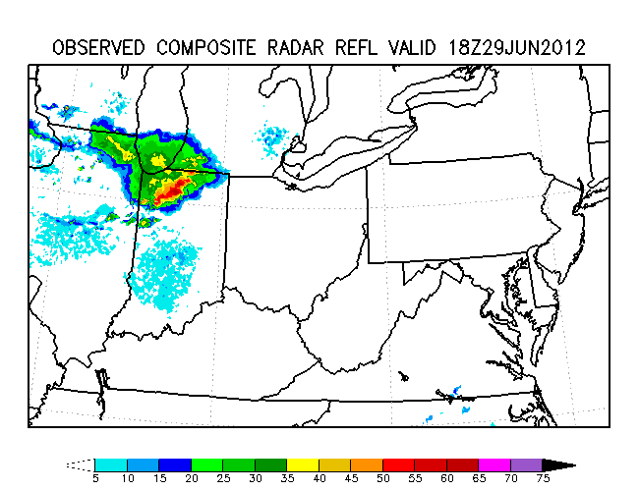
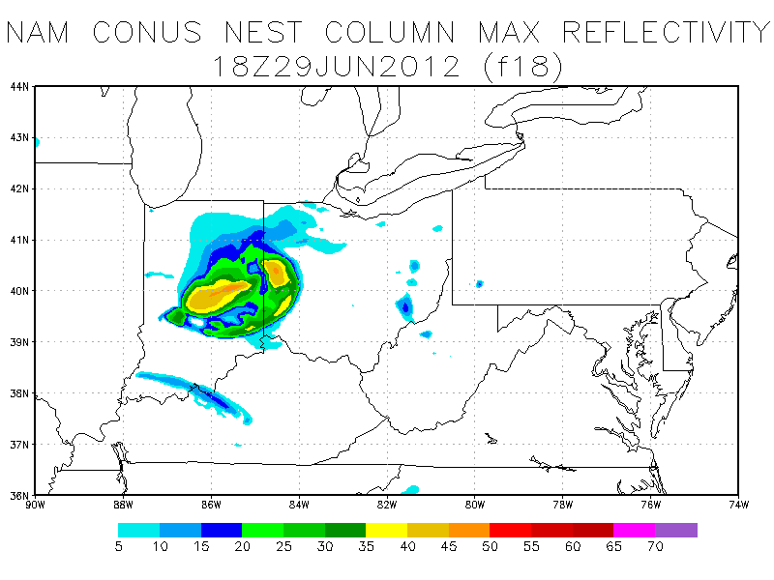
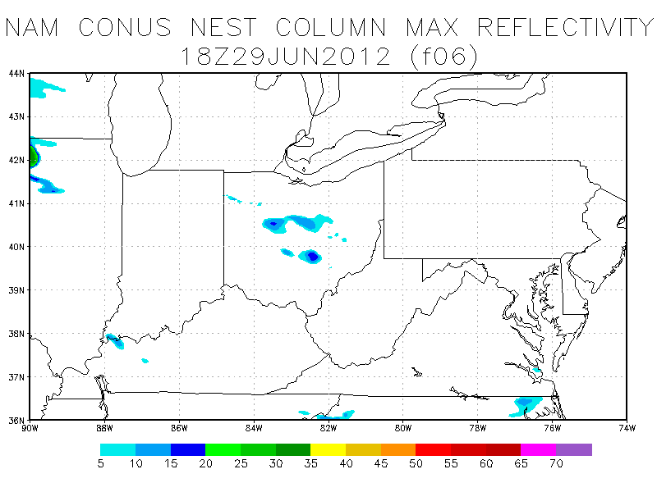
Composite Reflectivity of 29-30 June 2012 Derecho: Observations vs 4km Operational NAM
Operational NAM CONUS Nest
18-h (18Z)
06-h (18Z)
OBS
00Z/29 4km NAM
12Z/29 4km NAM
Too weak, too fast
Too slow
(in Iowa)
NAM=North American Mesoscale Forecast System

Slide 4
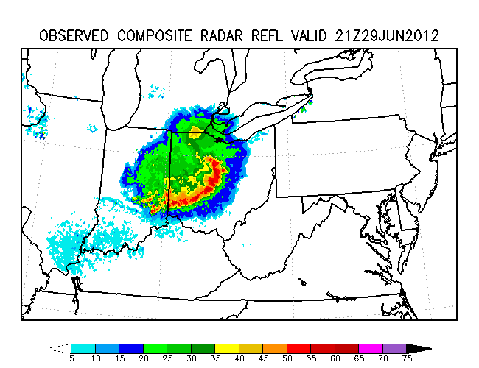
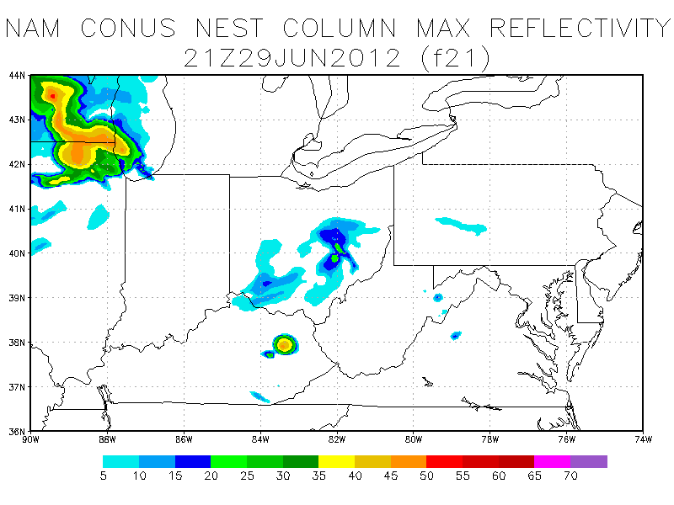
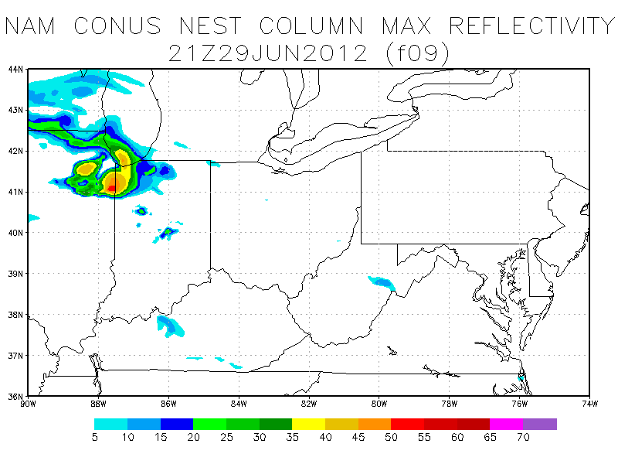
Composite Reflectivity of 29-30 June 2012 Derecho: Observations vs 4km Operational NAM
Operational NAM CONUS Nest
21-h (21Z)
09-h (21Z)
OBS
00Z/29 4km NAM
12Z/29 4km NAM
System dissipates in OH
NAM=North American Mesoscale Forecast System

Slide 5
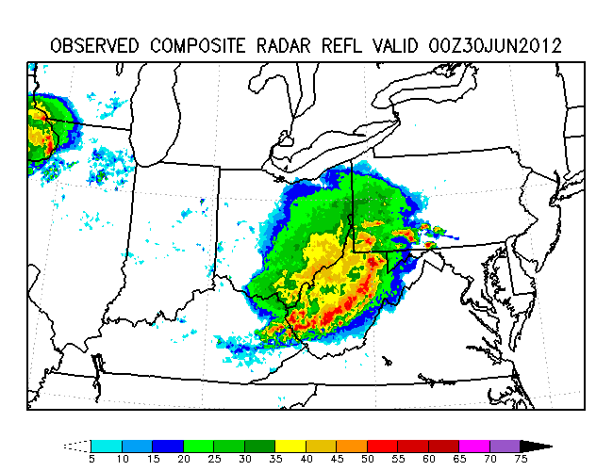
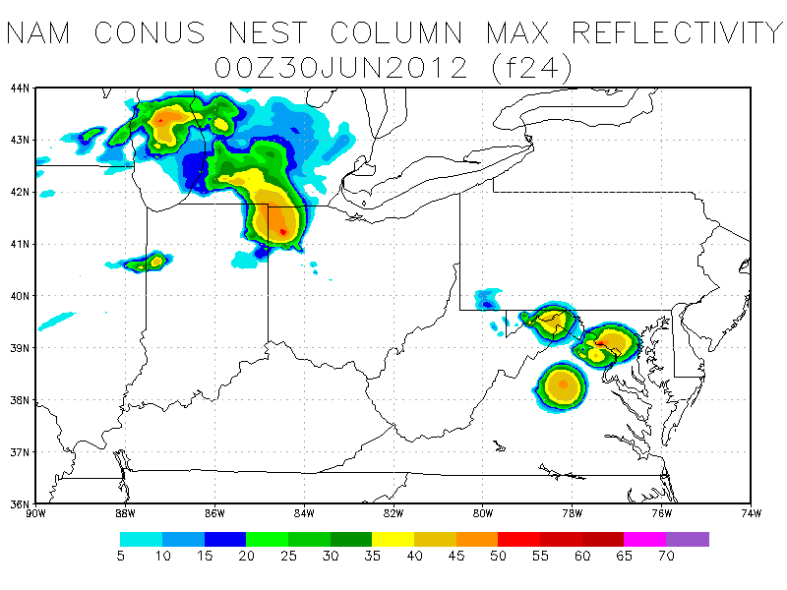
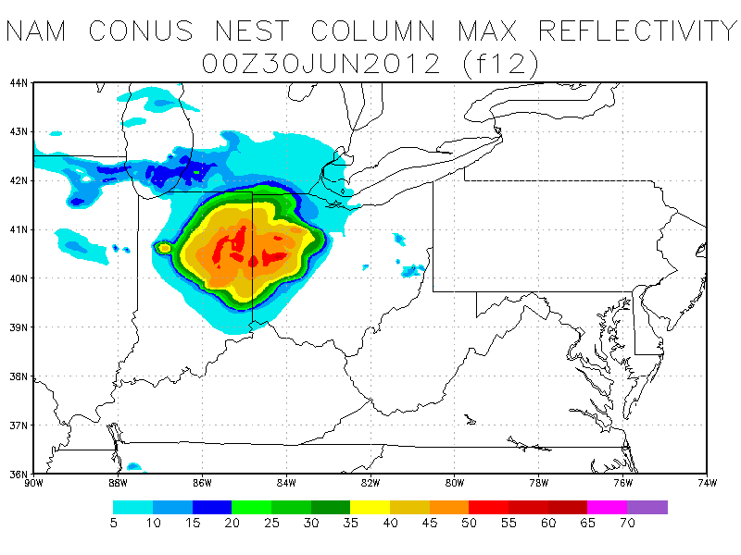
Composite Reflectivity of 29-30 June 2012 Derecho: Observations vs 4km Operational NAM
Operational NAM CONUS Nest
24-h (00Z)
12-h (00Z)
OBS
00Z/29 4km NAM
12Z/29 4km NAM
Too slow,
Massive complex
with little structure
NAM=North American Mesoscale Forecast System

Slide 6
4km NMMB Runs Included the Following NAM CONUS nest Upgrades:
Replaced legacy GFDL radiation with the RRTM.
Measures to improve severe storm signatures:
Reduced 2nd order diffusion (improves vertical storm structure in cases suggested by SPC).
Reduced diffusion of specific humidity and condensate from 4X to 1X.
Separate microphysics species advection of cloud water, rain water and total ice (examples shown later).
Turned off light BMJ convective scheme (explicit convection) based on experiments of the derecho (examples shown in next few slides).

Slide 7
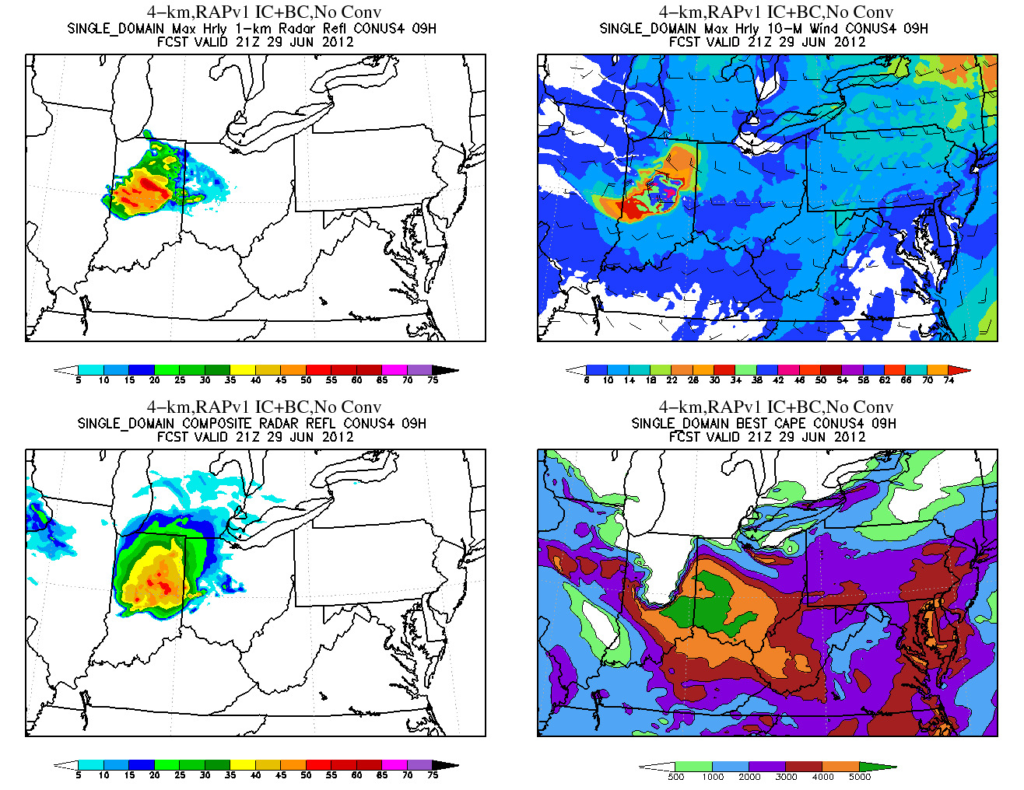
12Z RAPv1-based NMMB Run Explicit Convection
Max Hrly 1-km AGL Refl
Max Hrly 10-M Wind
09h/21Z
Composite Radar Refl
Most Unstable CAPE

Slide 8
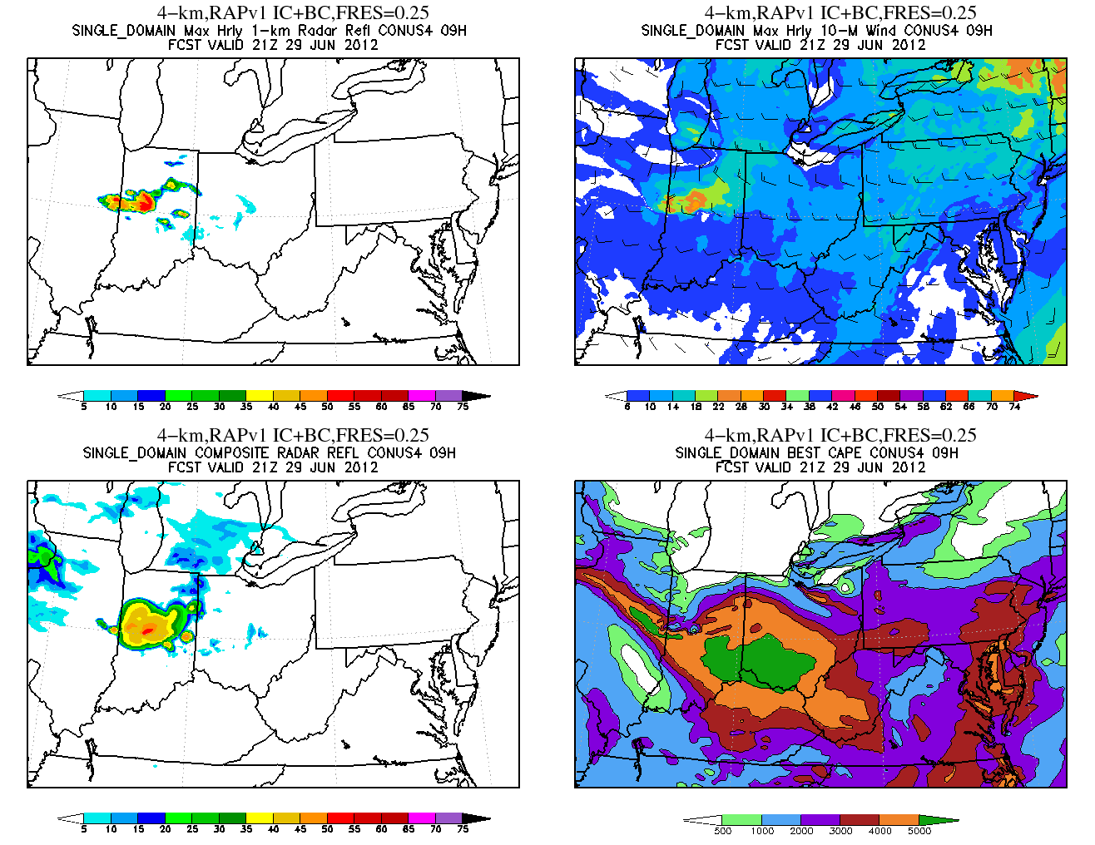
12Z RAPv1-based NMMB Run BMJ Convective Scheme
Max Hrly 1-km AGL Refl
Max Hrly 10-M Wind
09h/21Z
Composite Radar Refl
Most Unstable CAPE
System too slow to develop

Slide 9
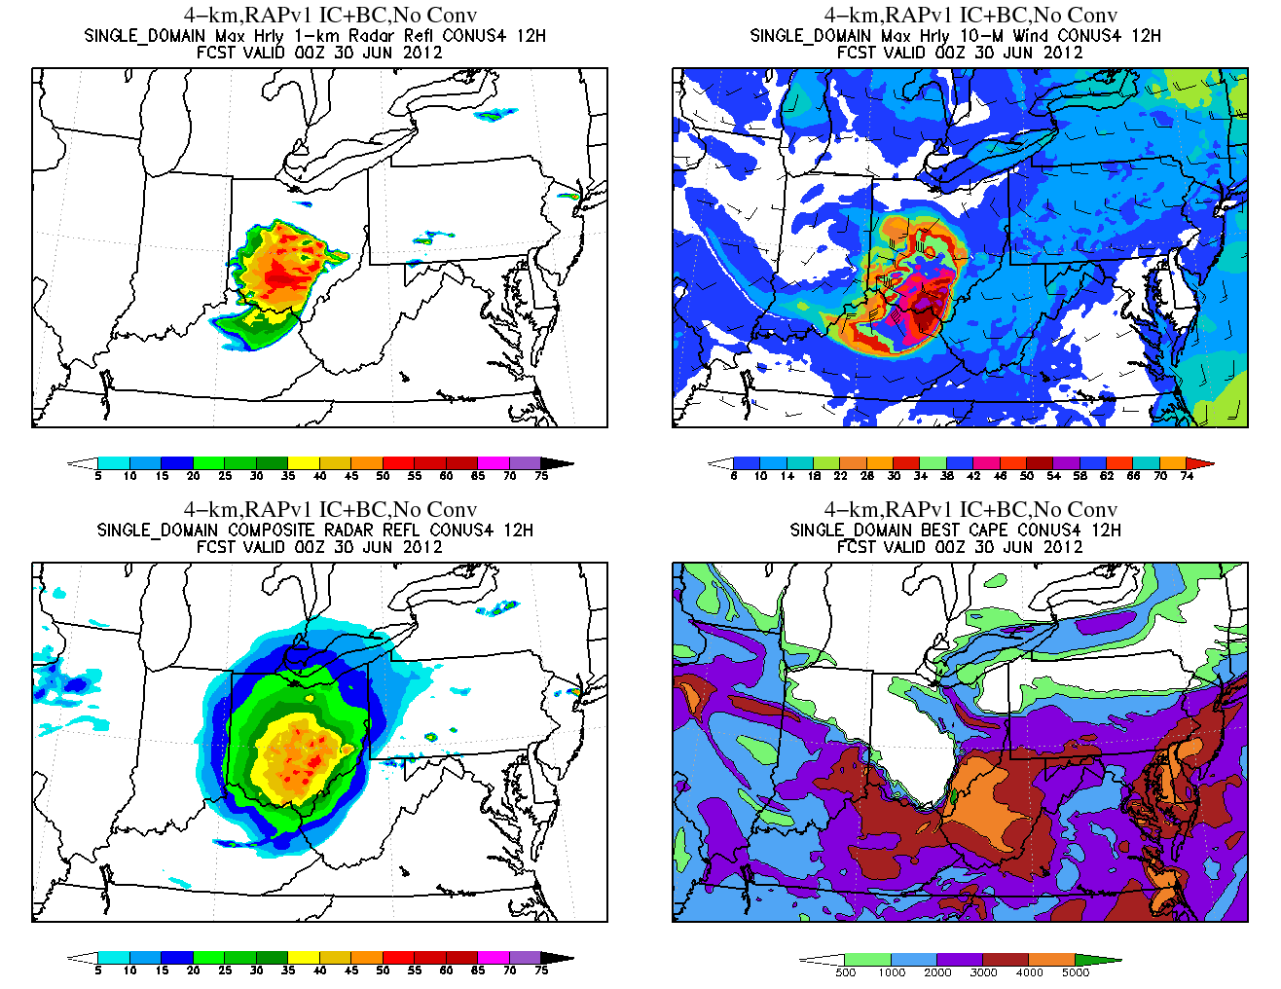
12Z RAPv1-based NMMB Run Explicit Convection
Max Hrly 1-km AGL Refl
Max Hrly 10-M Wind
12h/00Z
Composite Radar Refl
Most Unstable CAPE

Slide 10
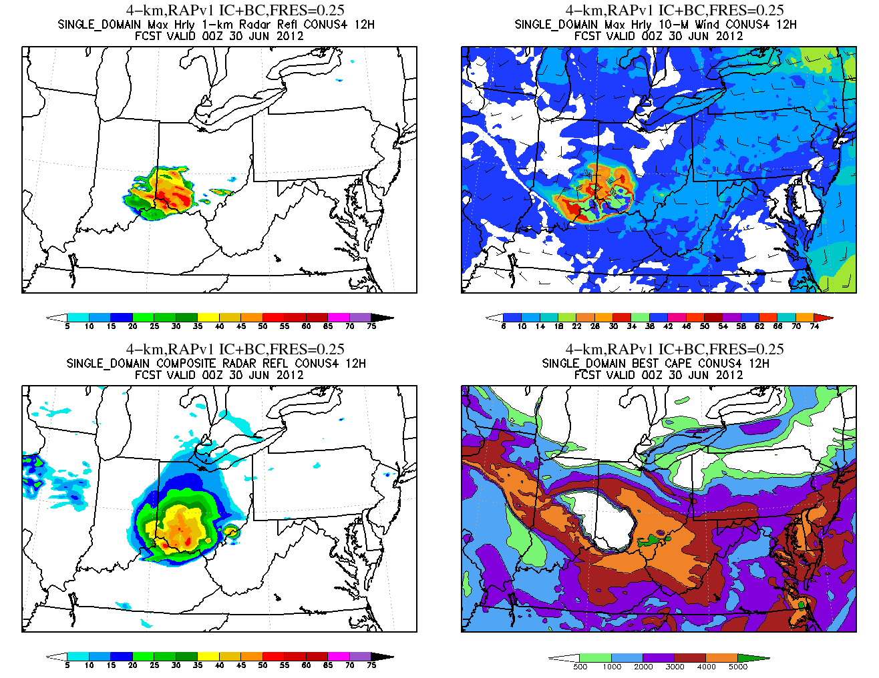
12Z RAPv1-based NMMB Run BMJ Convective Scheme
Max Hrly 1-km AGL Refl
Max Hrly 10-M Wind
Max Hrly 1-km AGL Refl
Max Hrly 10-M Wind
System too weak
Composite Radar Refl
12h/00Z
Most Unstable CAPE
Composite Radar Refl
Most Unstable CAPE

Slide 11
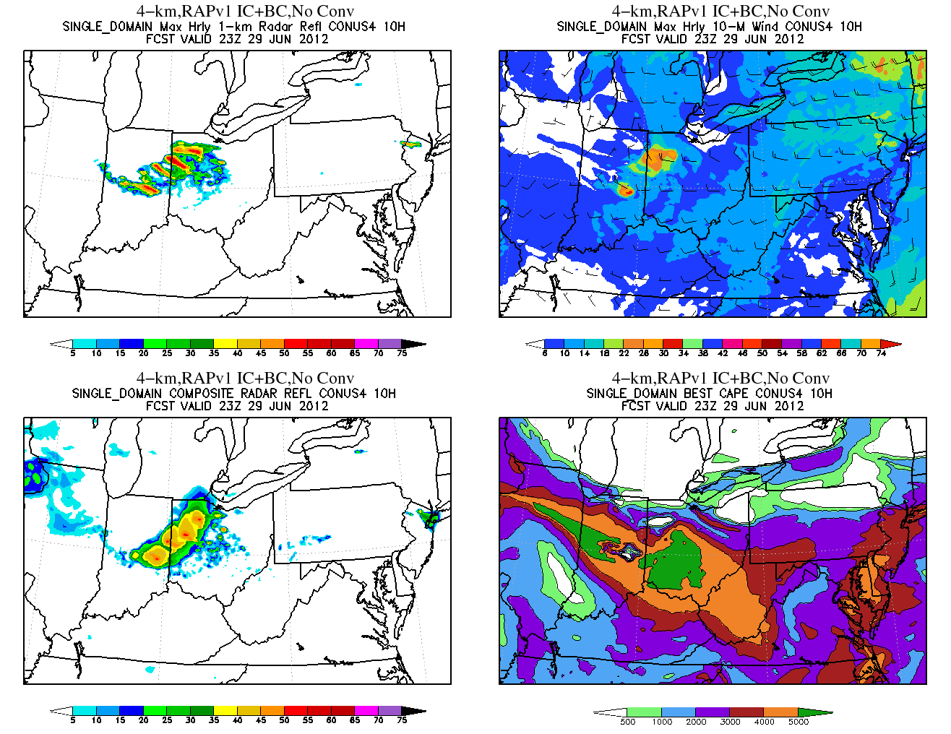
13Z RAPv1-based NMMB Run Explicit Convection
Max Hrly 1-km AGL Refl
Max Hrly 10-M Wind
Max Hrly 1-km AGL Refl
Max Hrly 10-M Wind
Composite Radar Refl
10h/23Z
Most Unstable CAPE
Composite Radar Refl
Most Unstable CAPE

Slide 12
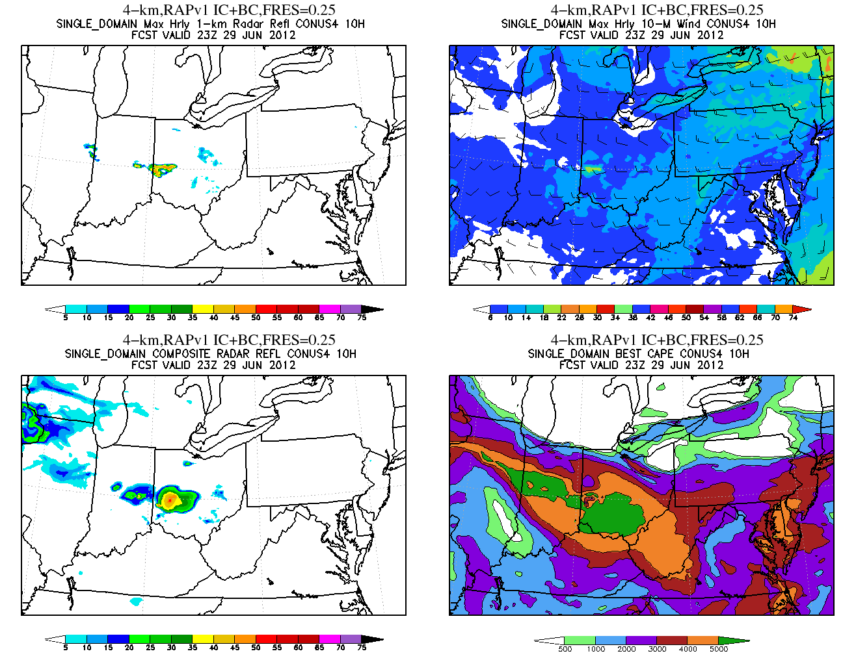
13Z RAPv1-based NMMB Run BMJ Convective Scheme
Max Hrly 1-km AGL Refl
Max Hrly 10-M Wind
Max Hrly 1-km AGL Refl
Max Hrly 10-M Wind
12h/00Z
Composite Radar Refl
10h/23Z
Most Unstable CAPE
Composite Radar Refl
Most Unstable CAPE

Slide 13
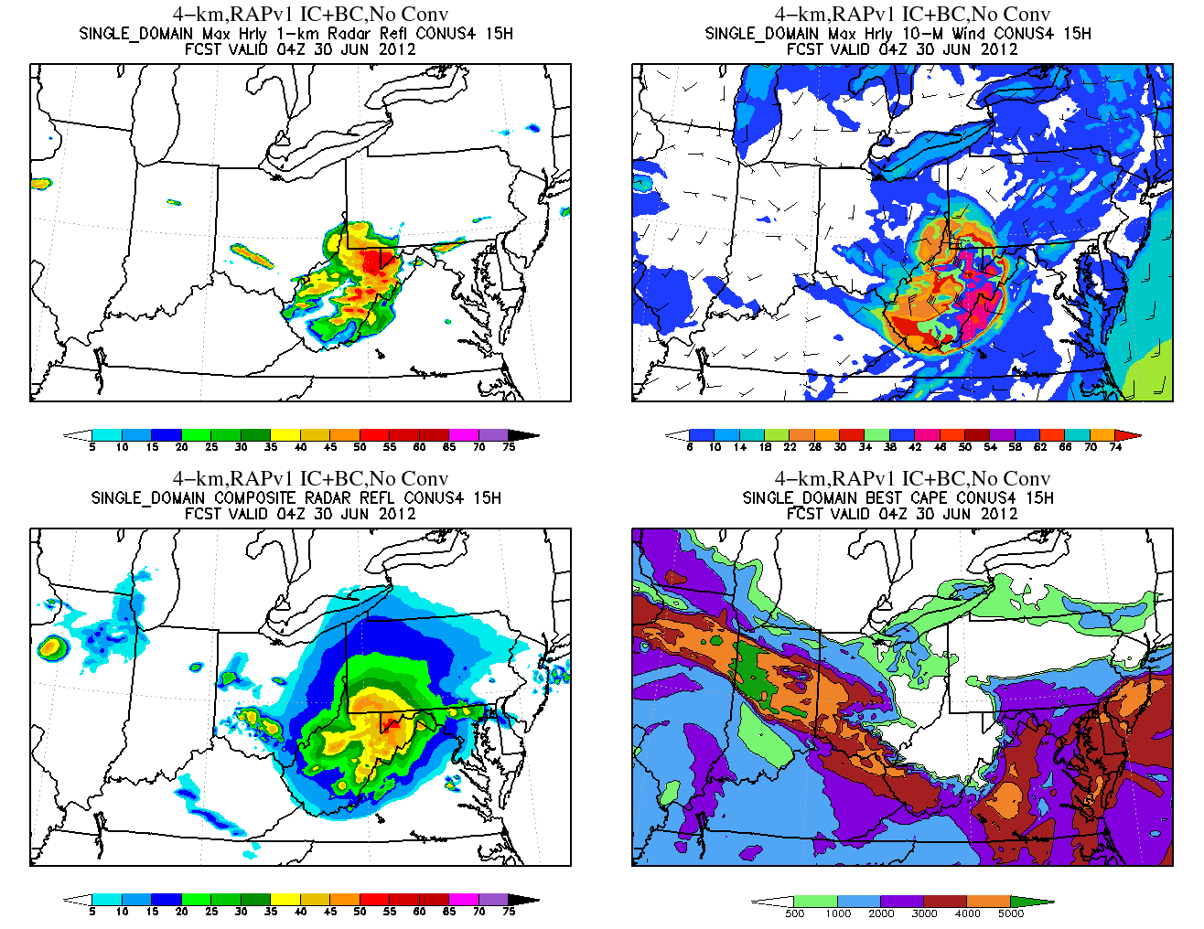
13Z RAPv1-based NMMB Run BMJ Convective Scheme
Max Hrly 1-km AGL Refl
Max Hrly 10-M Wind
Max Hrly 1-km AGL Refl
Max Hrly 10-M Wind
12h/00Z
Composite Radar Refl
15h/04Z
Most Unstable CAPE
Composite Radar Refl
Most Unstable CAPE

Slide 14
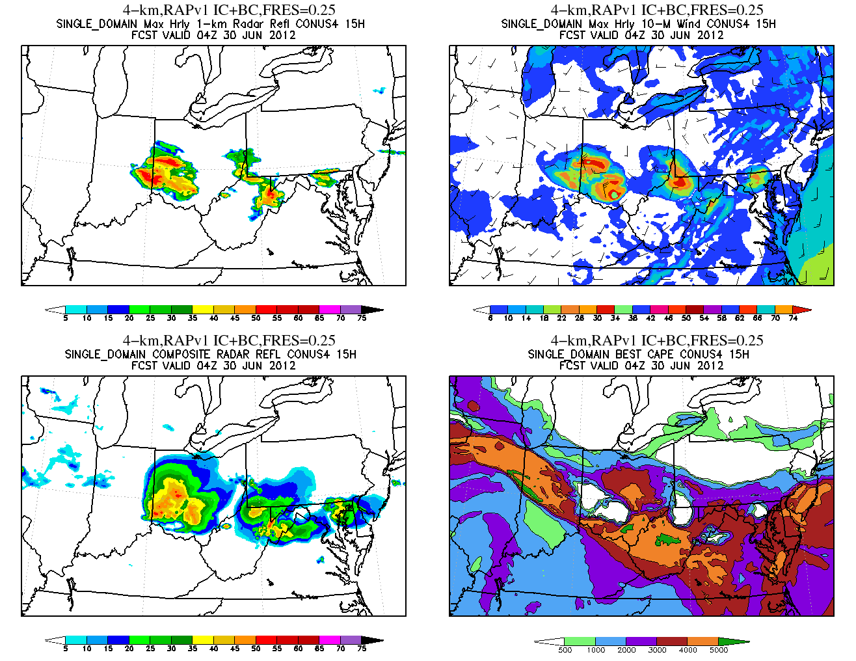
13Z RAPv1-based NMMB Run BMJ Convective Scheme
Max Hrly 1-km AGL Refl
Max Hrly 10-M Wind
Max Hrly 1-km AGL Refl
Max Hrly 10-M Wind
Spurious convection ahead of derecho
12h/00Z
Composite Radar Refl
15h/04Z
Most Unstable CAPE
Composite Radar Refl
Most Unstable CAPE

Slide 15
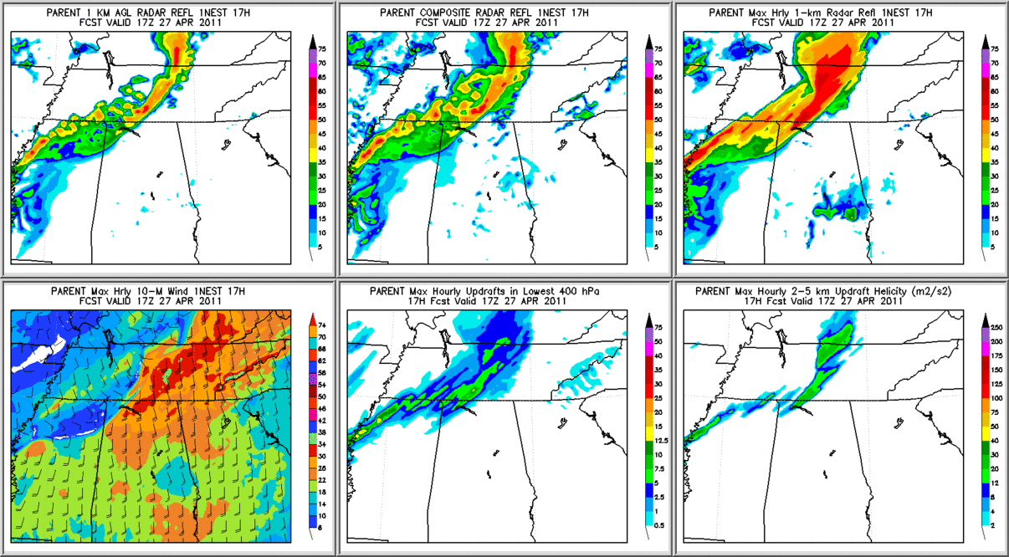
Huntsville, AL, April 27, 2011 Tornado Outbreak Total Condensate Advection 17-h (17Z/27)
1-km AGL Reflectivity
Composite Reflectivity
Max Hrly 1-km AGL Refl.
12h/00Z
Composite Radar Refl
Most Unstable CAPE
Composite Radar Refl
Most Unstable CAPE
Max Hrly 10-m Winds
Max Hourly Updrafts
Max Hr 2-5km Up Helicity

Slide 16
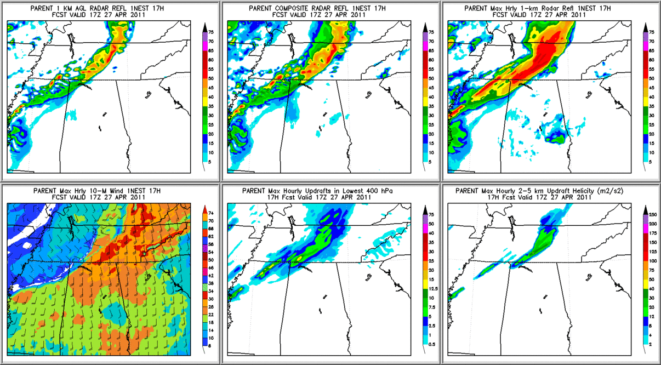
Huntsville, AL, April 27, 2011 Tornado Outbreak Separate Species Advection 17-h (17Z/27)
1-km AGL Reflectivity
Composite Reflectivity
Max Hrly 1-km AGL Refl.
Better storm structure
Max Hrly 10-m Winds
Max Hourly Updrafts
Max Hr 2-5km Up Helicity

Slide 17
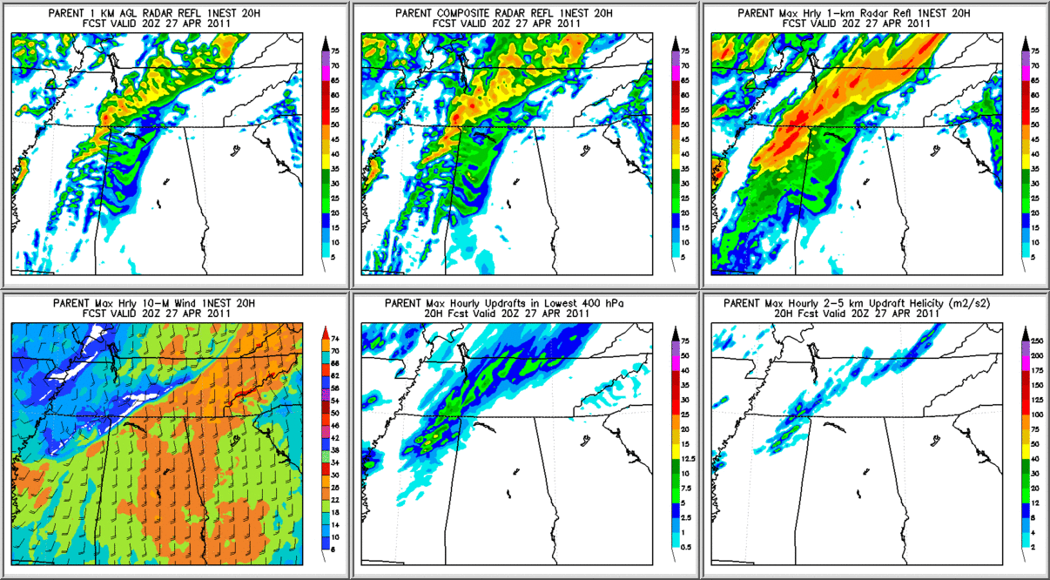
Huntsville, AL, April 27, 2011 Tornado Outbreak Total Condensate Advection 20-h (20Z/27)
1-km AGL Reflectivity
Composite Reflectivity
Max Hrly 1-km AGL Refl.
Max: 50 dBZ
Max Hrly 10-m Winds
Max Hourly Updrafts
Max Hr 2-5km Up Helicity

Slide 18
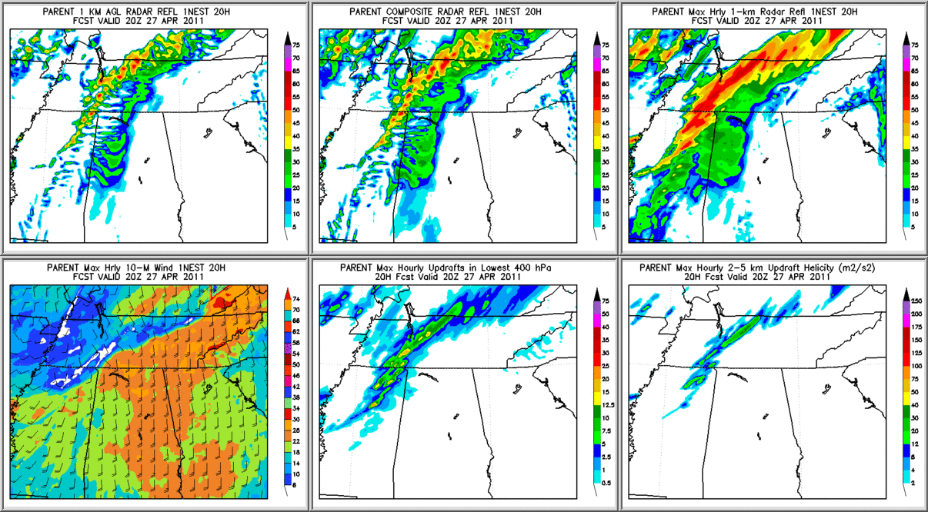
Huntsville, AL, April 27, 2011 Tornado Outbreak Separate Species Advection 20-h (20Z/27)
1-km AGL Reflectivity
Composite Reflectivity
Max Hrly 1-km AGL Refl.
Better storm structure,
more details
Max: 55 dBZ
Max Hrly 10-m Winds
Max Hourly Updrafts
Max Hr 2-5km Up Helicity
Stronger updrafts and helicity

Slide 19
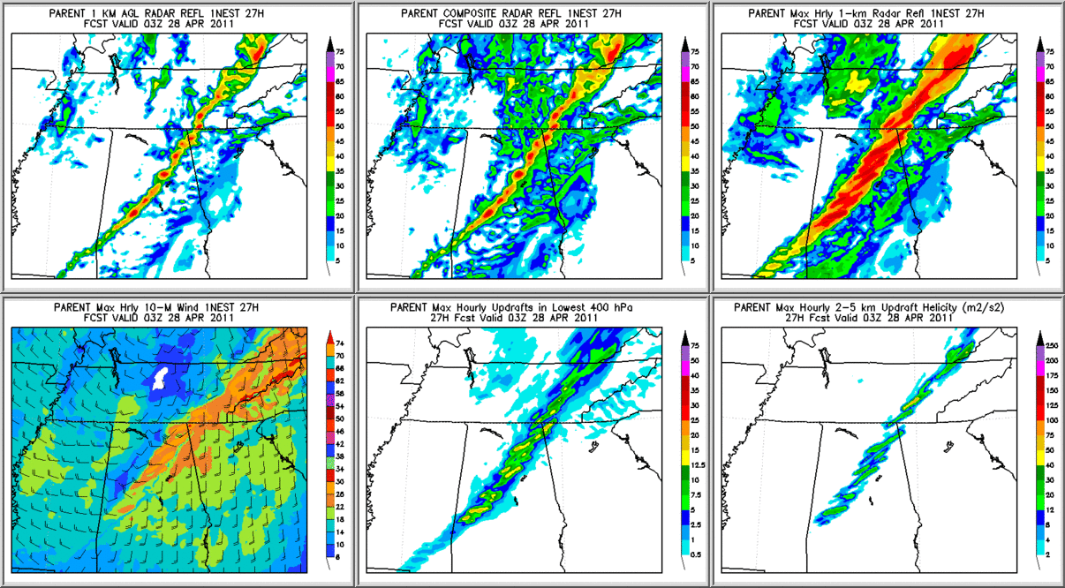
Huntsville, AL, April 27, 2011 Tornado Outbreak Total Condensate Advection 27-h (03Z/28)
1-km AGL Reflectivity
Composite Reflectivity
Max Hrly 1-km AGL Refl.
Max: 50 dBZ
Max Hrly 10-m Winds
Max Hourly Updrafts
Max Hr 2-5km Up Helicity

Slide 20
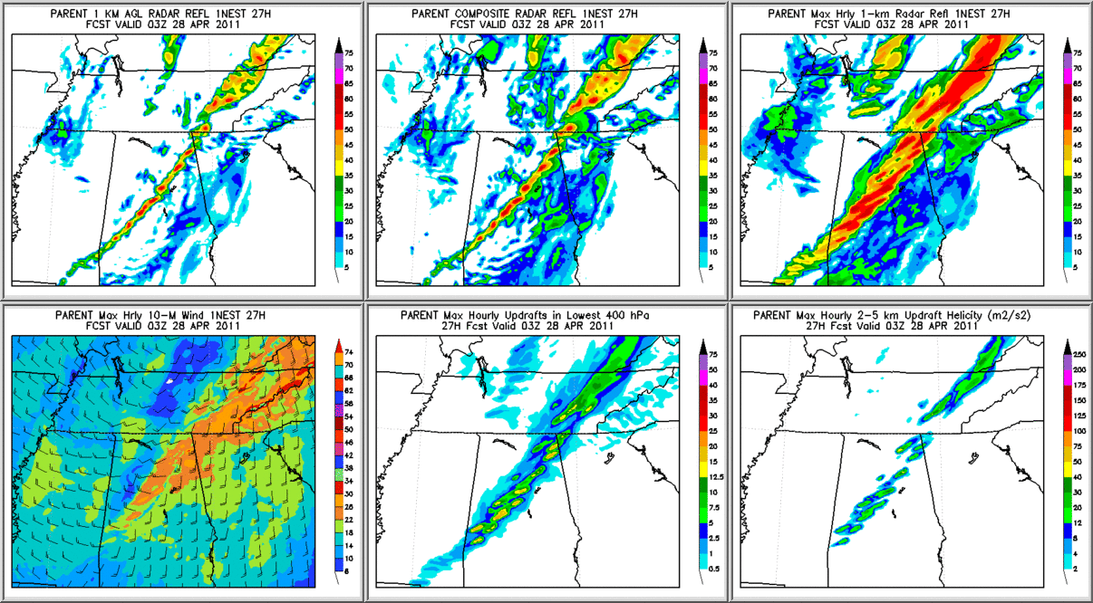
Huntsville, AL, April 27, 2011 Tornado Outbreak Separate Species Advection 27-h (03Z/28)
1-km AGL Reflectivity
Composite Reflectivity
Max Hrly 1-km AGL Refl.
Better storm structure,
more details
Max Hrly 10-m Winds
Max Hourly Updrafts
Max Hr 2-5km Up Helicity

Slide 21
Summary of 4-km NMMB Derecho Simulations
The GFS, NAM, RAPv1 and RAPv2 systems were used for initial and lateral boundary conditions (ICs and LBCs).
The best forecast was with the 15Z 29 June 2012 cycle of the RAPv2 (RAPv2 data provided by ESRL).
Used an NCEP developmental forecast system, the NAM Rapid Refresh (NAMRR), to drive 4-km NMMB simulations (examples shown next).
Hourly updated NAM forecast system.
Uses a cloud analysis and digital filter initialization with radar derived temperature tendencies.

Slide 22
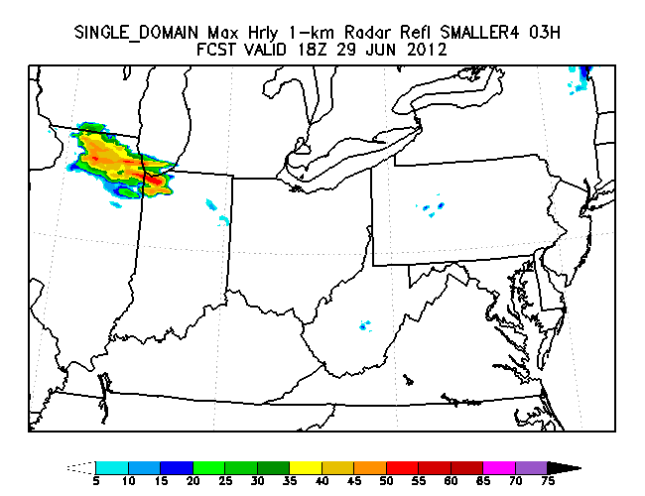
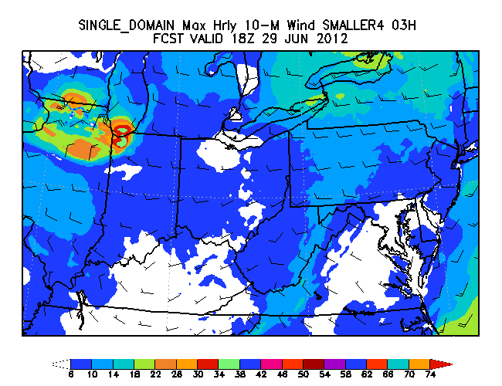
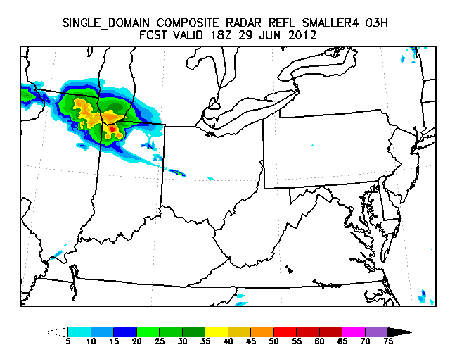
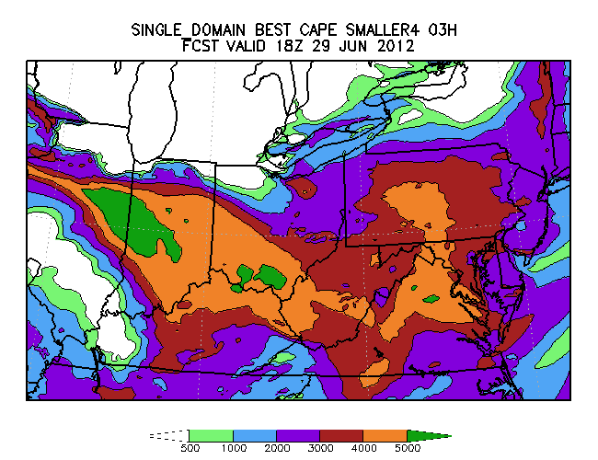
4km 15Z NMMB Run
NAMRR for ICs and LBCs,No Cu, Separate Spec. Adv.
Max Hrly 1-km AGL Refl
Max Hrly 10-M Wind
Composite Radar Refl
03h/18Z
Most Unstable CAPE
5000 J/kg

Slide 23
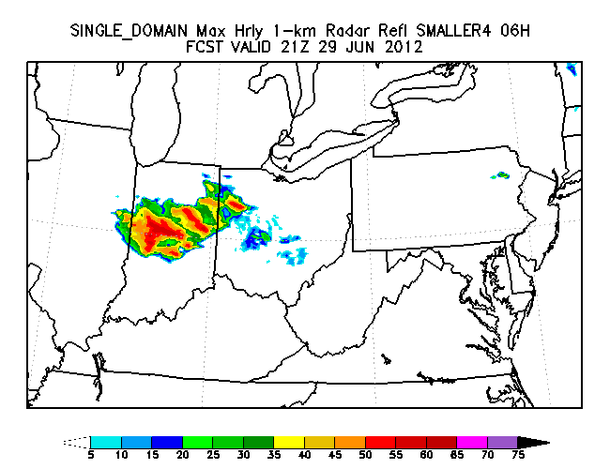
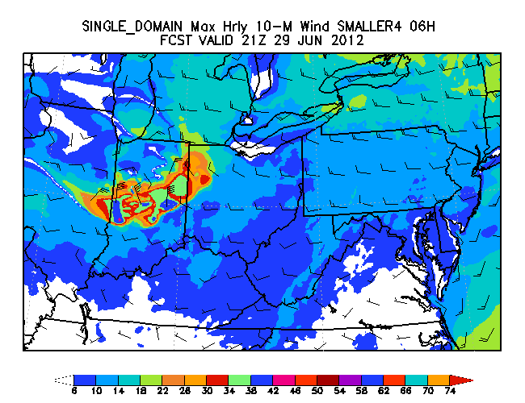
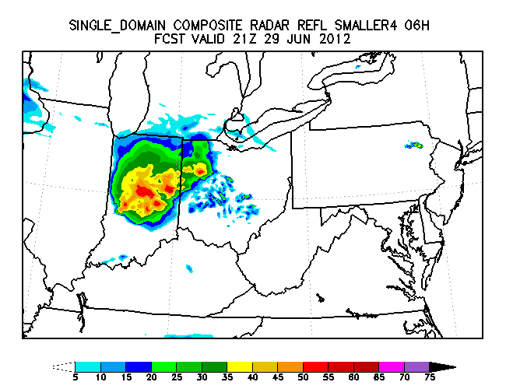
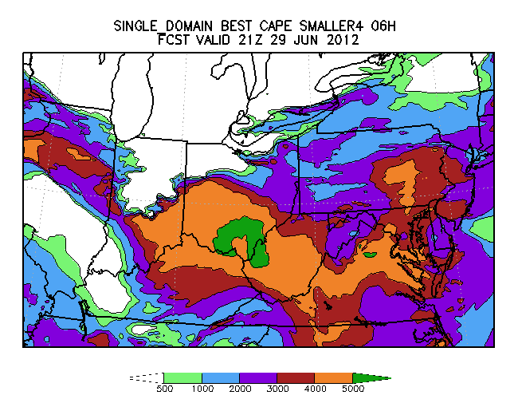
4km 15Z NMMB Run
NAMRR for ICs and LBCs,No Cu, Separate Spec. Adv.
Max Hrly 1-km AGL Refl
Max Hrly 10-M Wind
Composite Radar Refl
06h/21Z
Most Unstable CAPE

Slide 24
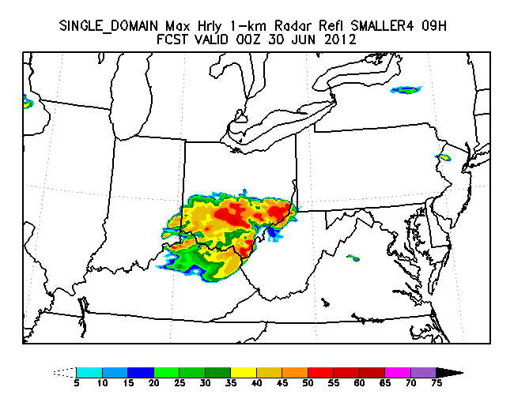
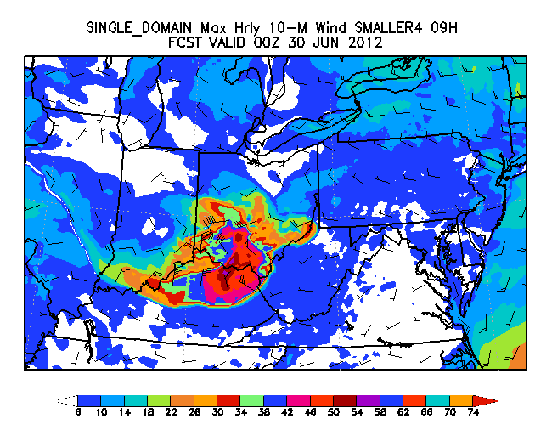
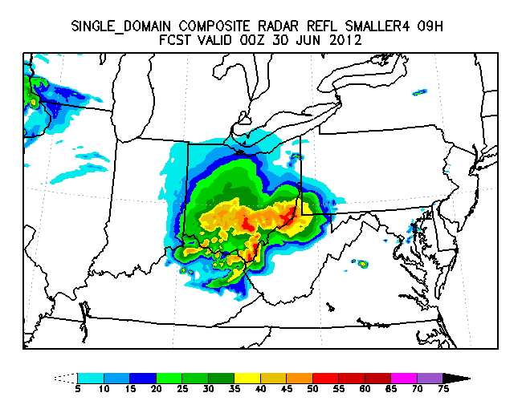
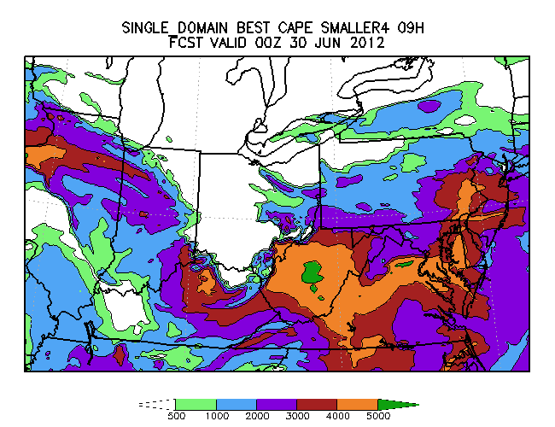
4km 15Z NMMB Run
NAMRR for ICs and LBCs,No Cu, Separate Spec. Adv.
Max Hrly 1-km AGL Refl
Max Hrly 10-M Wind
54 kts
Composite Radar Refl
09h/00Z
Most Unstable CAPE

Slide 25
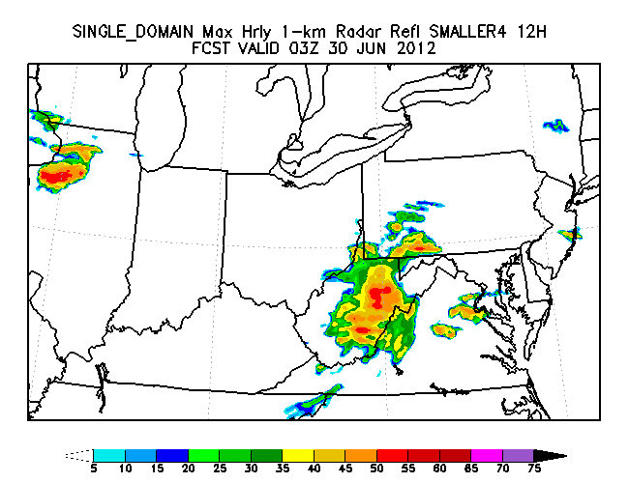
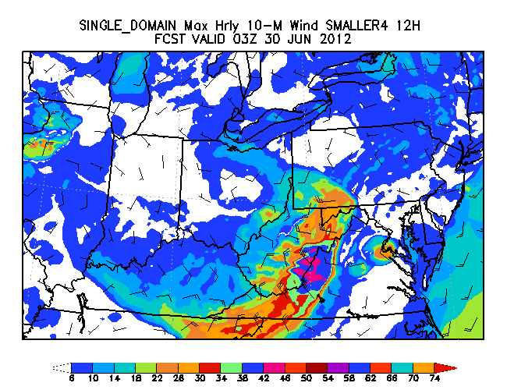
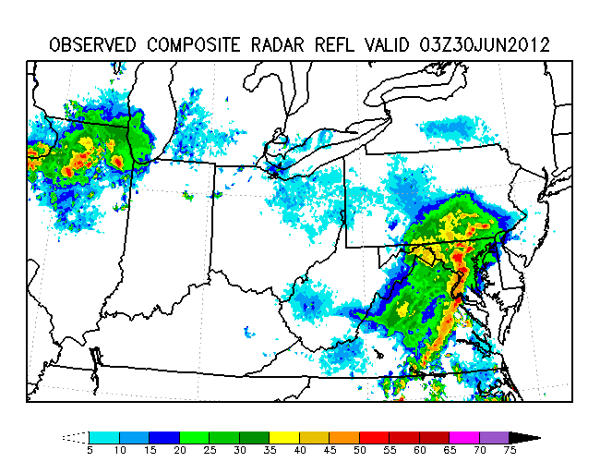
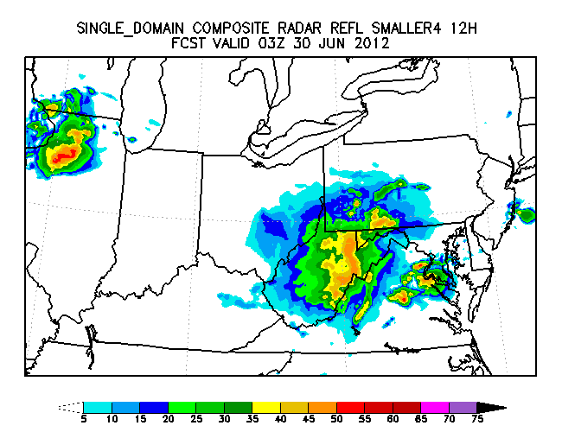
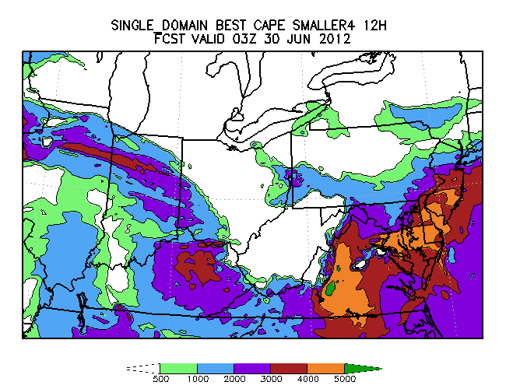
4km 15Z NMMB Run
NAMRR for ICs and LBCs,No Cu, Separate Spec. Adv.
Max Hrly 1-km AGL Refl
Max Hrly 10-M Wind
Composite Radar Refl
12h/03Z
Most Unstable CAPE
Too slow by ~ 2 hours

Slide 26
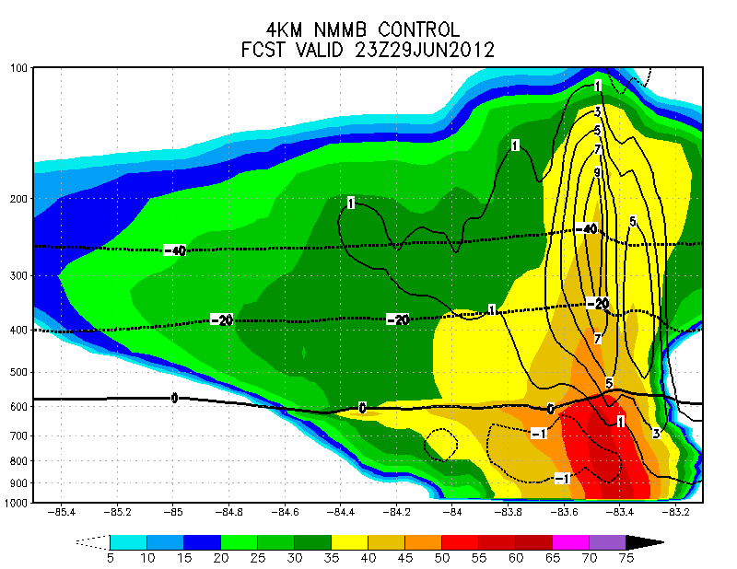
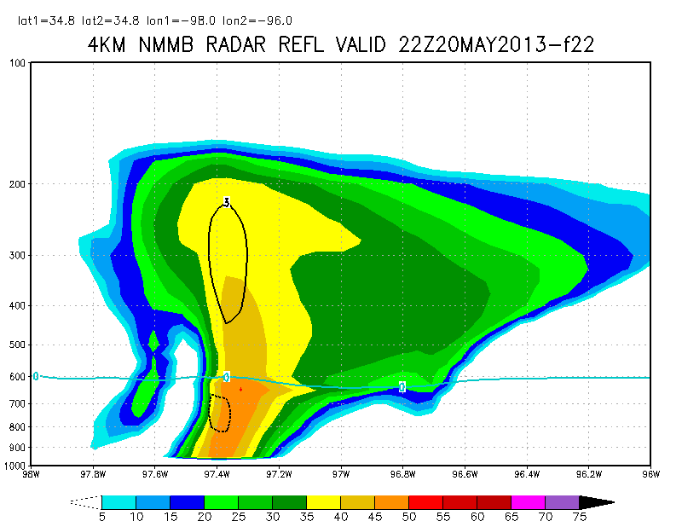
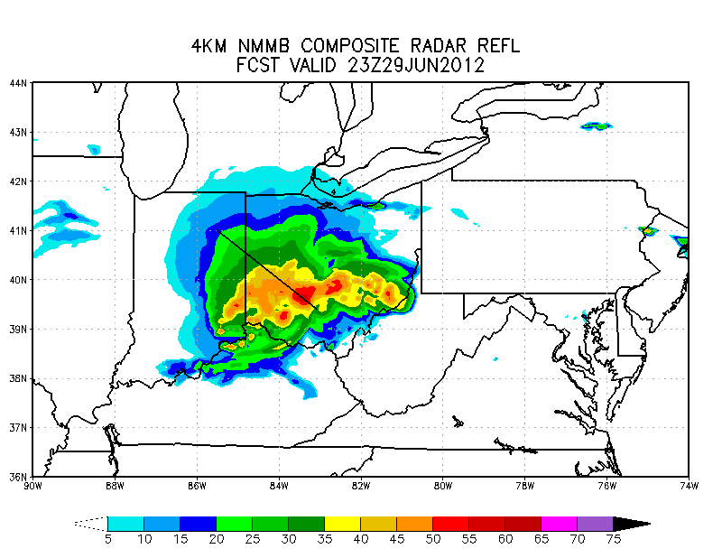
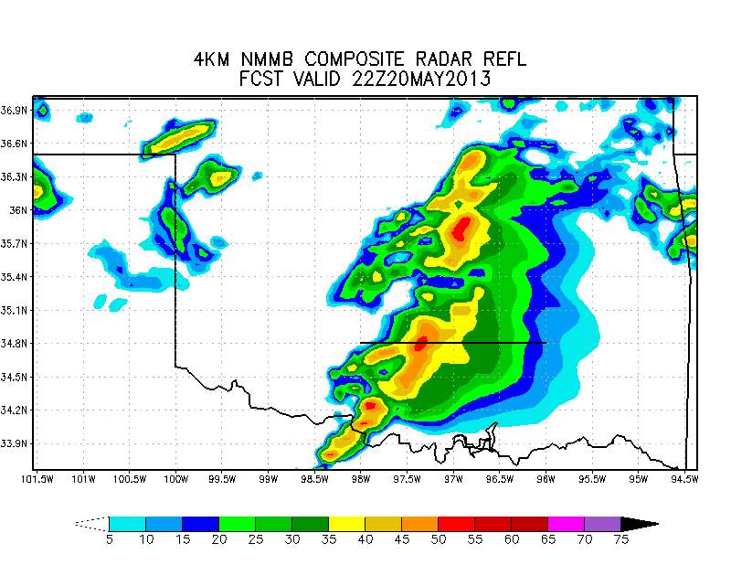
Motivation for Revised Microphysics
Derecho
Moore, OK
Operational Microphysics
Contours are vertical
velocities in m/s
A
B
A
B
Lack of a well defined,
deep convective core
A
B
A
B

Slide 27
Importance of Rime Factor (RF) Treatment in the Convective Region
(Growth of snow by liquid accretion + vapor deposition)
Rime Factor = (Growth by vapor deposition only)
Rime Factor (RF) = 1.0 if all growth is by vapor deposition
Larger values of RF mean more 'snow' (Qs) growth by liquid water accretion through cloud water riming and/or freezing of rain drops.
RF is not advected in operational microphysics, preventing higher RFs from reaching upper levels where temperatures are colder than -40C.
Advecting the mass-weighted RF (Qs*RF) helps higher RFs reach temps colder than -40C, allowing for more realistic RFs in the convective region.
The mass weighting is based on advecting large ice (snow/graupel, Qs) mixing ratios and advecting the product, Qs*RF

Slide 28
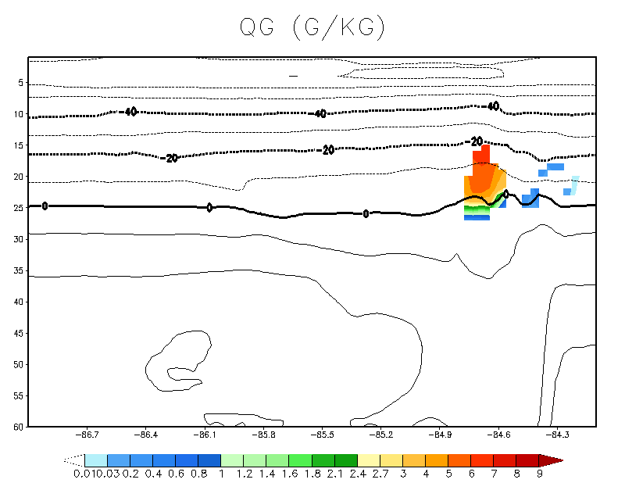
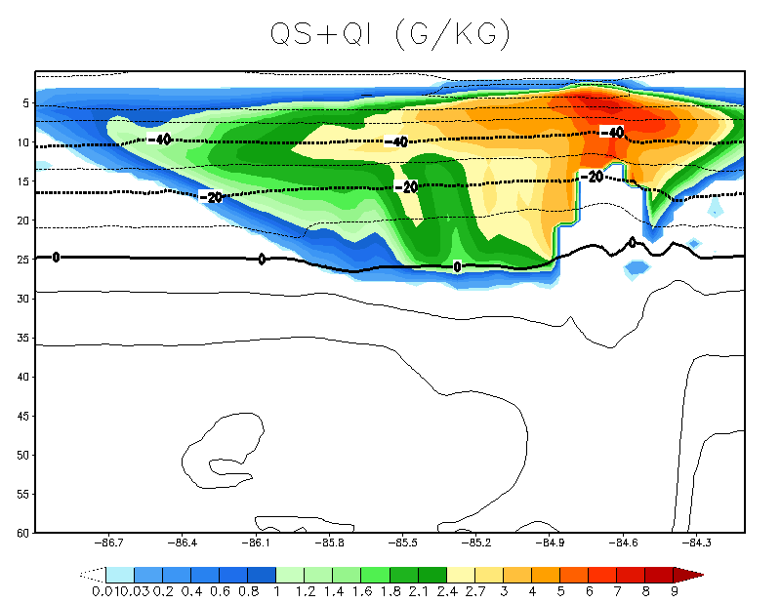
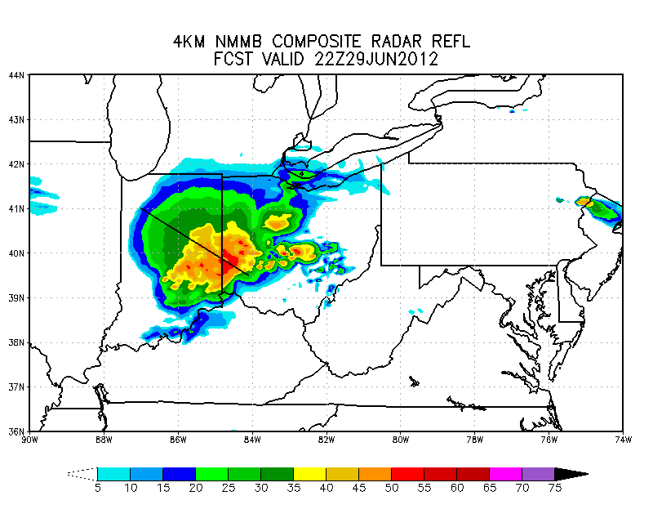
Operational Microphysics
Graupel (G/KG)
Snow+Cloud Ice (G/KG)
22Z 29 June 2012
Graupel restricted
to T > -20C
Most ice in the form of snow
A
A
B
A
B
B

Slide 29
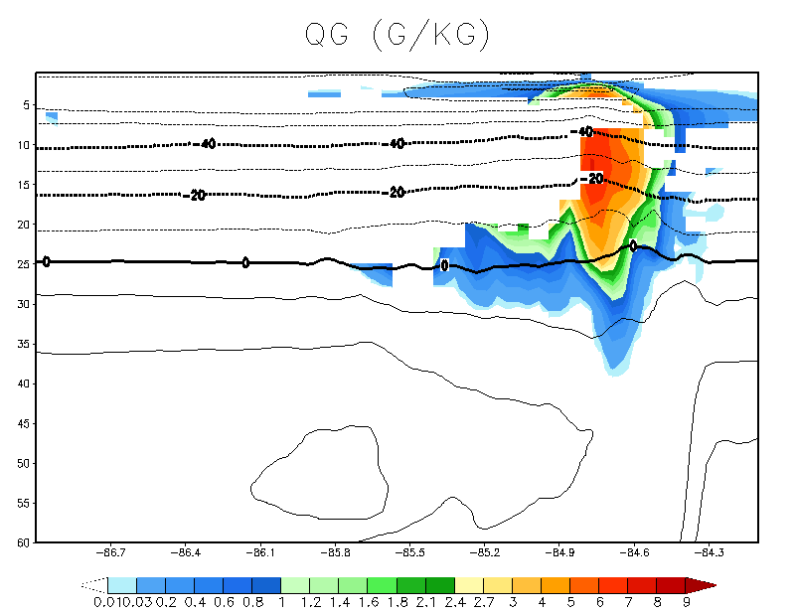
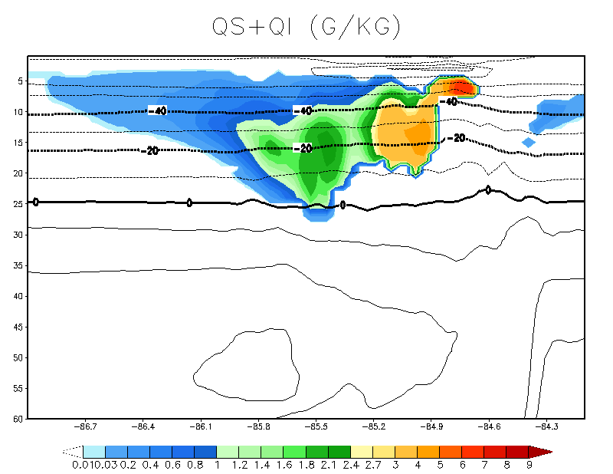
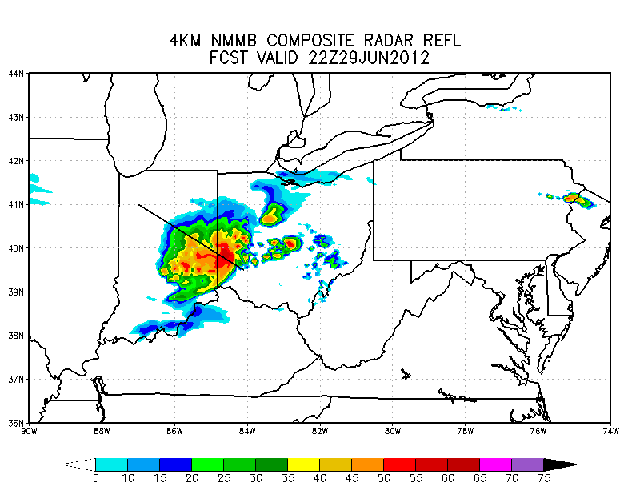
Operational Microphysics
Graupel (G/KG)
Snow+Cloud Ice (G/KG)
22Z 29 June 2012
A
Graupel restricted
to T > -20C
Most ice in the form of snow
A
B
A
B
B
With Mass-Weighted RF Advection
Higher convective core reflectivities, smaller anvil
A
More uniform graupel field
Graupel reaching to T < -40C
Less ice in the form of snow
B
A
B
A
B

Slide 30
Experiment: Reduced Rain Evaporation to Improve 1km AGL Reflectivities
07h/22Z
CONTROL
Reduced Rain Evaporation
Weak reflectivities overall and in stratiform region
Higher reflectivities, but still a weak stratiform region

Slide 31
Experiment: Reduced Rain Evaporation to Improve 1km AGL Reflectivities
09h/00Z
CONTROL
Reduced Rain Evaporation
Higher reflectivity

Slide 32
Experiment: Reduced Rain Evaporation to Improve 1km AGL Reflectivities
11h/02Z
CONTROL
Reduced Rain Evaporation
Higher reflectivity

Slide 33
Experiment: Reduced Rain Evaporation to Improve 1km AGL Reflectivities
07h/22Z
CONTROL
Reduced Rain Evaporation
Slower, weaker derecho
Max Hourly 10m Winds

Slide 34
Experiment: Reduced Rain Evaporation to Improve 1km AGL Reflectivities
09h/00Z
CONTROL
Reduced Rain Evaporation
Slower, weaker derecho
Max Hourly 10m Winds

Slide 35
Experiment: Reduced Rain Evaporation to Improve 1km AGL Reflectivities
11h/02Z
CONTROL
Reduced Rain Evaporation
Slower, weaker derecho
Max Hourly 10m Winds

Slide 36
Rain Evaporation and Microphysics Heating
Control
Reduced Rain Evap.
Composite Refl.
Peak evap. shifted to lower levels
B
Rain Evap.
A
A
B
A
B
Slab Averaged
Cross-Section
Cooling shifted to lower levels
Heating/Cooling
A
B
A
B

Slide 37
Experiment: Decreased Rimed Ice Fall Speeds to Improve Anvil Size
Control
Slower Fall Speeds
Reflectivity too high near melting level
Too broad of a convective region
Reflectivity
A
B
A
B
05h/20Z
B
B
A
Composite Refl.
A
Slab Averaged
Cross-Sections

Slide 38
Ferrier-Aligo Microphysics
Advection of mass-weighted rime-factor (RF; i.e. “variable ice density”).
Max N_{LI} a function of RF and temperature (no longer a constant).
“Stratiform mode” when RF<10, max N_{LI} ranges from 5-10 L⁻¹.
“Convective mode” when RF>=10, max N_{LI}=1 L⁻¹
“Hail mode” when RF>=10, mean diameters >=1mm (N_{LI}=1 L⁻¹).
Promote more supercooled liquid water.
Modest reduction in rimed ice fall speeds.
Increased radar backscatter from wet, melting ice, and at T<0C when rain & ice coexist in intense updrafts.
Combined radar return from rain and heavily rimed ice in areas of intense convection where either (a) ice is formed from freezing of rain drops or (b) rain is formed from melting of large ice.
(Other changes related to cloud ice production not discussed here)

Slide 39
Operational Microphysics
Ferrier-Aligo Microphysics
A
A
65 dBZ
B
B
08h/23Z
50+ dBZ reflectivity up to
250mb
50 dBZ reflectivity below 600 mb
A
B
A
B

Slide 40
Observed Reflectivity: 29-30 June 2012 Derecho
21Z
22Z
50 dBZ shading up to
250mb
A
B
A
B
A
A
B
B

Slide 41
20-21 May 2013 Moore, OK Tornado Outbreak
Operational
Microphysics
Ferrier-Aligo Microphysics
Observed
Reflectivity
< 50 dBZ
>= 55 dBZ
A
B
A
B
A
B
>= 55 dBZ
A
B
A
B
A
B
22h/22Z

Slide 42
23Z/20 May 2013 (23-h)
Operational
NAM CONUS Nest
Operational
Microphysics
Ferrier-Aligo
Microphysics
Observed
Reflectivity

Slide 43
Summary
Initial conditions were very important in forecasting the 29-30 June 2012 derecho.
15Z RAPv2 and NAMRR ICs and LBCs provided the best forecast although both were too slow in the progression of the derecho.
Ferrier-Aligo scheme improved vertical radar reflectivity structure of storms
Mass-weighted rime-factor (RF) advection
Max N_{LI} a function of RF and temperature
Higher reflectivities from mixed-phase ice

