Slide 1
HWRF Microphysics Tests
EMC HWRF team and Brad, Eric presented by Weiguo Wang
Feb. 27 2014

Slide 2
Outline
Description of experiments
East Pacific and Atlantic stats
Track and intensity of individual storms
Distribution of Hydrometers from one cycle
Summary and thoughts

Slide 3
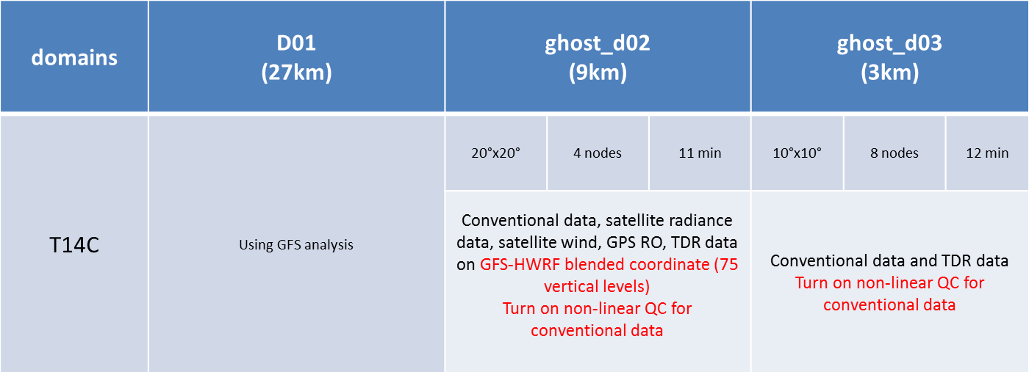
HWRF control run
T14C --- potential HWRF FY14 configuration

Slide 4
Experimental runs
● T14C -- control run
old mp + without advection
~60min Zeus (WRF part)
● H242 --- new mp + without advection
~60min Zeus (WRF part)
● H142 -- new mp + with advection
~80min Zeus (WRF part)

Slide 5
Priority cases for 2014 implementation tests
Landfalling storms
2010: Earl(07l), Mattew(15l)
2011: Harvey(08l), Irene(09l), Lee(13l), Nate(15l),
2012: Carlotta(03e),Paul(16e), Debby(04l), Ernesto(05l), Isaac(09l), Sandy(18l)
2013: Raymond(17e), Sonia(18e), Dorian(04l), Ingrid(10l), Karen(12l)
Total: 17 storms
Storms which perform bad
Frank(09e, 2010), Eugene(05e, 2011), Irene(09l, 2011), Hector(09e, 2010) Dalia(04e, 2013)
5 storms
Storms which perform well
Katia(12l,2011), Leslie(12l,2012), Erik(05e, 2013), Flossie(06e, 2013)
4 storms

Slide 6
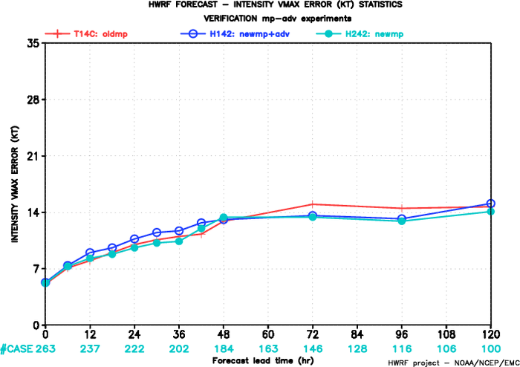
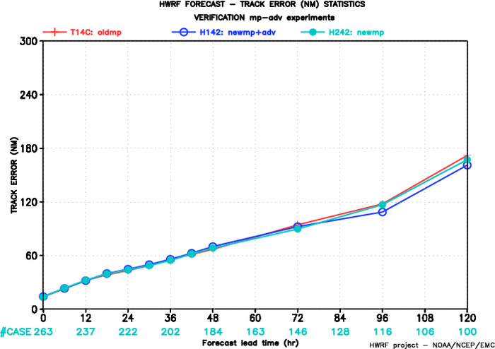
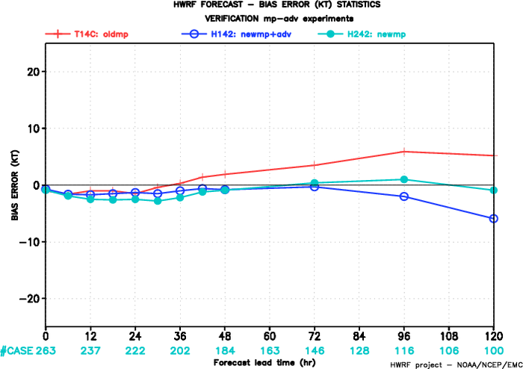
ATL all exp storms
Intensity error
Track error
Bias
Control
Newmp
Newmp+advect
Track similar, NewMp (H242) gives promising intensity improvement

Slide 7
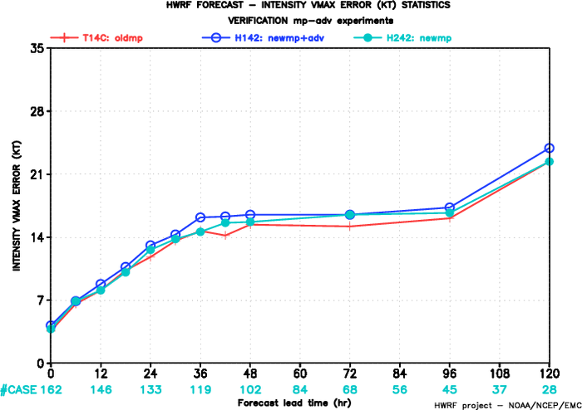
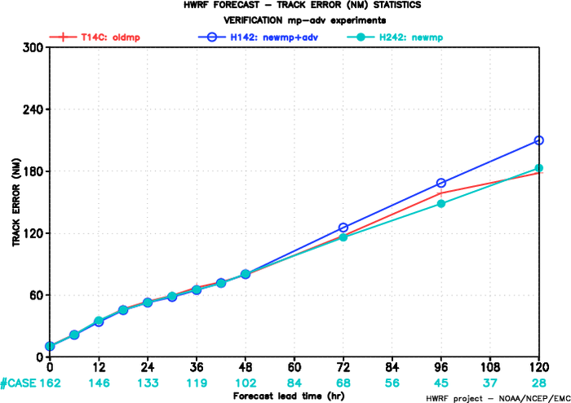
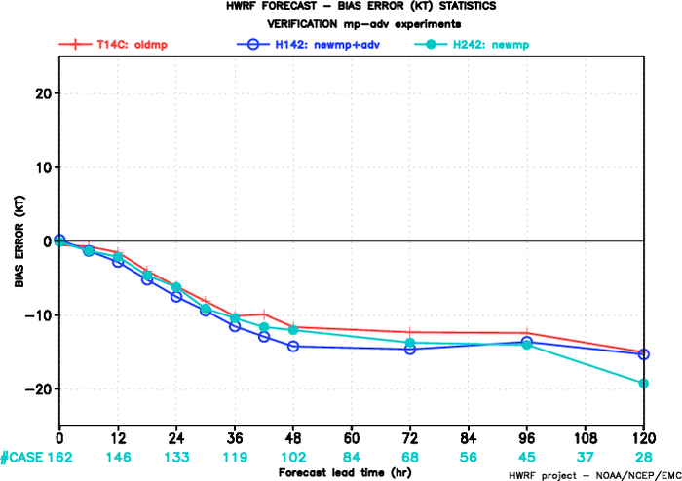
EP all exp storms
Intensity error
Track error
Control
Newmp
Newmp+advect
Bias
Track, similar < 72hrs
NewMp Track better > 72hrs Advec degrade
Intensity, a little worse > 24hrs

Slide 8
Composite track and intensity for individual storms
Landfalling storms --- Sandy 18L 2012
Storms which perform bad -- Hector 08E 2012
Storms which perform well -- Eric 05E 2013, Katia 12L2011

Slide 9
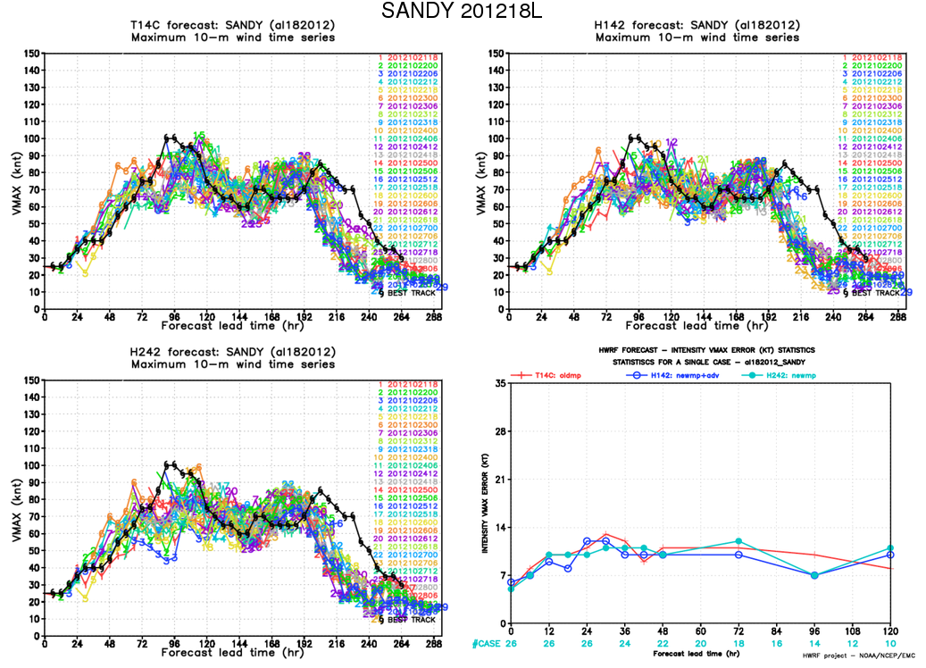
Sandy 18L 2012
Intensity
Control
NewMP+adv
Control
Newmp
Newmp+advect
NewMP

Slide 10
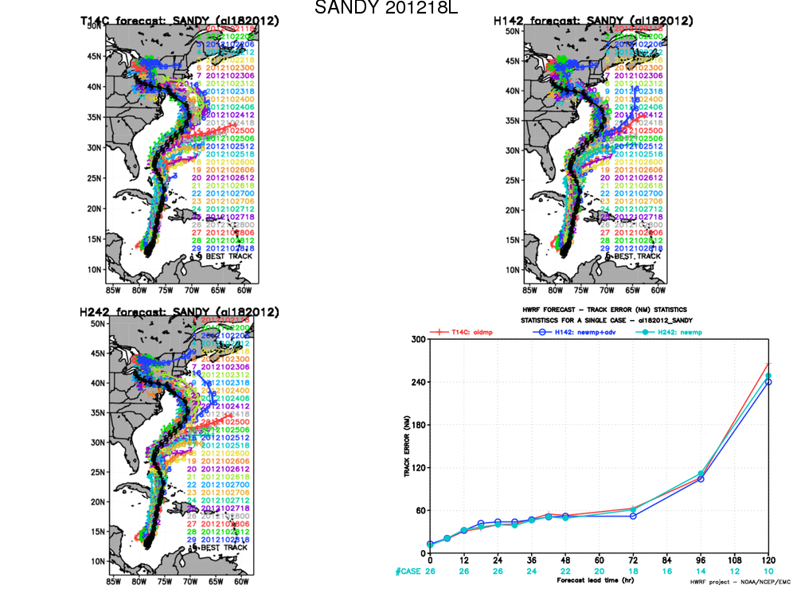
Sandy 18L 2012
Track
Control
NewMP+adv
Control
Newmp
Newmp+advect
NewMP

Slide 11
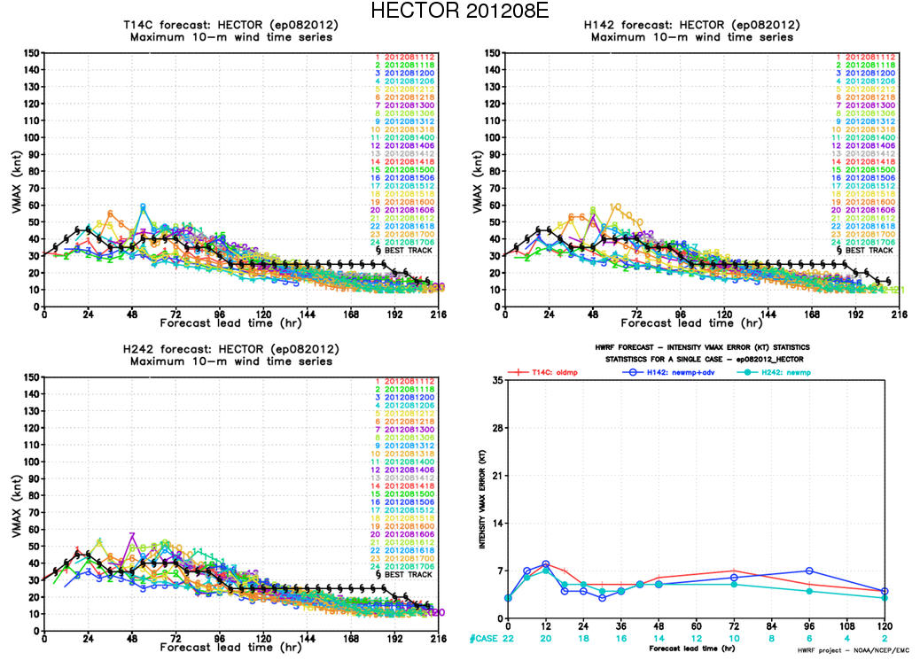
Hector 08E 2012
Intensity
Control
NewMP+adv
Control
Newmp
Newmp+advect
NewMP

Slide 12
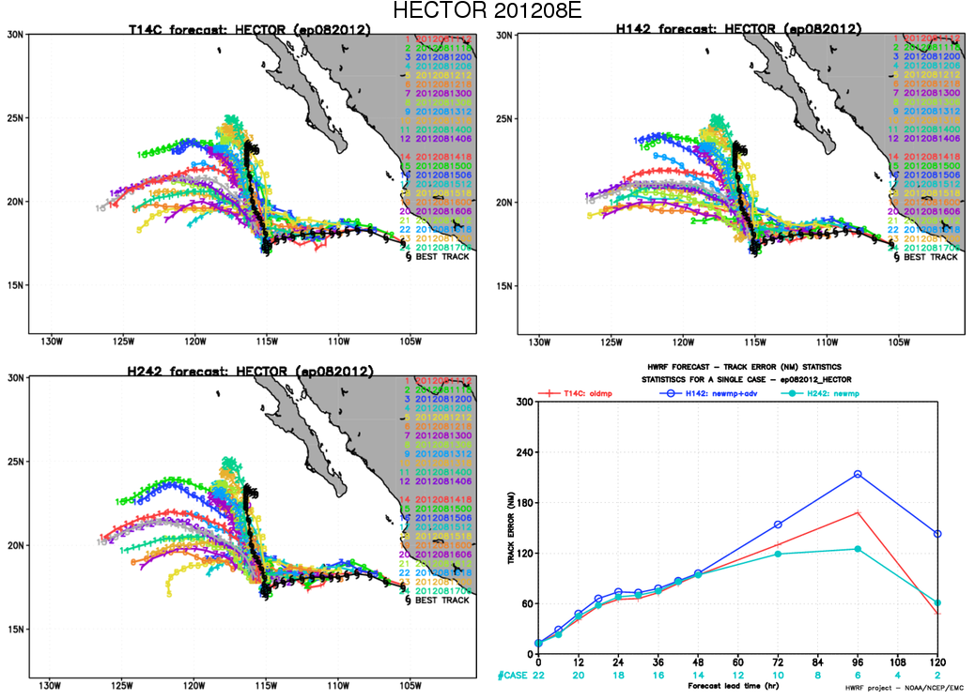
Hector 08E 2012
Track
Control
NewMP+adv
NewMP
Control
Newmp
Newmp+advect

Slide 13
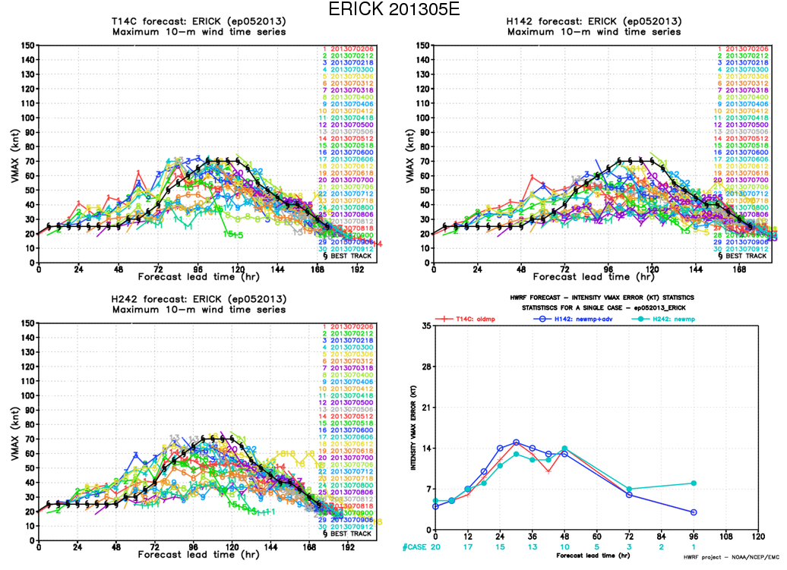
EriK 05E 2013
Intensity
Control
NewMP+adv
Control
Newmp
Newmp+advect
NewMP

Slide 14
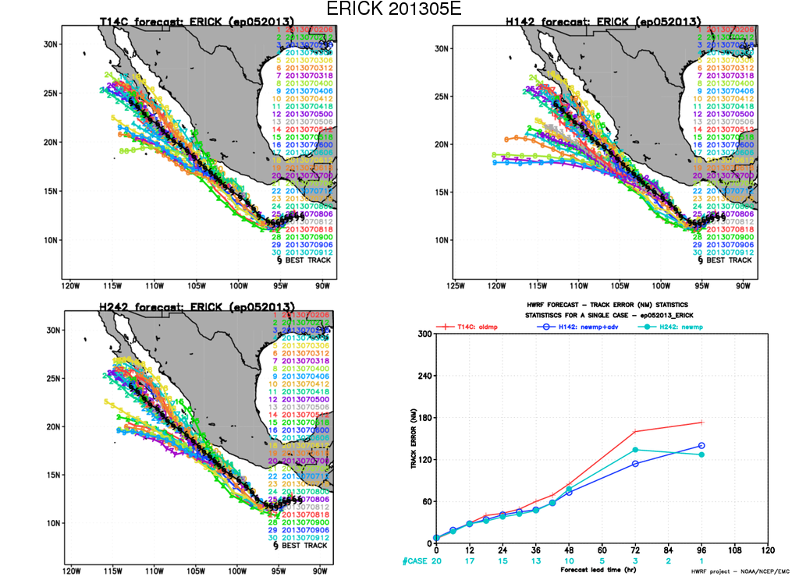
EriK 05E 2013
Track
Control
NewMP+adv
Control
Newmp
Newmp+advect
NewMP

Slide 15
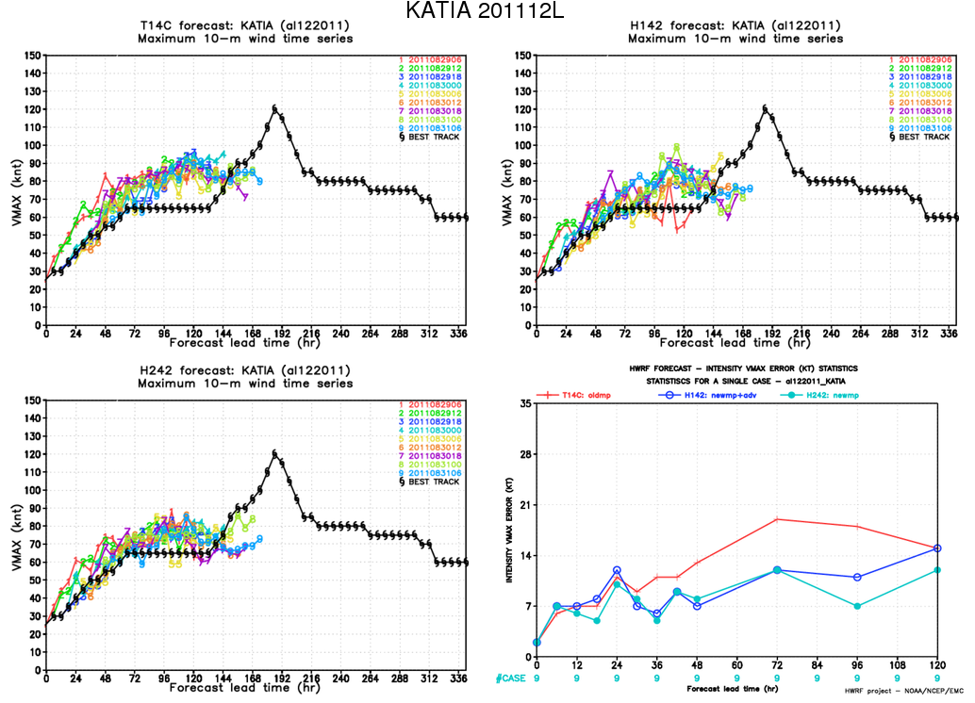
Katia 12L 2012
Intensity
Control
NewMP+adv
NewMP
Control
Newmp
Newmp+advect

Slide 16
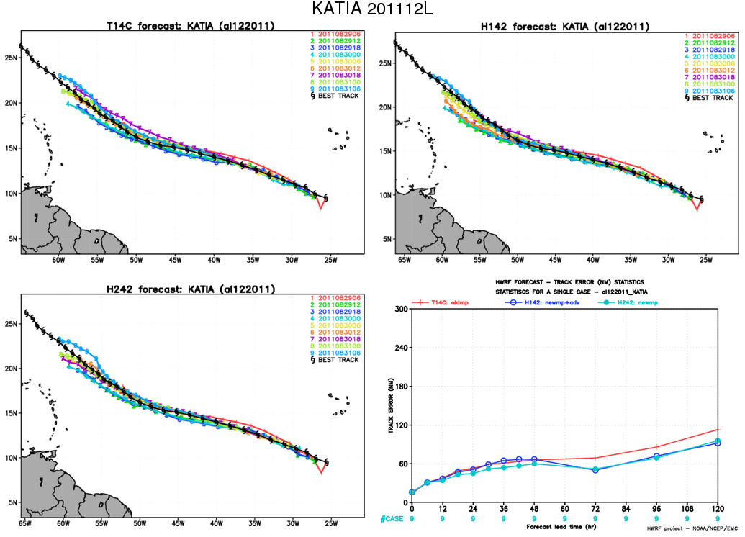
Katia 12L 2012
Track
Control
NewMP+adv
NewMP
Control
Newmp
Newmp+advect

Slide 17
Hydrometers
Sandy 18L 2012
First cycle, cold start, same initial condition

Slide 18
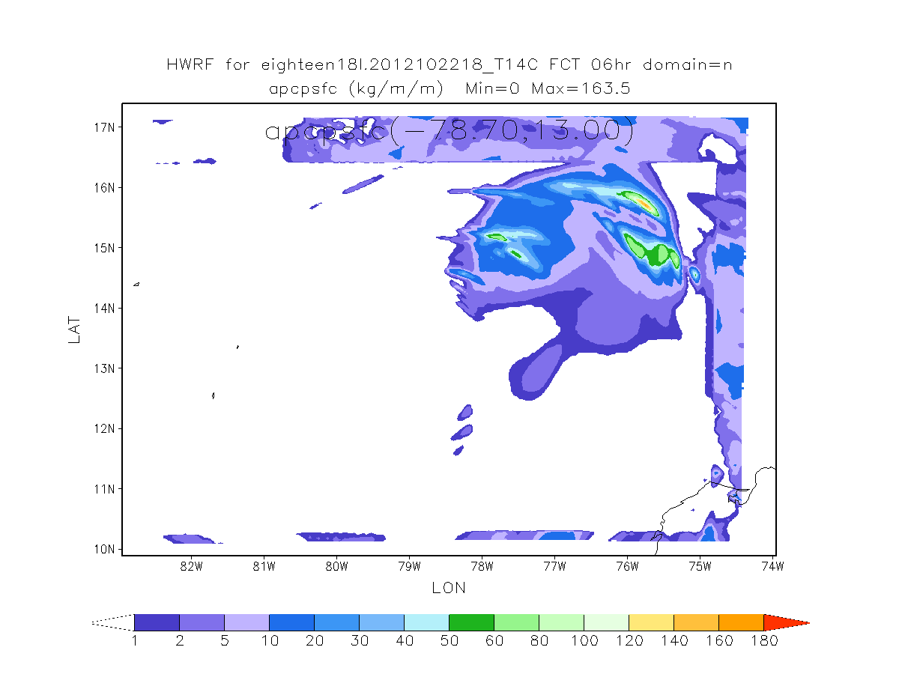
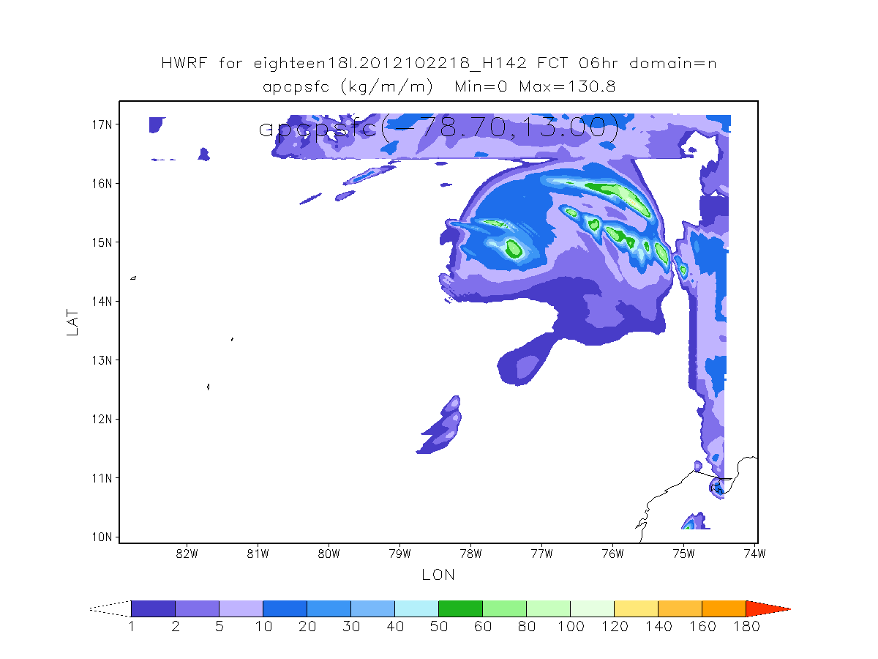
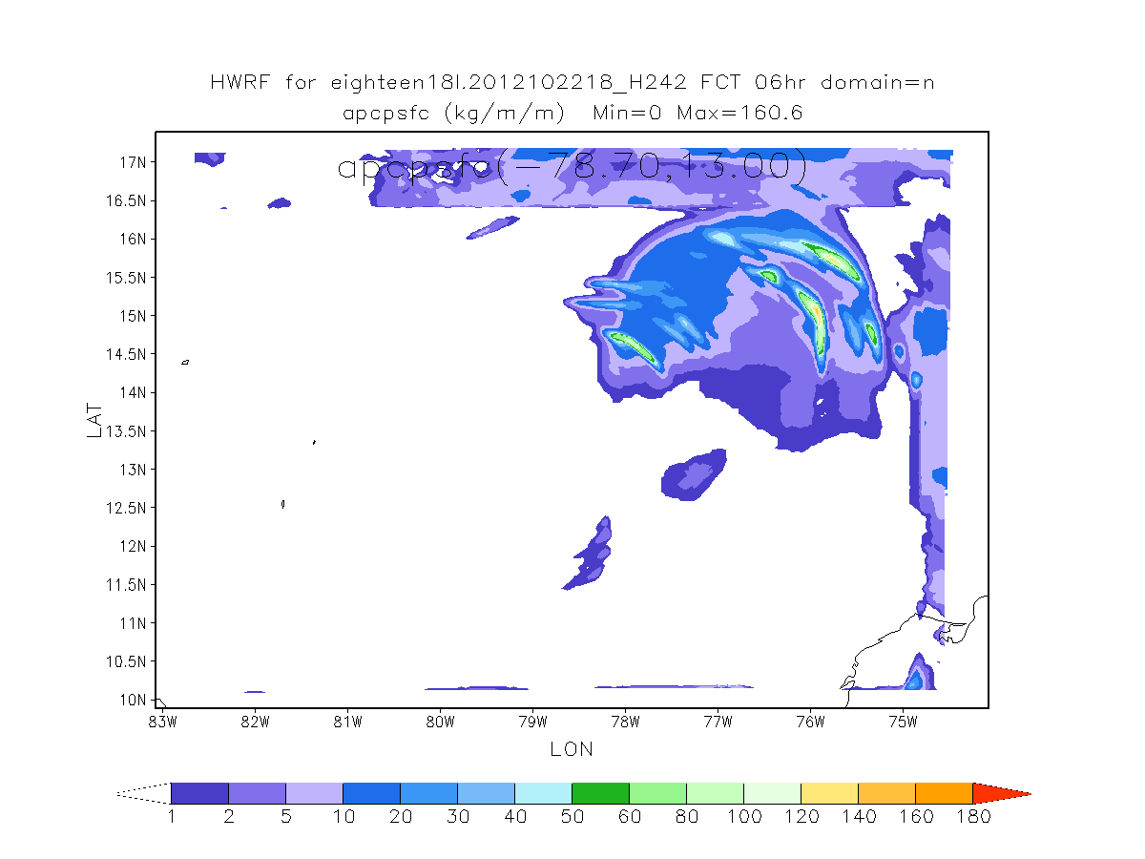
Accumulative Precip
Control
NewMP+adv
NewMP
Two New MP runs– more rain than CTL
With adv, smaller

Slide 19
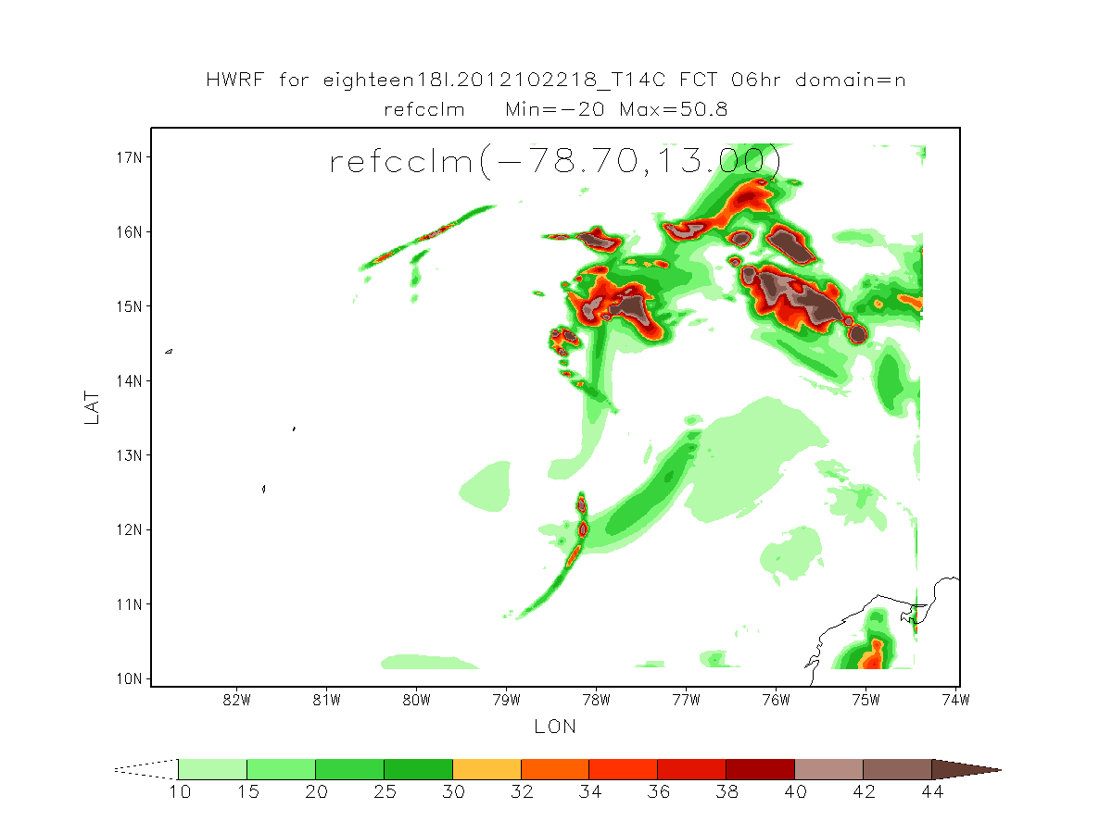
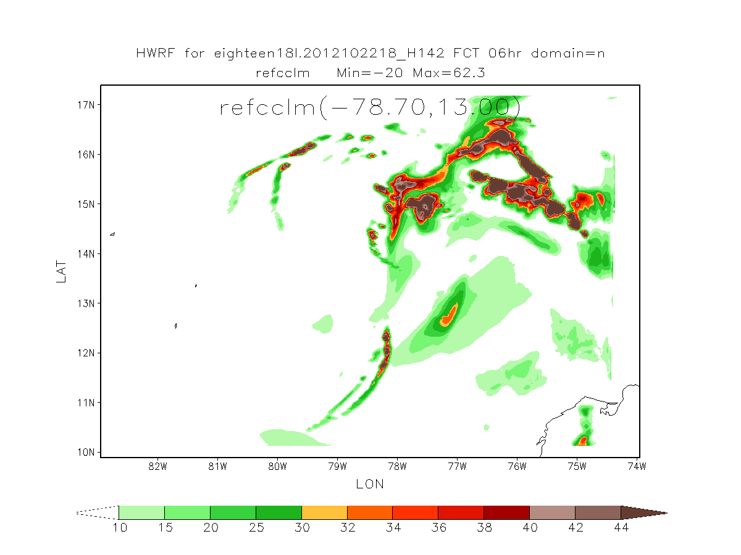
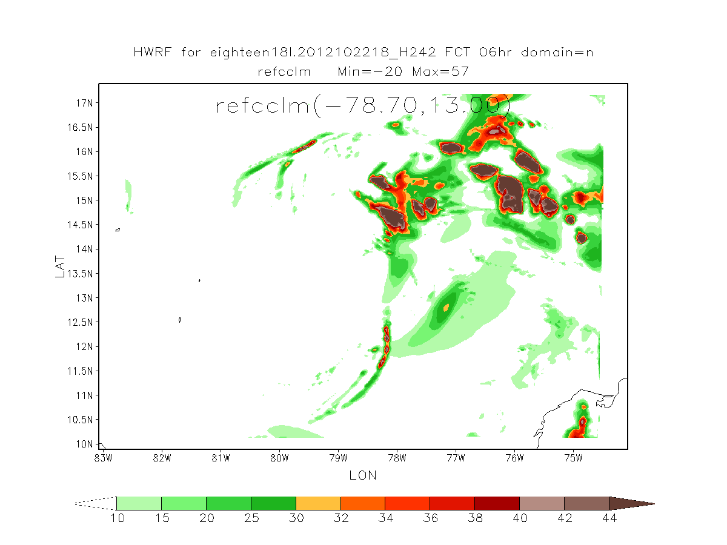
Composite Reflectivity
Control
NewMP+adv
NewMP
NewMP , larger

Slide 20
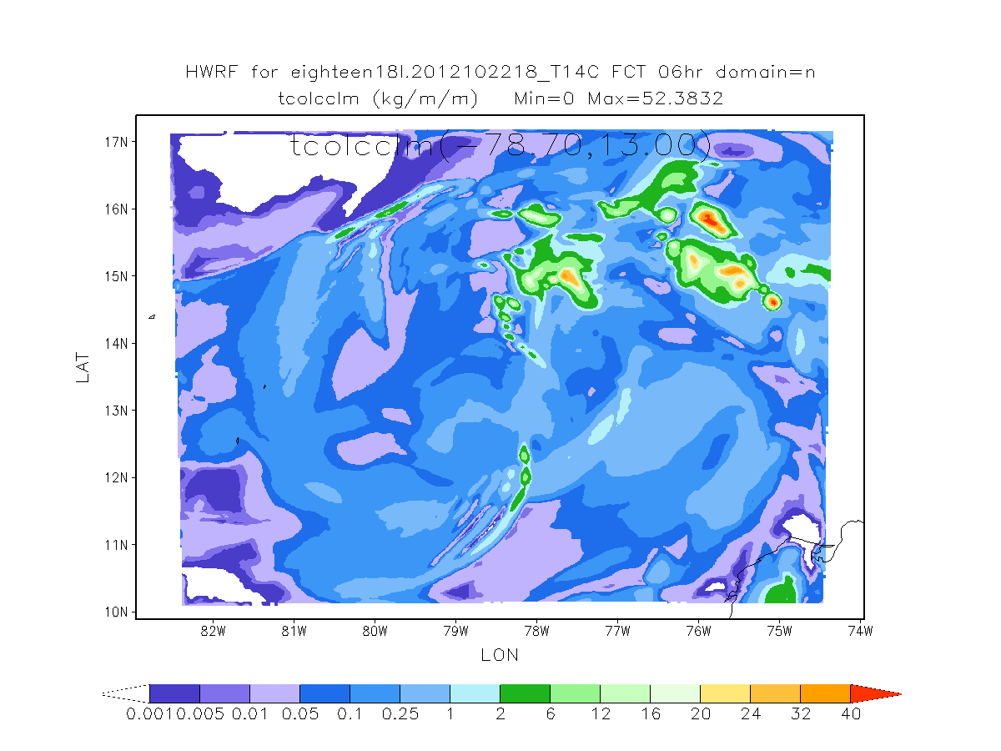
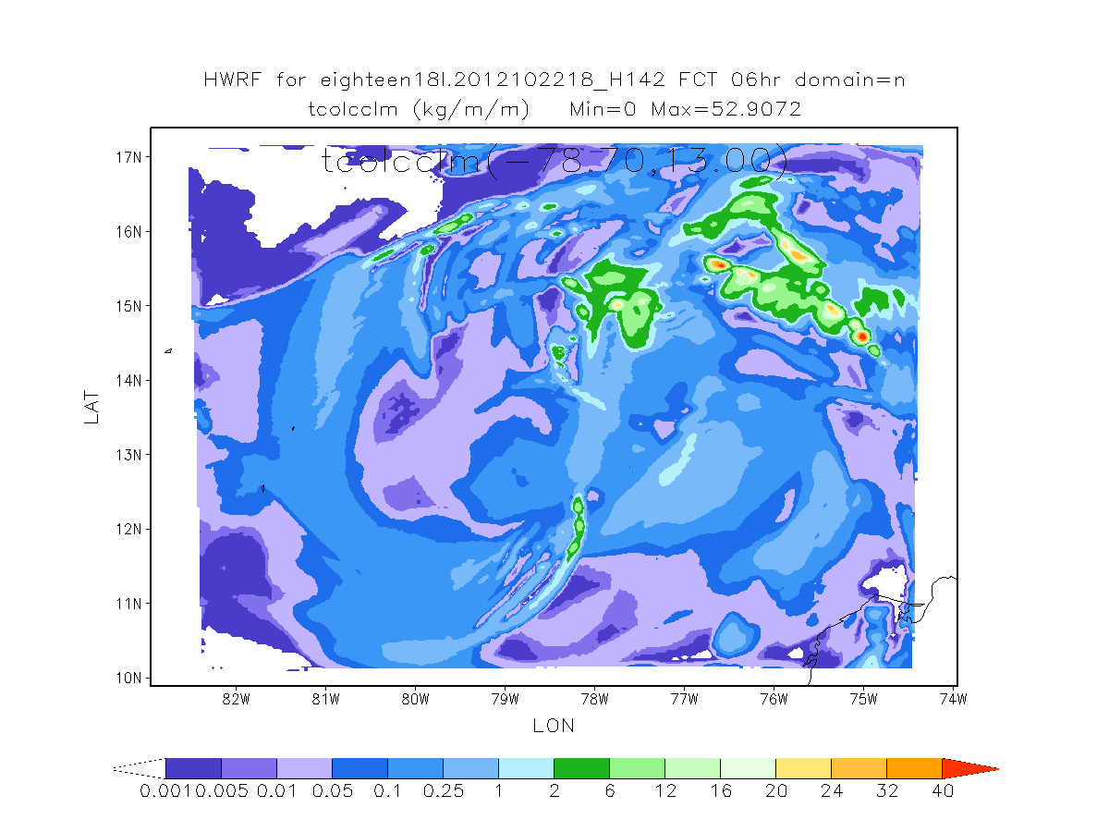
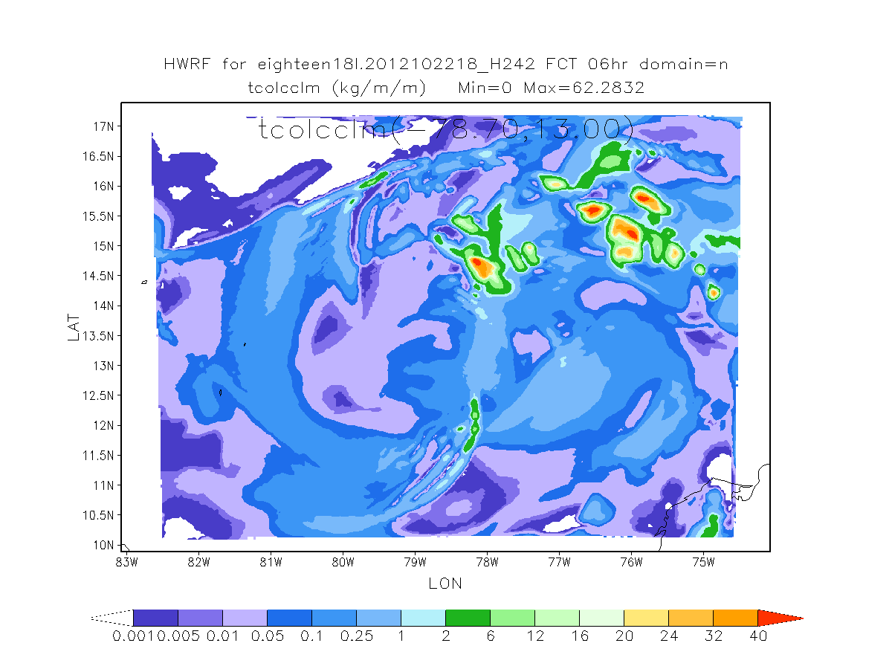
Tot column Condensate
Control
NewMP+adv
NewMP
NewMP, more cond, large max values

Slide 21
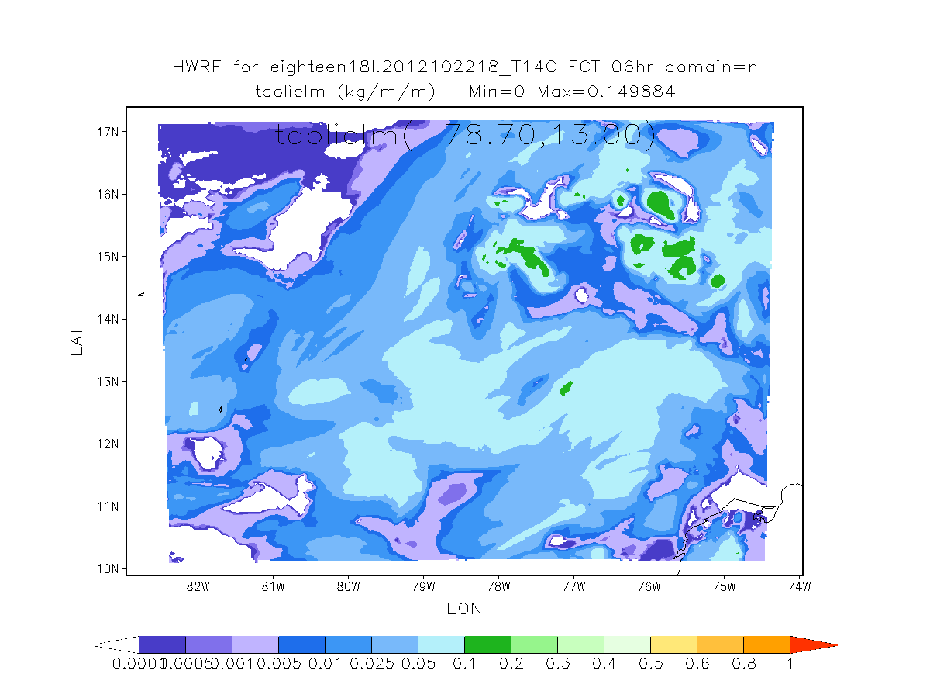
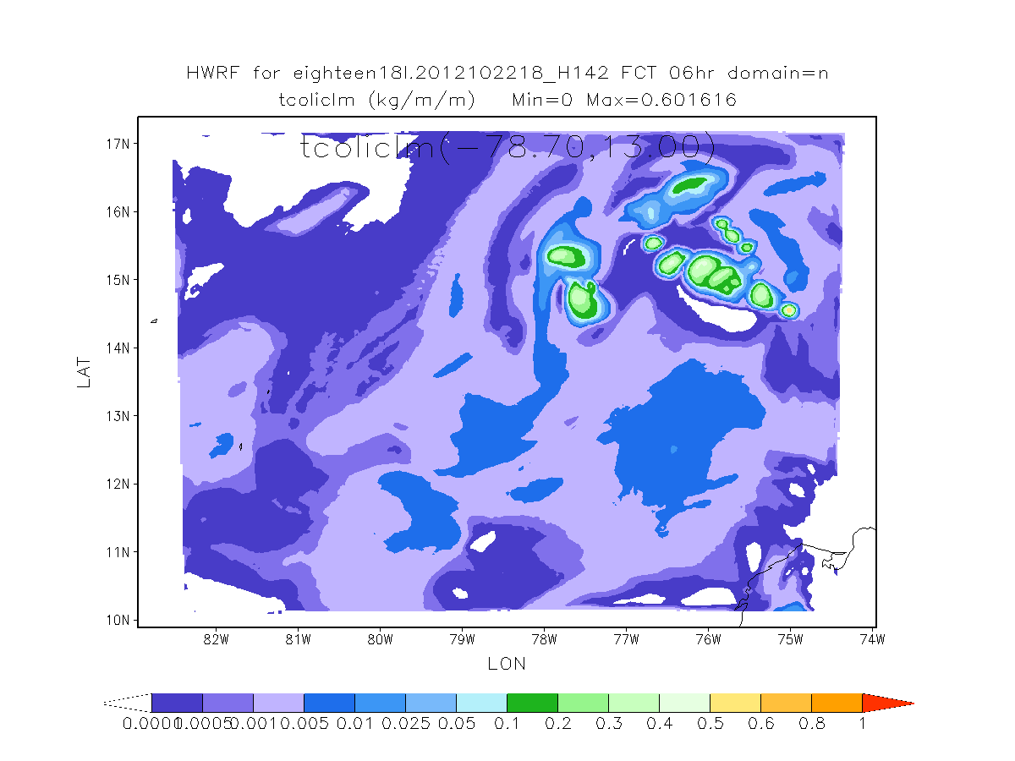
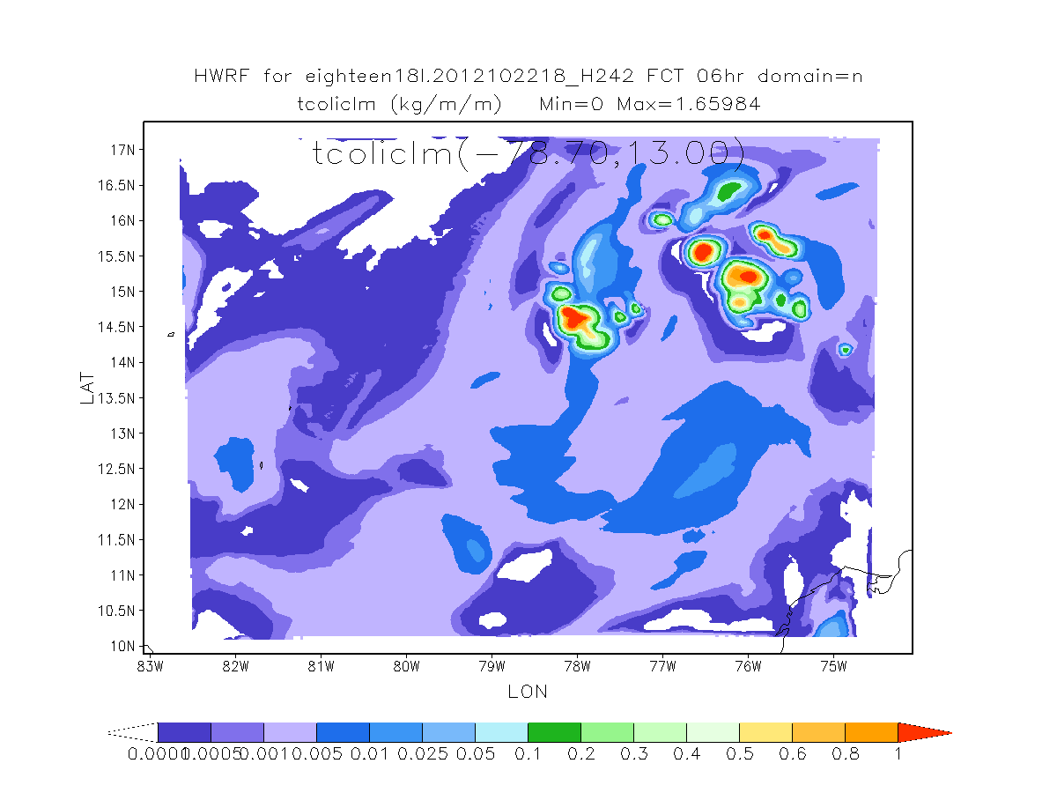
Total column ice
Control
NewMP+adv
NewMP
Compared with control, two NewMP runs less spread, larger max values
NewMP without adv, largest

Slide 22
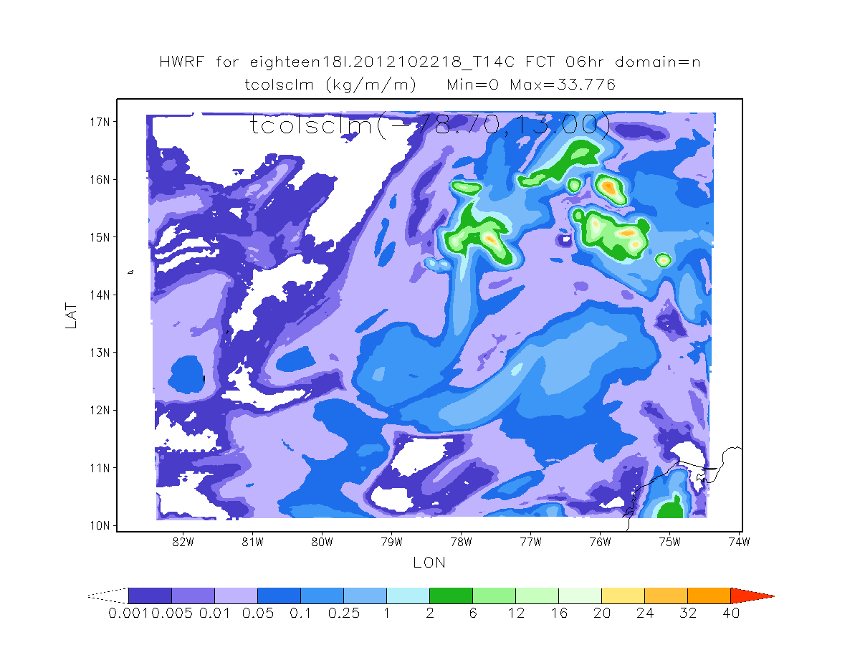
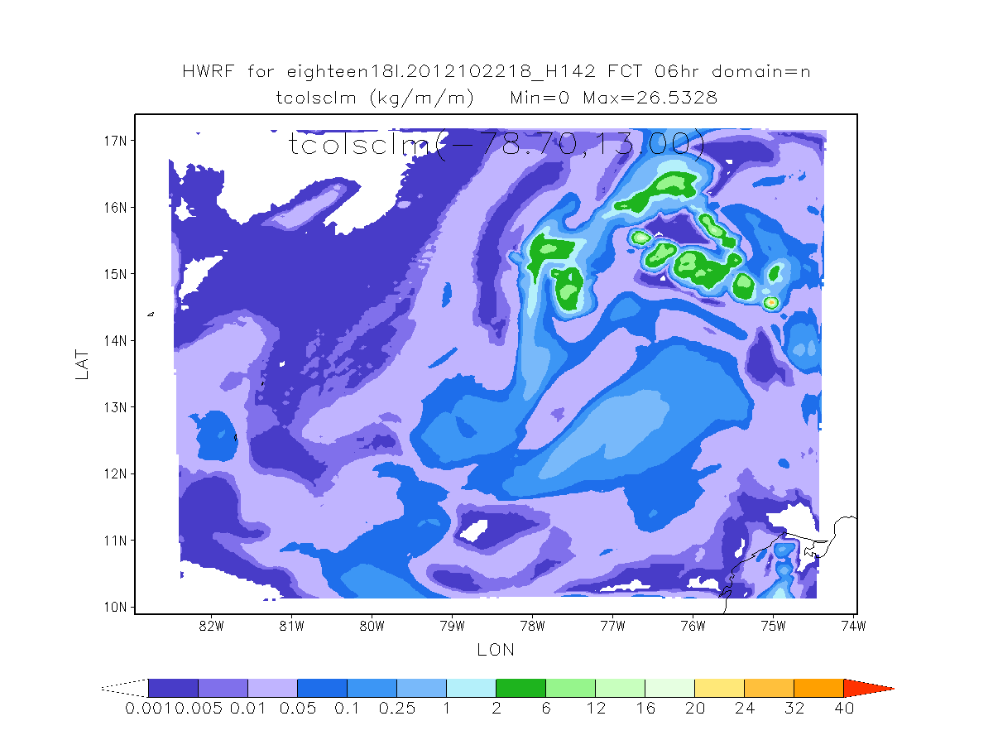
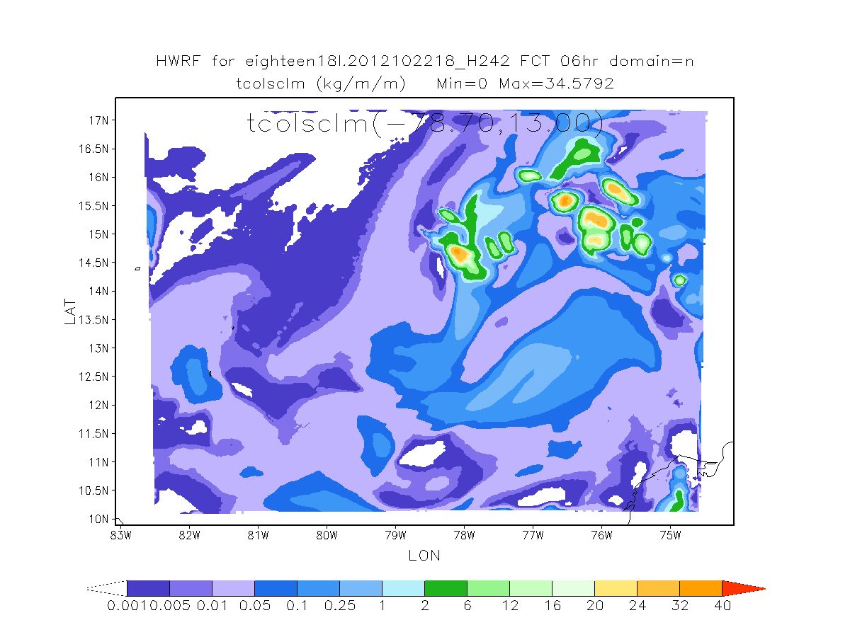
Tot column snow
Control
NewMP+adv
NewMP
Control , NewMP similar
NewMP+adv less snow

Slide 23
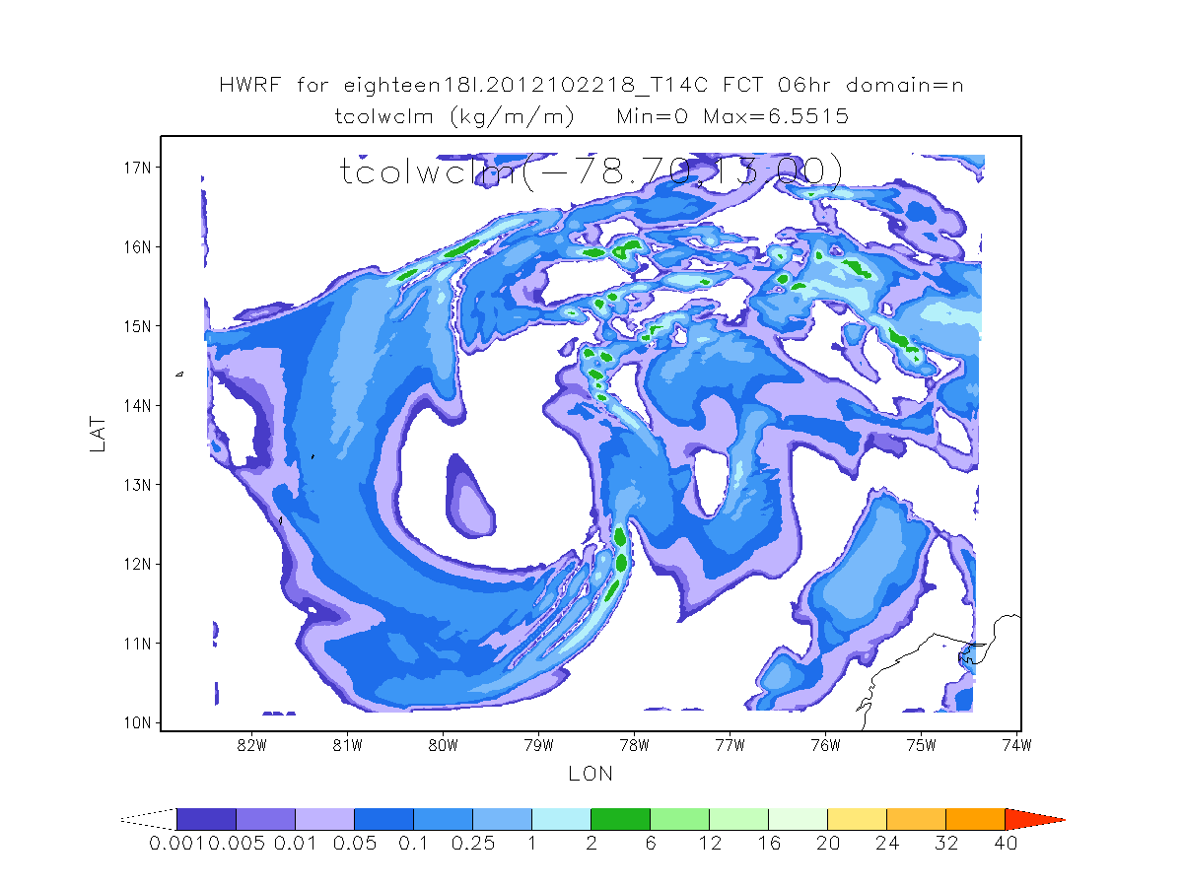
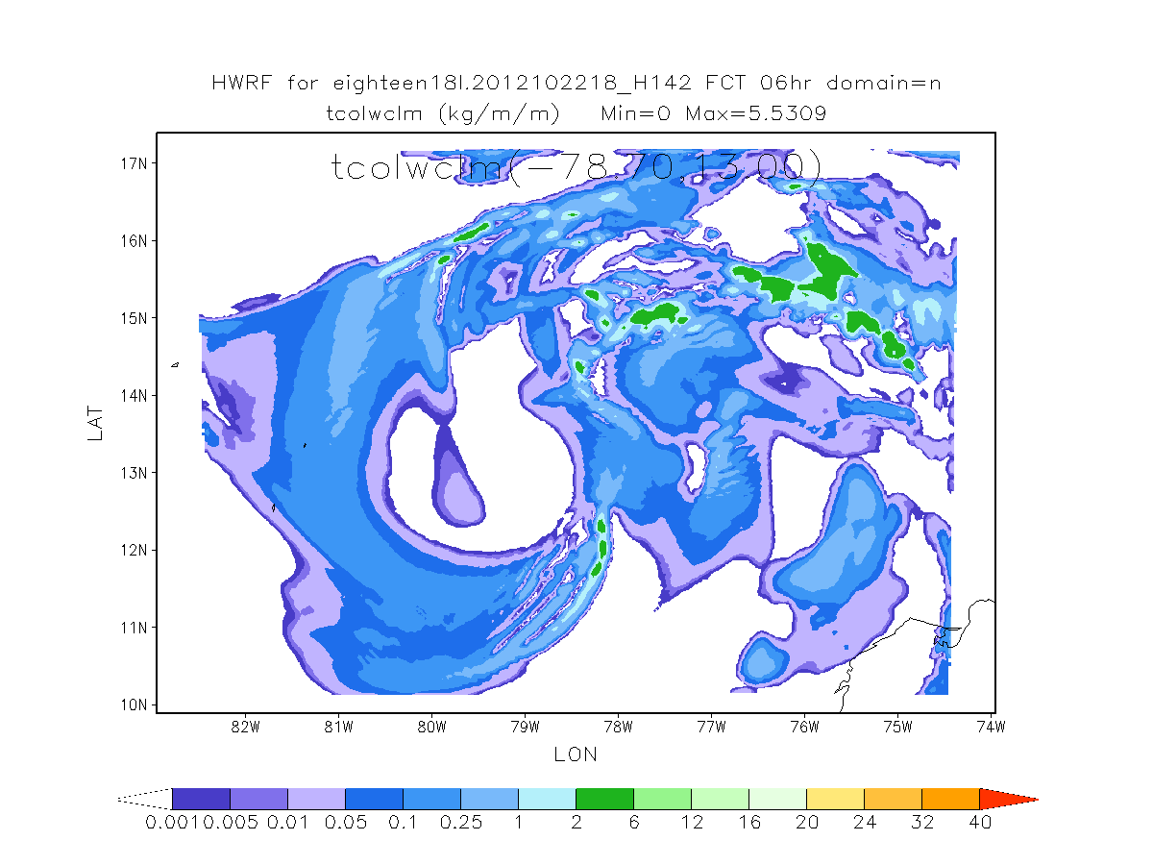
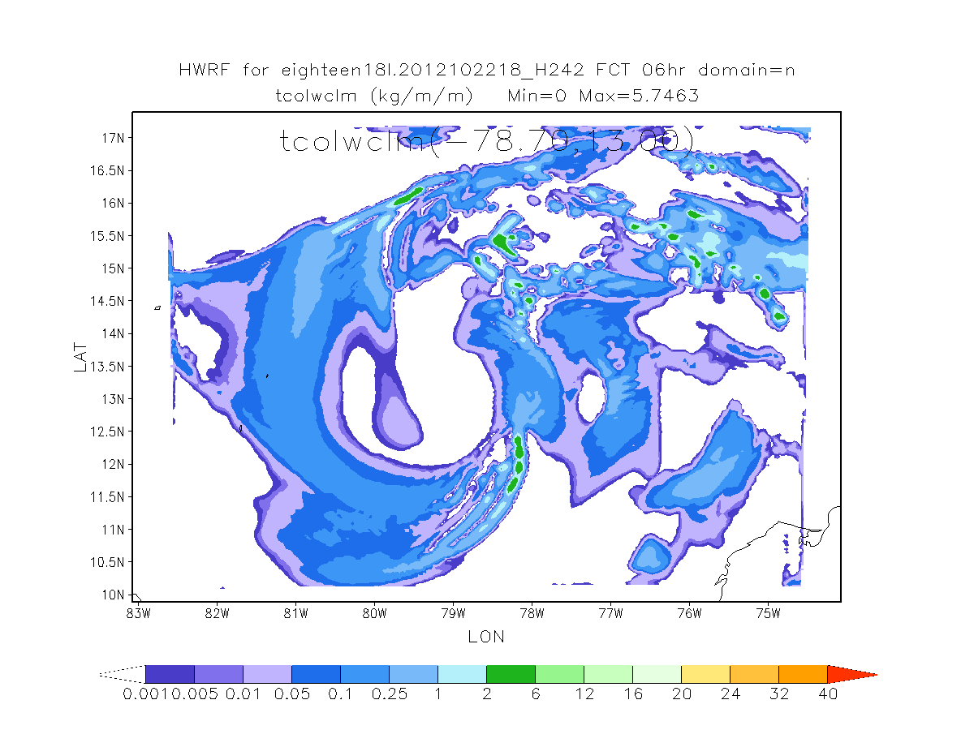
Total column cloud water
Control
NewMP+adv
NewMP
NewMP+adv : large areas with large cloud water

Slide 24
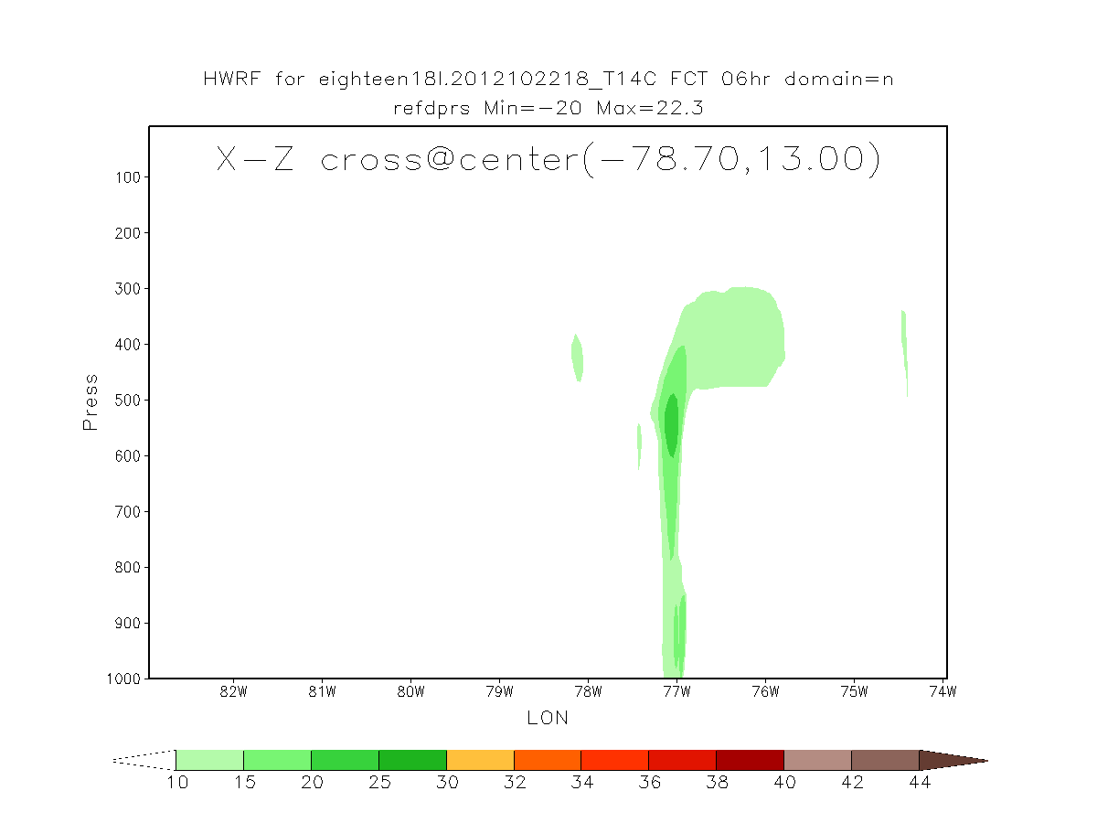
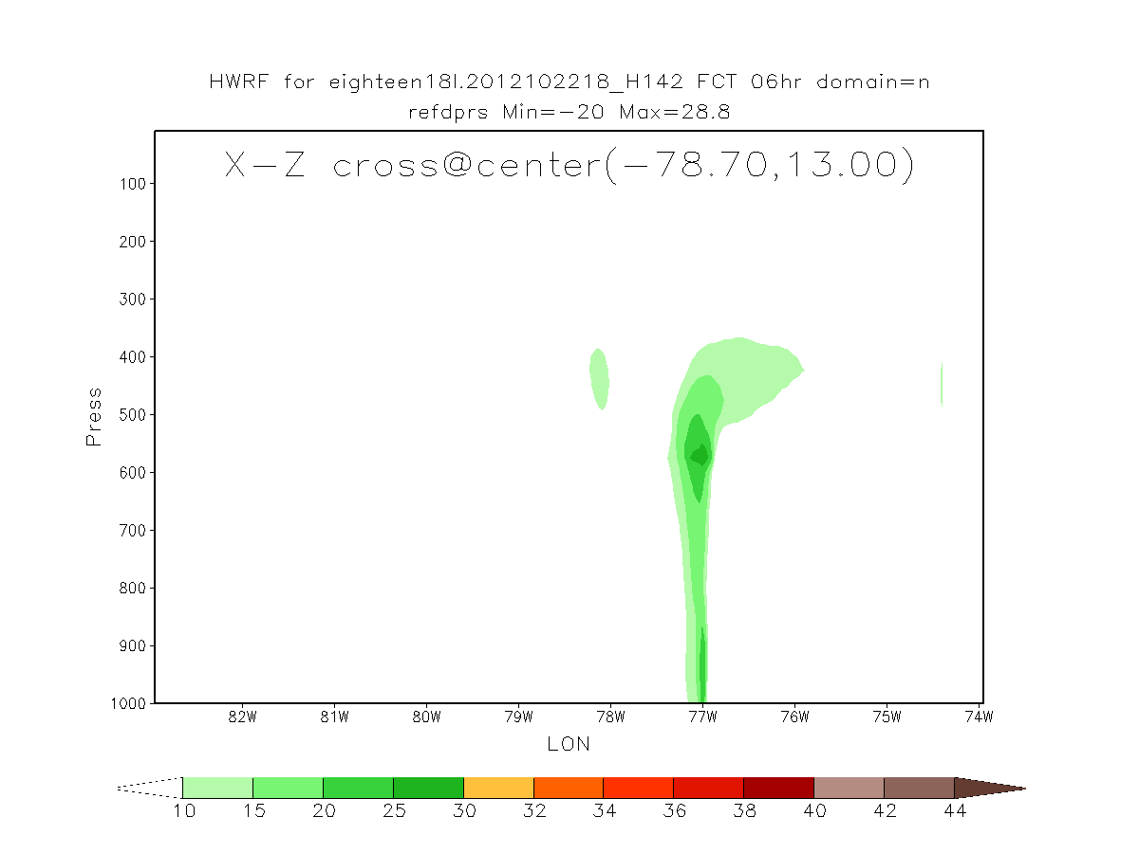
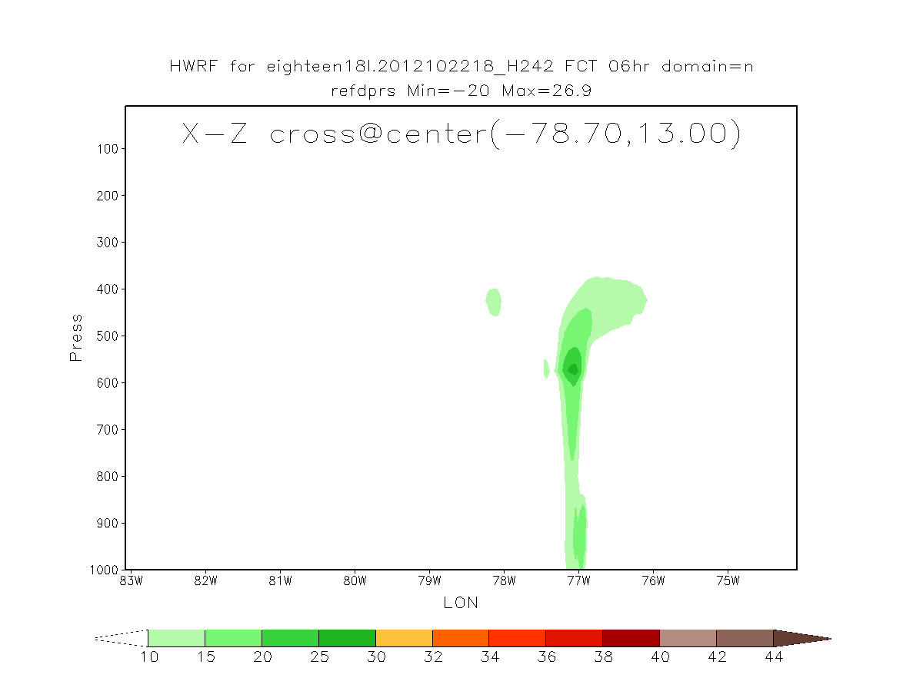
Reflectivity X-Z
Control
NewMP+adv
NewMP

Slide 25
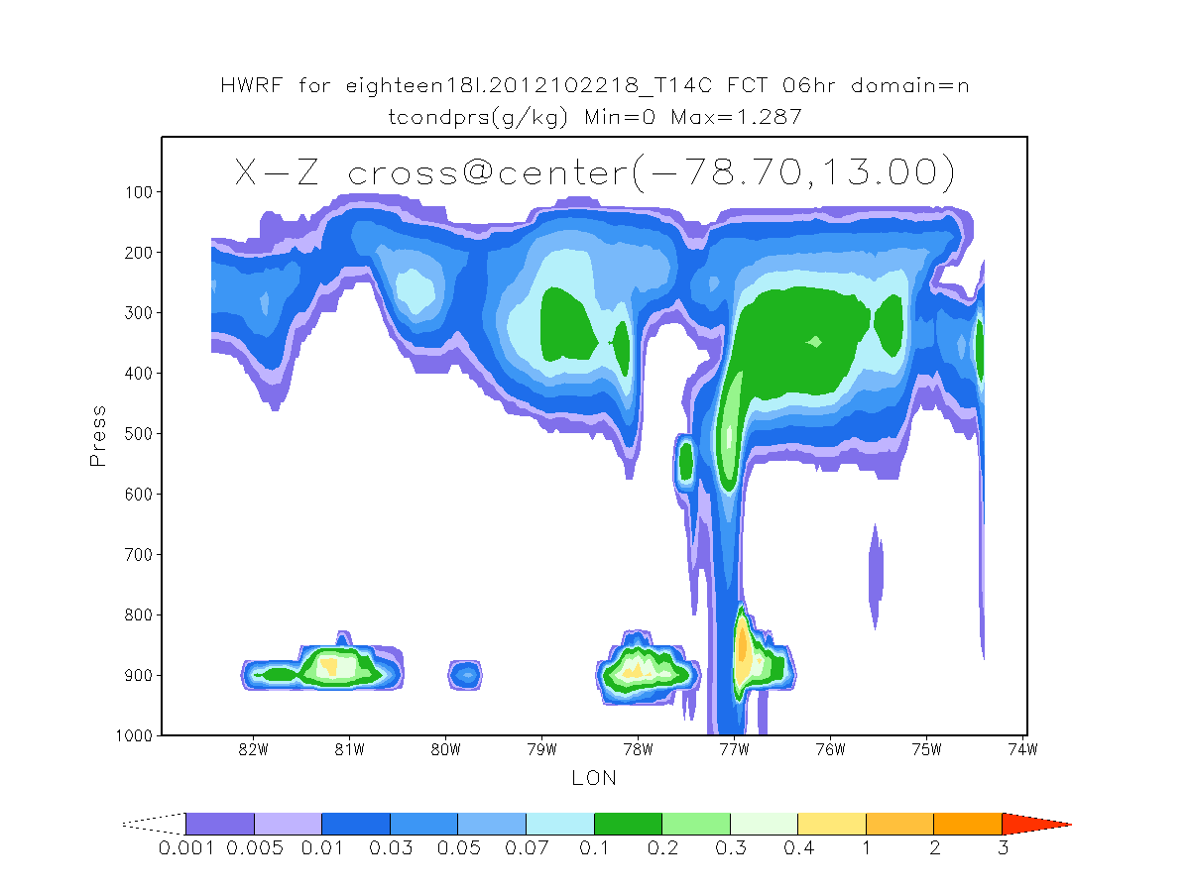
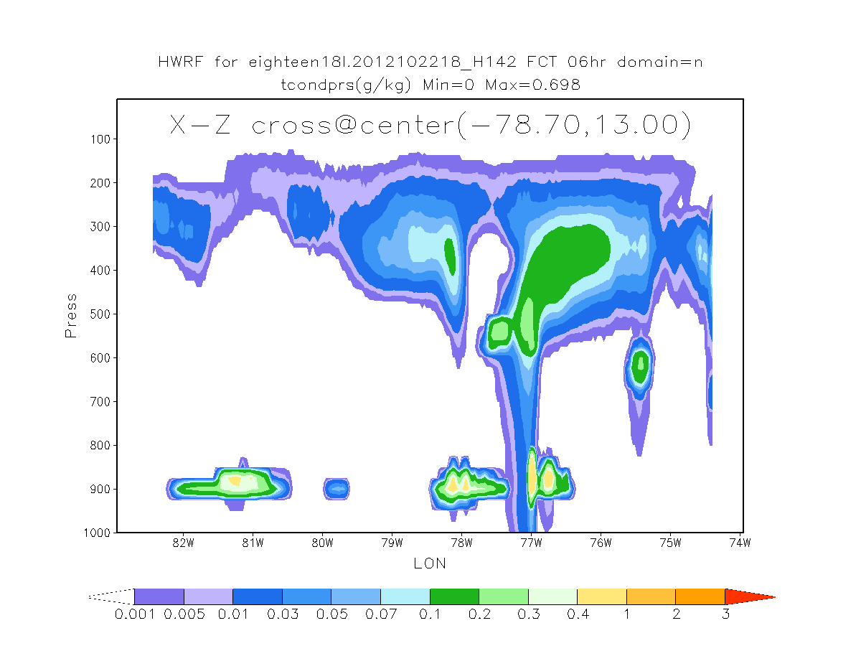
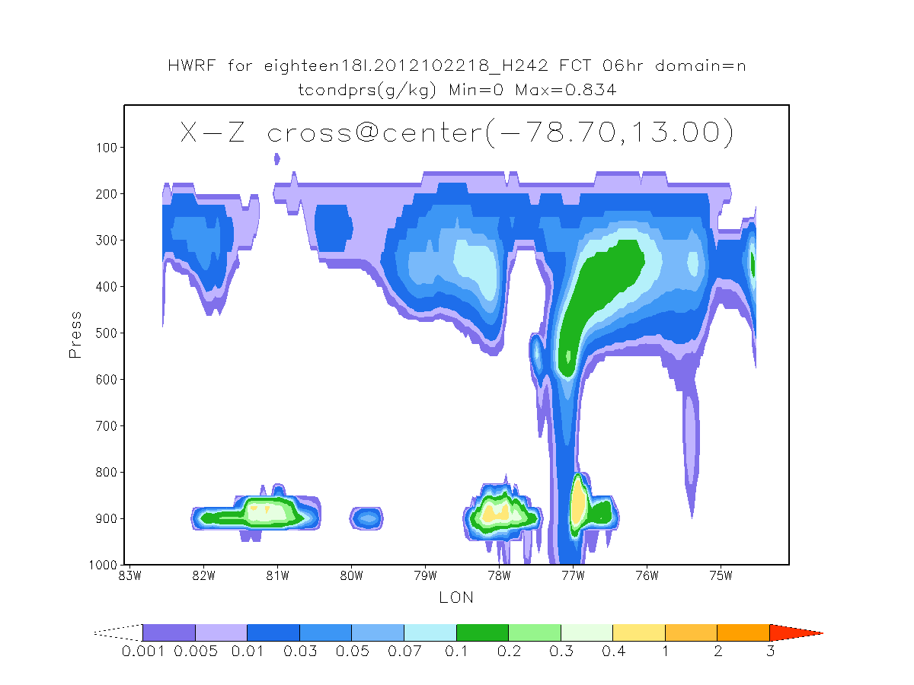
Tot cond X-Z crossection
Control
NewMP+adv
NewMP
Cross-section at storm center
Display multi strong convection areas

Slide 26
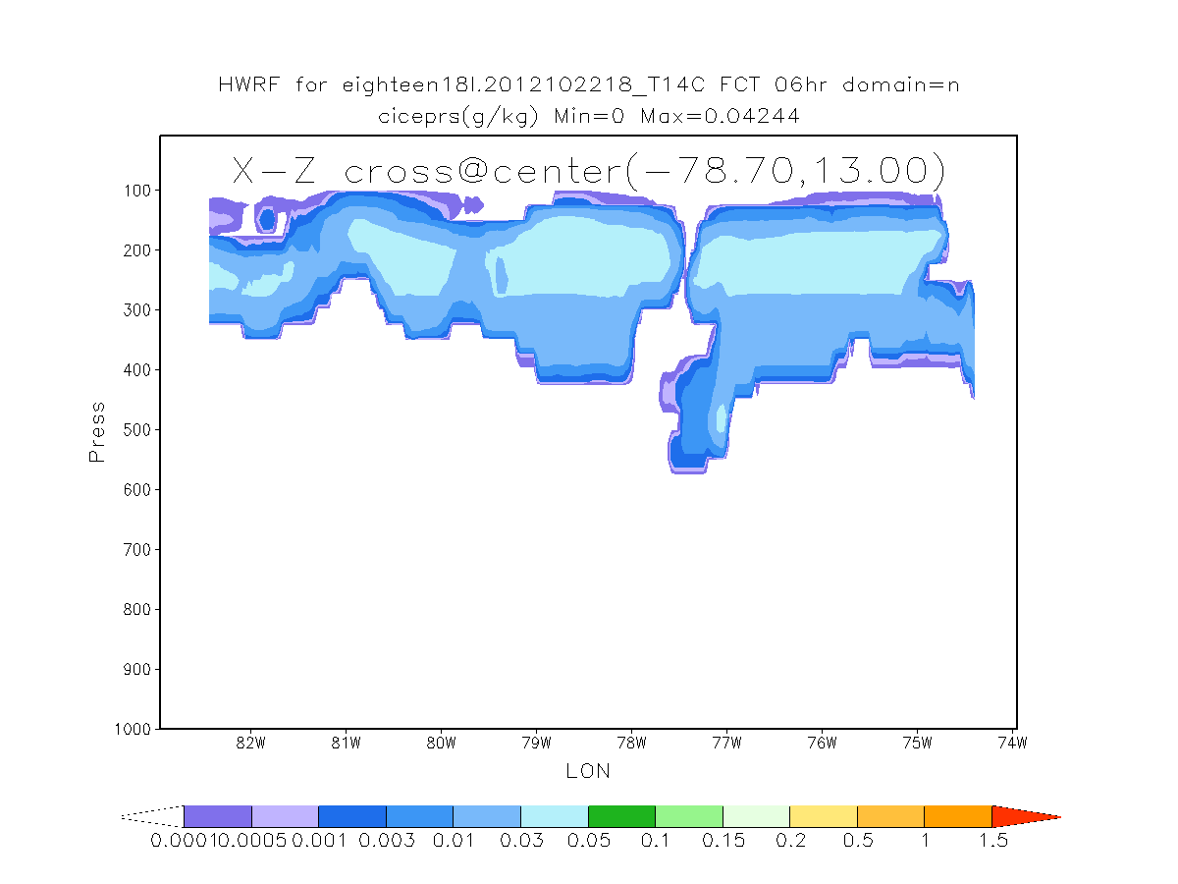
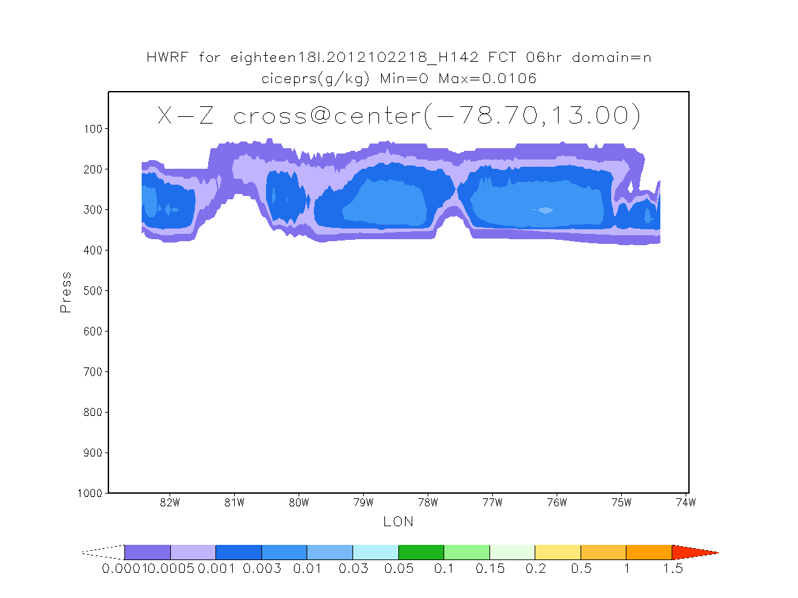
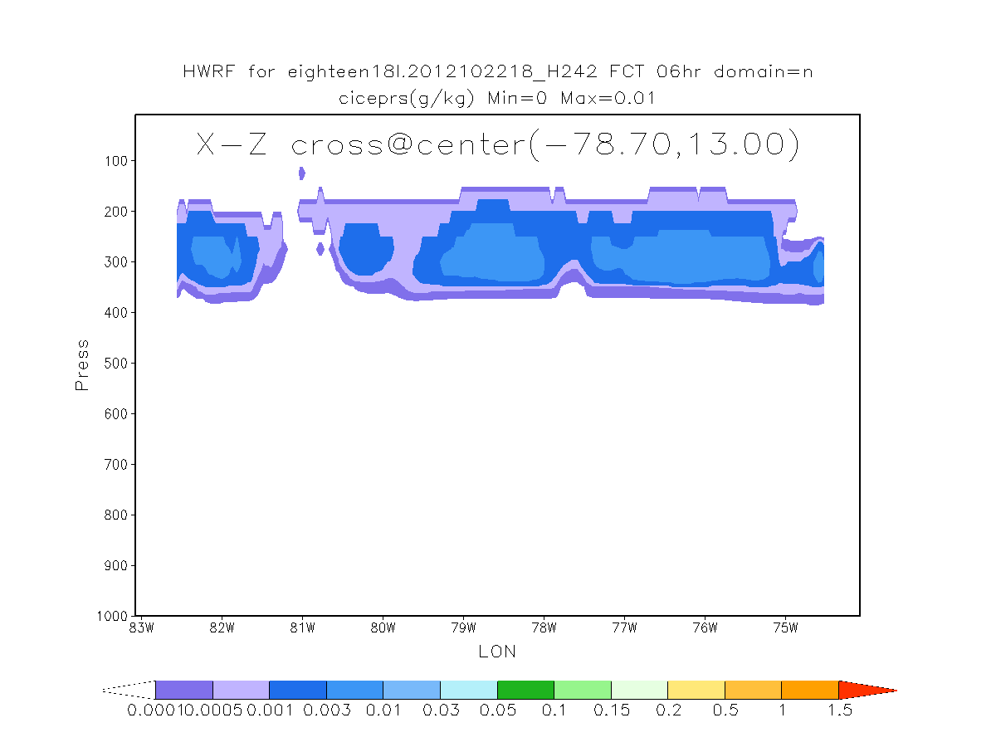
Tot cloud ice X-Z
Control
NewMP+adv
NewMP

Slide 27
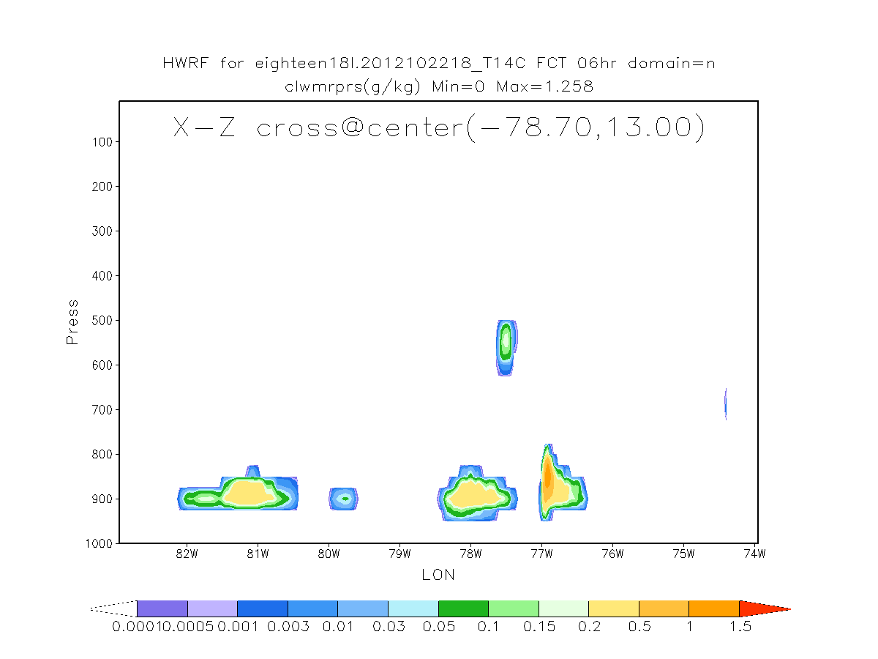
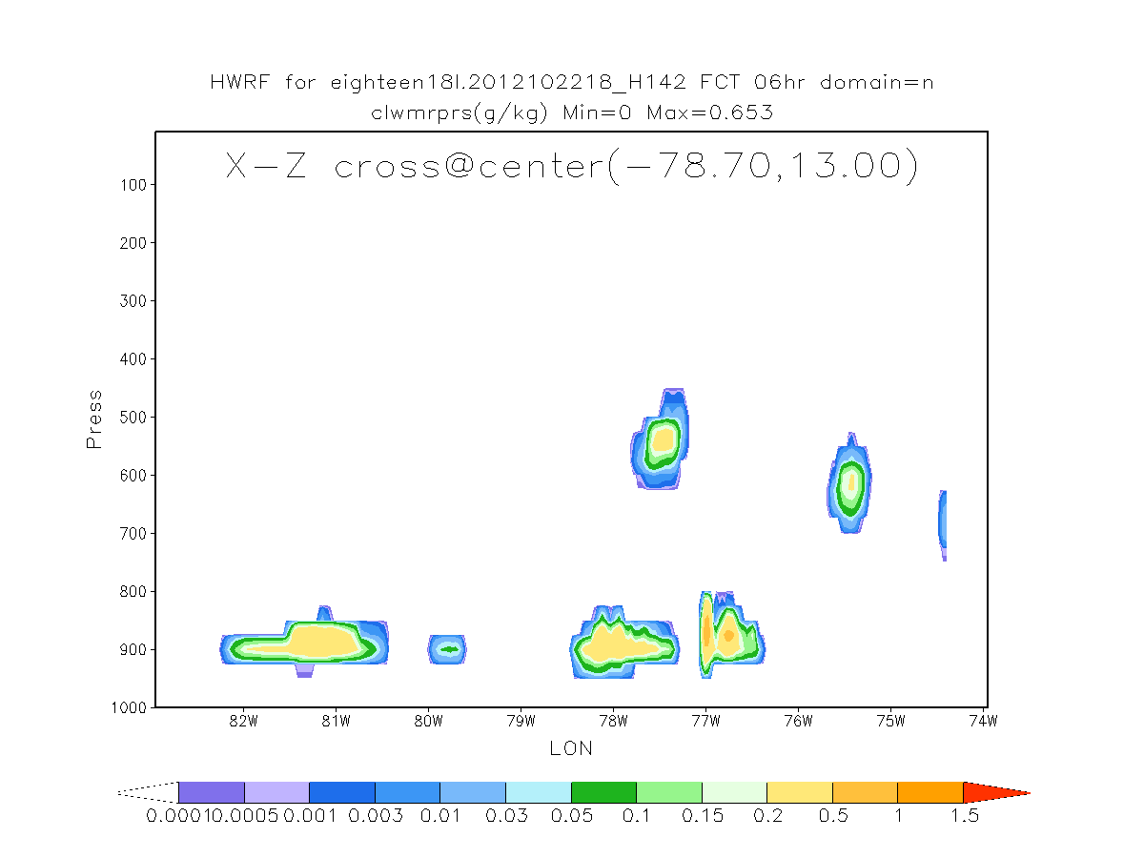
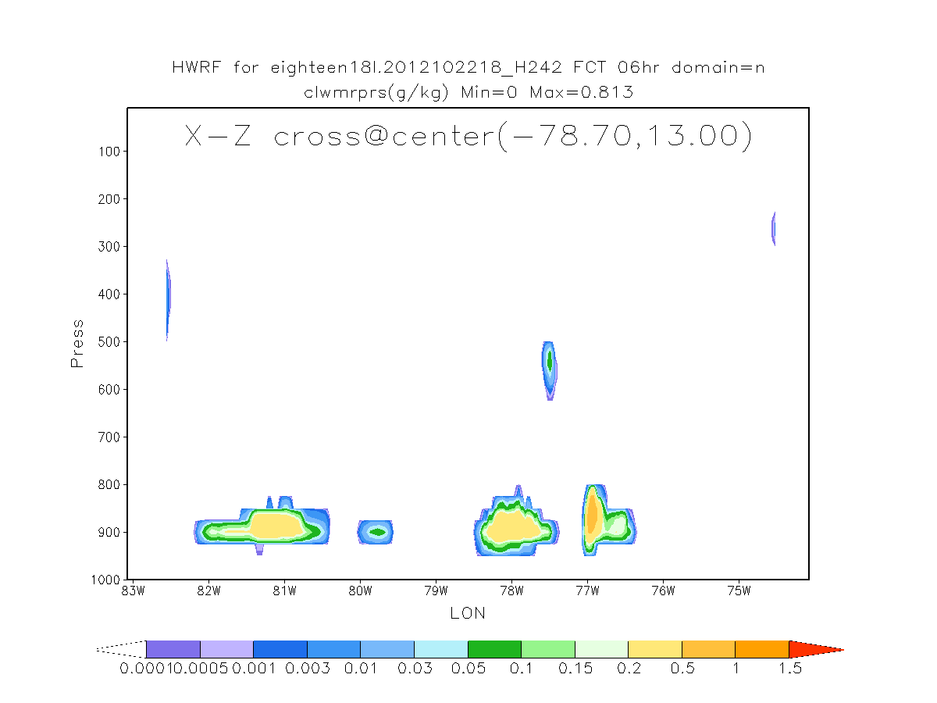
Tot cloud water X-Z
Control
NewMP+adv
NewMP

Slide 28
Summary
Compared with control, NewMP without adv gives promising intensity for ATL, degrades a little for EP.
With adv, takes 30% more time.
Afterthoughts
1. How to further improve from the perspective of MP?
2. What MP are most uncertain in the parameterization, and what have most impact on Hurricane? How to quantity those uncertainties? Ensemble style?
3. Any special treatment for strong convection scenarios?
4. Others …..

