Slide 1
2012 HWRF implementation tests
EXP | Description | Platform | Person in charge | Due date
HBSE | Baseline: with the stripe bug fix (a=0.5, coac=0.75, 3.0, 4.0) | Jet | Chanh | Feb. 24
HPHY | HBSE + S.C. + MP tune (dt=45s, no sas in d03) | Jet | Weiguo | Feb. 24
HINT | HPHY + new vertical interpolation | CCS/Intel | Sam | Feb. 24
HADV | HINT + separate MP advection | Intel | Sam | Feb. 24
HOCN | HPHY + new ocean | Intel/Jet | Vijay/Biju | Feb. 24
HGSI | HPHY + GSI (prepbufr only) | Jet | Mingjing/In-Hyuk | Feb. 24
HCOM | Combination of above (only positive exps) | CCS*/Jet | Zhan/Chanh | Mar. 16
H201 | HCOM + NEW GFS * | CCS | Zhan/Weiguo | Mar. 16
Intel: Can be run on Zeus when it becomes stable and reliable
All 2010 and 2011 cases
* GFS test only for 2011 storms

Slide 2
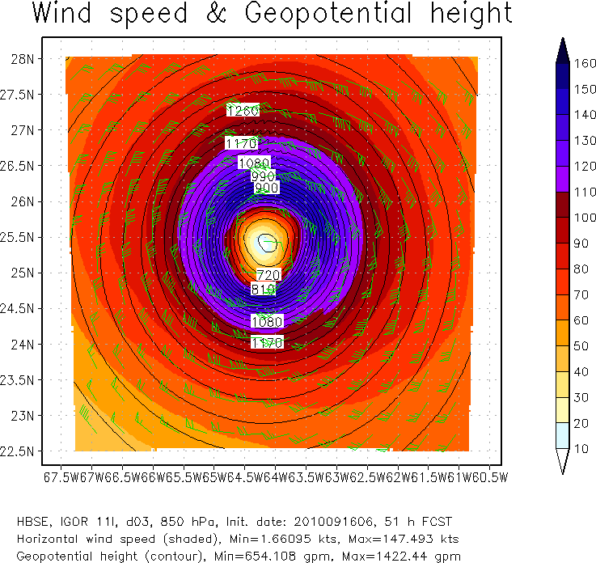
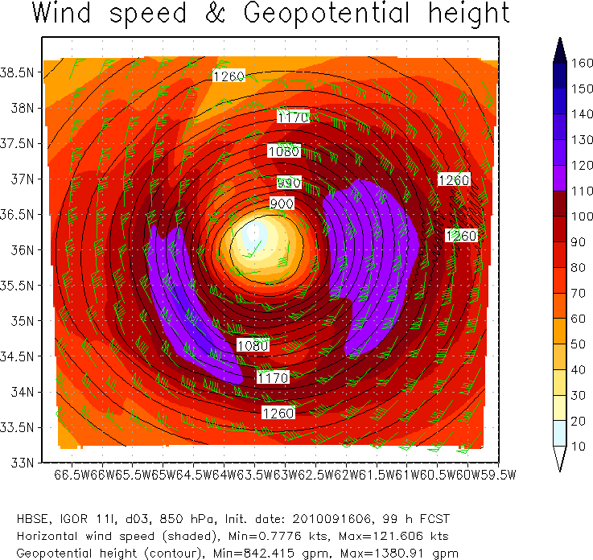
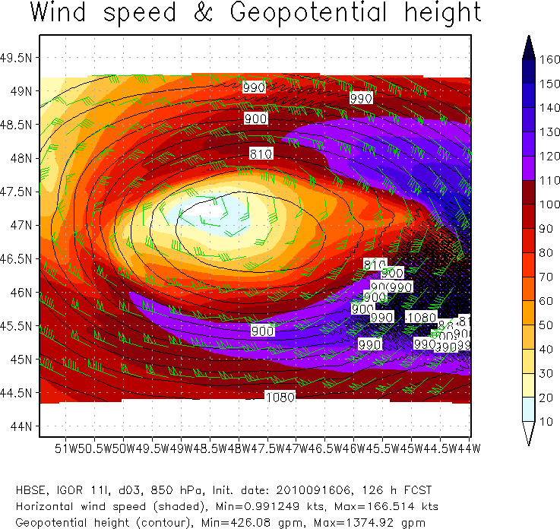
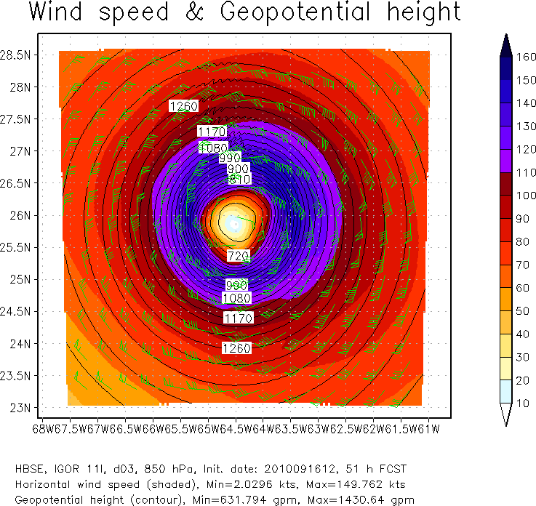
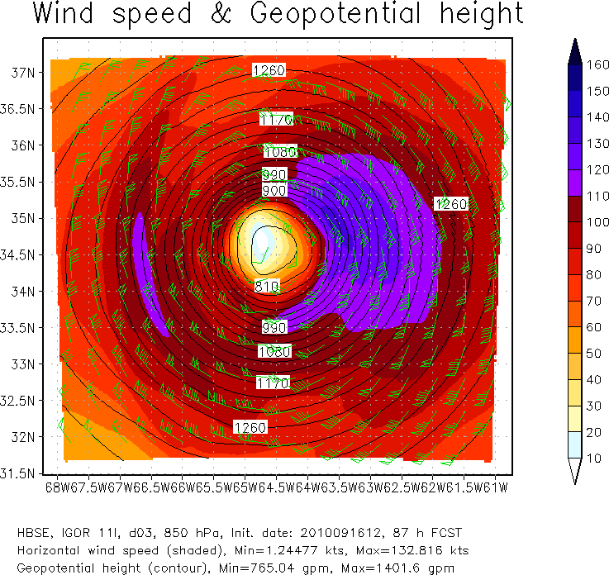
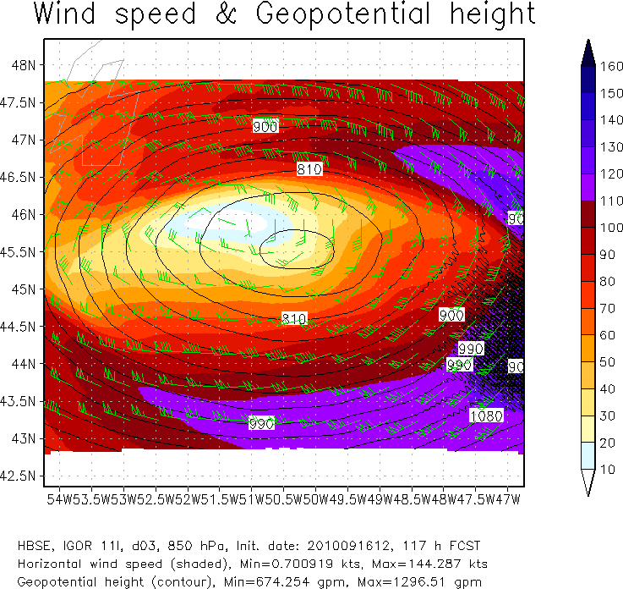
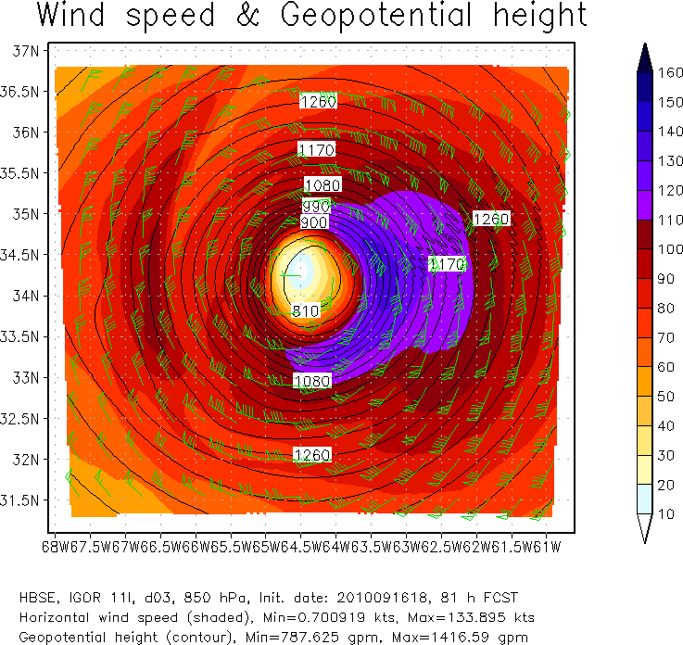
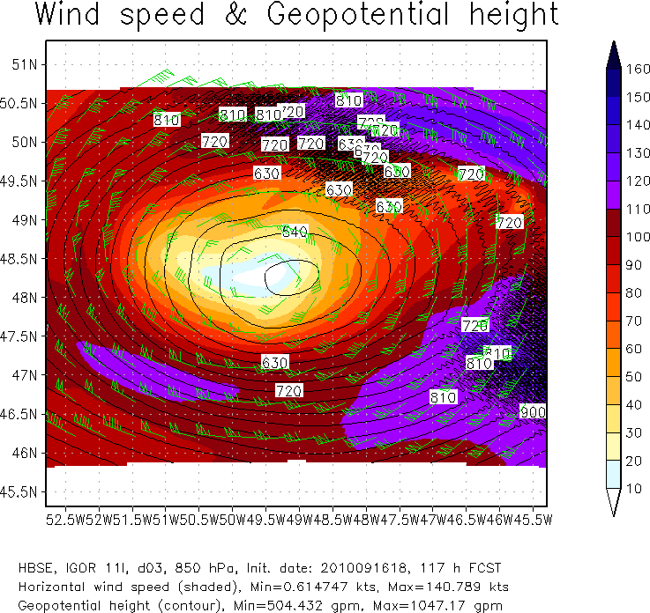
IGOR
091606
51h
99h
126h
IGOR
091612
51h
87h
117h
IGOR
091618
81h
117h

Slide 3
HOPS: operational HWRF HBSE: Baseline HPHY: HBSE+Physics update (MP and SC)
Stats for 2012 HWRF
pre-implement testing

Slide 4
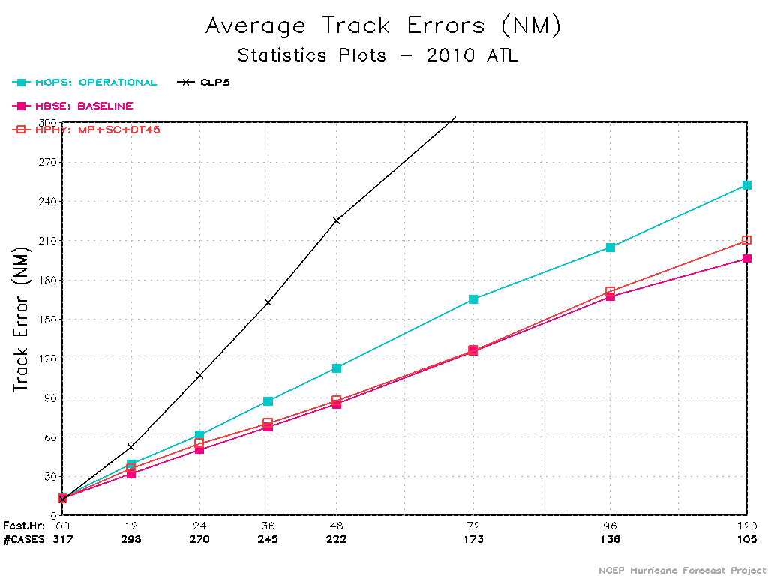
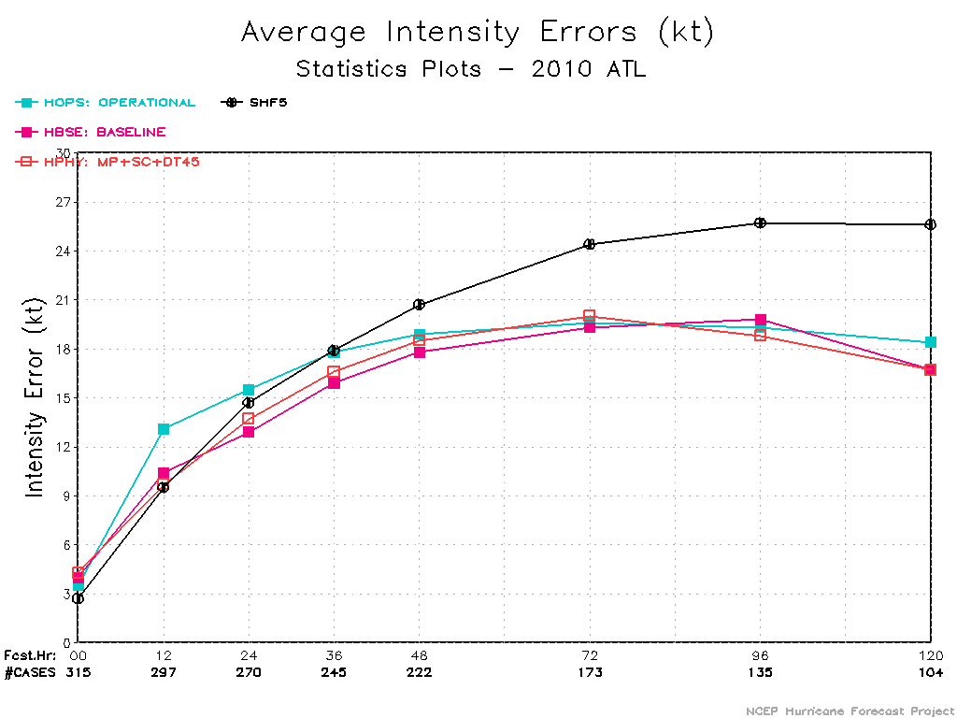
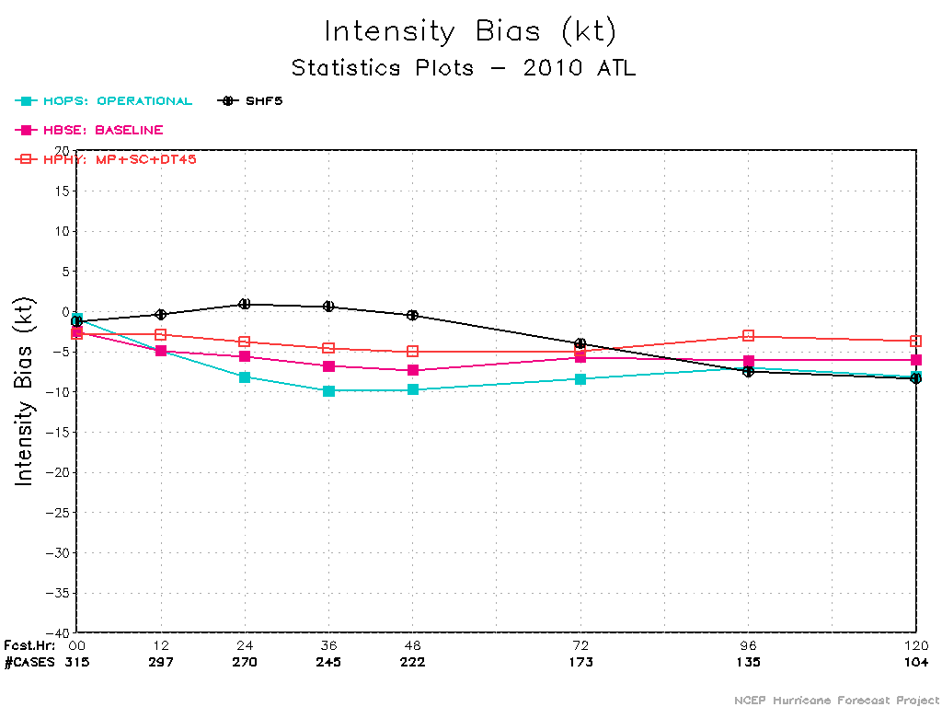
2010 ATL

Slide 5
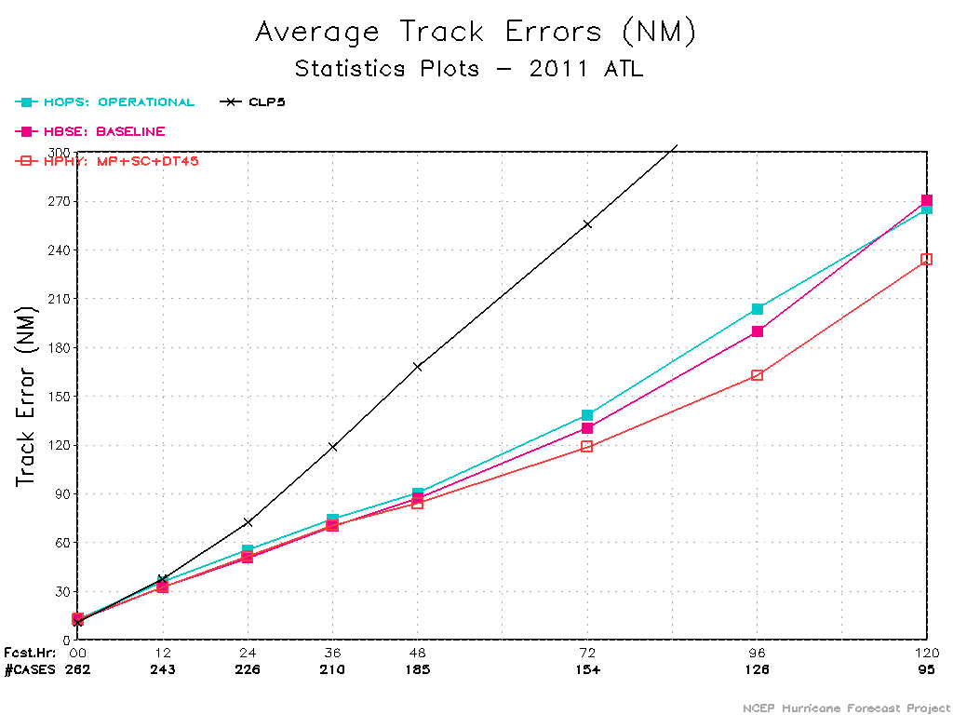
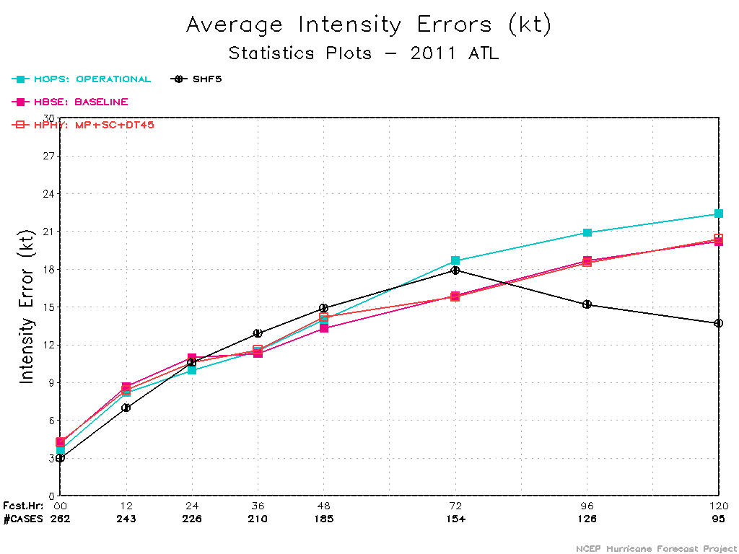
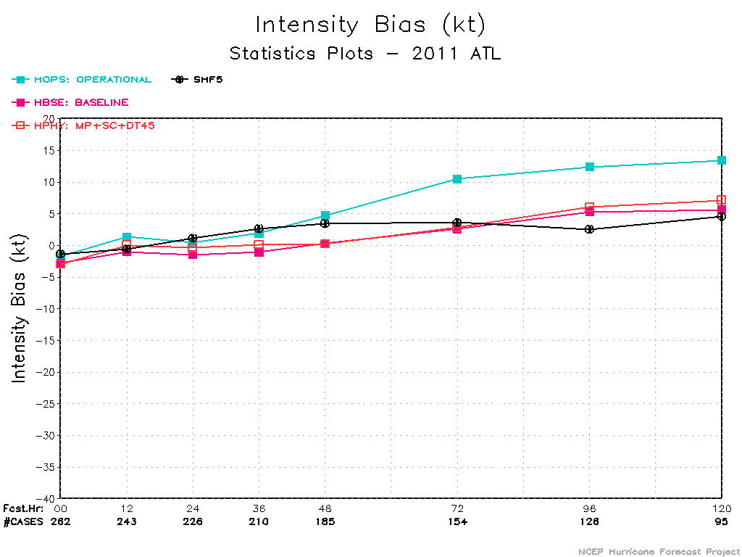
2011 ATL

Slide 6
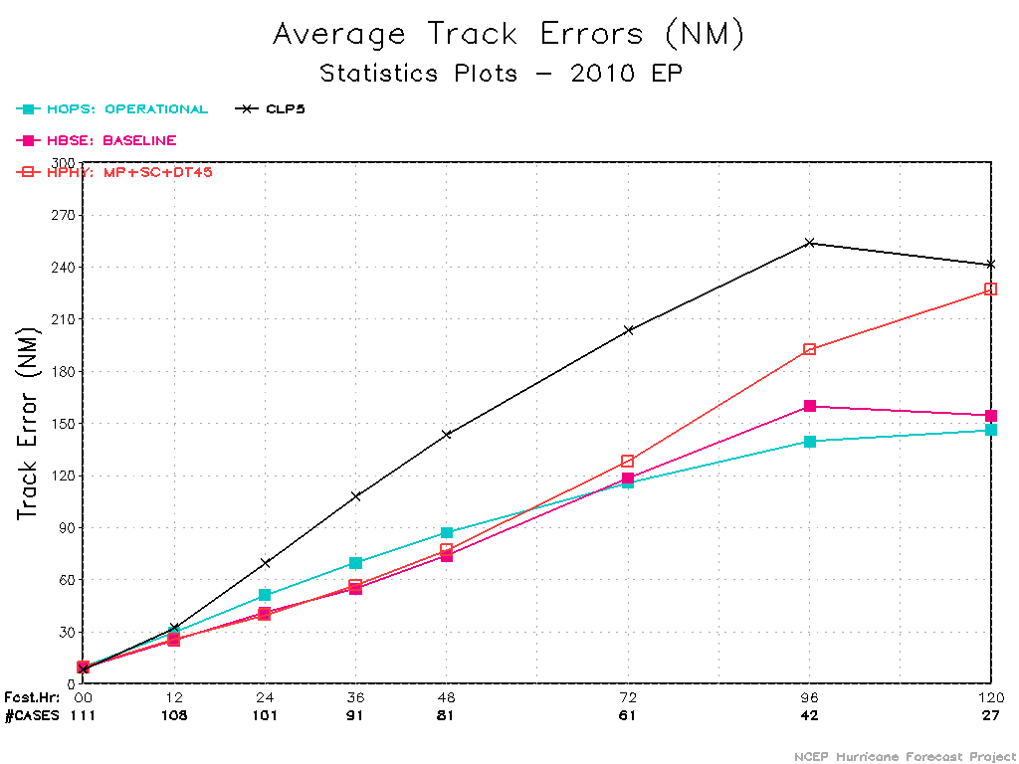
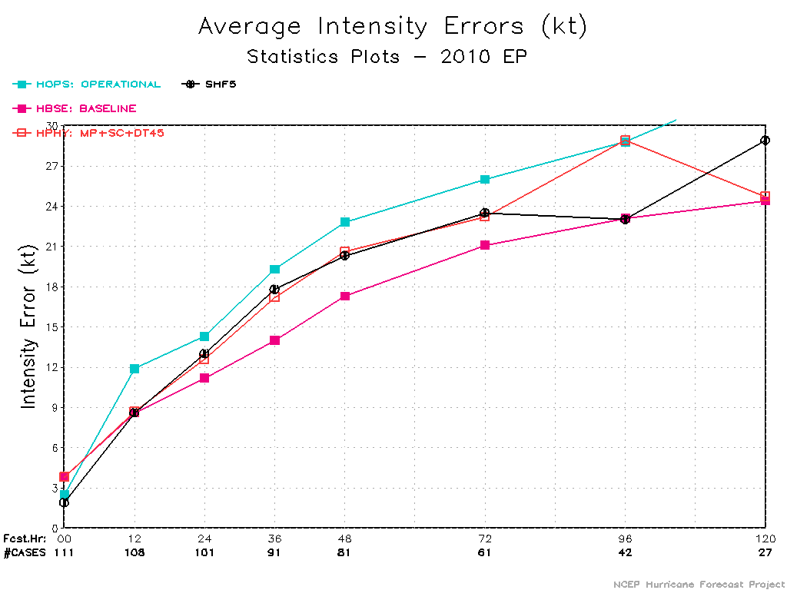
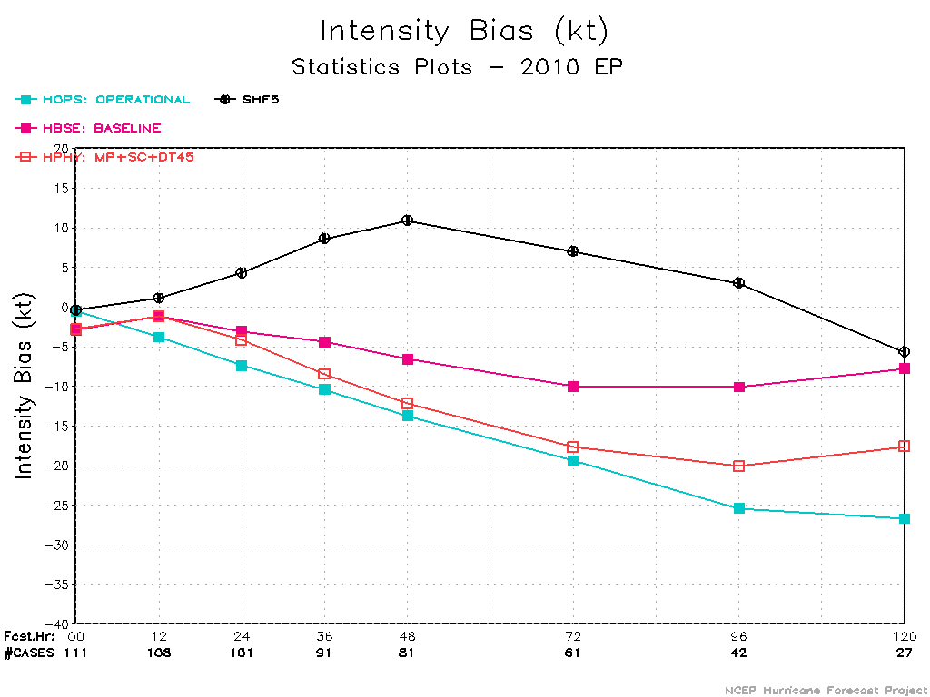
2010 EP

Slide 7
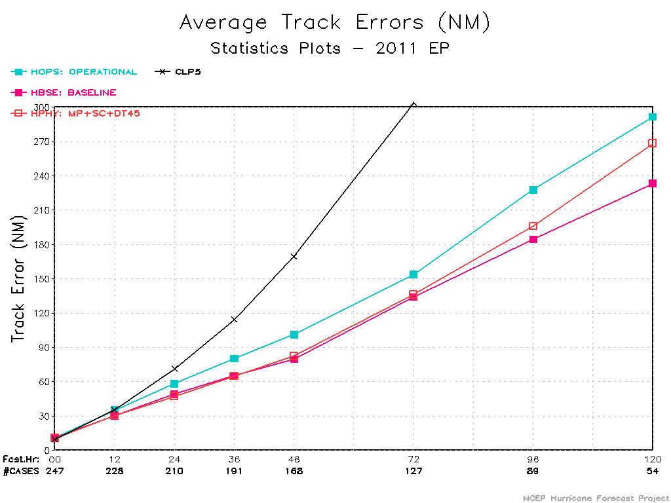
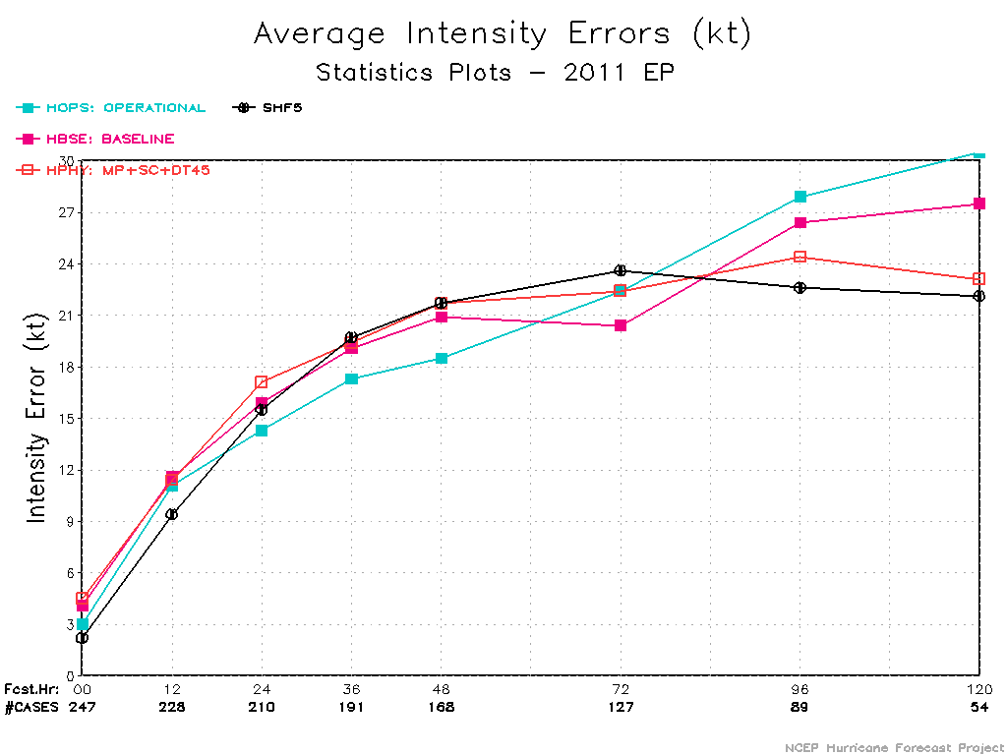
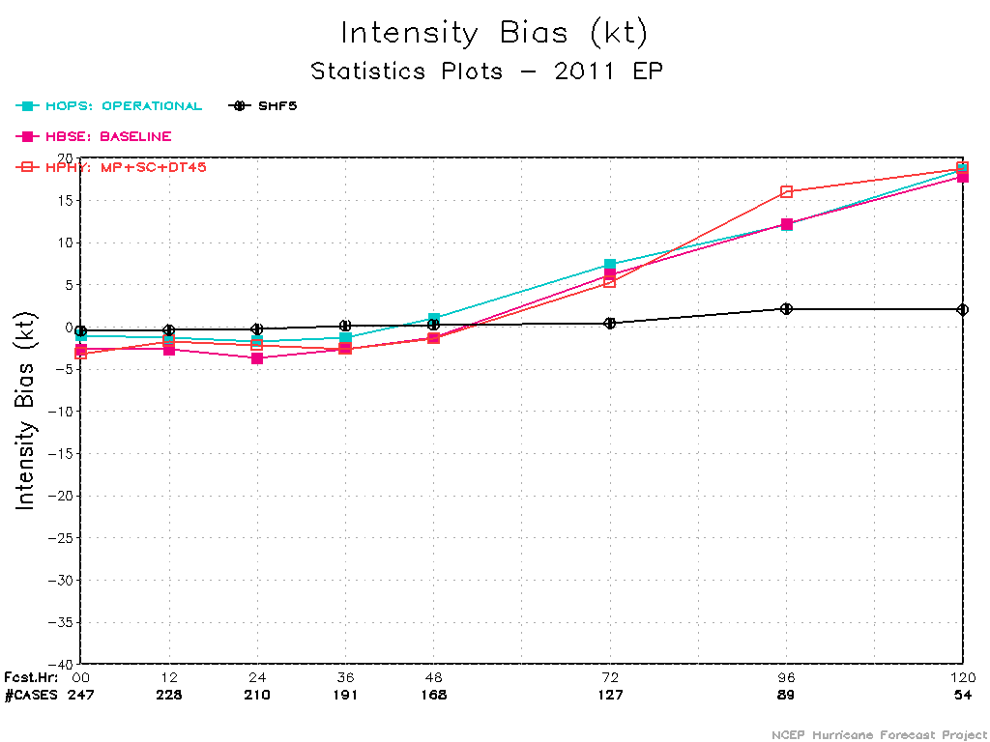
2011 EP

Slide 8
Stats of Individual Storms

Slide 9
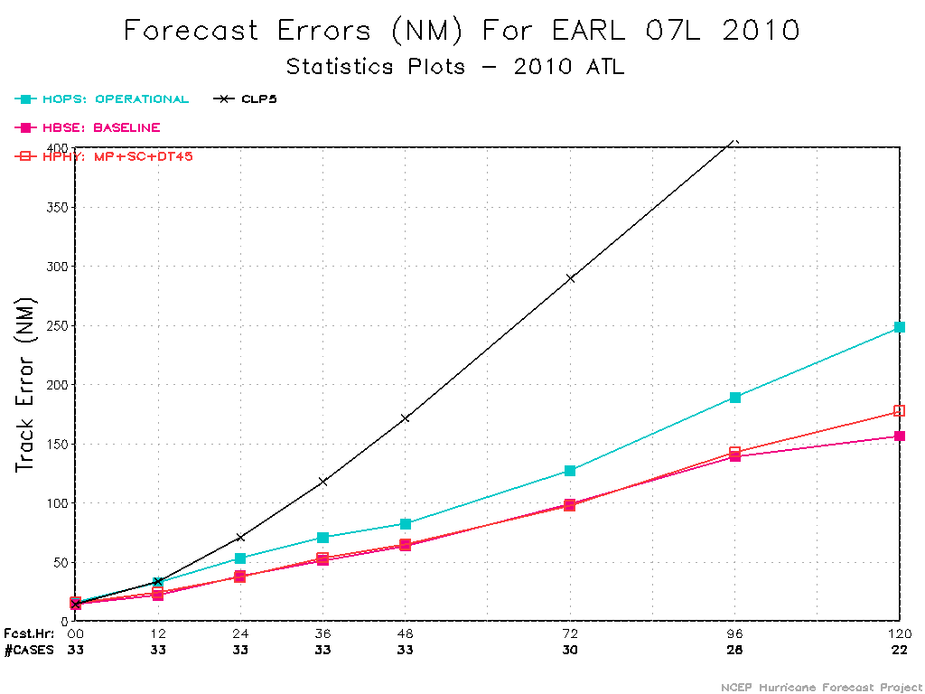
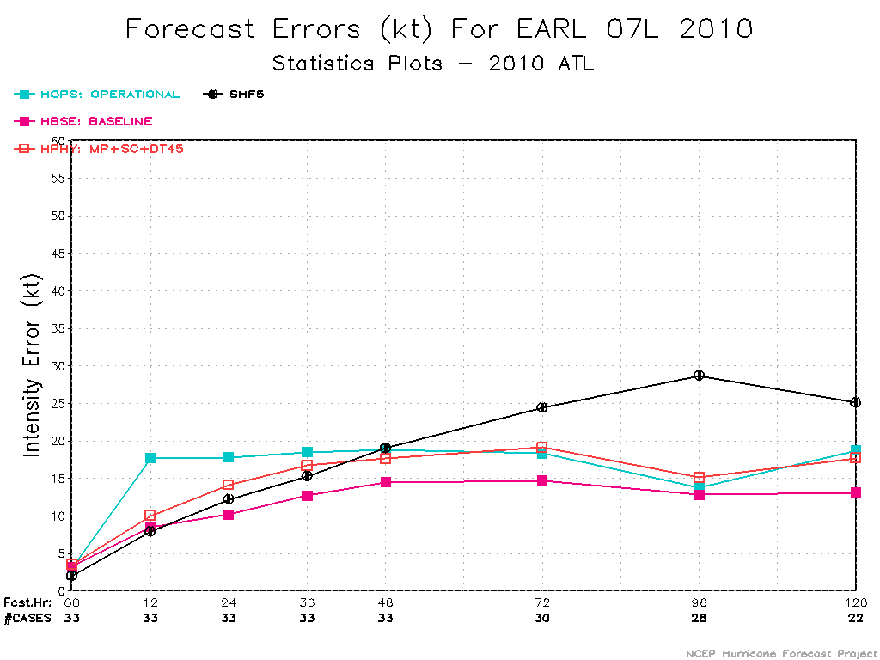
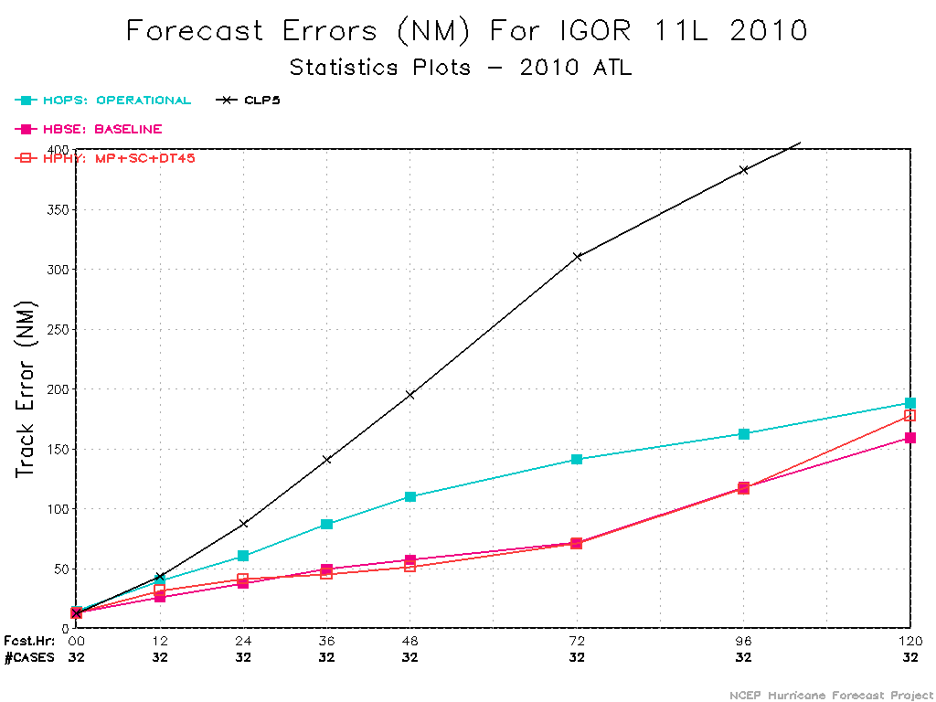
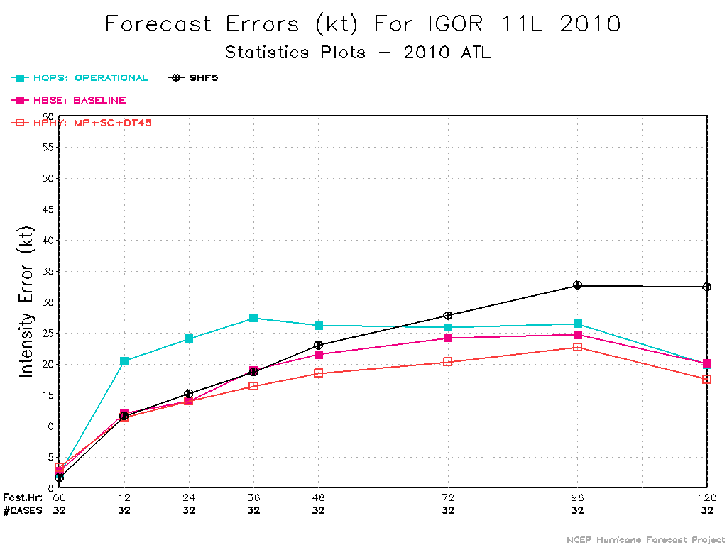

Slide 10
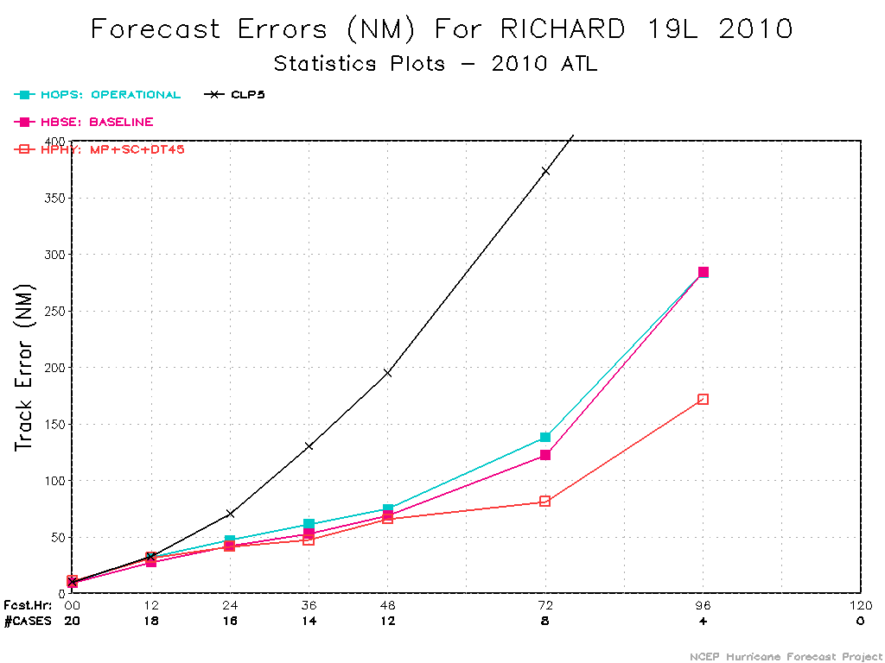
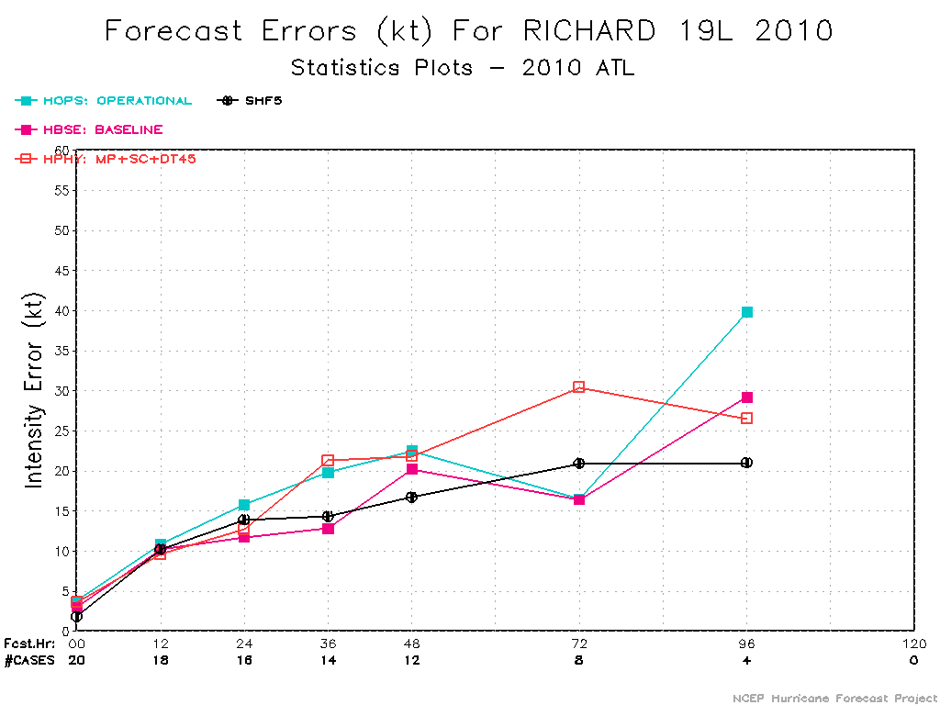
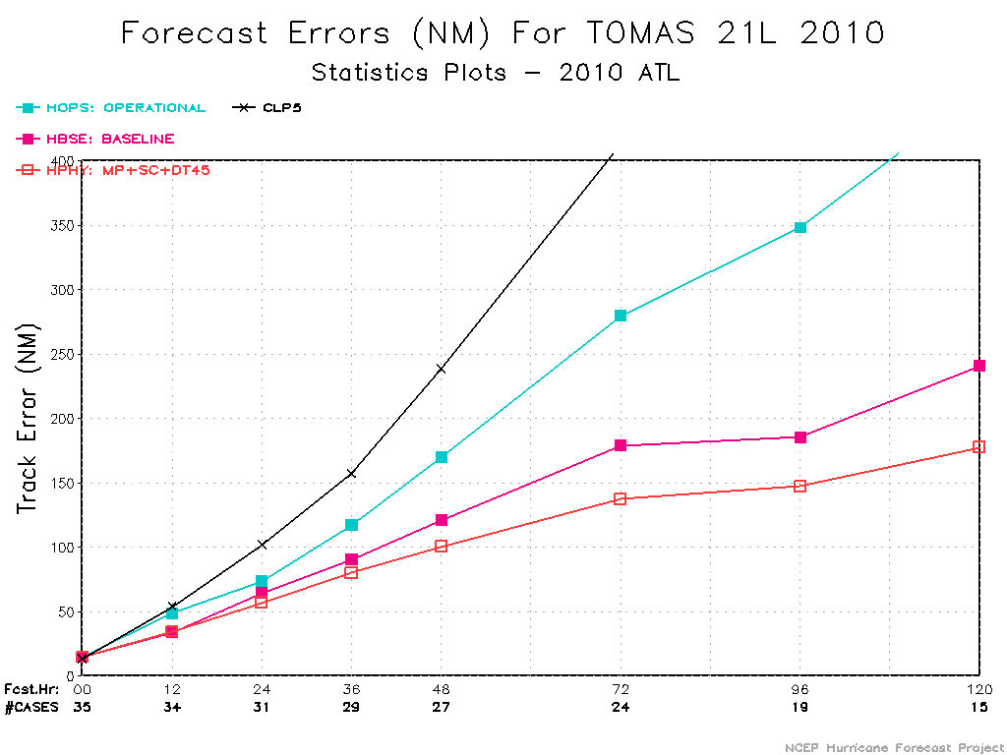
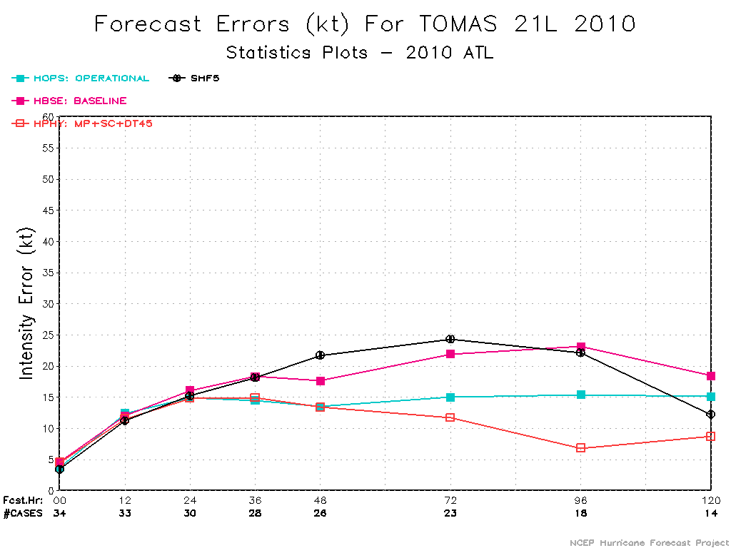

Slide 11
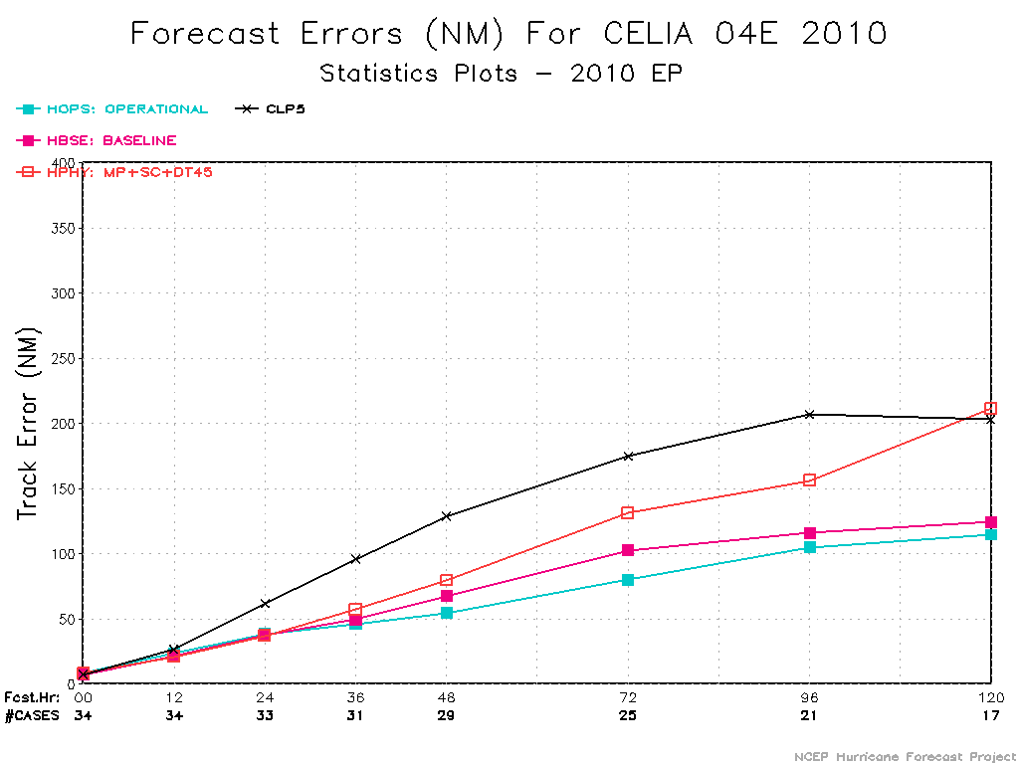
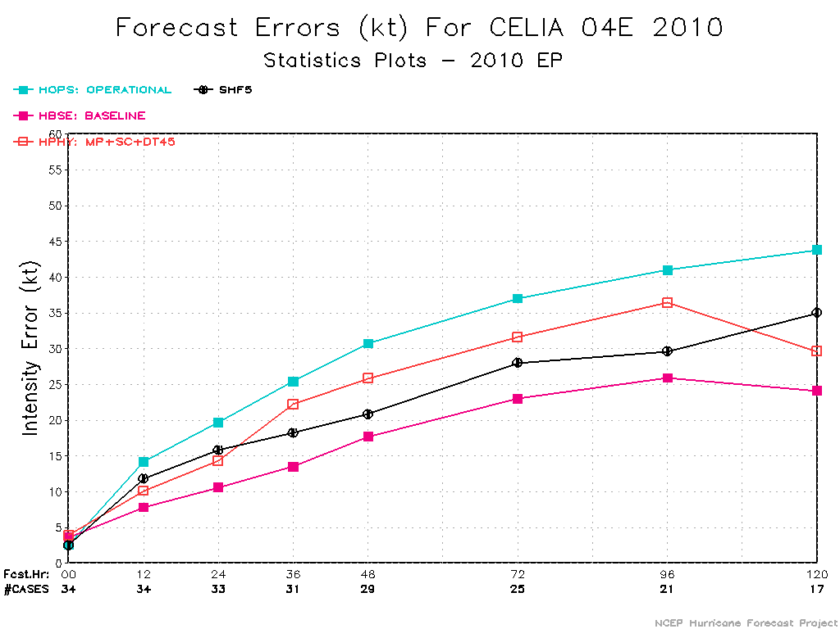
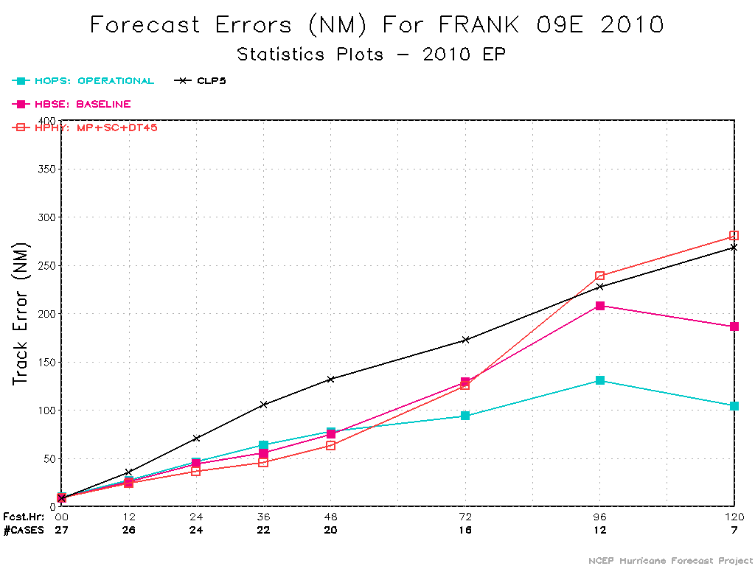

Slide 12
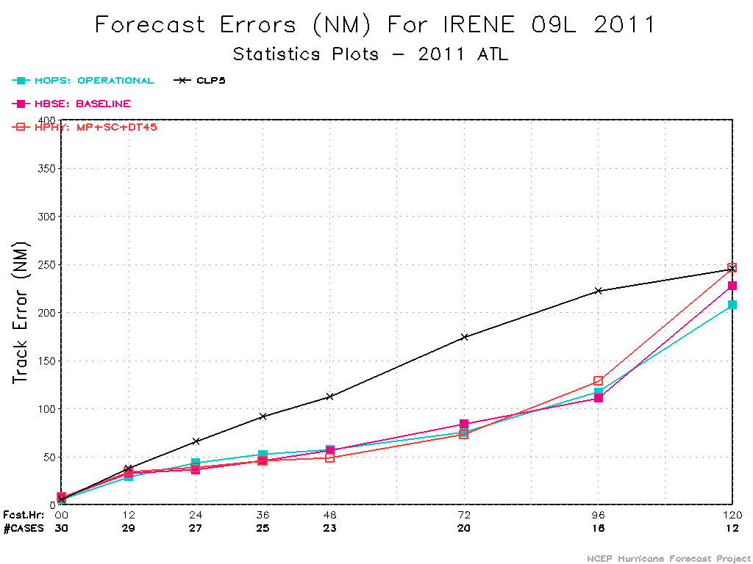
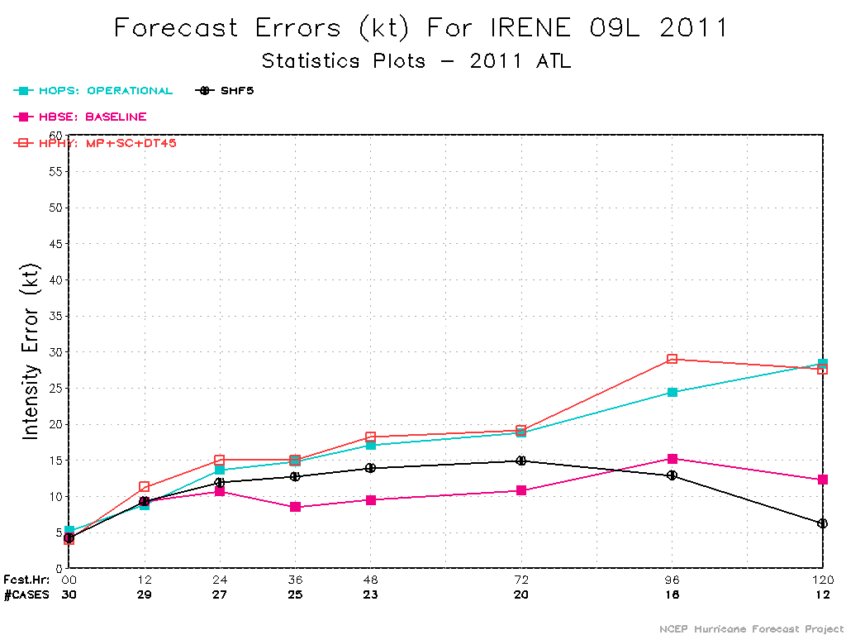
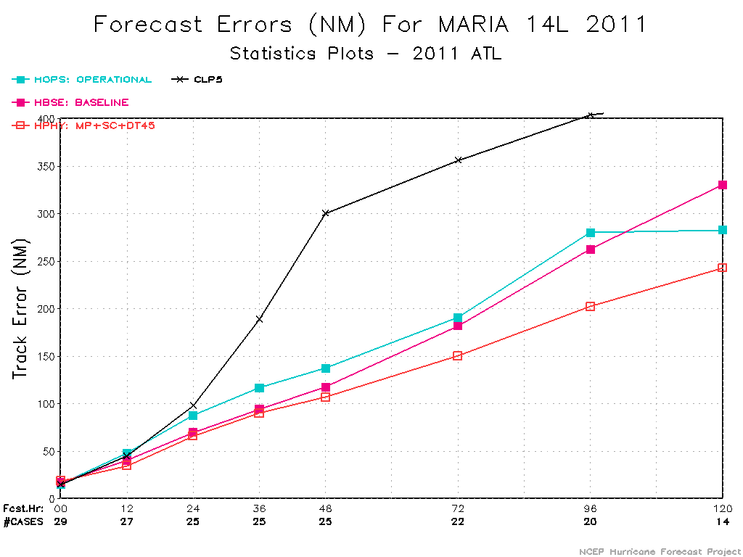
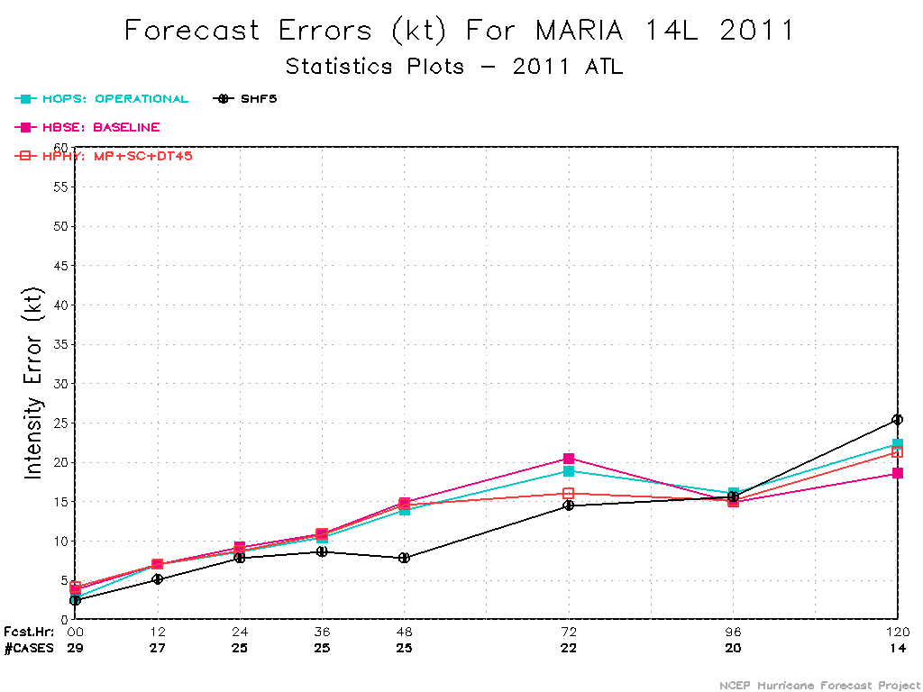

Slide 13
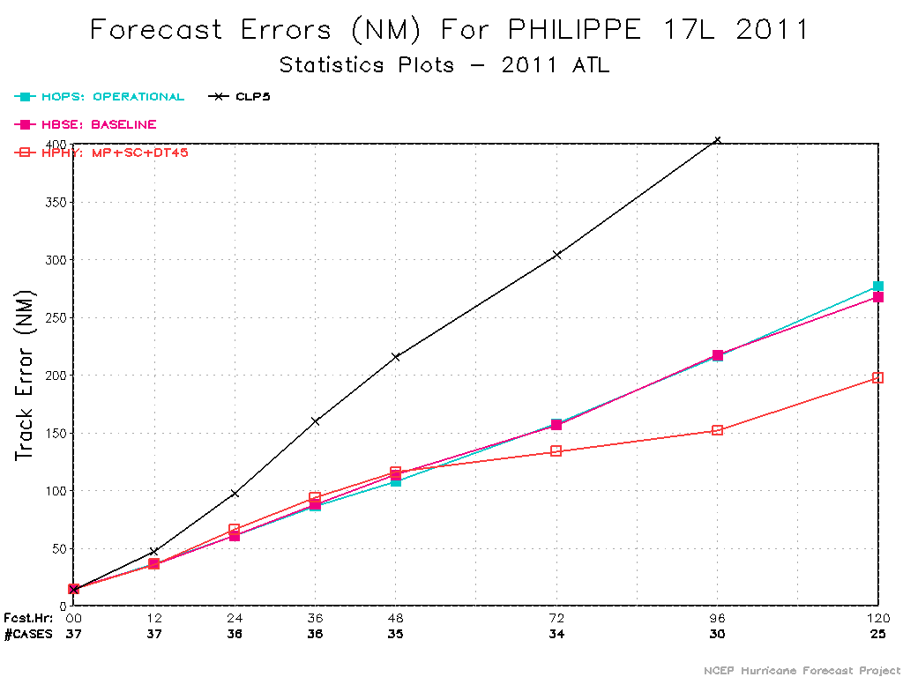
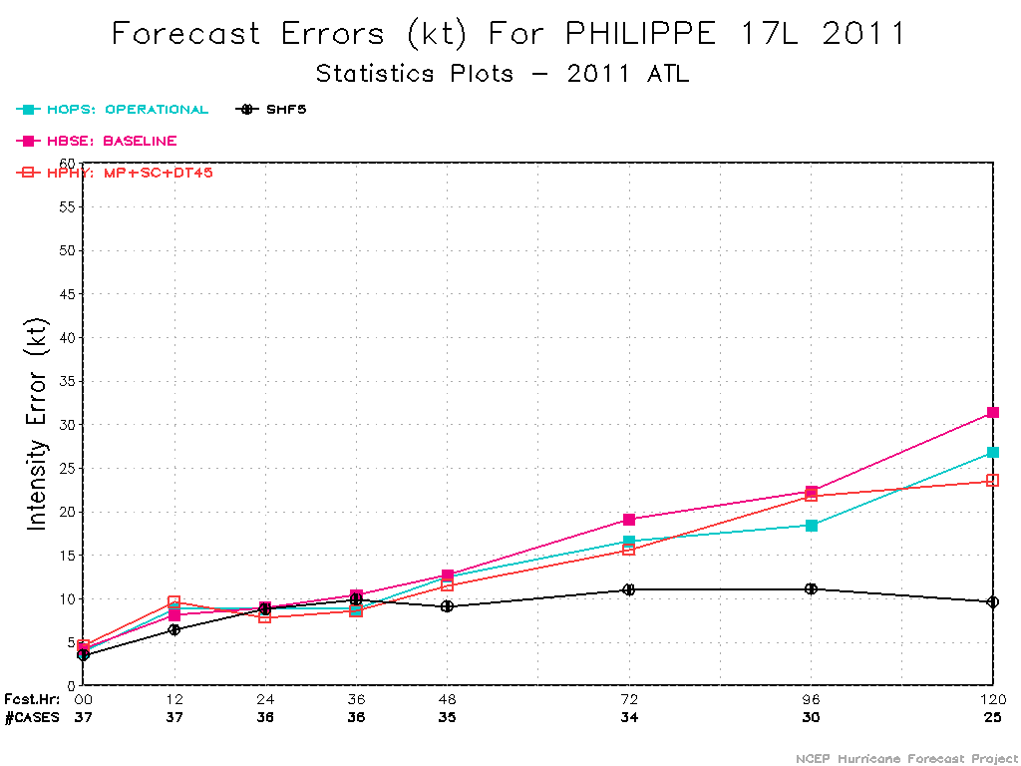
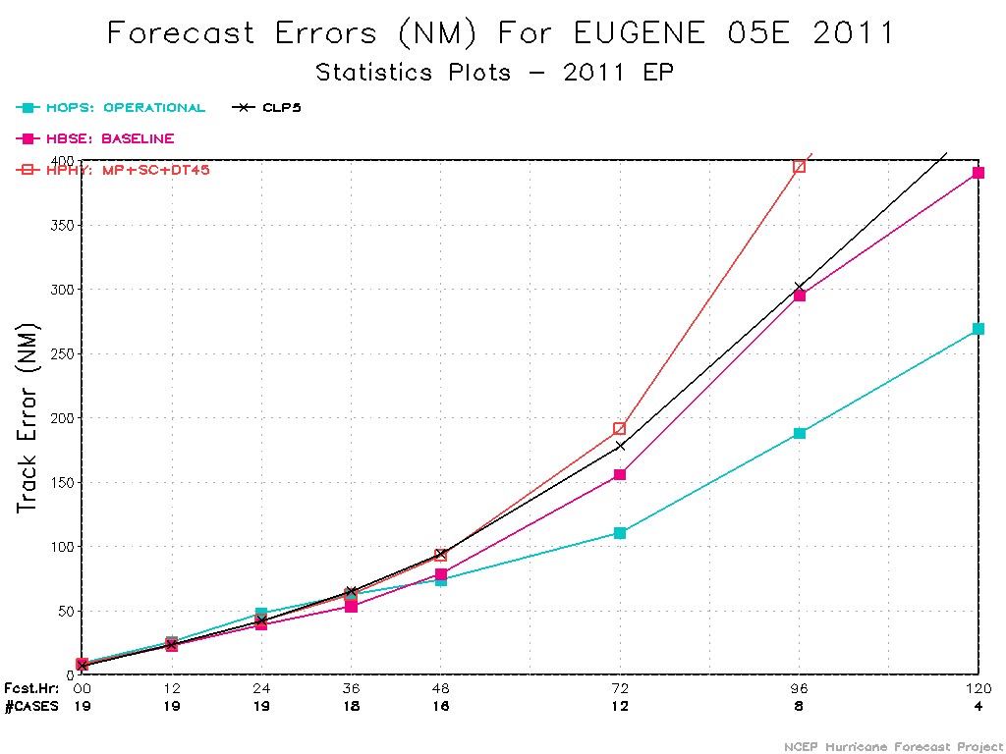
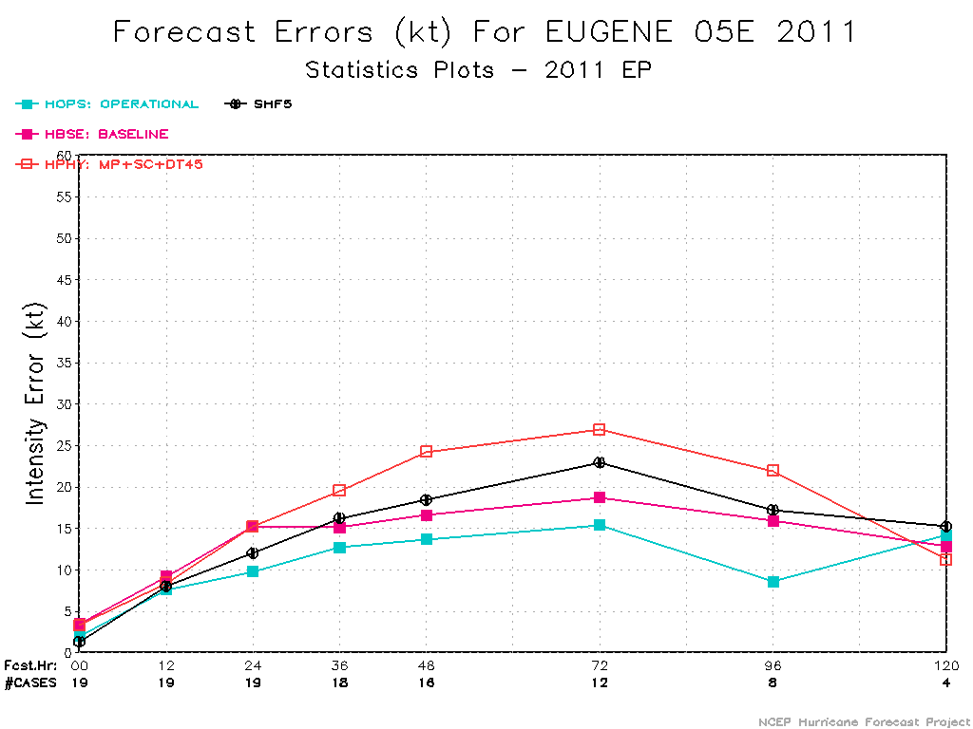

Slide 14
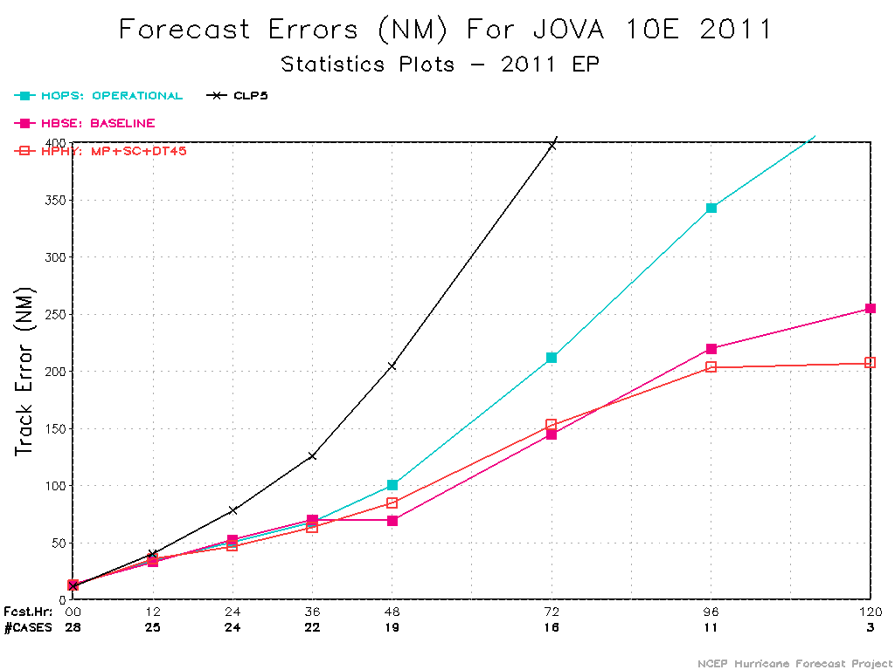
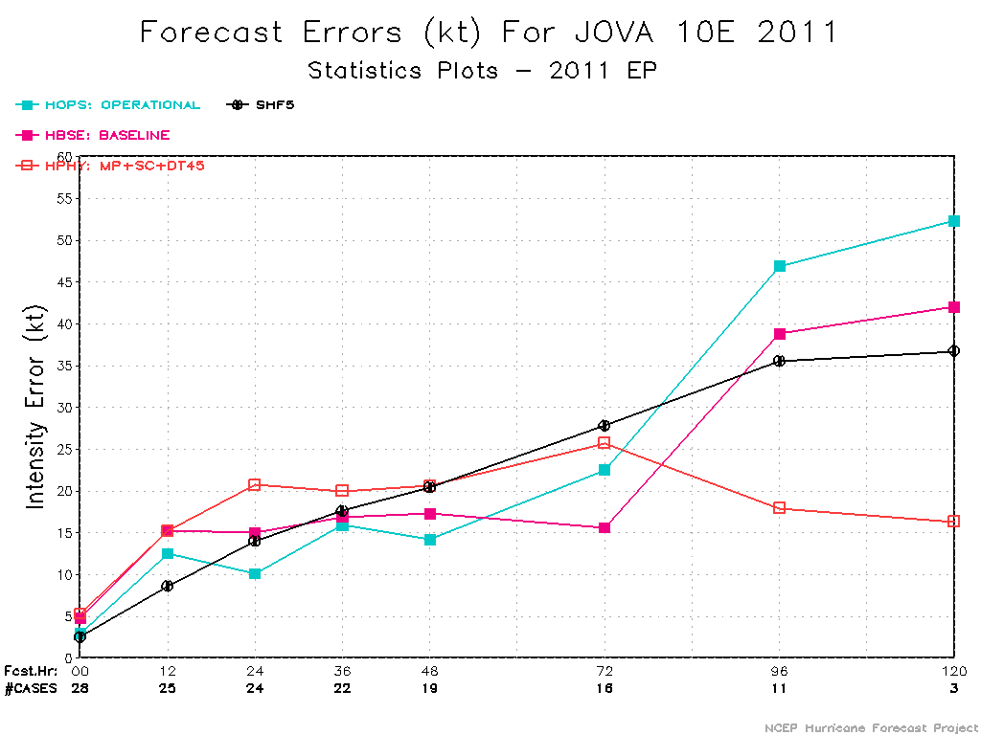

Slide 15
Changes Made for HGSI
1. Only assimilate prepbufr data
2. Removed all data with in 1200 km from TC center
3. Decreased the background error correlation length scale to half of the original one for ghost domain (inner analysis domain)
4. Increased observation error to 3 times of the original one

Slide 20
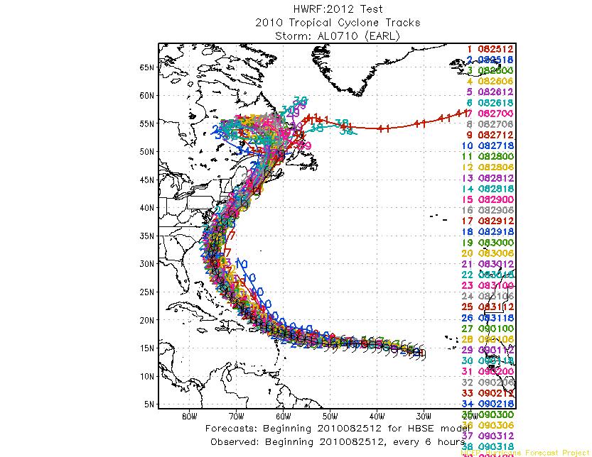
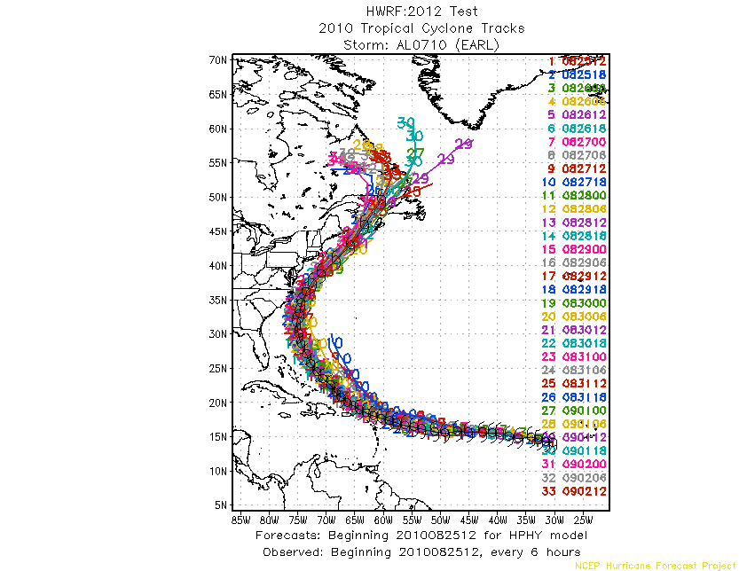
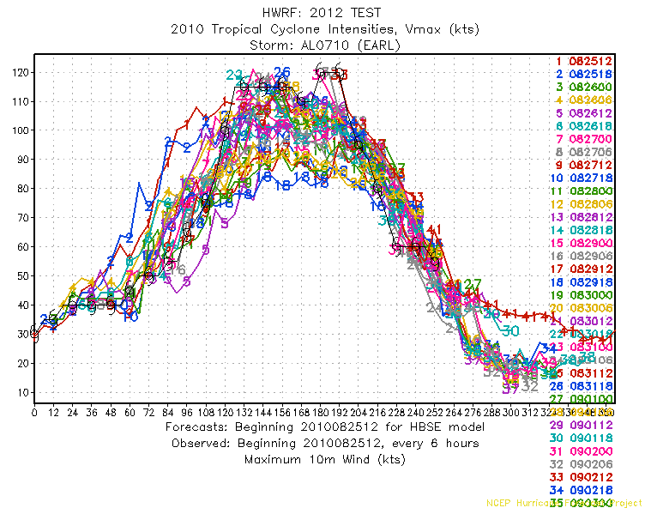
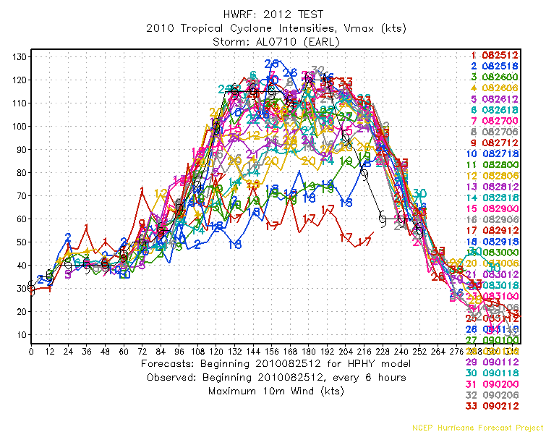
EARL 07L
HBSE HPHY

Slide 21
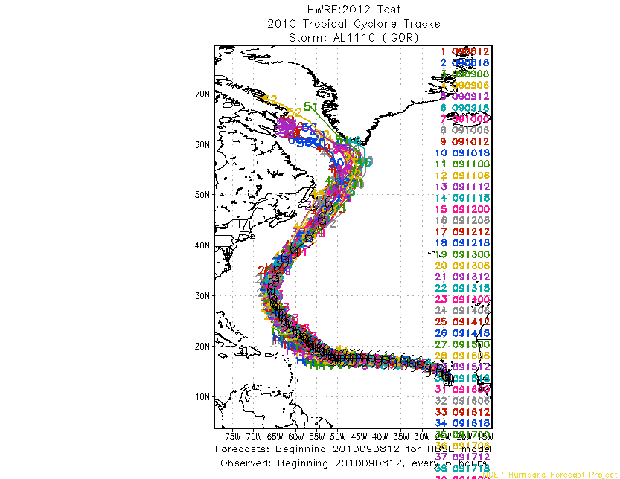
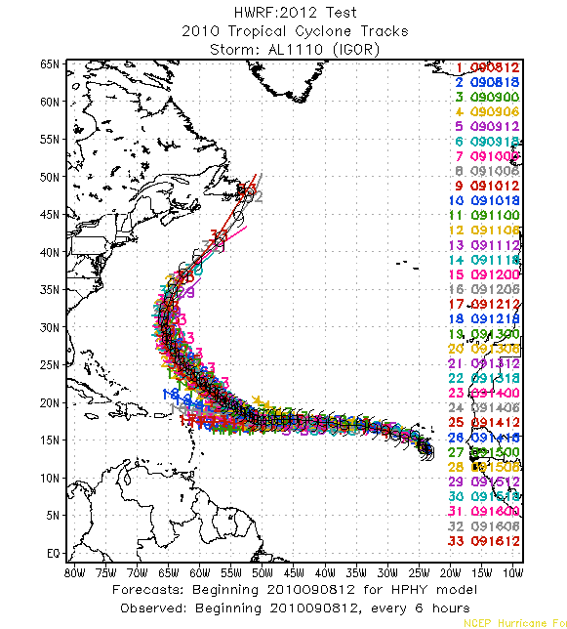
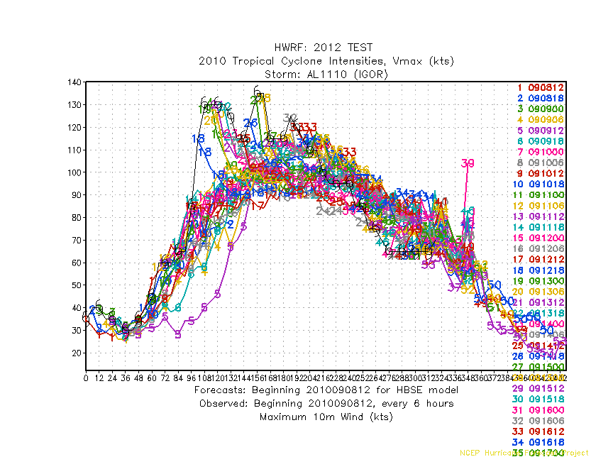
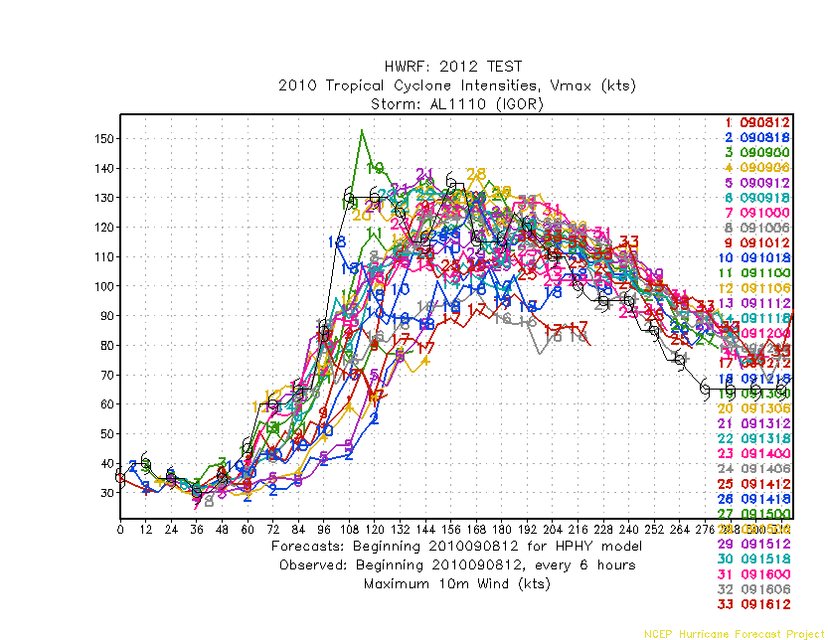
IGOR 11L
HBSE HPHY

Slide 22
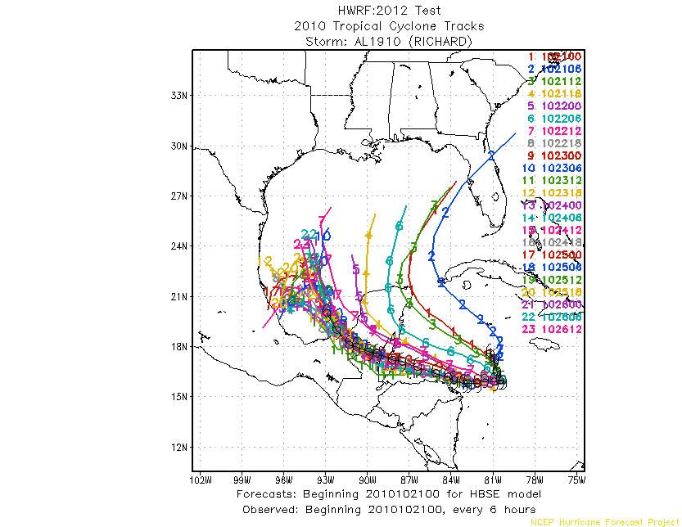
Richard 19L
HBSE HPHY

Slide 23
Tomas 21L
HBSE HPHY

Slide 24
IRENE 09L
HBSE HPHY

Slide 25
MARIA 14L
HBSE HPHY

Slide 26
OPHELIA 16L
HBSE HPHY

