Slide 1


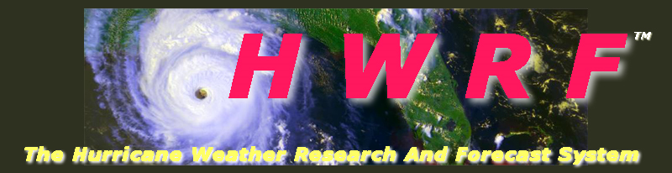

Impact of model vertical resolution on HWRF forecast: Idealized simulations and Hurricane Matthew
Bin Liu, Lin Zhu, Banglin Zhang, Zhan Zhang, and Avichal Mehra
Acknowledgements: Qingfu Liu, Mingjing Tong, Weiguo Wang, Jili Dong, Jason Sippel, Sergio Abarca, and others from EMC Hurricane group
Notes:
1
1

Slide 2
Outline
Background, motivation, objectives
Sensitivity tests through idealized HWRF simulations
Preliminary tests for Hurrciane Matthew
Summary and reccomendations

Slide 3
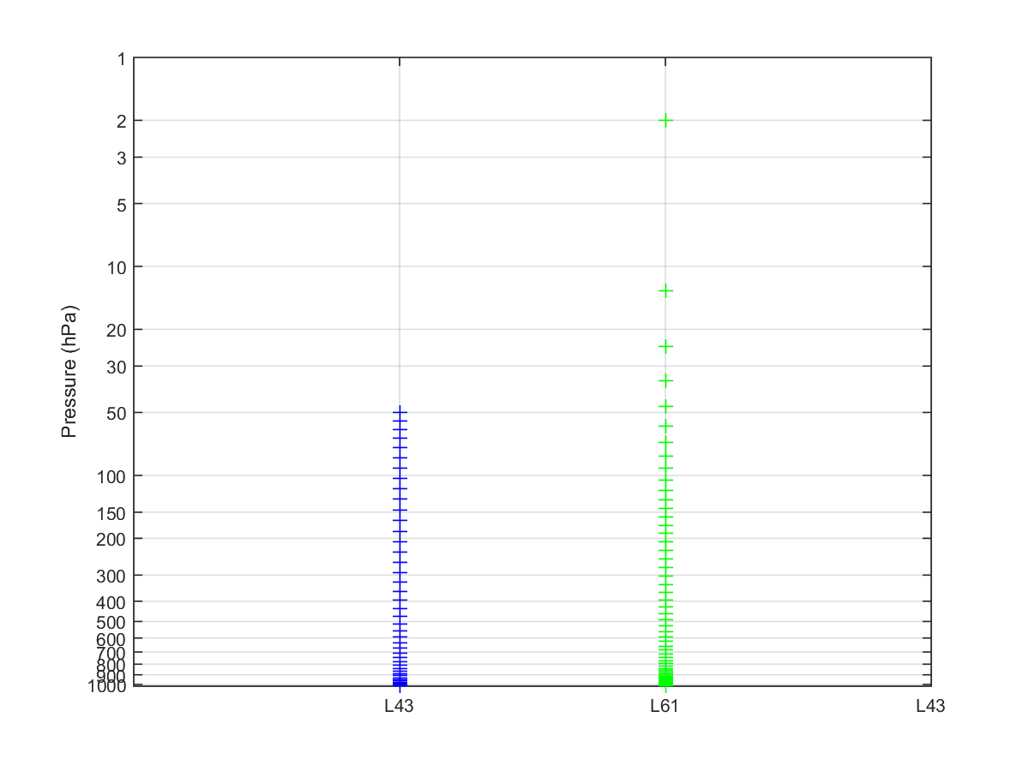
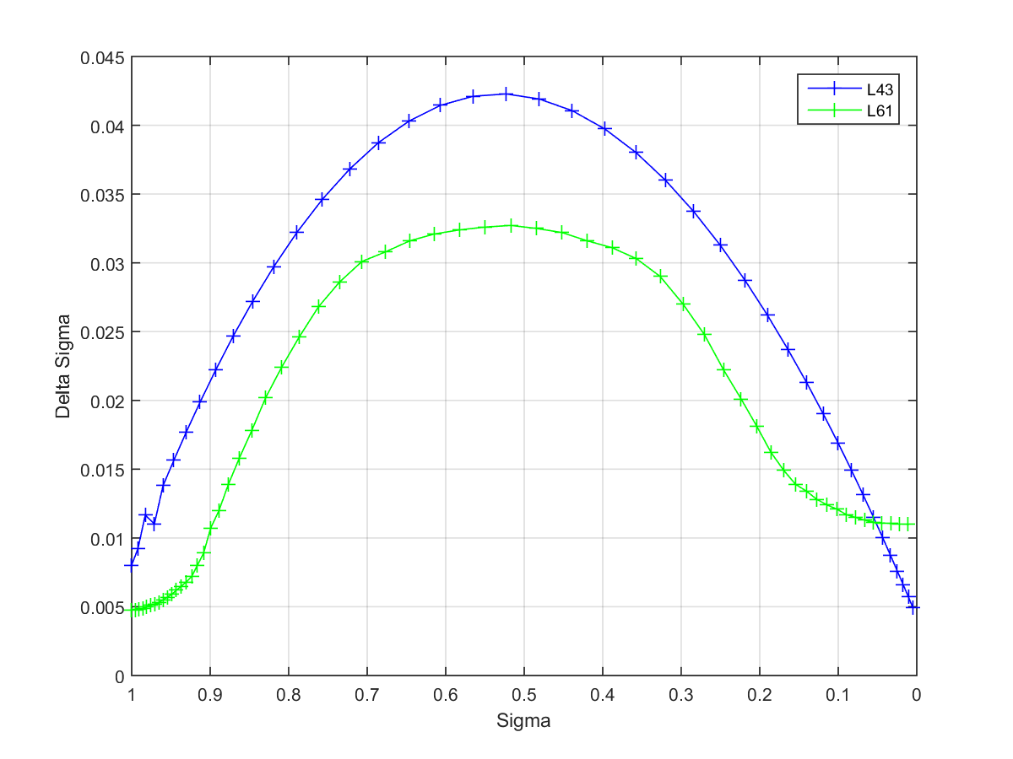
Current HWRF vertical levels
NATL, EPAC, CPAC: 61 levels with a 2-hPa model top
  Lowest half sigma level height: ~20 m
All other basins: 43 levels with a 50-hPa model top
  Lowest half sigma level height: ~34 m

Slide 4
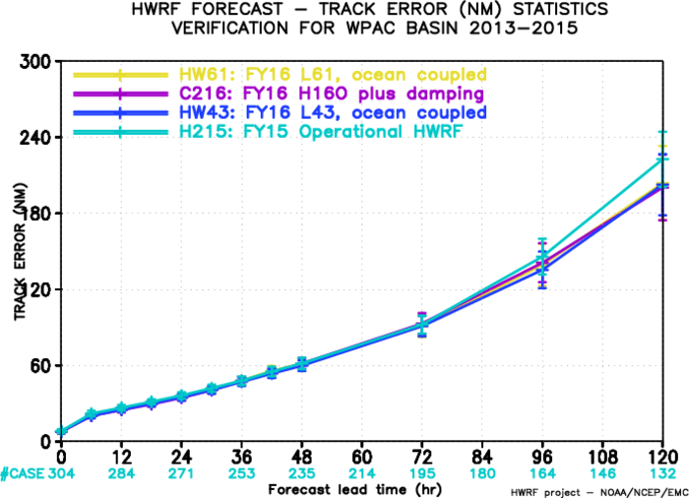
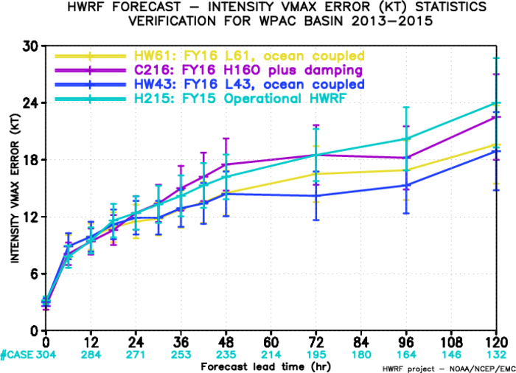
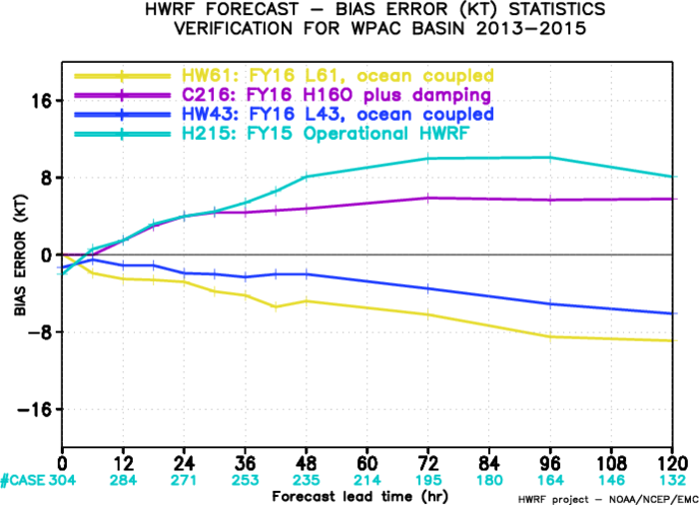
Motivation: 2015 WPAC Storms
H215 L43 FY2015 HWRF
C216 L43 H216 no ocean
HW43 L43 ocean coupled
HW61 L61 ocean coupled

Slide 5
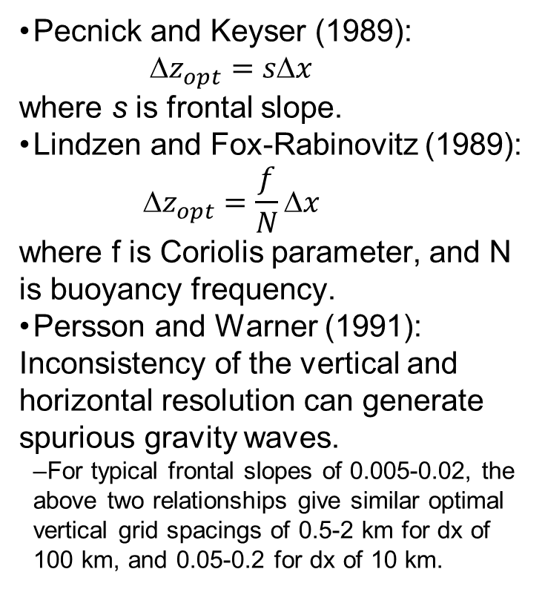
Consistency between vertical and horizontal resolution
Pecnick and Keyser (1989):
  $${\text{}z}_{opt}=s\text{Δ}x$$
  where s is frontal slope.
Lindzen and Fox-Rabinovitz (1989):
  $${\text{}z}_{opt}=\frac{f}{N}\text{Δ}x$$
  where f is Coriolis parameter, and N is buoyancy frequency.
Persson and Warner (1991): Inconsistency of the vertical and horizontal resolution can generate spurious gravity waves.
  For typical frontal slopes of 0.005-0.02, the above two relationships give similar optimal vertical grid spacings of 0.5-2 km for dx of 100 km, and 0.05-0.2 for dx of 10 km.
From Persson and Warner (1991)
Accordingly, for a dx of 2 km, the optimal vertical grid spacings would be in the range of 10-40 m.

Slide 6
Hurricane intensity and vertical resolution
Hurricane intensity and structure are very sensitive to vertical resolution and its vertical distribution. (Zhang and Wang, 2003)
Sufficient vertical levels are needed for resolve both the inflow and outflow layers to hurricane intensity simulation. (Kimball and Dougherty, 2006)
Zhang et al. (2015) suggested that higher vertical resolutions with a near-parabolic or omega shape distribution tend to produce smoother intensity variations and more typical inner-core structures.
Notes:
Zhang et al. (2015) investigated the sensitivity of HWRF to vertical resolution/distribution though idealized simulations. It is suggested that higher vertical resolutions with a near-parabolic or omega shape distribution tend to produce smoother intensity variations and more typical inner-core structures.

Slide 7
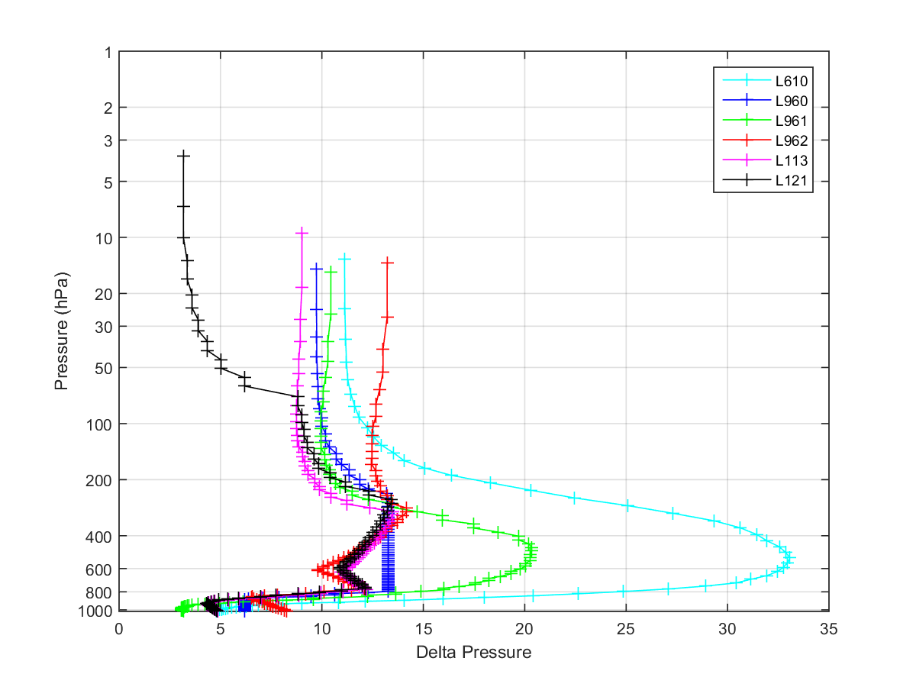
Hurricane track and vertical resolution
From B. Zhang et al. (2016), which shows that the track forecasts of
Hurricane Joaquin (2015) were greatly improved by increasing
the vertical resolution of HWRF.

Slide 8
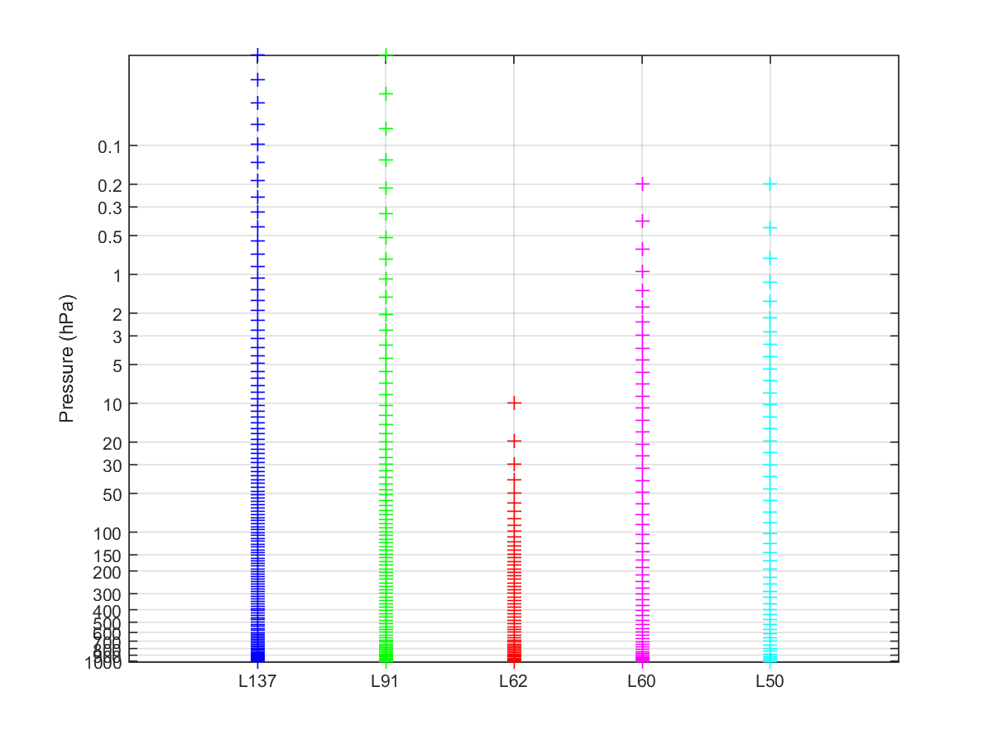
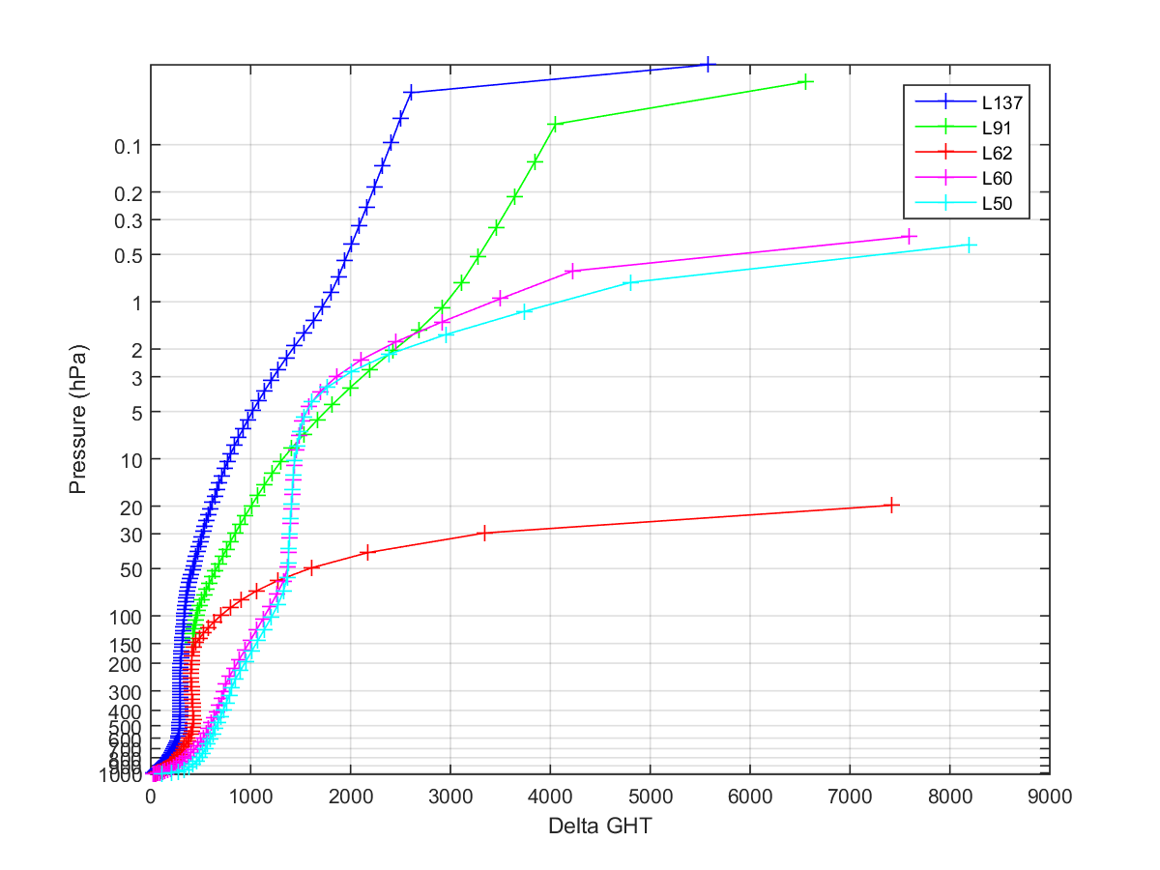
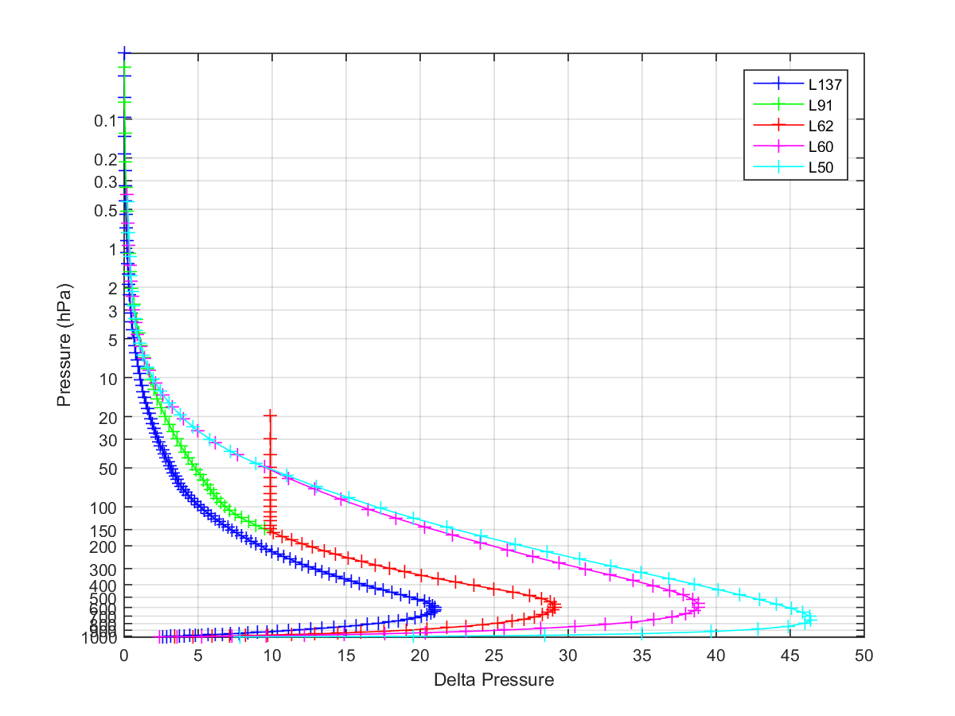
ECMWF IFS vertical levels
2013
2006

Slide 9
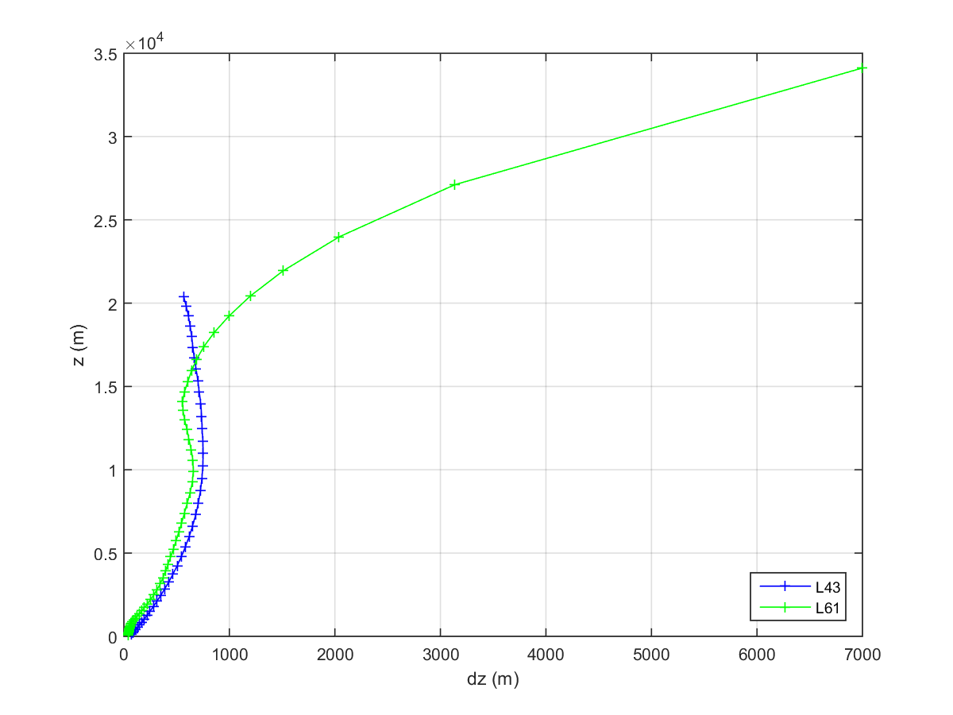
HWRF vertical levels
Sparse vertical levels near model top for L61
  dz > dx
Lowest model level height
  Lowest half sigma level height of ~20m (L61) and 34m (L43)
Relatively low vertical resolution in mid and upper troposphere

Slide 10
Objectives
Increase HWRF vertical resolution and make it more consistent with model horizontal resolution
Optimize vertical level distribution
Unify the model vertical level setting for all the TC basins
Improve HWRF track and intensity forecasting

Slide 11
Sensitivity tests through idealized HWRF simulations
Sensitivity of simulated TC intensity to:
  model tops
  vertical level distributions in low/mid/up atmosphere
  number of vertical levels
Specified environment
  U=-5 m/s
  VWS = 0
  Typical tropical vertical T, RH profile
  All ocean with specified constant SSTs
Bogused vortex
  vmax=30 m/s
  rmw=50 km

Slide 12
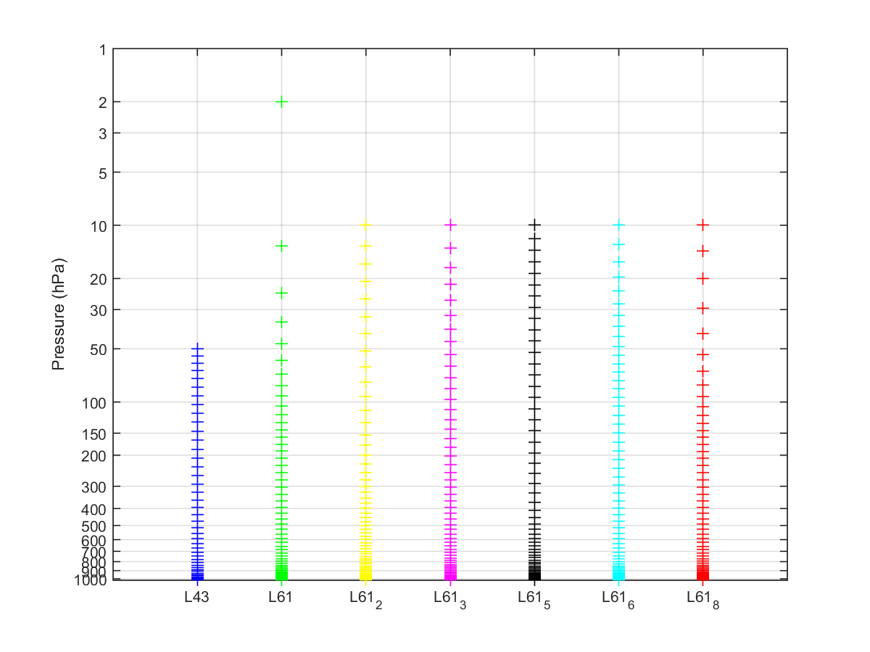
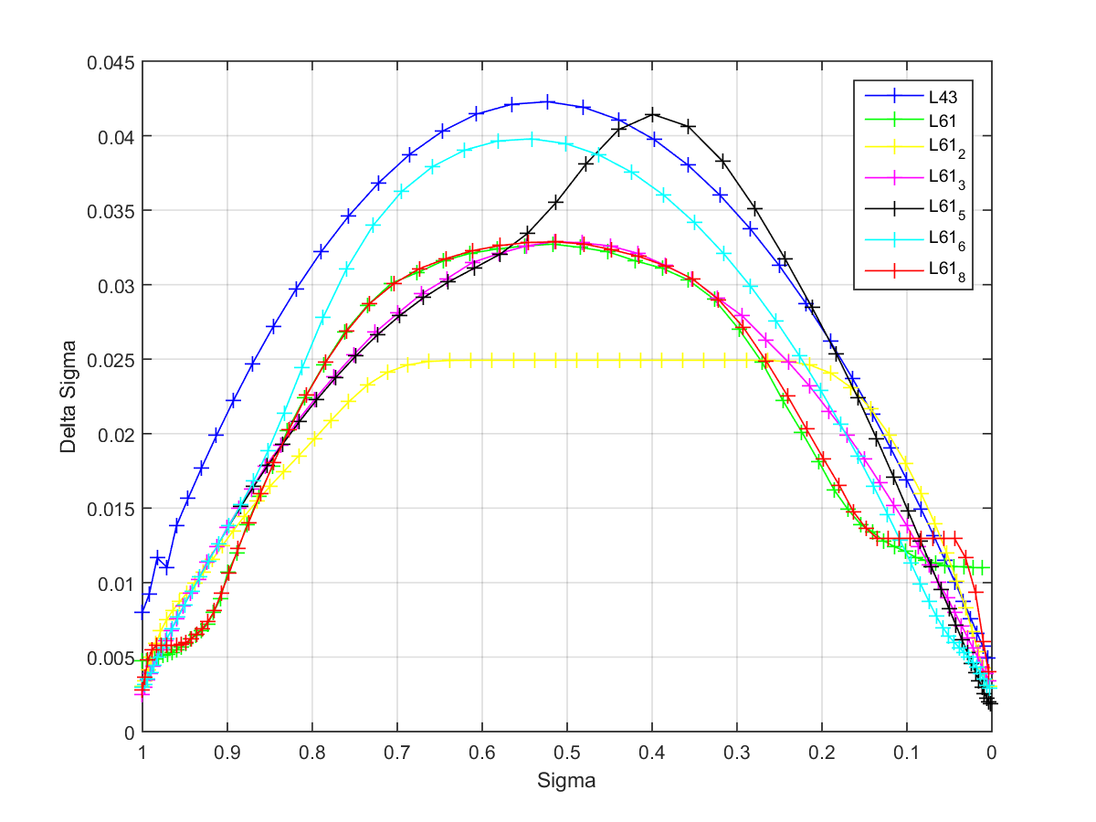
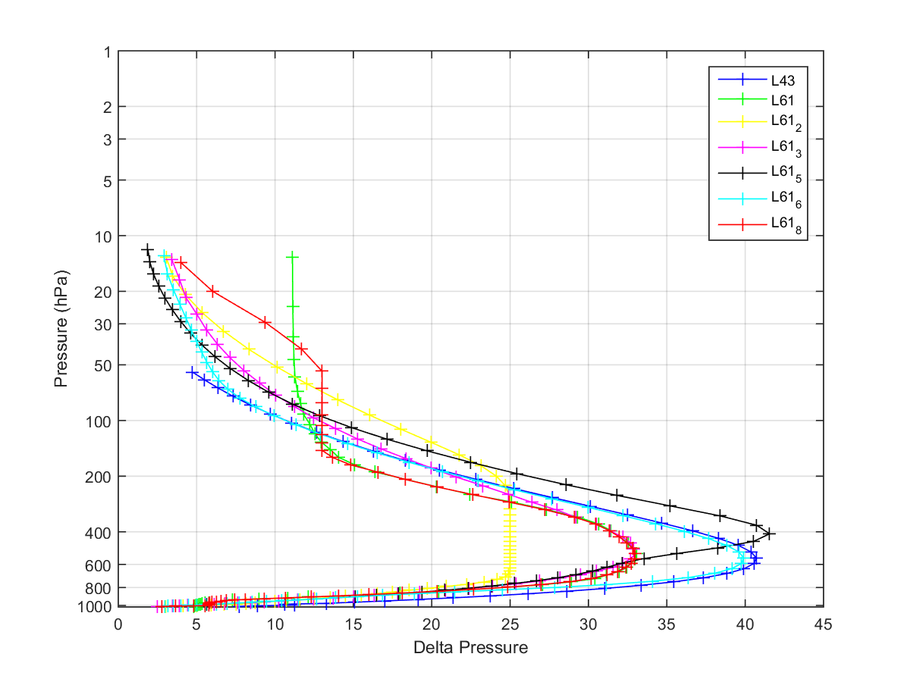
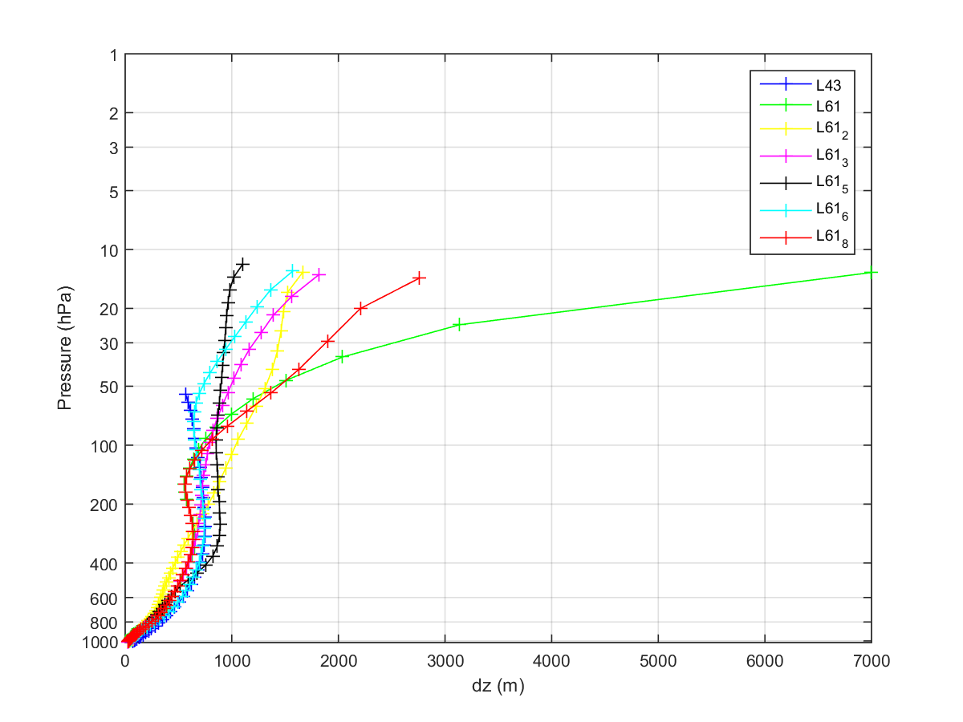
Experiments with different distributions for 61 vertical levels

Slide 13
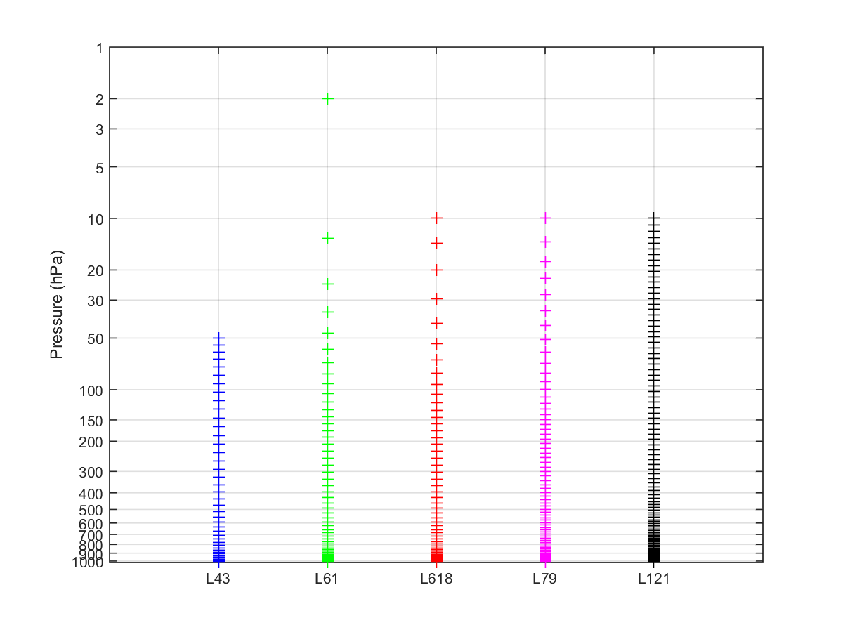
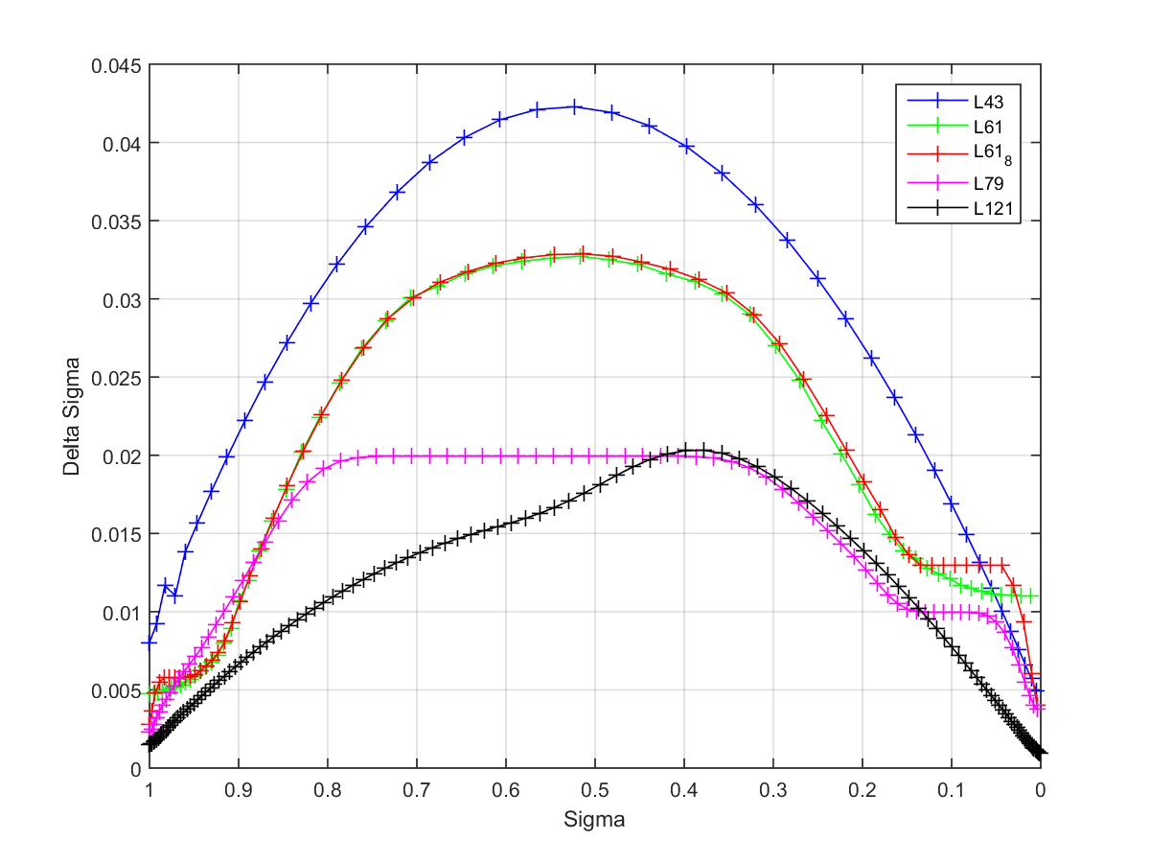
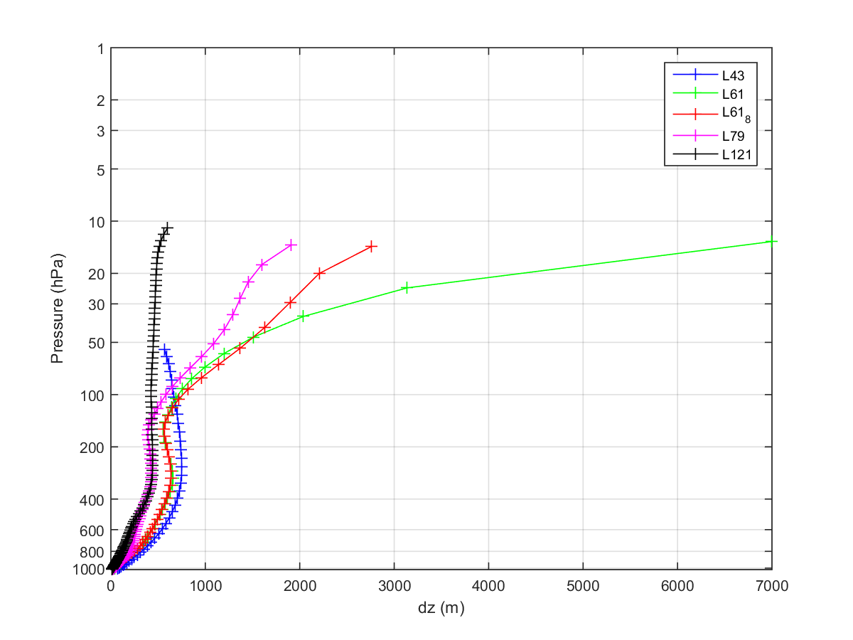
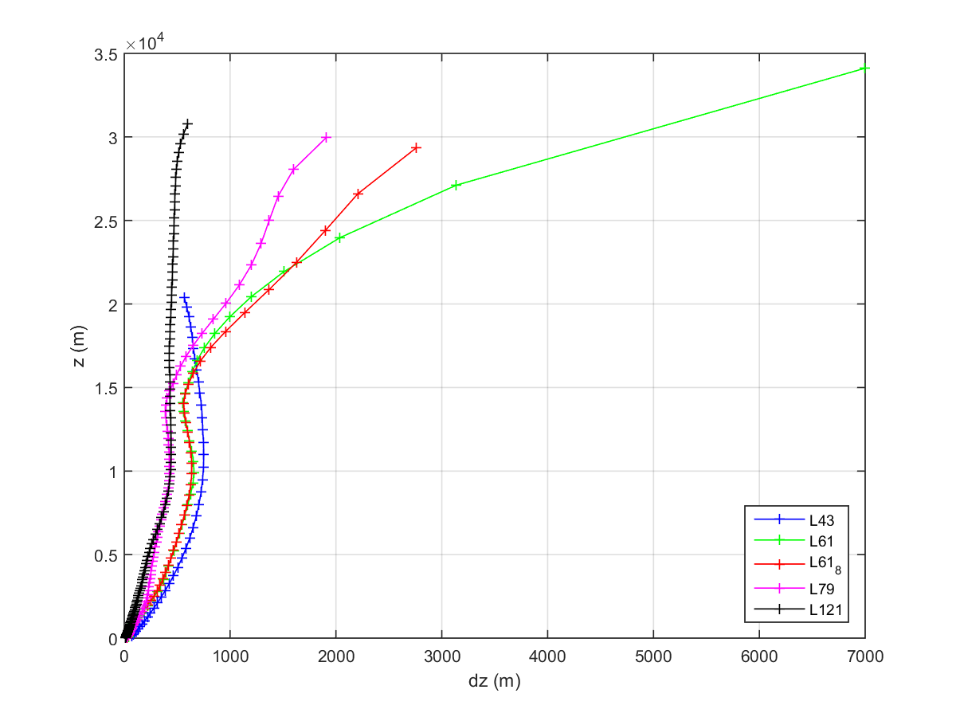
Experiments with different vertical levels

Slide 14
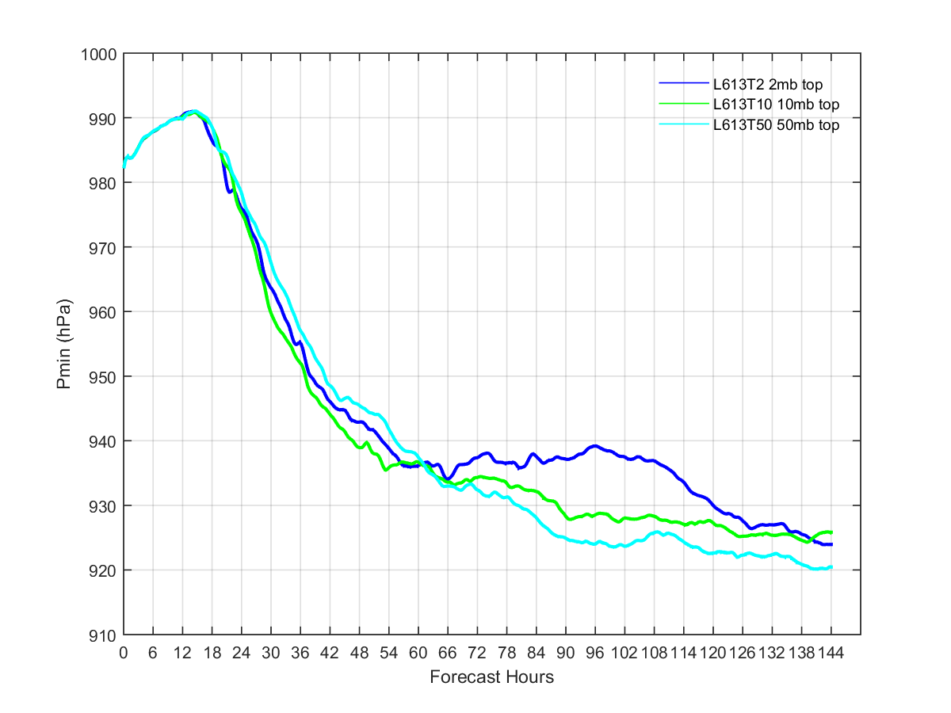
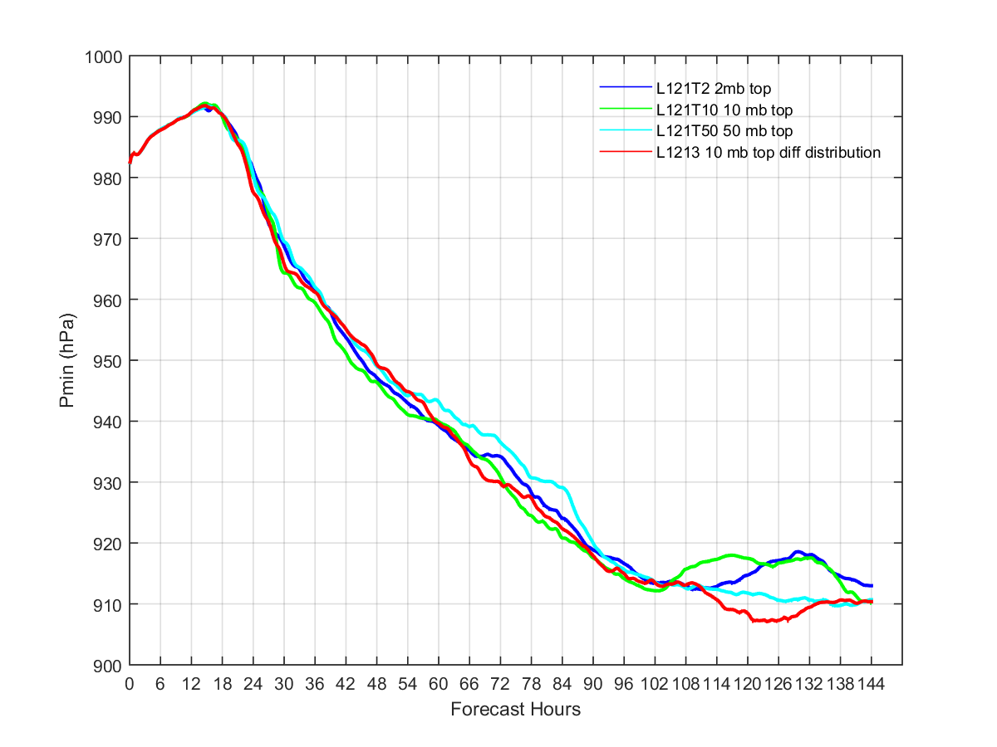
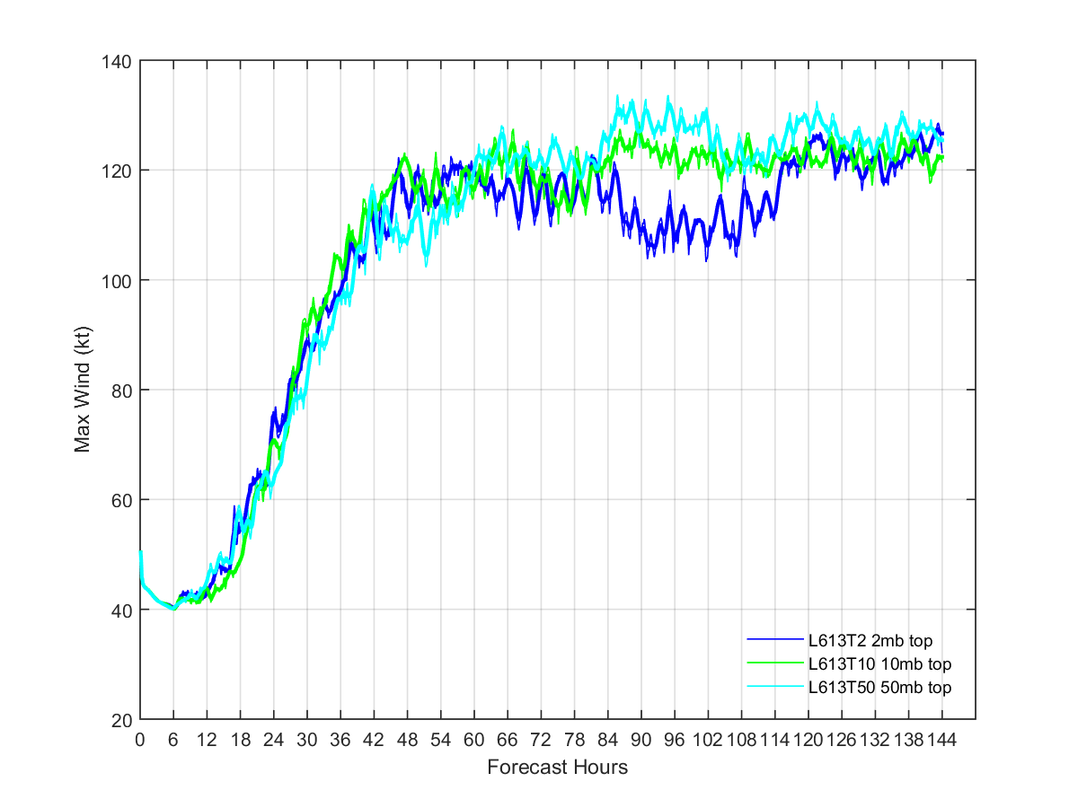
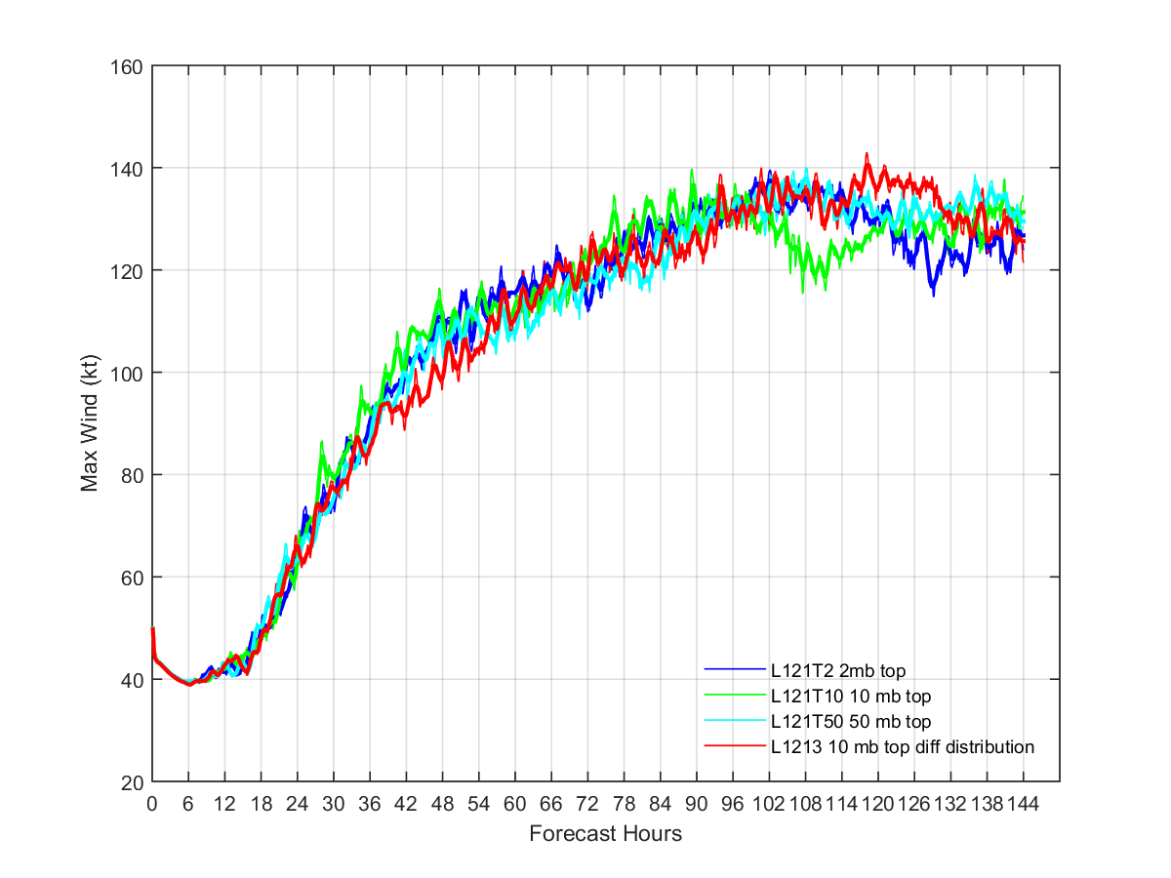
Sensitivity to different model tops
61 levels
121 levels

Slide 15
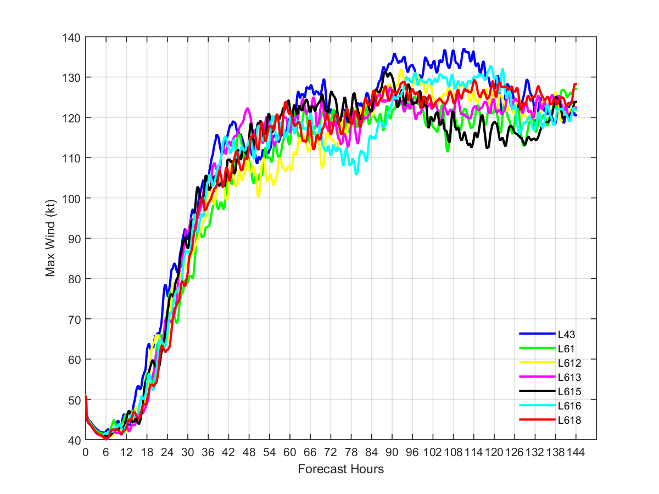
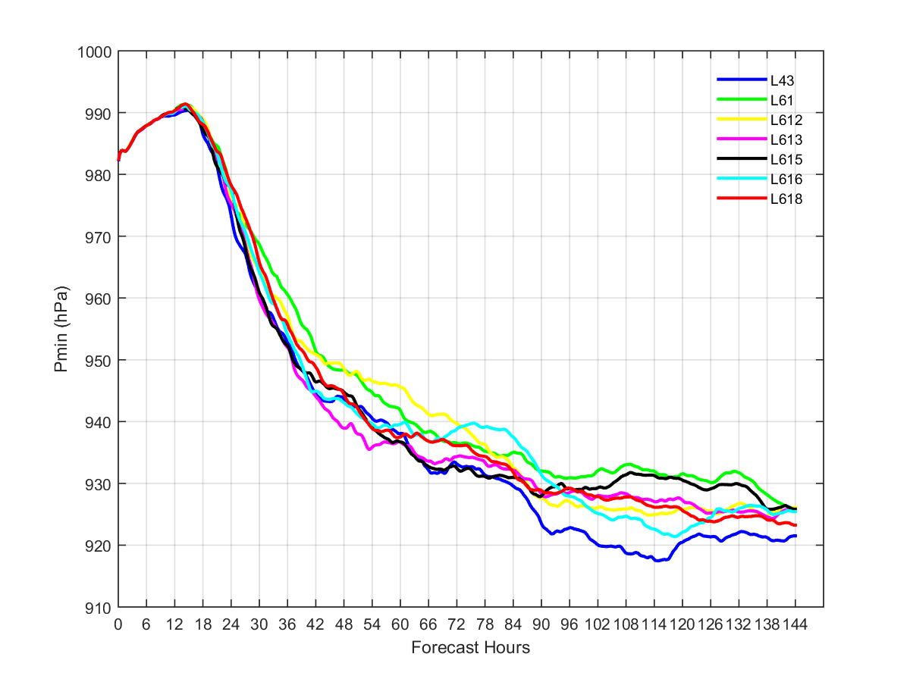
Sensitivity to vertical distributions for 61 vertical levels
Constant SST of 30 degC

Slide 16
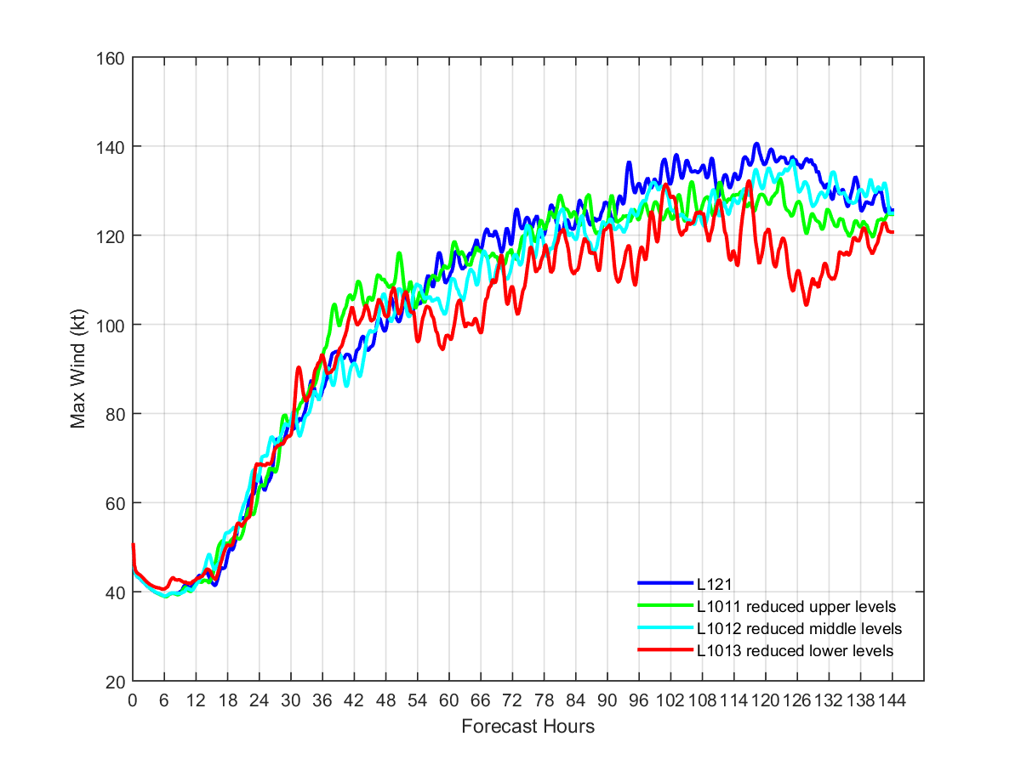
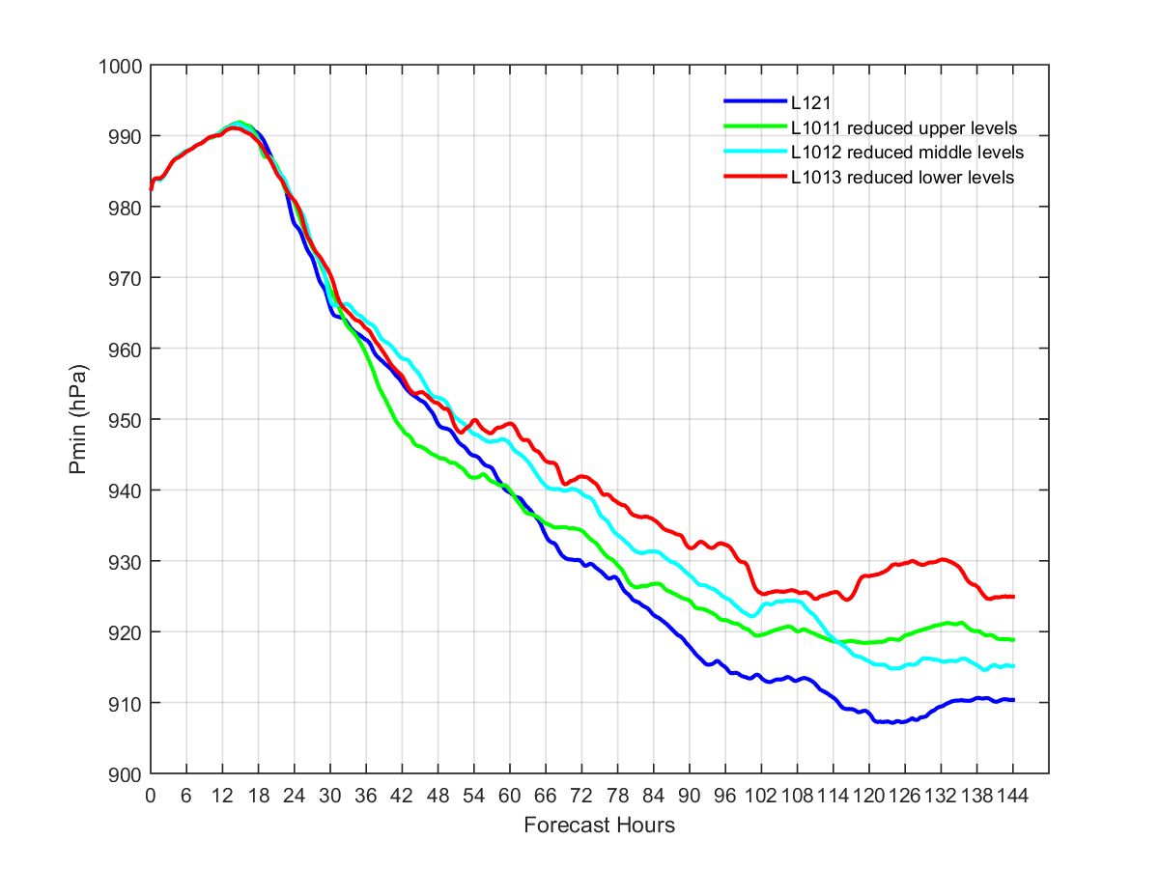
Sensitivity to vertical distribution in low/mid/up atmosphere
Comparing different L101s, which reduce vertical levels in up (L1011), mid (L1012), and low (L1013) atmosphere from L121

Slide 17
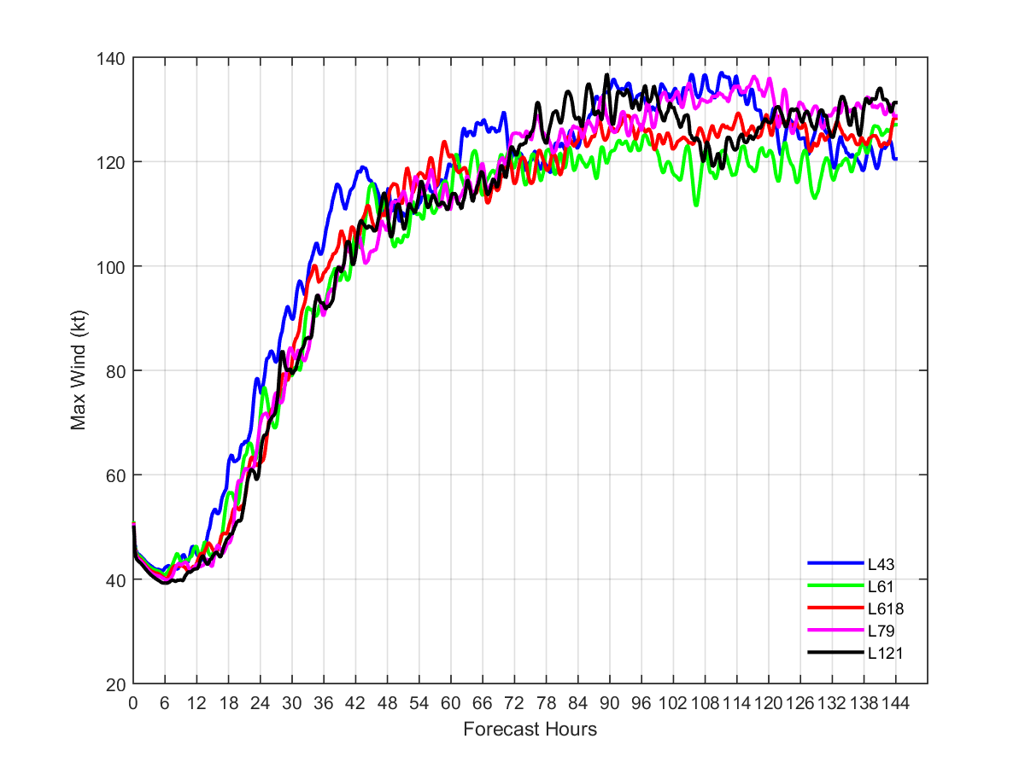
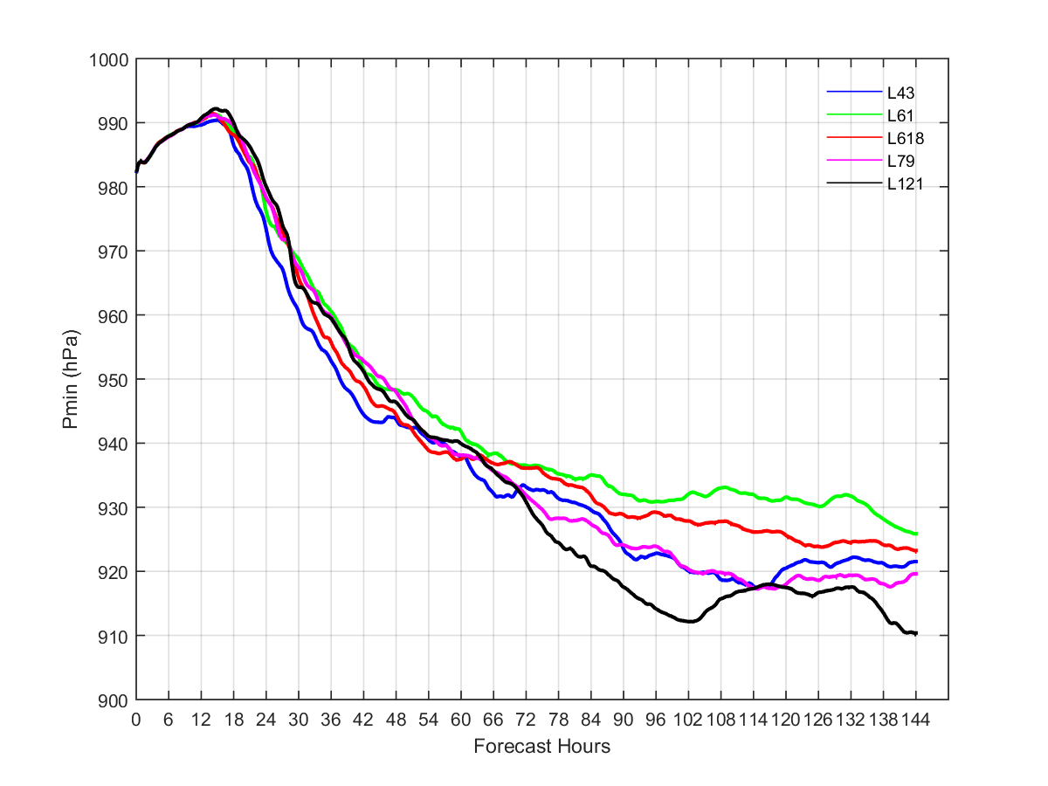
Sensitivity to different vertical levels
SST of 30 degC

Slide 18
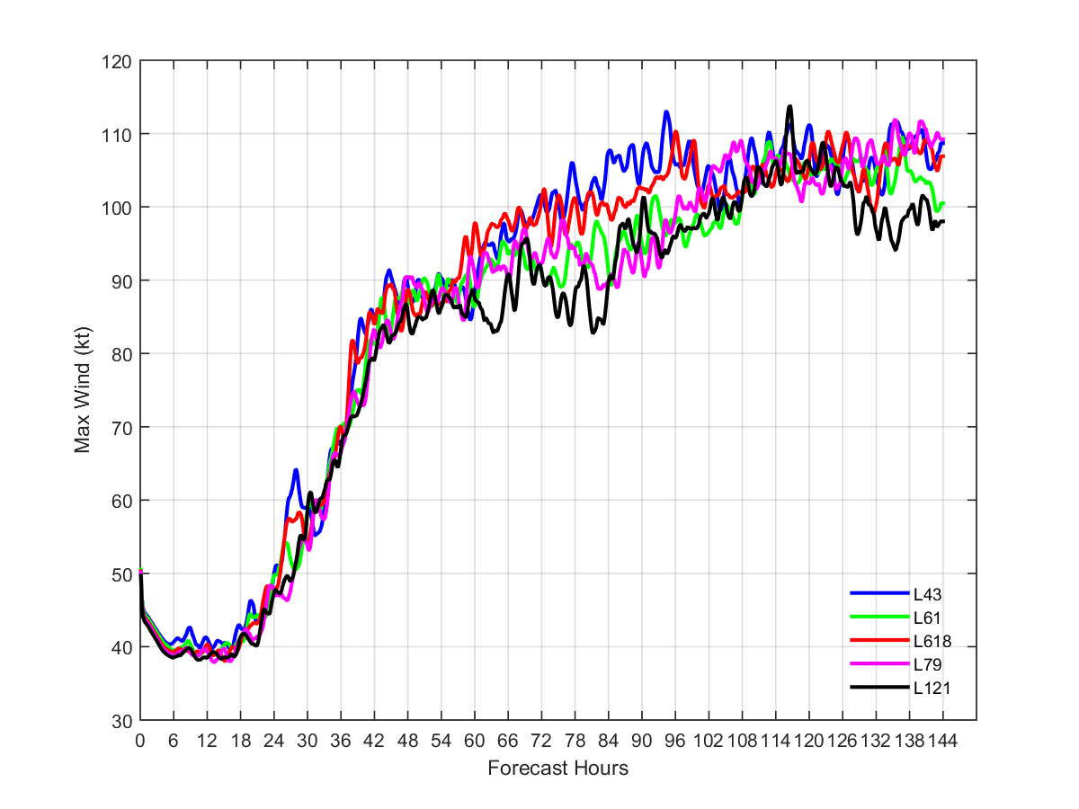
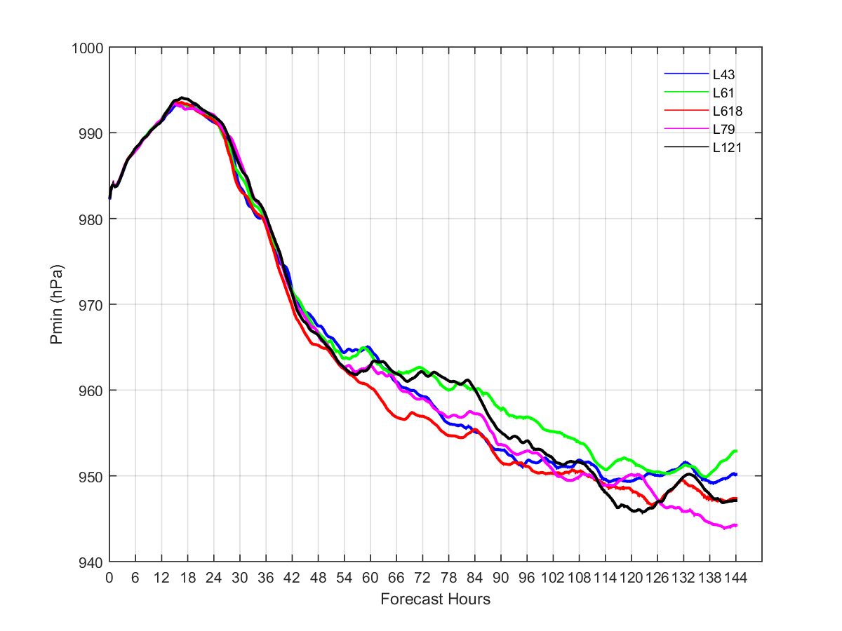
Sensitivity to different vertical levels
SST of 28 degC

Slide 19
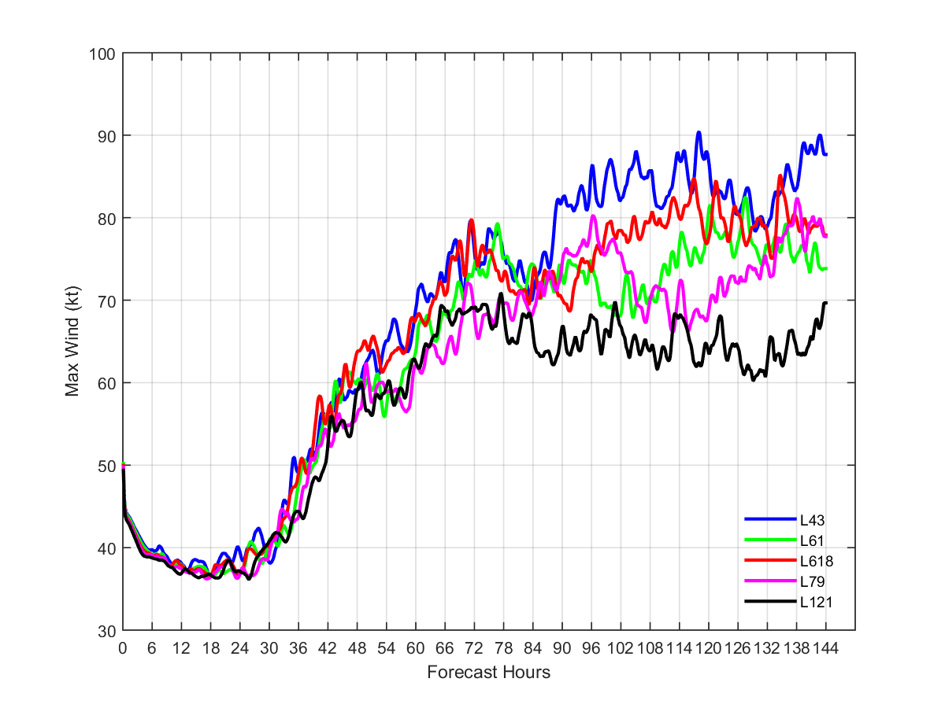
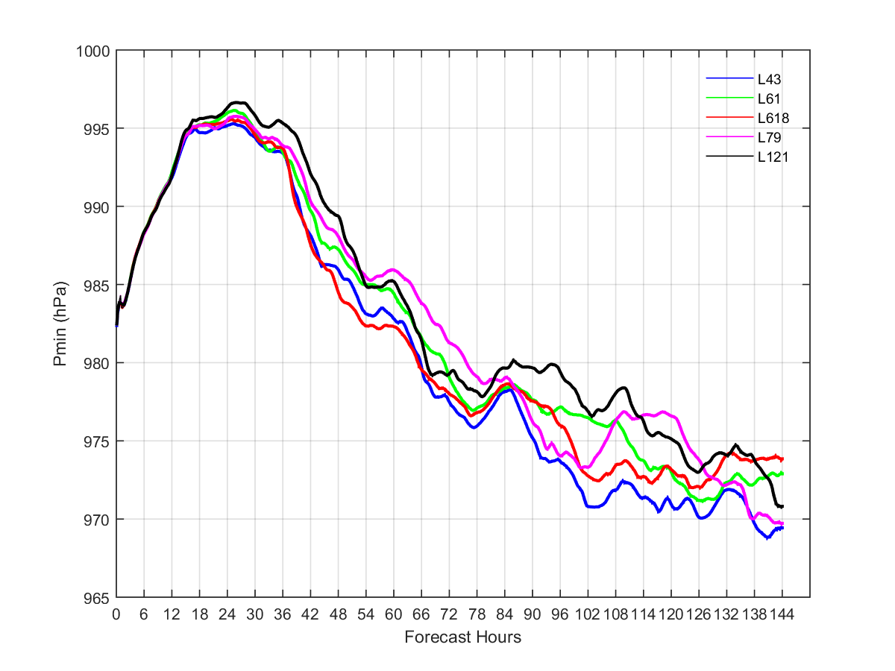
Sensitivity to different vertical levels
SST of 26 degC

Slide 20
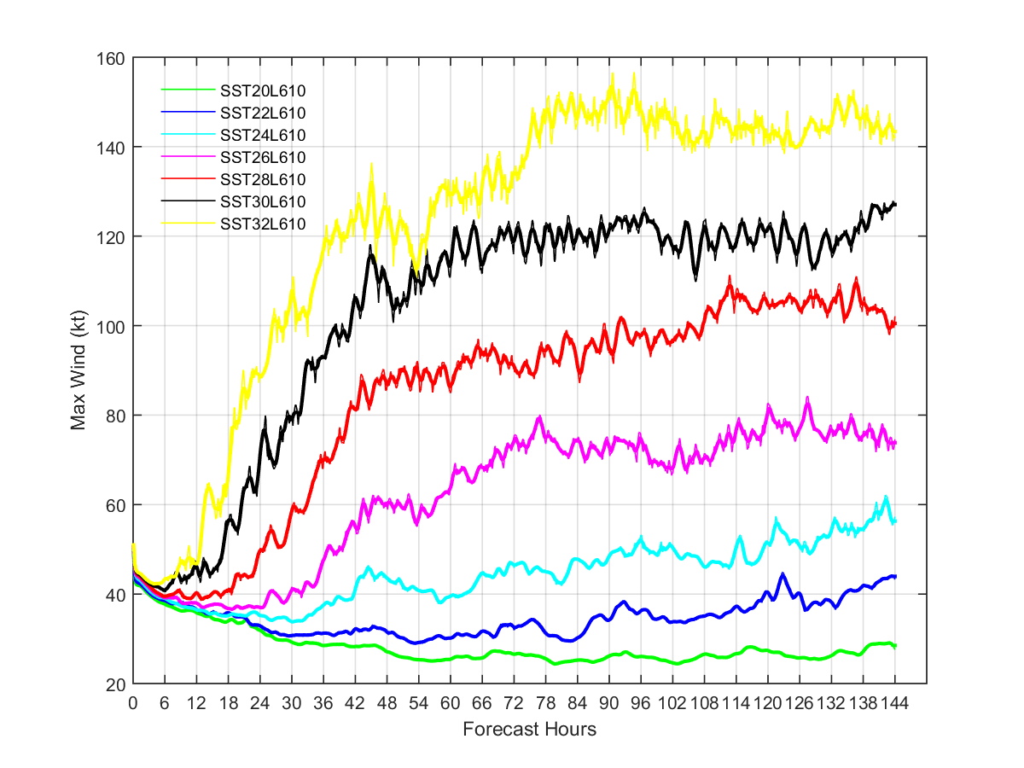
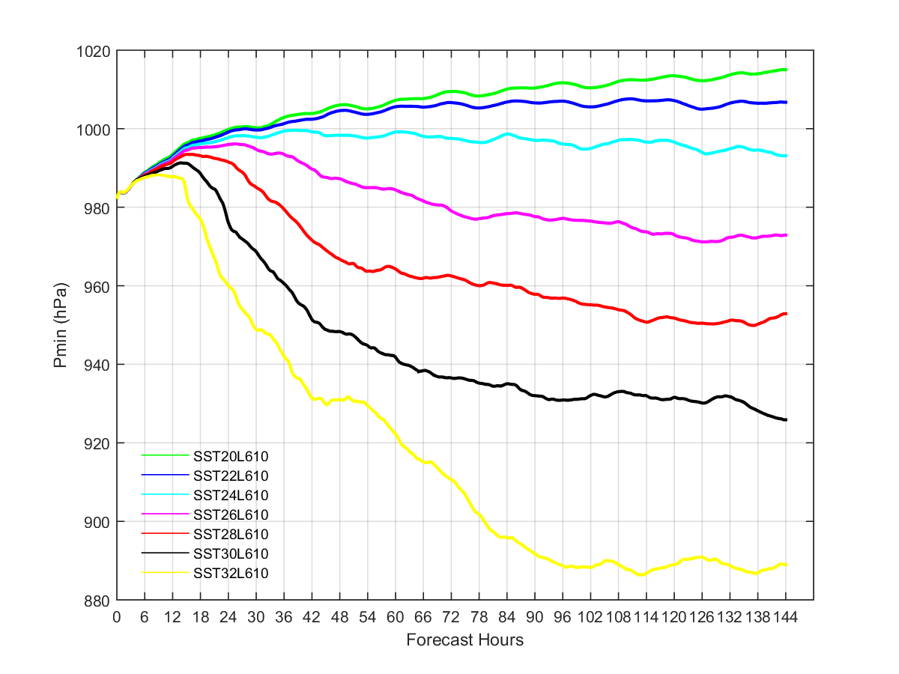
Idealized experiments for FY2016 HWRF
SST varying from 20 to 32 deg C

Slide 21
Some preliminary tests for Hurrciane Matthew

Slide 22
HWRFL79 VS Operational HWRF
HWRFL79
Operational HWRF
Reduced d02/d03 sizes :
  D01: 288x576
  D02: 237x472
  D03: 265x472
Model top at 10 hPa
79 vertical levels
Modifications for vortex initialization to be able to handle more vertical levels
Modifications for GSI to be able to handle more vertical levels
U10 related fix
Consider storm movement in the N-S direction when choosing domain center for D01
Triple-nested domains: 18-6-2 km
  D01/D02/D03 mesh sizes: 288x576
Model top at 2 hPa
61 vertical levels

Slide 23
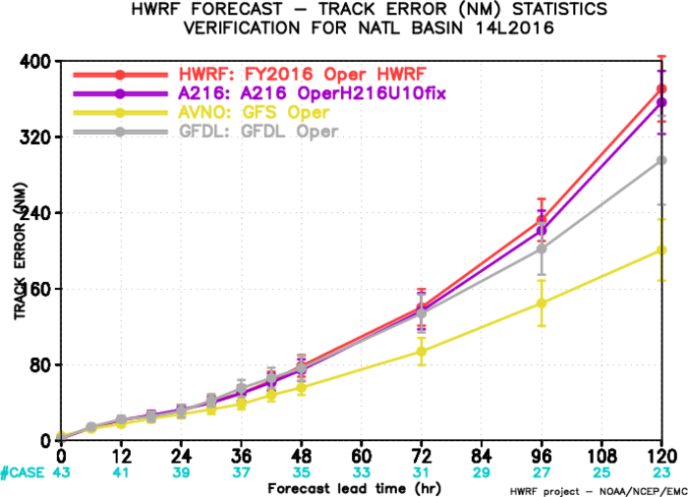
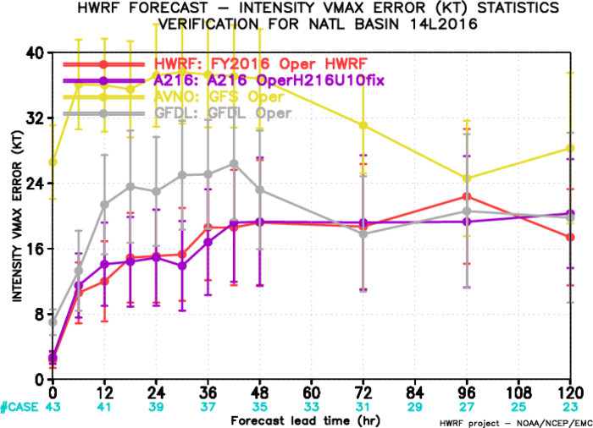
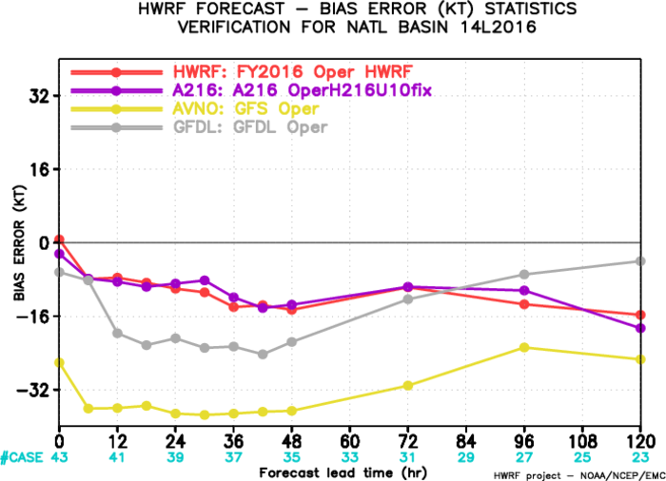
Impact of U10fix for Matthew

Slide 24
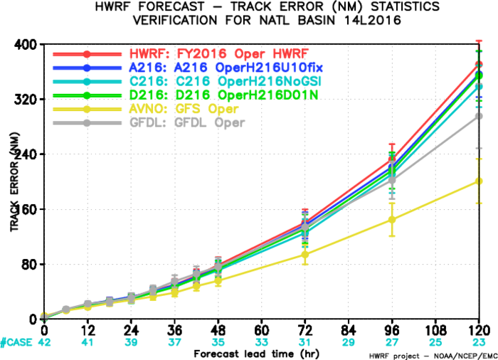
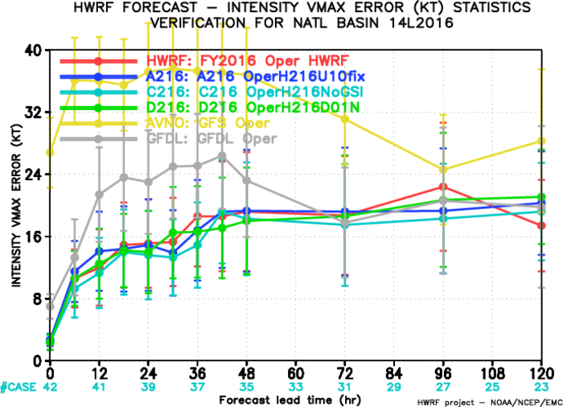
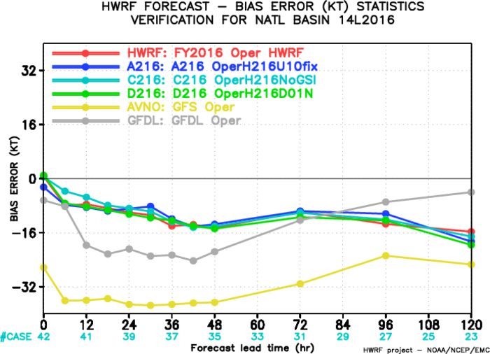
Impact of considering storm’s meridional movement when choosing domain center

Slide 25
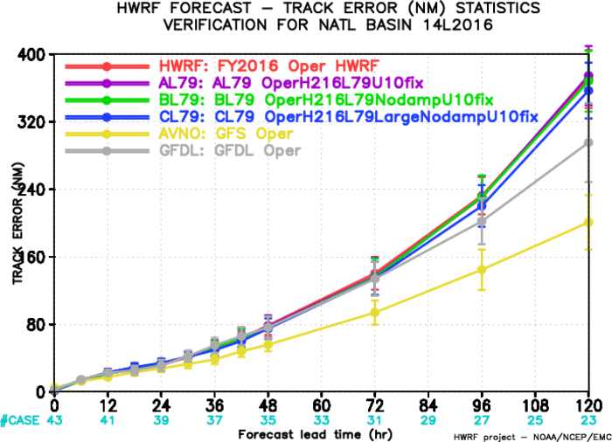
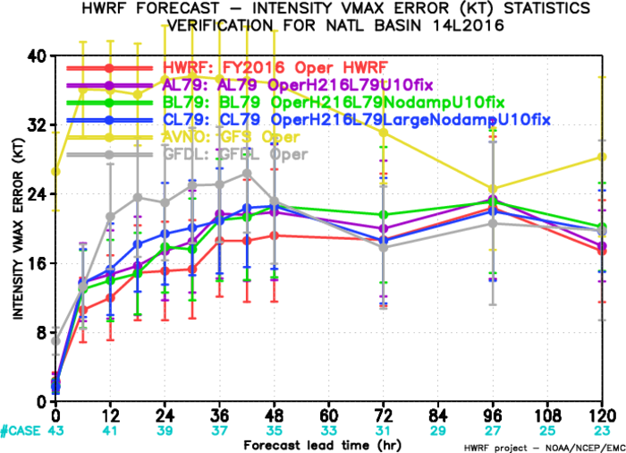
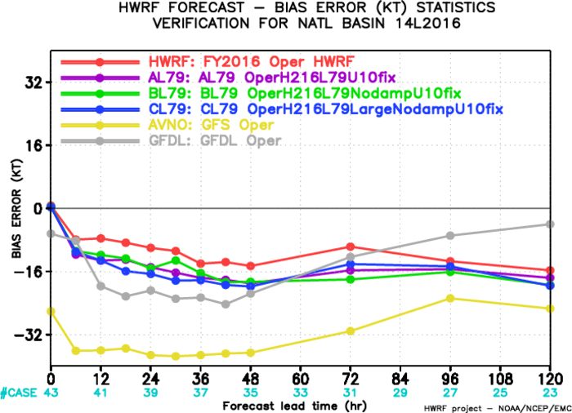
HWRFL79 for Hurricane Matthew
CL79 uses the same domain sizes as FY2016 HWRF

Slide 26
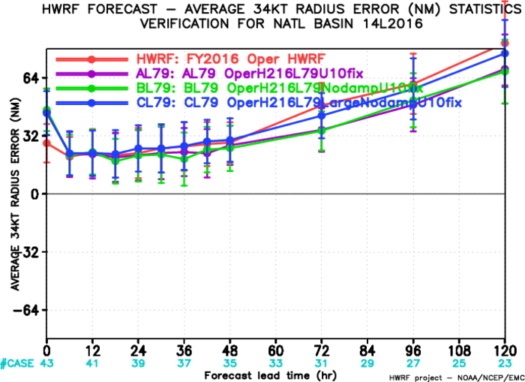
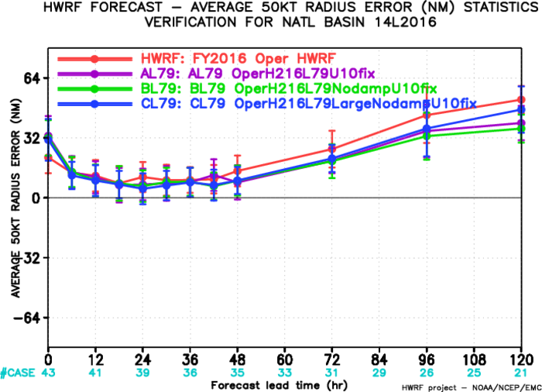
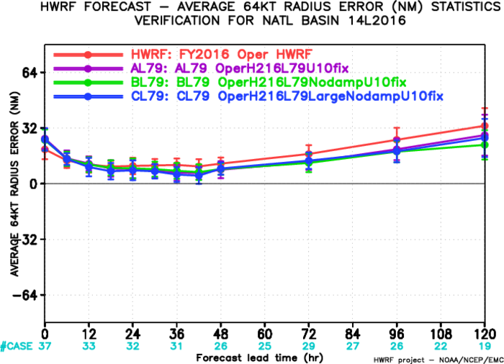
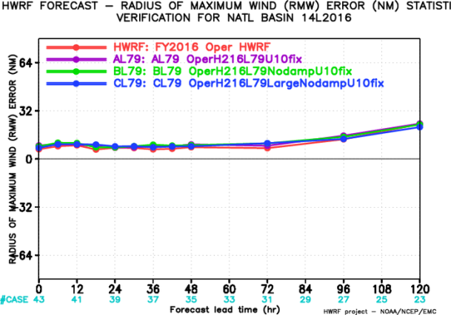
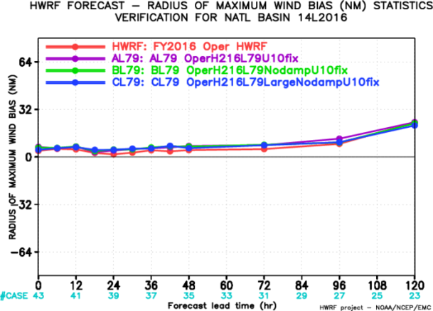
HWRFL79 for Hurricane Matthew

Slide 27
Summary
Hurricane simulation/forecast are every sensitive to model vertical resolution/distribution.
  Strong storms tend to be more sensitive than weak storms in terms of peak intensity
  Intensification rate/phase also vary with different vertical resolutions/distributions
Consistent vertical and horizontal resolution needs to be considered.

Slide 28
Recommendations
Conduct a somewhat large retrospective test with the OperH216L79 settings (hopefully in the following two weeks or so)
Test L618 setting with H217 baseline experiment
  It only redistributes several levels near the model top to reduce the largest dz and modifies a few levels near surface to reduce the lowest half-sigma model level height.
Test L79 settings with one of the combined physics experiments
  Lower model to 10 mb and increasing vertical levels to 79 levels
  23 levels below 850 mb level with lowest half sigma level height of ~10m
  Increased vertical resolution at all levels, especially for mid levels
  Largest vertical spacing < 2 km near the model top

Slide 29
Thank you!

Slide 30



Impact of increasing vertical levels on Matthew

