Slide 1
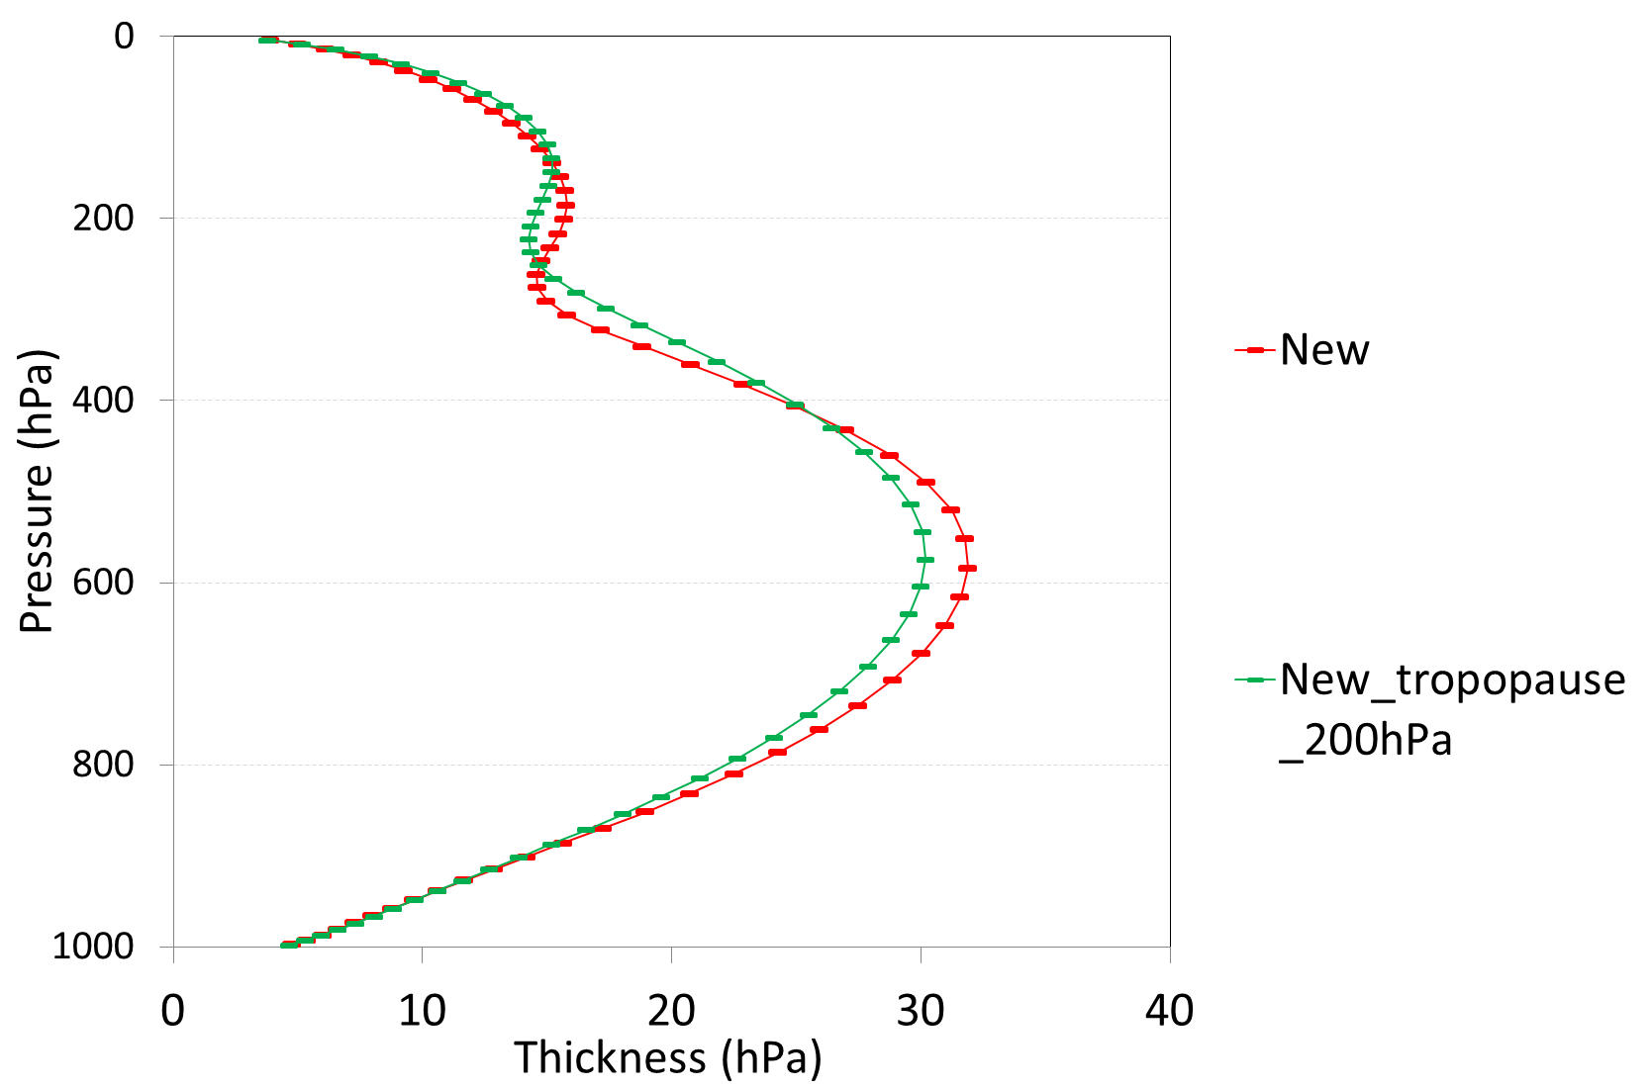
New : the new vertical distribution by the code Sam gave me, the higher resolution at upper-level is at about 300 hPa.
New_tropopause_200hPa : the same as New, except move higher resolution at upper-level to 200 hPa.

Slide 2
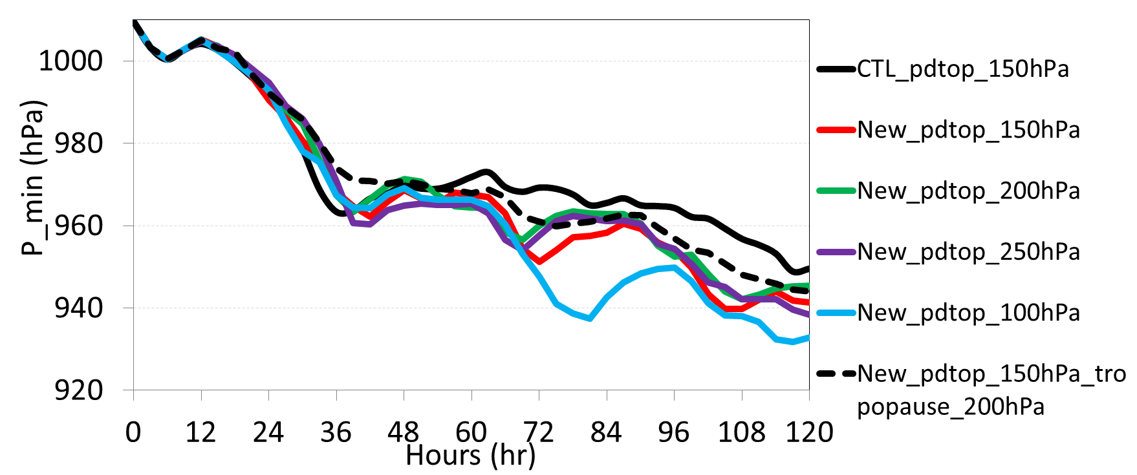
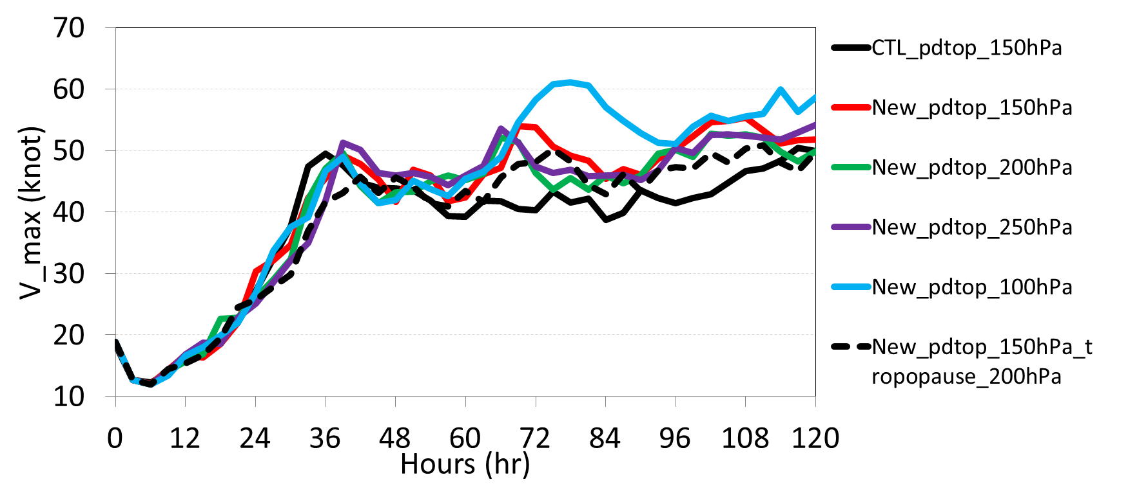
CTL_pdtop_150 hPa : the results from H214 and pdtop is 150 hPa.
New_pdtop_150 hPa, New_pdtop_200 hPa, New_pdtop_250 hPa, New_pdtop_100 hPa : the results from the tests with vertical levels from New in slide 1, except using different pd_top.
New_pdtop_150 hPa : the results from the test with vertical levels from New_tropopause_200 hPa in slide 2, pdtop is 150 hPa.

