Slide 1
The Vertical Structure of Tangential Winds in Tropical Cyclones: Observations, Theory, and Numerical Simulations
Daniel P. Stern

Slide 2
Motivating Questions
How does the wind field change with height in a tropical cyclone, and why?
How much does the vertical structure vary between storms? What governs this variability?
Is there a theory which can predict the manner in which the winds change with height?
Do numerical simulations reproduce observed hurricane structural variability?
Where is the height of the warm core?

Slide 3
But Why Should We Care?
The efficiency with which convective heating can be converted to kinetic energy depends critically on the strength of the winds aloft.
Idealized linear models must specify a basic state vortex. Currently, the vertical structure used in such studies is arbitrary.
The accuracy of real-data simulations depend on the initial conditions.

Slide 4
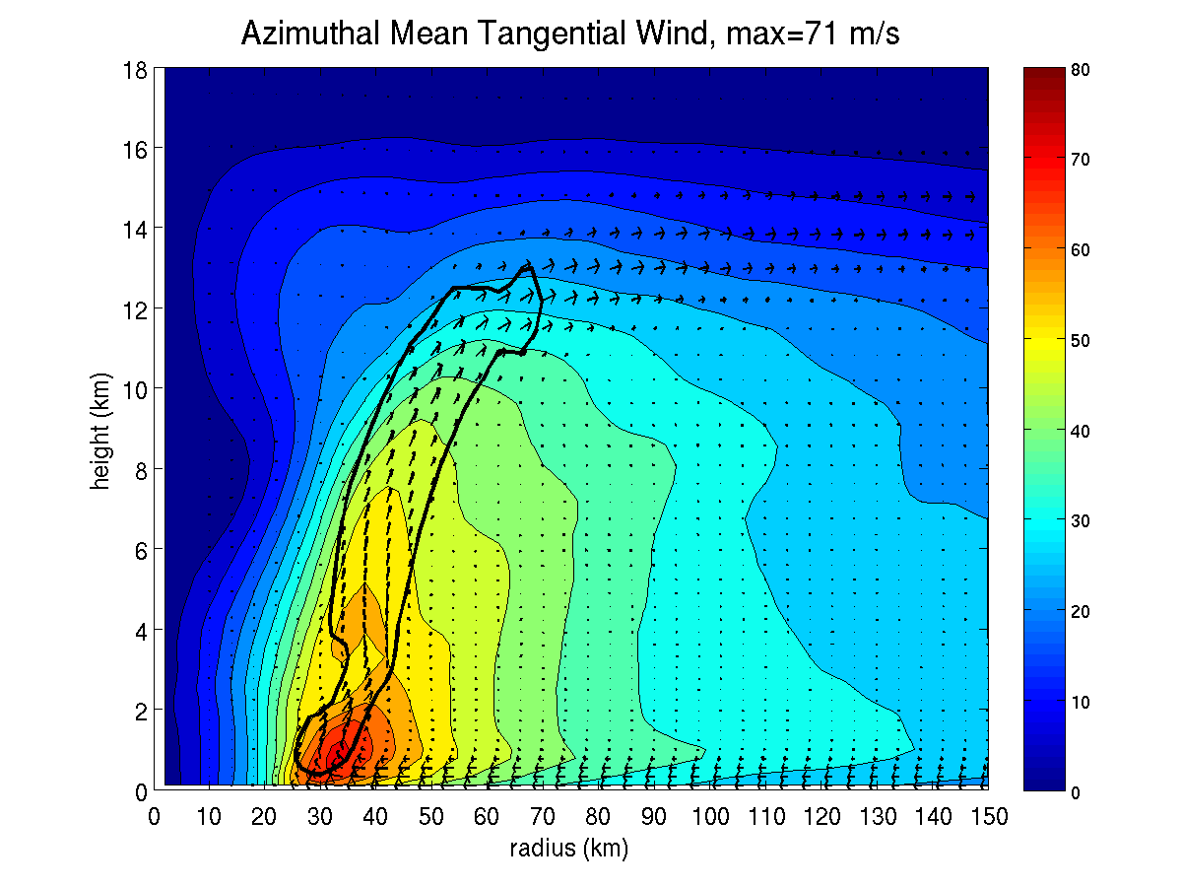

Slide 5
Upper-Level Outflow
Eyewall Updraft
RMW
Tangential Wind Jet
Boundary Layer Inflow

Slide 6
Some More Specific Questions
How rapidly do the maximum tangential winds in tropical cyclones decay with height? What determines the rate of decay, and how variable is it?
By how much does the Radius of Maximum Winds (RMW) change with height?
Why does the Radius of Maximum Winds (RMW) slope outwards with increasing height?

Slide 7
The 3 Conventional Wisdoms of Vertical Structure
CW1: The outward slope of the RMW decreases with increasing intensity.
CW2: The outward slope of the RMW increases with increasing size of the RMW.
CW3: The RMW is approximately a surface of constant absolute angular momentum (M), where

Slide 8
Observations
3D Doppler wind swaths acquired from the NOAA Hurricane Research Division. Horizontal and vertical resolutions of 2 km and 500 m respectively.
Composited multiple legs.
For finding relatively smooth RMW, interpolated cubically to finer grid (Δx=Δy=500 m).
Placed Cartesian data in 500m radial bins and azimuthally averaged.

Slide 9
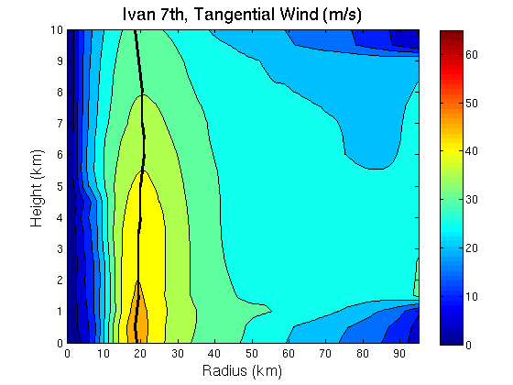
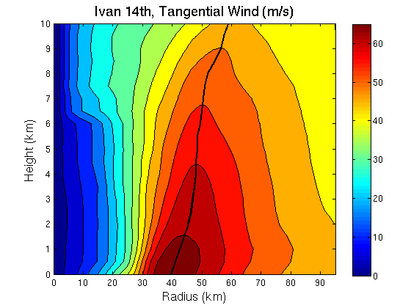
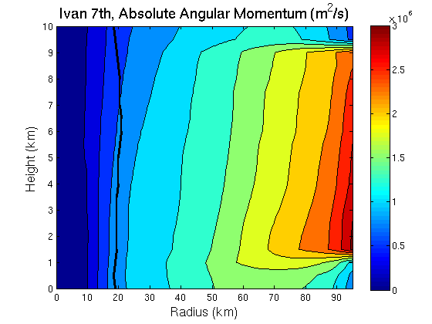
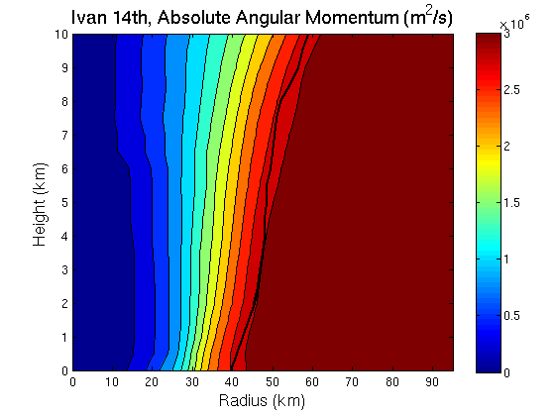

Slide 14
Notes:
Average slopes range from -21 to +70 degrees from vertical.

Slide 15
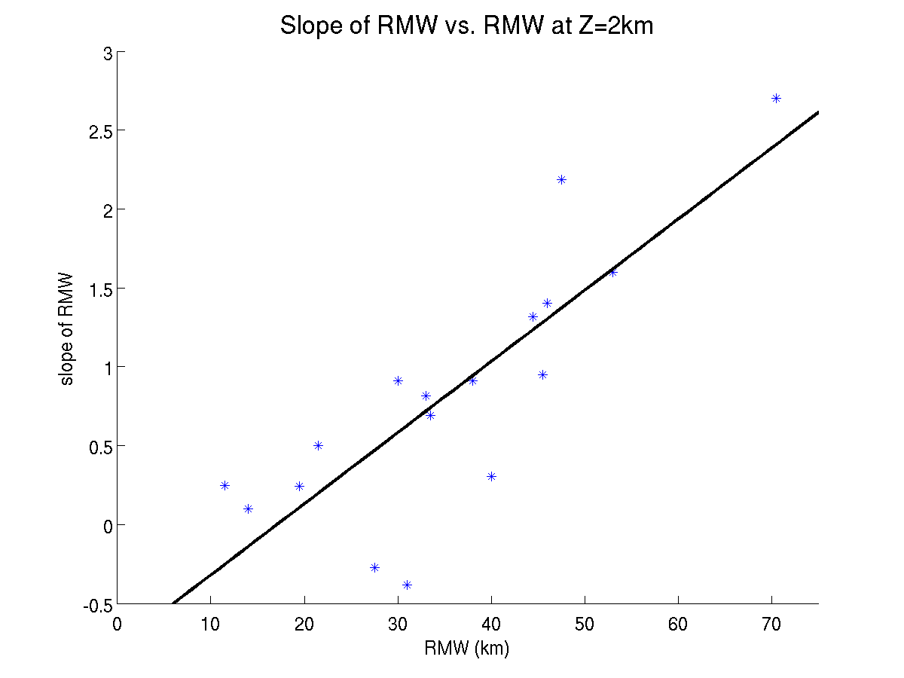
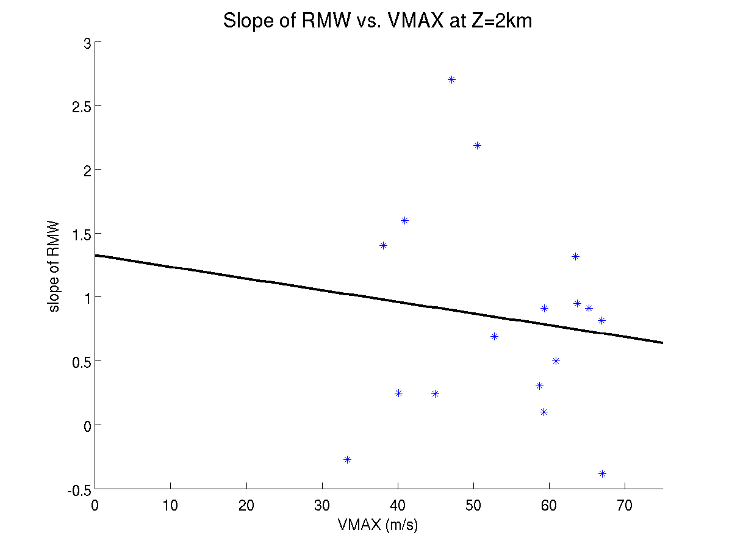
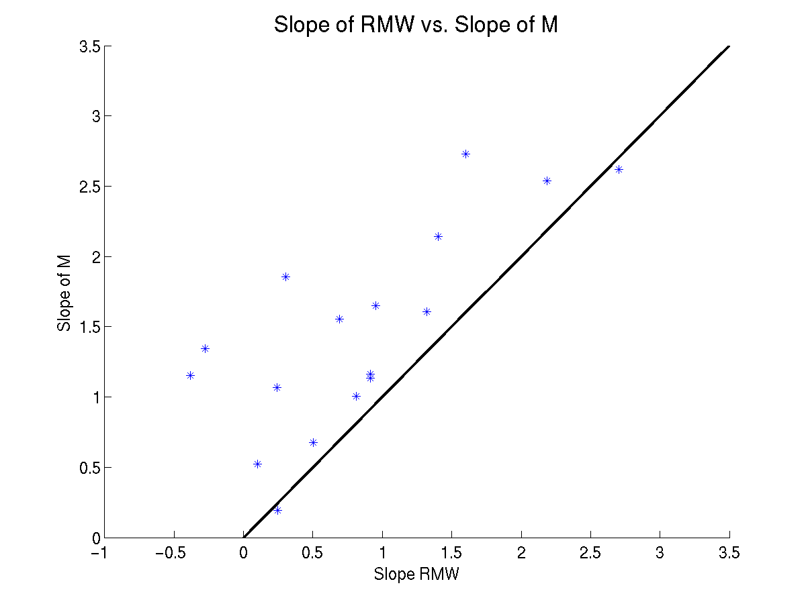
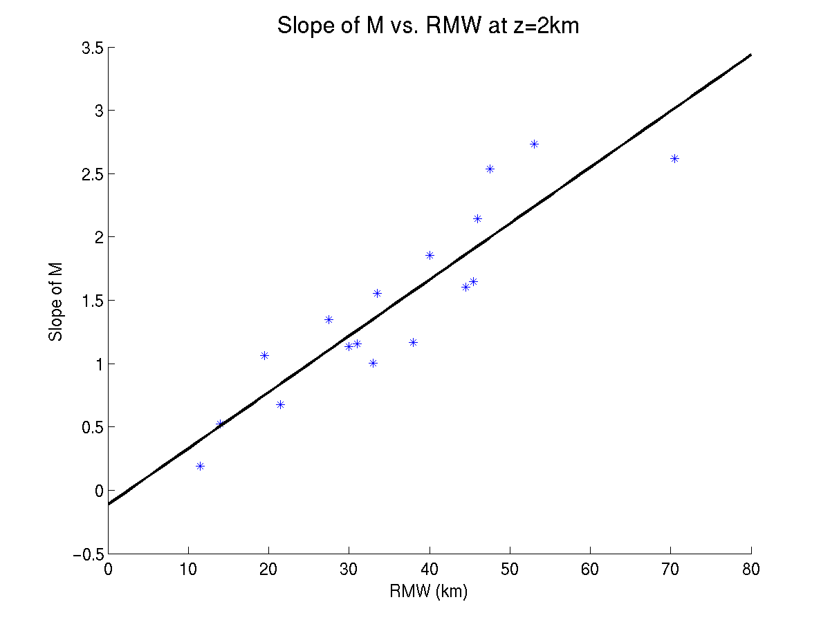
Notes:
Slope of M surf originating at 2km RMW vs size of RMW. Observations highly correlated, slope increases linearly with RMW.

Slide 16
CW2 = True
CW1 = False
CW3 ~ True
Notes:
Slope of M surf originating at 2km RMW vs size of RMW. Observations highly correlated, slope increases linearly with RMW.

Slide 17
Emanuel’s (1986) Theory
Vortex model assumes slantwise moist neutrality and thermal wind balance everywhere in the free atmosphere.
When coupled to a model of the boundary layer, predicts a steady-state maximum potential intensity (MPI), given SST and an outflow temperature.
Also predicts an exact axisymmetric radius-height structure of tangential winds.

Slide 18
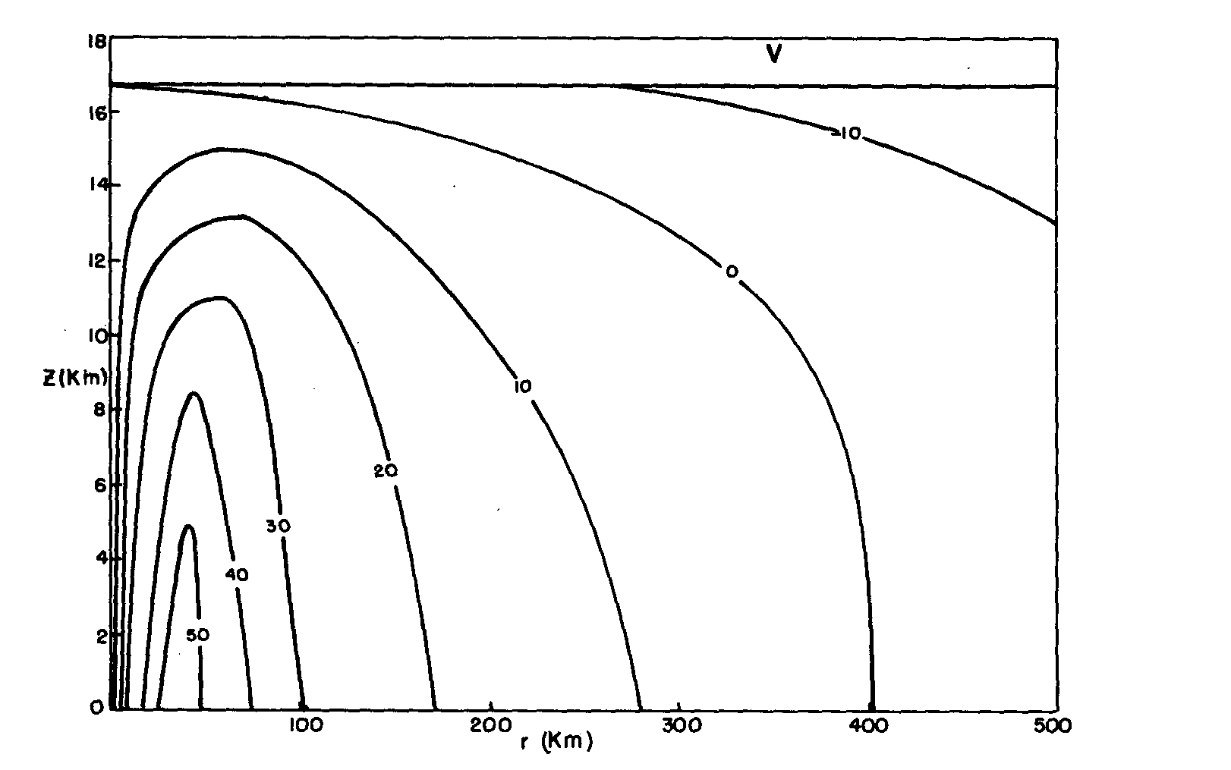
Example from Emanuel (1986)

Slide 19
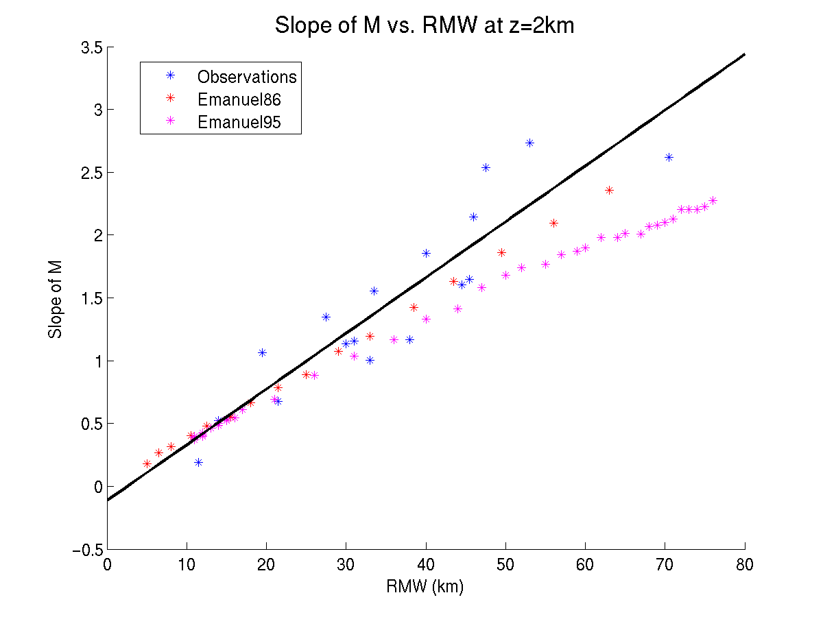
Theory vs. Observations
Notes:
SST=27C for Emanuel models

Slide 20
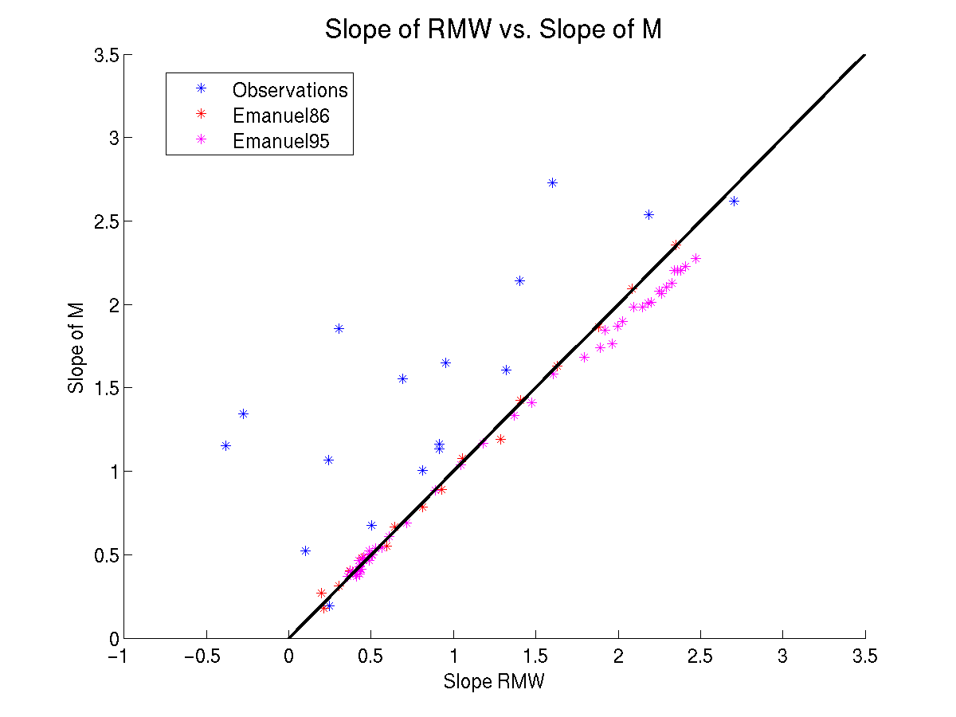
Theory vs. Observations

Slide 21
At what rate do the maximum winds decay with height?
In the observed storms, the maximum winds decrease by ~15-25% between 2 km and 8 km height.
This rate is nearly independent of both the size and intensity of the tropical cyclone.
We now show that Emanuel’s theory predicts the same result.

Slide 22
RMW=5 km
RMW=63.5 km
Notes:
Vmaxnorm increases from .73 at 24C to .84 at 30C, within the observed range of variability.

Slide 23
The Limitations of Observations and Theory
The predictions made by Emanuel’s theory are in good agreement with the observations.
However, we have no means of testing the validity of the assumptions made by Emanuel’s theory:
        Slantwise Moist Neutrality
        Thermal Wind Balance

Slide 24
Idealized Hurricane Simulations
WRF V3.1.1
3 nested grids: 18/6/2 km
Doubly Periodic BCs
40 vertical levels
f-plane
YSU PBL, WSM-6 Microphysics
SST = 28C, non-SAL sounding
Initialized with weak tropical cyclone-like vortex
5 m/s easterly flow in environment

Slide 26
Rapid Intensification
Rapid Intensification
Rapid Intensification

Slide 27
Slow Intensification
Slow Intensification
Slow Intensification

Slide 28
Quasi-Steady State
Quasi-Steady State
Quasi-Steady State

Slide 31
Evaluation of Slantwise Moist Neutrality
Moist Neutrality (i.e. conditional neutrality) is defined by the constancy of saturation equivalent potential temperature with height, i.e., a moist adiabatic lapse rate.
Slantwise moist neutrality is defined by the constancy of with height along an M surface.
Emanuel’s (1986) theory assumes slantwise moist neutrality to hold everywhere above the boundary layer.

Slide 32
Black = M surfaces
Blue = RMW

Slide 34
Evaluation of Gradient Wind Balance
Gradient wind balance is defined by the balance between the pressure gradient force (PGF), Coriolis force (Co), and centrifugal force (Ce).
Ce
Co
PGF
We can calculate the theoretical gradient windspeed (v_{g}), and compare it to the actual tangential windspeed (v).

Slide 35
Tangential Windspeed
Gradient Windspeed

Slide 36
Tangential Windspeed
Gradient Windspeed
Boundary Layer Tangential Wind Jet
No Jet

Slide 37
Tangential Windspeed
Gradient Windspeed
Boundary Layer Tangential Wind Jet
No Jet

Slide 38
White = 1, 3 m/s
Magenta = 5, 10, 15, 20 m/s
Solid = positive (supergradient)
Dashed = negative (subgradient)

Slide 39
Solid Black = radial outflow (+ 5, 10, 15 m/s …)
Dashed Black = radial inflow (-5, -10, -15 m/s …)

Slide 40
The Influence of Intensity on Unbalanced Winds

Slide 41
The Influence of Intensity on Unbalanced Winds

Slide 43
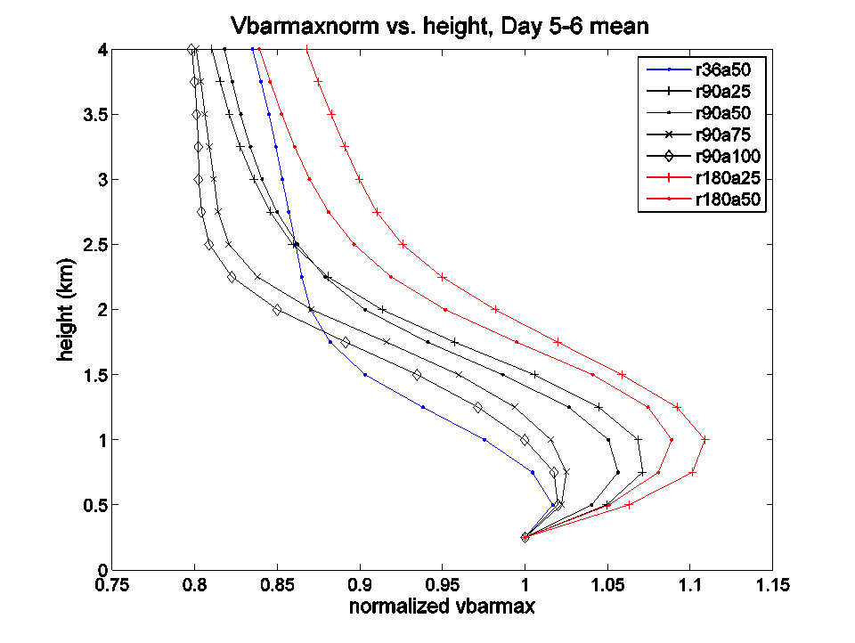

Slide 44
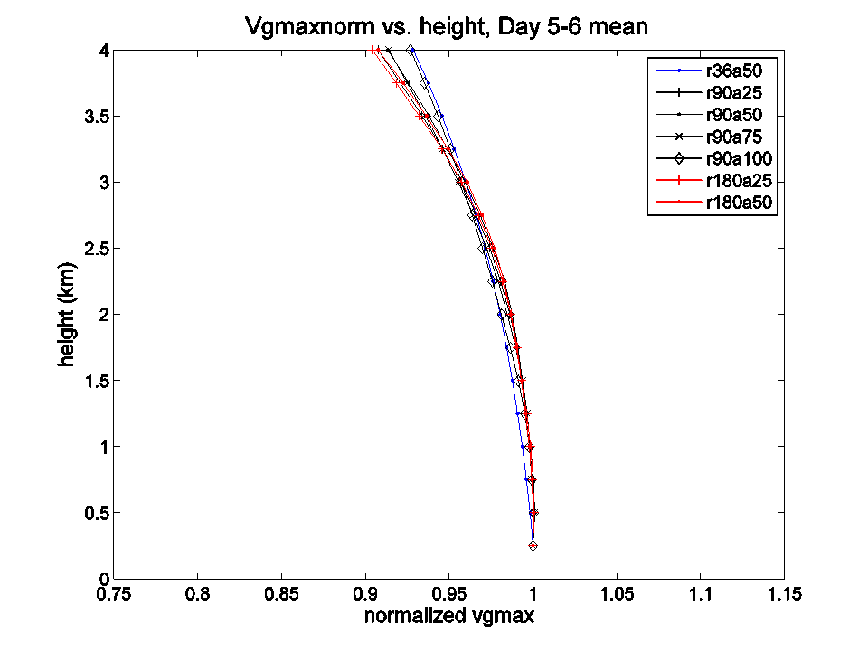

Slide 45
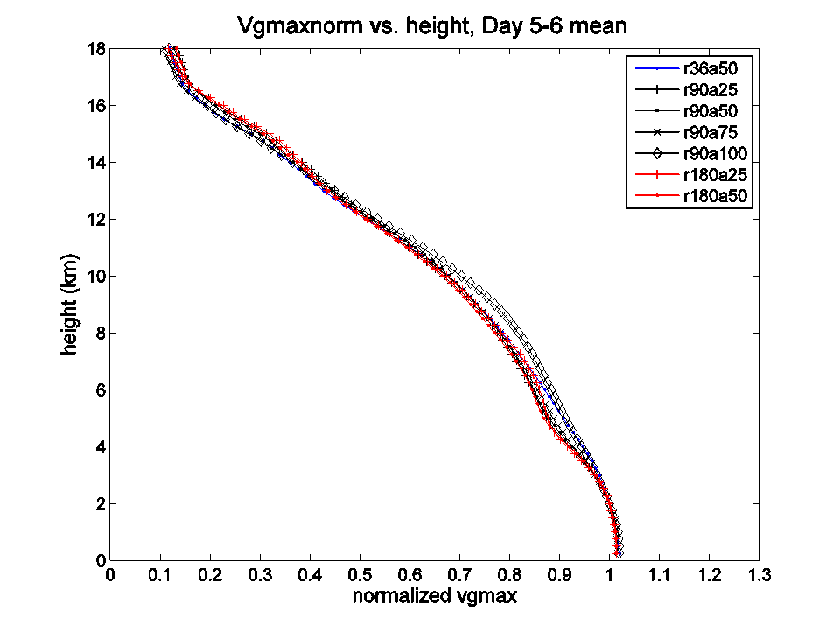

Slide 47
A Different Topic:
The Warm Core

Slide 48
Where is the height of the warm core?
Thermal wind balance requires that wherever the tangential winds decrease with height, the temperature must increase inwards.
The temperature is therefore warmest at the center of tropical cyclones.
The warm core is often characterized by its strength (the deviation from some environmental temperature) and the height at which it is strongest.

Slide 49
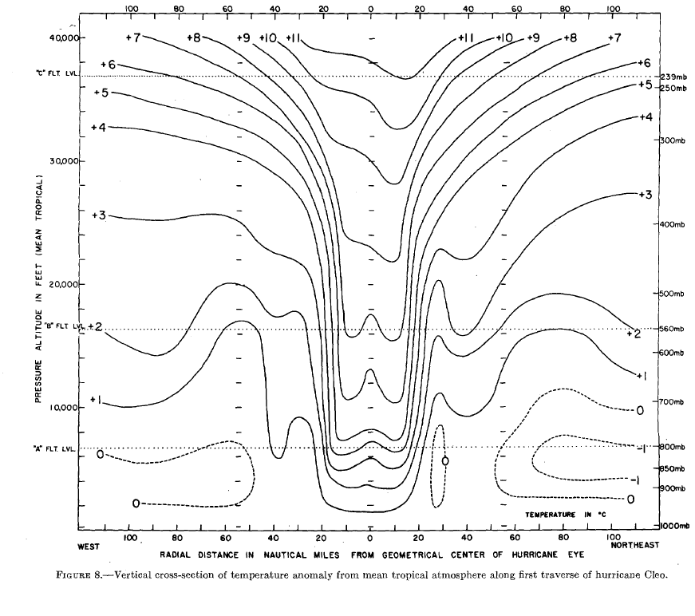
Warm Core ~11 km
LaSeur and Hawkins 1963

Slide 50
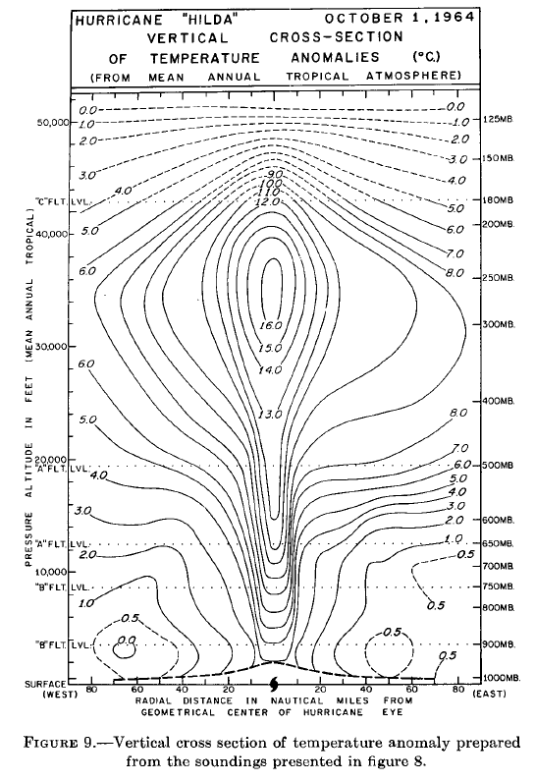
Warm Core ~11 km
Hawkins and Rubsam 1968

Slide 51
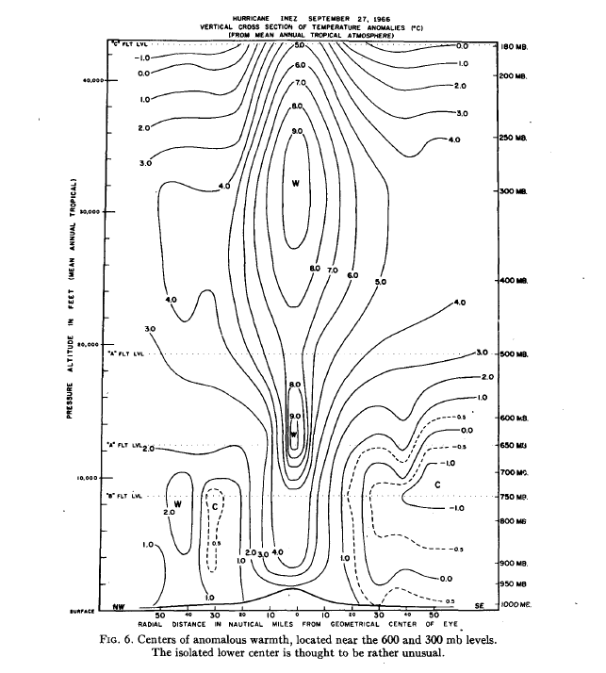
Warm Core ~10 km
Warm Core ~4 km
Hawkins and Imbembo 1976

Slide 52
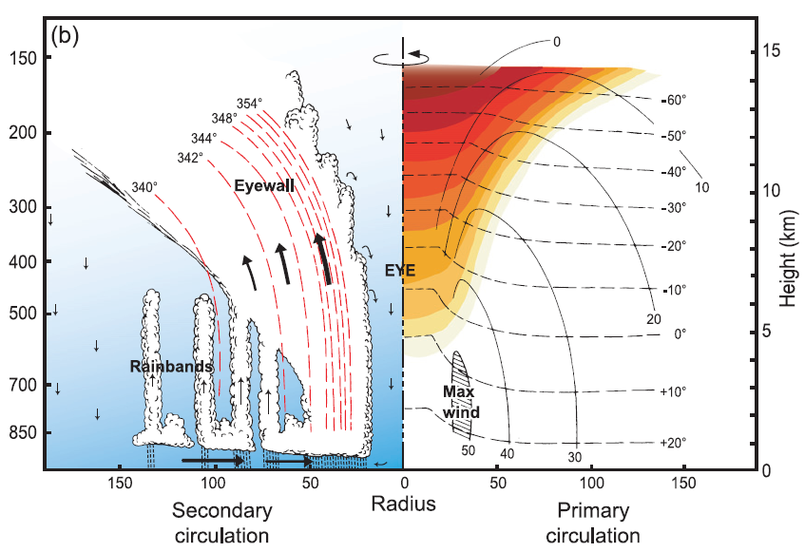
Warm Core ~14 km
Houze 2010

Slide 53
Red = RMW

Slide 54
So who is correct? And does it matter?
The direct evidence of a preferred upper-tropospheric warm core is weak, as it is based on only a few 40 year old case studies with flights at 3-5 levels.
Because of this belief about where the warm core should be, some recent studies that show evidence for a lower warm core try to explain it as an anomaly that is caused by wind shear.
The height of the warm core is also sometimes assumed to be related to intensity.

Slide 55
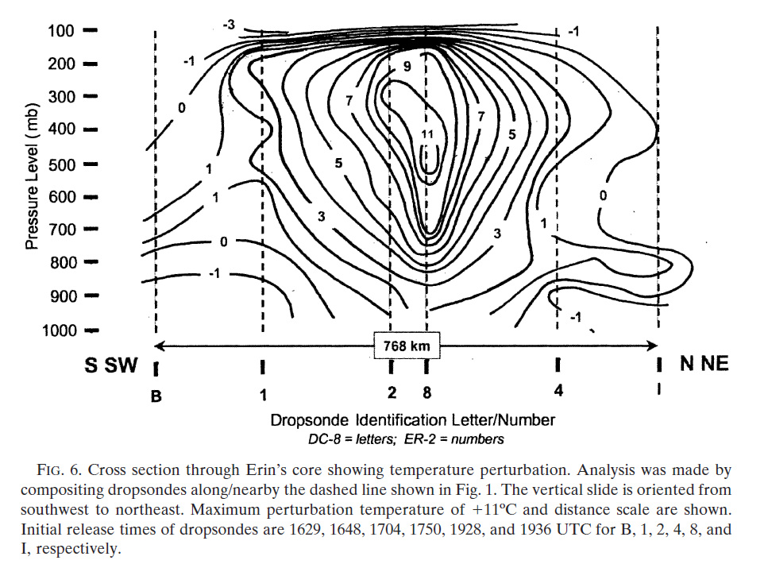
Warm Core ~6 km
Halverson et al. 2006

Slide 56
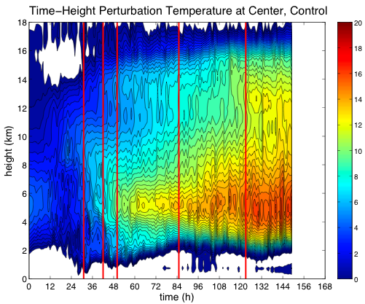
Cat 1
Cat 2
Cat 3
Cat 4
Cat 5

Slide 57
So who is correct? And does it matter?
Observationally, it remains unclear where the warm core is most “typically” found.
On the other hand, it is also unclear whether or not real variations in the height of the warm core have any significant relationship to the vertical structure of the maximum tangential winds.

Slide 58
Thermal Wind Balance (Schubert et al. 2007)
Radial Temperature Gradient (C/km)
Vertical Gradient of Tangential Wind
ms⁻¹/km

Slide 59
Thermal Wind Balance (Schubert et al. 2007)
Radial Temperature Gradient (C/km)
Vertical Gradient of Gradient Wind
ms⁻¹/km

Slide 60
Thermal Wind Balance (Schubert et al. 2007)
Radial Temperature Gradient (C/km)
m²s⁻²/km

Slide 61
Thermal Wind Balance (Schubert et al. 2007)
Radial Temperature Gradient (C/km)
C/km

Slide 62
Thermal Wind Balance (Schubert et al. 2007)
Radial Temperature Gradient (C/km)
Perturbation Temperature (C)

Slide 63
Summary and Conclusions
The slope of the RMW is independent of intensity.
The slope of the RMW increases (linearly) with its size.
The RMW is almost exactly an M surface in theory. The RMW is still well approximated by an M surface in both observations and simulations.
The rate at which the maximum tangential winds decrease with height is nearly independent of the size of the RMW.
The rate at which the maximum tangential winds decrease with height is nearly independent of both intensity and the rate of intensification with time.

Slide 64
More Conclusions
There are systematic deviations from gradient wind balance in the eyewall of tropical cyclones, and the magnitude of unbalanced flow increases with intensity.
This can have an effect on the vertical structure of the maximum tangential winds, and is very likely responsible for observed deviations from the more general profile.
Slantwise moist neutrality is also systematically violated in tropical cyclones.
In spite of the violation of both of the assumptions of Emanuel’s theory, the predictions of the theory are in good agreement with both observations and simulations.

Slide 65
Even More Conclusions
The height of the warm core in the simulations is much lower than what conventional wisdom would suggest.
There are insufficient observational studies to characterize where the warm core is most “typically” found.
Studies which suggest that the height of the warm core is well related to either intensity or shear may be incorrect.
The relationship between the temperature and wind fields is more subtle than is often assumed, and so the structure of the warm core may not be that well related to the vertical structure of the maximum tangential winds.

Slide 67
Extra Slides

Slide 68
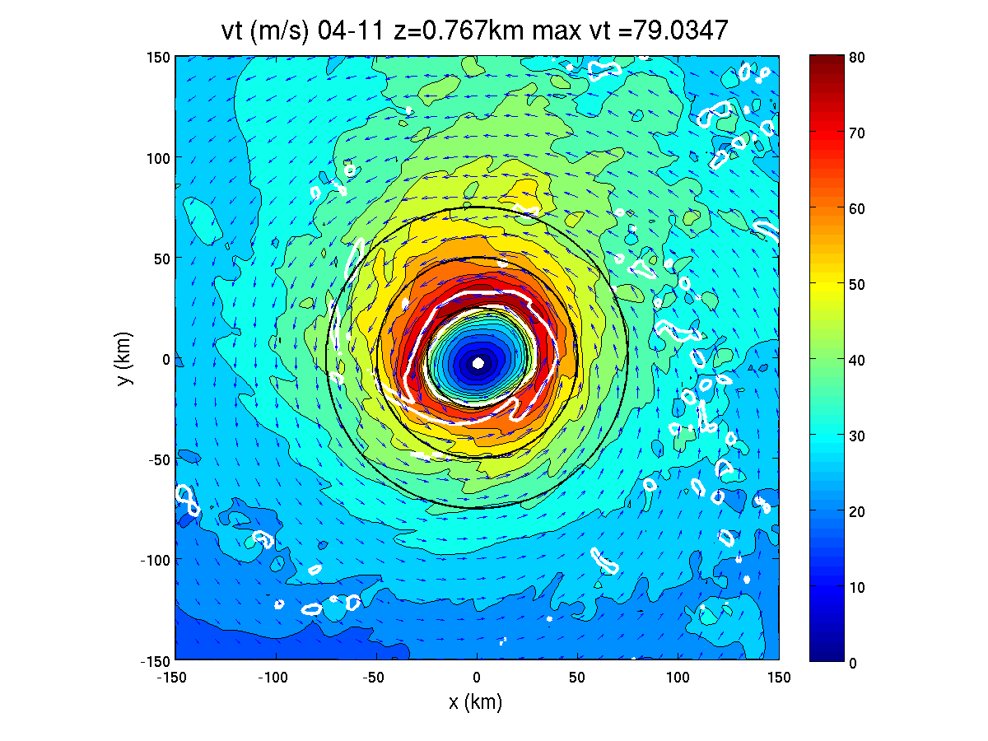

Slide 69
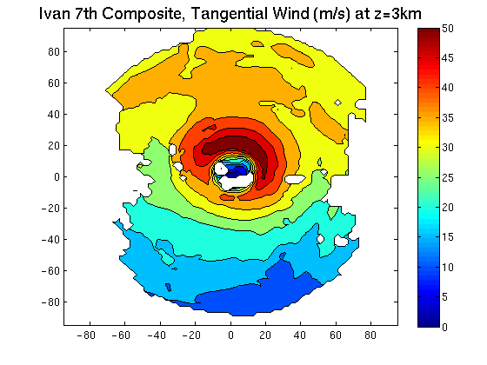

Slide 70
Why Does the RMW Slope Outwards with Height?

Slide 71
In the context of Emanuel’s theory, we have shown that…
The slope of an M surface (at constant height) is an almost linear function of radius and is nearly independent of intensity.
This relationship is entirely a consequence of the constraints of thermal wind balance and slantwise moist neutrality.
We have also previously shown that the RMW is itself nearly an M surface, and so its outward slope is for the same reasons.

Slide 72
Why is there a near-universal decay structure?
Definition of M:
Definition of m:
v at some height along M₀:
v at some greater height along M₀:
Ratio of v₁ to v₀, or the normalized tangential windspeed along M₀ :
From the definitions of M and m, this can be rewritten as:

Slide 73
Why is there a near-universal decay structure?
The RMW is nearly an M surface (CW3 is true) and so this now represents the normalized maximum tangential windspeed:
The difference in RMWs between the two heights is approximately equal to the depth times the average slope:
Finally, this can be rewritten as:

Slide 74
Why is there a near-universal decay structure?
Equation for the normalized maximum tangential wind speed
CW2 (which is true) says that the slope increases linearly with the size. Therefore the term inside the parentheses is nearly constant.
As the variation of relative angular momentum along an M surface at the RMW is very small, the 1st term on the RHS is also nearly constant.
As a consequence of CW2 and CW3, the vertical decay of the maximum tangential winds is independent of the size of the RMW.
Because the slope does not vary with intensity (CW1 is false), the vertical decay is also independent of intensity.

Slide 75
Why is Neutrality Violated?
Numerous additional simulations have revealed that the stability structure shown above is very robust. This remains true for simulations which are initialized in an (unrealistic) moist neutral environment.
is not conserved in real convection, even in the absence of entrainment, due to microphysical processes.
Tropical cyclones will inevitably evolve towards a non-neutral structure for the same reasons that the mean tropical sounding is non-neutral:
    The melting and evaporation of precipitation falling into subsaturated air.
    The finite terminal fall speed of precipitation.

