Slide 1
Physics and Initialization Tests for H216: Large-scale results and recommendations for H217

Slide 2
Motivation
Understand causes of HWRF inner-core size bias
Document impacts of vortex initialization and blending have not been documented
Document individual impacts of H216 upgrades
H215: Analysis 10-m winds and RMW vs. observed RMW in Edouard

Slide 3
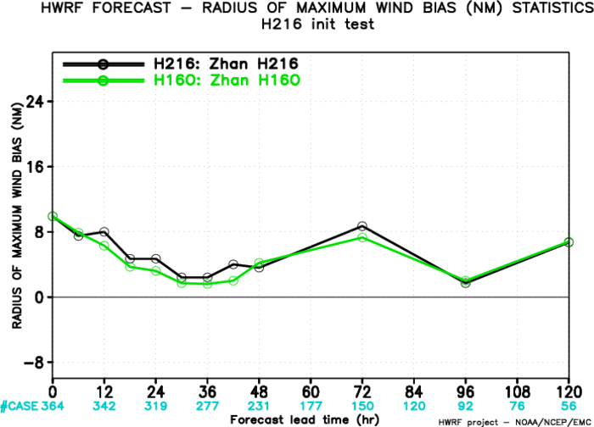
Background: Size Bias
Joe Cione discovered a huge RMW size bias for Hurricane Edouard in H215 (pvs slide)
The Edouard bias was largest in the analysis and tended to decrease through 48h
The bias appears to be common in H216 for both AL and EP basins
RMW bias for H16O pre-implementation test and H216 final test for 2013-2015 in Atlantic

Slide 4
RMW Cluster analysis from Chun-Sil
NATL
EPAC
CPAC
WPAC
ALL
(H215/H216)
Classification
(H215)
Classification
(H216)
RMW bias for initial intensity classification

Slide 5
RMW Cluster analysis from Chun-Sil
NATL
EPAC
CPAC
WPAC
ALL
(H215/H216)
Classification
(H215)
Classification
(H216)
RMW bias for initial RMW classification

Slide 6
Experiment outline
INIT TESTS - 2014 AL & MUCH OF 2014 EP
HNBA – H216 with no blending or vortex adjustments
HNBD – H216 with blending turned off for ALL storms
HB65 – H216 with blending > 65 kt

Slide 7
Experiment outline
PHYSICS TESTS (2014 AL06 & AL08)
HCOA – Lower COAC on D2-3
HCOB – Lower COAC on D2-3, lower timestep to 15s
HT15 – Decrease timestep to 15s
HC15 – Roll back to H215 COAC (higher)
HGFS – Roll back to old GFS PBL
HGDO – Roll back Cd/Ch changes

Slide 8
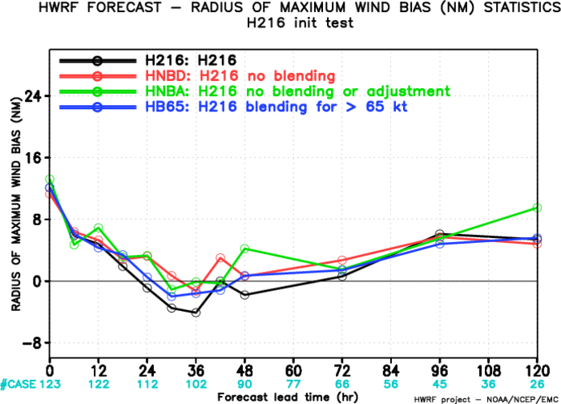
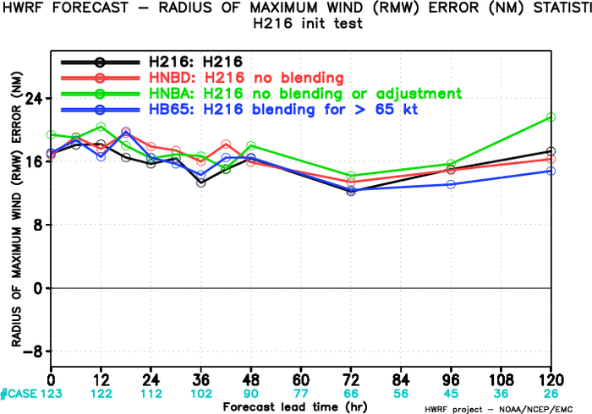
INIT Results – AL RMW
Initial RMW bias is slightly worse when VI is off (so adjustments are working)
Consistent with previous results, RMW bias deceases w/ time
No major differences between experiments

Slide 9
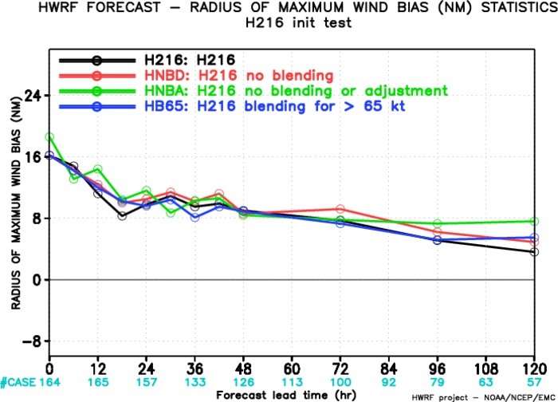
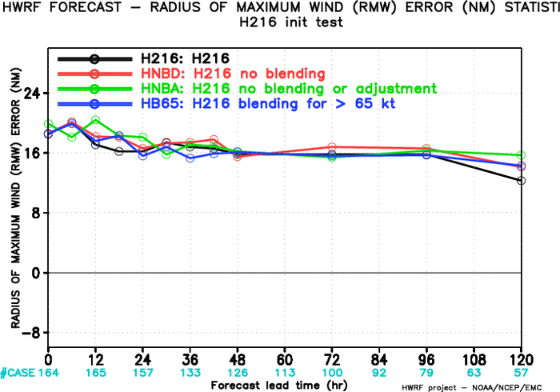
INIT Results – EP RMW
Similar to AL, bias is worst at analysis time & bias is slightly worse when VI is off
Biases tend to be larger than in Atlantic
No major differences between experiments

Slide 10
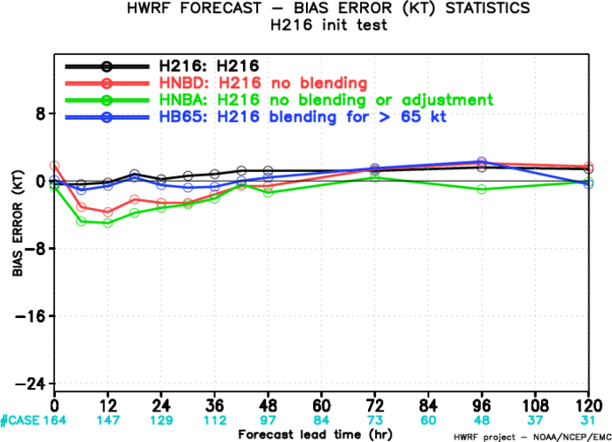
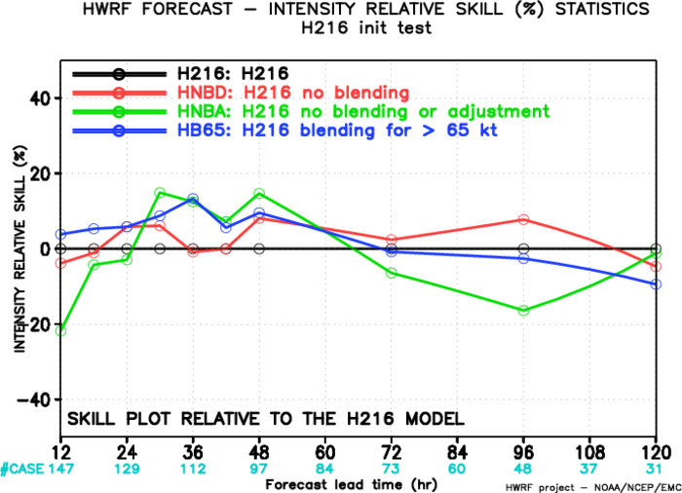
INIT Results – AL Vmax
Blending & VI significantly help Vmax by reducing spindown & bias (strong storms)
Increasing the blending threshold to 65 kt has a significant positive impact on short-medium term intensity

Slide 11
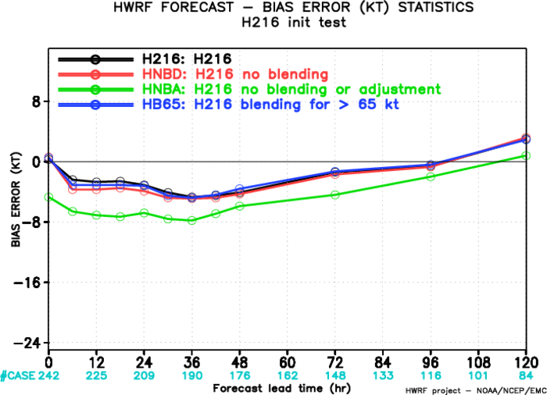
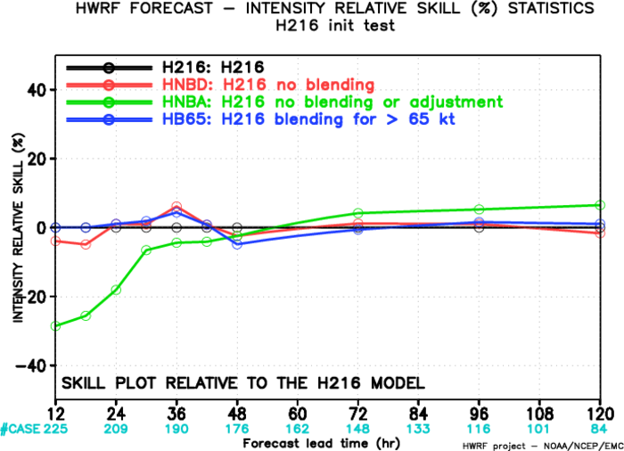
INIT Results – EP Vmax
VI significantly helps Vmax by reducing bias (strong storms)
Increasing the blending threshold to 65 kt has NO impact on intensity

Slide 12
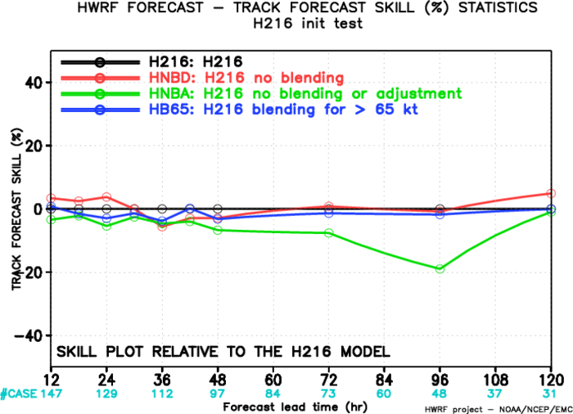
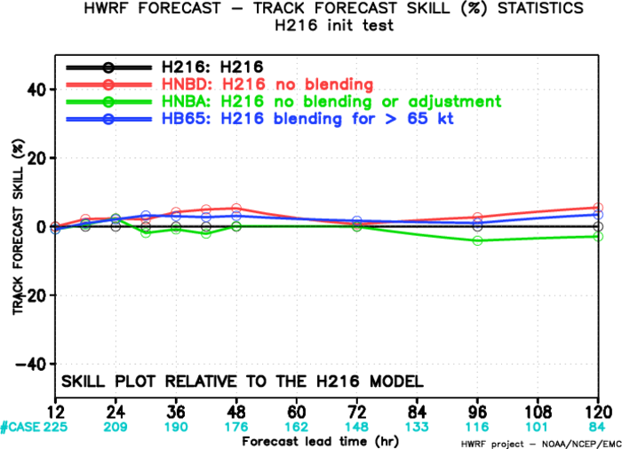
INIT Results – AL & EP track
VI helps the track in the Atlantic, but not much in the Pacific
Increasing blending threshold to 65 kt has no net impact on track
AL
EP

Slide 13
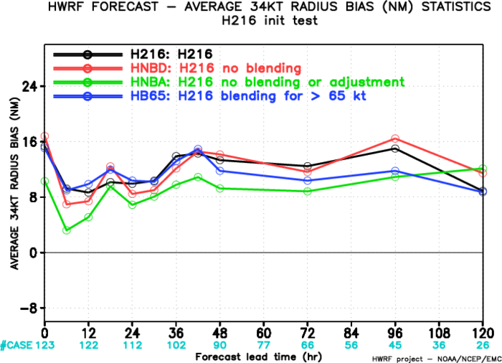
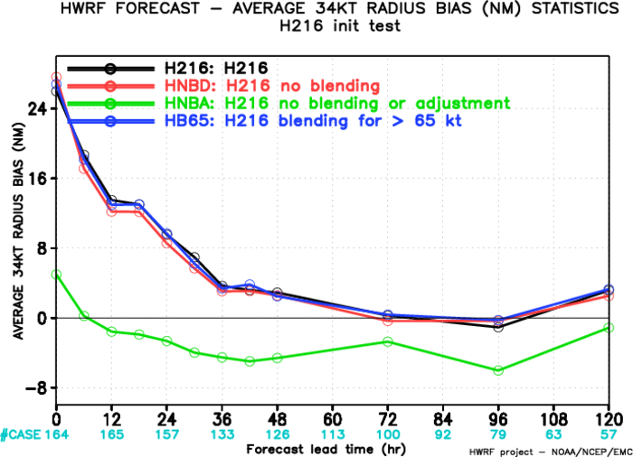
INIT Results – AL & EP R34 bias
EP & to some extent AL have a very large R34 bias
Correcting EP Vmax bias appears to screw up wind radii. Can we fix this?
Increasing blending threshold helps AL R34
AL
EP

Slide 14
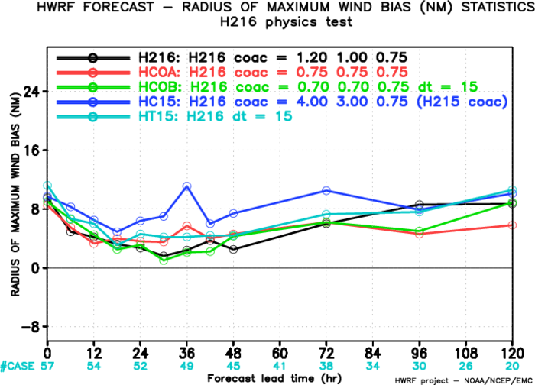
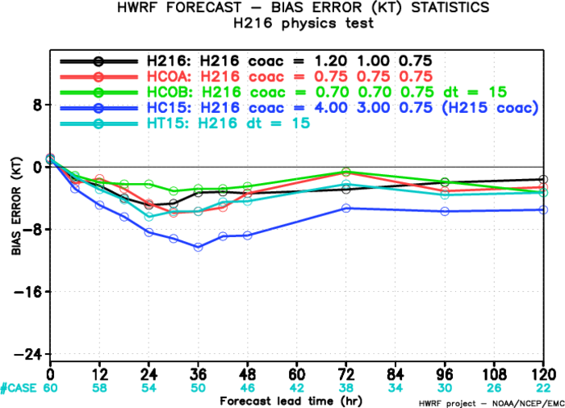
COAC results – RMW & Vmax bias
Decreasing COAC (mixing length) from H215 to H216 reduced Vmax & RMW bias
Further decreases to COAC are very useful IF we reduce the timestep as well (cut in half)

Slide 15
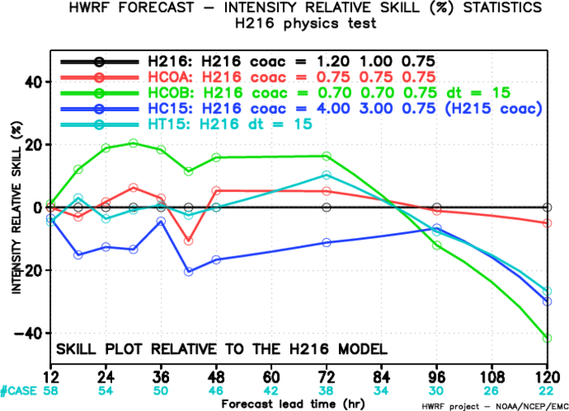
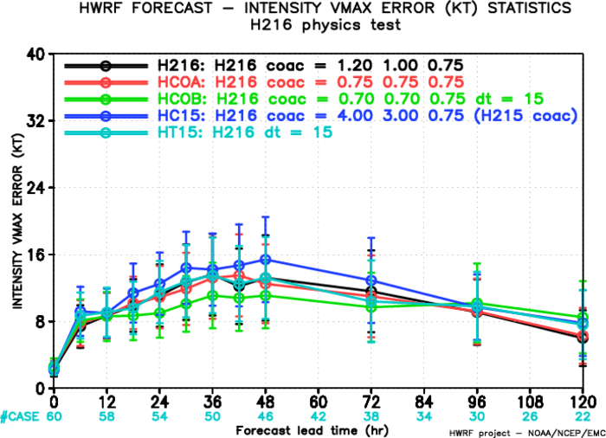
COAC results – Vmax skill & error
Decreasing COAC (mixing length) from H215 to H216 reduced Vmax & RMW bias
Further decreases to COAC are very useful IF we reduce the timestep as well (cut in half)

Slide 16
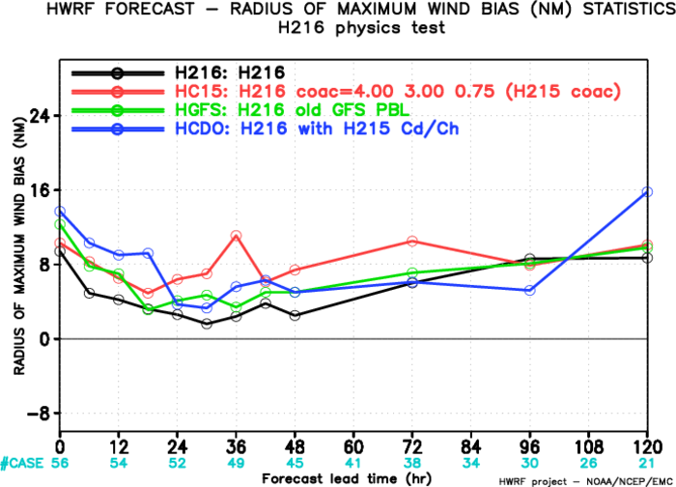
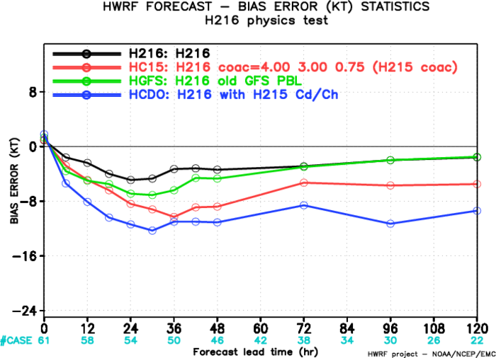
Physics test – RMW & Vmax bias
PBL, COAC, and Cd/Ch change all reduced Vmax and RMW bias
RMW bias still larger at analysis time than at 6h for all tests & remains positive throughout forecast

Slide 17
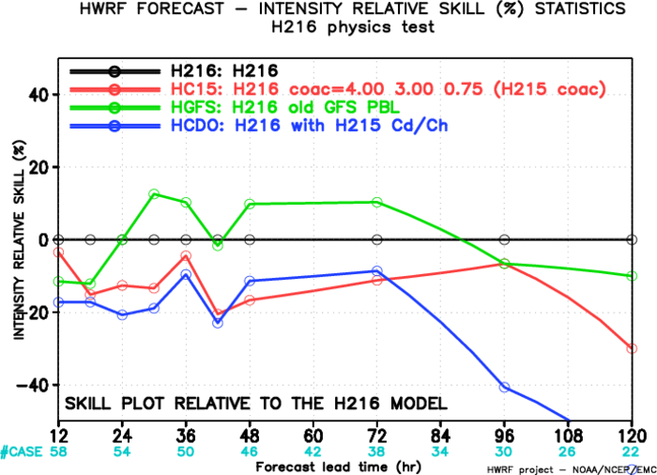
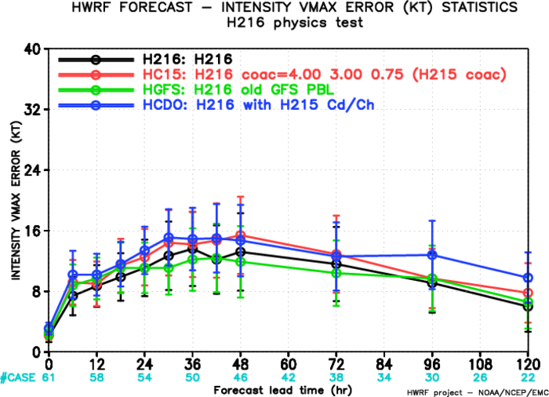
Physics test – Vmax skill & error
COAC, and Cd/Ch change positively impacted Vmax error/skill
PBL change made Vmax error slightly worse, suggesting some work to do there

Slide 18
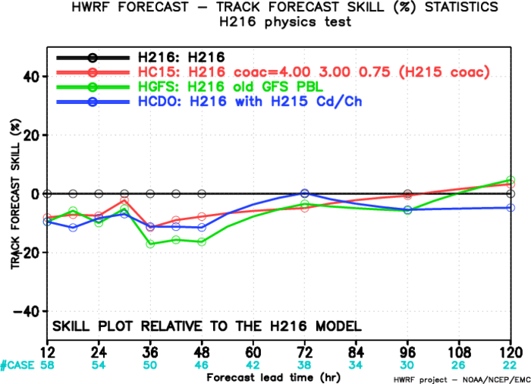
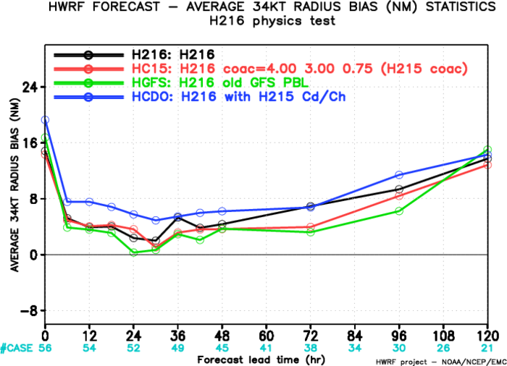
Physics test – track & size
All changes slightly improved the track
PBL change appears to have worsened R34 bias, whereas Cd/Ch change improved it
All experiments have LARGE 0-h bias

Slide 19
Recap – RMW bias
VI making correct adjustments, but error evolution suggests something in initialization is the culprit
This could be a result of how VI uses the global fields in the first guess process – could argue for D1 warm start & cycling
H216 physics changes examined so far improve RMW bias, but H216 is worse than H215. Why? SAS?

Slide 20
Recap – considerations for H217
Results so far suggest 65-kt blending threshold is appropriate (AL intensity!)
PBL tuning needed R34 Vmax errors
Reducing COAC and timestep combined appears to significantly improve Vmax
Warm start & cycling of D1?
Compare RMW bias in HWRF and HNMMB
Relationship between Vmax & radii in VI?
Need to assess impact of SAS

Slide 21
EXTRA SLIDES

Slide 22
Background: Blending
Vortex initialization provides location, intensity, and size updates as a first guess for DA
To combat spindown, we zero-out DA increments in the inner core – in H216 this is done for Vmax > 50 kt
What impacts do the initialization procedures have on the forecast?
300 km
150 km
No DA increment
Partial increment
Full increment
“Blending” initialization

