Slide 1
Secondary eyewalls in HWRF

Slide 2
All together
Physics changes
Track and intensity
improvement
Other model changes
Are specific changes improvements?
-Relative to the particular model configuration
-Black box or efforts to understand

Slide 3
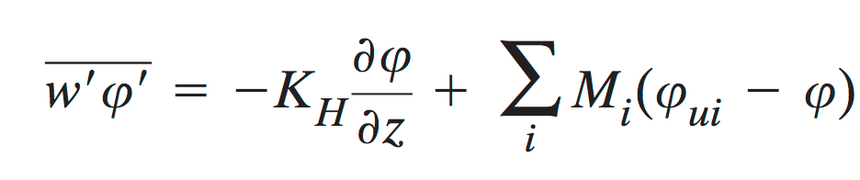
HWRF 2016 PBL
Eddy diffusivity + Mass flux
“EDMS”
M_{i}-Mass flux (product horizontal area and vertical velocity)

Slide 4
Assessment of secondary eyewalls (HWRF 2015)
a) Rare
b) Too close to the primary eyewall
c) Too quick to replace the primary eyewall
In the region of SEF, secondary maxima of supergradient winds exist prior to the SE but not prior to the dv/dt>0
HWRF 2015

Slide 5
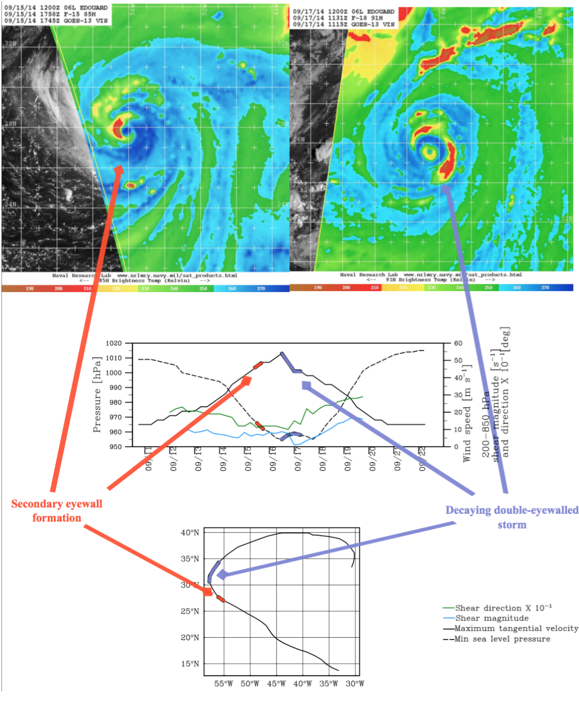
Edouard (2014)
Well observed case:
NOAA- reconnaissance flights
NASA- Global Hawk (HS3)

Slide 6
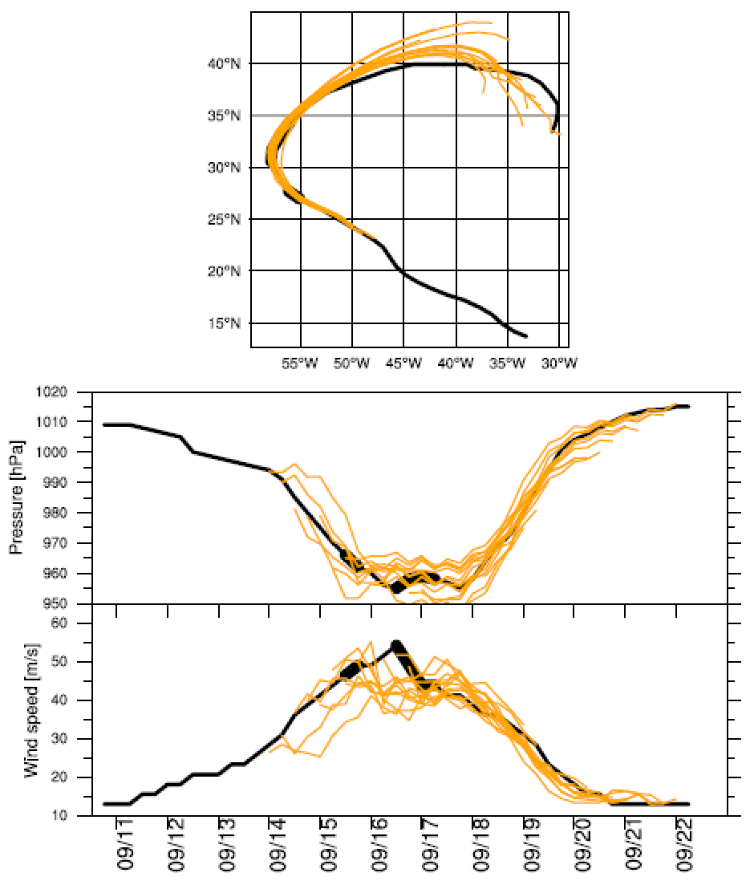
Bestrack
HWRF
Edouard (2014)
Good track and intensity
forecast!
HWRF 2015

Slide 7
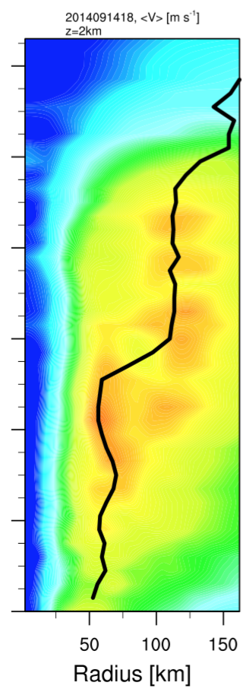
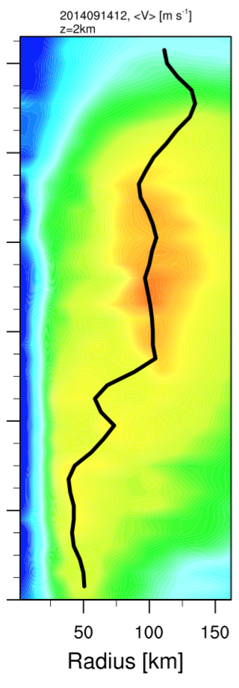
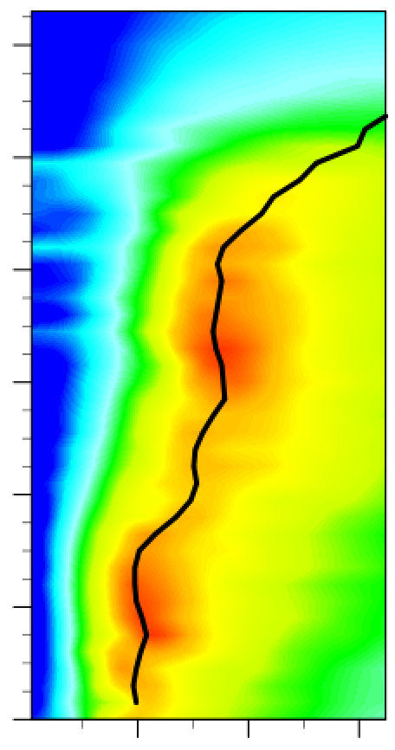
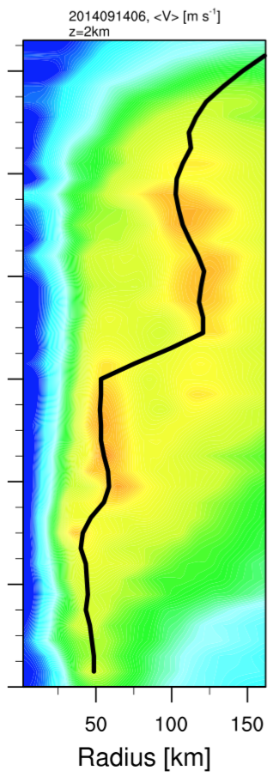
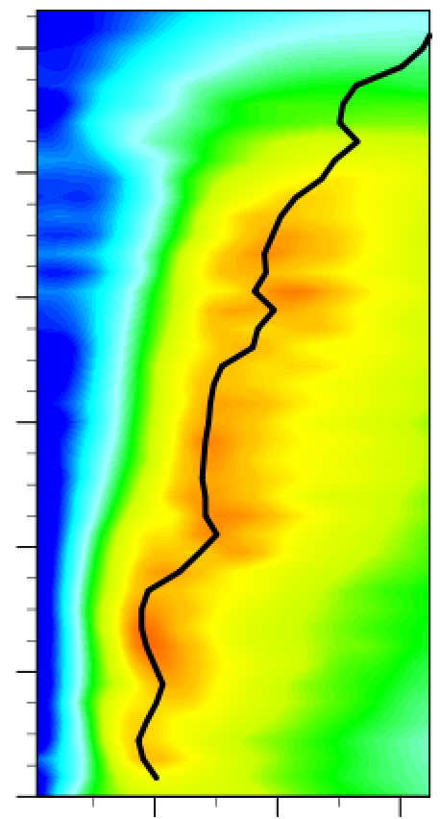
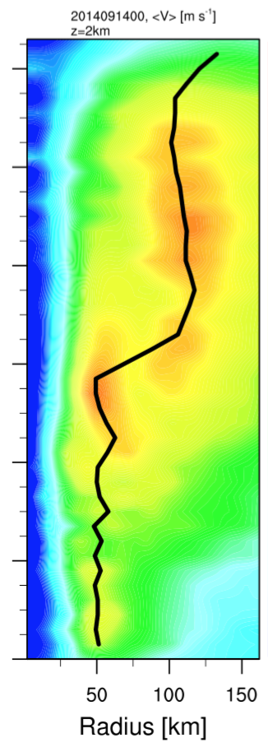
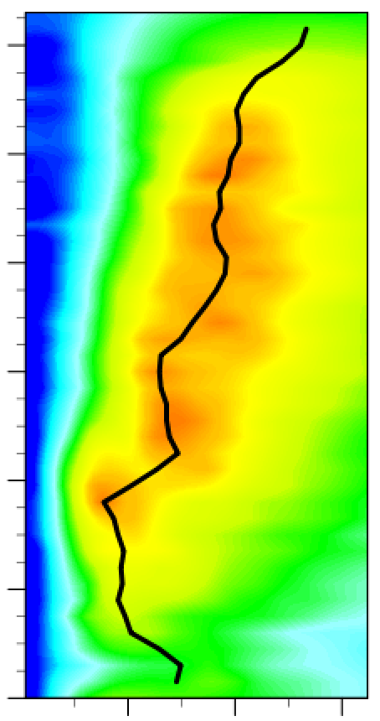
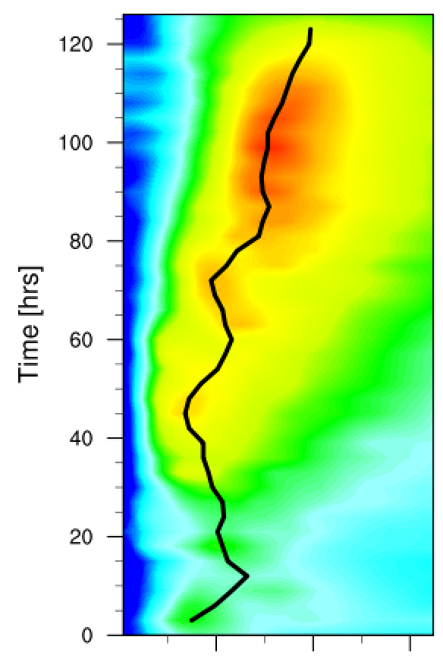
Edouard (2014)
09/14
ms⁻¹
SE
HWRF 2015

Slide 8
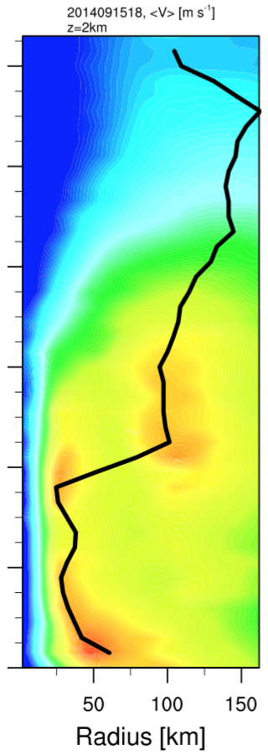
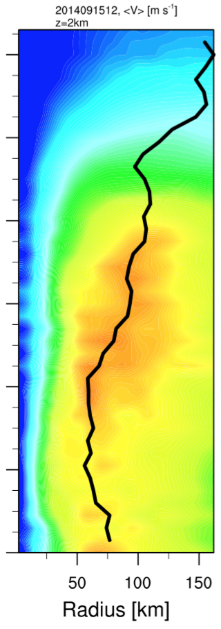
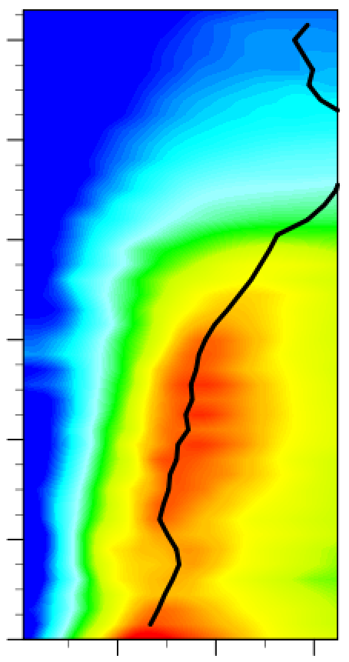
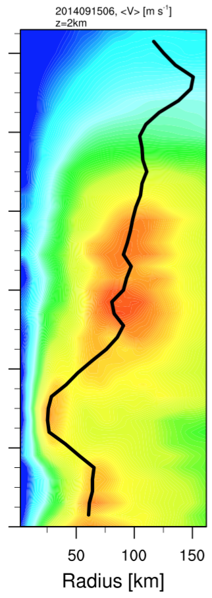
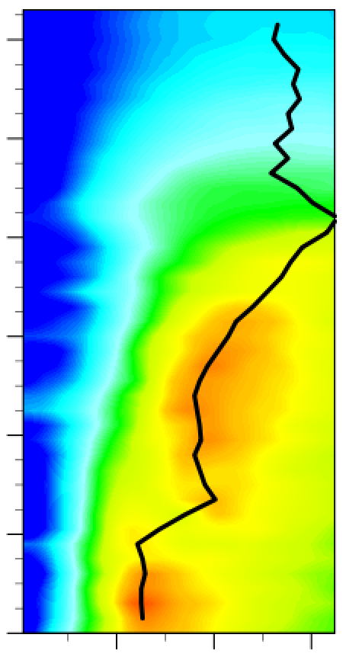
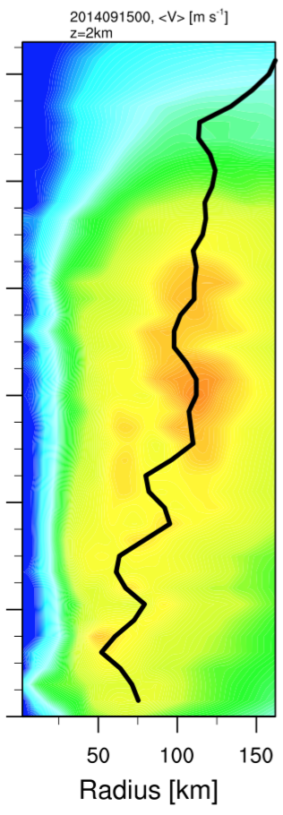
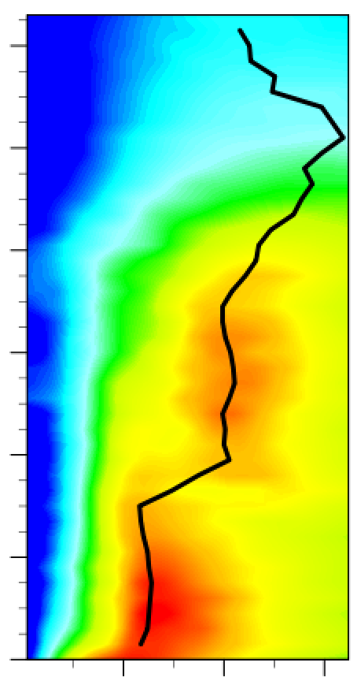
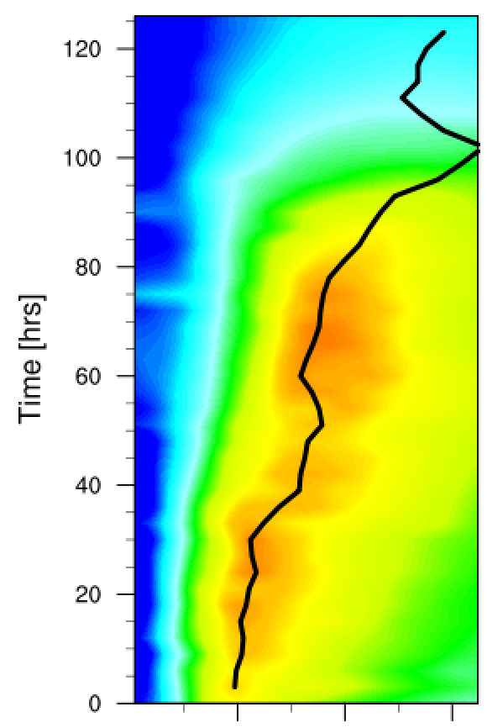
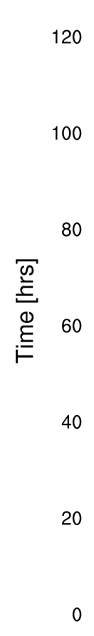
Edouard (2014)
09/15
ms⁻¹
SE
HWRF 2015

Slide 9
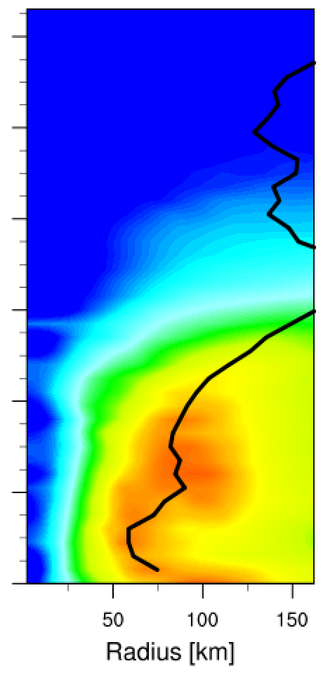
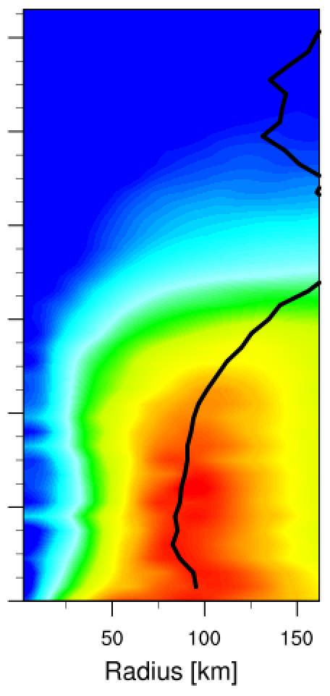
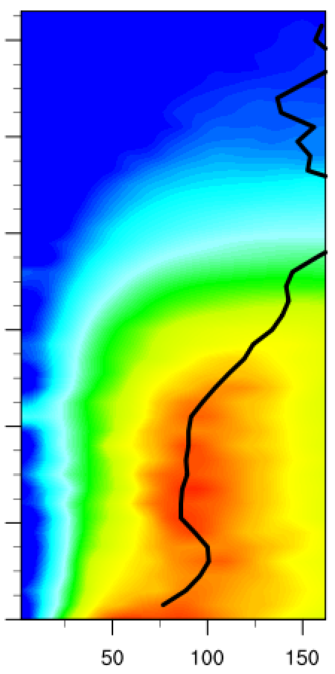
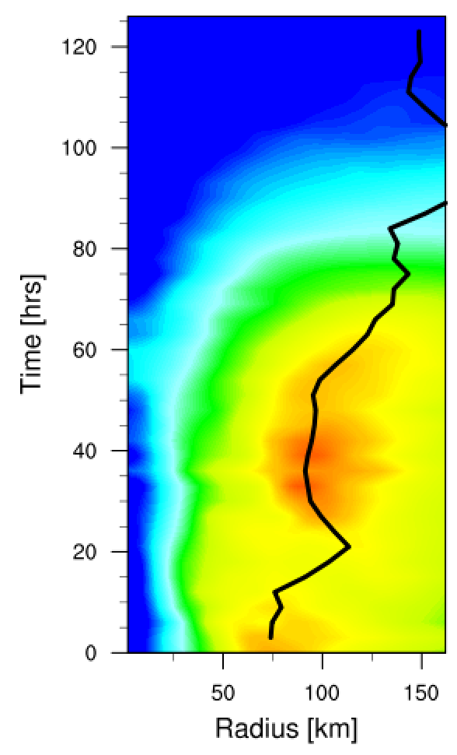
Edouard (2014)
09/16
ms⁻¹
SE
HWRF 2015

Slide 10
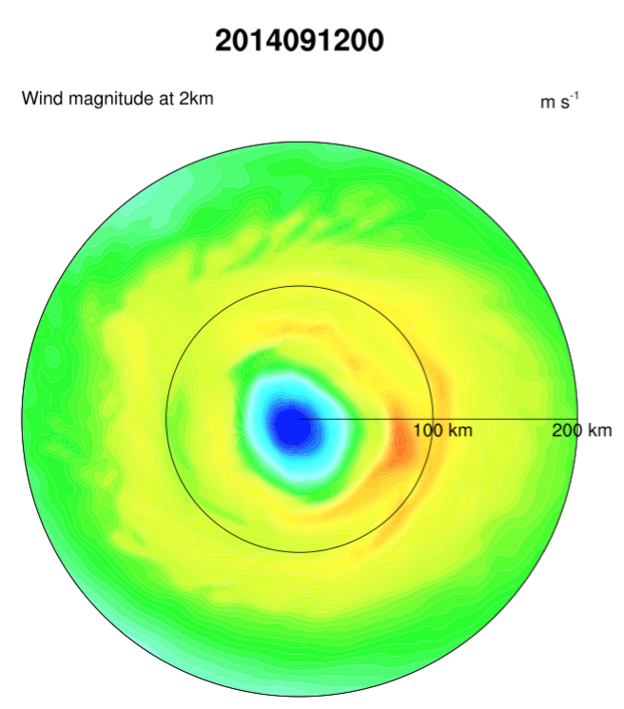
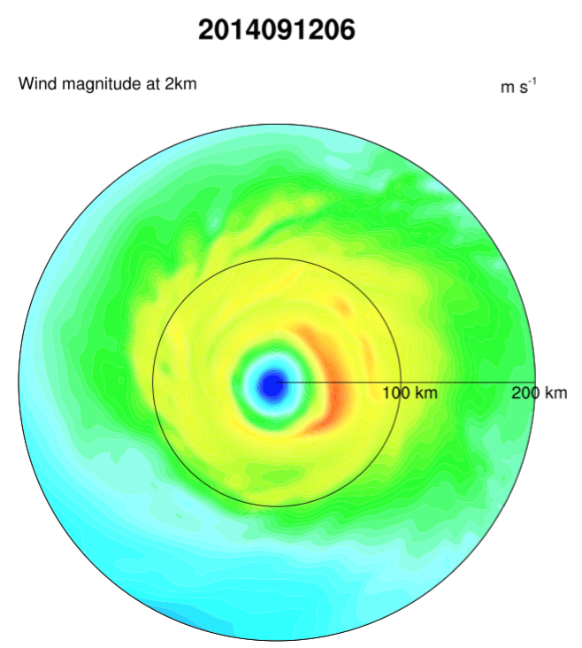
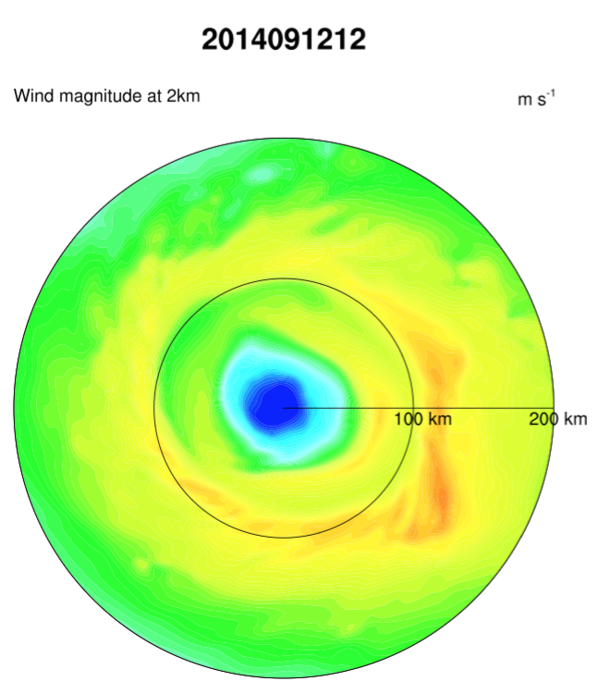
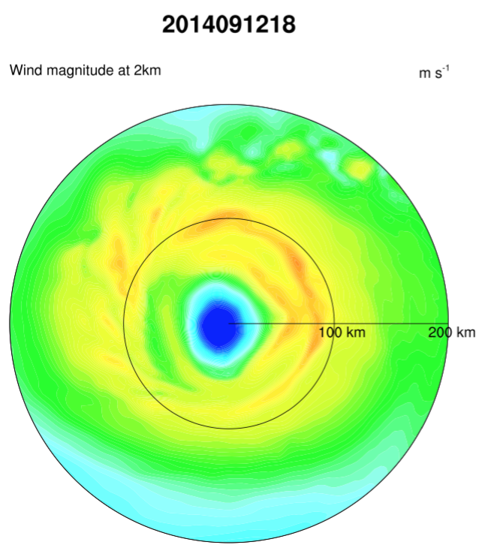
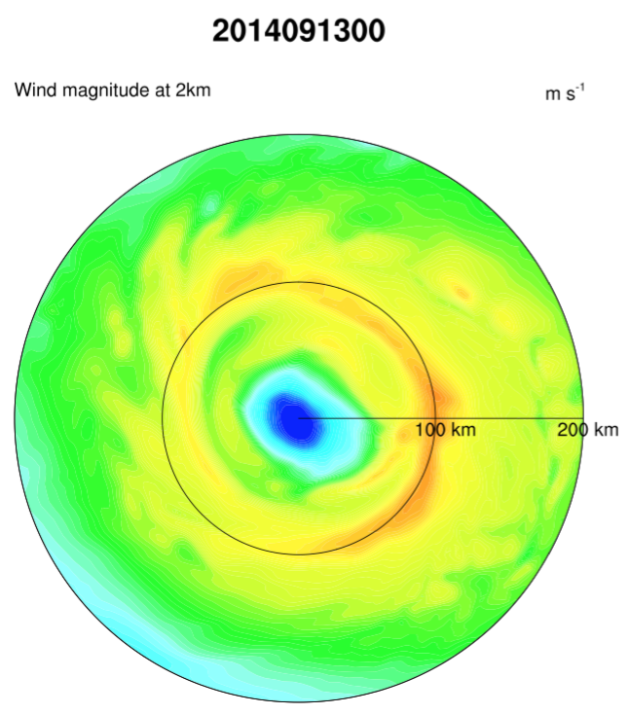
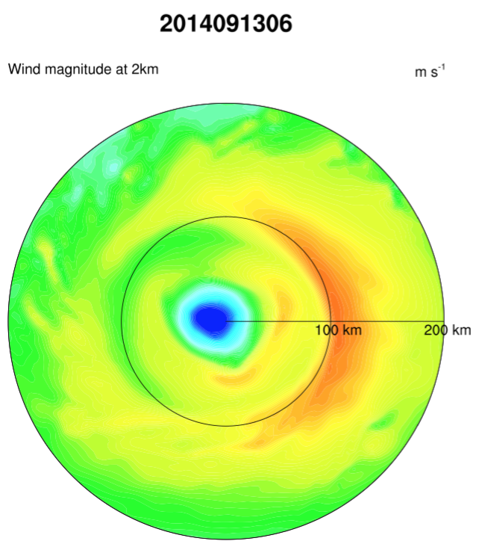
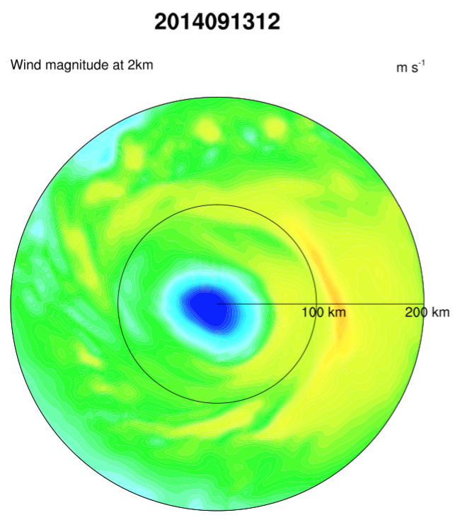
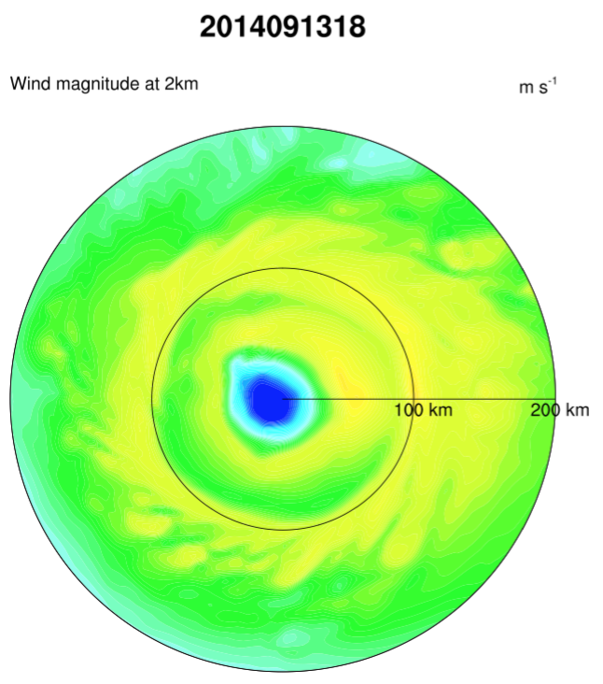
HWRF 2016

Slide 11
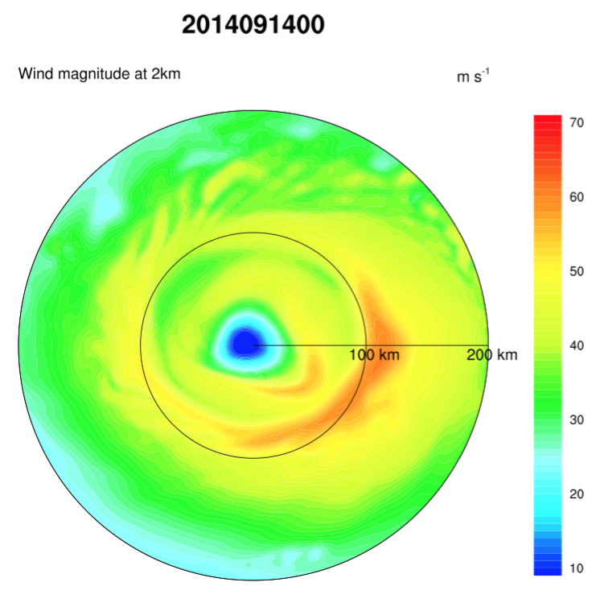
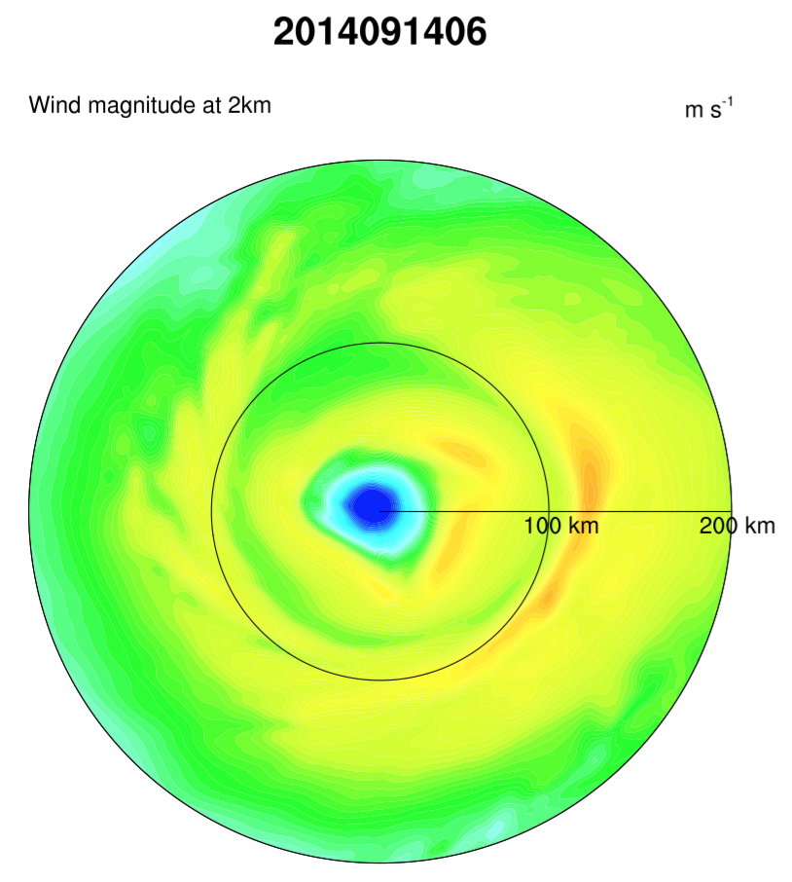
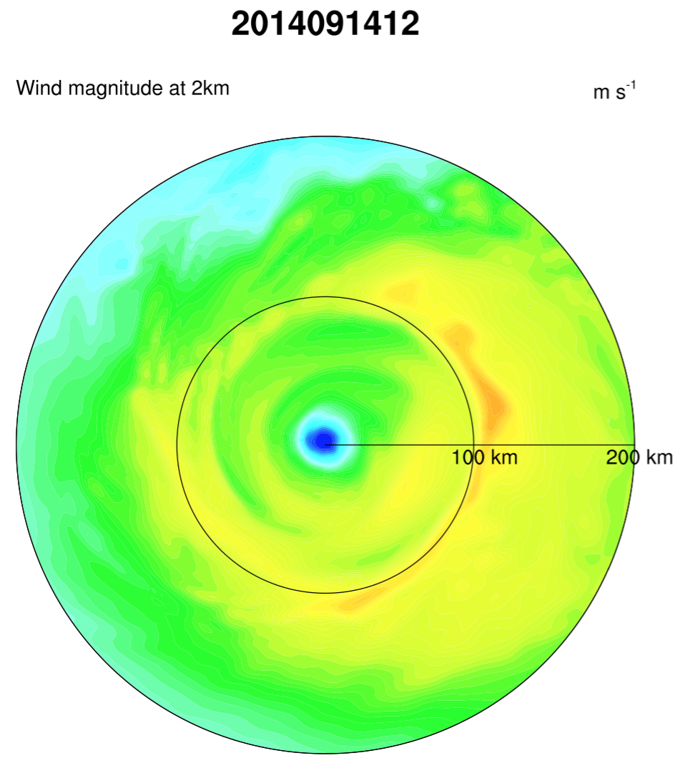
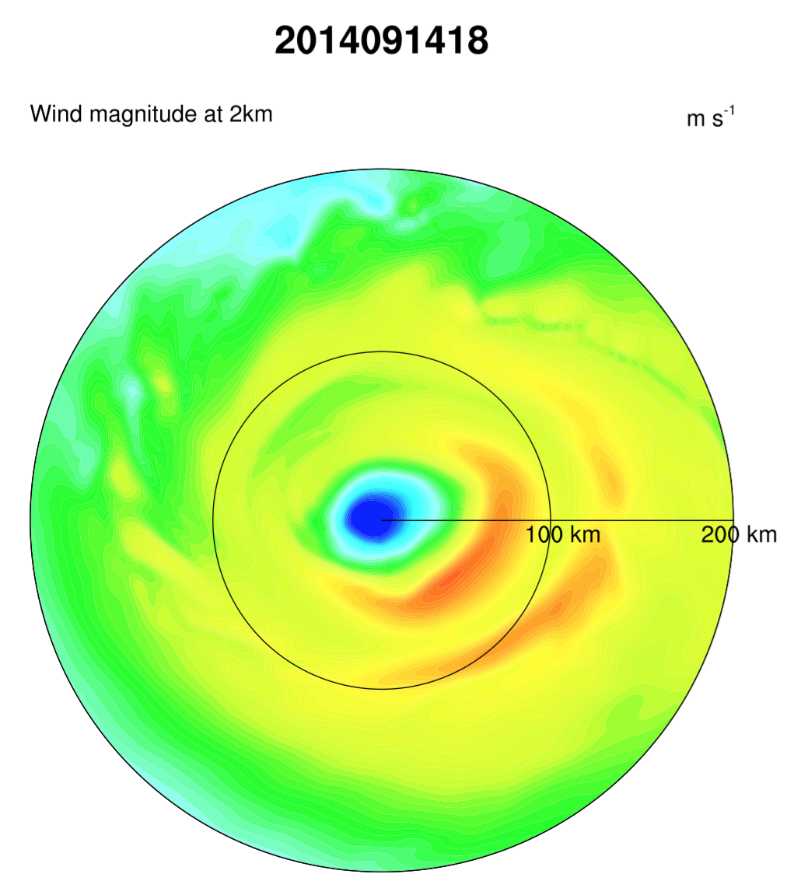
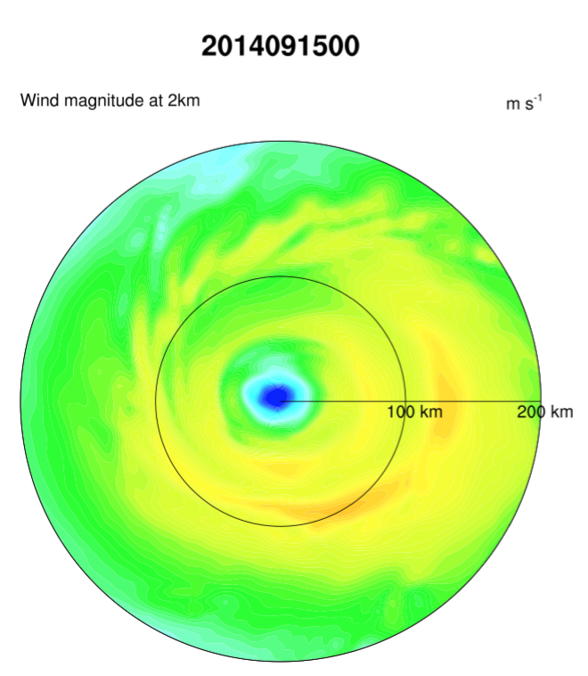
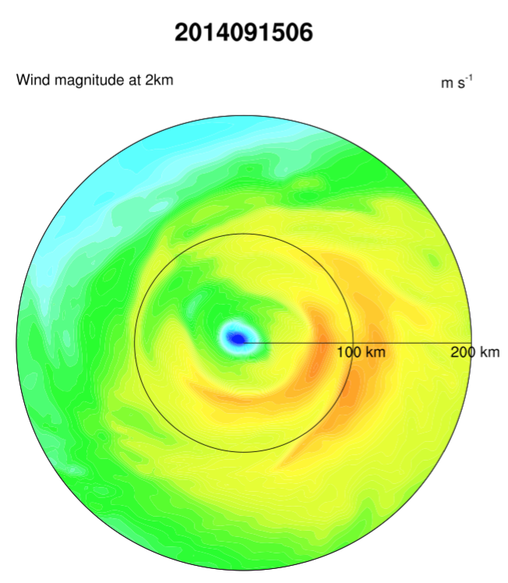
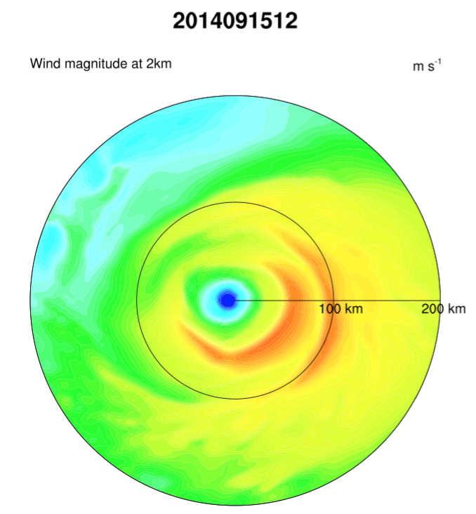
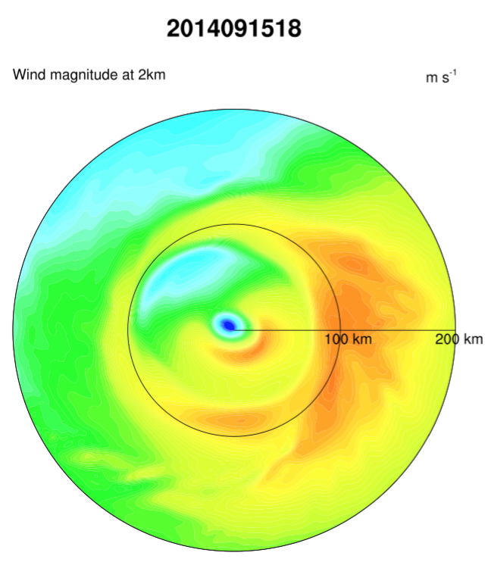
ms⁻¹
Hr 66
Hr 60
Hr 54
Hr 48
Hr 48
Hr 48
Hr 45
Hr 42
HWRF 2016

Slide 12
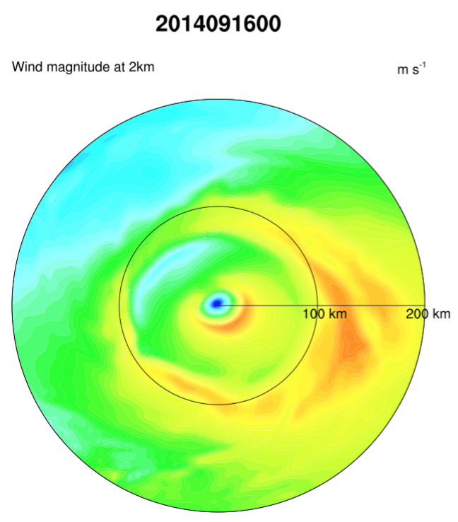
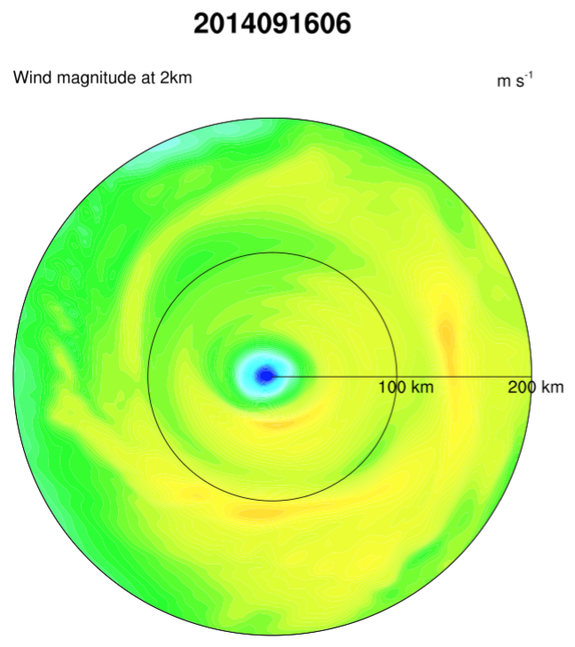
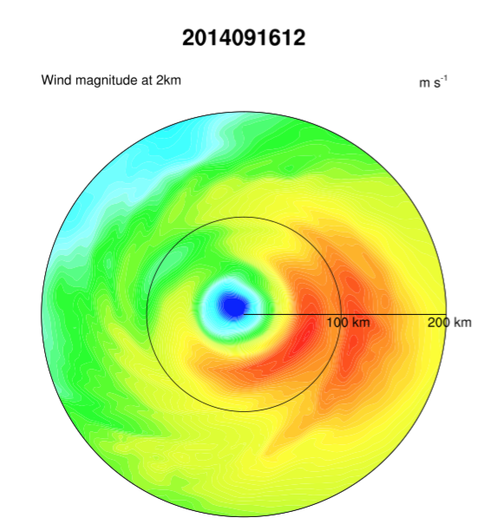
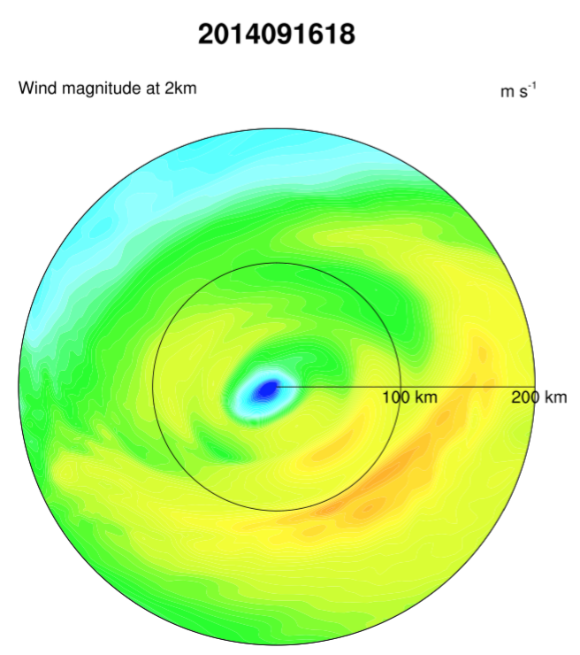
Hr 12
Hr 24
Hr 36
Clear secondary wind maxima in
all integrations
ms⁻¹
HWRF 2016

Slide 13
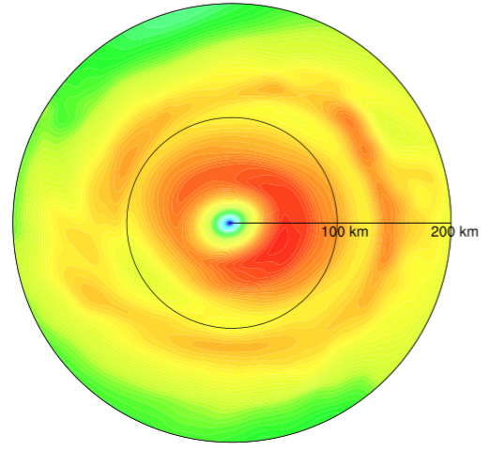
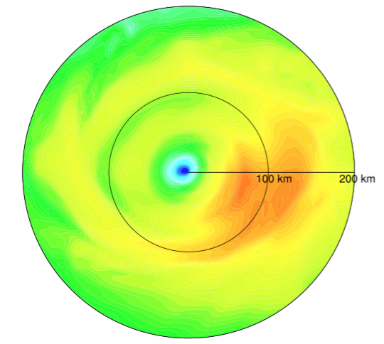
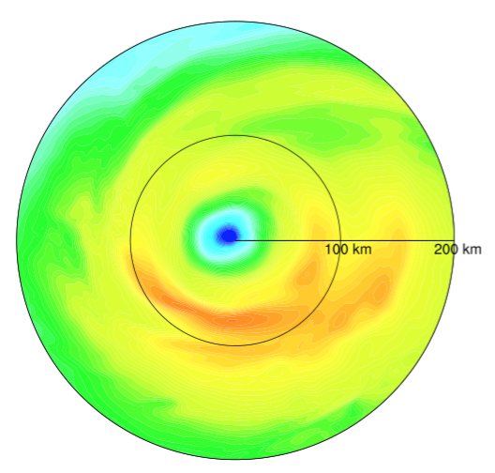
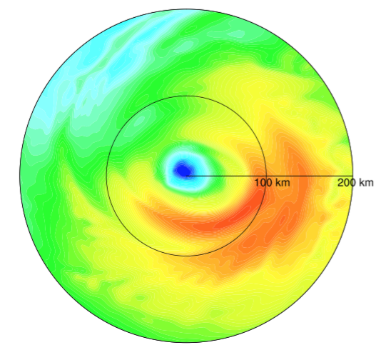
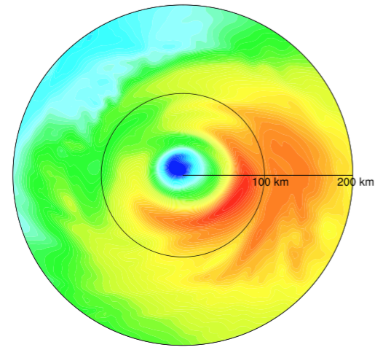
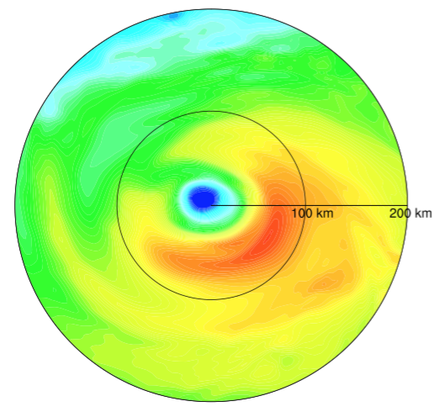


ms⁻¹
09/16 @12 Z
Initialized with a double wind maxima that lasts ~1.5 day
Hr 0
Hr 6
Hr 12
Hr 18
Hr 24
Hr 30
Hr 36
Hr 42
HWRF 2016

Slide 14








09/16 @18 Z
Initialized with a double wind maxima that lasts ~1.5 day
ms⁻¹
Hr 0
Hr 6
Hr 12
Hr 18
Hr 24
Hr 30
Hr 36
Hr 42
HWRF 2016

Slide 15




Edouard (2014)
SE
ms⁻¹
09/12
HWRF 2016

Slide 16




Edouard (2014)
09/13
ms⁻¹
SE
HWRF 2016

Slide 17
Edouard (2014)
09/14
ms⁻¹
SE
HWRF 2016

Slide 18
Edouard (2014)
09/15
ms⁻¹
SE
HWRF 2016

Slide 19




Edouard (2014)
09/16
ms⁻¹
SE
HWRF 2016

Slide 20
Take home messages
Preliminary results
Clear secondary wind maxima in all integrations
  Encouragingly long lasting
  Do not necessarily form too close to the primary eyewall
Large diversity in radius of origin and evolution

Slide 21


Hurricane Blanca (2015)
H4
H3
H2
Rapid weakening
Upwelling of cooler waters (slow-moving hurricane)
Eyewall replacement
H1
Surface wind products from SSMI, SSMIS, AMSR2 and GMI (provided by H-S. Kim and P. Black)

Slide 22




Blanca (2015)
06/01
ms⁻¹
SE
HWRF 2016, no GSI (no data for it)

Slide 23




Blanca (2015)
06/01
ms⁻¹
SE
Hr 111
Hr 78
Hr 75
Hr 93
HWRF 2016, no GSI (no data for it)

Slide 24




Blanca (2015)
06/02
ms⁻¹
SE
HWRF 2016, no GSI (no data for it)

Slide 25




Blanca (2015)
06/02
ms⁻¹
SE
Hr 66
Hr 48
Hr 51
Hr 69
HWRF 2016, no GSI (no data for it)

Slide 26




Blanca (2015)
06/03
ms⁻¹
SE
HWRF 2016, no GSI (no data for it)

Slide 27

Blanca (2015)
06/03
ms⁻¹
SE
Hr 66
SE is less clear. Often two transient wind max are identified (they re-apear ~the same radii)
HWRF 2016, no GSI (no data for it)

Slide 28




Blanca (2015)
06/04
ms⁻¹
SE
HWRF 2016, no GSI (no data for it)

Slide 29


Blanca (2015)
06/04
ms⁻¹
SE
Hr 12
Hr 00
Hr 42
=(
HWRF 2016, no GSI (no data for it)

Slide 30


H4
H3
H2
H1

Slide 31






Gonzalo (2014)
SE
HWRF 2016

Slide 32





Gonzalo (2014)
SE
Hr 77
Hr 75
Hr 69
Hr 87
Hr 84
Hr 69
HWRF 2016

Slide 33
Let’s focus on Blanca 2015 06 01 00
  Began as tropical depression
  No GSI (no TDR data)

Slide 34


HWRF 2015
HWRF 2016
Blanca
Began as tropical depression
No GSI (unless TDR data?)
<V>_{2km}
[ms⁻¹]
SE
Nature

Slide 35
HWRF 2015
HWRF 2016
<V>_{2km}
[ms⁻¹]
SE
Nature

Slide 36


HWRF 2015
HWRF 2016
<V>_{2km}
[ms⁻¹]
SE
Nature

Slide 37



HWRF 2015
HWRF 2016
Agradient Force, z=1km
ms⁻¹hr⁻¹
SE
Nature

Slide 38



HWRF 2015
HWRF 2016
<𝜍_{a}>_{2km}
[X10⁻⁴s⁻¹]
SE
Nature

Slide 39



HWRF 2015
HWRF 2016
𝜍_{a2km}Variance
[X10⁻⁴s⁻²]
SE
Nature

Slide 40





Secondary Eyewall in idealized HWRF simulations
Lin Zhu¹ , Sergio F. Abarca¹, Weiguo Wang¹, Zhan Zhang¹, Vijay Tallapragada²
¹IMSG at EMC/NCEP/NOAA, College Park, MD
²EMC/NCEP/NOAA, College Park, MD
AMS 32nd Hurricane Conference, San Juan PR, April 18 2016
Lin et al

Slide 41
Model Configurations
Experiment | CTL |  | NEWPBL
Initial condition | Vt= 20 m/s, RMW=45km, no mean flow
Grid number (nx×ny×nz) | 265×472×62
Resolutions | 18/6/2 km
Microphysics | Thompson
Radiation scheme | RRTM
Convection scheme | Kain-Fritsch
PBL scheme | GFS eddy-diffusivity counter-gradient (EDCG) PBL (as operational HWRF 2015) | GFS eddy-diffusivity mass-flux (EDMF) PBL (as operational HWRF 2016)
GFS EDMF improves convective boundary layer growth, which improve the convective develop in the strain-dominate flow.
Lin et al

Slide 42

Intensity
Secondary Eyewall Formation (SEF)
P_{MIN}_CTL
P_{MIN}_NEWPBL
…… V_{MAX}_CTL
…... V_{MAX}_NEWPBL
The interesting thing is no big difference in intensity between CTL and NEWPBL, even during SEF and ERC.
Lin et al

Slide 43


Primary results
CTL
NEWPBL
?
(a)
(b)
NO Secondary Eyewall
Secondary Eyewall
Simulation hours (hr)
Simulation hours (hr)
Vt expansion
Vt expansion
Radius (km)
Radius (km)
Hovmoller diagrams of vertical motion (shading, m s⁻¹) and tangential velocity (contoured, m s⁻¹) at 1 km.
Lin et al

Slide 44




Agradient Force Hypothesis
(a) 135 h
Z = 1km
Height (km)
(b) 138 h
Simulation hours (hr)
Height (km)
Secondary maximum of Vt
(c) 141 h
Radius (km)
Agradient force (shading, m s⁻¹ hr⁻¹)
Tangential velocity (black contour, m s⁻¹)
Height (km)
Secondary maximum of agradient force
Secondary maximum of Vt shows early than secondary maximum of agradient force.
Radius (km)
Lin et al

Slide 45








Okubo-Weiss parameter at 850 hPa
OW > 0, rotation dominate (red, s⁻²)
OW < 0, strain dominate (blue, s⁻²)
132 h
135 h
138 h
141 h
large strain-dominate flow outside RMW
CTL
convections survive in strain-dominate flow
NEWPBL
Lin et al

Slide 46
In an annular region where SEF occurs…
Control
New-PBL
Total number of gridpoints with 𝜍_{a1km} >0
Normalized vorticity [s⁻¹]
Number of grid points
Azimuthally accumulated 𝜍_{a1km}
Time [hours]

Slide 47
Concluding remarks
Secondary eyewalls in HWRF 2016:
  Common in the model! (a first in the world!)
  Exhibit realistic features (timing and evolution)
  Can not explain yet the intensity evolution
  Can be traced back to changes in the PBL

Slide 48












Vorticity & Convection at 850 hPa
Absolute voriticity
Radar reflectivity
CTL
NEWPBL
CTL
NEWPBL
135 h
138 h
141 h
Lin et al

Slide 49


f000
f024
Lin et al

Slide 50



HWRF 2015
HWRF 2016
Total added positive
𝜍_{a2km}
[X10⁻⁴s⁻¹]
SE
Nature

Slide 51


HWRF 2015
HWRF 2016
Num grid points
with 𝜍_{a2km} >0
SE
Nature

