Slide 1
Puzzling simulated hurricane inner core structures
HWRF team
Aug 6, 2015

Slide 2
Outline
Problem and its scope (Jason)
Case study
  Inner core (Sergio)
  Storm-environment interaction (Bin)
Fixing and discussion

Slide 3
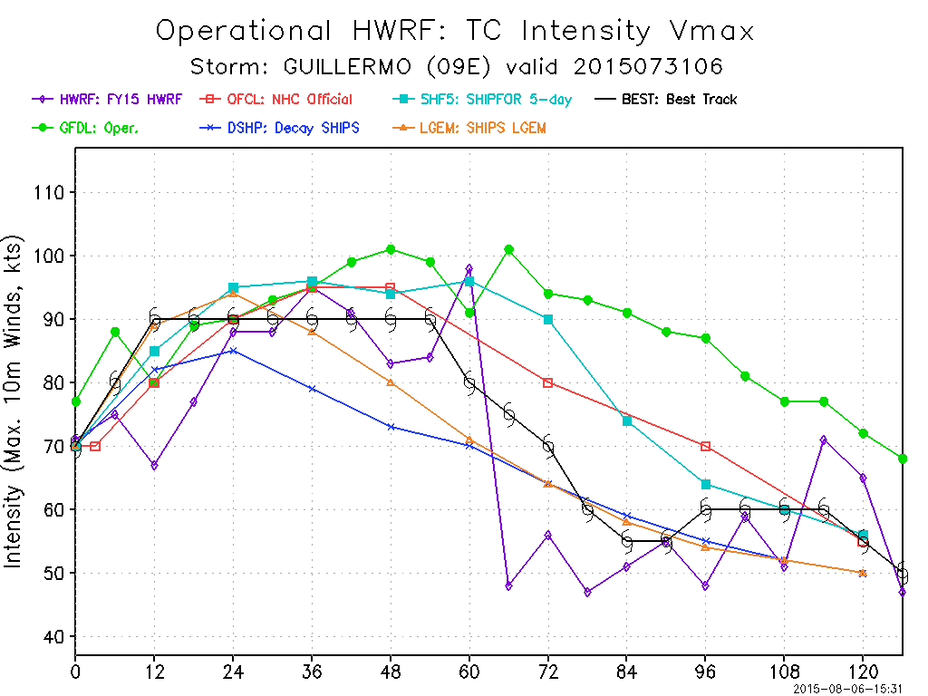
HWRF forecast from Guillermo:
What happens at 66 h?!

Slide 4
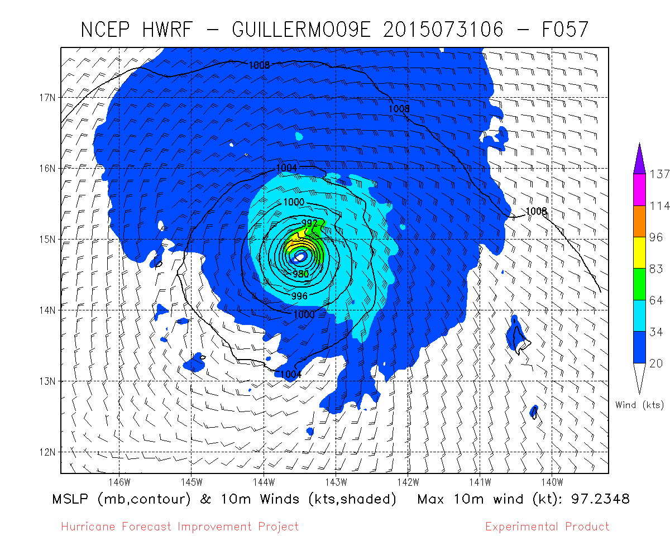
Look at the wind field…
What IS this?!

Slide 5
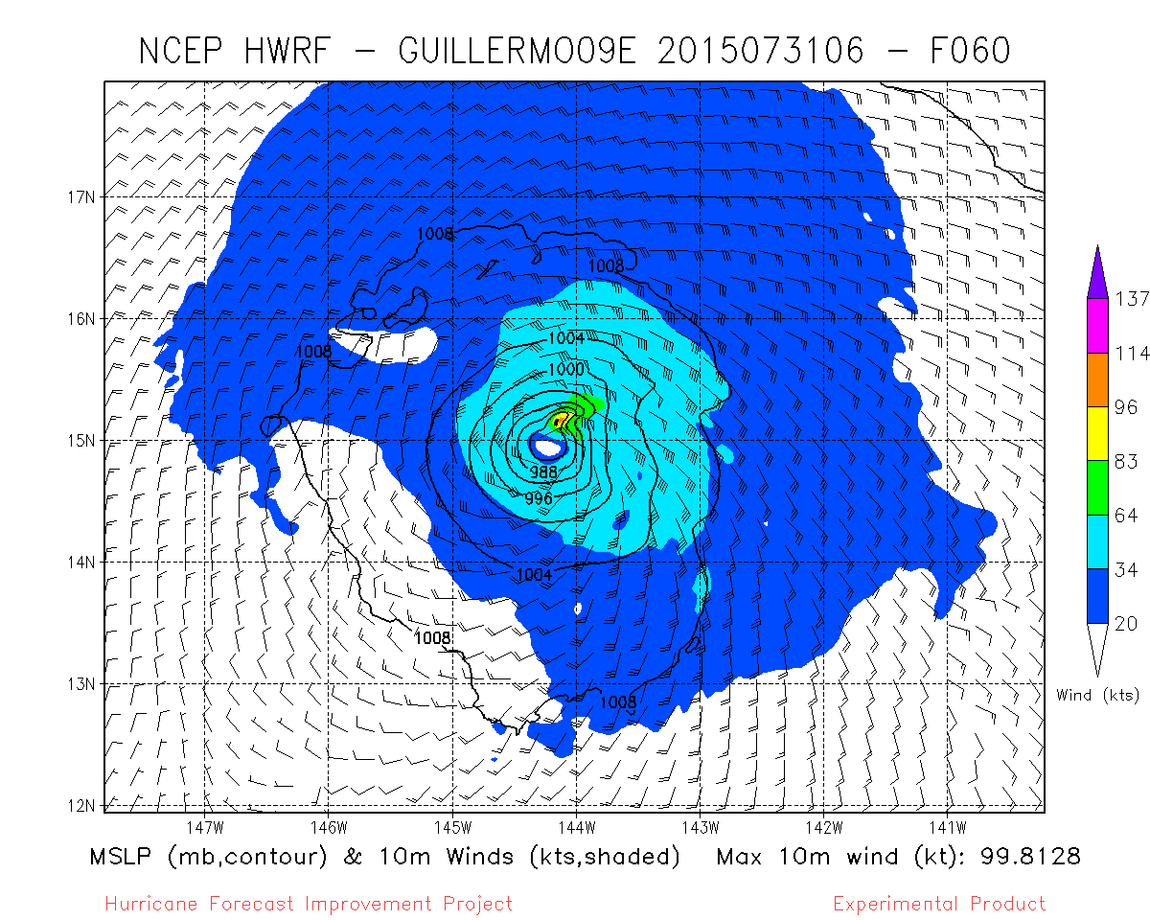
Look at the wind field…
What IS this?!

Slide 6
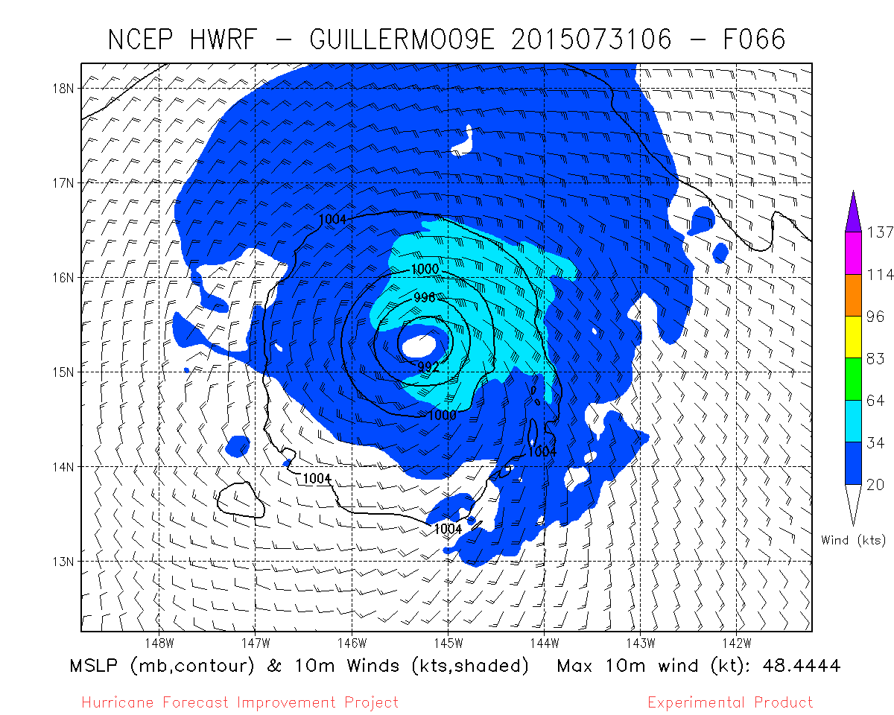
Look at the wind field…
What just happened?!

Slide 7
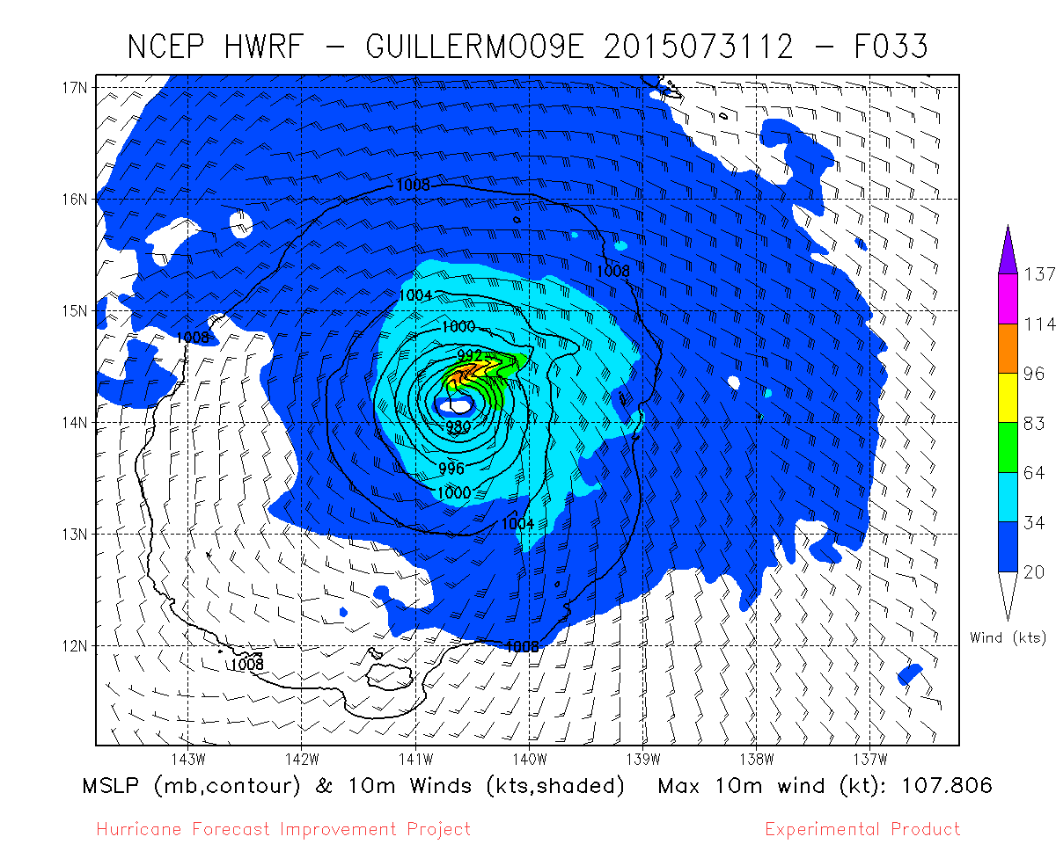
Another from an adjacent cycle…
It just doesn’t look “right”

Slide 8
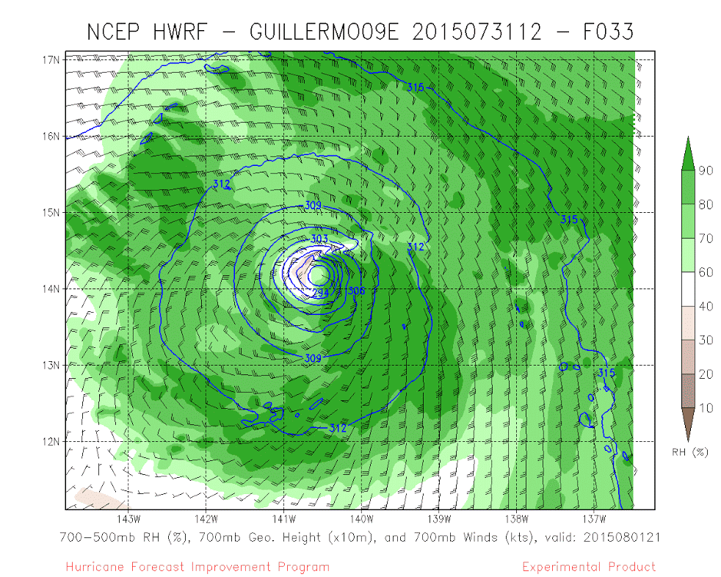
A coherent, deep structure….
700 hPa hgt / humidity
Sfc pressure / winds
It just doesn’t look “right”

Slide 9
Do other forecasts have “these”?
VERY MUCH SO SOMEWHAT
Guillermo (2015 09E) – most cycles after 2015073000
Maysak (2015 04W) - 2015041112
Higos (2015 02W) - basically every cycle
Amanda (2014 01E) - any cycle after 2014052312
Vance (2014 21E) - there are hints of it in many cycles, but it gets worse after 2014110306
Eduoard (2014 06L) - maybe, not a priority case, could be ET as well
Fay (2014 07L) - cycles beginning with 2014101106, could be ET later
Bertha (2014 03L) - 2014080400-2014080412 and maybe a few around those
Hagupit (2014 22W) - 2014120306-2014120406 (after this forecasts took it over land)
Tapah (2014 06W) - 2014042718-2014042900
Faxai (2014 03W) - looks like a few cycles starting with 2014022218, but not as clear
Ana (2014 02C) - 2014101700-2014101900 (before this land interaction with Hawaii)
Francisco (2013 26W) - 2013102200-2013102418
Lorenzo (2013 13L) – 2013102118-2013102218
Jerry (2013 11L) – 2013092900-2013092906
Gabrielle (2013 07L) – 2013091112

Slide 10
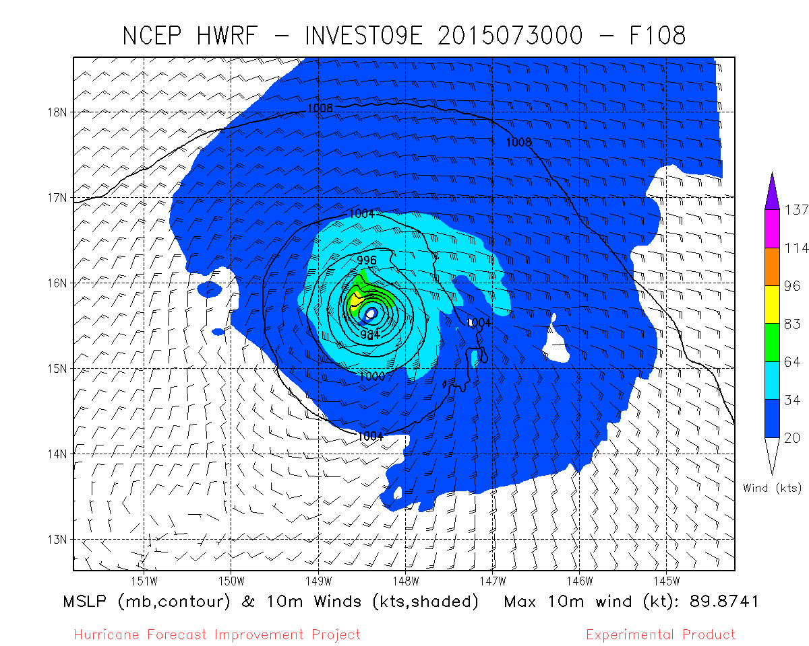
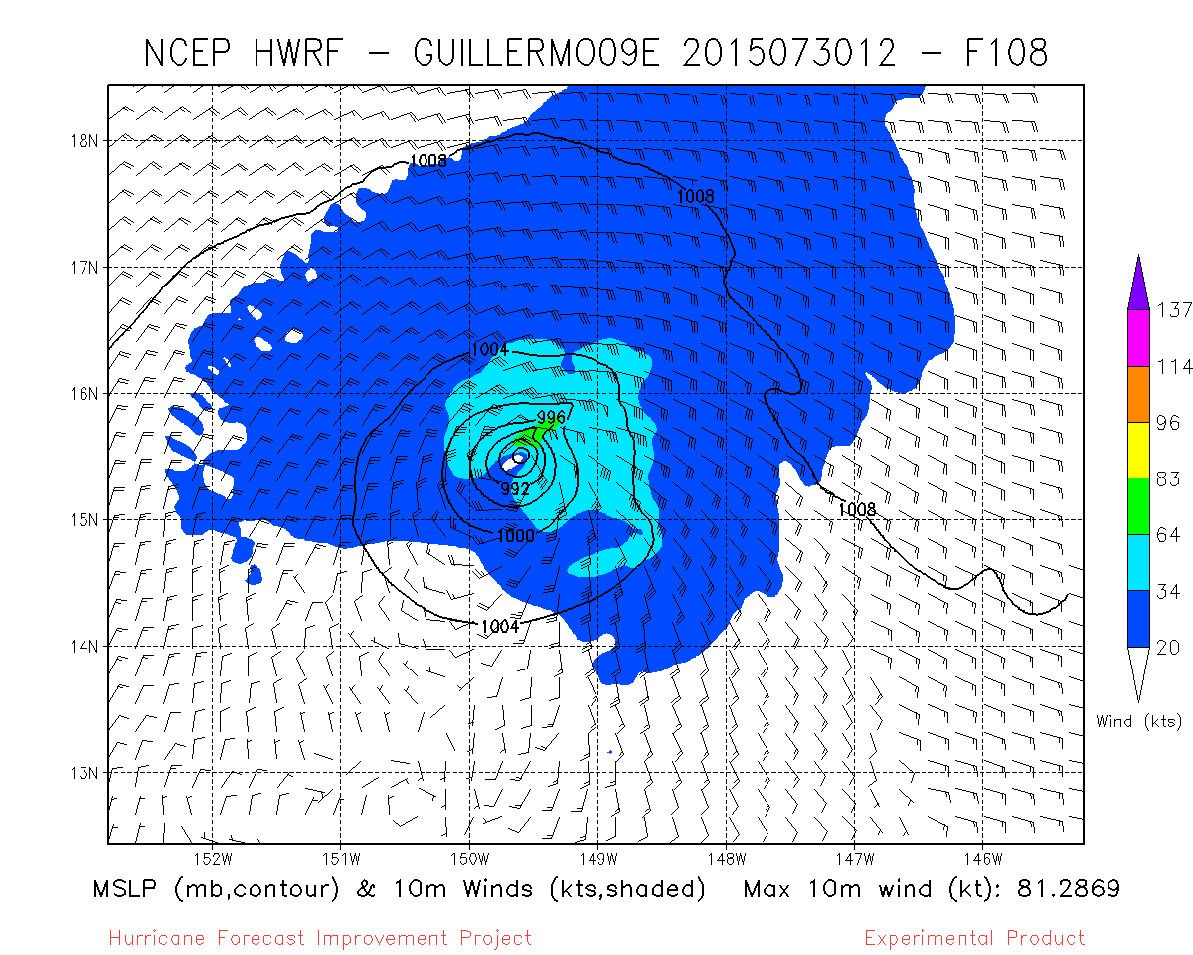
Guillermo: 2015 09E

Slide 11
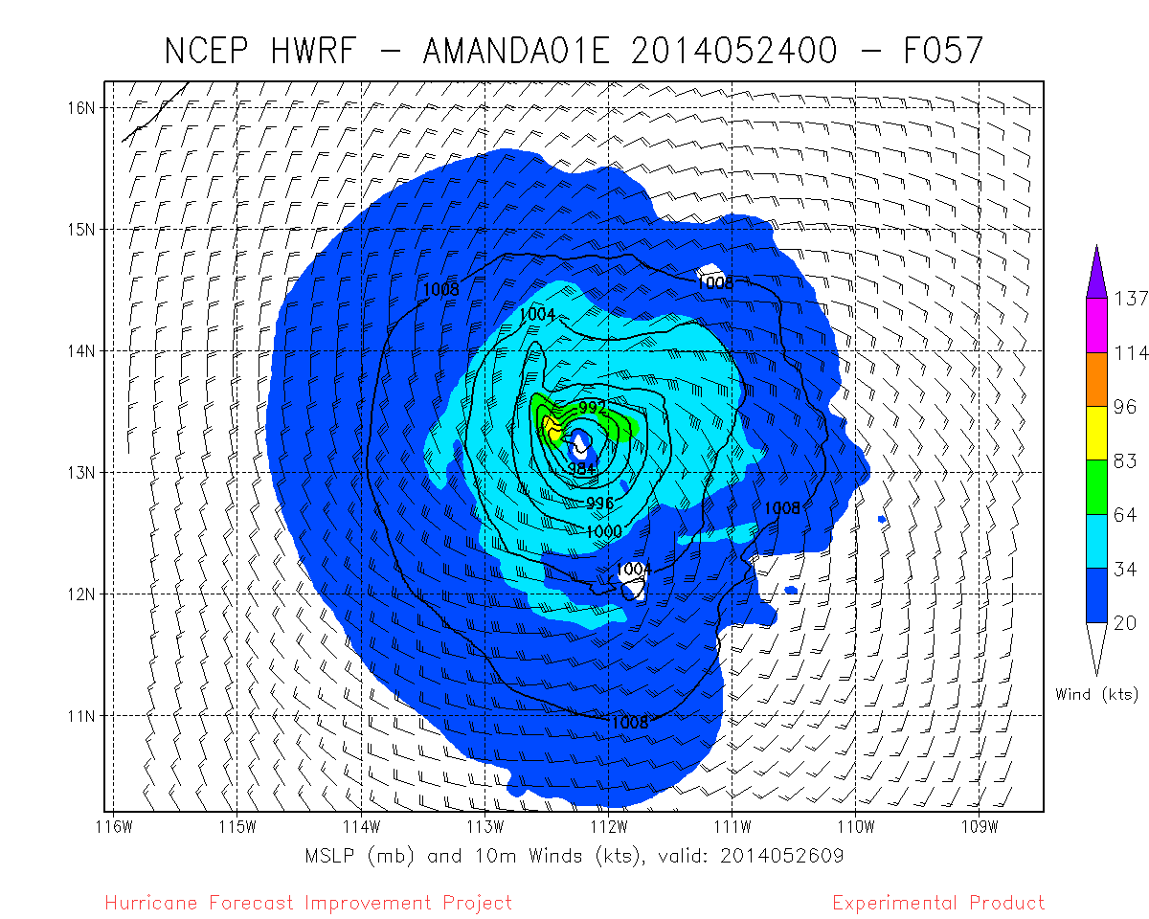
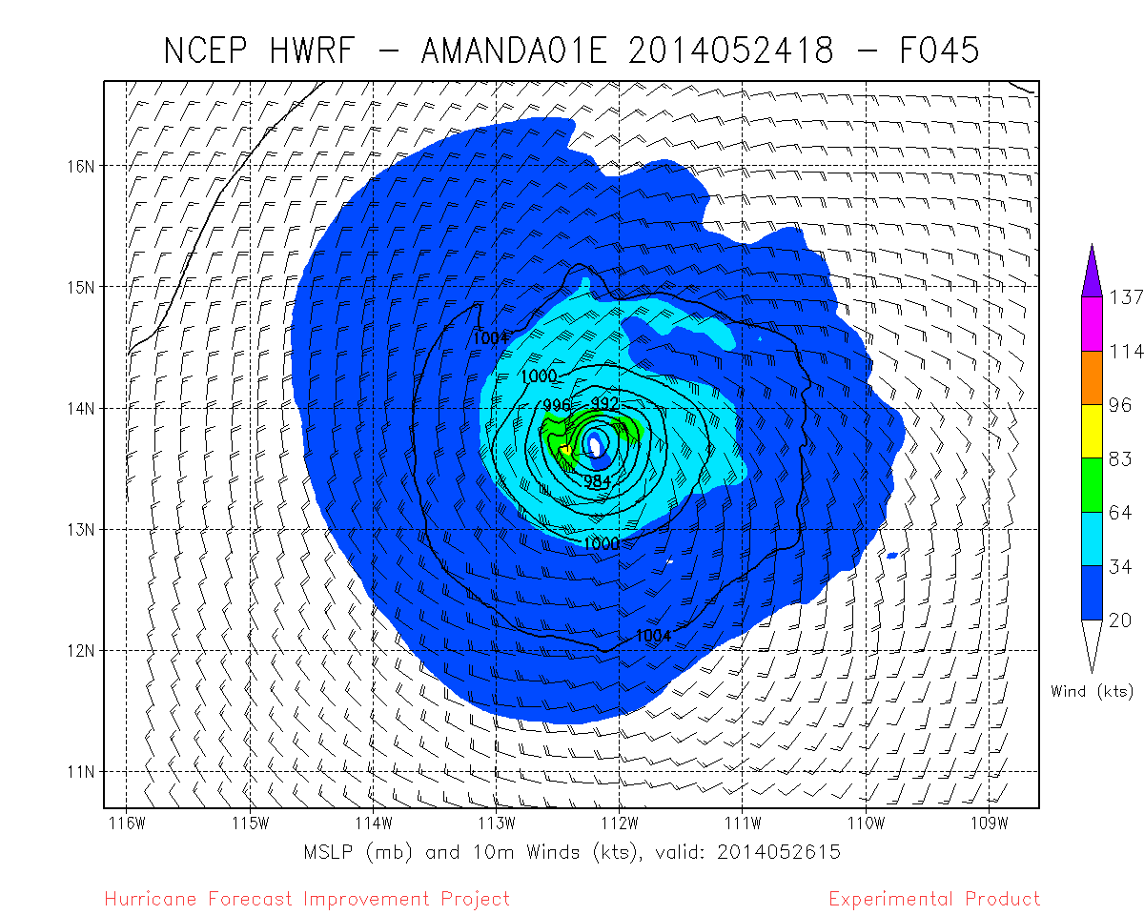
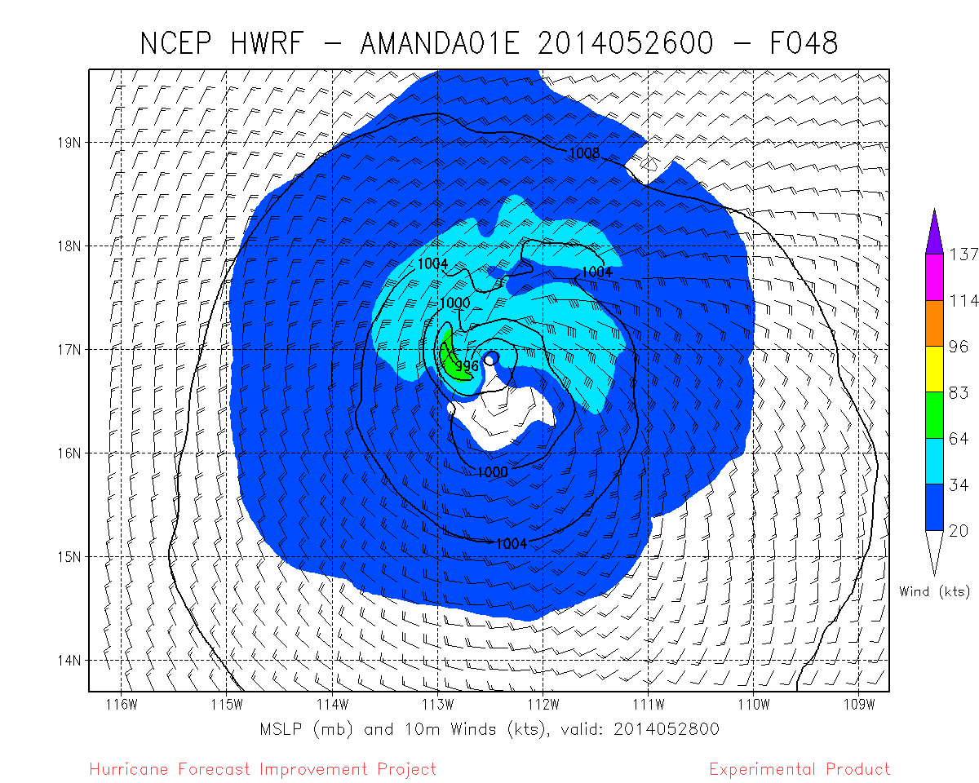
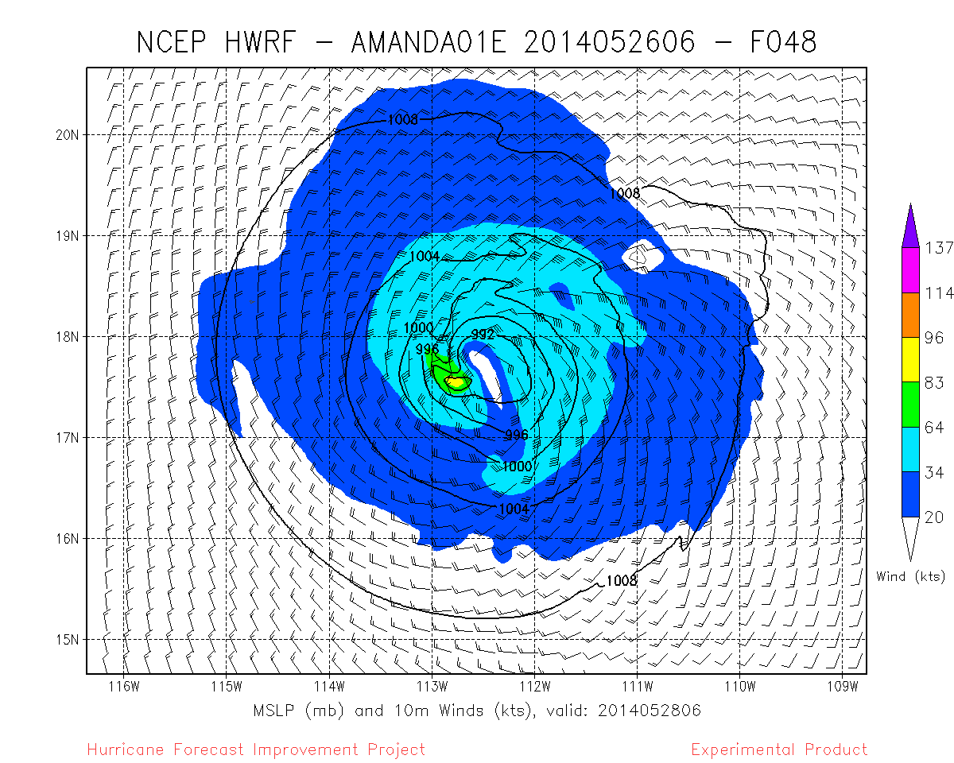
Amanda: 2014 01E

Slide 12
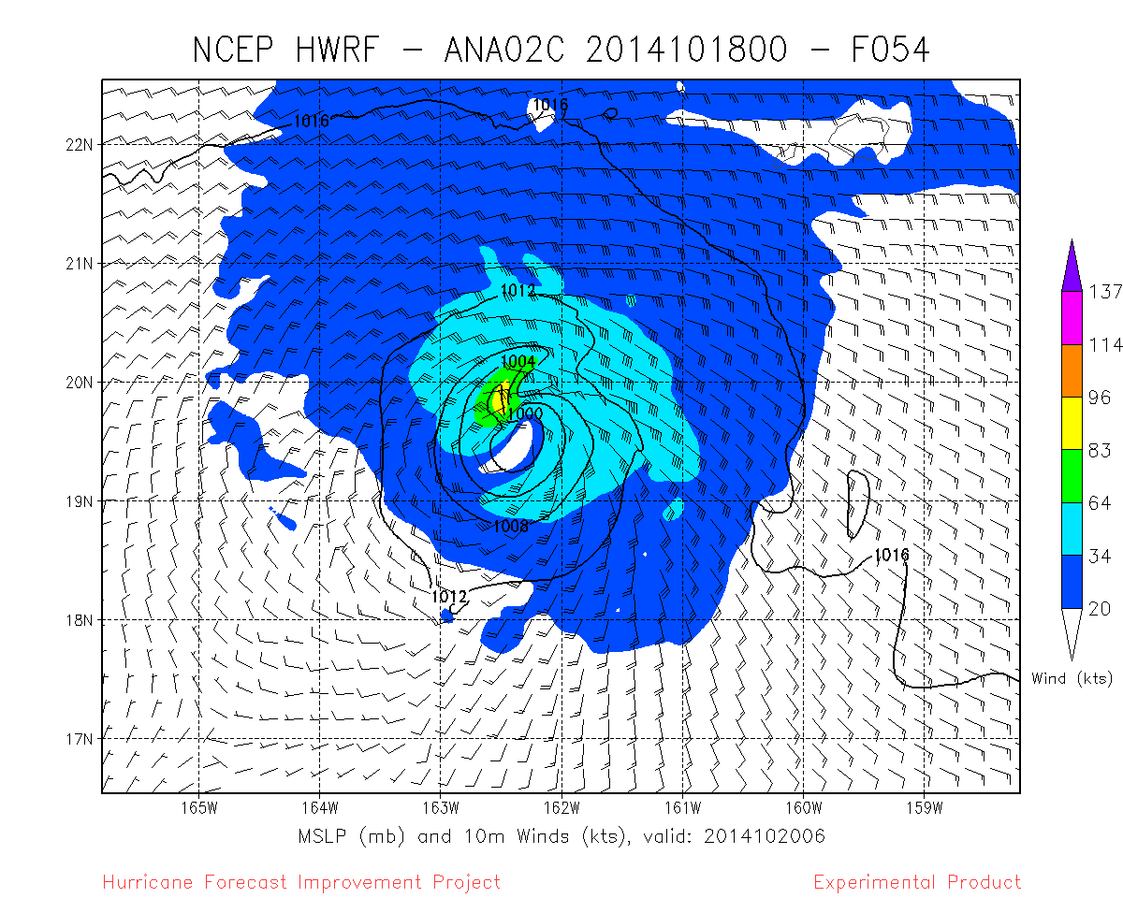
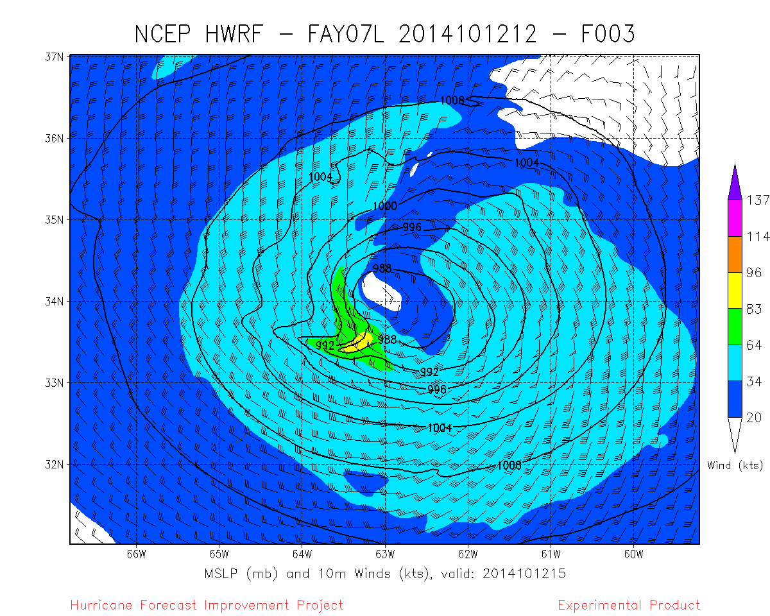
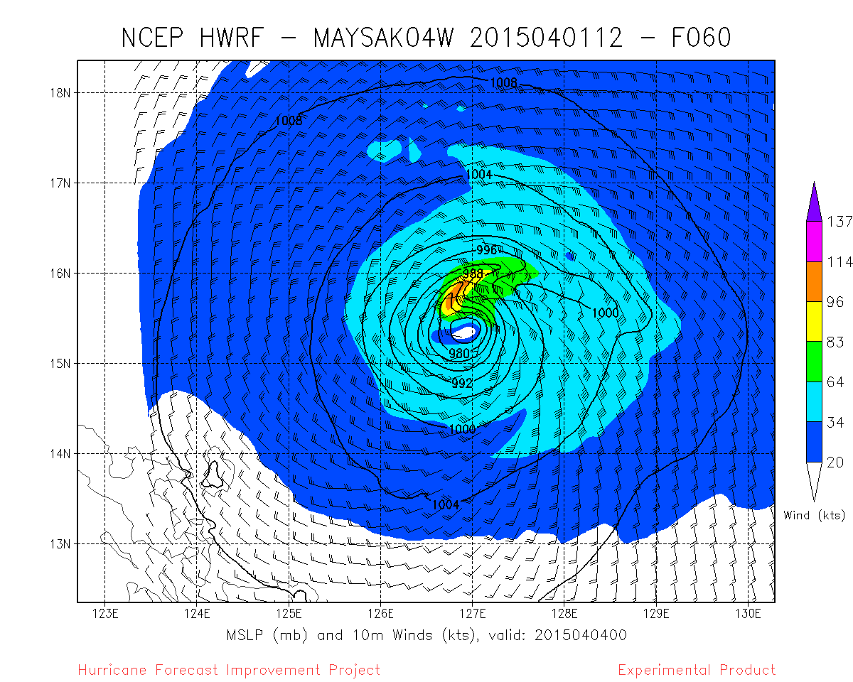
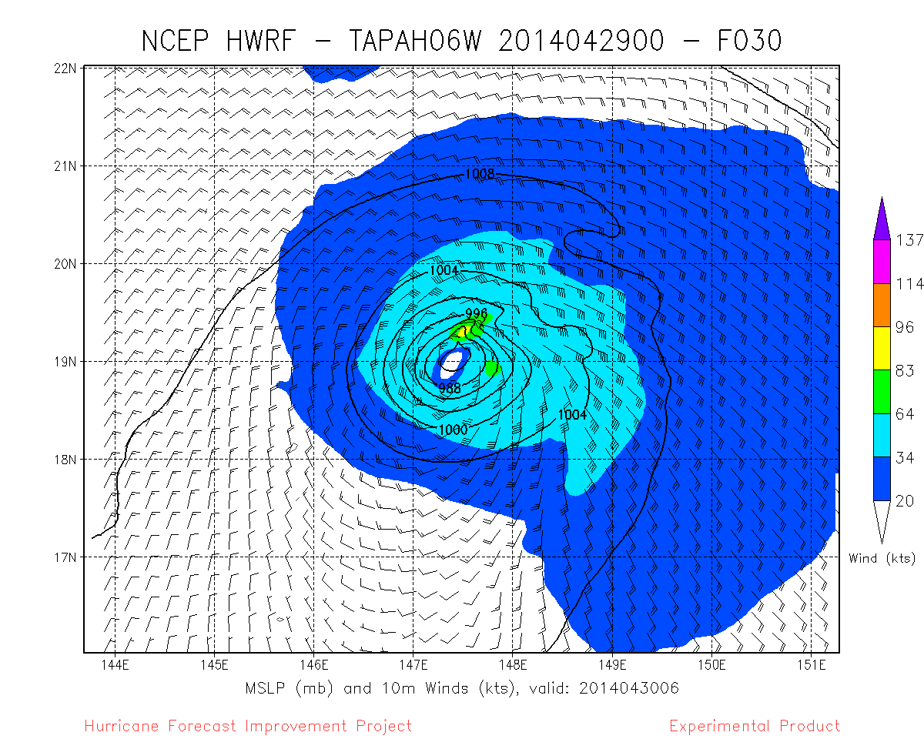
Ana: 2014 07C
Fay: 2014 07L
Maysak: 2015 04W
Tapah: 2014 06W

Slide 13
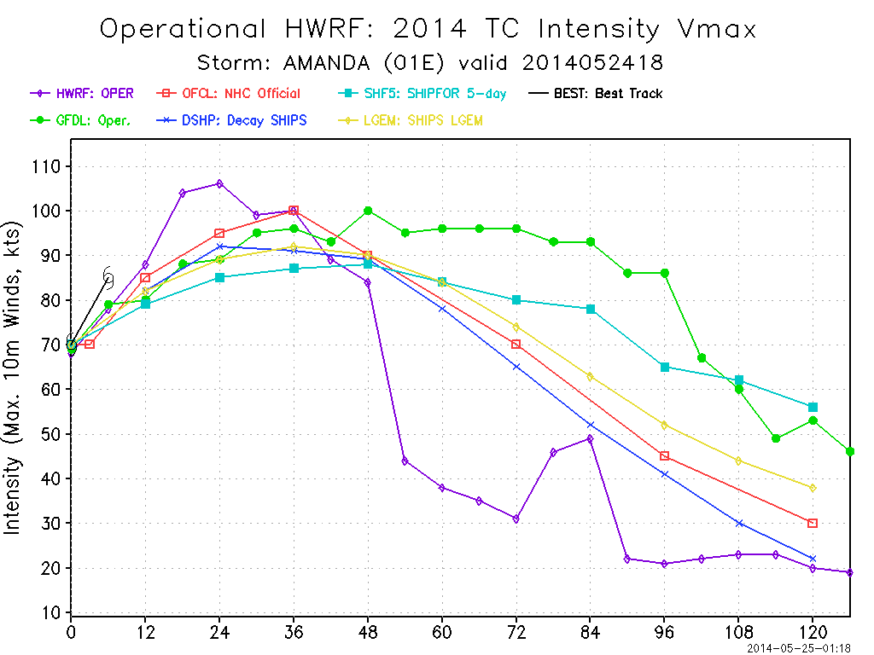
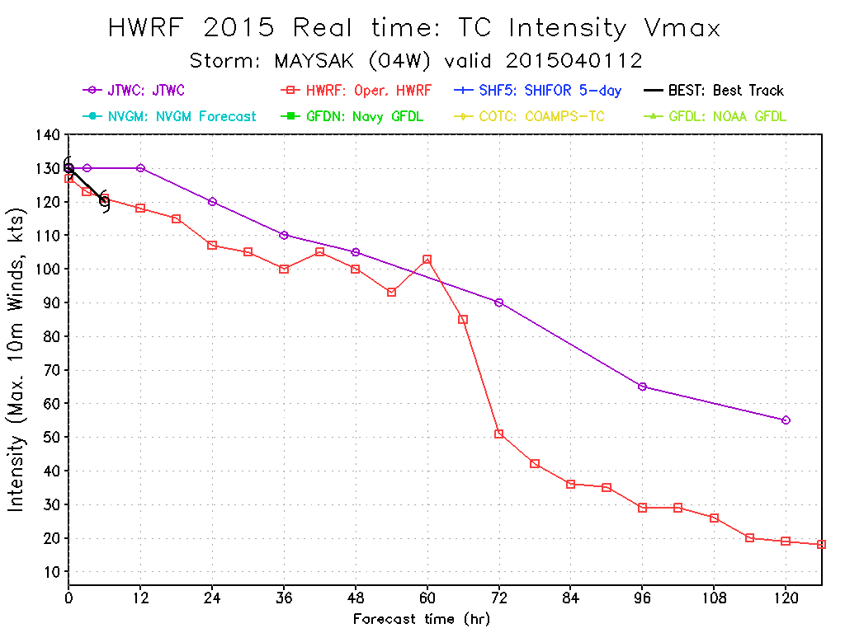
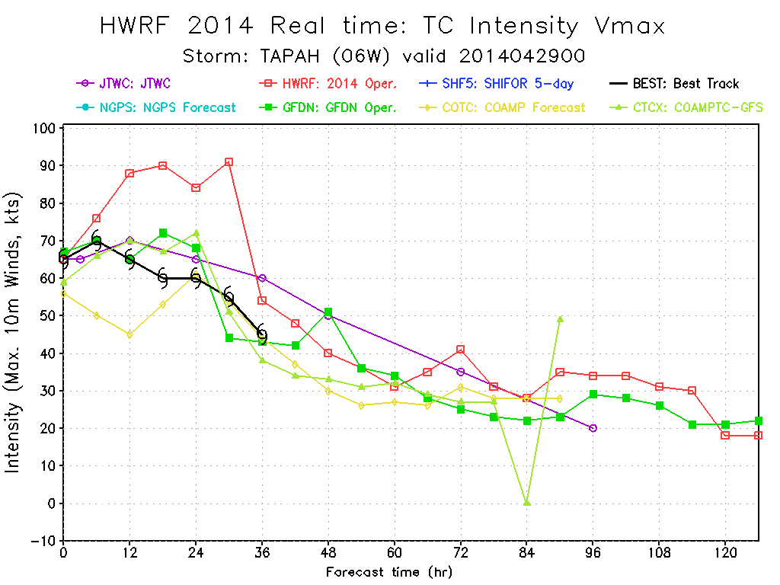
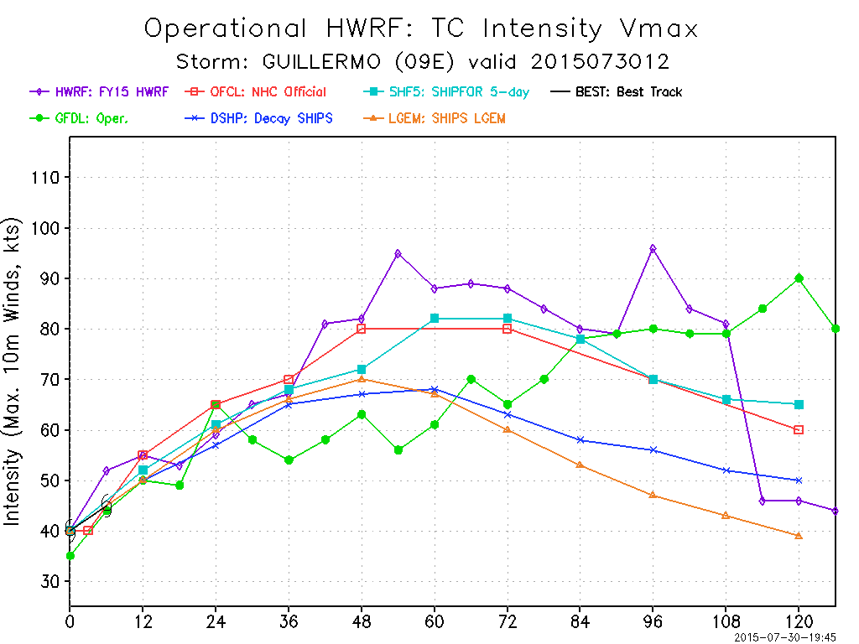
Frequently associated with large intensity drops… when there are none

Slide 14
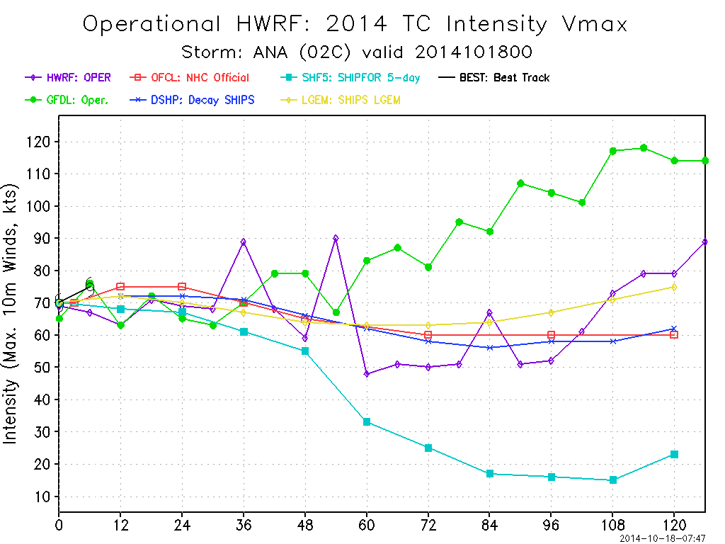
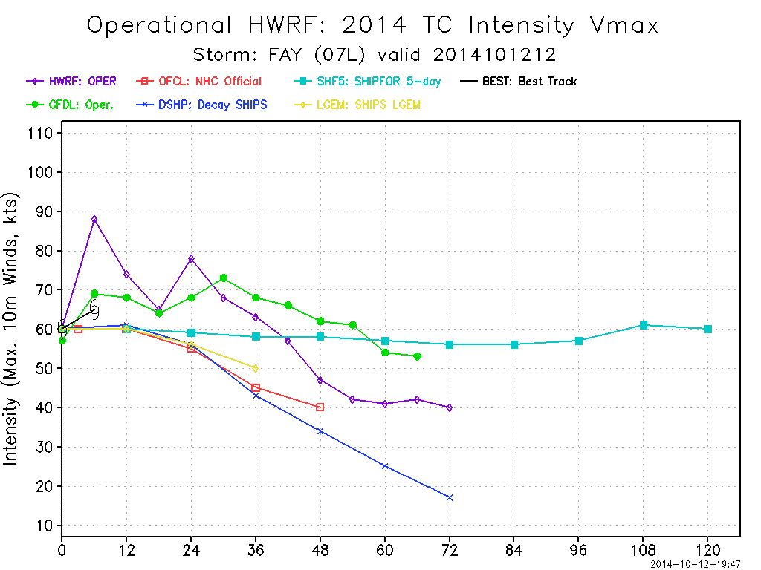
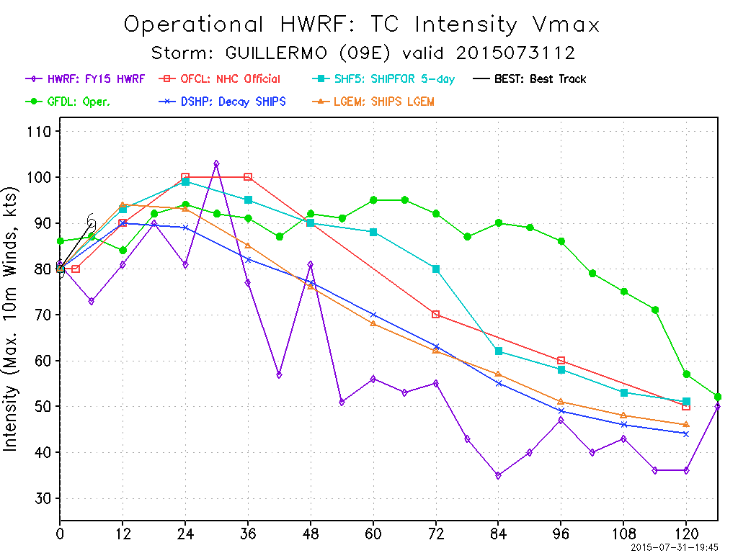
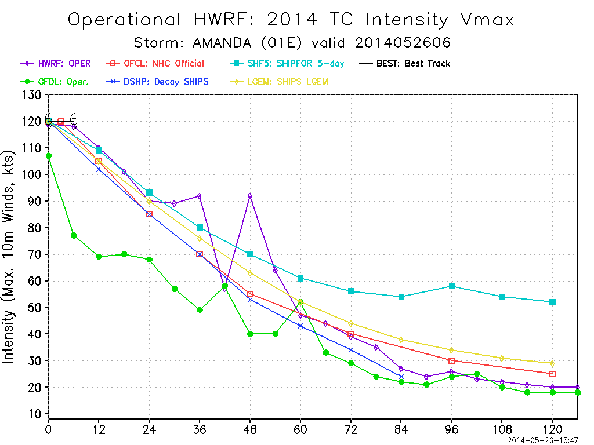
Sometimes associated with intensity spikes….
When there are none

Slide 15
Other findings
Unrealistically large Vmax changes (40-50 kt in 3-6 h)
Usually associated with vertical wind shear
Usually occur downshear left
Often propagates against the flow
Often associated with large intensity forecast errors (30 kt + )
Can lead to large track errors as well (decoupling)

Slide 16
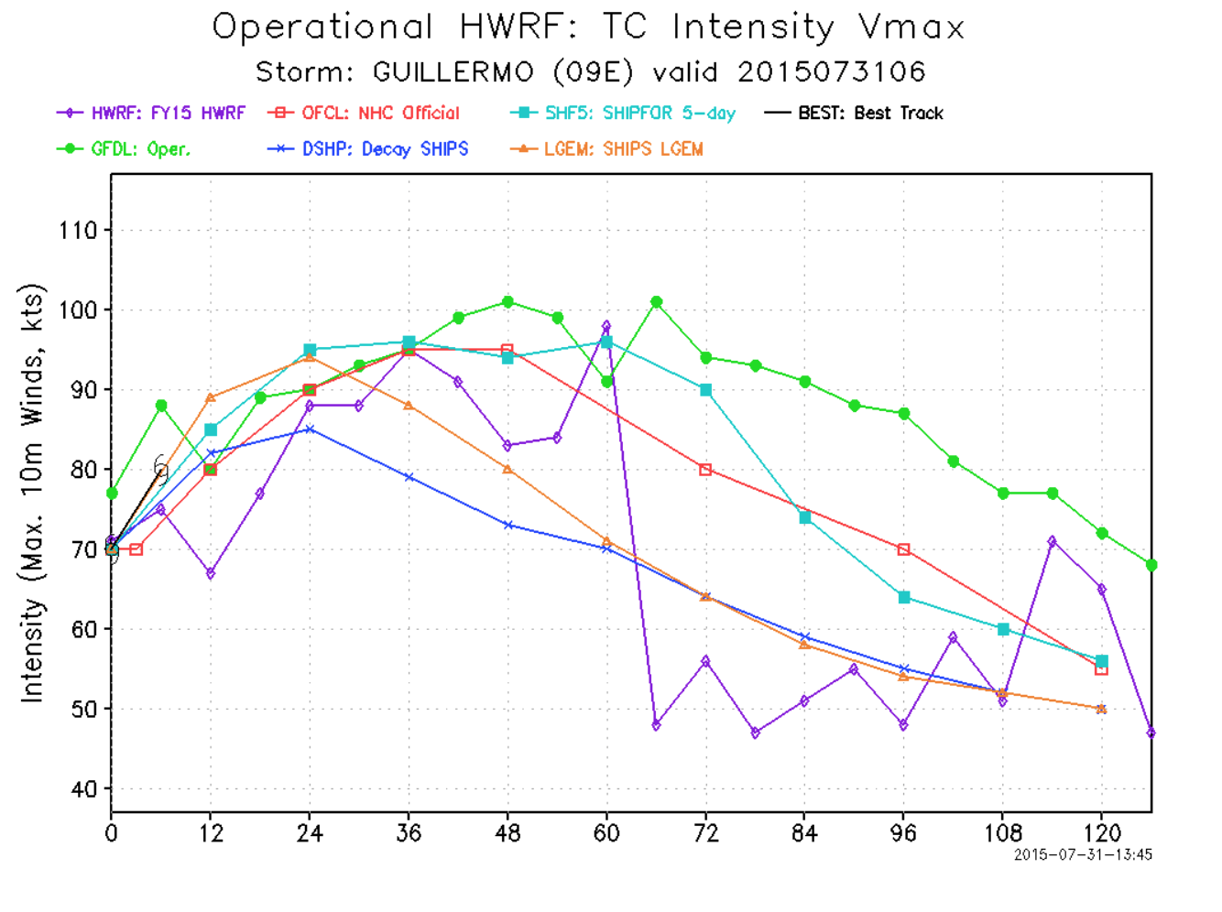
What is happening
Inner Core & Environment
Other cases
Realistic?
How to fix?
~50 kt in 6 hrs!! Rapid weakening X
Large intensity errors!!!

Slide 17
Inner core

Slide 18
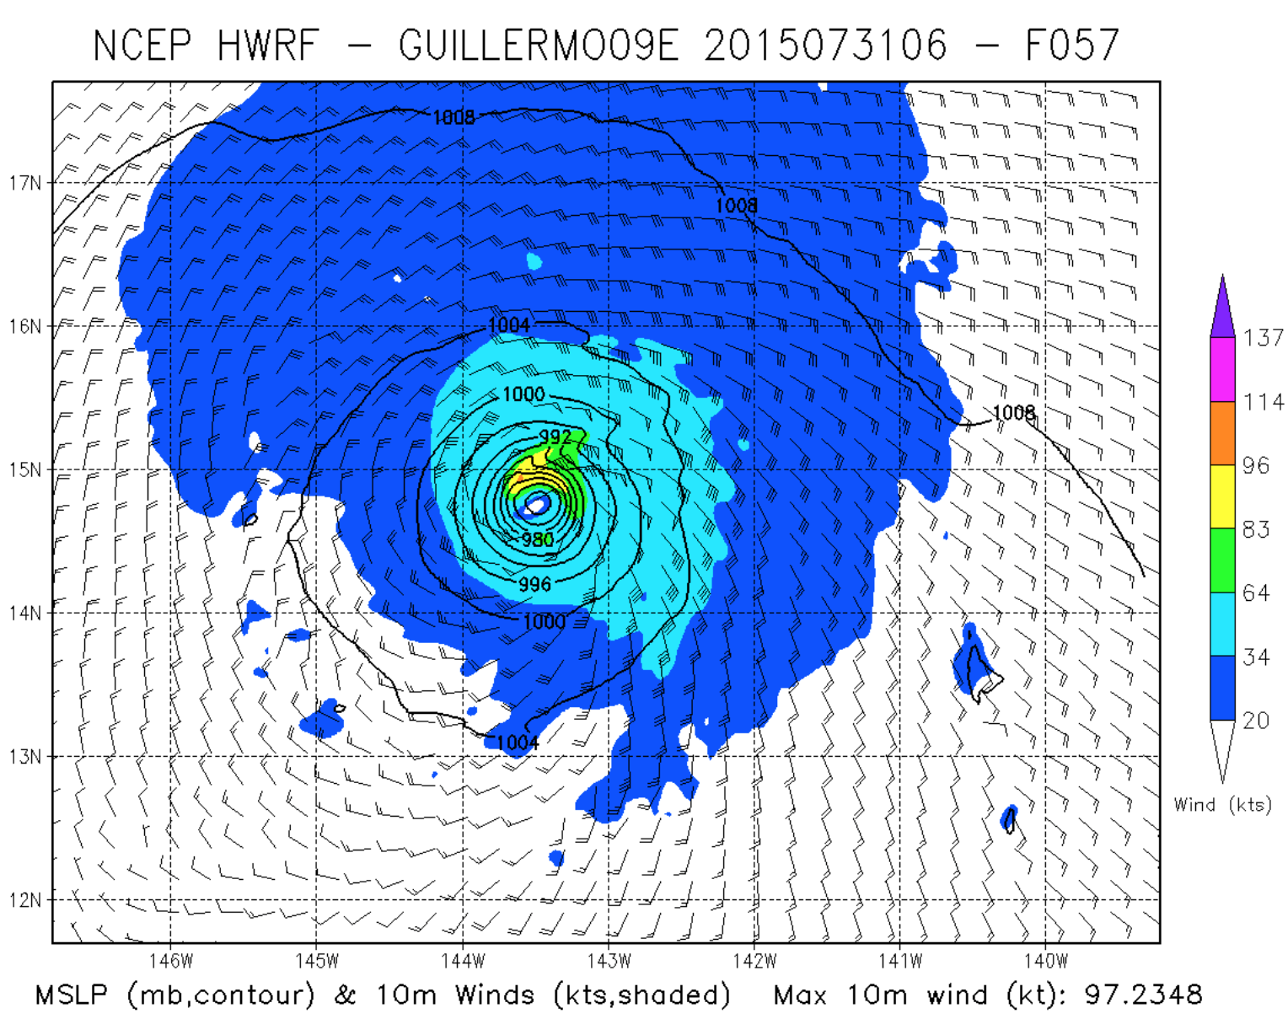
http://www.emc.ncep.noaa.gov/gc_wmb/vxt/HWRF/tcall.php?selectYear=2015&selectBasin=Eastern%20North%20Pacific&selectStorm=GUILLERMO09E

Slide 19
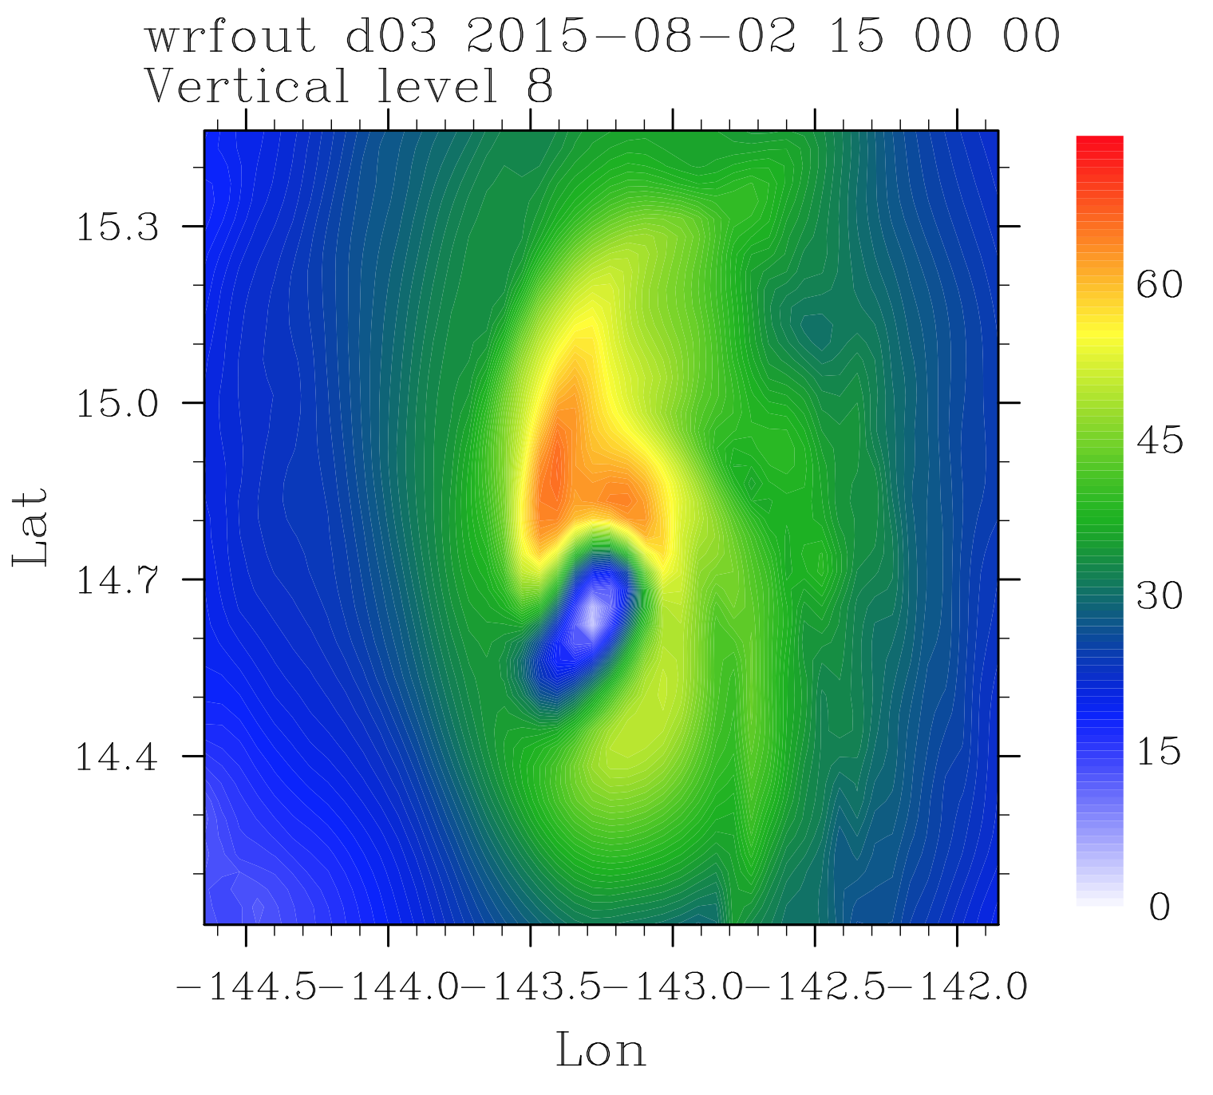
|V|, m/s
Max velocity at the hook
Stationary to the NW
(expect ~1 rotation per hour)

Slide 20
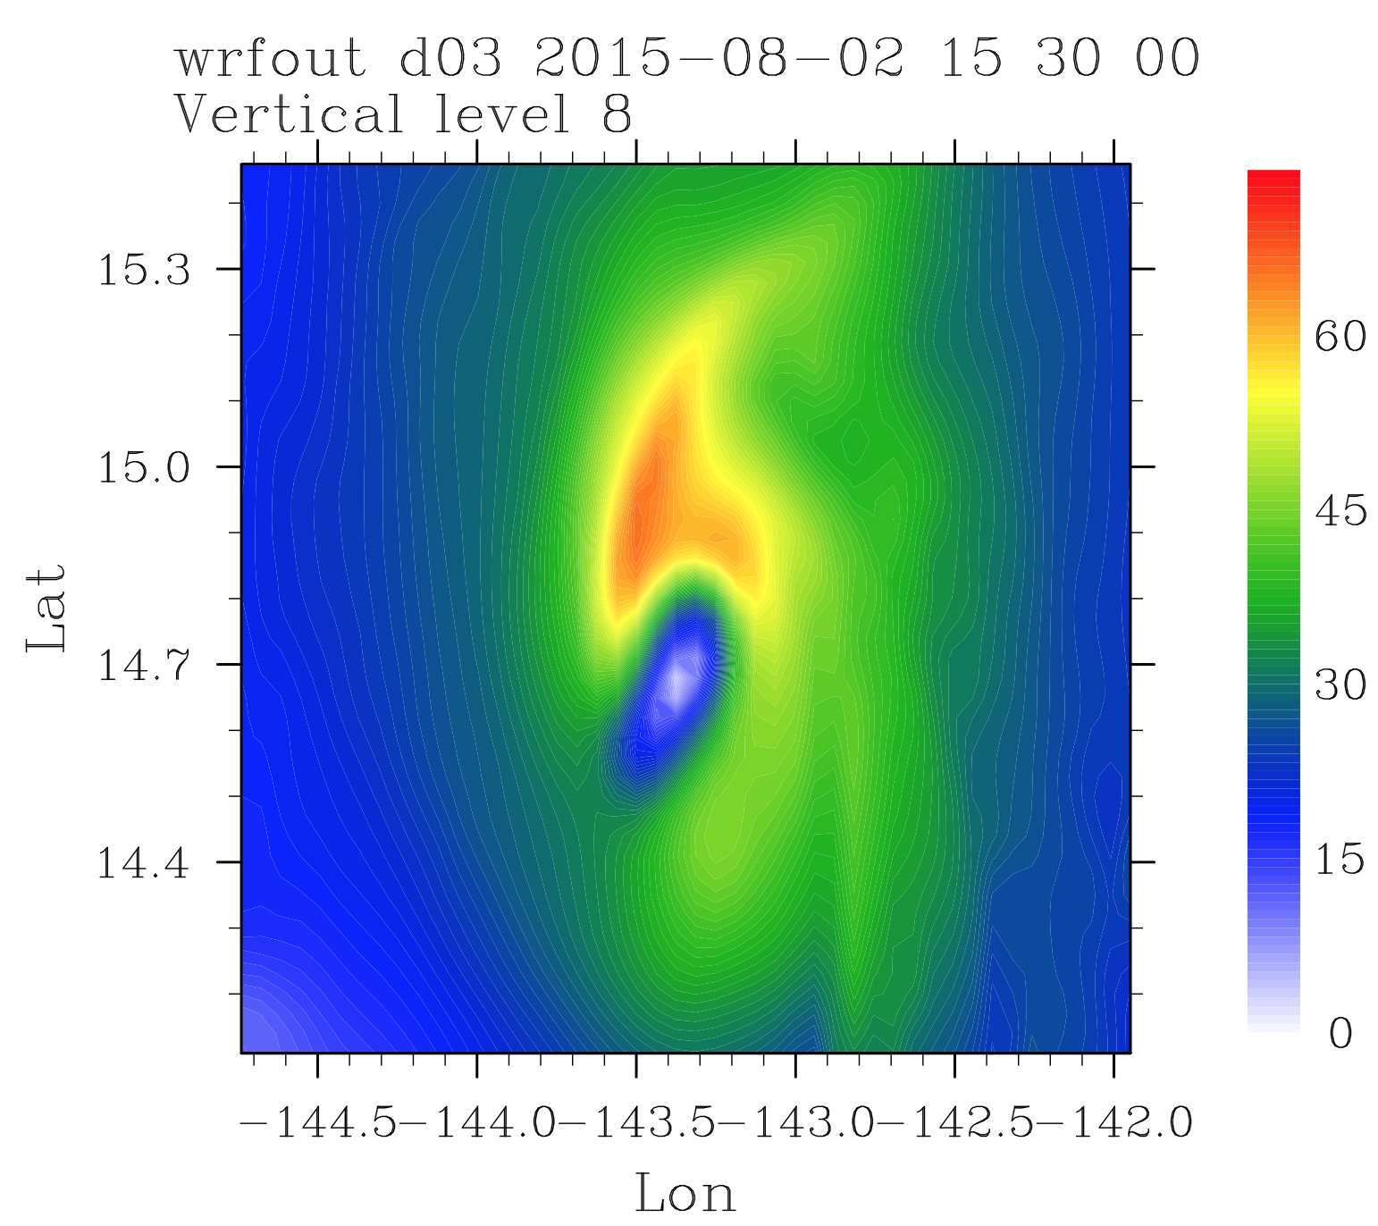
|V|, m/s

Slide 21
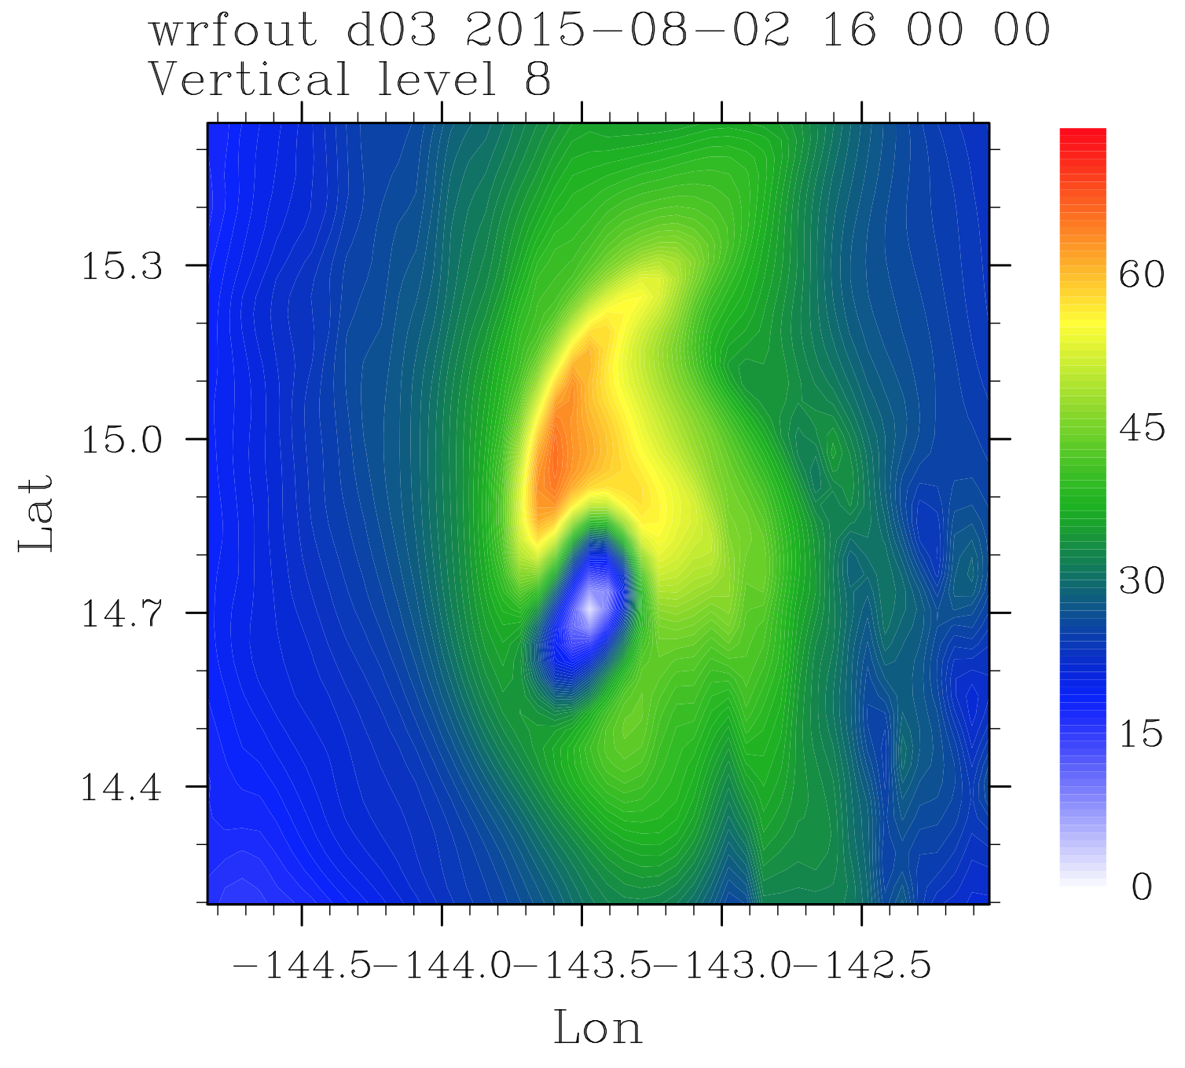
|V|, m/s

Slide 22
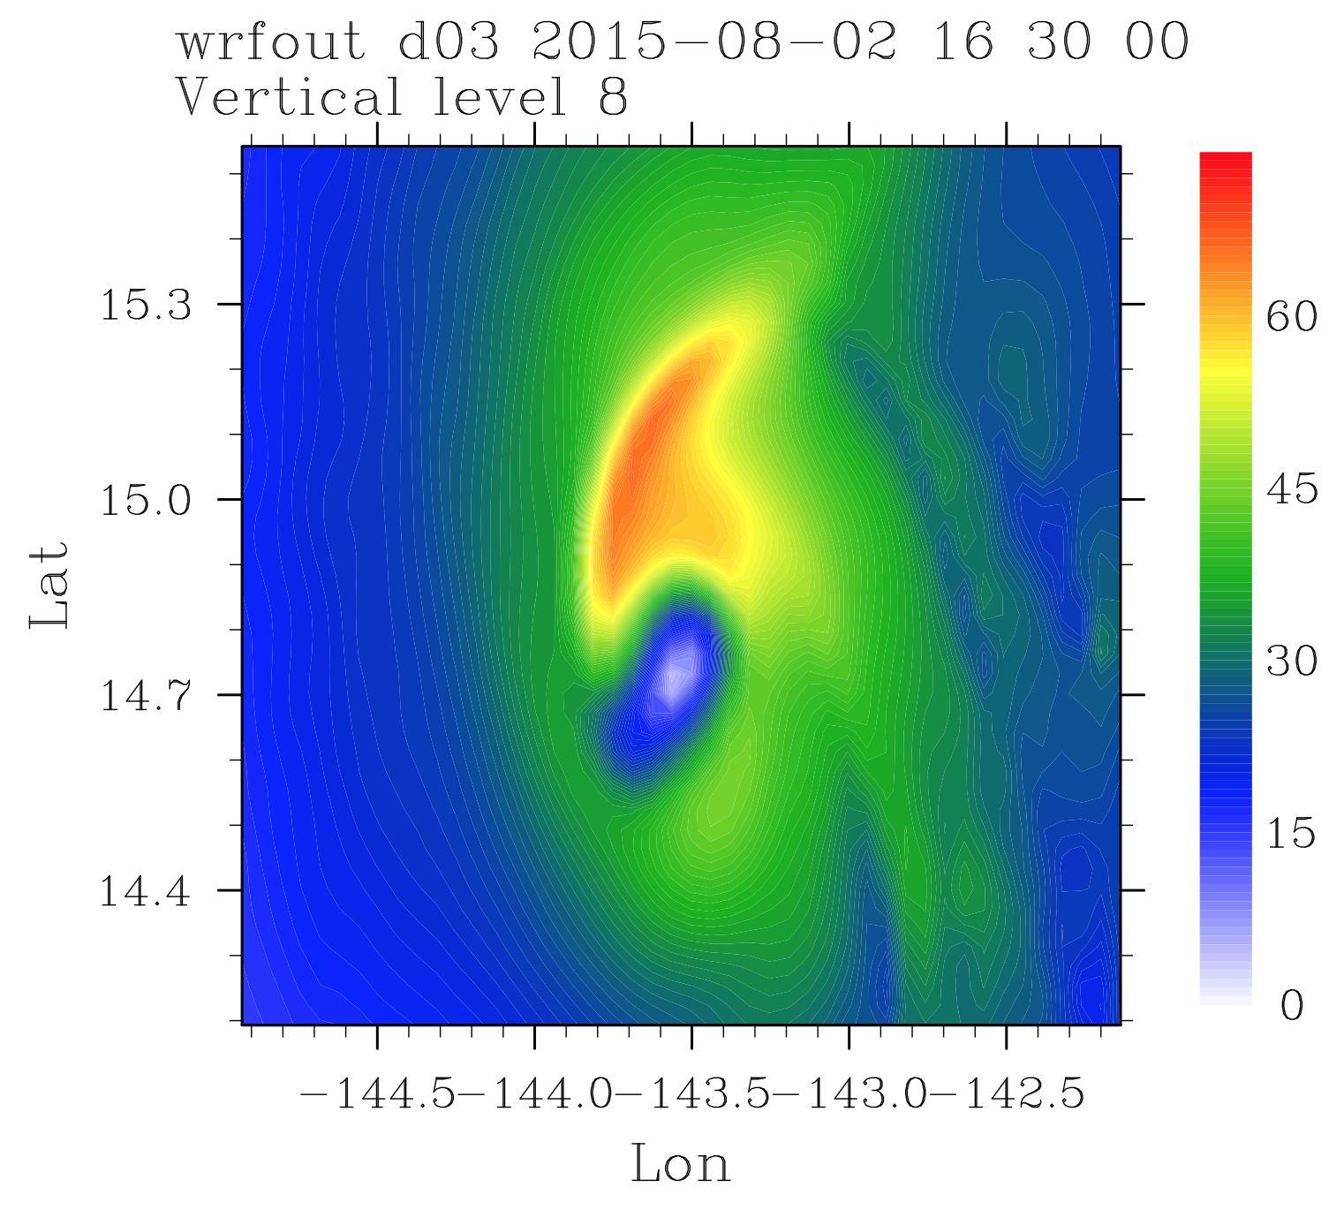
|V|, m/s

Slide 23
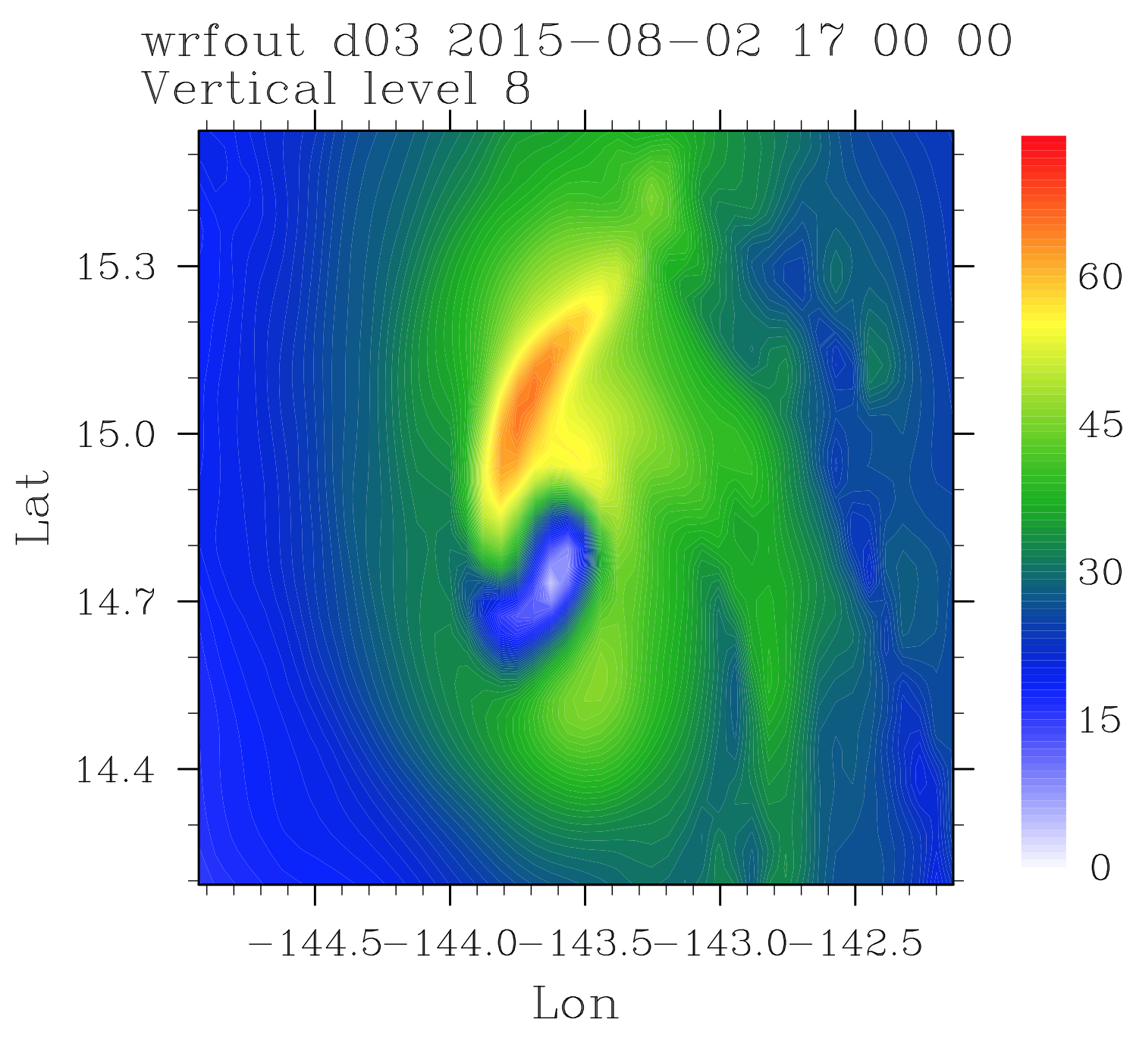
|V|, m/s

Slide 24
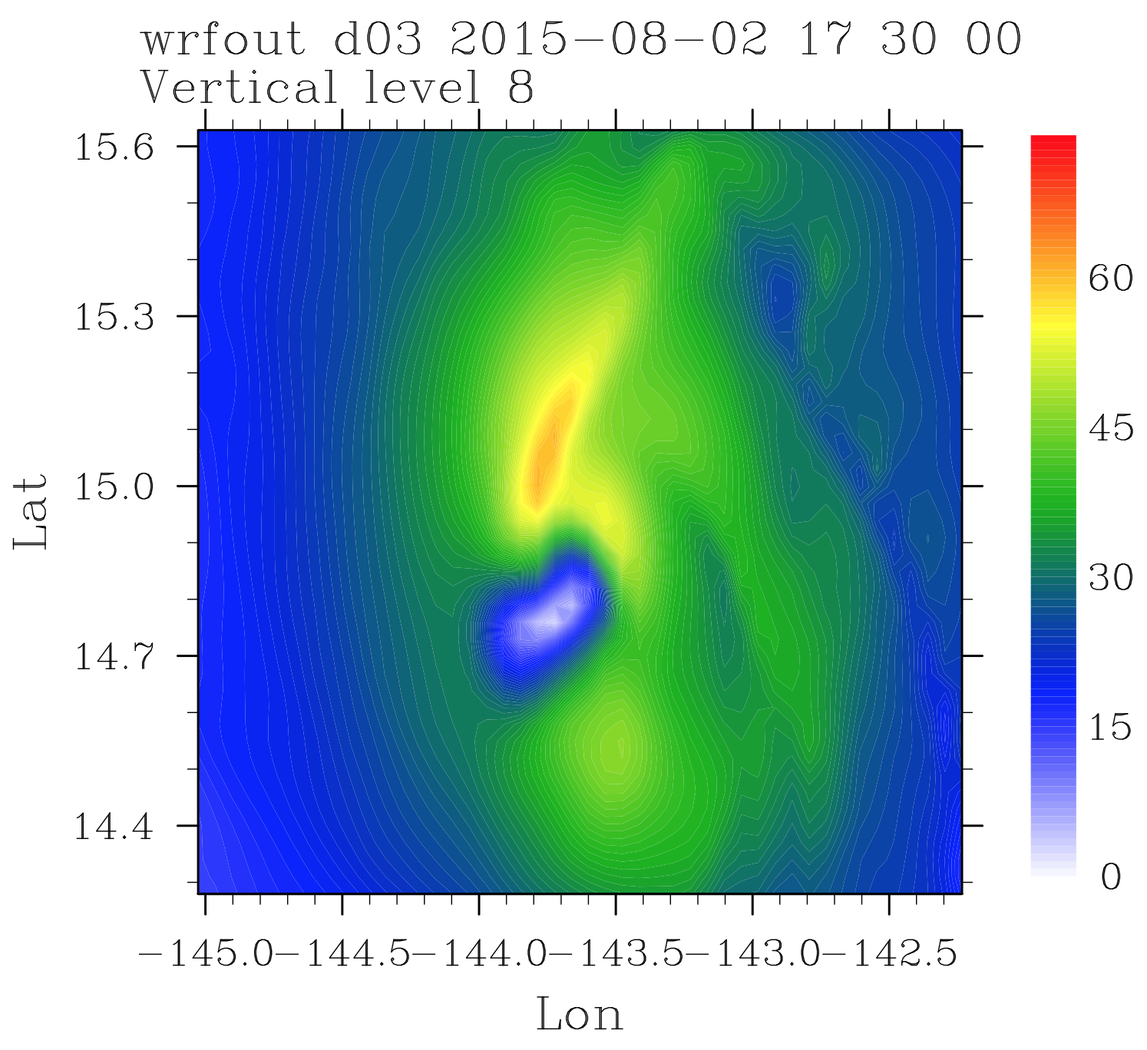
|V|, m/s

Slide 25
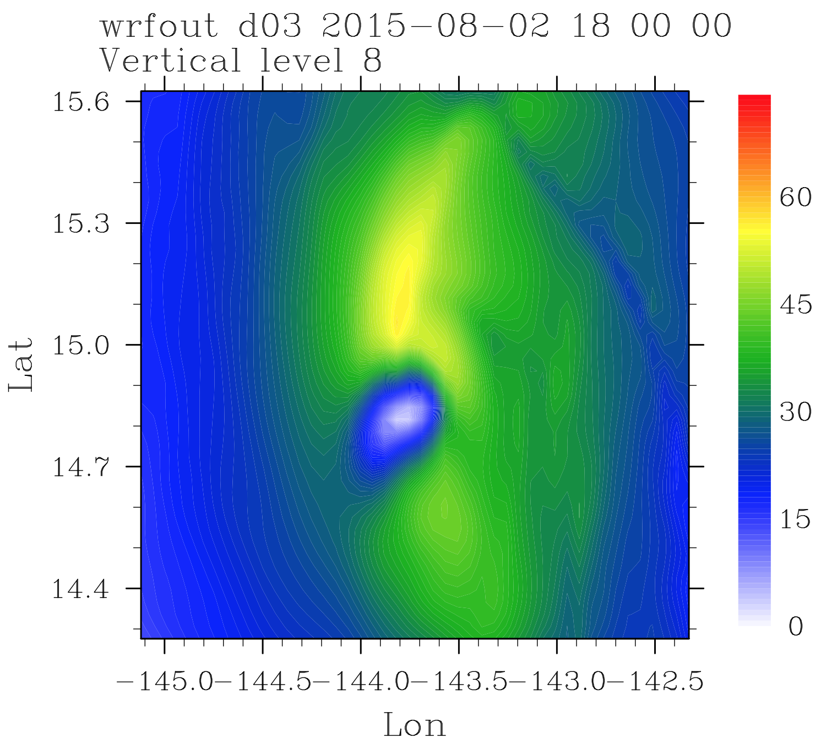
|V|, m/s

Slide 26
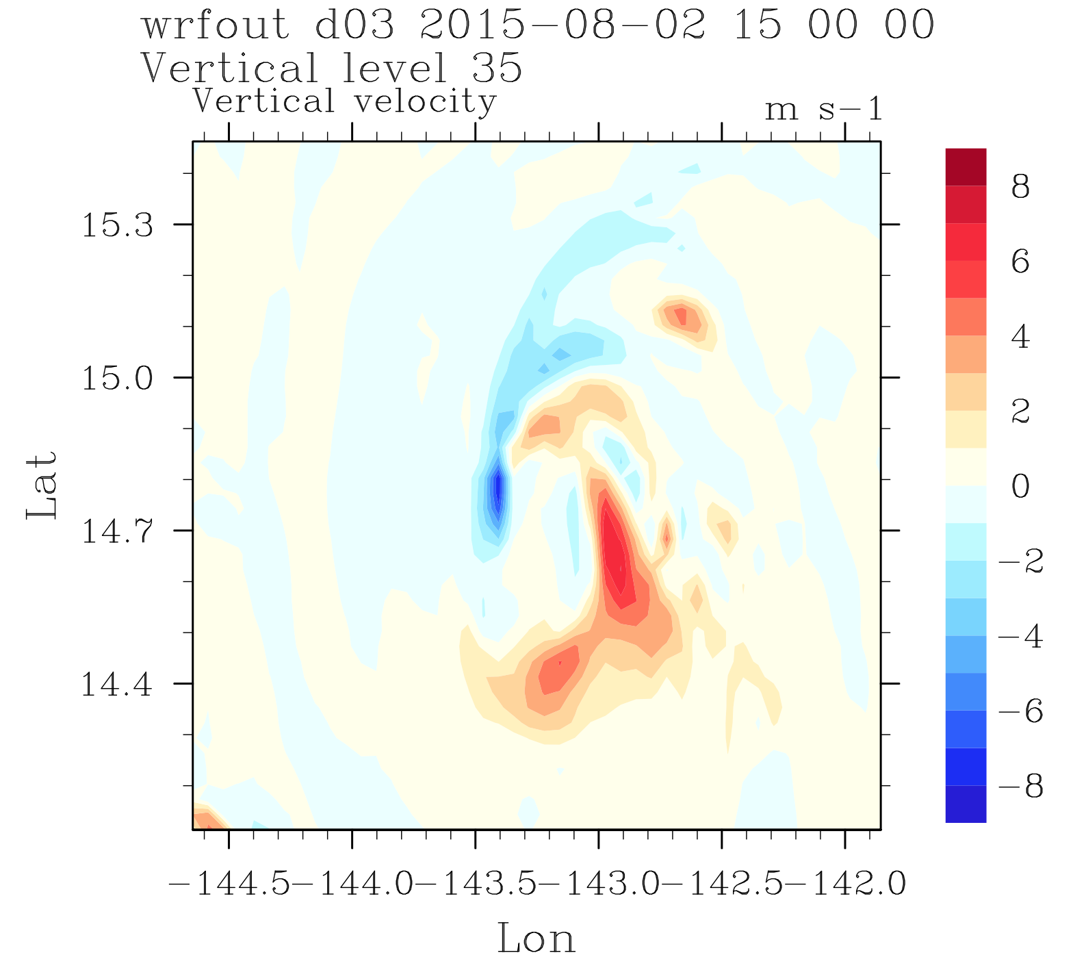
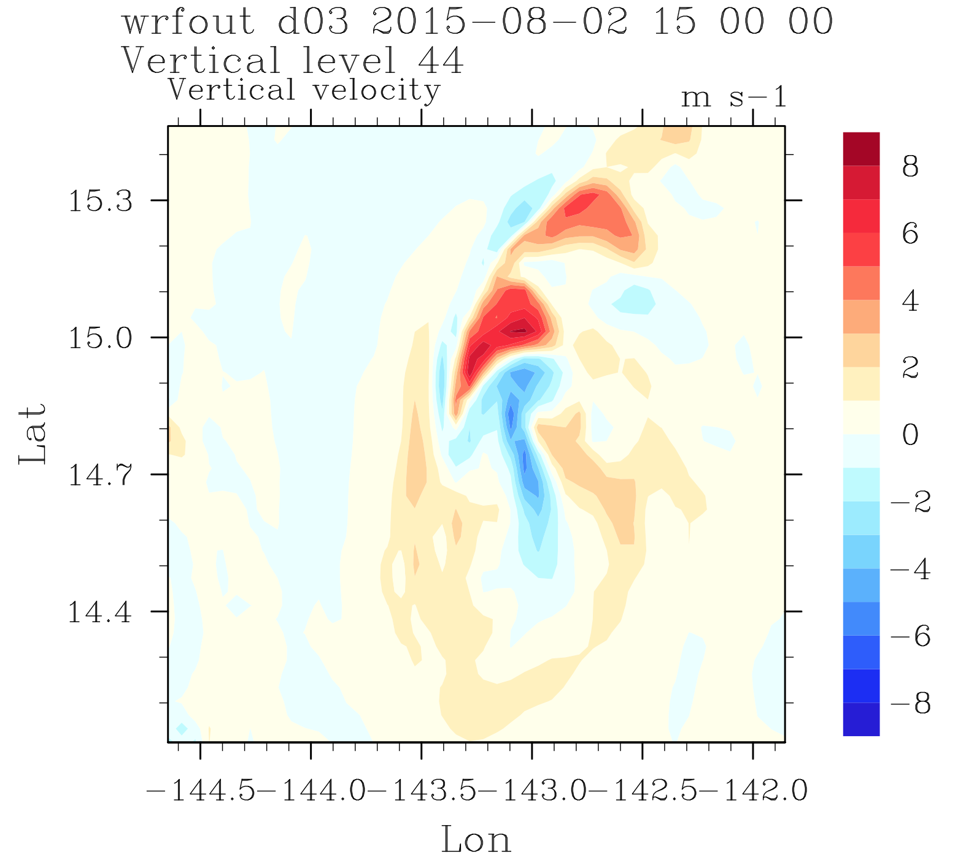
Max in vertical velocity at higher altitude in the hook than in the eyewall

Slide 27
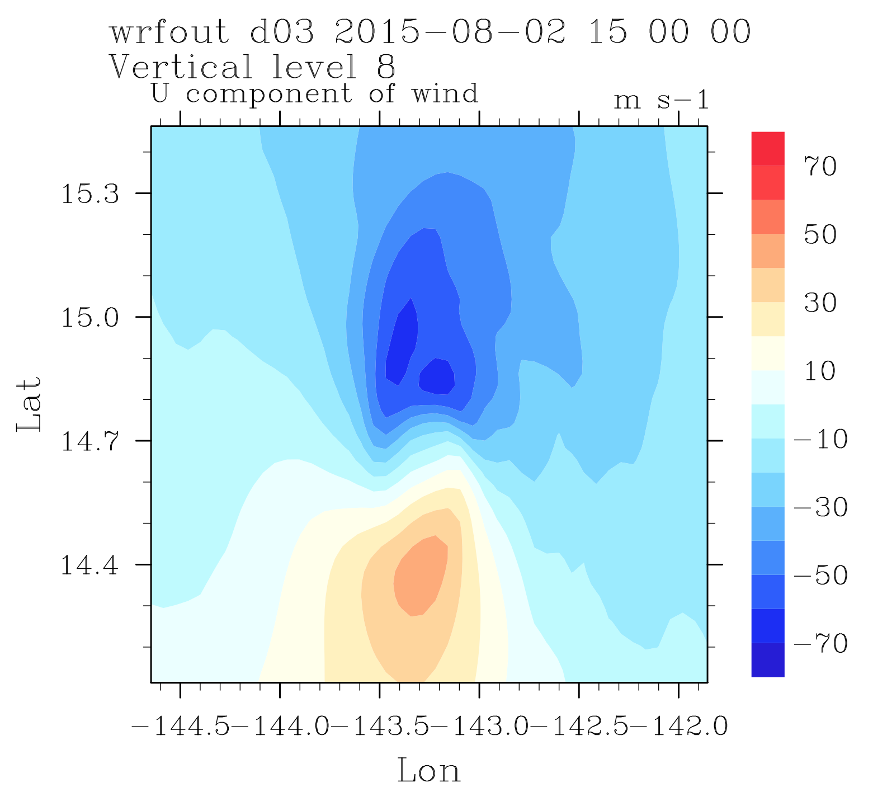
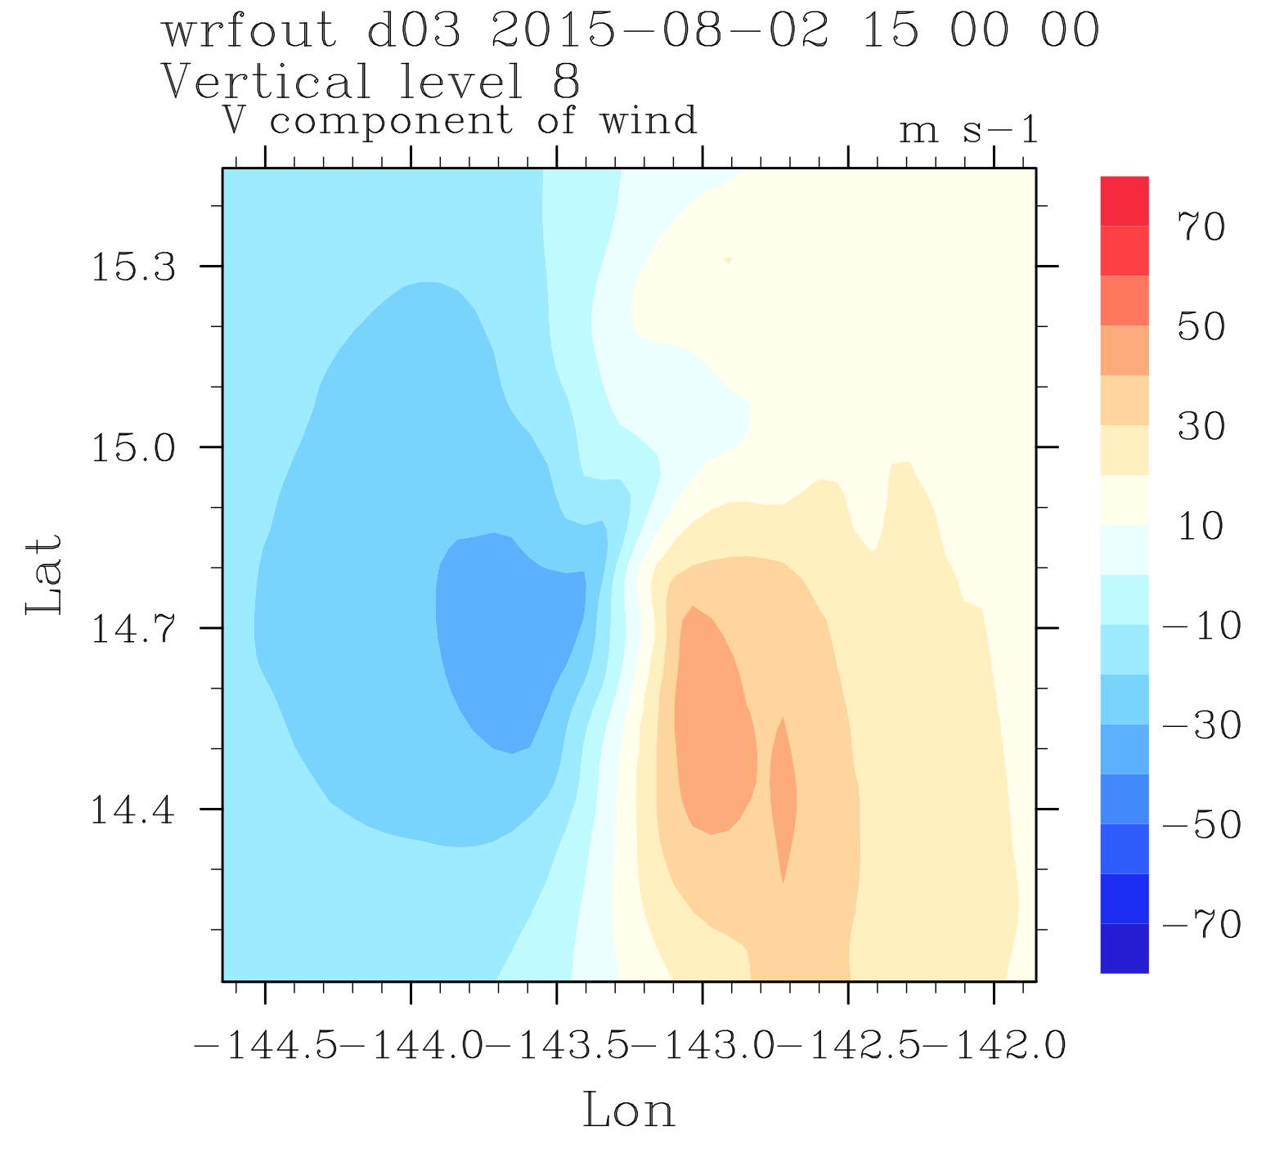
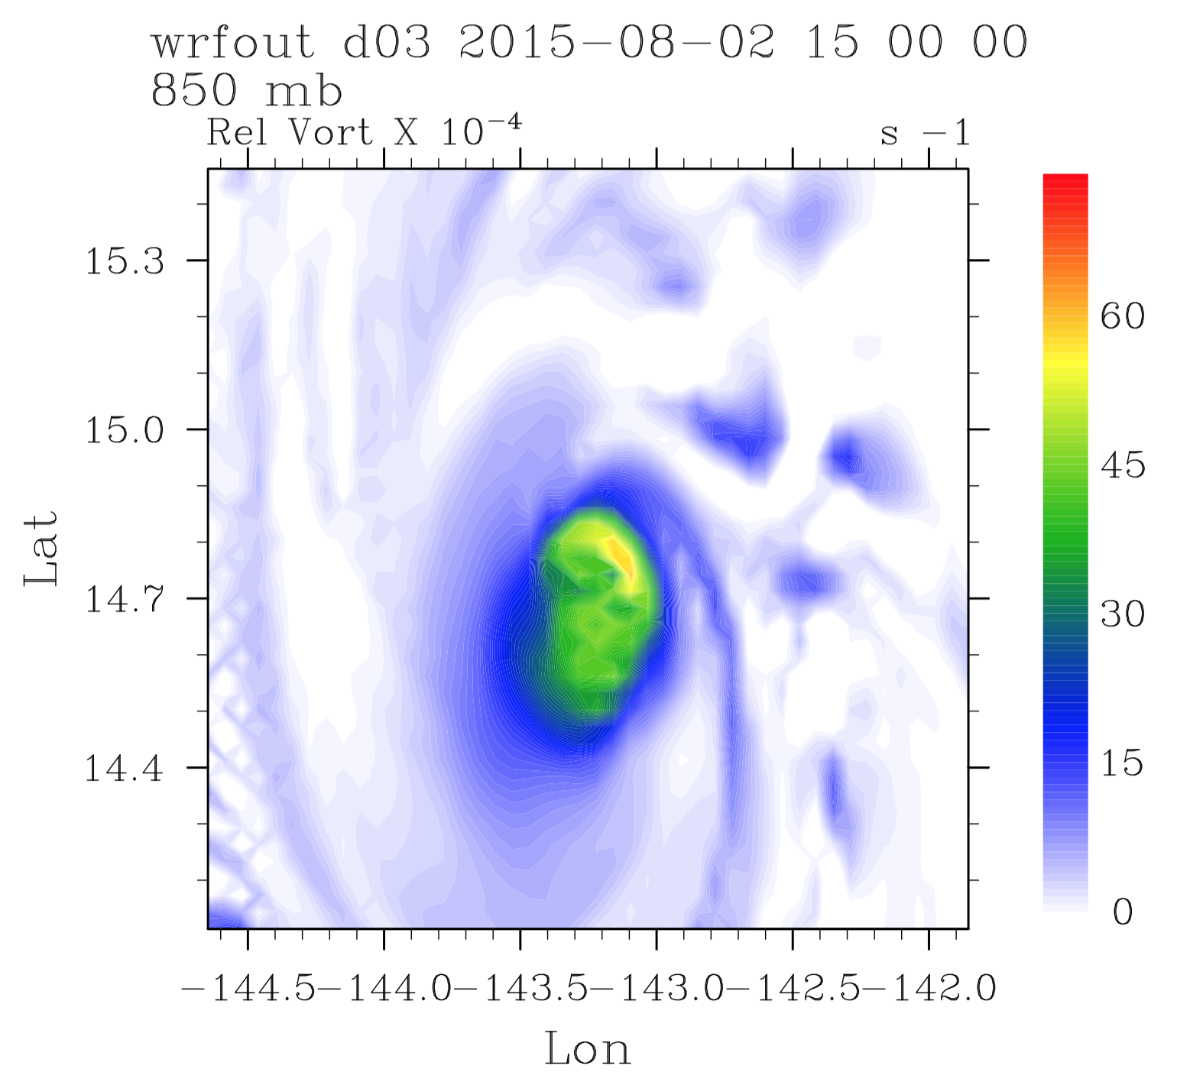
Large winds only in u
(no large vorticity)

Slide 28
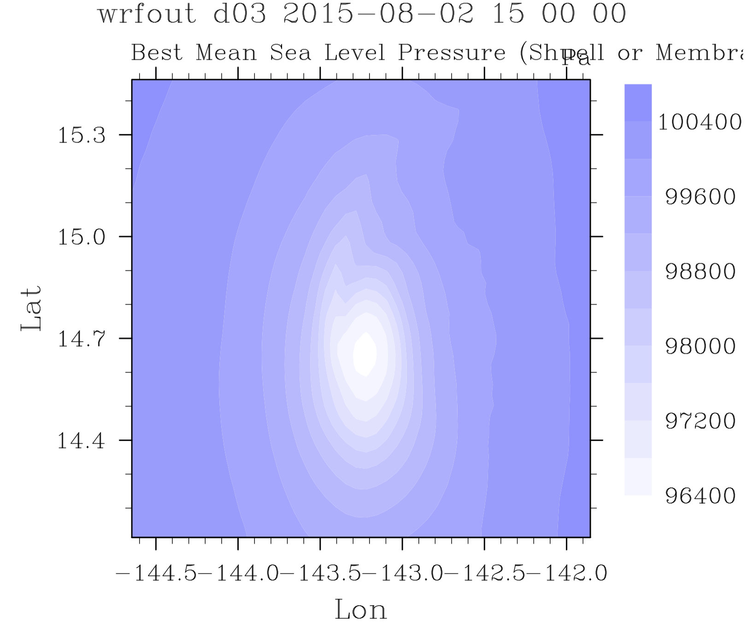
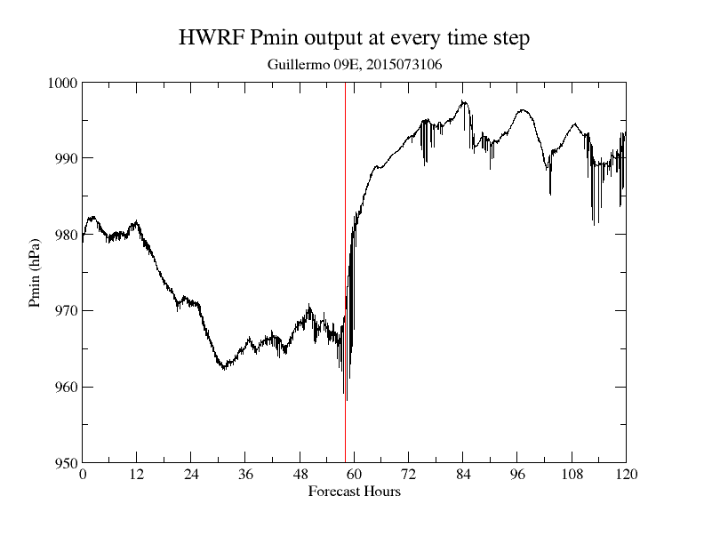
Somebody recommended to show
Mean Sea level pressure,
Not remember what was the point

Slide 29
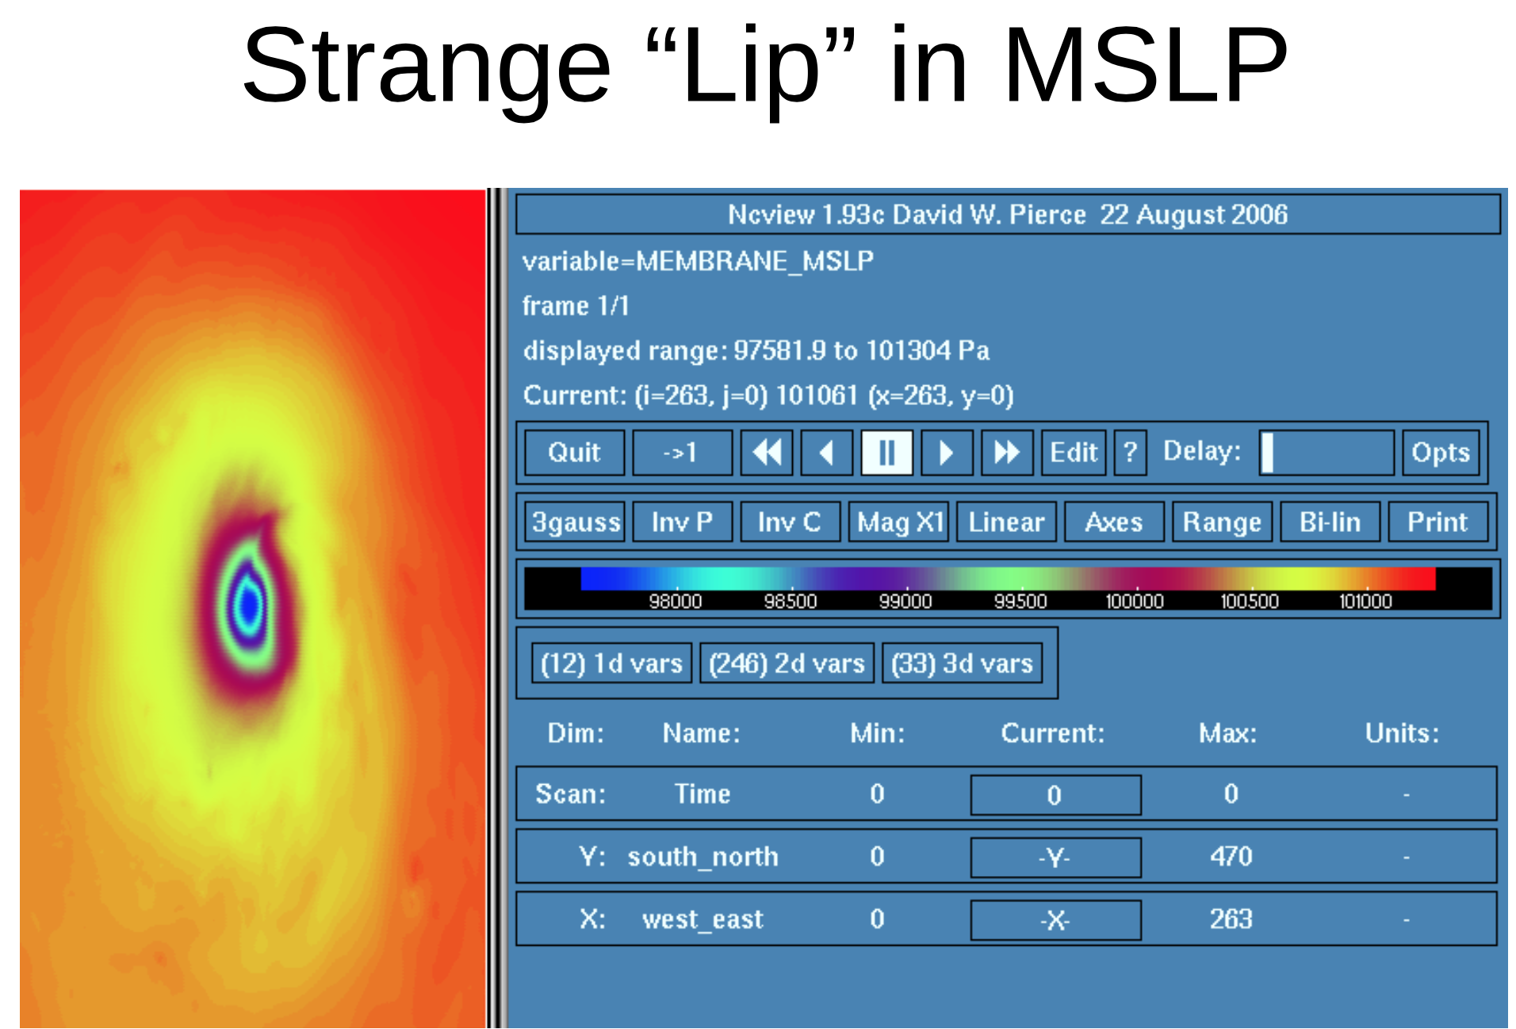

Slide 30
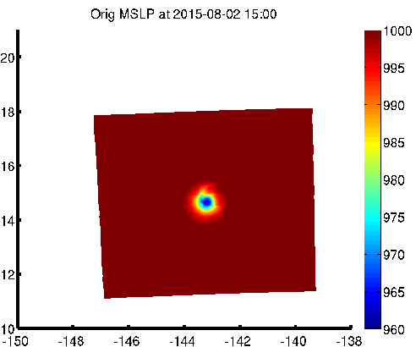
“Lip" of low MSLP reaching North from the west side of the storm's core
http://www.emc.ncep.noaa.gov/HWRF/sam/orig-mslp.gif

Slide 31
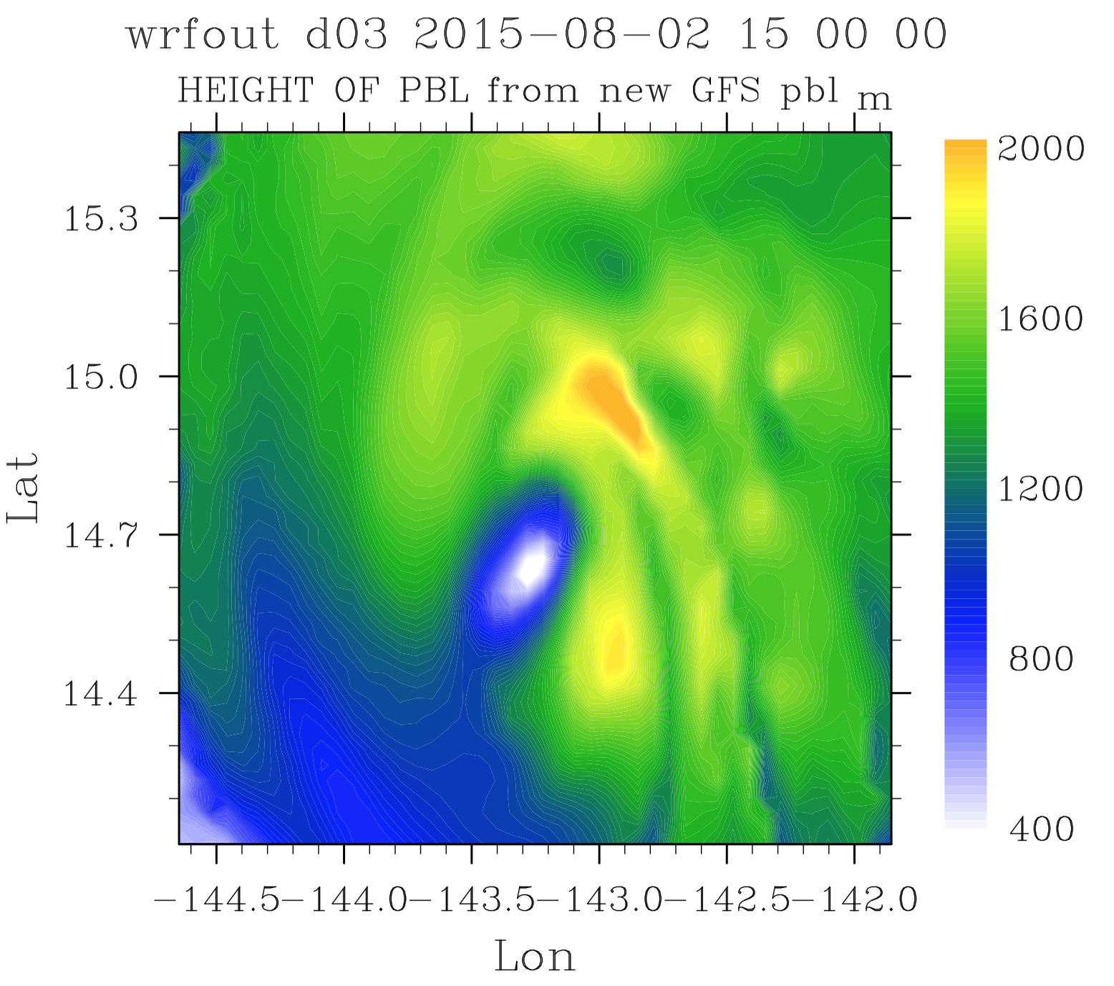
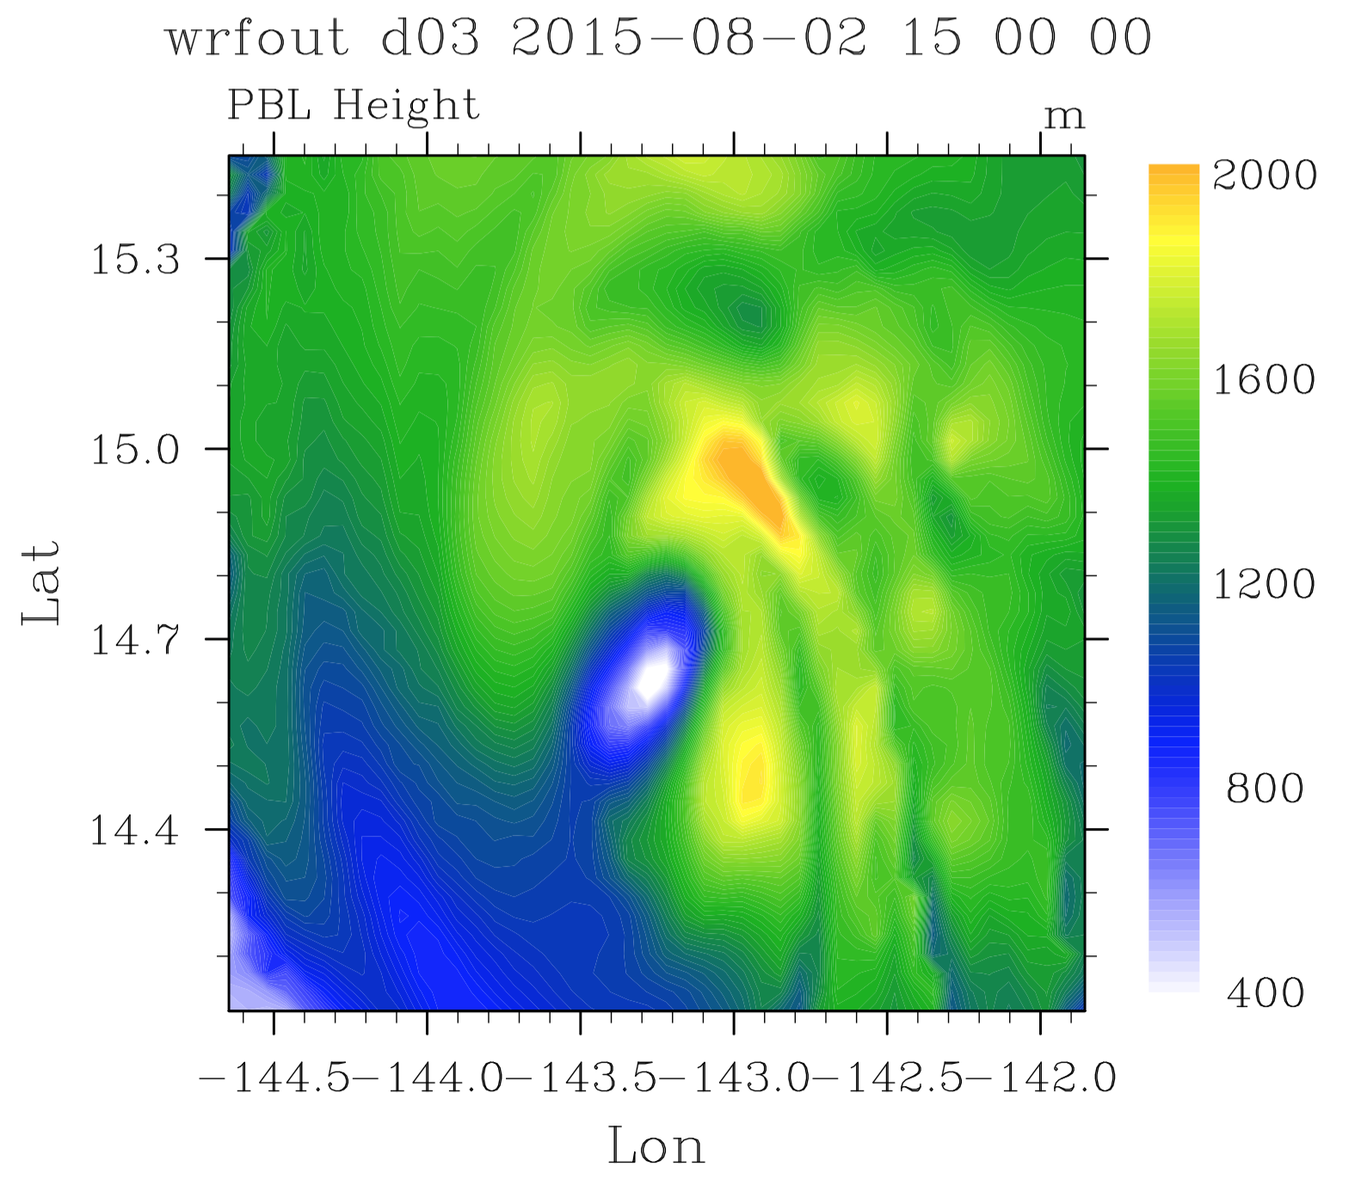
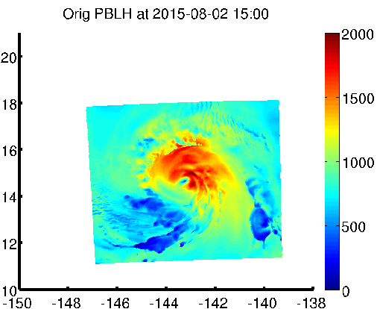
http://www.emc.ncep.noaa.gov/HWRF/sam/orig-pblh.gif
Pbl height

Slide 32
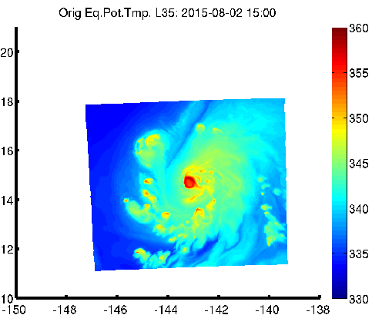
level 35 (~300 mbar)
Dry air mass moving in from the west
http://www.emc.ncep.noaa.gov/HWRF/sam/orig-thetae35.gif

Slide 33
TC-environment interaction

Slide 34
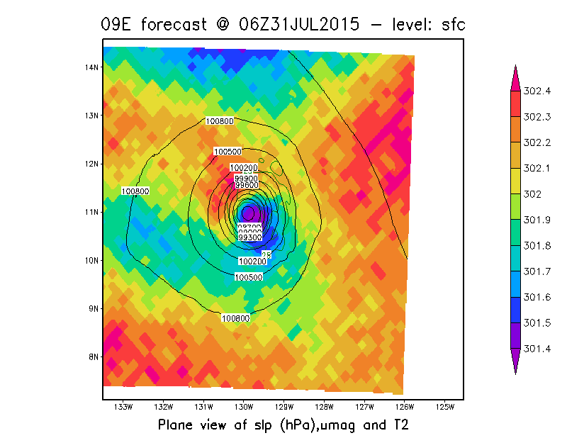
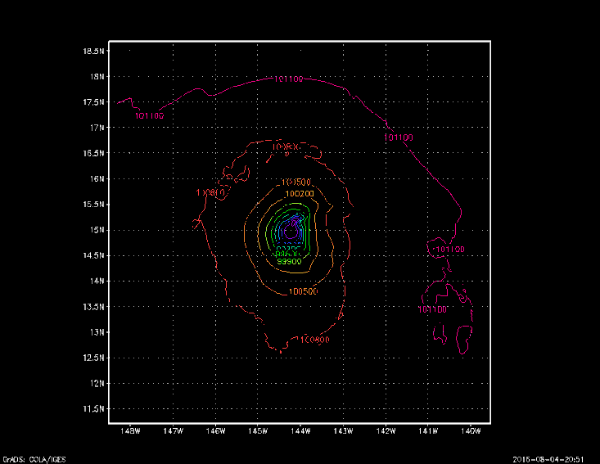
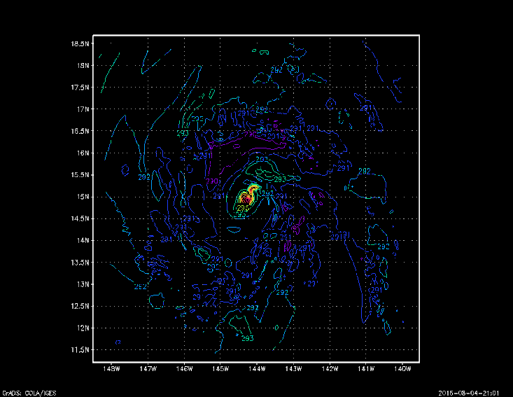
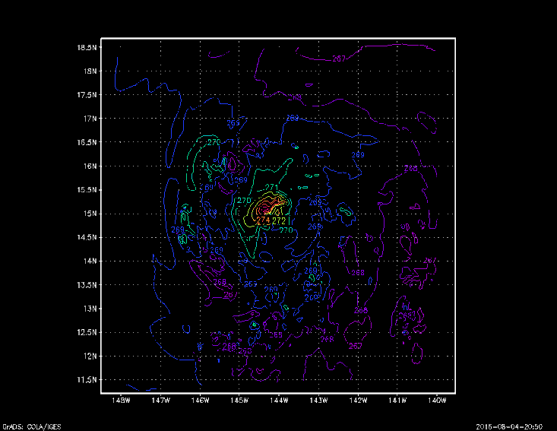
SLP
850hPa Ta
500hPa Ta
SLP and 10-m wind

Slide 35








Slide 36






W-E
S-N
Guillermo09E

Slide 37










Slide 38





Slide 39

Amanda
Different HWRF versions
Similar intensity drop

Slide 40




Amanda01E 2014

Slide 41





Slide 42








Slide 43








W-E
S-N
Amanda01E
W-E
S-N

Slide 44


NMMB for Amanda01E 2014
NMMB MSLP animation

Slide 45








GFDL model
for Amanda01E 2014

Slide 46


Other models

Slide 47
TC Extratropical Transition
A significant number of tropical cyclones move into the mid-latitudes and transform into extratropical cyclones.
This process is generally referred to as extratropical transition (ET).
Tropical cyclones transform into extratropical cyclones as they move northward, usually between 30° and 40° latitude.
During ET a cyclone frequently acquires increased forward motion and sometimes intensify substantially, so that such systems pose a serious threat to land and maritime activities.

Slide 48

From Klein et al. (2000)

Slide 49
From Jones et al. (2003)

Slide 50

VWS in EPAC
http://www.cpc.ncep.noaa.gov/products/assessments/assess_97/fig39.gif

Slide 51
Fixing and discussion

Slide 52
Discussion
To what extent the HWRF simulated hook-shaped SLP associated with strong winds could be realistic?
  A. May happen in the real world
  B. Partly realistic, but HWRF has it too dramatic
  C. Could not happen in real world, totally artificial
  High resolution observations for TCs when it entering strong vertical wind shear areas are urgently needed to confirm these fine structure features

Slide 53
Discussion (cont.)
If these features are partly or totally artificial, what could be the causes of these?
  A. Dynamical cores (maybe diffusions as well)
  B. Physical Parameterization schemes (likely)
    Microphysics scheme, convection scheme, PBL scheme, Radiation scheme
    Sam also has done some experiments with several combinations
  C. Physical Parameterization schemes (less likely)
    surface layer, ocean coupling, LSM
  D. Domain nesting techniques/model time steps
    Samuel has fixed a bug to retain non-hydrostatic status for the nested domain interior when the nests move. This alleviates the strong hook-shaped SLP feature for 09E. Besides, these features still exists in other storms, e.g. 01E2014.

Slide 54


Slide 55


Absence of the
extreme weakening!
But the feature remains =(

Slide 56


AFTER THE FIX (trunk, short timestep, keep non-hydrostatic state):
Level 35 (~300 mbar)
Largely axisymmetric
MSLP
The dry air mass from the
West slowly spiraling in
http://www.emc.ncep.noaa.gov/HWRF/sam/keepnh-thetae35.gif
http://www.emc.ncep.noaa.gov/HWRF/sam/keepnh-mslp.gif

Slide 58




Slide 59


Non-Hydrostatic state retention
  Alleviates Guillermo’s intensity drop but problem seem to still be present to an extent

Slide 60
Discussion (cont.)
Could these processes happen in low latitudes (10-20N) in EPAC be explained by Extratropical Transition? To what extent?

Slide 61
Thank you!

Slide 62
Useful links
HWRF forecasts for Guillermo09E and Amanda01E2014
  http://www.emc.ncep.noaa.gov/gc_wmb/vxt/HWRF/tcall.php?selectYear=2015&selectBasin=Eastern%20North%20Pacific&selectStorm=GUILLERMO09E
  http://www.emc.ncep.noaa.gov/gc_wmb/vxt/HWRF/tcall.php?selectYear=2014&selectBasin=Eastern+North+Pacific&selectStorm=AMANDA01E
HWRF forecasts for Guillermo09E and Amanda01E2014, with moving nesting bug fix and smaller time step
  http://www.emc.ncep.noaa.gov/gc_wmb/vxt/webHTST-coupled/tcall.php?selectYear=2015&selectBasin=Eastern%20North%20Pacific&selectStorm=INVEST09E
  http://www.emc.ncep.noaa.gov/gc_wmb/vxt/webHTST-coupled/tcall.php?selectYear=2015&selectBasin=Eastern%20North%20Pacific&selectStorm=AMANDA01E
Some animations with smaller output time step
  http://www.emc.ncep.noaa.gov/HWRF/sam/
NMMB simulation for Amanda01E2014
  ftp://ftp.emc.ncep.noaa.gov/mmb/wd20ww/cp-tmp/201401e/
Some more diagnoses for these two storms
  http://www.emc.ncep.noaa.gov/gc_wmb/vxt/bliu/

Slide 63


Hurricane Guillermon 09E, 2015073106
The deterministic version of HWRF-EPS (HW00: blue line) had a similar “rapid weakening” as operational HWRF (purple line), but at different time: 36h for HW00 vs 60h for HWRF.
BEST track

Slide 64

Intensity Forecasts from individual Ensemble Members
Most of members that have stronger intensities experienced “RW” at different forecast hours.
The impact was smoothed out in ensemble mean

Slide 65
Discussion
Identified through rapid intensity changes a feature in HWRF that:
  Can hold the maximum winds and be associated to extreme intensity fluctuations (mostly weakening)
  Is nearby but radially outside the eyewall
  May cause the vortex to collapse
  Mostly (but not exclusively) in strong storms
  Seem to be present in presence of large VWS

Slide 66
TC ET
Interaction with upper-level troughs or shortwaves in the westelies, and preexisting baroclinic zones is an important factor in ET.
During extratropical transition, cyclones begin to tilt back into the colder airmass with height, and the cyclone's primary energy source converts from the release of latent heat from condensation (from convection near the center) to baroclinic processes.
The low pressure system eventually loses its warm core and becomes a cold-core system. During this process, a cyclone in extratropical transition will invariably form or connect with nearby fronts and/or troughs. Due to this, the size of the system will usually appear to increase. After or during transition, the storm may re-strengthen, deriving energy from primarily baroclinic processes, aided by the release of latent heat.
The cyclone will also distort in shape, becoming less symmetric with time, but sometimes retains a tight, tropical-like core.

Slide 67
Impacts of ET
Severe flooding associated with the ET of Tropical Storm Agnes [1972
Hurricane Hazel (1954) resulted in 83 deaths in the Toronto area of southern Ontario, Canada. In the northwest Pacific, severe flooding and landslides have occurred in association with ET.
An example is the ET of Tropical Storm Janis (1995) over Korea, in which at least 45 people died and 22 000 people were left homeless.
In one southwest Pacific ET event (Cyclone Bola) over 900 mm of rain fell over northern New Zealand).
Another event brought winds gusting to 75 m s-1 to New Zealand's capital city, Wellington (Hill 1970 ), resulting in the loss of 51 lives when a ferry capsized.
Extratropical transition has produced a number of weather-related disasters in eastern Australia, due to severe flooding, strong winds, and heavy seas [e.g., Cyclone Wanda in 1974).
Tropical systems that reintensify after ET in the North Atlantic constitute a hazard for Canada [e.g., Hurricane Earl in 1998 and for northwest Europe. The extratropical system that developed from Hurricane Lili (1996) was responsible for seven deaths and substantial economic losses in Europe.
Many of the largest NW windstorms are ET events (Columbus Day Storm, 1981 storm and others)
http://hwe.niwa.co.nz/event/April_1968_New_Zealand_Ex-tropical_Cyclone_Giselle

