Slide 1
Preliminary results of coupled HWRF-HYCOM near real-time forecasts
for W. Pacific
Outline:
Verification
Forecast analysis of super Typhoon Jelawat (18w) and Soulik (07w)
Ocean diagnostics graphics (examples)
Thursday August 1, 2013

Slide 2
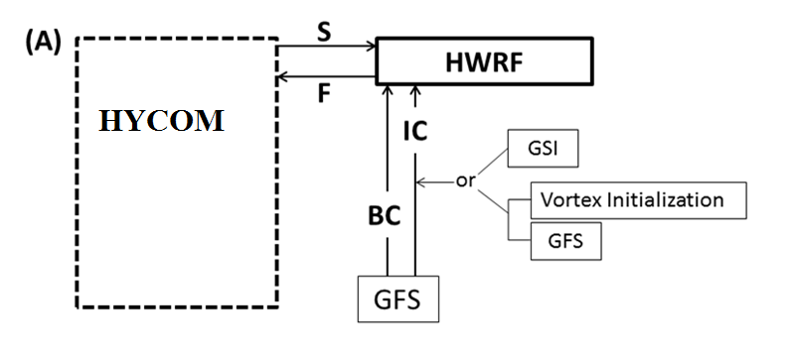
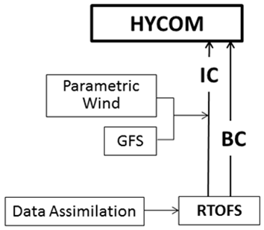
Hurricane Weather Research Forecast model (HWRF) coupled eddy-resolving 3D HYCOM
HYCOM:
IC/BC – real-time & data assimilated fields
dx/dy=9km
32 hybrid layers
Relatively finer resolution of MLD - 1 m (top), 4 m (2nd), …
KPP mixing

Slide 3
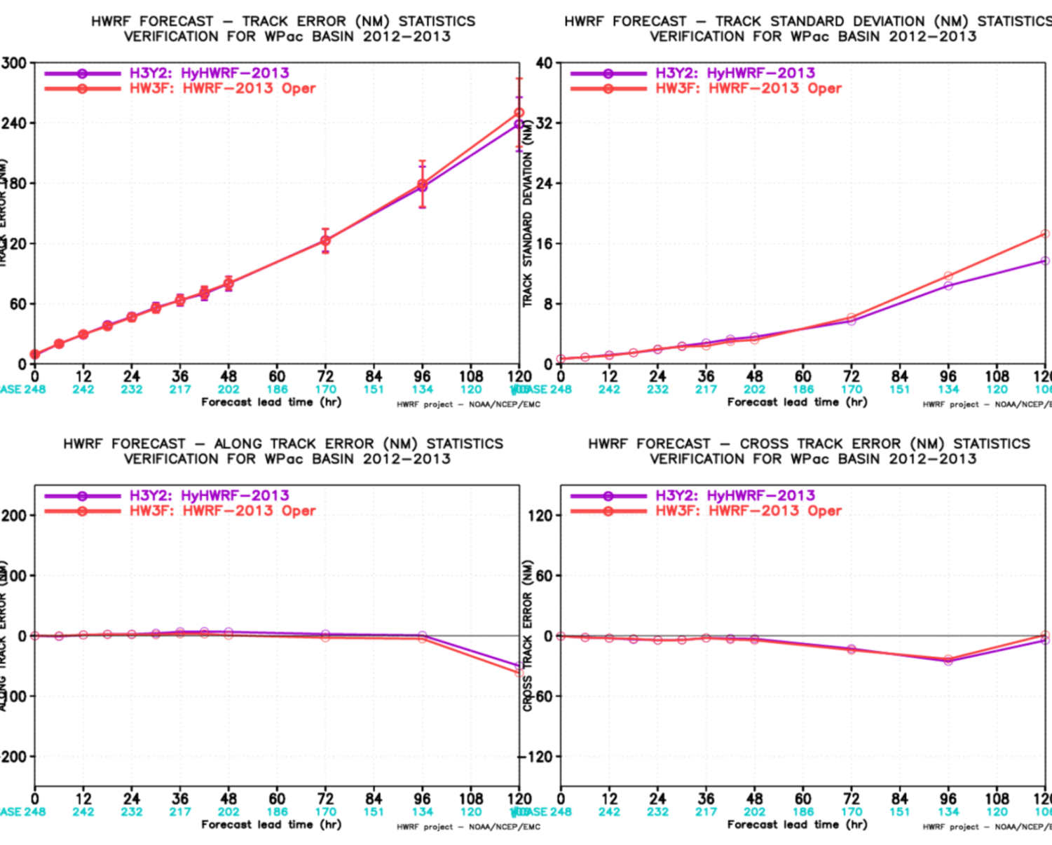
Typhoon Forecasts for 2012-2013: Track (248 cases)
2012: Guchol (05w), Talim (06w), Saola (10w), Tembin (15w), Bolaven (16w), Sanba (17w), Jelawat (18w)
2013: Yagi (03w), Rumbia (06w), Soulik (07w), Cimaron (08w)
5 Super-Typhoons (underlined) =
4 (2012) + 1 (2013)
Error
STD
HWRF-HYCOM (purple)
HWRF (red)
Better skill from 96-h onward, but little difference elsewhere.
Along Track Error
Cross Track Error

Slide 4
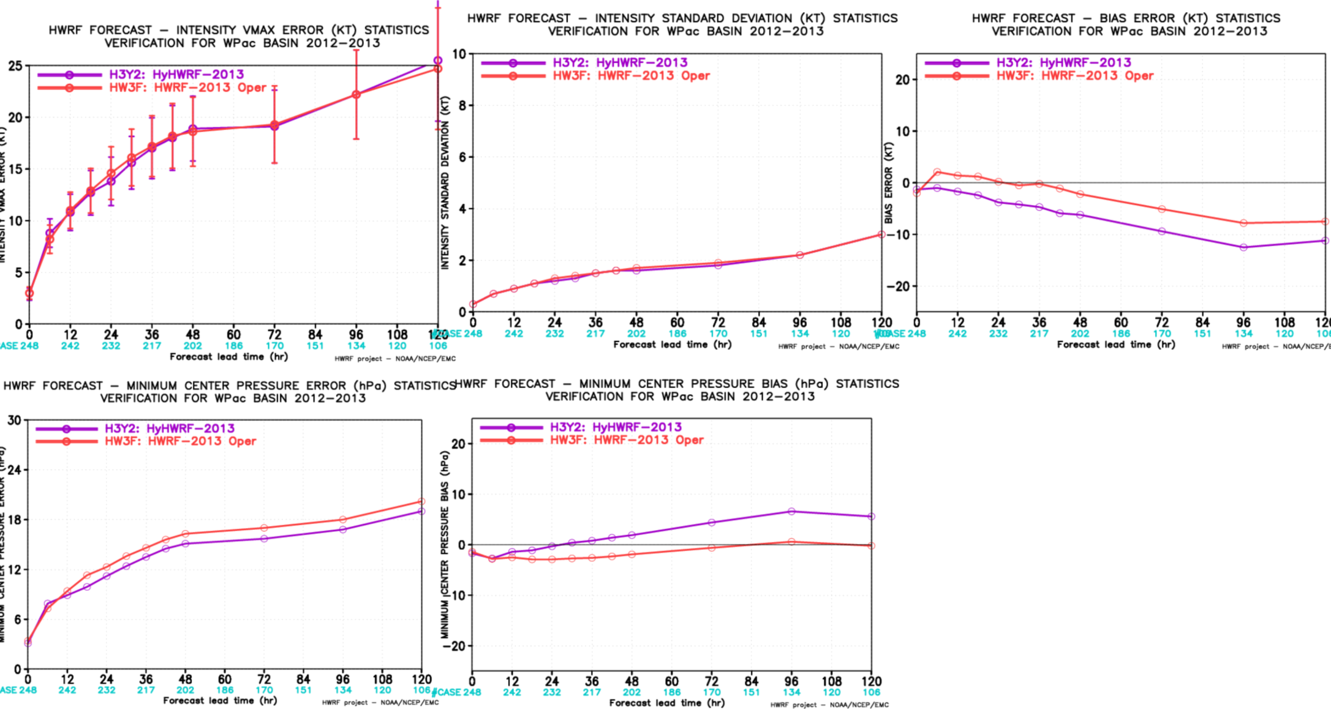
Typhoon Forecasts for 2012-2013: Intensity (248 cases)
Bias error in Vmax
Vmax STD
Vmax error
HWRF-HYCOM (purple)
HWRF (red)
More negative bias error in Vmax.
Lower Pmin and higher Pmin bias.
Pmin error
Pmin bias
Bias error in Vmax and bias in Pmin are mainly contributed by the 2012 cases.

Slide 5
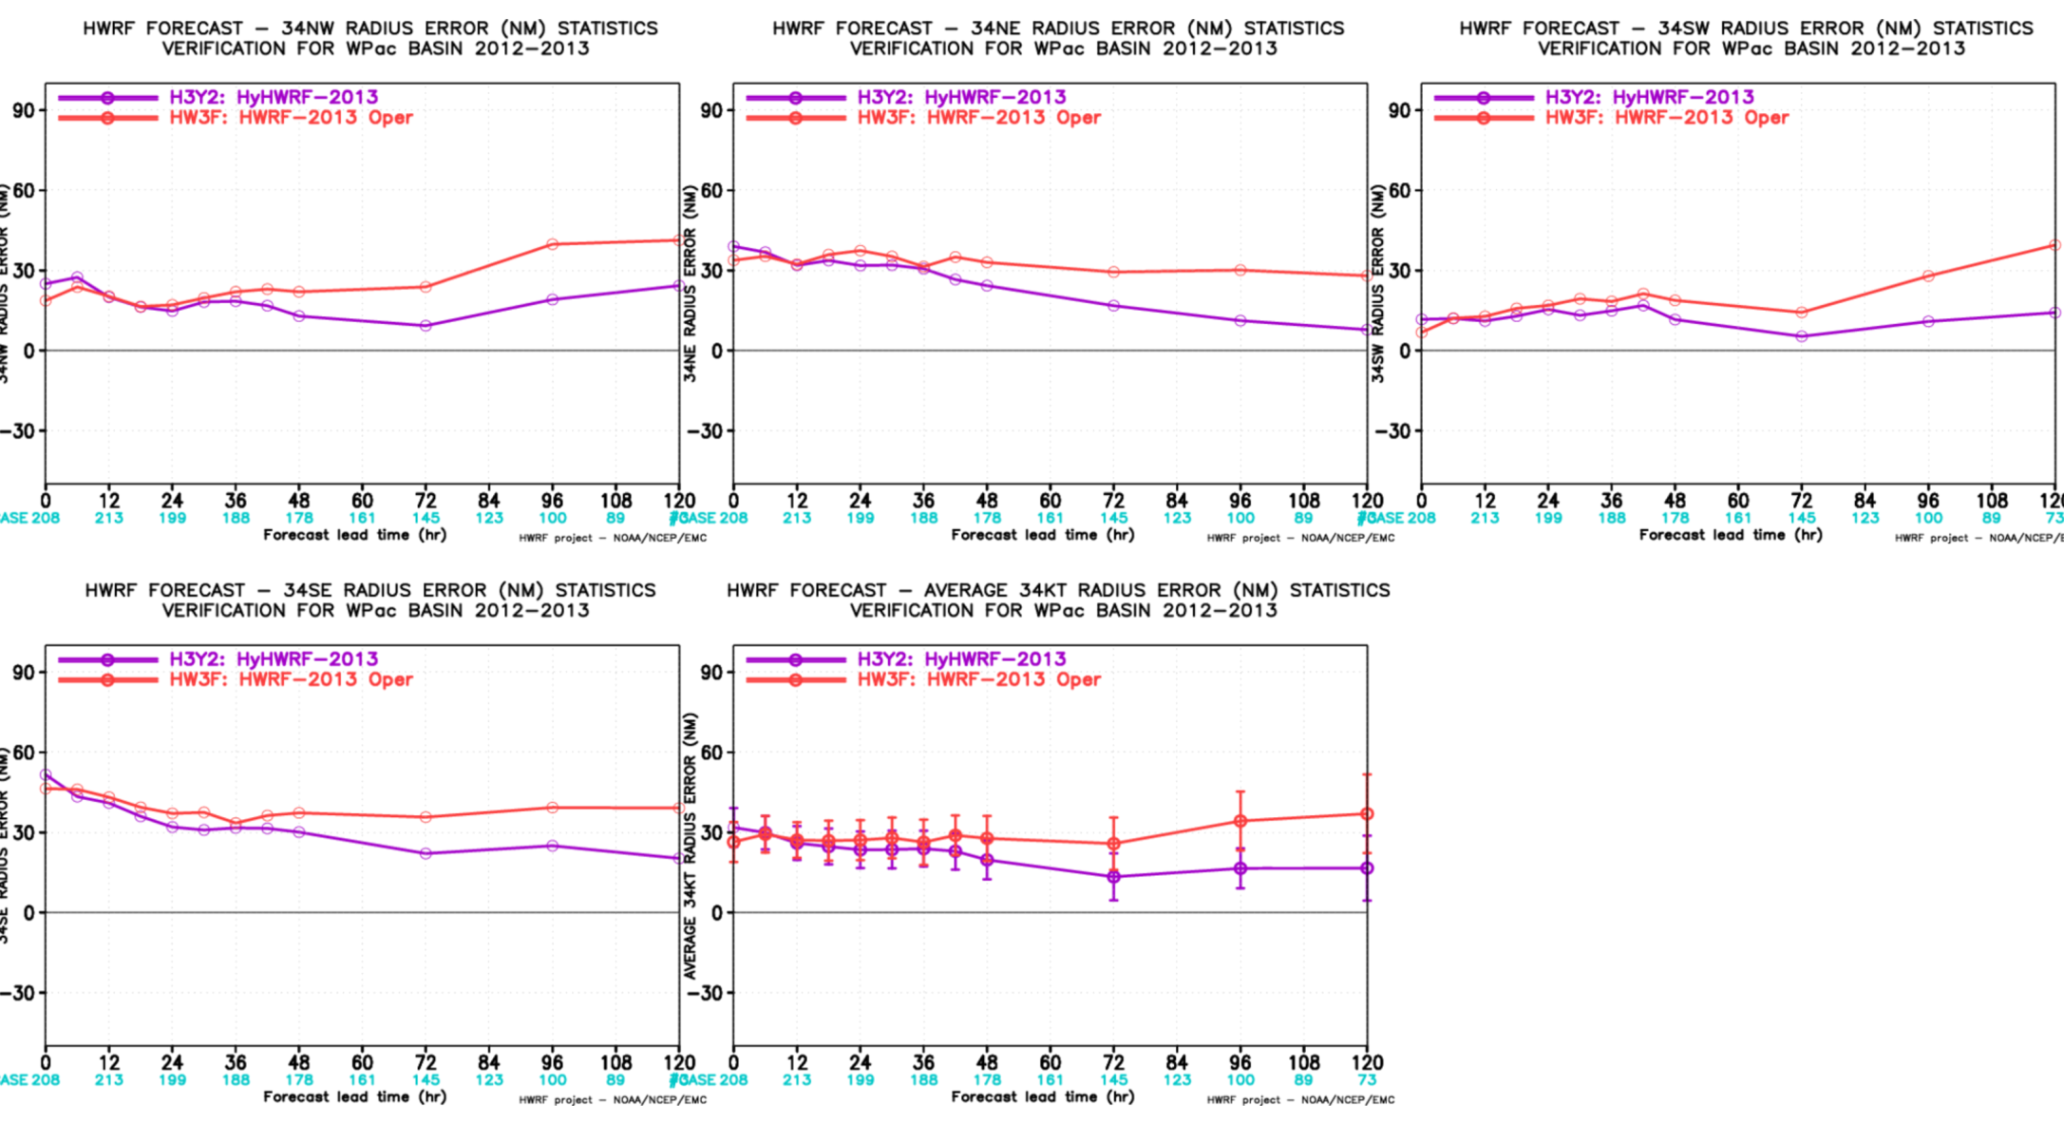
Typhoon Forecasts for 2012 and 2013: 34-kt Radius
NW
NE
SW
Smaller 34-kt Ri, especially later forecast hours
34-kt Ri decreases with time
Asymmetric: Smaller on the SW quadrant
SE
average

Slide 6
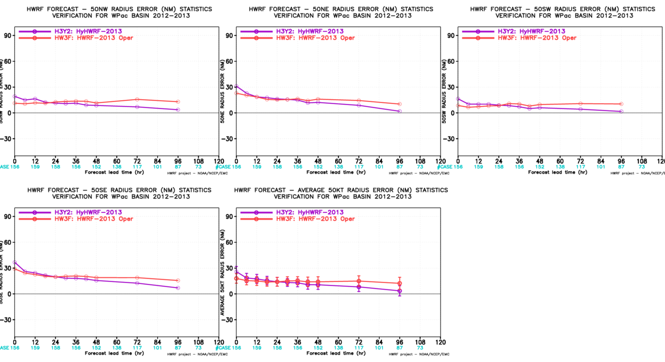
Typhoon Forecasts for 2012 and 2013: 50-kt Radius
NW
NE
SW
50-kt Ri decreases in time
Rapid decrease < 12-h. ➔ more contracting outer radius.
Asymmetric: Smaller on the NW/SW quadrants
SE
average
Note: Verification of 65-kt Ri is similar to 50-kt RI

Slide 7
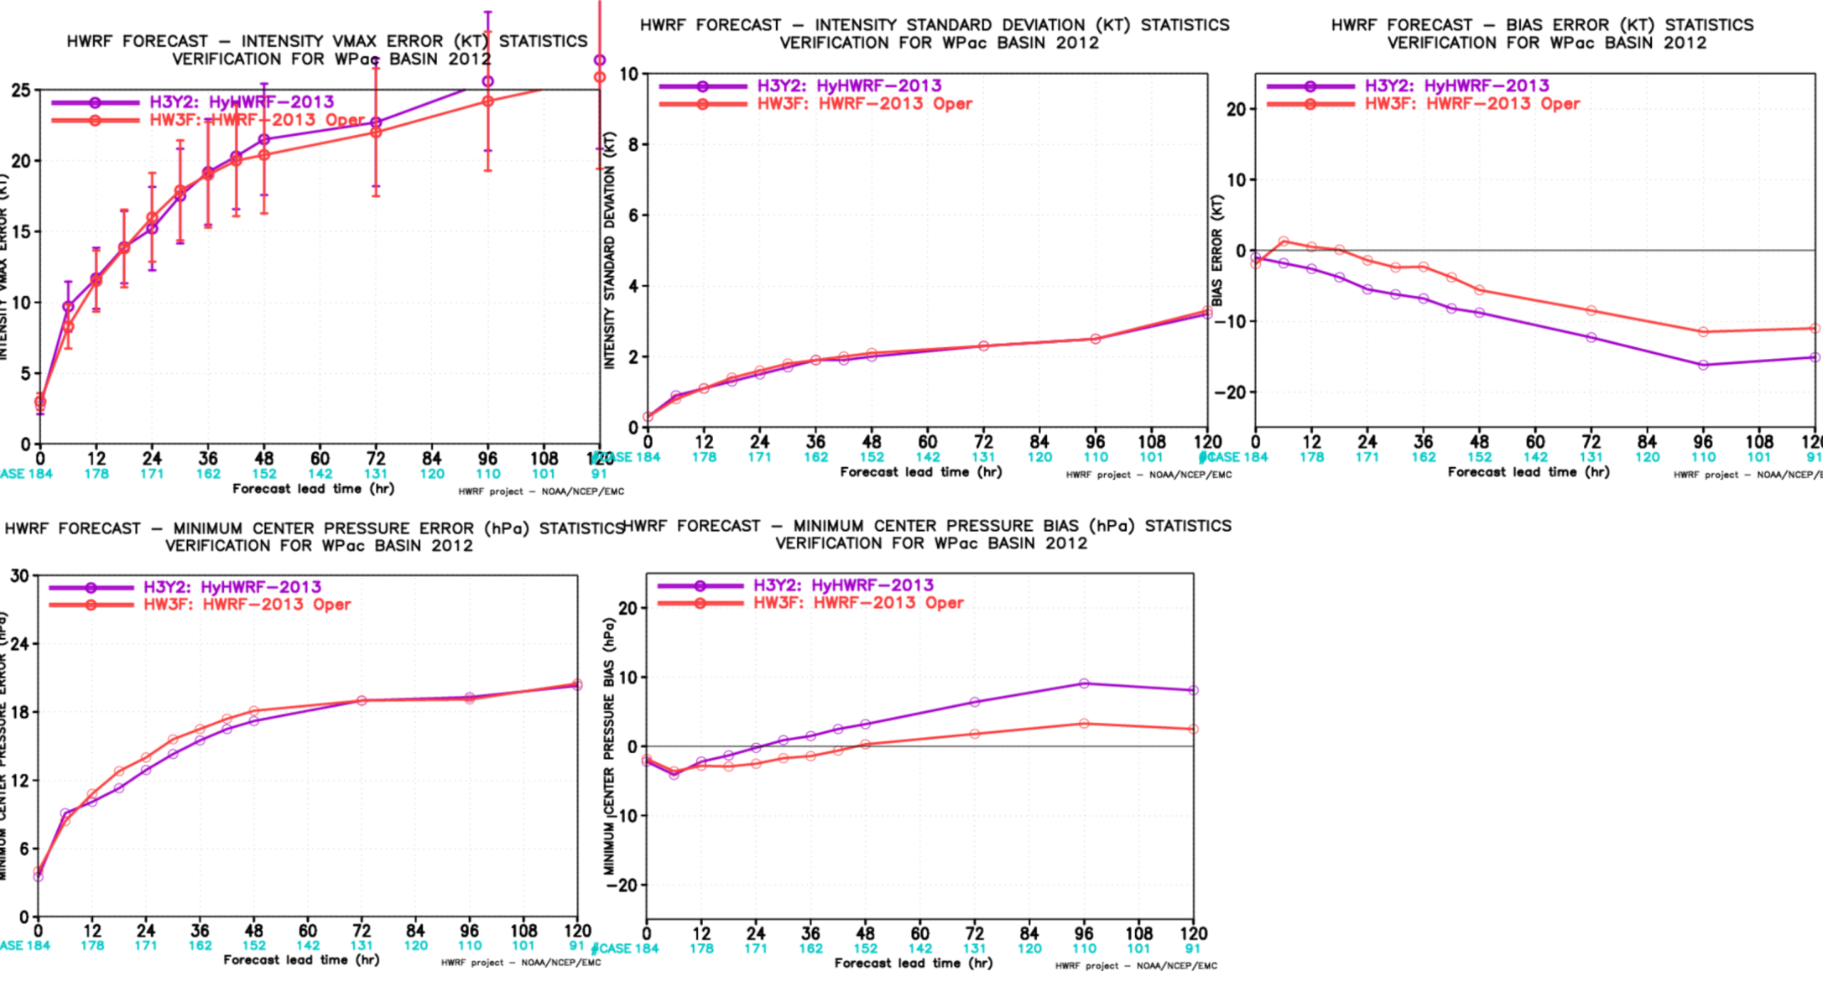
Typhoon Forecasts for 2012: Intensity (184 cases)
Bias error in Vmax
Vmax STD
Vmax error
Vmax:
STD is almost identical;
Positive error and more negative bias error
Pmin error
Pmin bias
Pmin:
Smaller error for forecast hours 12-60;
Error changes at 24-h from negative to positive.

Slide 8
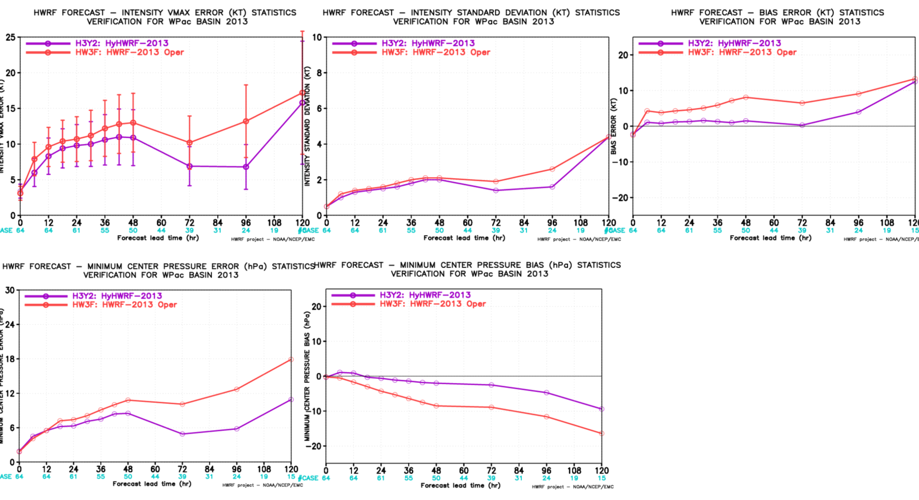
Typhoon Forecasts for 2013: Intensity (64 cases)
Vmax error
Vmax std
Bias error in Vmax
Vmax and Pmin:
Better forecast skill.
Is this because # of cases is smaller, the storms are weak, or their track would be matter?
Pmin bias
Pmin error

Slide 9
Analysis of the 2012-2013 Typhoon Forecasts
(coupled) HWRF-HYCOM compared to (non-coupled) HWRF:
Smaller storm size on average, and Contracting with time.
Asymmetric wind pattern.
Slower translation speed (see later)
Lower surface enthalpy (see later)
HYCOM SST cooler than GFS (see later)
Meso-scale dominant (see later)
Next Slides
Analysis – Jelawat (18W) and Soulik (07W).

Slide 10
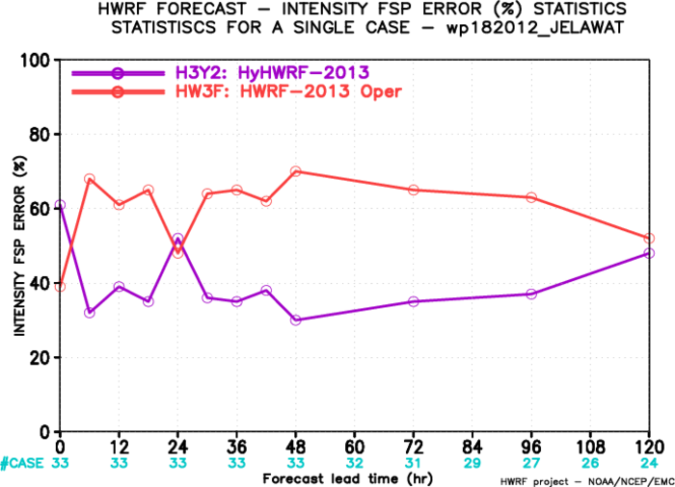
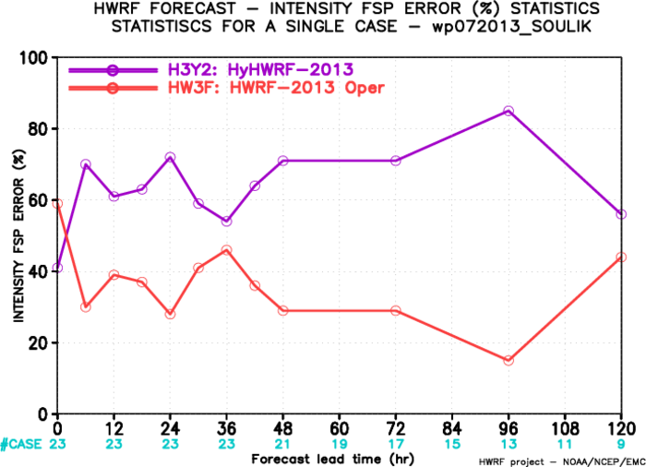
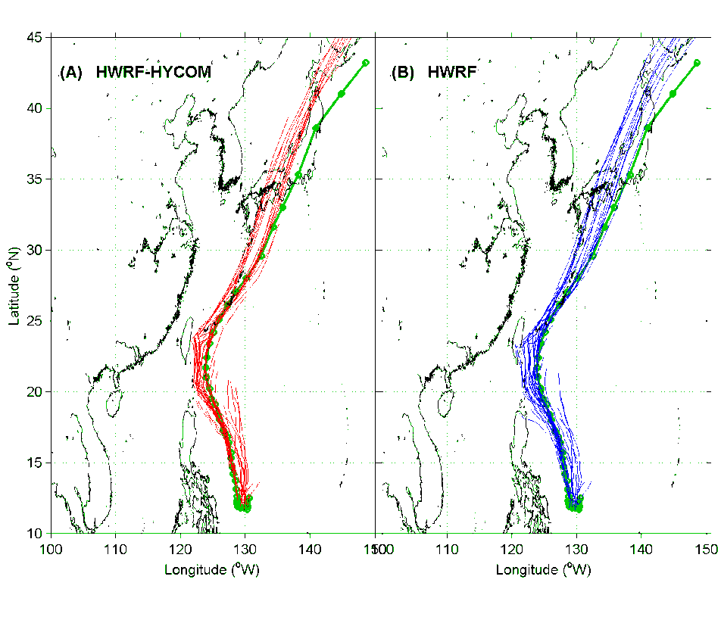
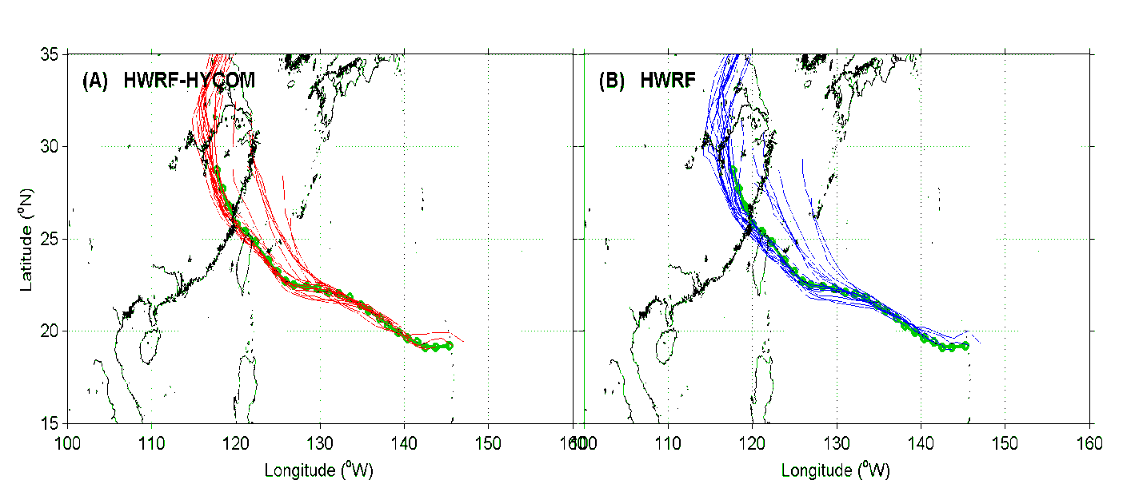
The worst and best case
Super Typhoon 5 (jelawat) for 5-days; and 4 (soulik) for 6-hrs.
Different tracks
Soulik over warm water
Jelawat from warm to cold (similar to Guchol, Bolaven and Sanba)
Worst – Jelawat 18W Best – Soulik 07W

Slide 11
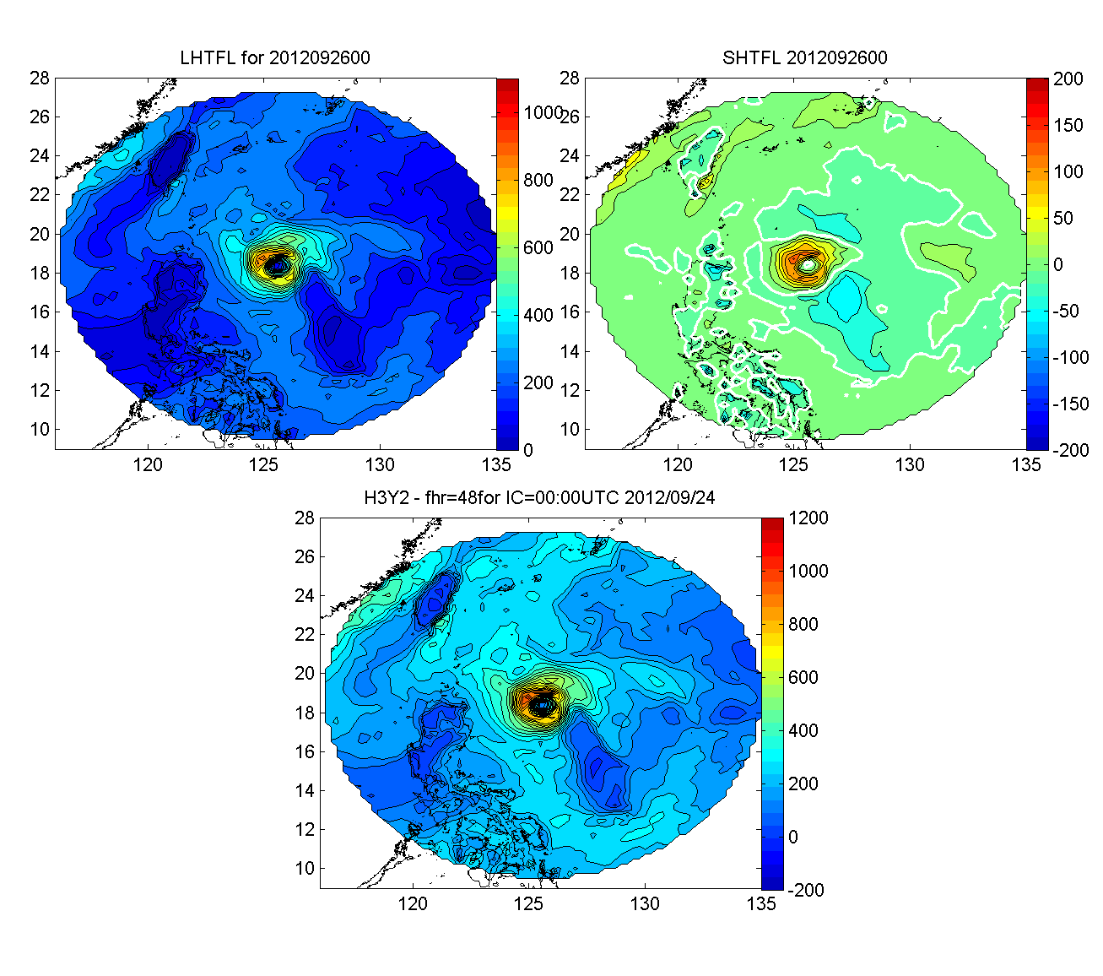
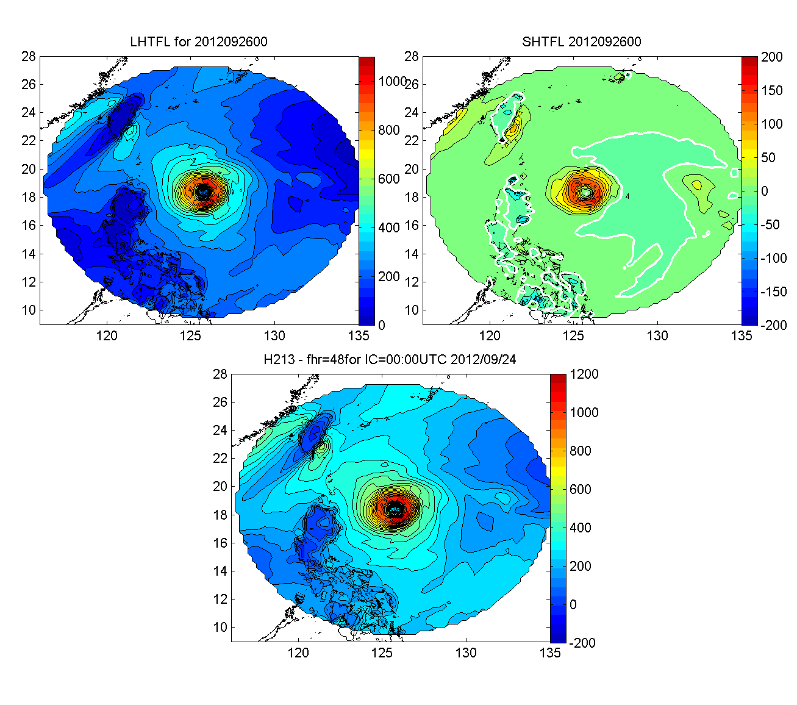
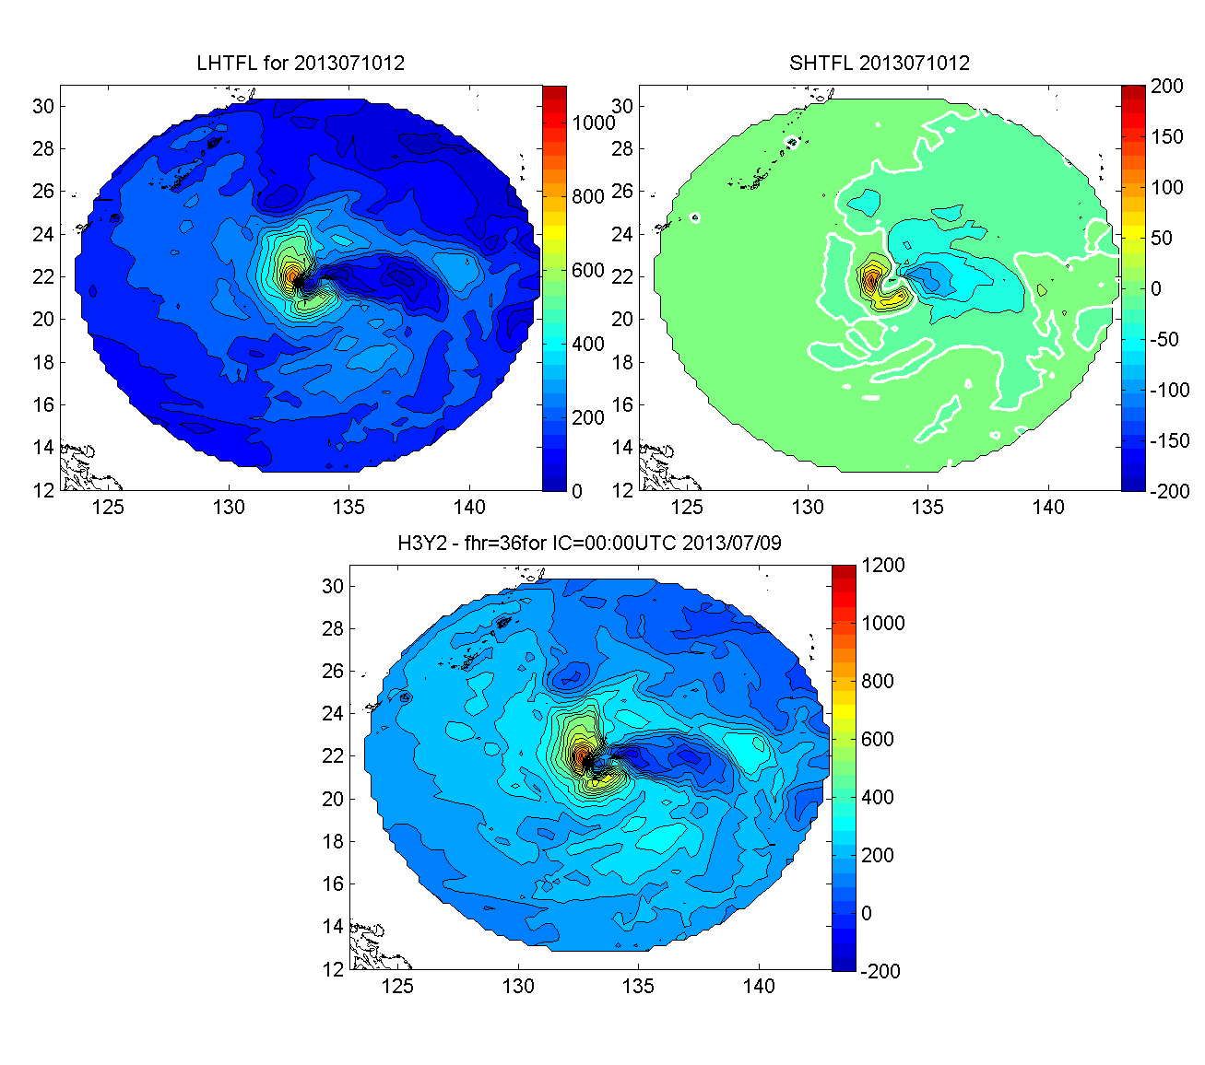
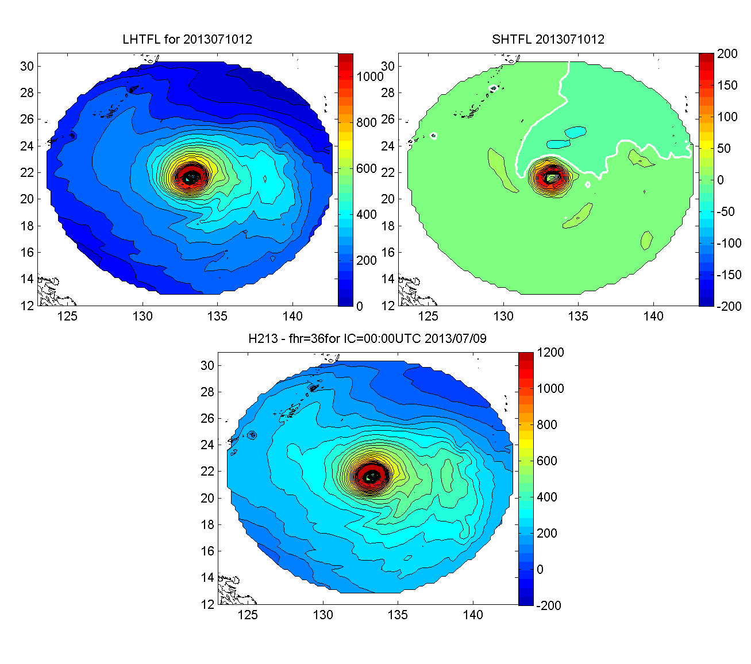
1-2. Storm size and asymetric wind pattern
Each panel has:
LHT (top left) 0~1100;
SHT (top right) -200~200;
LHT+SHT (bottom) -200~1200
HWRF-HYCOM HWRF
Jelawat 18W
In addition to the size and pattern difference, the heat flux magnitude is different: HWRF-HYCOM – lower than HWRF
(details later).
This is an example, but what mentioned above are common.
Soulik 07W

Slide 12
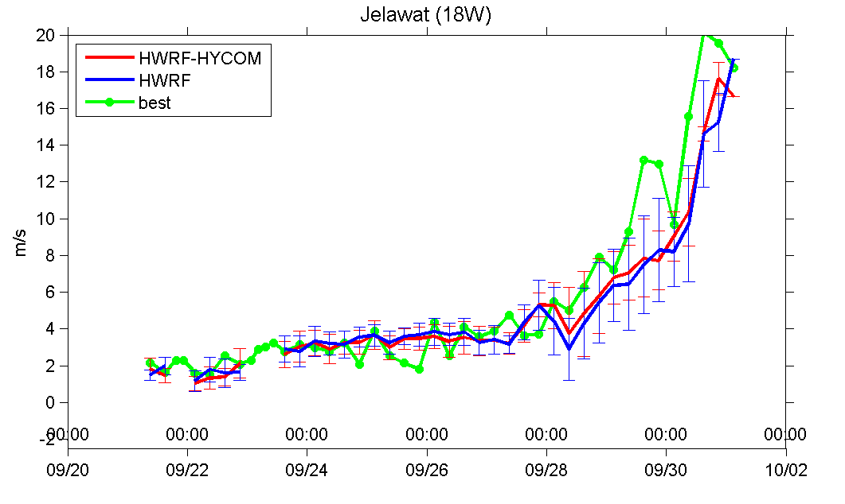
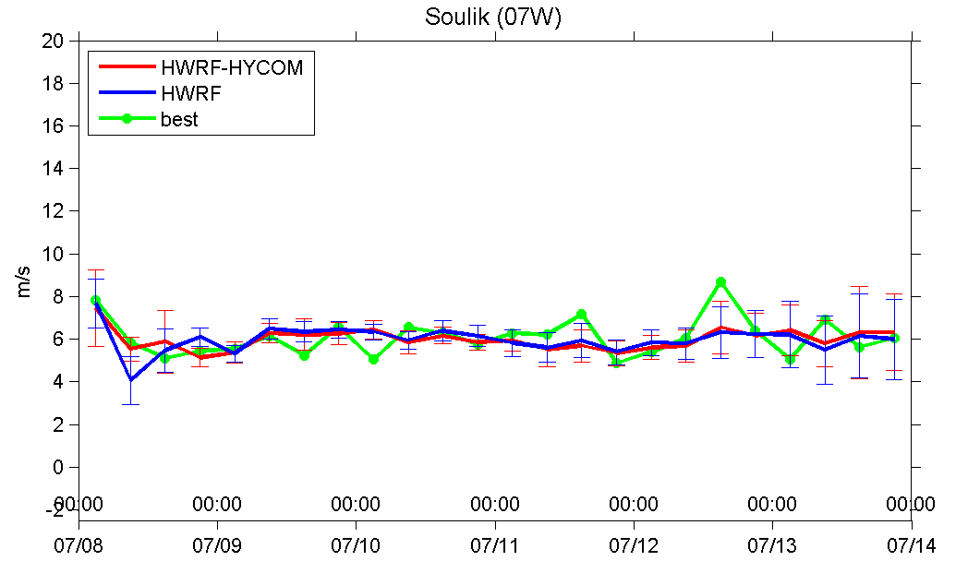
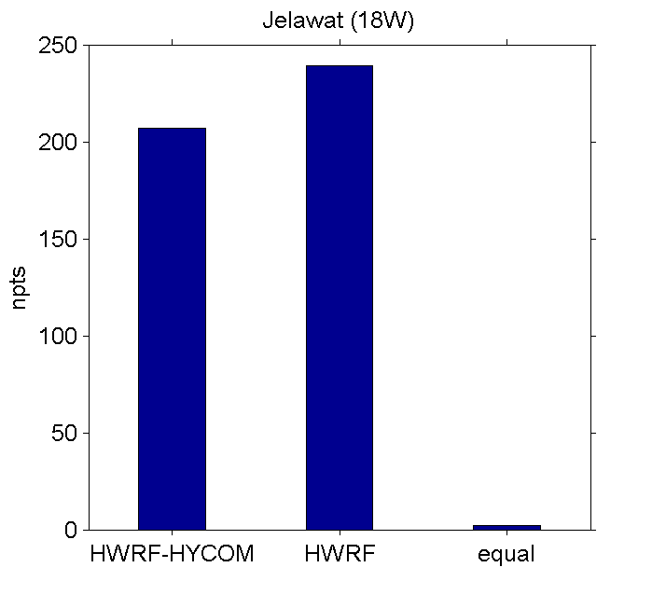
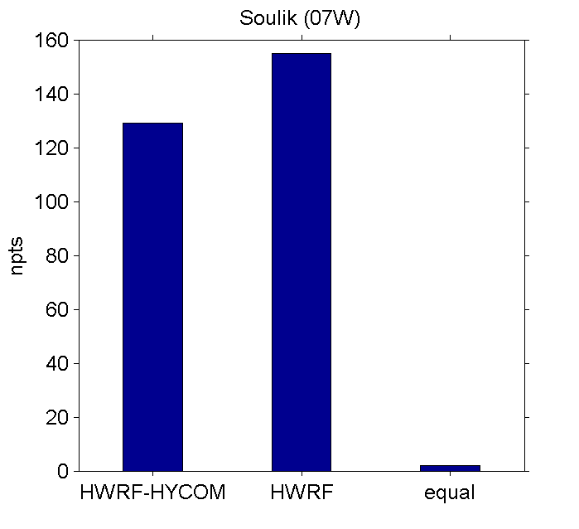
➔ 3. The Storm Translation Speed (m/s)
Jelawat 18w
Soulik 07w
# of counts for higher speed compared to the other.
33 cases
23 cases

Slide 13
➔ 4. Lower surface enthalpy
Each panel:
LHT+SHT (left); LHT (middle); SHT (right)
for three different cycles
HWRF-HYCOM
HWRF
Soulik 07W
Jelawat 18W
HWRF-HYCOM
Roughly,
LHT+SHT < 300 W/m²
LHT < 200 W/m²
SHT < 80 W/m²
HWRF

Slide 14
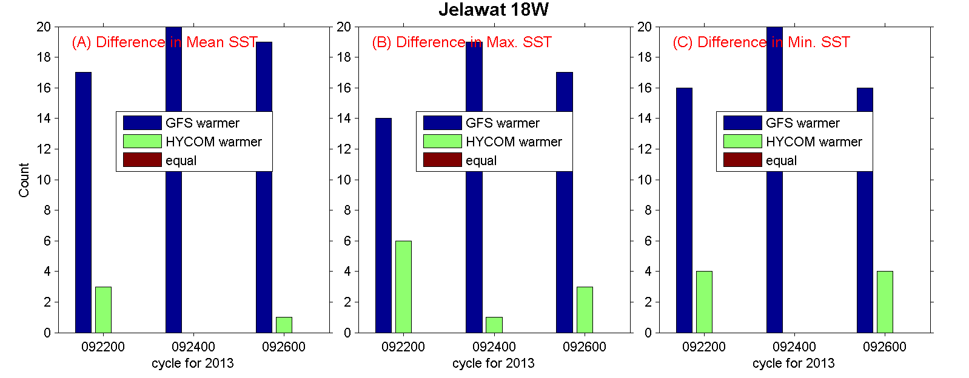
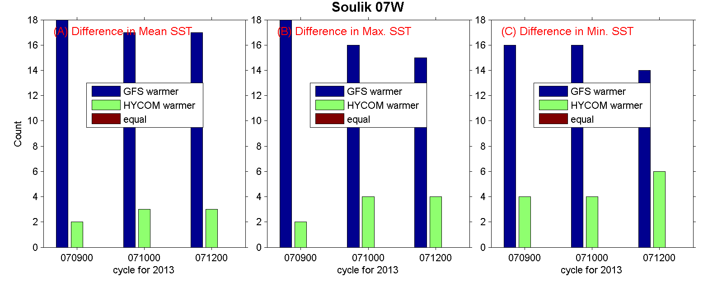
5. HYCOM SST cooler than GFS, but similar to Obs.
Number of Counter
Footprint average, min. and max. SST (R<=150 km)

Slide 15
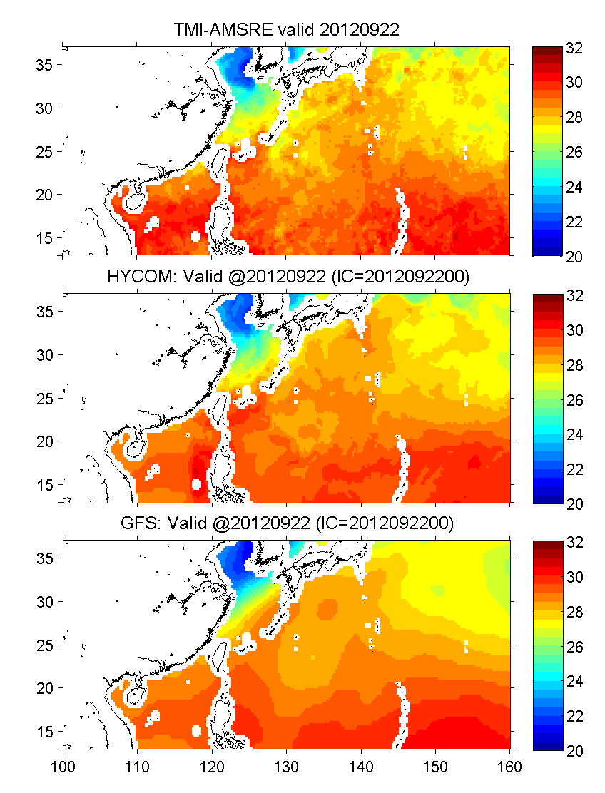
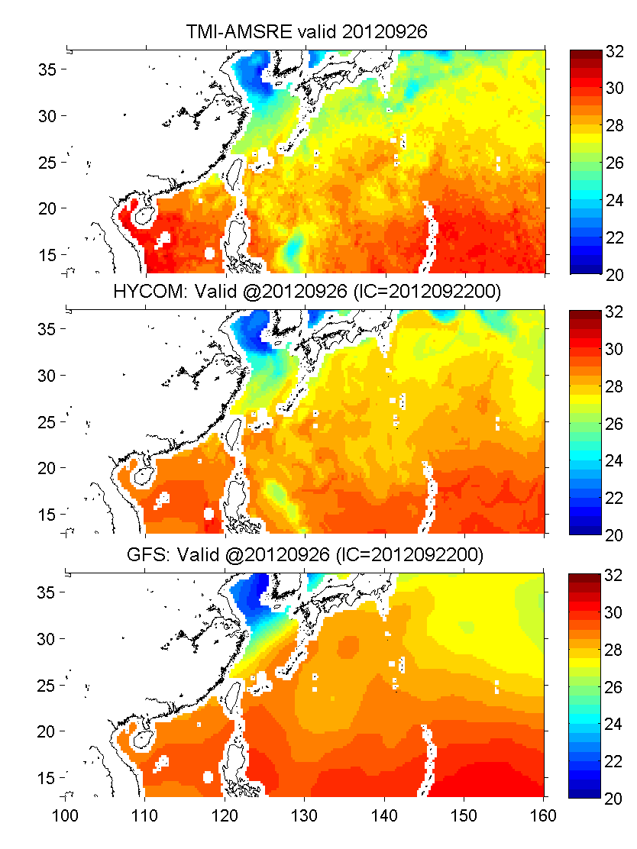
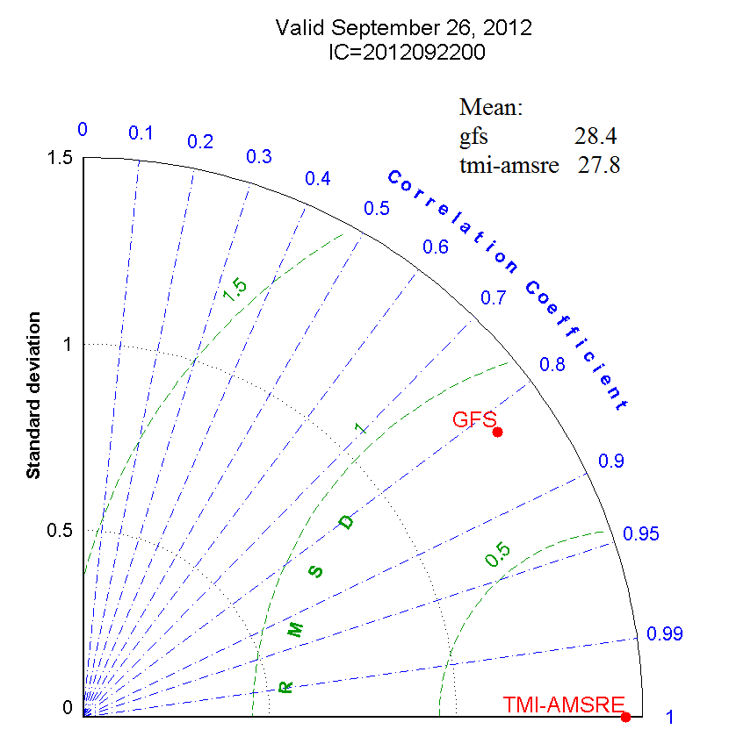
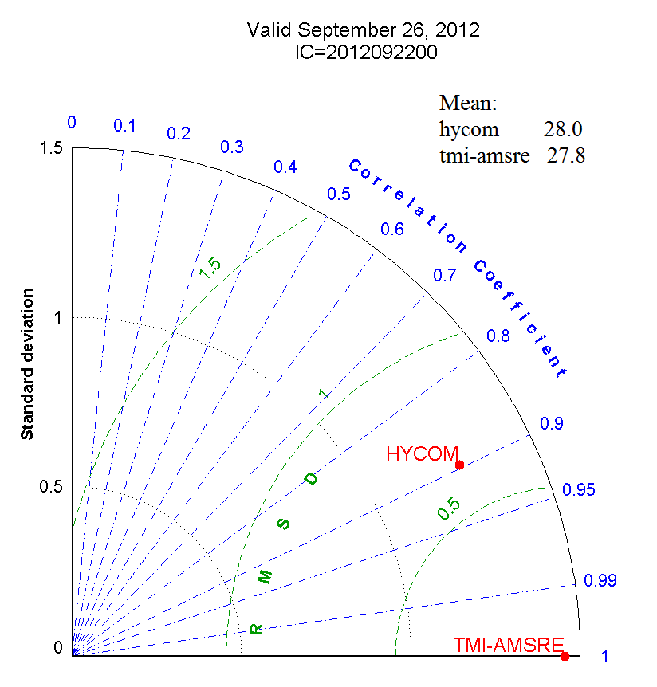
5. …. but HYCOM SST similar to Obs.
Daily SST for day 1 (left) and day 5 (right):
HYCOM –
Similar cold wake (~26ºC) at a similar degree of cooling (~3ºC)
Mesoscale variability
GFS –
No change in GFS SST.
NO cold wake and no cooling
No Mesoscale variability
Comparison against daily TMI & AMSRE OI SST
Obs.
HYCOM
GFS
Statistics for day 5:
HYCOM –
Similar magnitude of mean
Higher correlation coefficient (0.9)
Lower RMSD (0.6) and STD 0.5).
@day 5 Jelawat 18W: cycle=2012092200

Slide 16
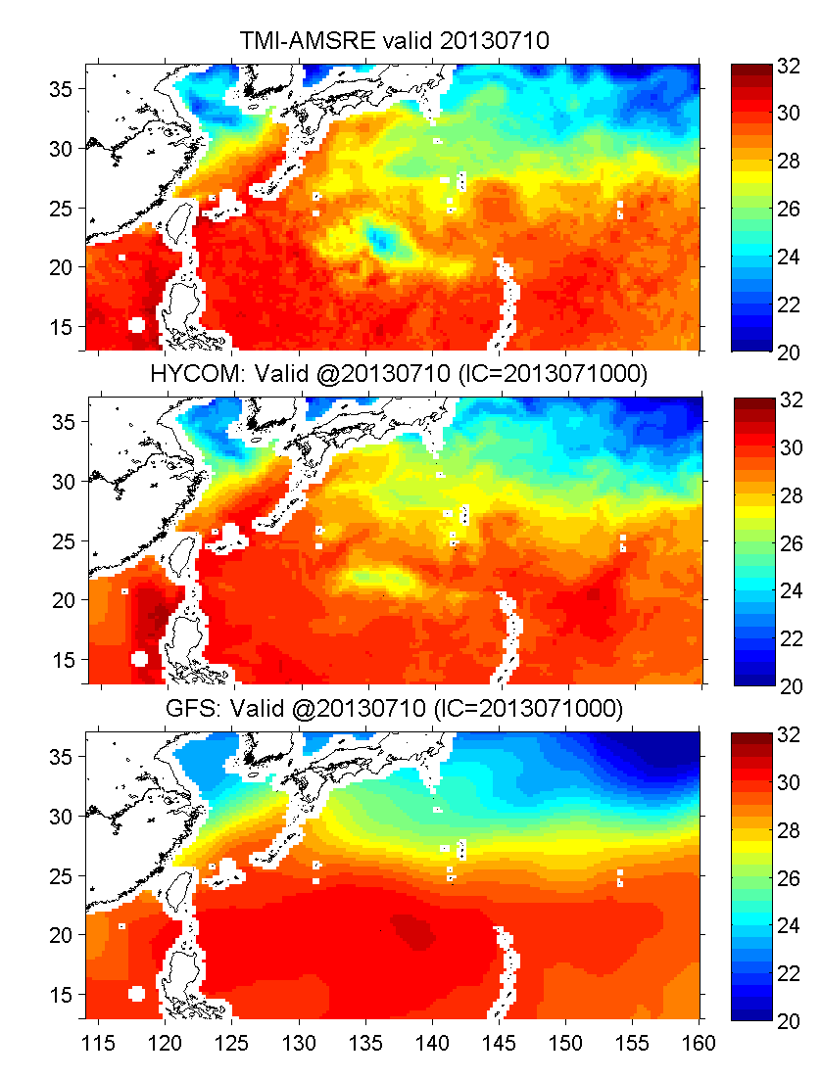
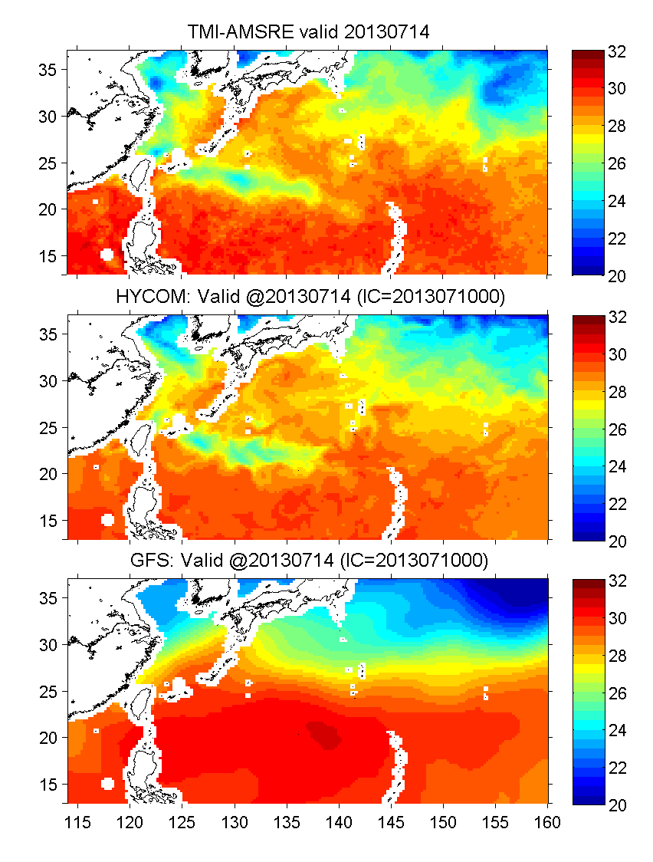
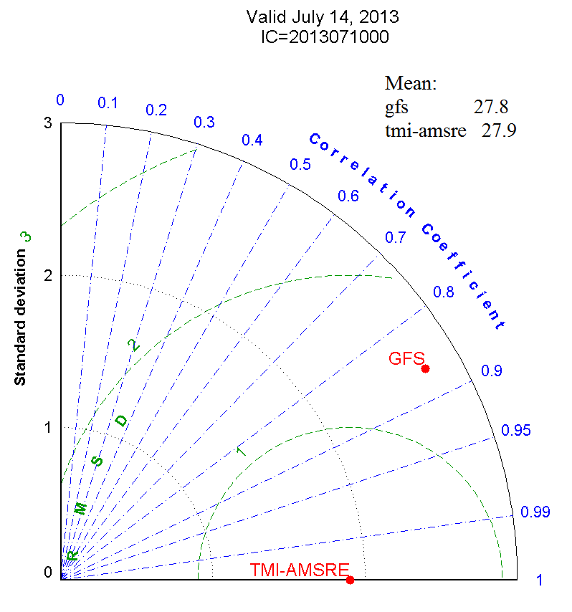
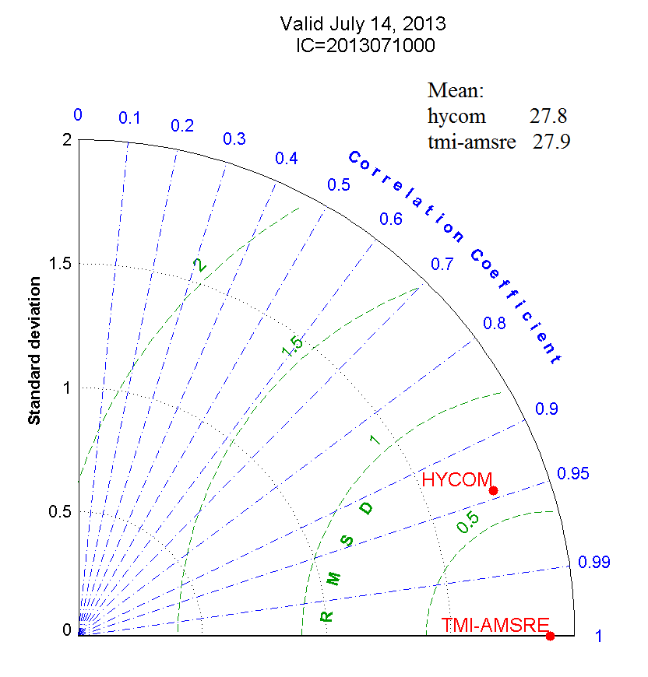
5. …. but HYCOM SST similar to Obs.
Daily SST for day 1 (left) and day 5 (right):
HYCOM –
Similar cold wake (~26ºC) at a similar degree of cooling (~4ºC)
Mesoscale variability
GFS –
No change in GFS SST.
NO cold wake and no cooling
No Mesoscale variability
@day 1
HYCOM – Weaker cooling
GFS – relatively warm
Comparison against daily TMI & AMSRE OI SST
Obs.
HYCOM
GFS
Statistics for day 5:
HYCOM –
Similar magnitude of mean
Higher correlation coefficient (0.93)
Lower RMSD (0.6) and STD 0.5).
@day5 Soulik 07W: cycle=2013071000

Slide 17
Maximum Potential Intensity (MPI)
(coupled) HWRF-HYCOM compared to (non-coupled) HWRF:
Smaller storm size on average, and Contracting with time.
Asymmetric wind pattern.
Slower translation speed (see later)
Lower surface enthalpy (see later)
HYCOM SST cooler than GFS (see later)
Meso-scale dominant (see later)
Emanuel (2003)
T1 = SST;
T2 = outflow temperature;
Cd = drag coefficient;
and
Fh = (LHT+SHT) the surface flux of enthalpy.
T1, LHT, SHT, Cd and (Ch) are either explicitly or implicitly related with SST.
Coupling w/ an ocean model results in the SST feedback. A good example is shown.
Hence, re-considered are:
Sub-grid parameterization in both the atmospheric and oceanic components;
Optimizing air-sea flux parameters to two-way coupling system, e.g. Cd & Ch.

Slide 18
Ocean Model Diagnostics
Ocean parameters – SST, MLD, OHC, and Z26
Flux parameters – Heat flux components
Data for comparison – daily TMI+AMSRE OI (near realtime)
Graphics:
Footprint SST/MLD/Z26.
SST cooling (=SST-SSTo) in near storm area.
SST+surface velocity fields.
T-profiles from each quadrant in time.

Slide 19
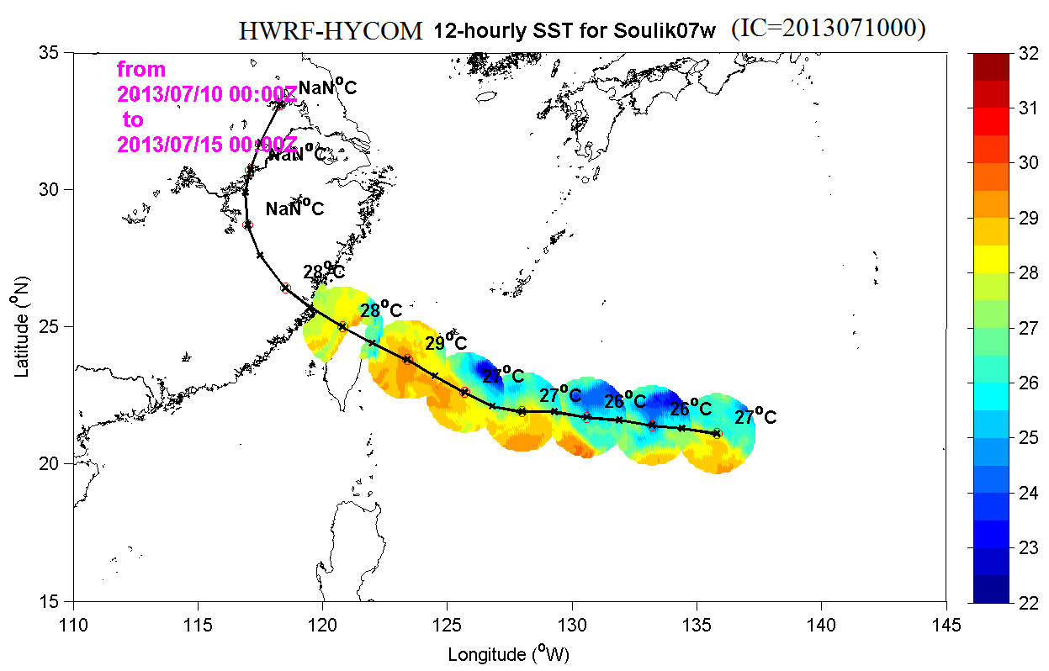
Footprint SST at 12-h intervals w/
areal means.
SST cooling at the time of the storm passing
(=SST_{storm} – SST_{init})

Slide 20
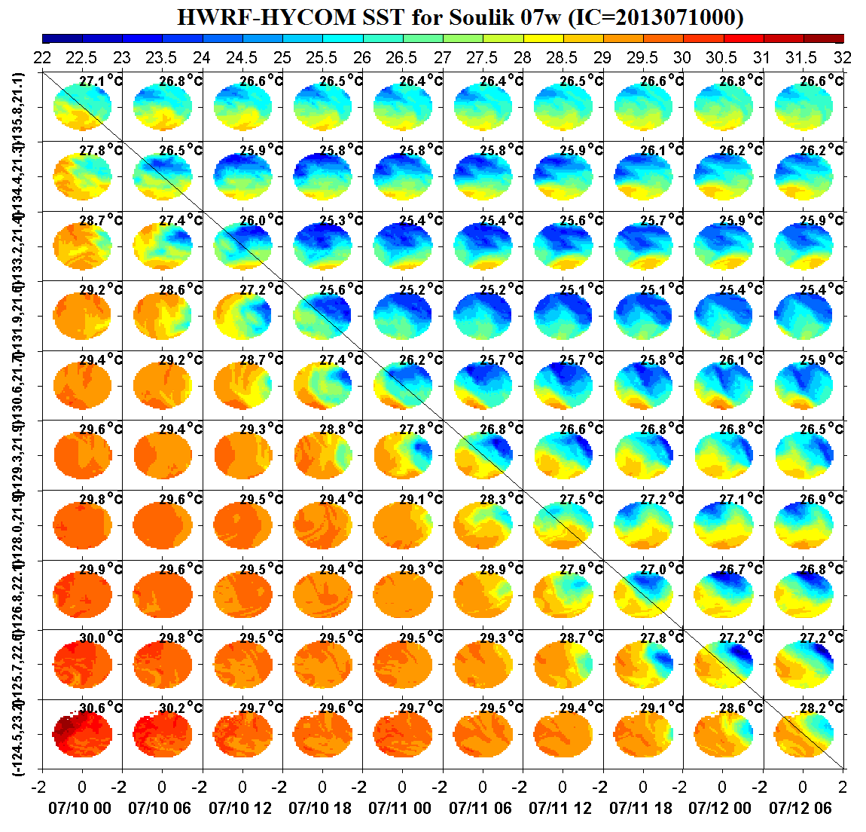
Instantaneous footprint SST – before and after the storm passing.
The storm moves diagonally from top-left to lower-right.
Cooling over 6 hrs

Slide 21
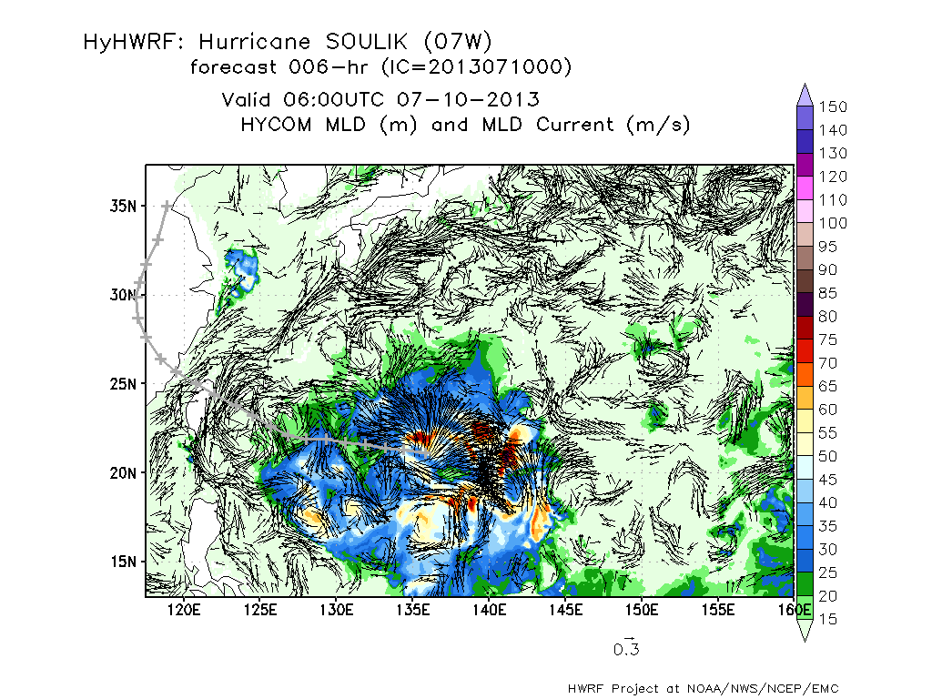
Mixed Layer Depth (MLD) and Currents at MLD

