Slide 1
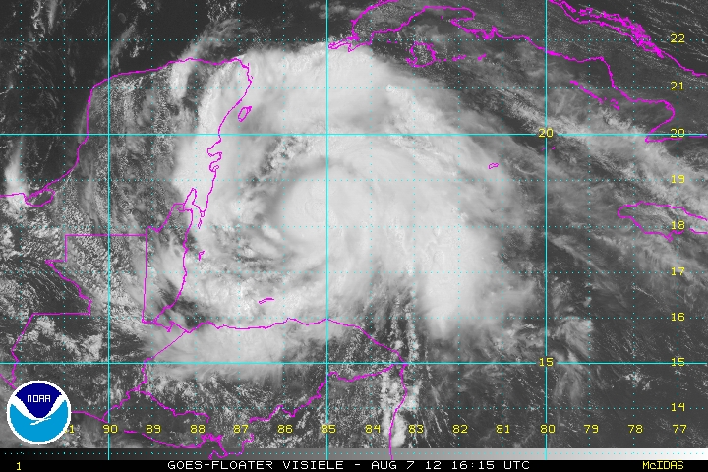
THE CRITICAL ROLE MOISTURE MAY HAVE PLAYED IN THE INTENSITY PREDICTION OF HURRICANE ERNESTO
HFIP Diagnostic Workshop
World Weather Building
August 9th, 2012

Slide 2
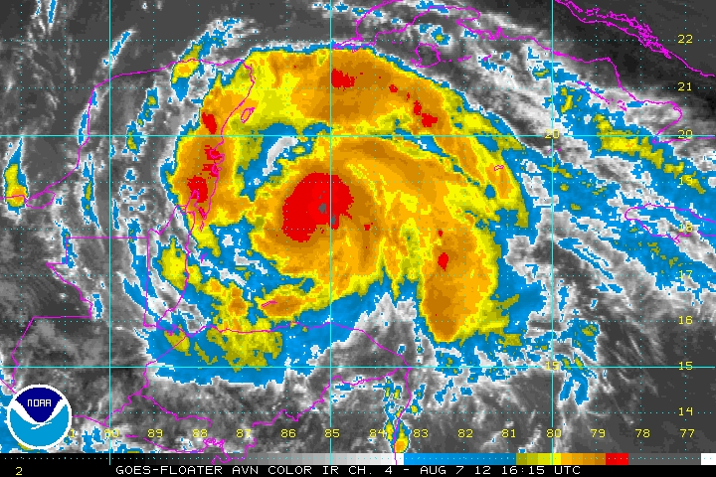
Throughout its lifetime Hurricane Ernesto intensity forecasts posed a huge challenge

Slide 3
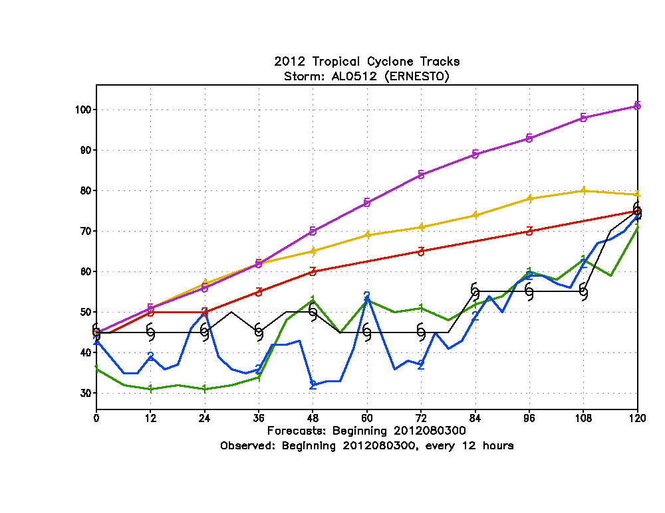
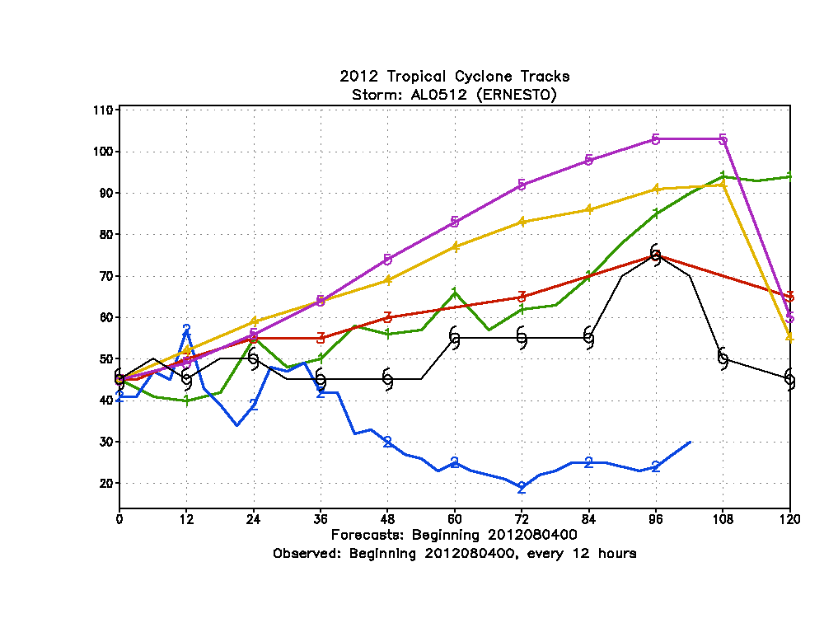
Statistical Models predicted Ernesto would intensity into a major hurricane while the operational dynamical model guidance usually predicted much less development
Hurricane Ernesto Maximum Surface winds (knots)
0000 UTC 3rd August
0000 UTC 4th August
LGEM
LGEM
D SHIPS
D SHIPS
OFFICIAL
GFDL
GFDL
HWRF
HWRF

Slide 4
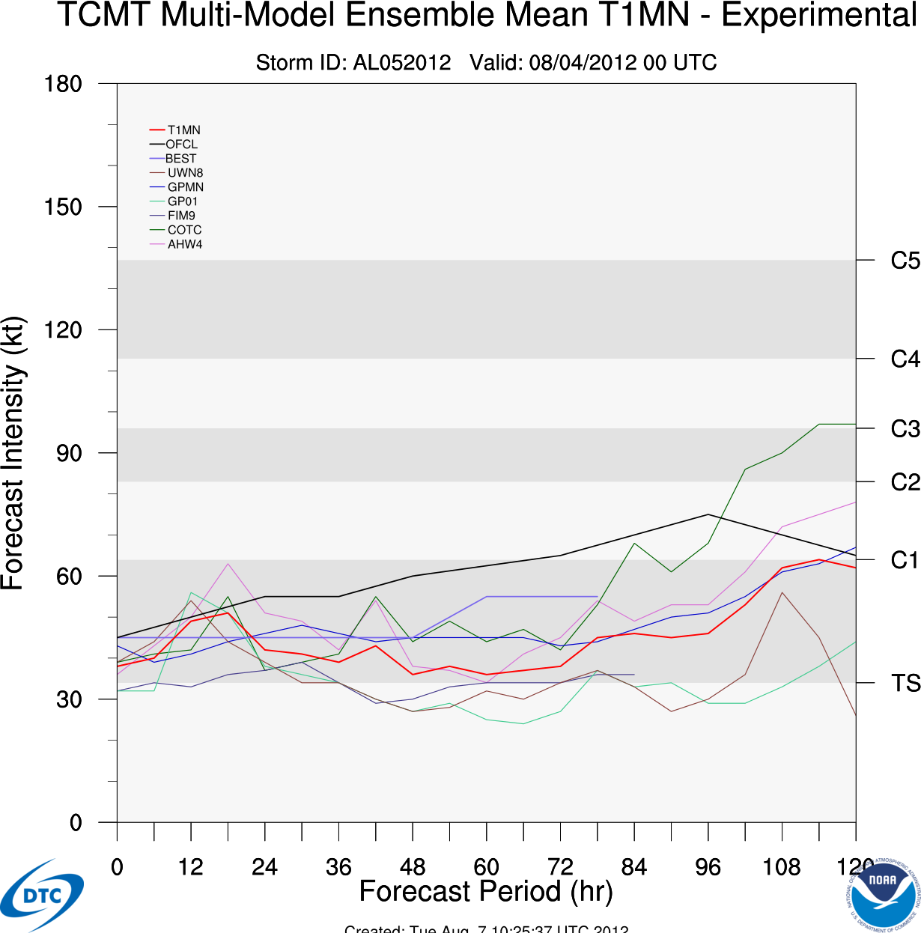
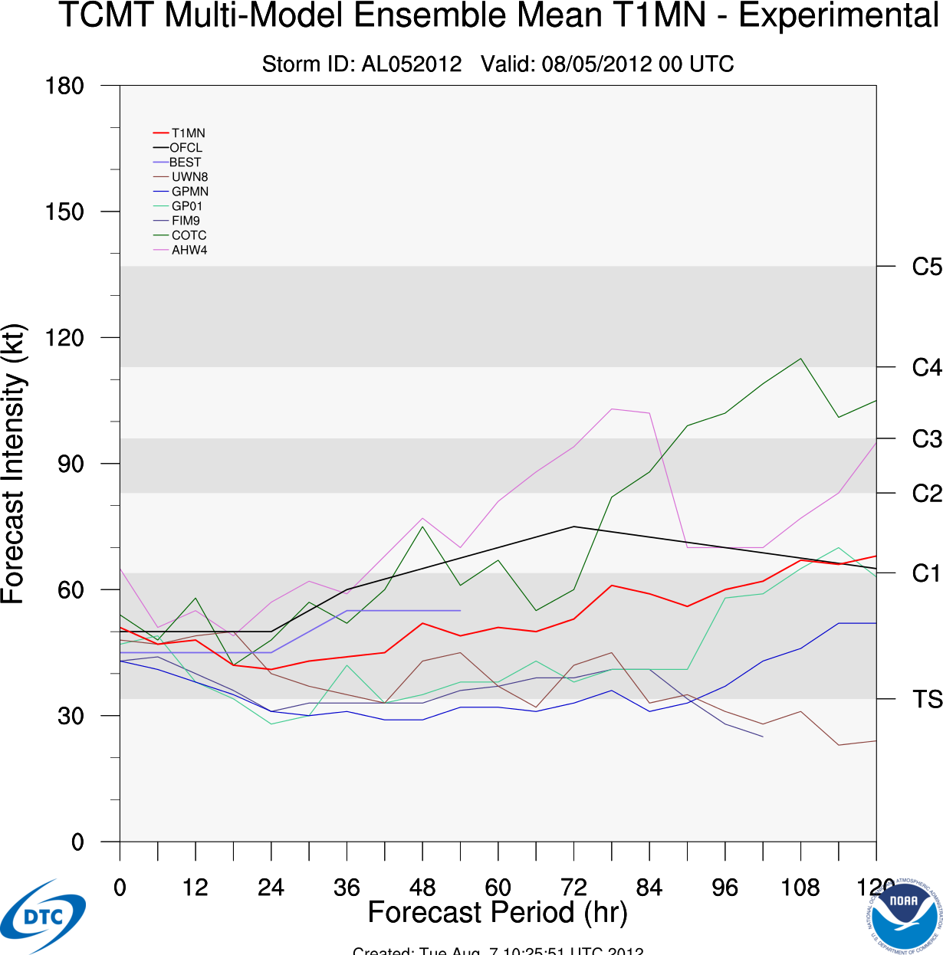
High resolution HFIP regional models showed large variability in intensification as well

Slide 5
GFDL ensemble membership for 2012
16-member ensemble: 15 perturbed members + control fcst
P00: Control forecast (2012 operational GFDL using GFS)
P01: Unbogussed forecast
P02: Increase Vmax₍₀₎ +10%, 34R (+25%), 50R (+40%), ROCI (+25%)
P03: Decrease Vmax₍₀₎ -10%, 34R (-25%), 50R (-40%), ROCI (-25%)
P04: Increase core moisture by a max of 10%
P05: Decrease core moisture by a max of 10%
P06: Increase near-storm SSTs by a max of 1º C
P07: Decrease near-storm SSTs by a max of 2º C
P08: Control forecast (2012 operational GFDL using NCEP GEFS)
P09: Unbogussed forecast
P10: Increase Vmax₍₀₎ +10%, 34R (+25%), 50R (+40%), ROCI (+25%)
P11: Decrease Vmax₍₀₎ -10%, 34R (-25%), 50R (-40%), ROCI (-25%)
P12: Increase core moisture by a max of 10%
P13: Decrease core moisture by a max of 10%
P14: Increase near-storm SSTs by a max of 1º C
P15: Decrease near-storm SSTs by a max of 2º C
GFS-based
Members
NCEP Ensemble-based
Members

Slide 6
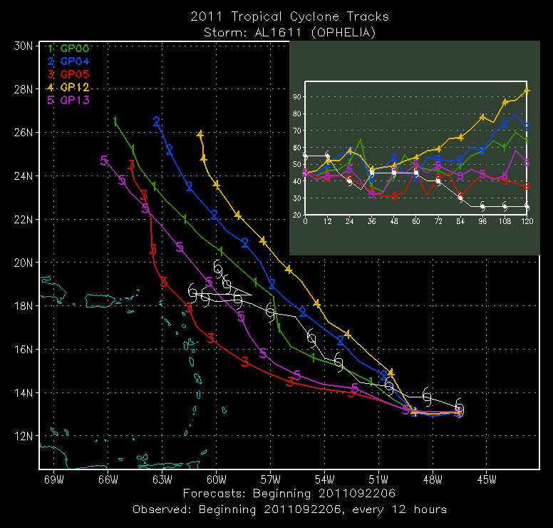
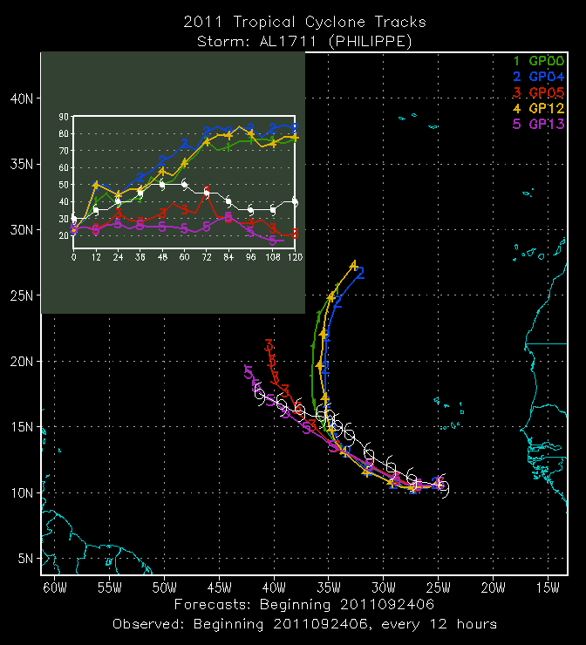
Retro Runs from last season demonstrated Track and Intensity Forecast Sensitivity to Initial Moisture Field Perturbation
Ophelia: 2011092206
Philippe: 2011092406
10% moisture increase
10% moisture
decrease
10% moisture
decrease

Slide 7
The GFDL ENSEMBLE PRODUCT ALSO SHOWED HUGE SPREAD IN INTENSITY.
LARGEST IMPACT WAS WITH INCREASE /DECREASE OF INNER-CORE MOISTURE BY 10%
(PERTURBATION MAXIMUM AT STORM CENTER)
IMPACT OF MOISTURE MORE IMPORTANT THEN +1 degree C SST INCREASE
+10% MOISTURE
SST
CONTROL
SST
-10% MOISTURE

Slide 8
The GFDL ENSEMBLE PRODUCT ALSO SHOWED HUGE SPREAD IN INTENSITY.
LARGEST IMPACT WAS WITH INCREASE /DECREASE OF INNER-CORE MOISTURE BY 10%
(PERTURBATION MAXIMUM AT STORM CENTER)
IMPACT OF MOISTURE MORE IMPORTANT THEN +1 degree C SST INCREASE
+10% MOISTURE
-10% MOISTURE

Slide 9
MOISTURE PERTURBATION ALSO HAD LARGE IMPACT ON TRACK (-10% TRACK CONSIDERABLY FURTHER WEST)
0000 UTC 4th August
0000 UTC 5th August
+10% MOISTURE
-10% MOISTURE

Slide 10
RELATIVE HUMIDITY CROSS-SECTION
CONTROL
10%
MOISTURE
INCREASE
10%
MOISTURE
DECREASE
Dry air to the west of the storm

Slide 11
RELATIVE HUMIDITY CROSS-SECTION
CONTROL
10%
MOISTURE
INCREASE
10%
MOISTURE
DECREASE

Slide 12
CONCLUDING THOUGHTS
OF ALL THE VARIABLES PERTURBED IN THE GFDL ENSEMBLE, THE INNER CORE MOISTURE BY FAR HAD THE GREATEST IMPACT ON THE INTENSIFICATION OF ERNESTO.
RESULTS DEMONSTRATE THE CRITICAL ROLE CORRECT MOISTURE INITIALIZATION MAY PLAY IN ACCURATE STORM INTENSITY PREDICTION.
RESULTS SUGGESTS HFIP MODEL DIAGNOSTICS NEED TO PAY MORE ATTENTION TO MOISTURE ANALYSIS PARTICULARLY IN THE STORM REGION.
THE GFDL ENSEMBLE MAY HELP IDENTIFY SOME OF THE OTHER KEY PARAMETERS THAT SHOULD BE EMPHASIZED IN MODEL DIAGNOSTICS TO IMPROVE MODEL INTENSITY PREDICTION.

