Slide 1
Proposed bug fix for SAS deep convection in operational HWRF (Crisis RFC Implemented on August 3rd at 18Z)
HWRF team, with the help of DTC, identified a problem in the SAS deep convection code where the vertical level array was found to go out of bounds while determining the maximum level convection can reach. This was discovered when the 2011 HWRF public release (HWRFV3.3) configuration with new GFS SAS scheme was found crashing on tJet when compiled with PGI compilers.
In the program phys/module_cu_sas.F:
! if (prsl(i,k)*tx1(i) .gt. 0.04)kmax(i) = k + 1 !original(bug)
if (prsl(i,k)*tx1(i) .gt. 0.04)kmax(i) = min(km,k+1) ! Proposed bug fix
If P(sfc) is 1000mb, then the level higher than p(k)=40mb will meet this condition (introduced to reduce the computational time). However, HWRF model top is 50mb, so kmax becomes always km+1
This out of bound array is found to have significant impact since kmax is used in the computation of HEO and HEOS, (moist static energy and saturation moist static energy)
if(cnvflg(i)) then
k = kmax(i)
heo(i,k) = g * zo(i,k) + cp * to(i,k) + hvap * qo(i,k)
heso(i,k) = g * zo(i,k) + cp * to(i,k) + hvap * qeso(i,k)
Nature of this bug is unpredictable. The out-of-bound array takes undefined values from machine’s memory and has a potential to crash the model when something goes wrong on the nodes where the model is running.

Slide 2
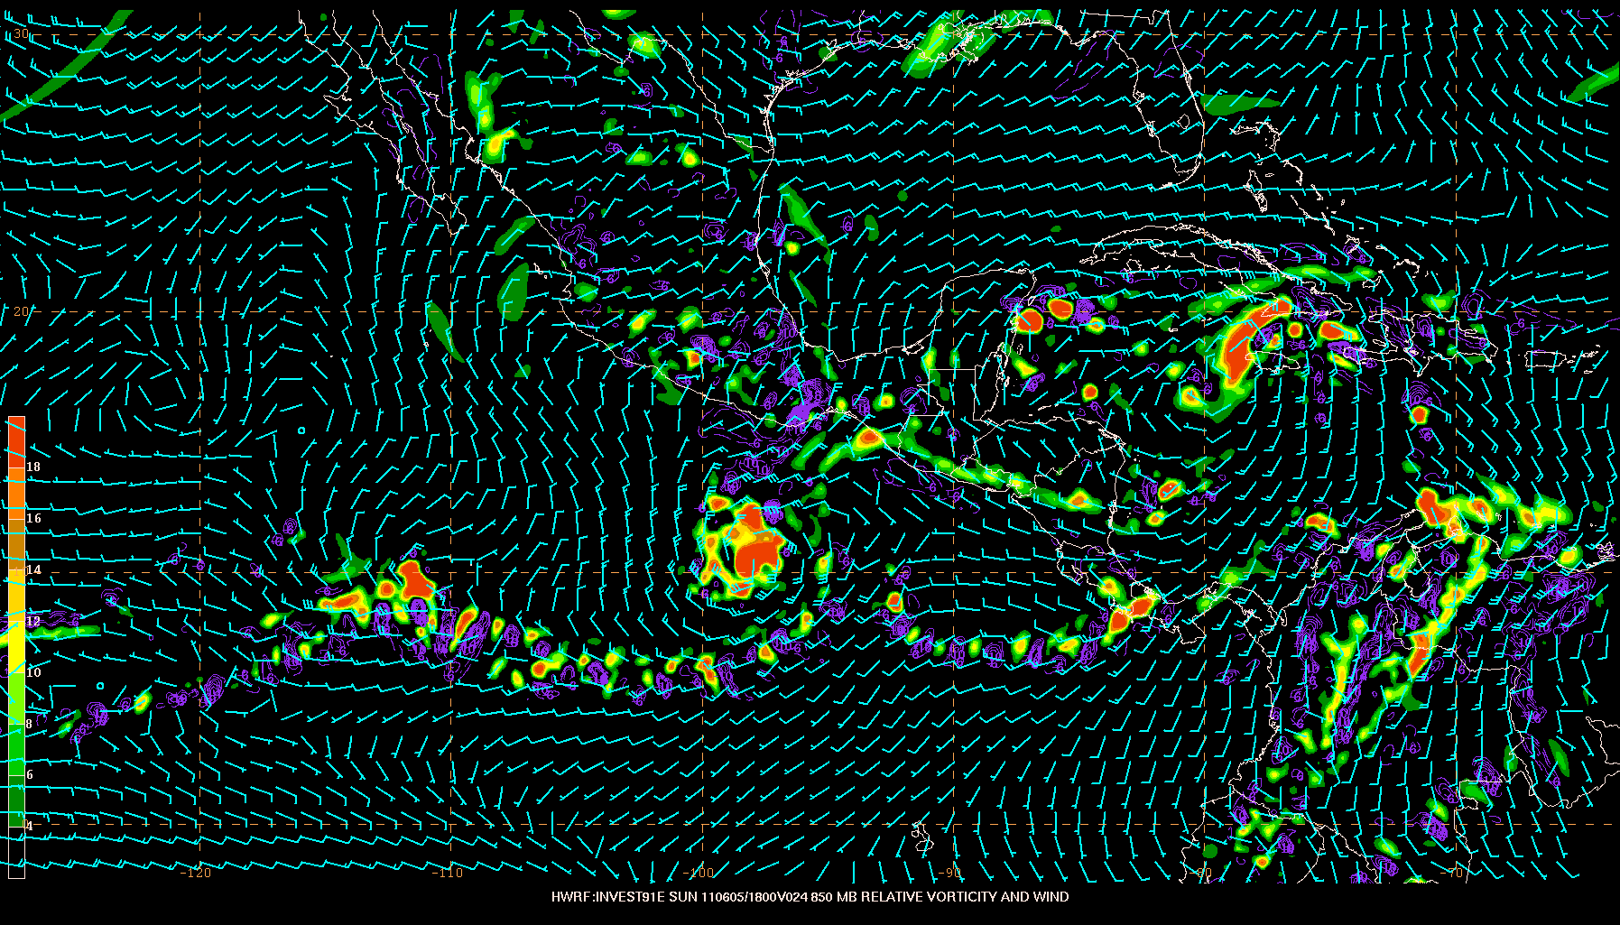
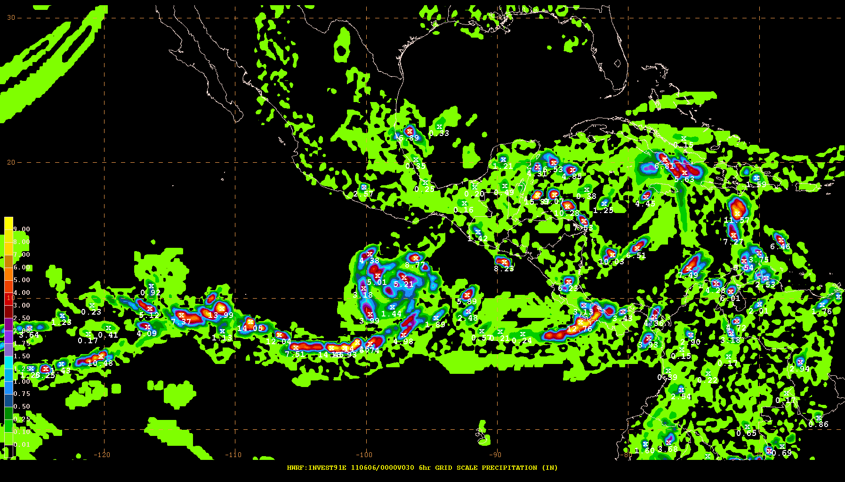
Initial observations from Mike Brennan (NHC): 18 to 24 hours into the HWRF model run the low-level vortex associated with the invest appears to break down. The model shows a patchwork pattern of low-level vorticity maxima and minima in association with the invest, along the ITCZ, and in the high terrain of Mexico. This appears to be due to very large amounts of grid-scale precipitation, in some areas exceeding 5 or even 10 inches in a 6-h period across much of the domain. Interestingly, the precip amounts produced by the convective scheme are quite small (generally < 1 inch in a 6-h period).
Grid-Scale Precipitation
850 hPa Vorticity

Slide 3
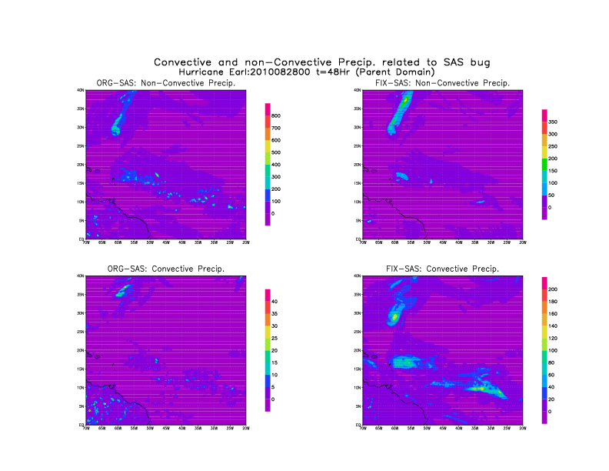
800kg/m²
350kg/m²
Large-scale precip
200kg/m²
40kg/m²
Conv. precip
Original SAS
Bug-fixed SAS

Slide 4
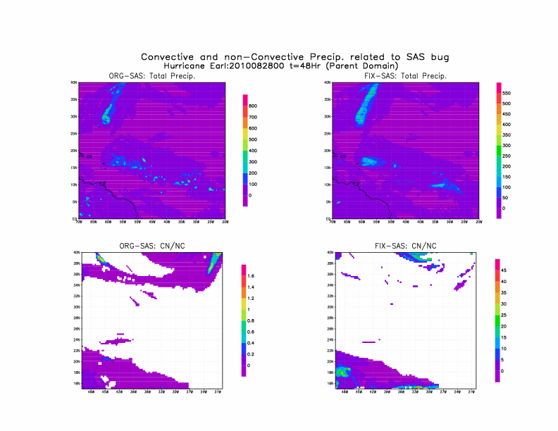
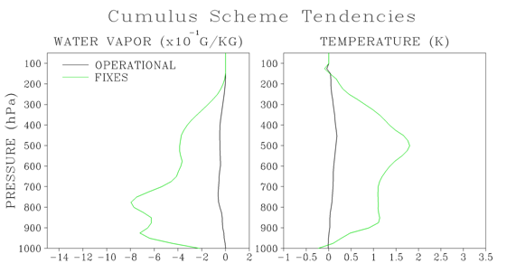
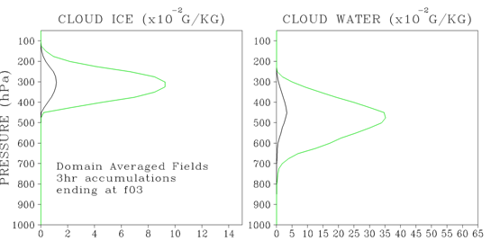
Total precip
Ratio of convective to non-convectiveprecip

Slide 5
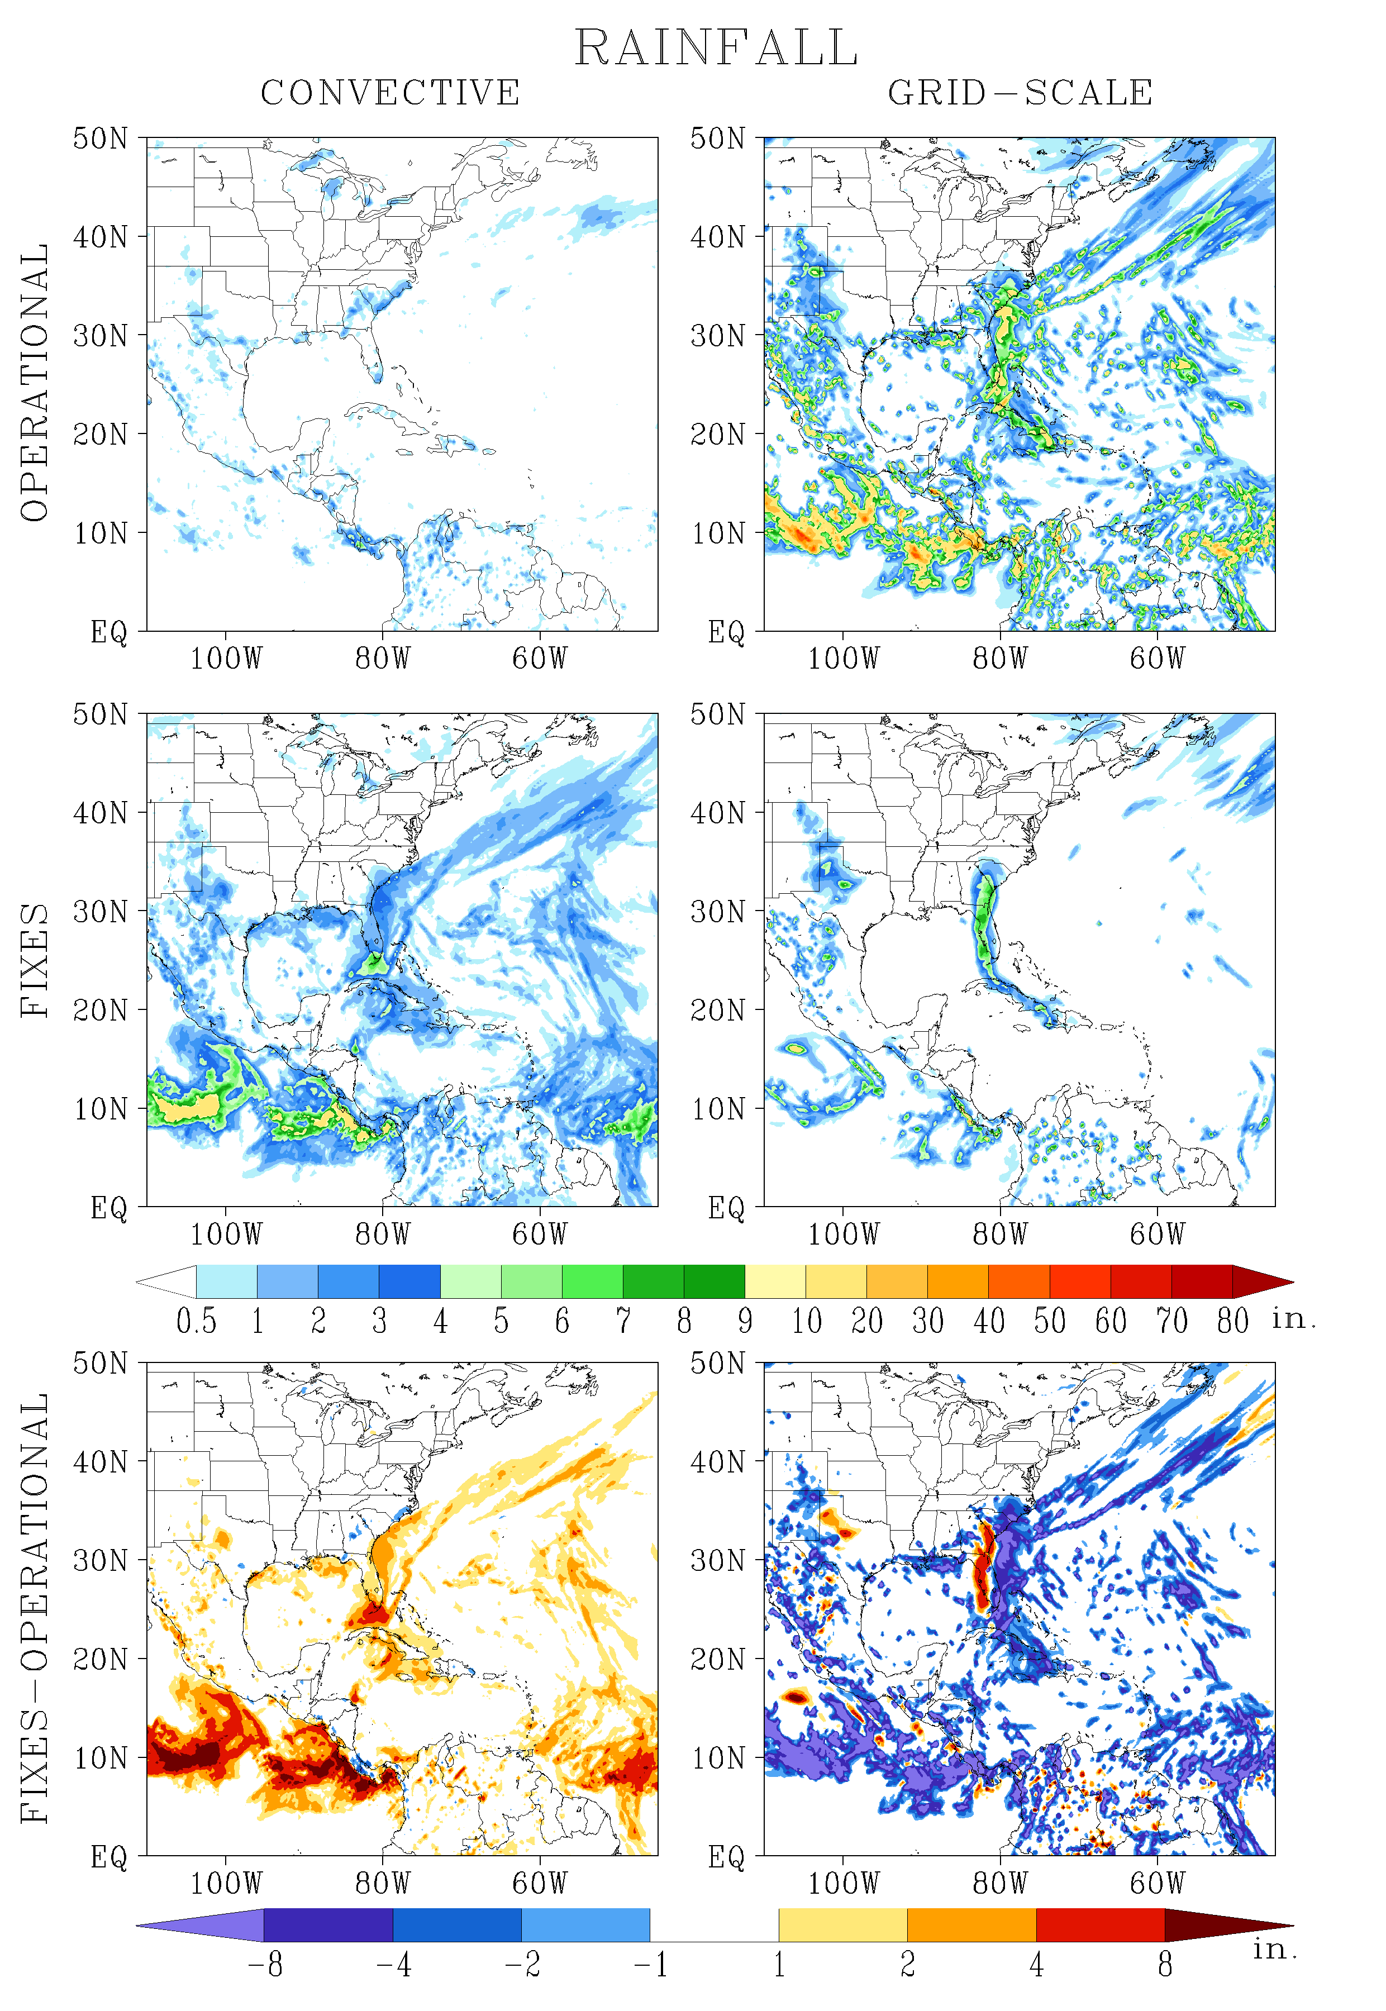
Forecast Total Rainfall (Hour 126)
Much less convective rainfall and much more grid-scale rainfall in operational run

Slide 6
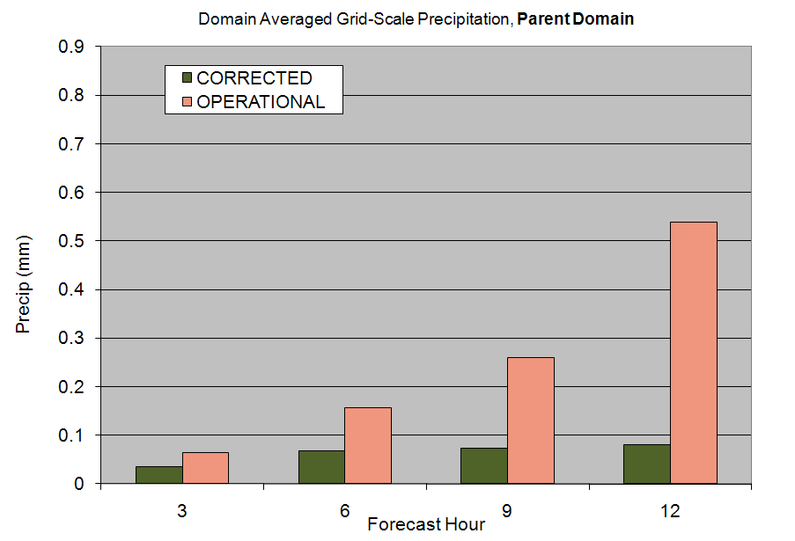
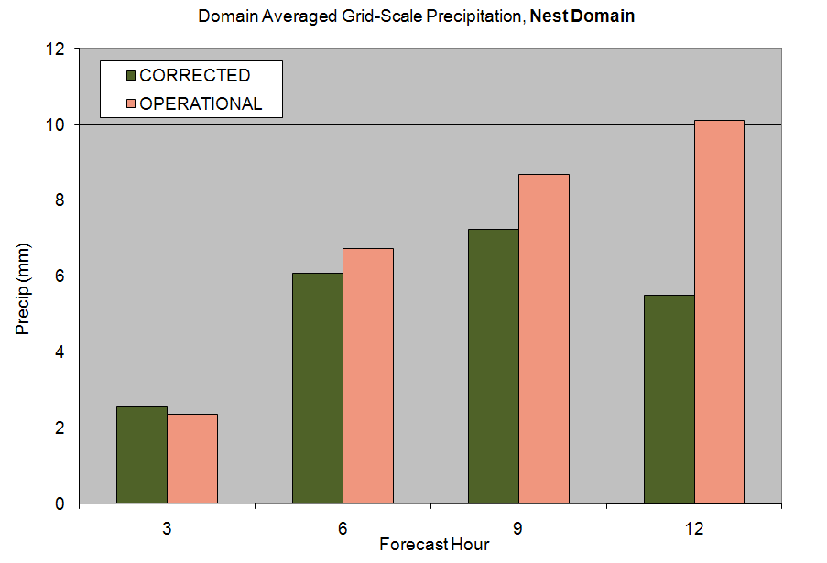
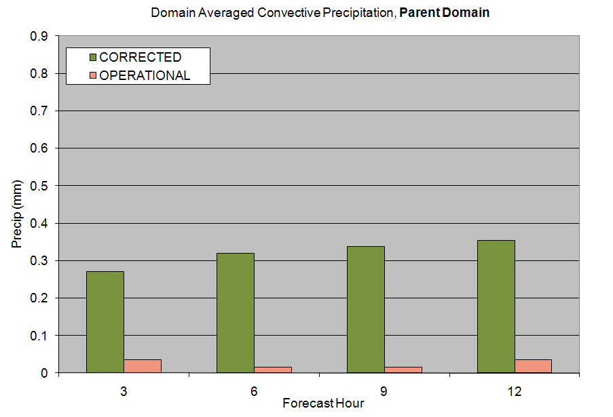
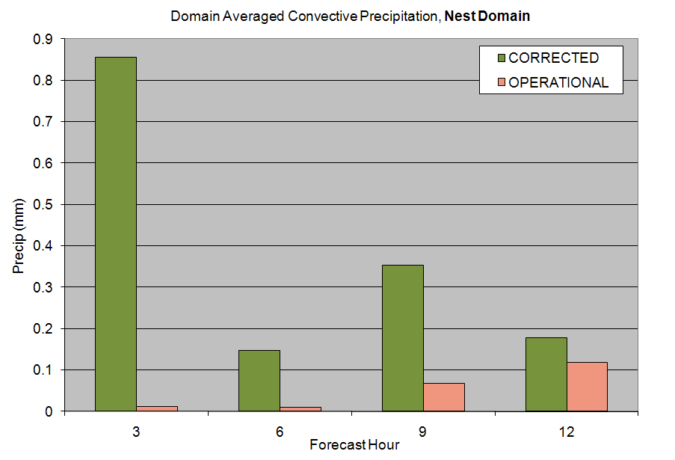
Reduction in grid-scale rainfall
Reduction in grid-scale rainfall
Substantial increase in convective rainfall
Substantial increase in convective rainfall

Slide 7
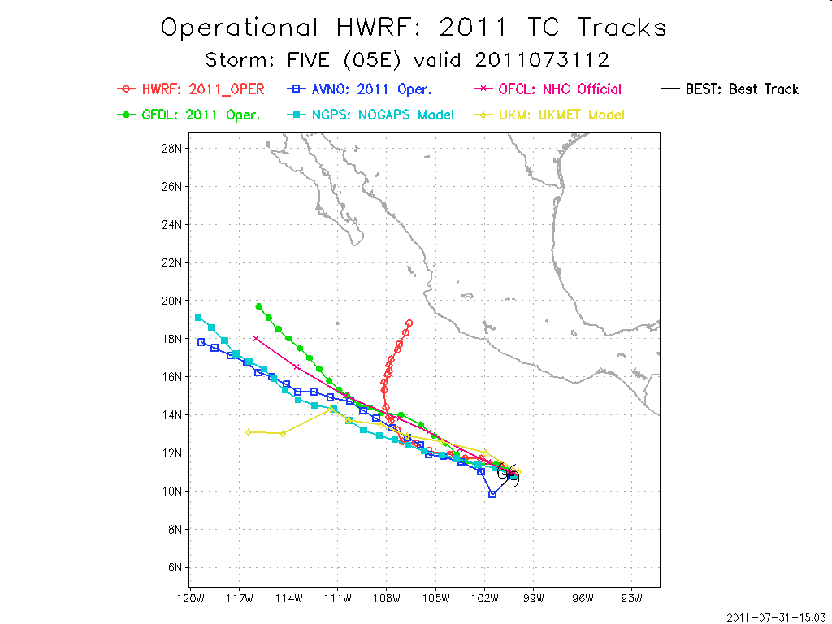
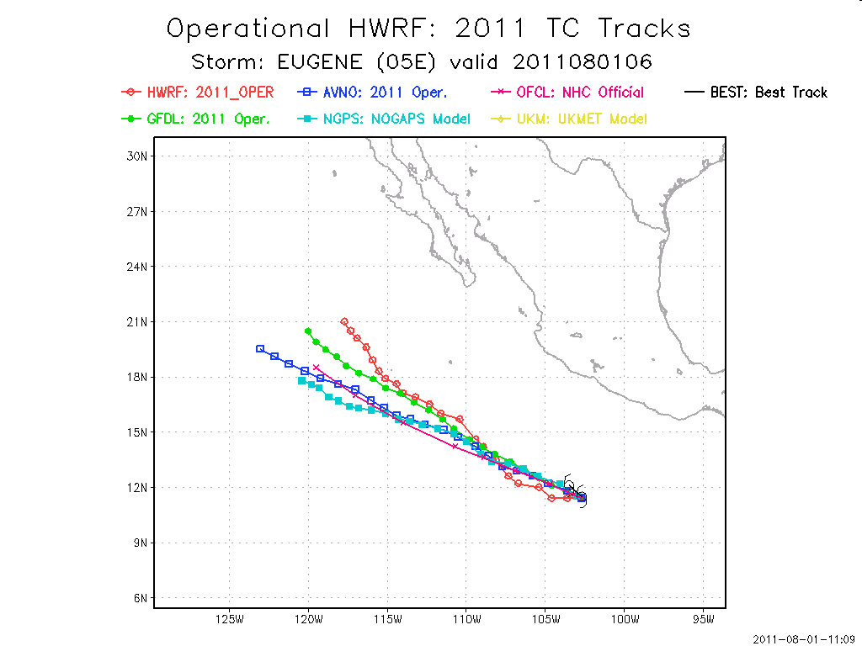
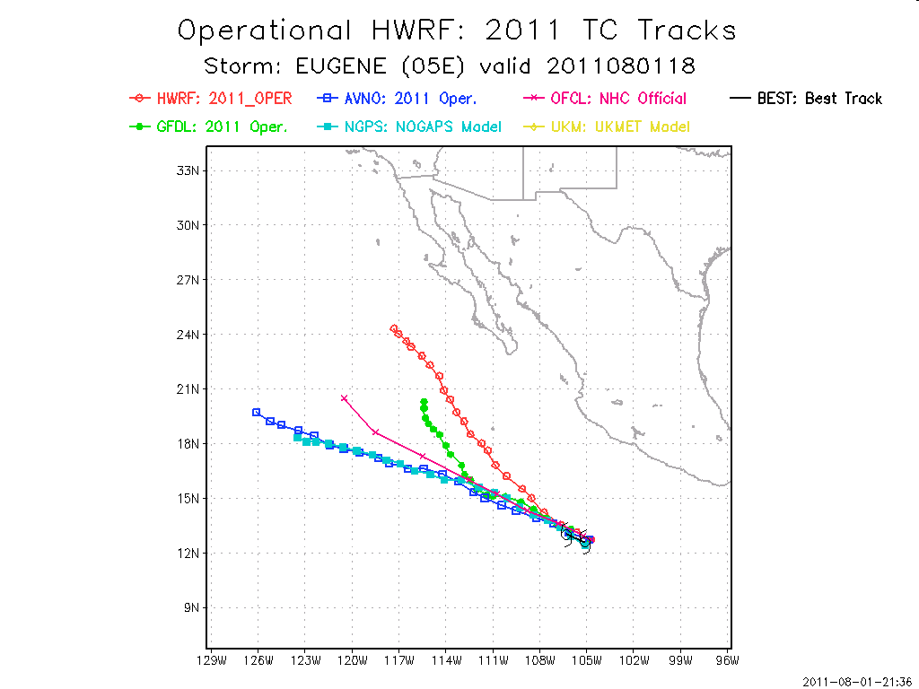
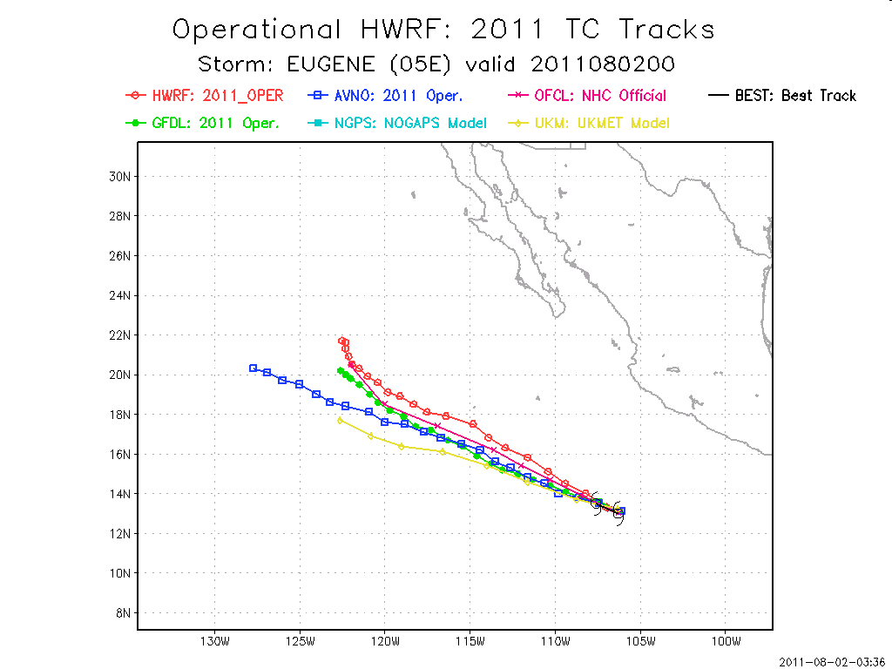
Unpredictable nature of the out-of-bound array problem

Slide 8
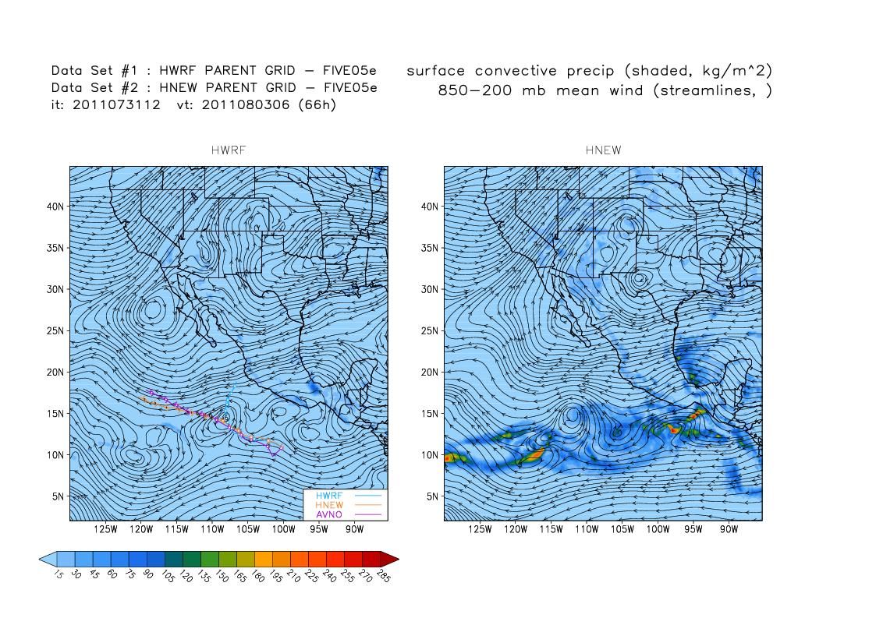

Slide 9
2011 Operational HWRF
HWRF with SAS Corrections
Hurricane Eugene, 2011

Slide 10
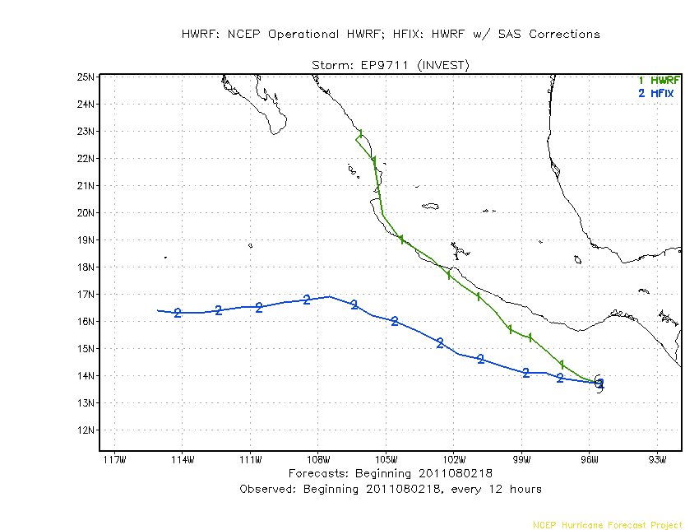
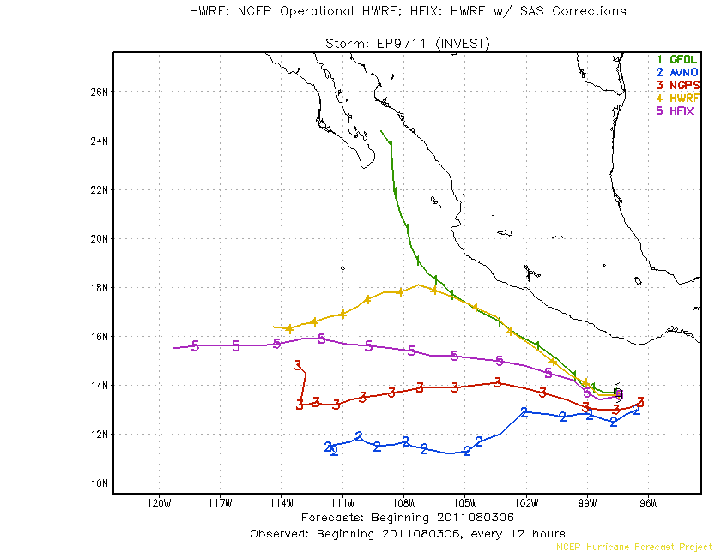
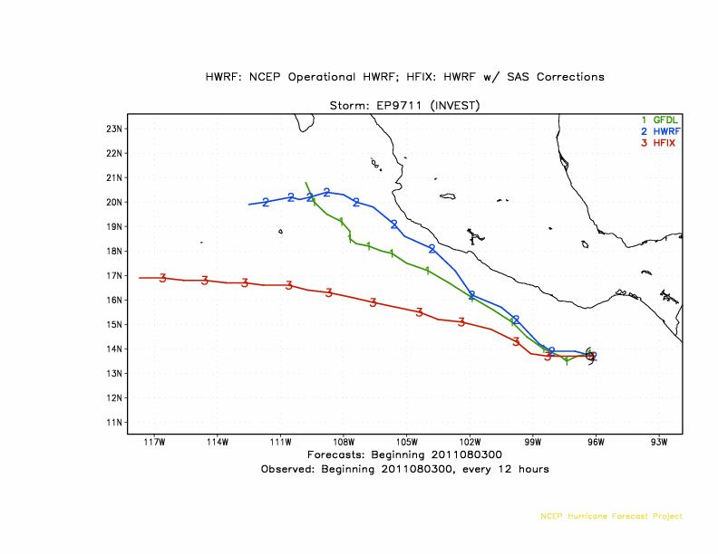
INVEST 97E

Slide 11
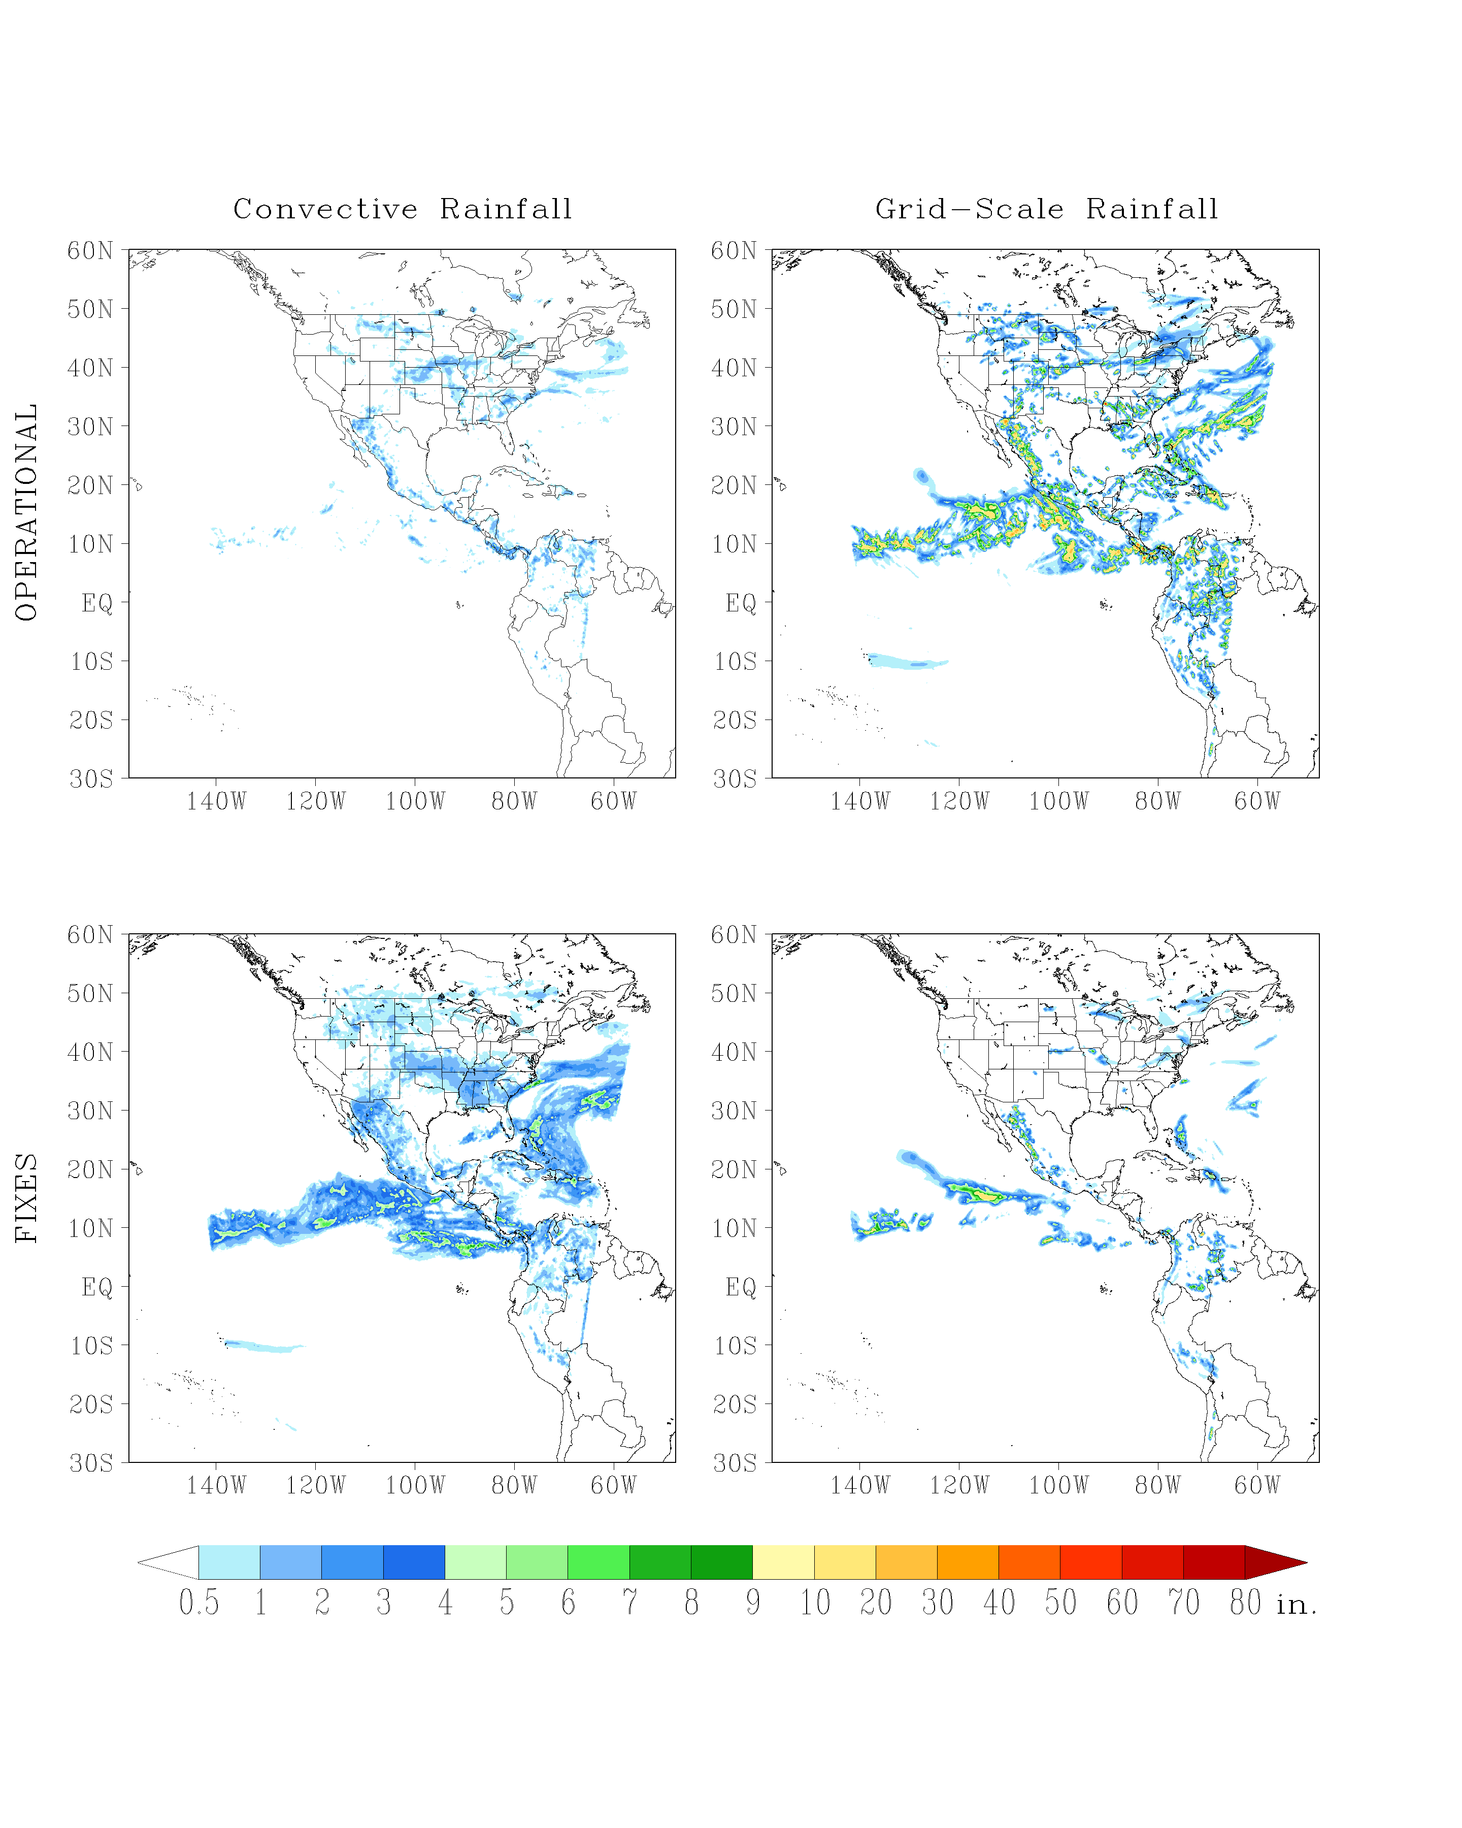
Rainfall distribution; Invest 97E 2011080306

Slide 12
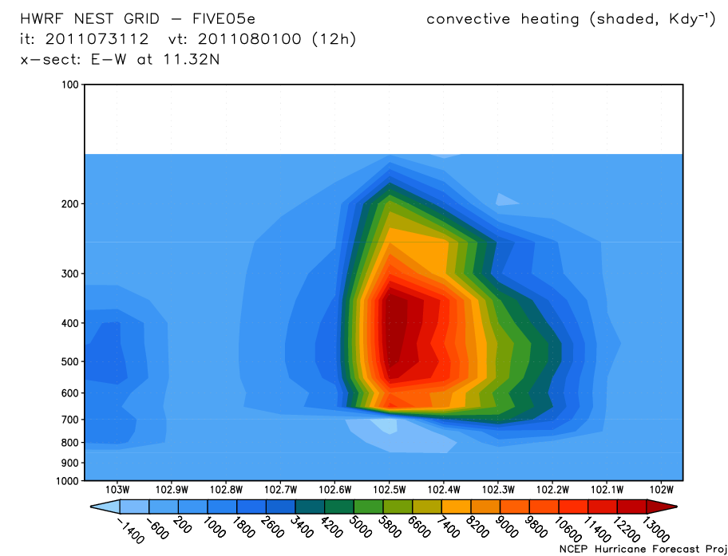
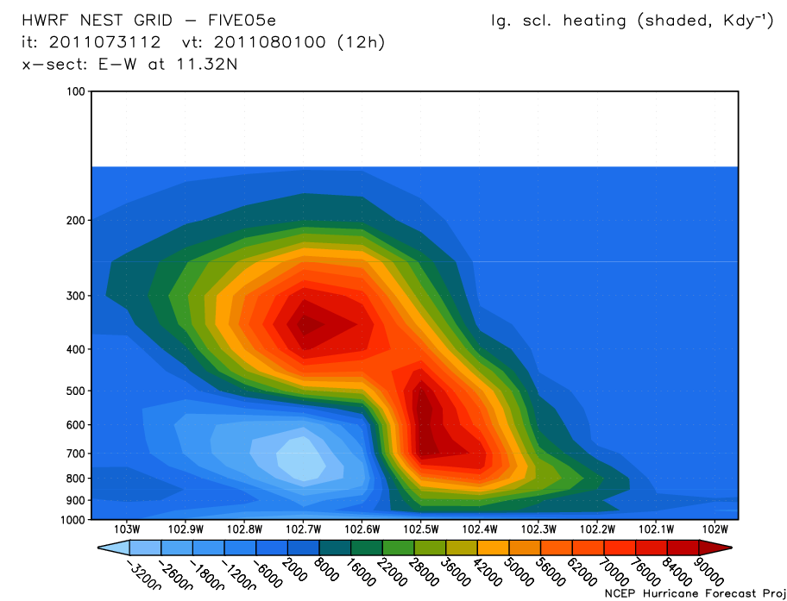
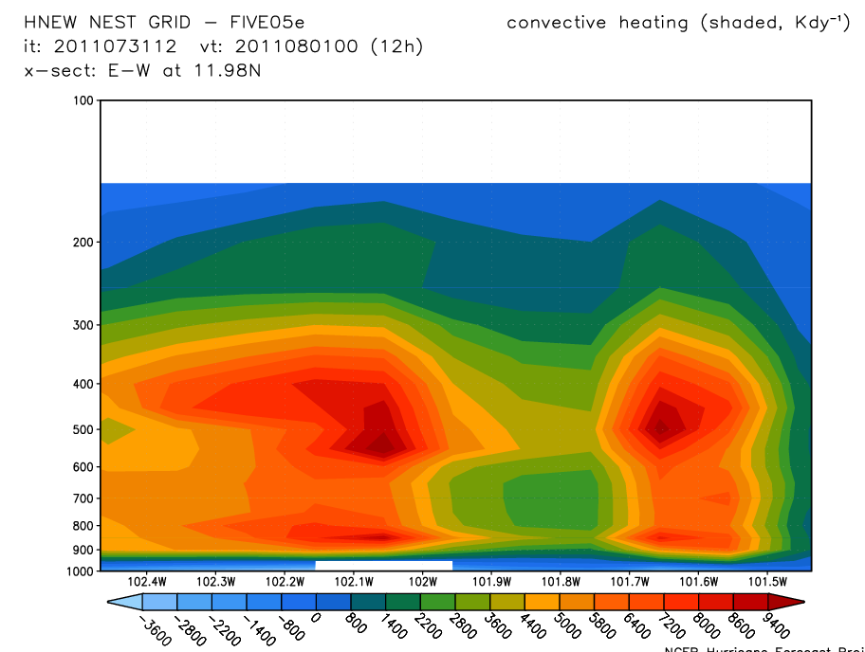
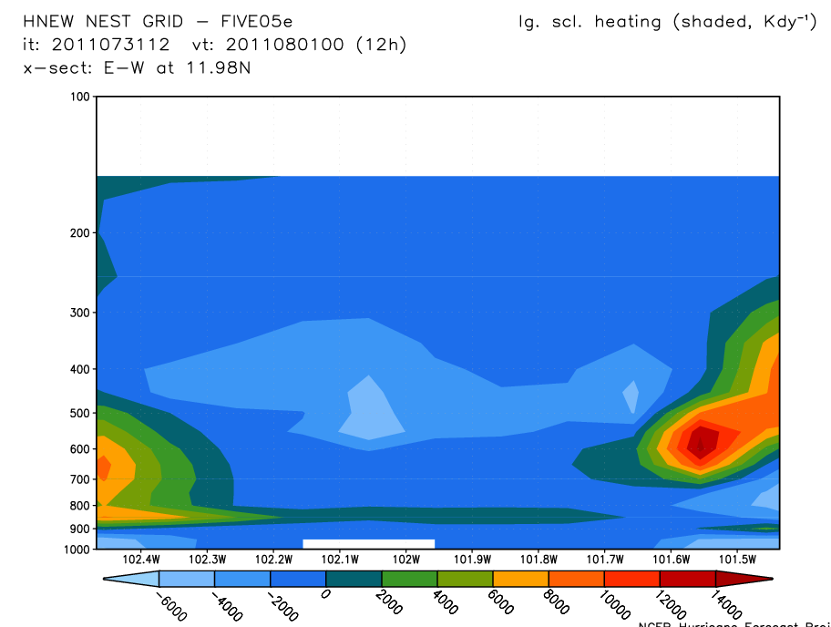

Slide 13
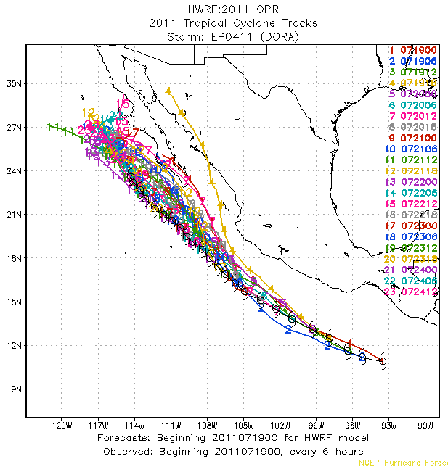
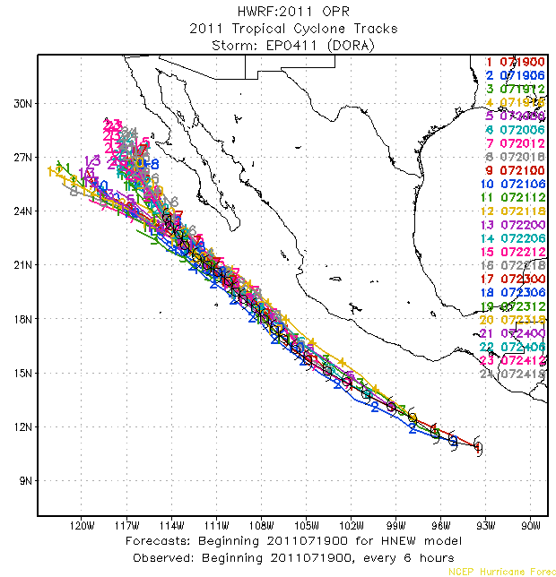
2011 Operational HWRF
HWRF with SAS Corrections
Hurricane Dora, 2011

Slide 14
2011 Operational HWRF
HWRF with SAS Corrections
Hurricane Calvin, 2011

Slide 15
2011 Operational HWRF
HWRF with SAS Corrections
TS Don, 2011

Slide 16
2011 Operational HWRF
HWRF with SAS Corrections
Hurricane Earl, 2010

Slide 17
2011 Operational HWRF
HWRF with SAS Corrections
Hurricane Earl, 2010

Slide 18
Hurricane Igor, 2010
2011 Operational HWRF
HWRF with SAS Corrections

Slide 19
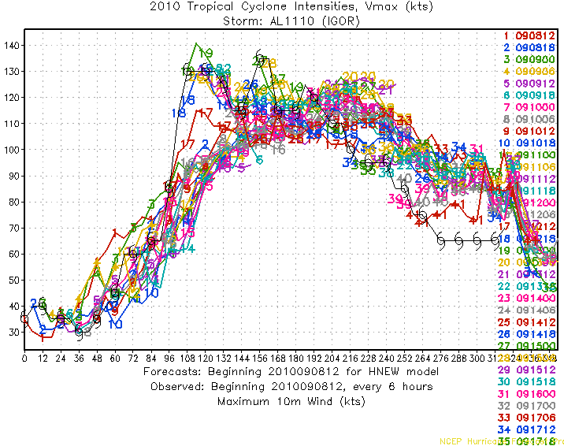
2011 Operational HWRF
HWRF with SAS Corrections
Hurricane Igor, 2010

Slide 20
2011 Operational HWRF
HWRF with SAS Corrections
TS Cindy, 2011

Slide 21
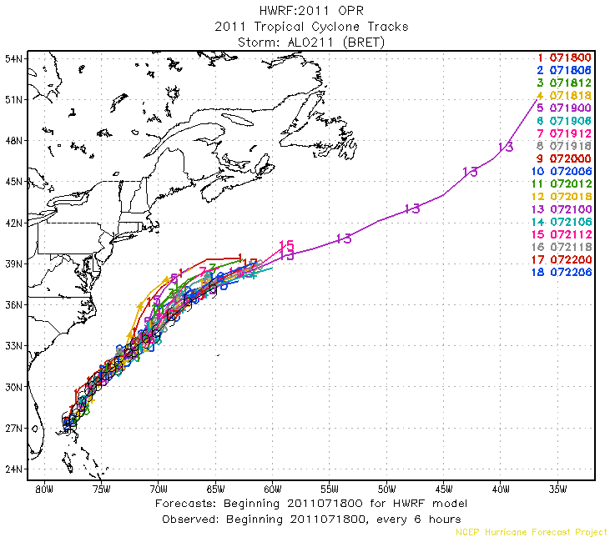
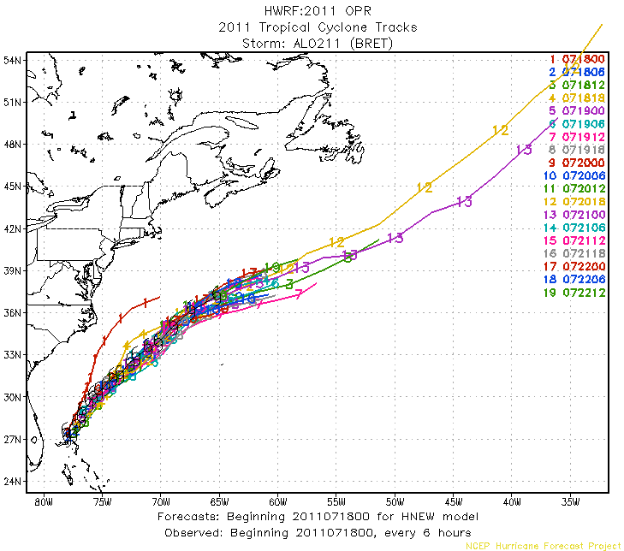
2011 Operational HWRF
HWRF with SAS Corrections
TS Bret, 2011

Slide 22
2011 Operational HWRF
HWRF with SAS Corrections
Hurricane Beatriz, 2011

Slide 23
2011 Operational HWRF
HWRF with SAS Corrections
Hurricane Adrian, 2011

Slide 24
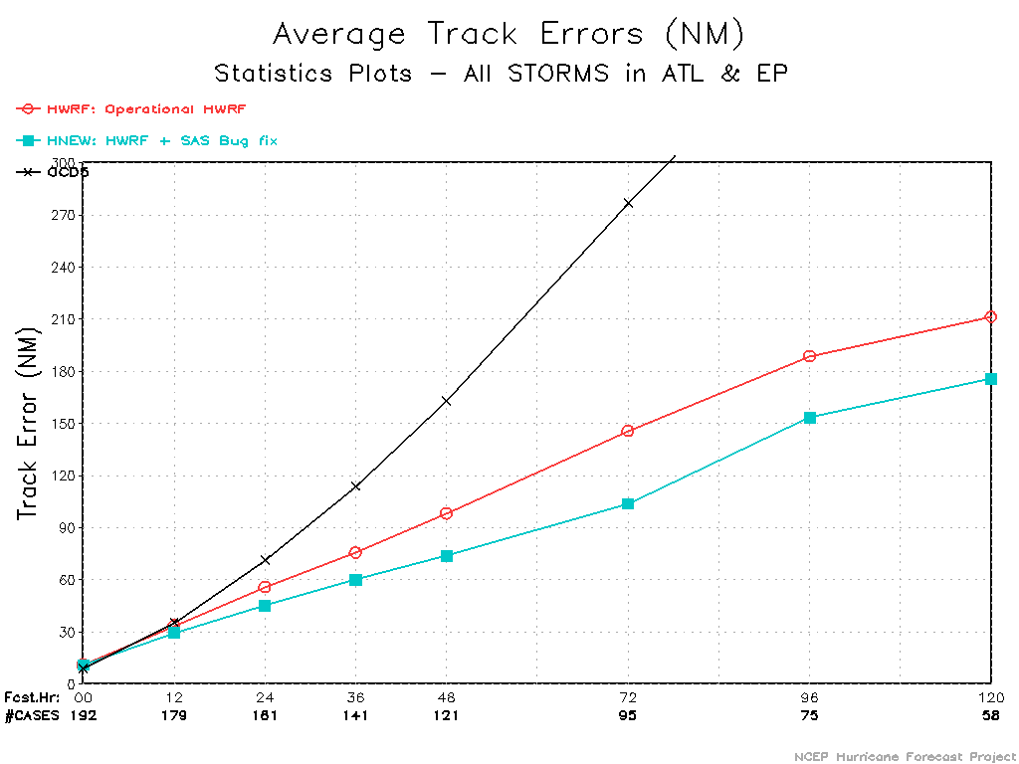
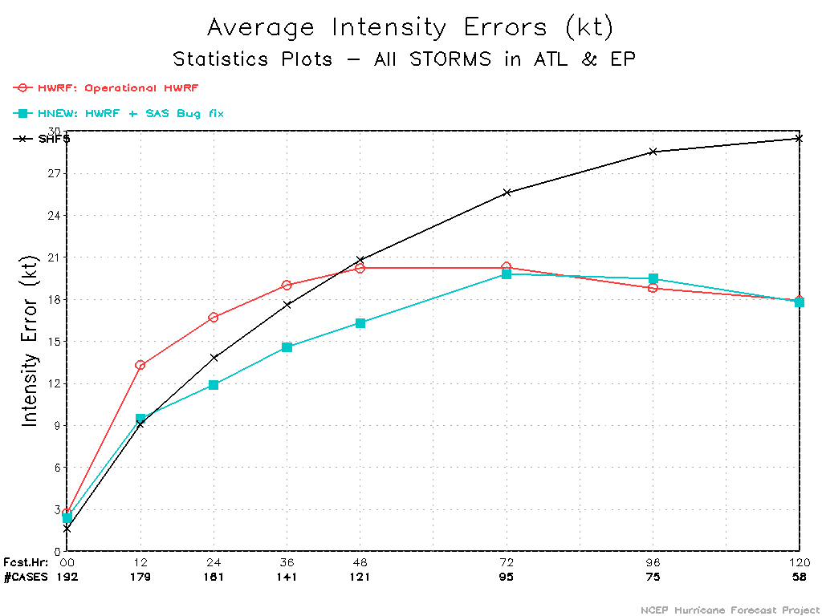
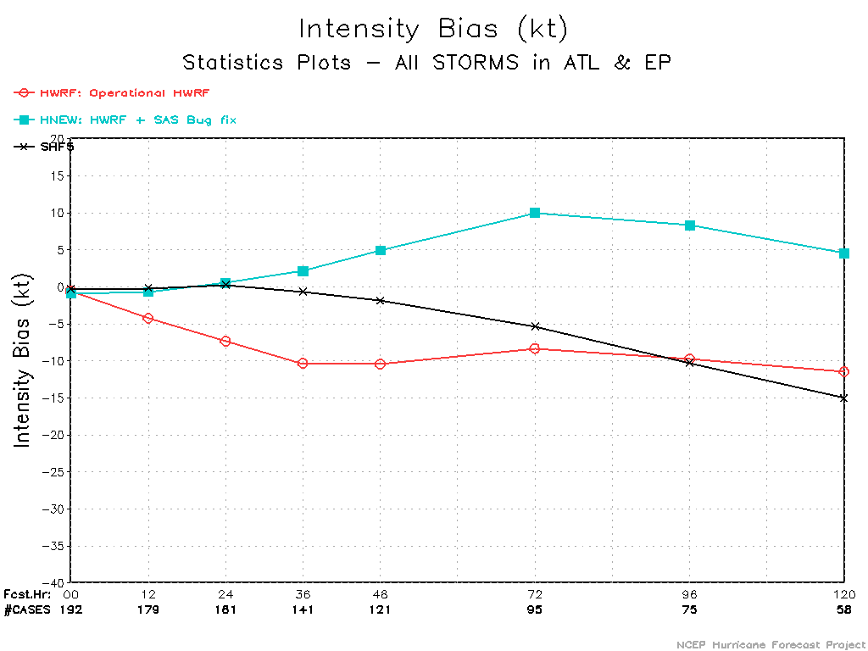

Slide 25
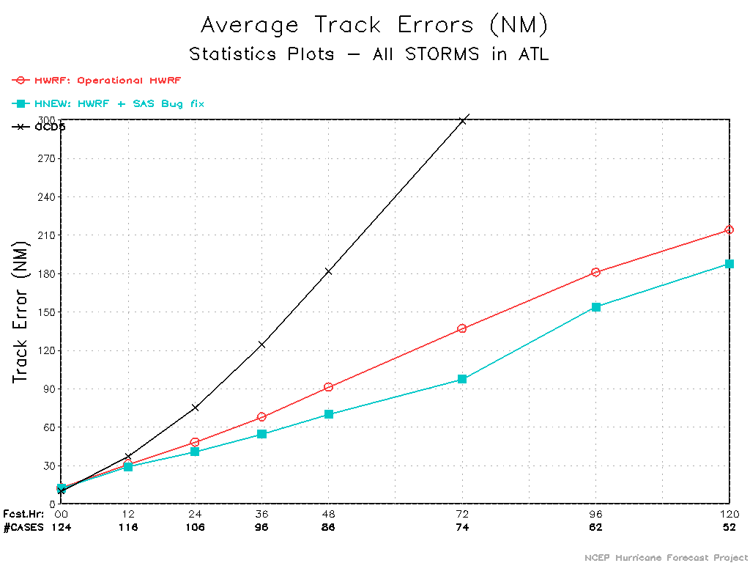
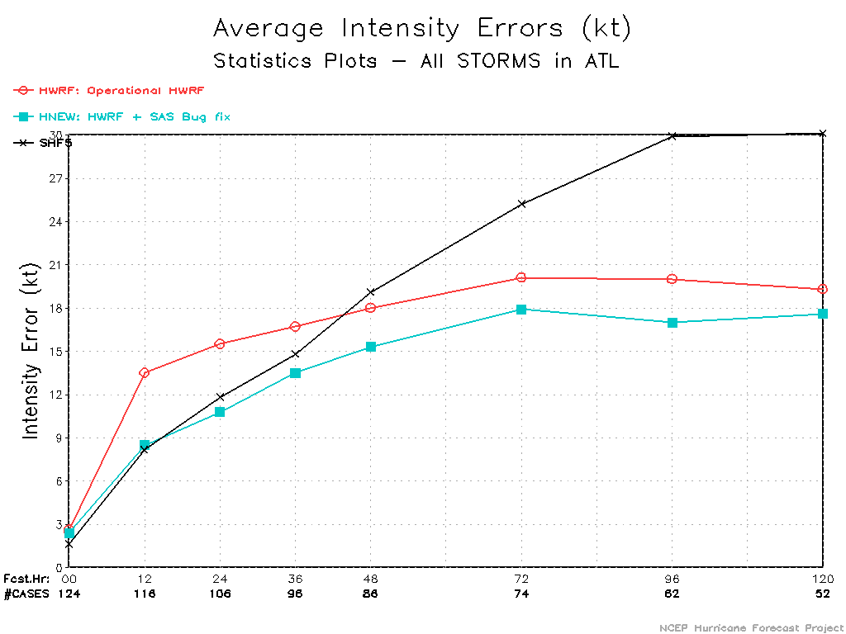
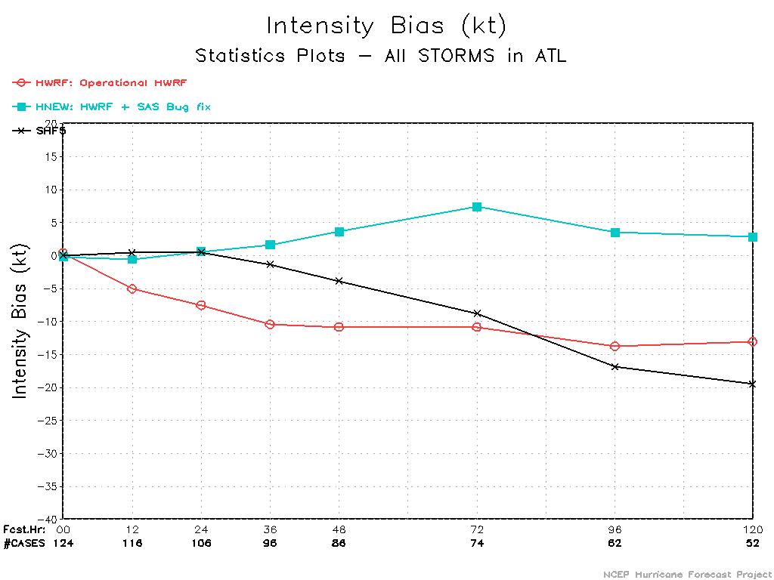

Slide 26
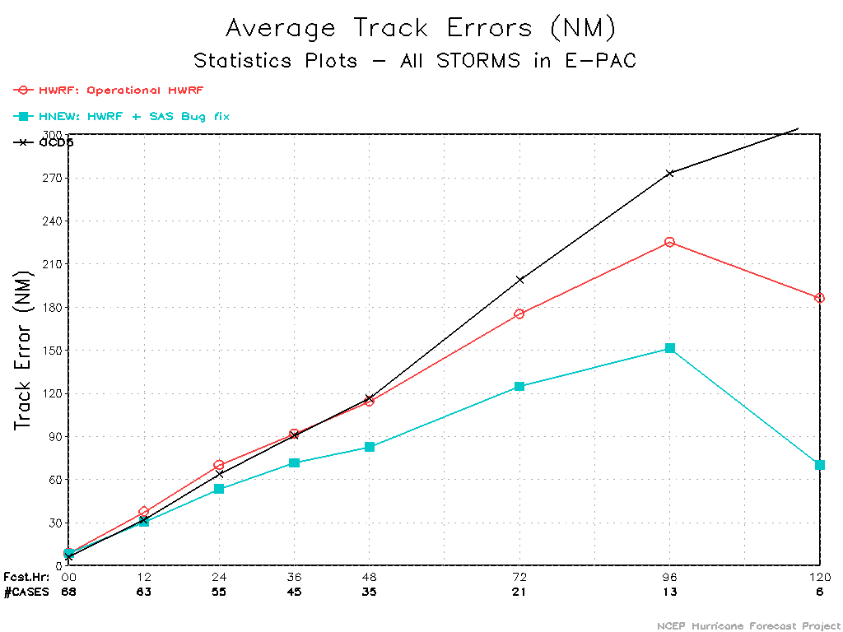
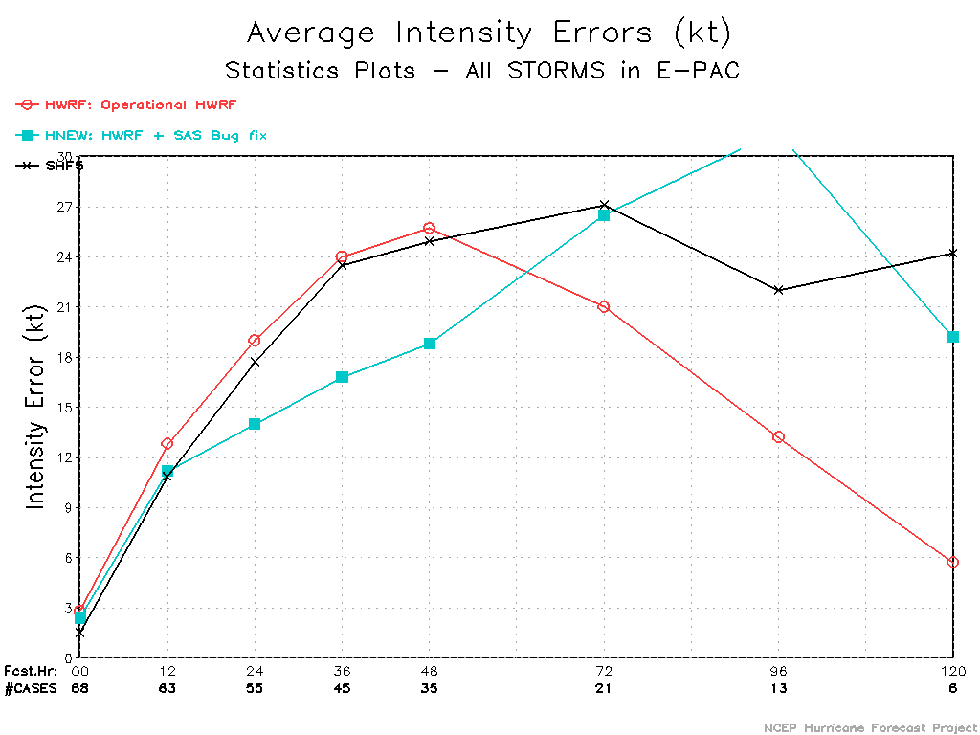
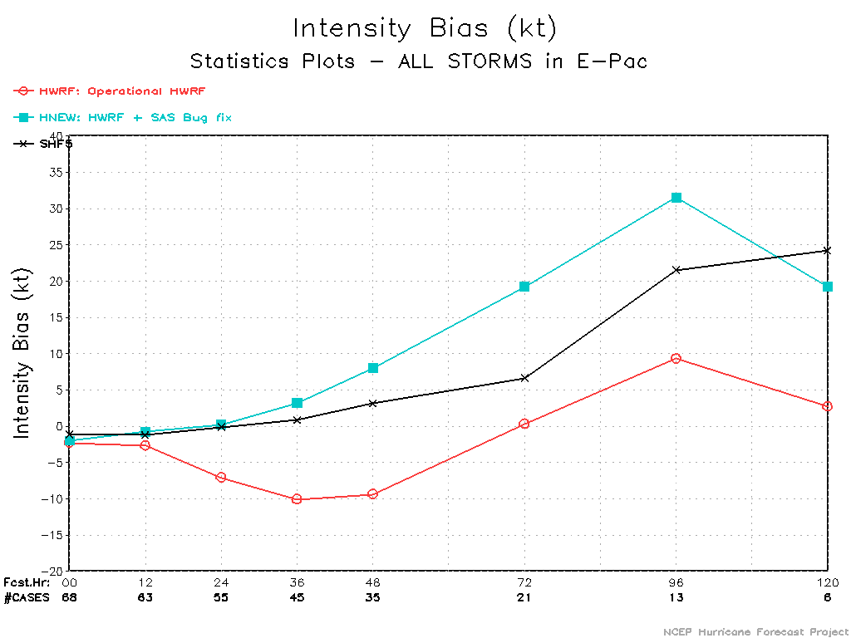

Slide 27
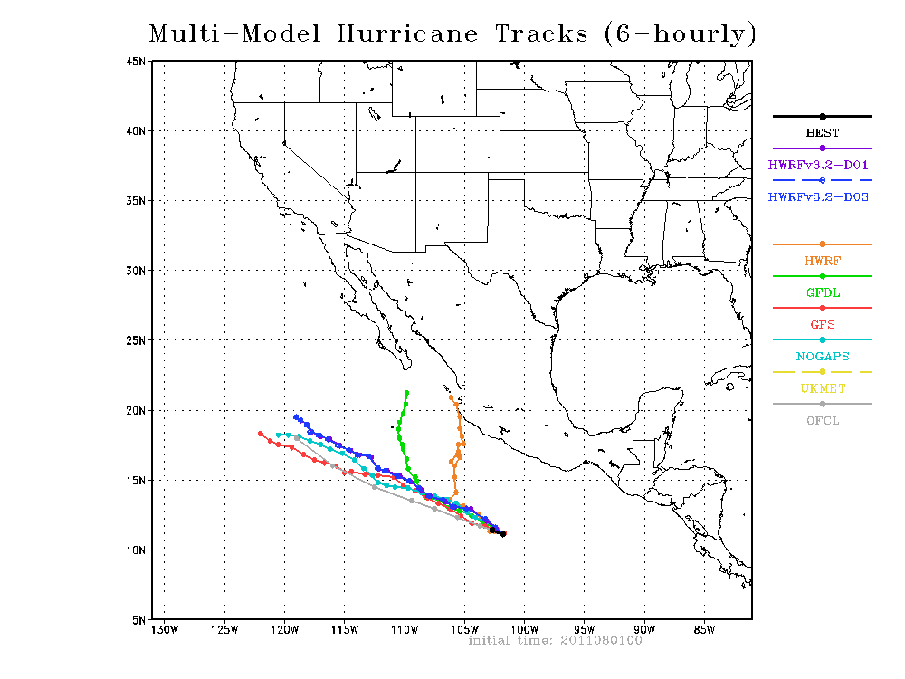
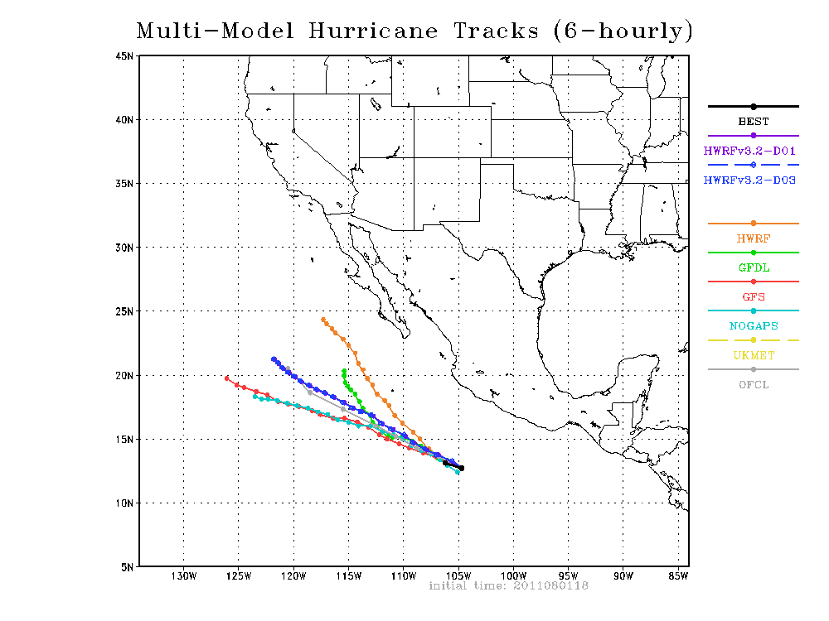
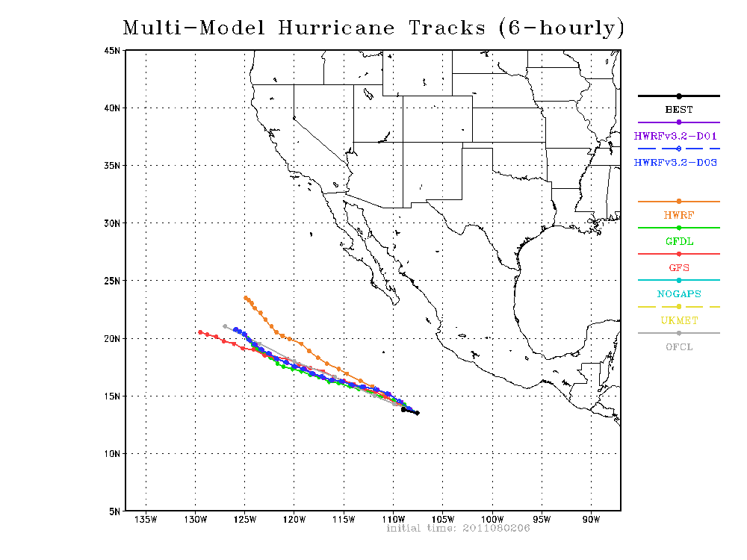

Slide 28
Next steps
More diagnostics on the impact of changes to the operational HWRF
Update all HWRFV3.2 based parallel configurations with this bug fix (including real-time runs)
Evaluate the impact of bug fix on t-Jet vs. CCS
Improve the coding standards – use strict complier options to trace such problems
Better code management through subversion

