Slide 1


High-Resolution Hurricane Reanalysis and Reforecasts Using State-of-the-Art Operational HWRF Model
Zaizhong Ma and Avichal Mehra
Environmental Modeling Center
NOAA/NWS/NCEP
Acknowledgements: HWRF Project team at EMC and Coastal Act project team

Slide 2
Outline
Motivation
  Why do we need to revisit the retrospective storms?
Sample of Storm simulation
  Hurricane IKE (2008)
  Challenges for data assimilation
  Preliminary results
Summary and Future plan

Slide 3
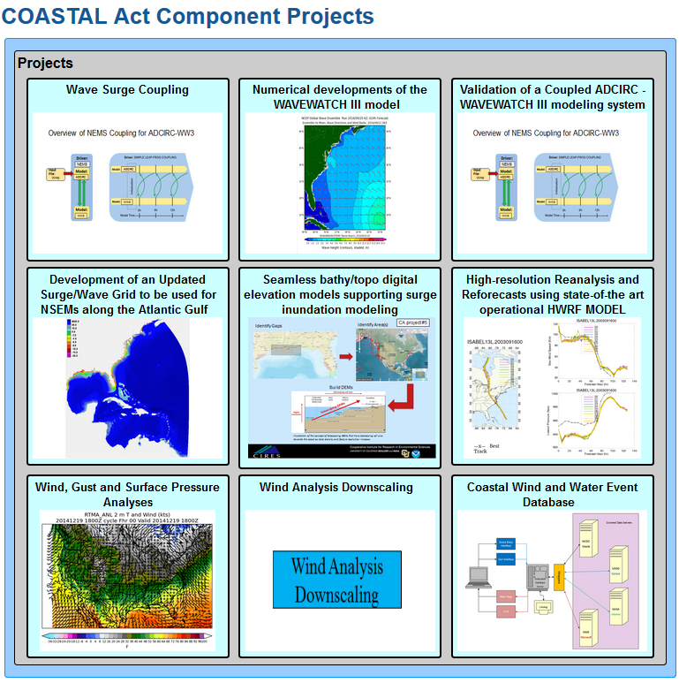
Motivation
COASTAL Act:
The Consumer Option for an Alternative System to Allocate Losses Act was signed into law on July 6, 2012.
Purpose:
To lower costs to FEMA’s National Flood Insurance Program (NFIP) by better discerning wind versus water damage in the case of “indeterminate losses.”
(website: http://www.weather.gov/sti/coastalact)
Require:
NOAA to produce detailed “post-storm assessments” in the aftermath of a damaging tropical cyclone that strikes the U.S. or its territories.
Develop the Named Storm Event Modeling (NSEM) system

Slide 4
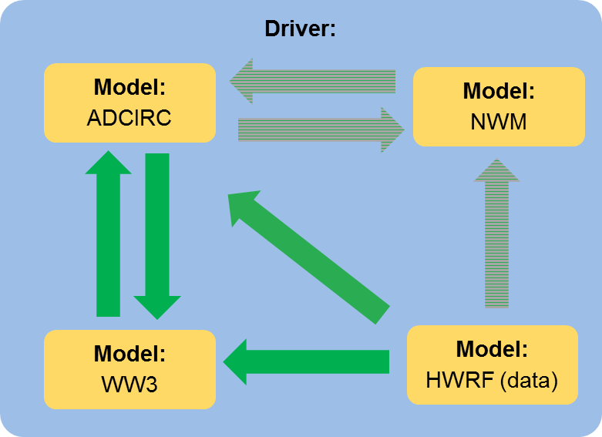
Role of HWRF in the COASTAL Act
HWRF System:
  Nested domain (18/6/2 km), 75 vertical levels with model top
  at 10hPa
  ICs/BCs: with 4D-Hybrid GDAS/GFS
  Ocean coupling with MPIPOM
  Hybrid EnKF-3DVAR DA: hybrid 40-member HWRF-based high resolution ensembles and GSI system
  Forecast outputs: including processed GRIB1 and GRIB2 files (projected to lat-lon grids), track files, rainfall swath data, and wind products containing information about the tropical cyclone.
For COASTAL Act:
  Generate wind and surface pressure analysis from HWRF retrospectives for the selected land falling tropical cyclones.
  Provide background fields for Un-Restricted Mesoscale Analysis (URMA) which will perform mean wind, gust, pressure and air-sea temperature difference (atmospheric stability, AS) surface analysis over the area impacted by a land falling tropical cyclone.

Slide 5
Landfalling storms selected
Reason and benefit
  The requirement for COASTAL Act project
  A good opportunity to build reanalysis and reforecasts datasets for selected landfalling storms.
How will we work on this?
  Select landfalling storms
  Collect any available and useful data.
  Simulation with the latest operational HWRF system.
  Test all kinds of model configurations

Slide 6
Milestones and Issues
Three retrospective storms (Andrew 1992; Isabel 2003 and IKE 2008) simulations have been done with HWRF (H216) system.
  Data collection
    ICs/BCs: GFS Forecasts: 2.5deg Reanalysis & 1.0deg GEFS
    Observations: conventional, satellites, optional for TDR and High Density Observation data
  HWRF configurations (ocean coupling, data assimilation)
Main Issues:
  Input Data for HWRF
  Specify setup for each storms, especially about DA setup
  No ensemble inputs for GSI hybrid ensemble-variational DA before 2012

Slide 7
HWRF Reanalysis and Reforecasts for Hurricane IKE (2008)

Slide 8
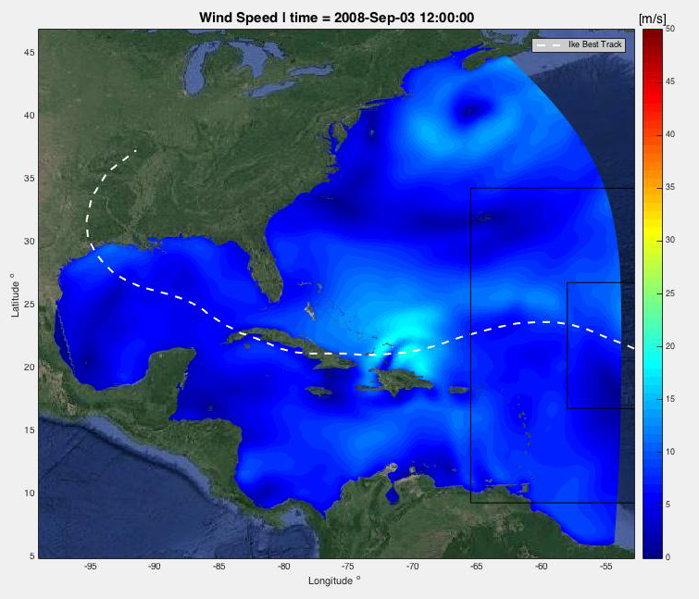
Experiments Designed for IKE Simulation
Time Period: 1-14, September 2008
Experiments:
  GR05: IKE simulation with 0.5 degree GFS (No DA, No Ocean)
  OC05: IKE simulation with 0.5 degree GFS (No DA, with Ocean)
  DA05: IKE simulation with 0.5 degree GFS (With 3D-Var, with Ocean)
  BC05: IKE simulation with 0.5 degree GFS (With 3D-Var, Ocean and adjusted satellite bias corrections)
Preliminary Results focus on track and intensity forecasts

Slide 9
Special DA Adjustment for IKE
Issues:
  Satellite bias corrections available for the year 2008 can not use in current version of the GSI system.
Solution:
  Replace with files from the same month in 2017, bias correction coefficients are directly from GDAS with no adjustment;
  Adjust adaptive radiance bias corrections using an Enhanced radiance bias correction scheme (Yanqiu Zhu etc. al.);
  Rerun Hurricane IKE simulation with adjusted radiance bias corrections

Slide 10
Bias Correction in GSI
Default in HWRF:
BC from global
BC from global
BC from global
BC from global
1800 UTC
0000 UTC
0006 UTC
0012 UTC
With Adjustment:
BC from global
Self-cycled
Bias Correction
Self-cycled
Bias Correction
Self-cycled
Bias Correction
1800 UTC
0000 UTC
0006 UTC
0012 UTC

Slide 11
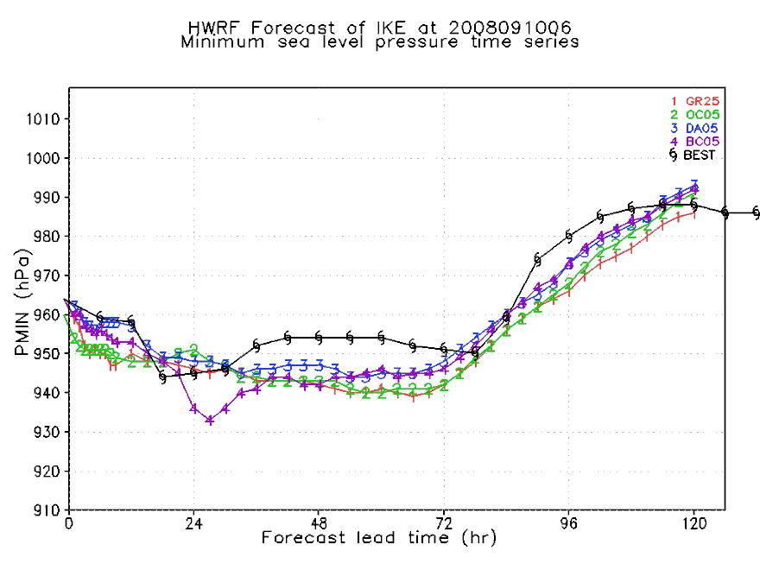
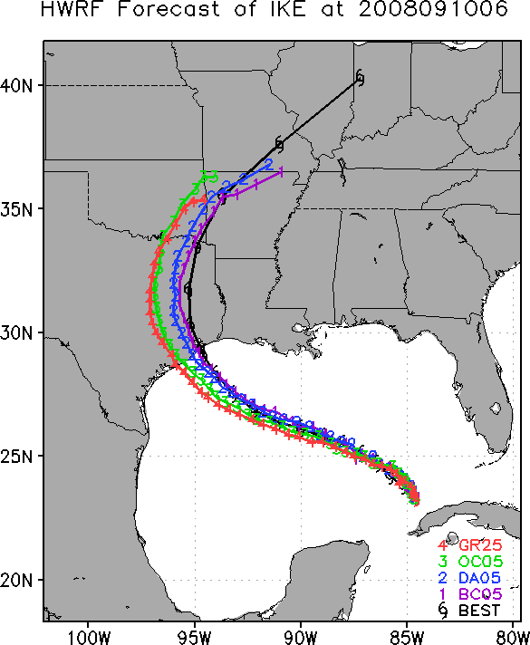
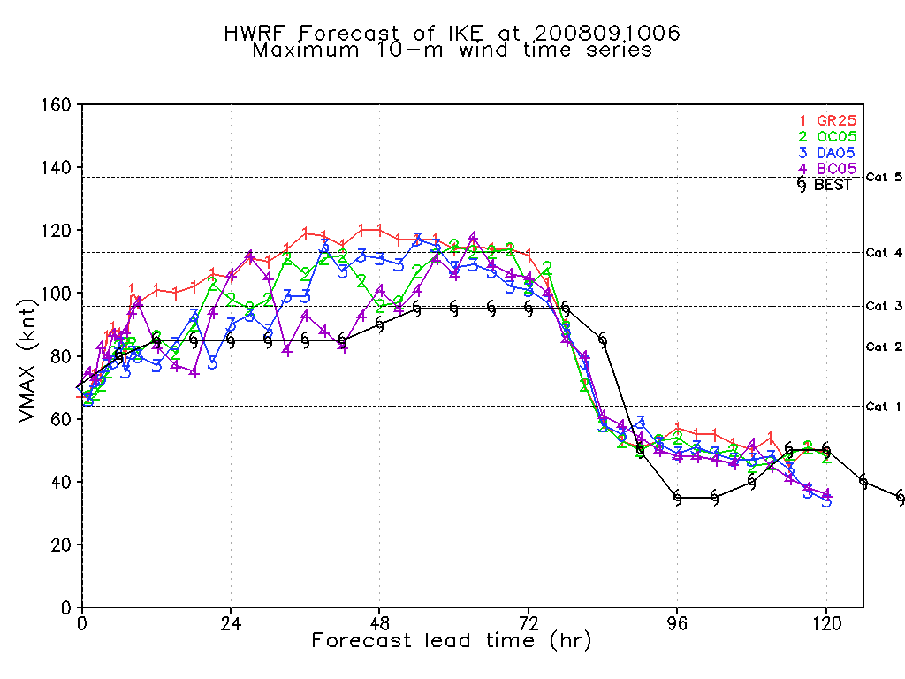
Single Cycle Comparison

Slide 12
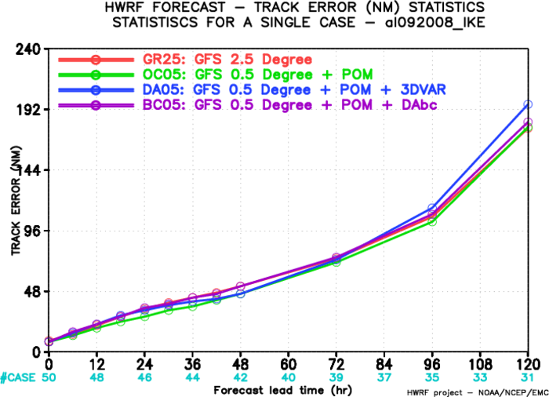
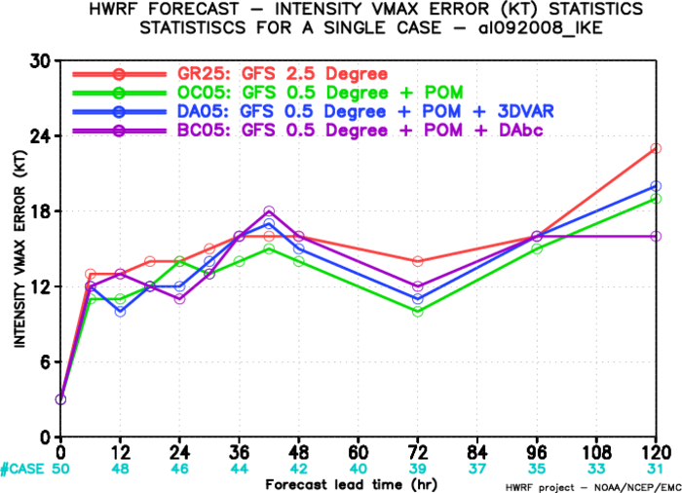
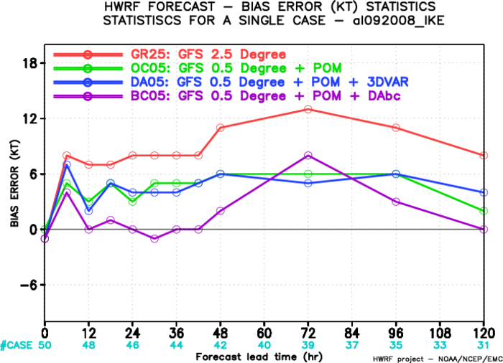
Preliminary Statistics Results for IKE

Slide 13
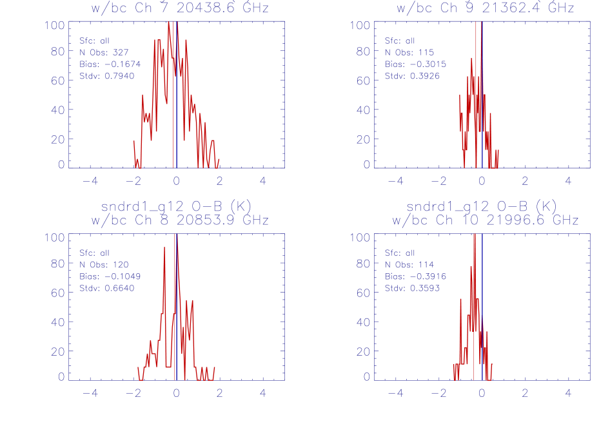
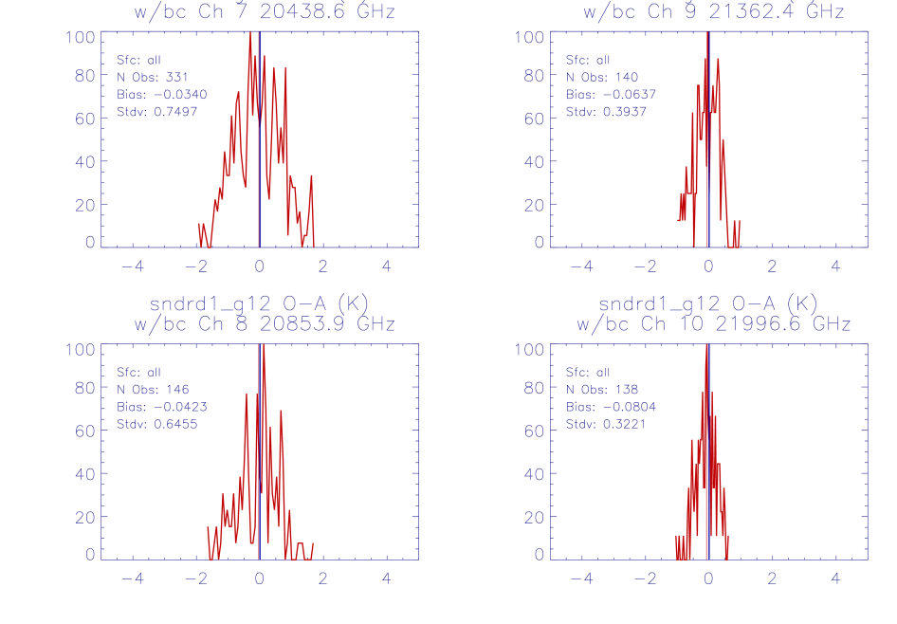
Small impacts from DA?
O-B
O-A
Ch7
Ch9
Ch7
Ch9
Ch8
Ch10
Ch8
Ch10
GOES-12 comparison before/after assimilation

Slide 14
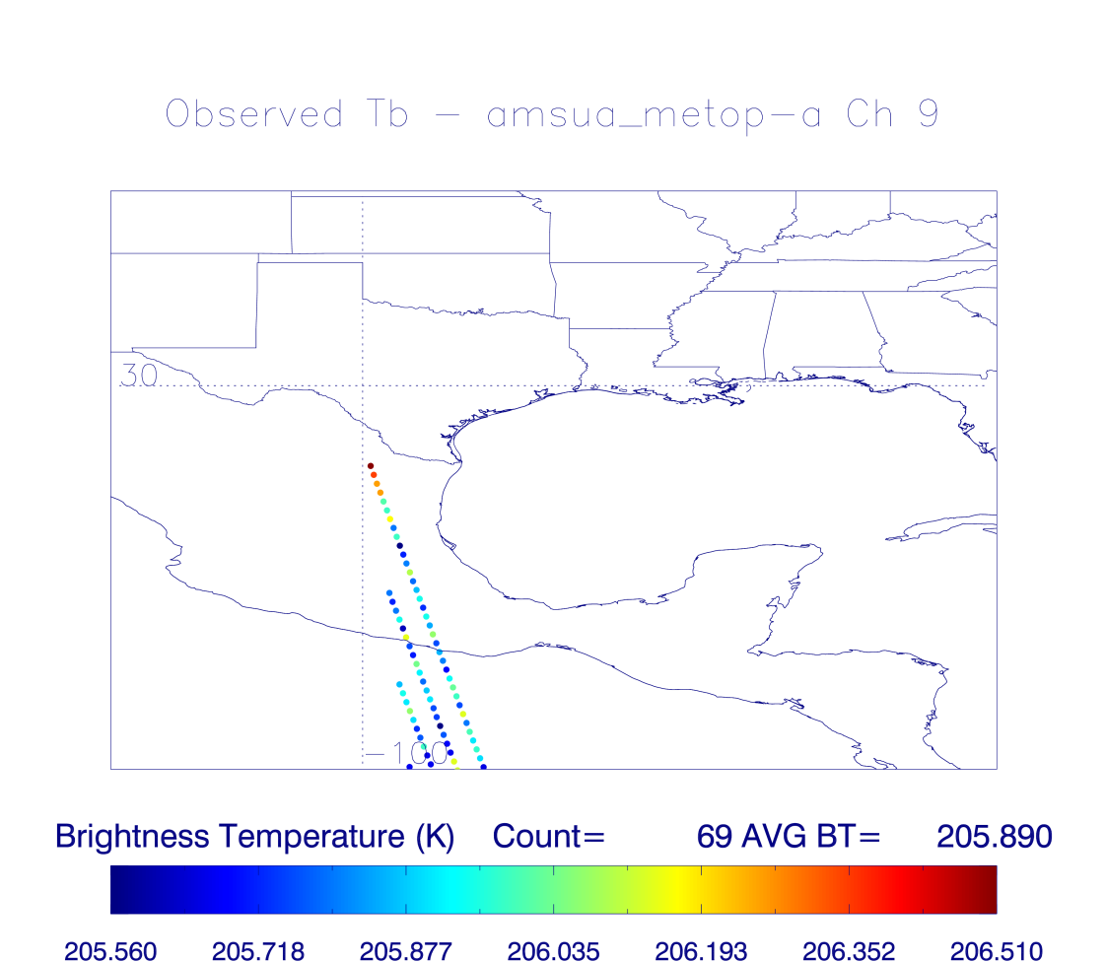
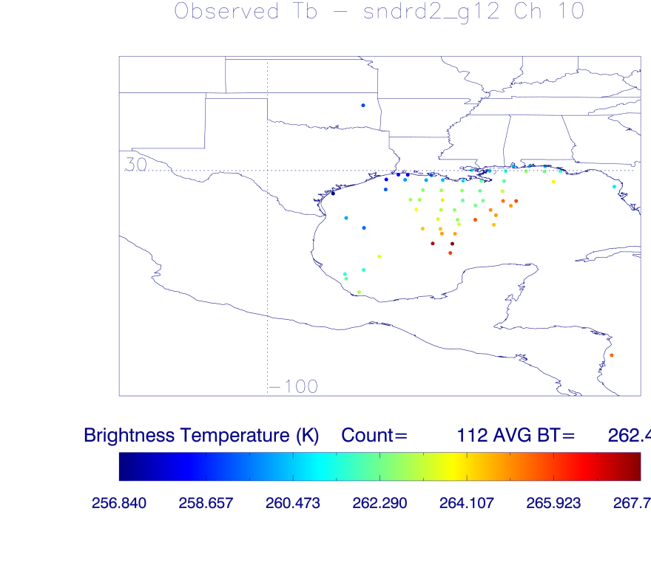
Small impacts from DA?
amsua_metop-a
G12

Slide 15
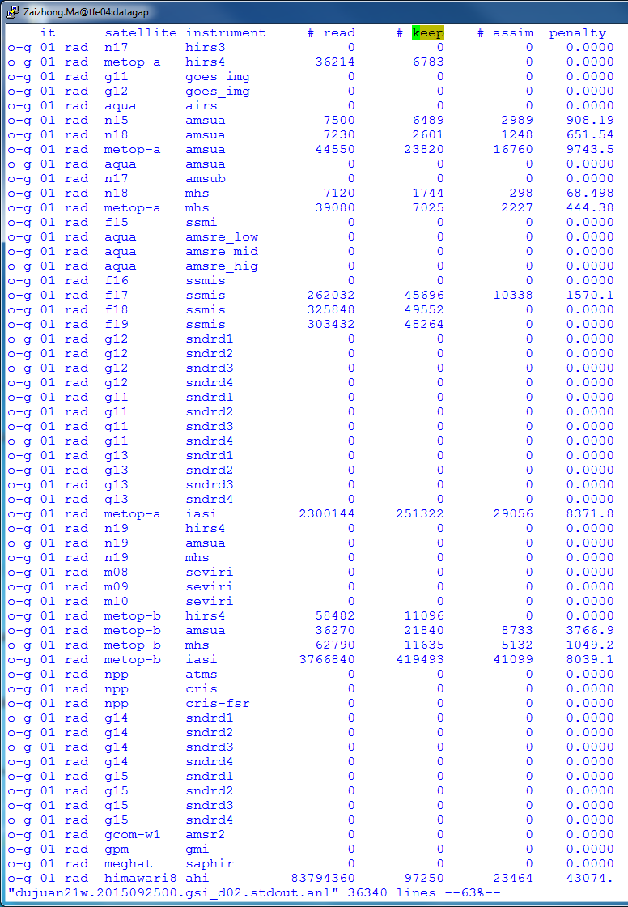
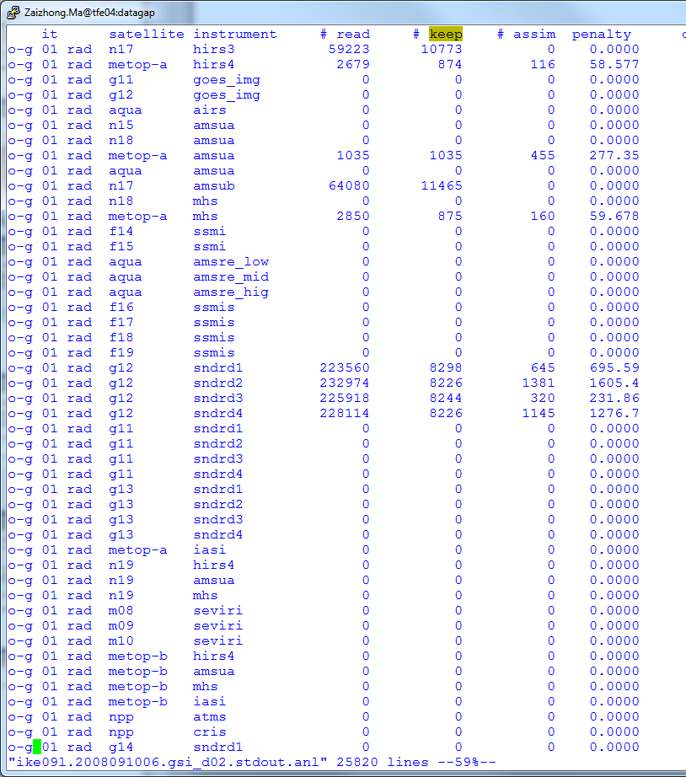
Why little contribution from DA?
AHI OSE (2015)
Data Check: IKE (2008)

Slide 16
Summary and Future Plan
Summary:
Completed HWRF simulations for three selected land-falling storms;
Completed multiple experiments for Hurricane IKE simulations;
Applied satellite self-cycle bias corrections in HWRF for IKE.
Future Plans:
Test satellite self-cycle bias corrections in HWRF for more recent storms, such as Sandy (2012) etc.;
Simulate Recent retrospective storm with hybrid ensemble-variational DA;
Consider the possibility of assimilating satellite data with advanced satellite bias corrections in the parent domain D1.

