Slide 1
RECENT AND PLANNED UPGRADES TO THE OPERATIONAL HWRF DATA ASSIMILATION SYSTEM
Henry R. Winterbottom¹, Jason Sippel², Zhan Zhang¹, and Avichal Mehra³
16 April 2018
¹I. M. Systems Group, Inc. (IMSG) and NOAA/NWS NCEP EMC
²NOAA AOML/HRD
³NOAA/NWS NCEP EMC

Slide 2
Outline:
Milestones for 2017 – 2018

Slide 3
Outline:
Milestones for 2017 – 2018
Planned Data Assimilation Testing

Slide 4
Outline:
Milestones for 2017 – 2018
Planned Data Assimilation Testing
Planned Activities During the Next 2-3 Years

Slide 5
Outline:
Milestones for 2017 – 2018
Planned Data Assimilation Testing
Planned Activities During the Next 2-3 Years
Conclusions

Slide 6
Milestones for 2017-2018:
Cycling, Hybrid-Ensemble Data Assimilation
Member 01
Member 01
Member 01
Member 02
Member 02
Member 02
Member 03
Member 03
Member 03
Member 04
Member 04
Ensemble Kalman Filter
Member 04
Re-center Ensemble
Member 05
Member 05
Member 05
Member N
Member N
Member N
Ensemble Covariance
High-resolution Control Forecast
Ensemble-3DVAR (Hybrid) Data Assimilation
High-resolution Control Analysis
Legend:
Background Forecast(s)
Observation Statistics
Data Assimilation
Updated Initial Condition(s)

Slide 7
Milestones for 2017-2018:
Cycling, Hybrid-Ensemble Data Assimilation
H
W
R
F
Member 01
Member 01
Member 01
Member 02
Member 02
Member 02
Member 03
Member 03
Member 03
Member 04
Member 04
Ensemble Kalman Filter
Member 04
Re-center Ensemble
Member 05
Member 05
Member 05
Member N
Member N
Member N
Ensemble Covariance
High-resolution Control Forecast
Ensemble-3DVAR (Hybrid) Data Assimilation
High-resolution Control Analysis
Legend:
Background Forecast(s)
Observation Statistics
Data Assimilation
Updated Initial Condition(s)

Slide 8
Milestones for 2017-2018:
Cycling, Hybrid-Ensemble Data Assimilation
H
W
R
F
Member 01
Member 01
Member 01
G
S
I
Member 02
Member 02
Member 02
Member 03
Member 03
Member 03
Member 04
Member 04
Ensemble Kalman Filter
Member 04
Re-center Ensemble
Member 05
Member 05
Member 05
Member N
Member N
Member N
Ensemble Covariance
High-resolution Control Forecast
Ensemble-3DVAR (Hybrid) Data Assimilation
High-resolution Control Analysis
Legend:
Background Forecast(s)
Observation Statistics
Data Assimilation
Updated Initial Condition(s)

Slide 9
Milestones for 2017-2018:
Cycling, Hybrid-Ensemble Data Assimilation
H
W
R
F
E
N
K
F
Member 01
Member 01
Member 01
G
S
I
Member 02
Member 02
Member 02
Member 03
Member 03
Member 03
Member 04
Member 04
Ensemble Kalman Filter
Member 04
Re-center Ensemble
Member 05
Member 05
Member 05
Member N
Member N
Member N
Ensemble Covariance
High-resolution Control Forecast
Ensemble-3DVAR (Hybrid) Data Assimilation
High-resolution Control Analysis
Legend:
Background Forecast(s)
Observation Statistics
Data Assimilation
Updated Initial Condition(s)

Slide 10
Milestones for 2017-2018:
Cycling, Hybrid-Ensemble Data Assimilation
H
W
R
F
E
N
K
F
H
W
R
F
Member 01
Member 01
Member 01
G
S
I
Member 02
Member 02
Member 02
Member 03
Member 03
Member 03
Member 04
Member 04
Ensemble Kalman Filter
Member 04
Re-center Ensemble
Member 05
Member 05
Member 05
Member N
Member N
Member N
Ensemble Covariance
High-resolution Control Forecast
Ensemble-3DVAR (Hybrid) Data Assimilation
High-resolution Control Analysis
Legend:
Background Forecast(s)
Observation Statistics
Data Assimilation
Updated Initial Condition(s)

Slide 11
Milestones for 2017-2018:
Testing New Observation Types for HWRF 2017
Three new classes of satellite Atmosphere Motion Vectors (AMV) added to the operational configuration

Slide 12
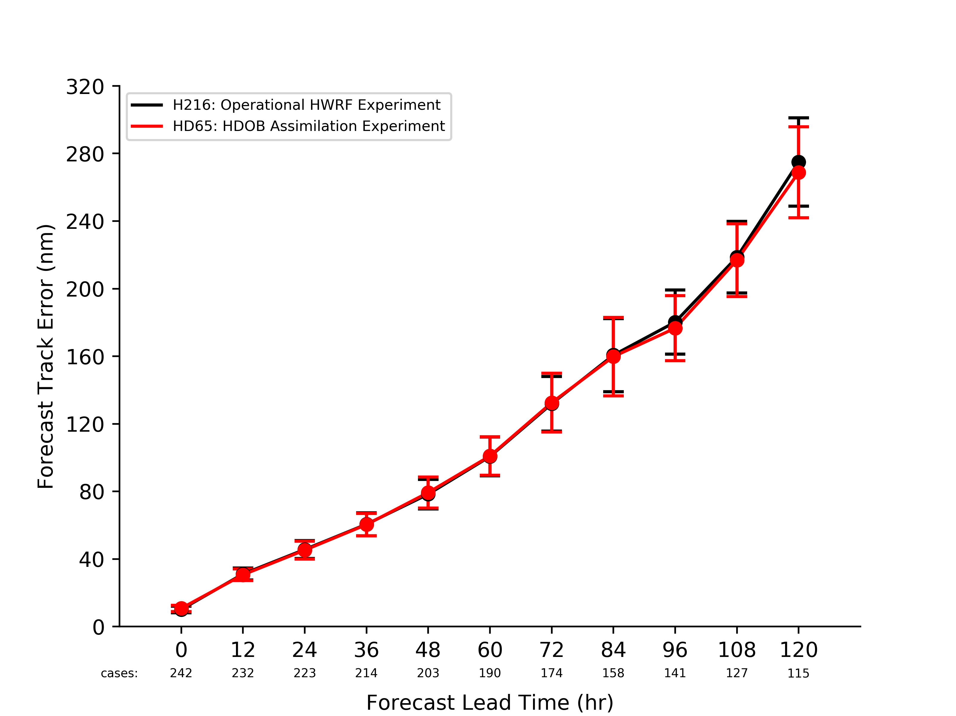
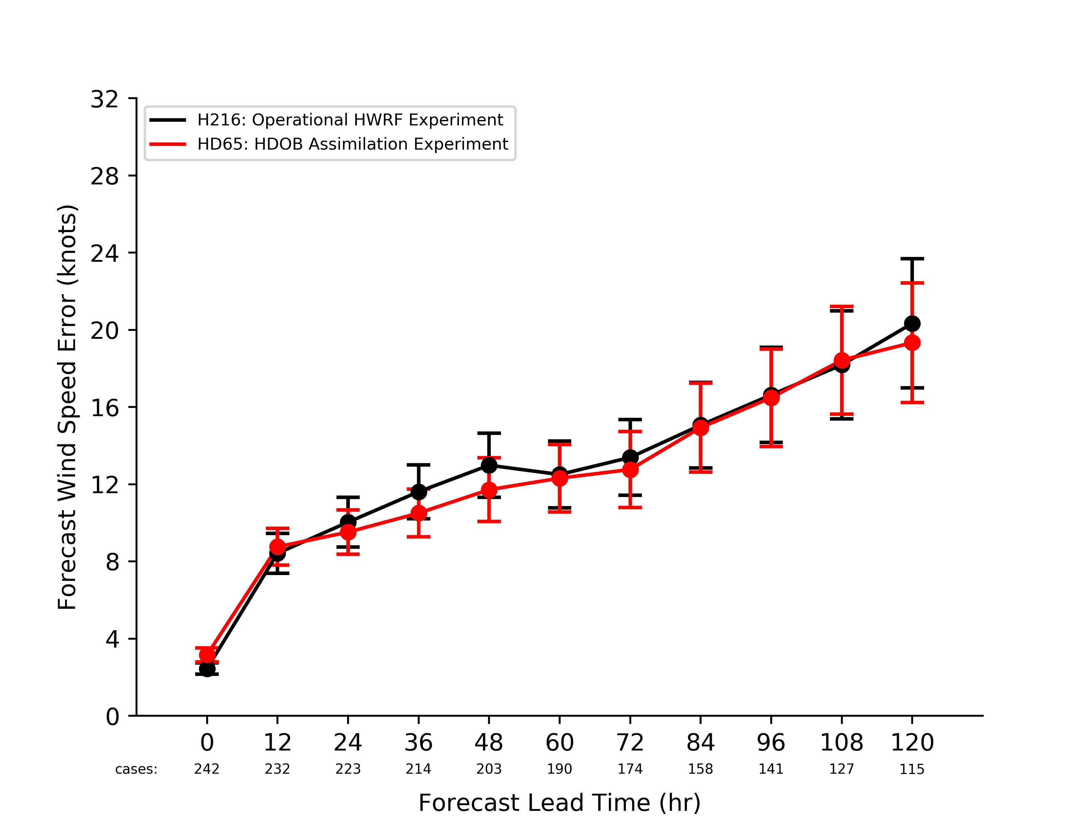
Milestones for 2017-2018:
Testing New Observation Types for HWRF 2017
Three new classes of satellite Atmosphere Motion Vectors (AMV) added to the operational configuration
Flight-level (e.g., High-density Observations, HDOB) are assimilated
Track Forecast Errors Relative to Observations
Maximum Wind Speed Forecast Errors Relative to Observations
Control Experiment
Control Experiment
Data Assimilation Experiment
Data Assimilation Experiment

Slide 13
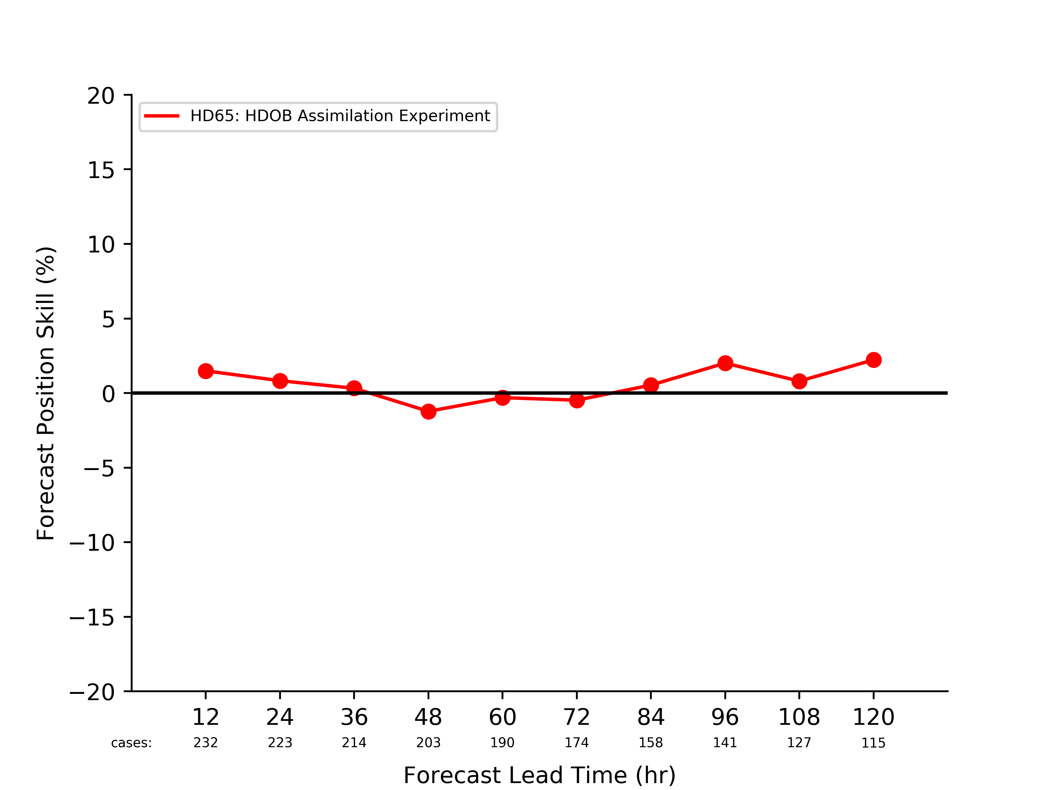
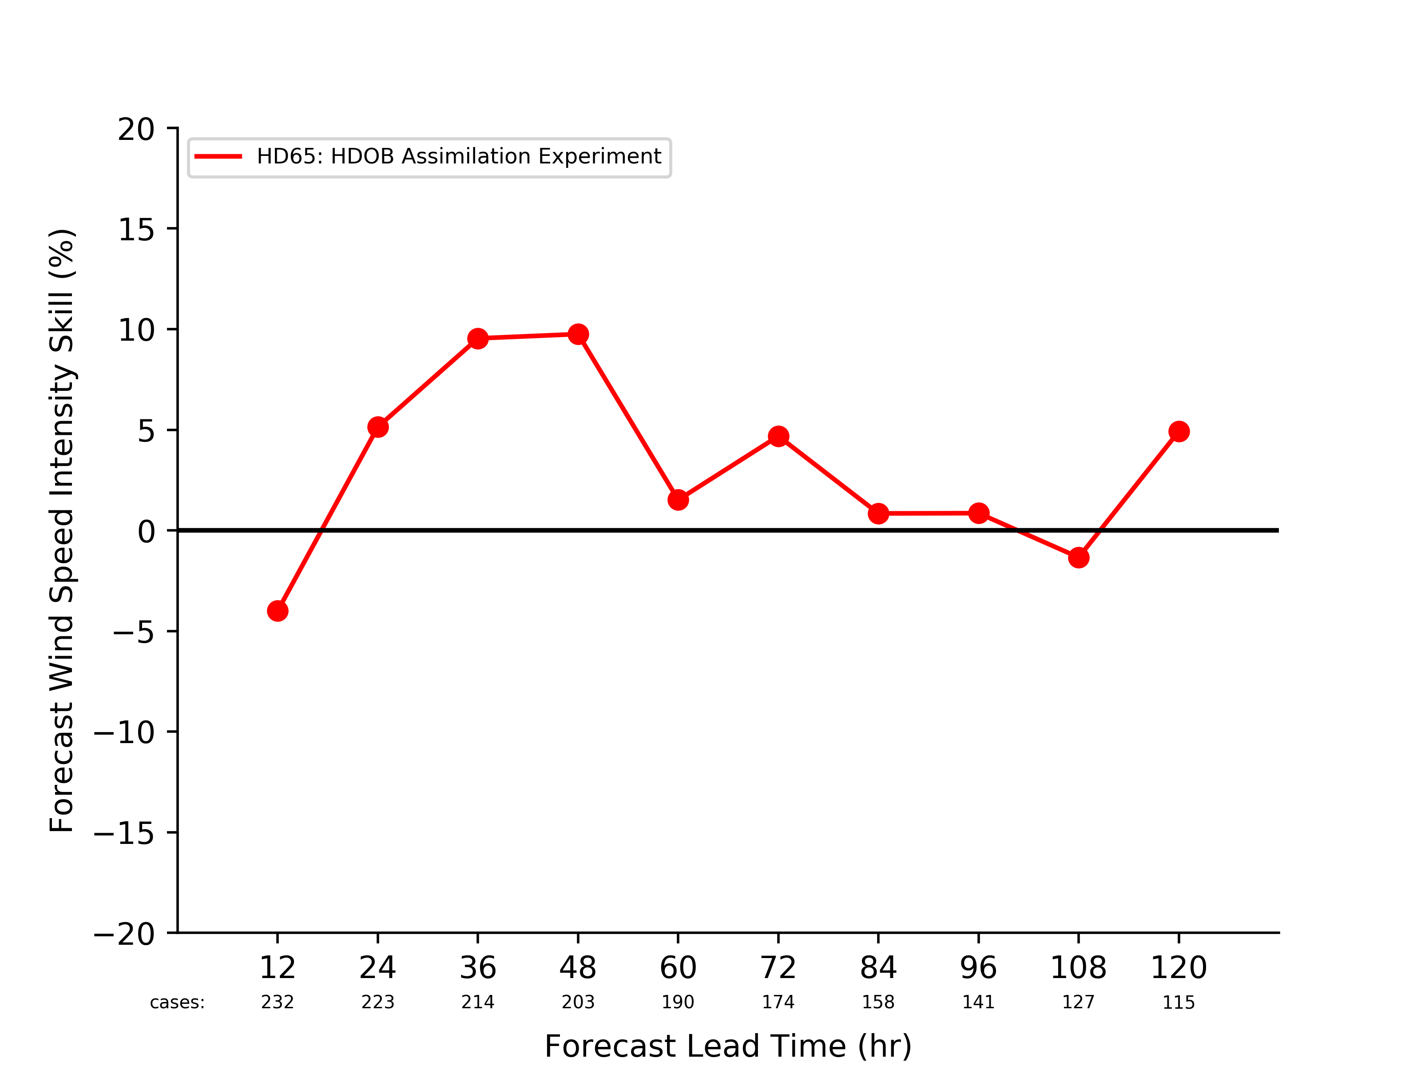
Milestones for 2017-2018:
Testing New Observation Types for HWRF 2017
Three new classes of satellite Atmosphere Motion Vectors (AMV) added to the operational configuration
Flight-level (e.g., High-density Observations, HDOB) are assimilated
Implementation testing illustrates positive improvement for intensity forecasts
Control Experiment
Control Experiment
Data Assimilation Experiment
Data Assimilation Experiment
Track Forecast Skill Relative to Control Experiment
Intensity Forecast Skill Relative to Control Experiment

Slide 14
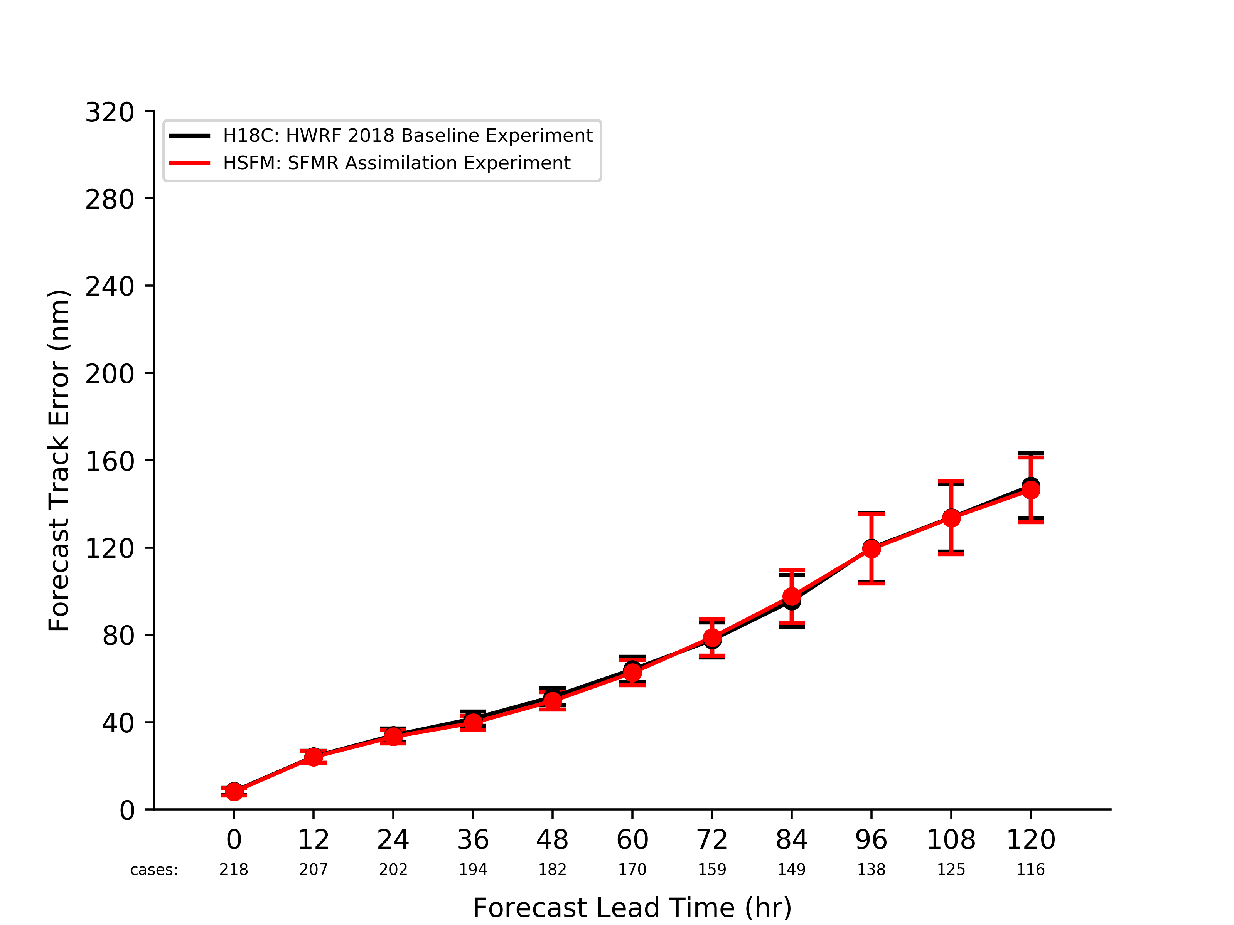
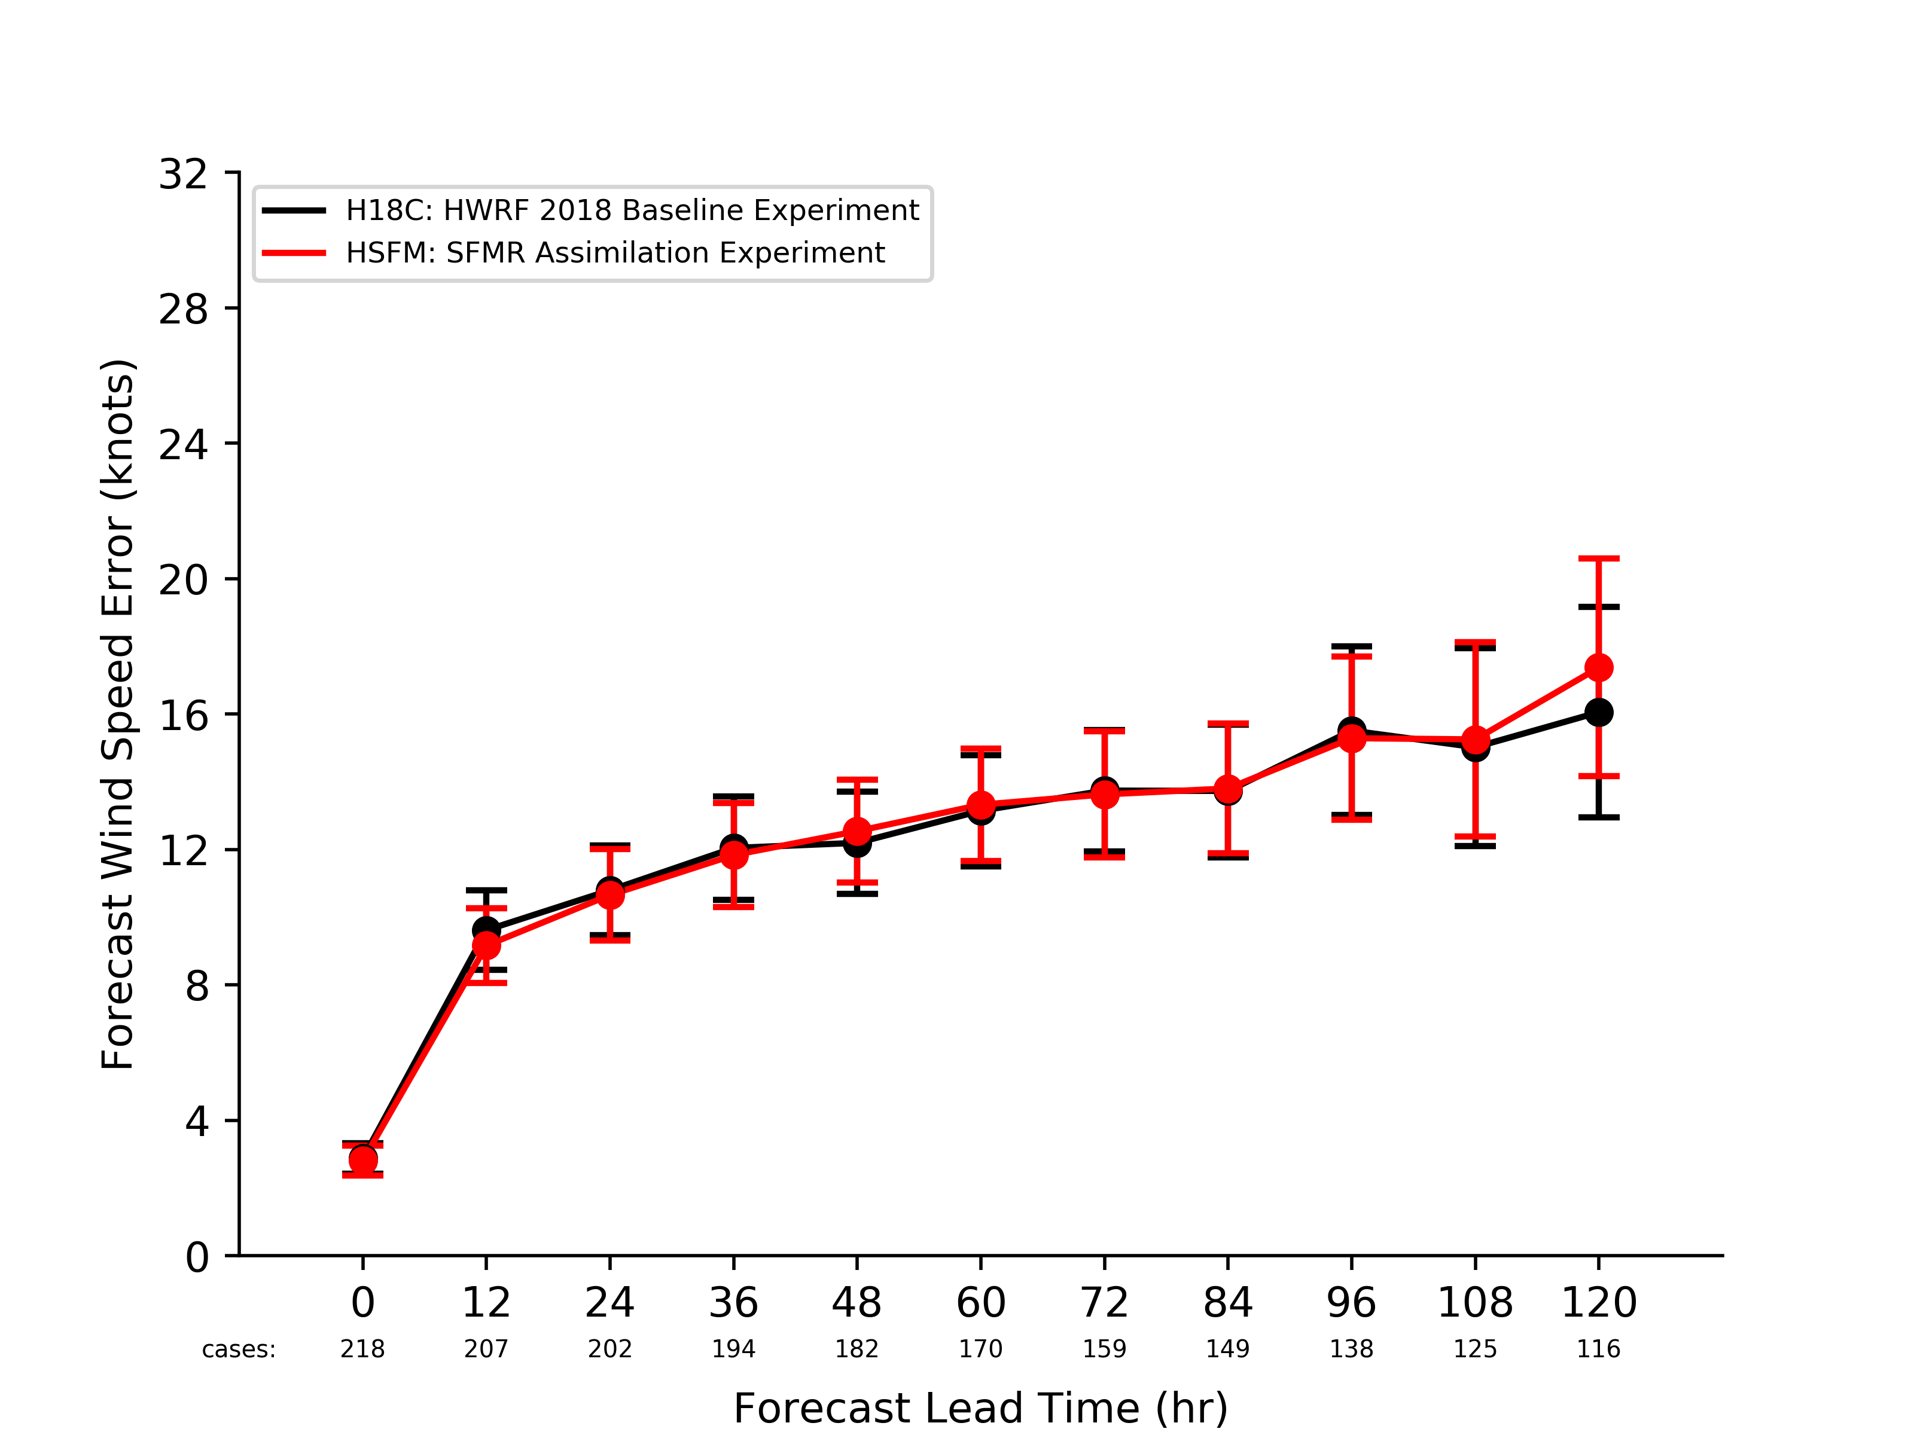
Milestones for 2017-2018:
Testing New Observation Types for HWRF 2018
Stepped Frequency Microwave Radiometer (SFMR) and Tail-Doppler Radar (TDR) observations assimilation added
Track Forecast Errors Relative to Observations
Maximum Wind Speed Forecast Errors Relative to Observations
Control Experiment
Control Experiment
Data Assimilation Experiment
Data Assimilation Experiment

Slide 15
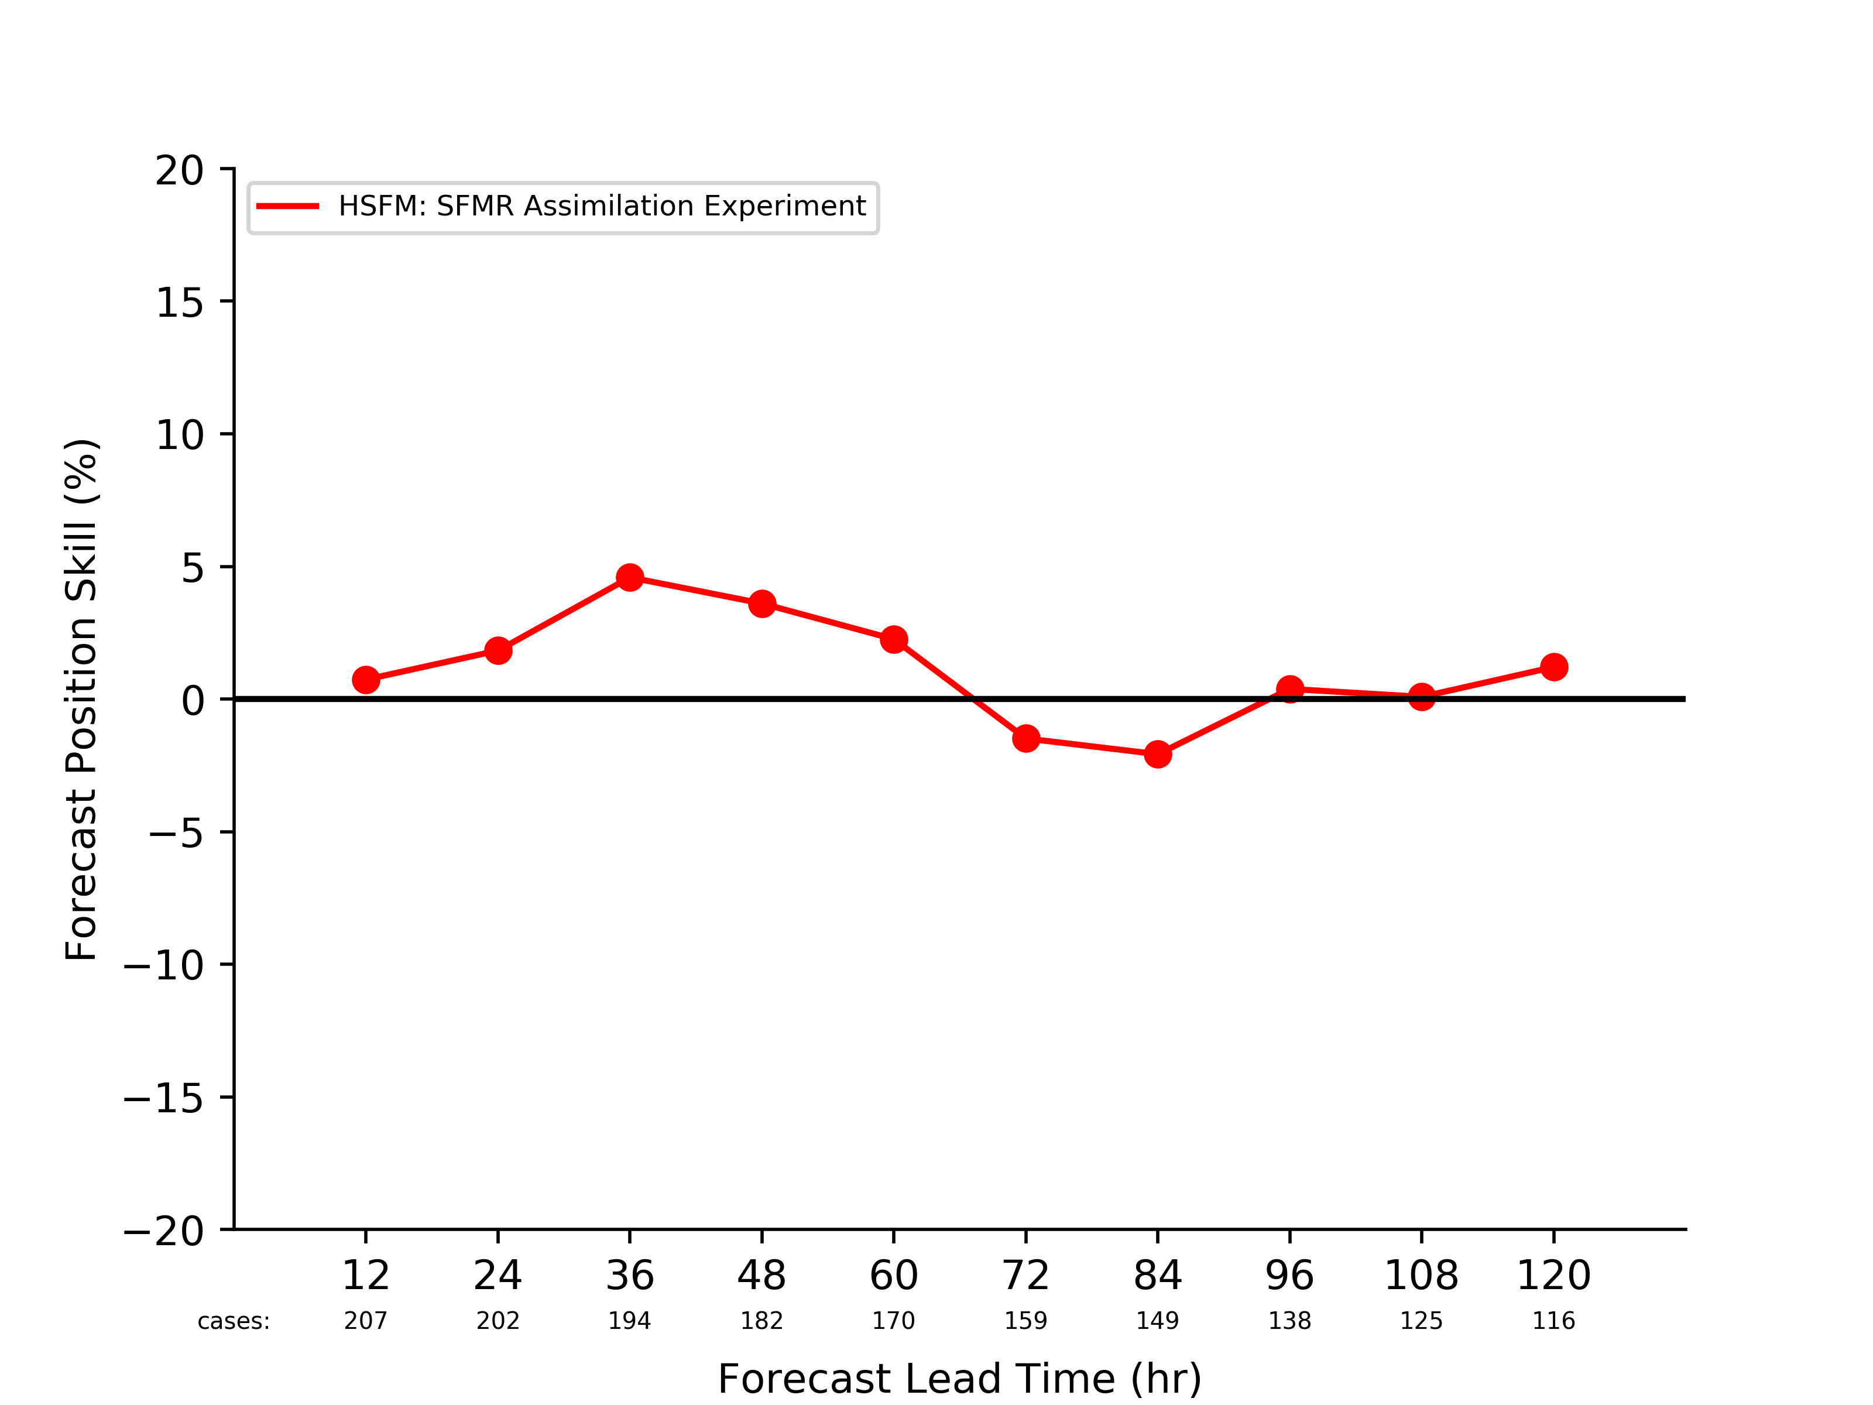
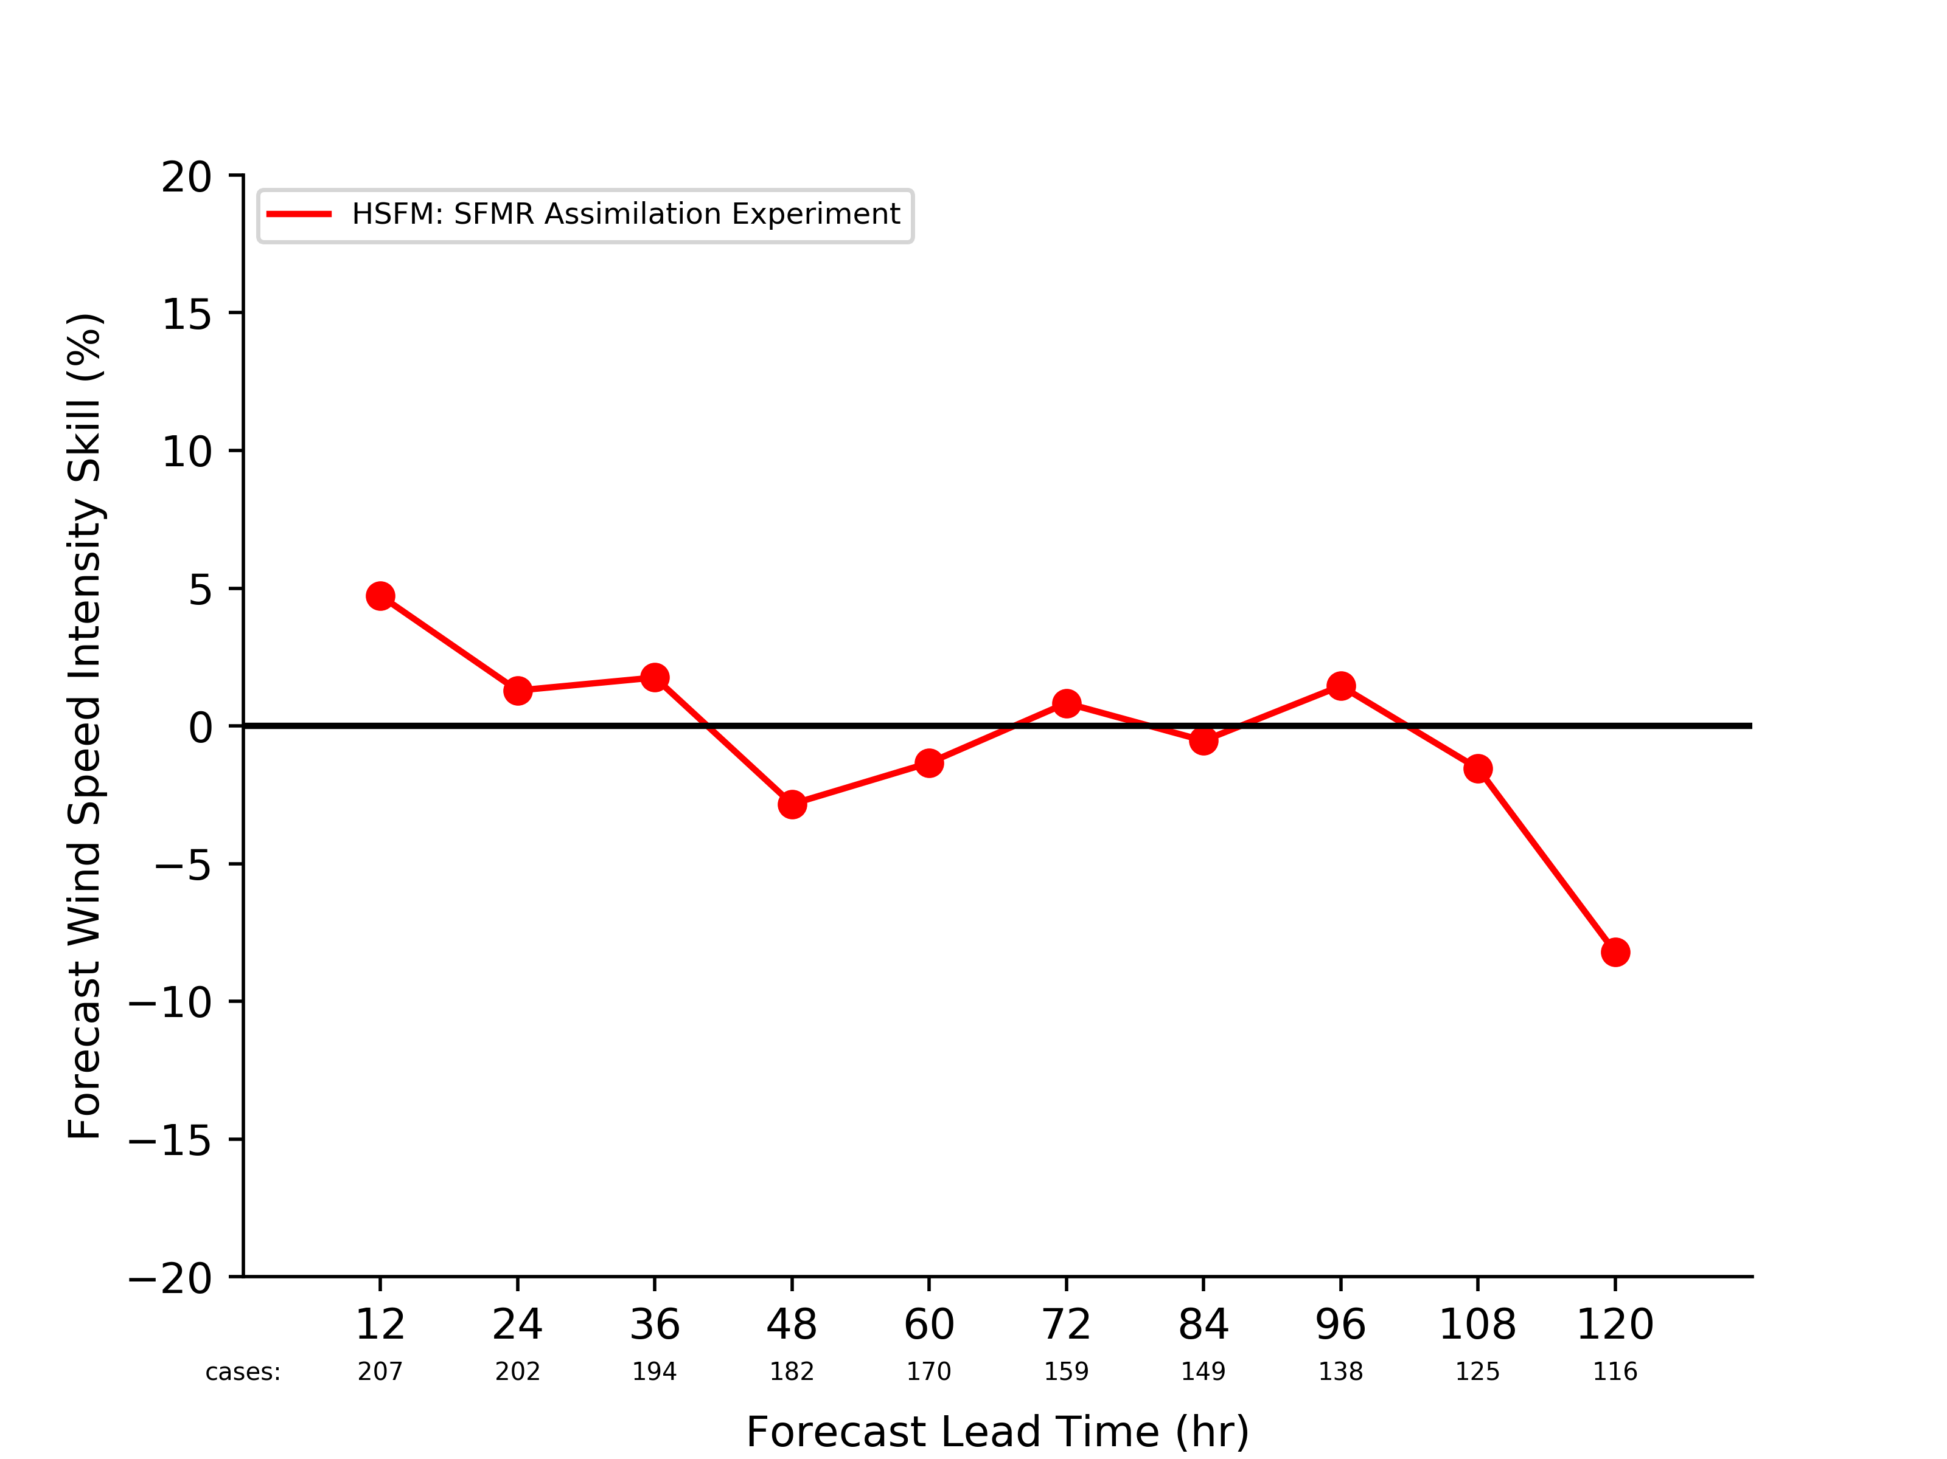
Milestones for 2017-2018:
Testing New Observation Types for HWRF 2018
Stepped Frequency Microwave Radiometer (SFMR) and Tail-Doppler Radar (TDR) observations assimilation added
SFMR illustrates generally positive forecast impacts, especially for track prediction
Control Experiment
Control Experiment
Data Assimilation Experiment
Data Assimilation Experiment
Track Forecast Skill Relative to Control Experiment
Intensity Forecast Skill Relative to Control Experiment

Slide 16
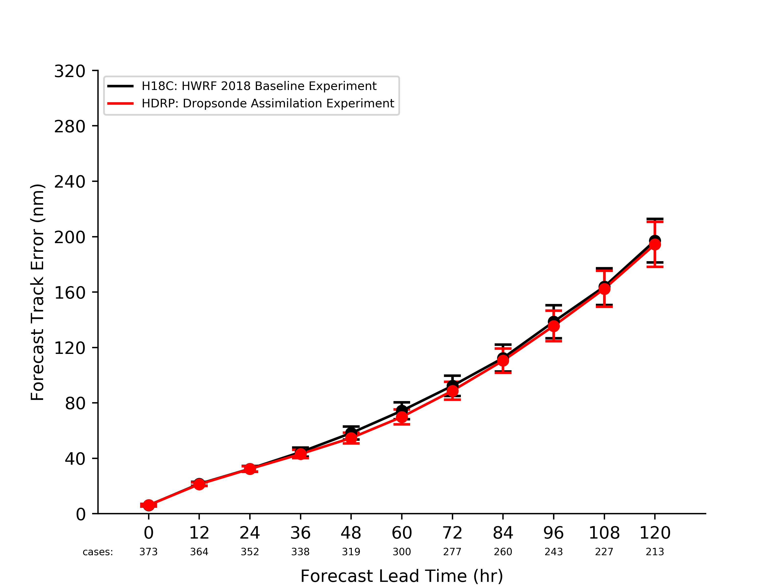
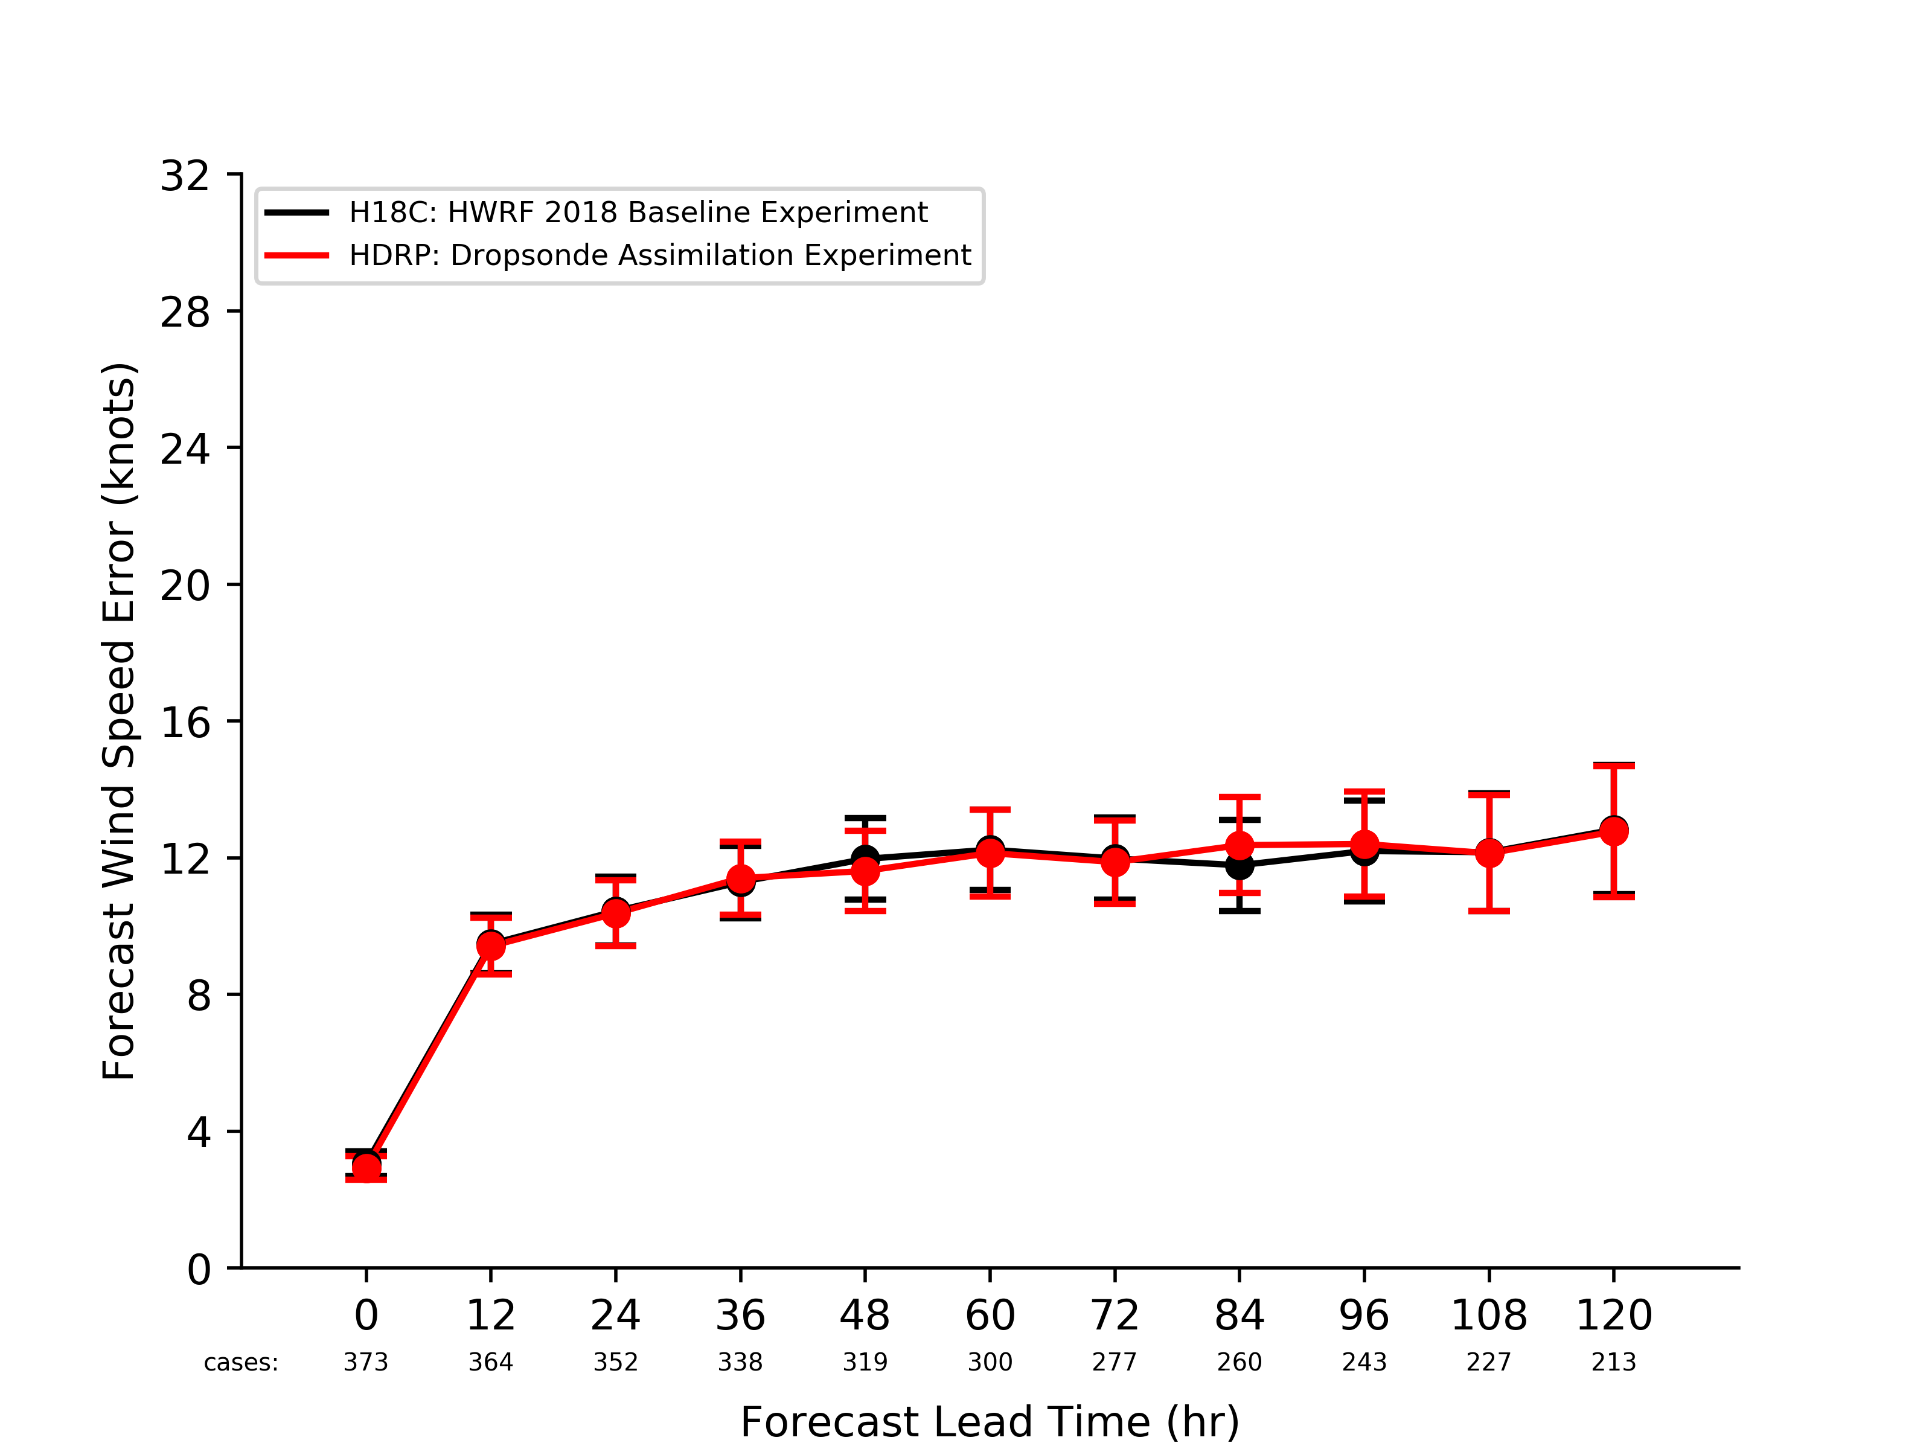
Milestones for 2017-2018:
Testing New Observation Types for HWRF 2018
All Global Positioning System (GPS) dropsondes, launched by reconnaissance aircraft, are assimilated – including TC inner-core; GPS dropsonde advection is estimated as discussed in Aberson et al., [2017]
Track Forecast Errors Relative to Observations
Maximum Wind Speed Forecast Errors Relative to Observations
Control Experiment
Control Experiment
Data Assimilation Experiment
Data Assimilation Experiment

Slide 17
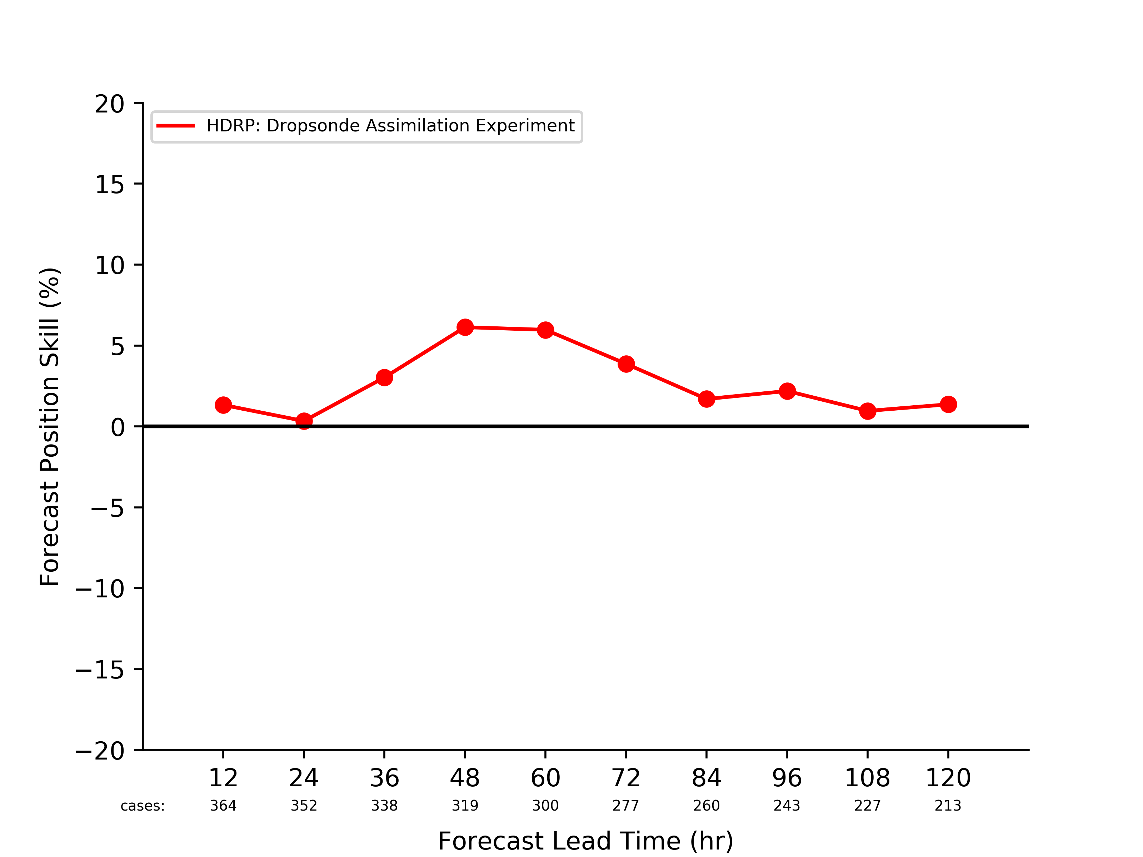
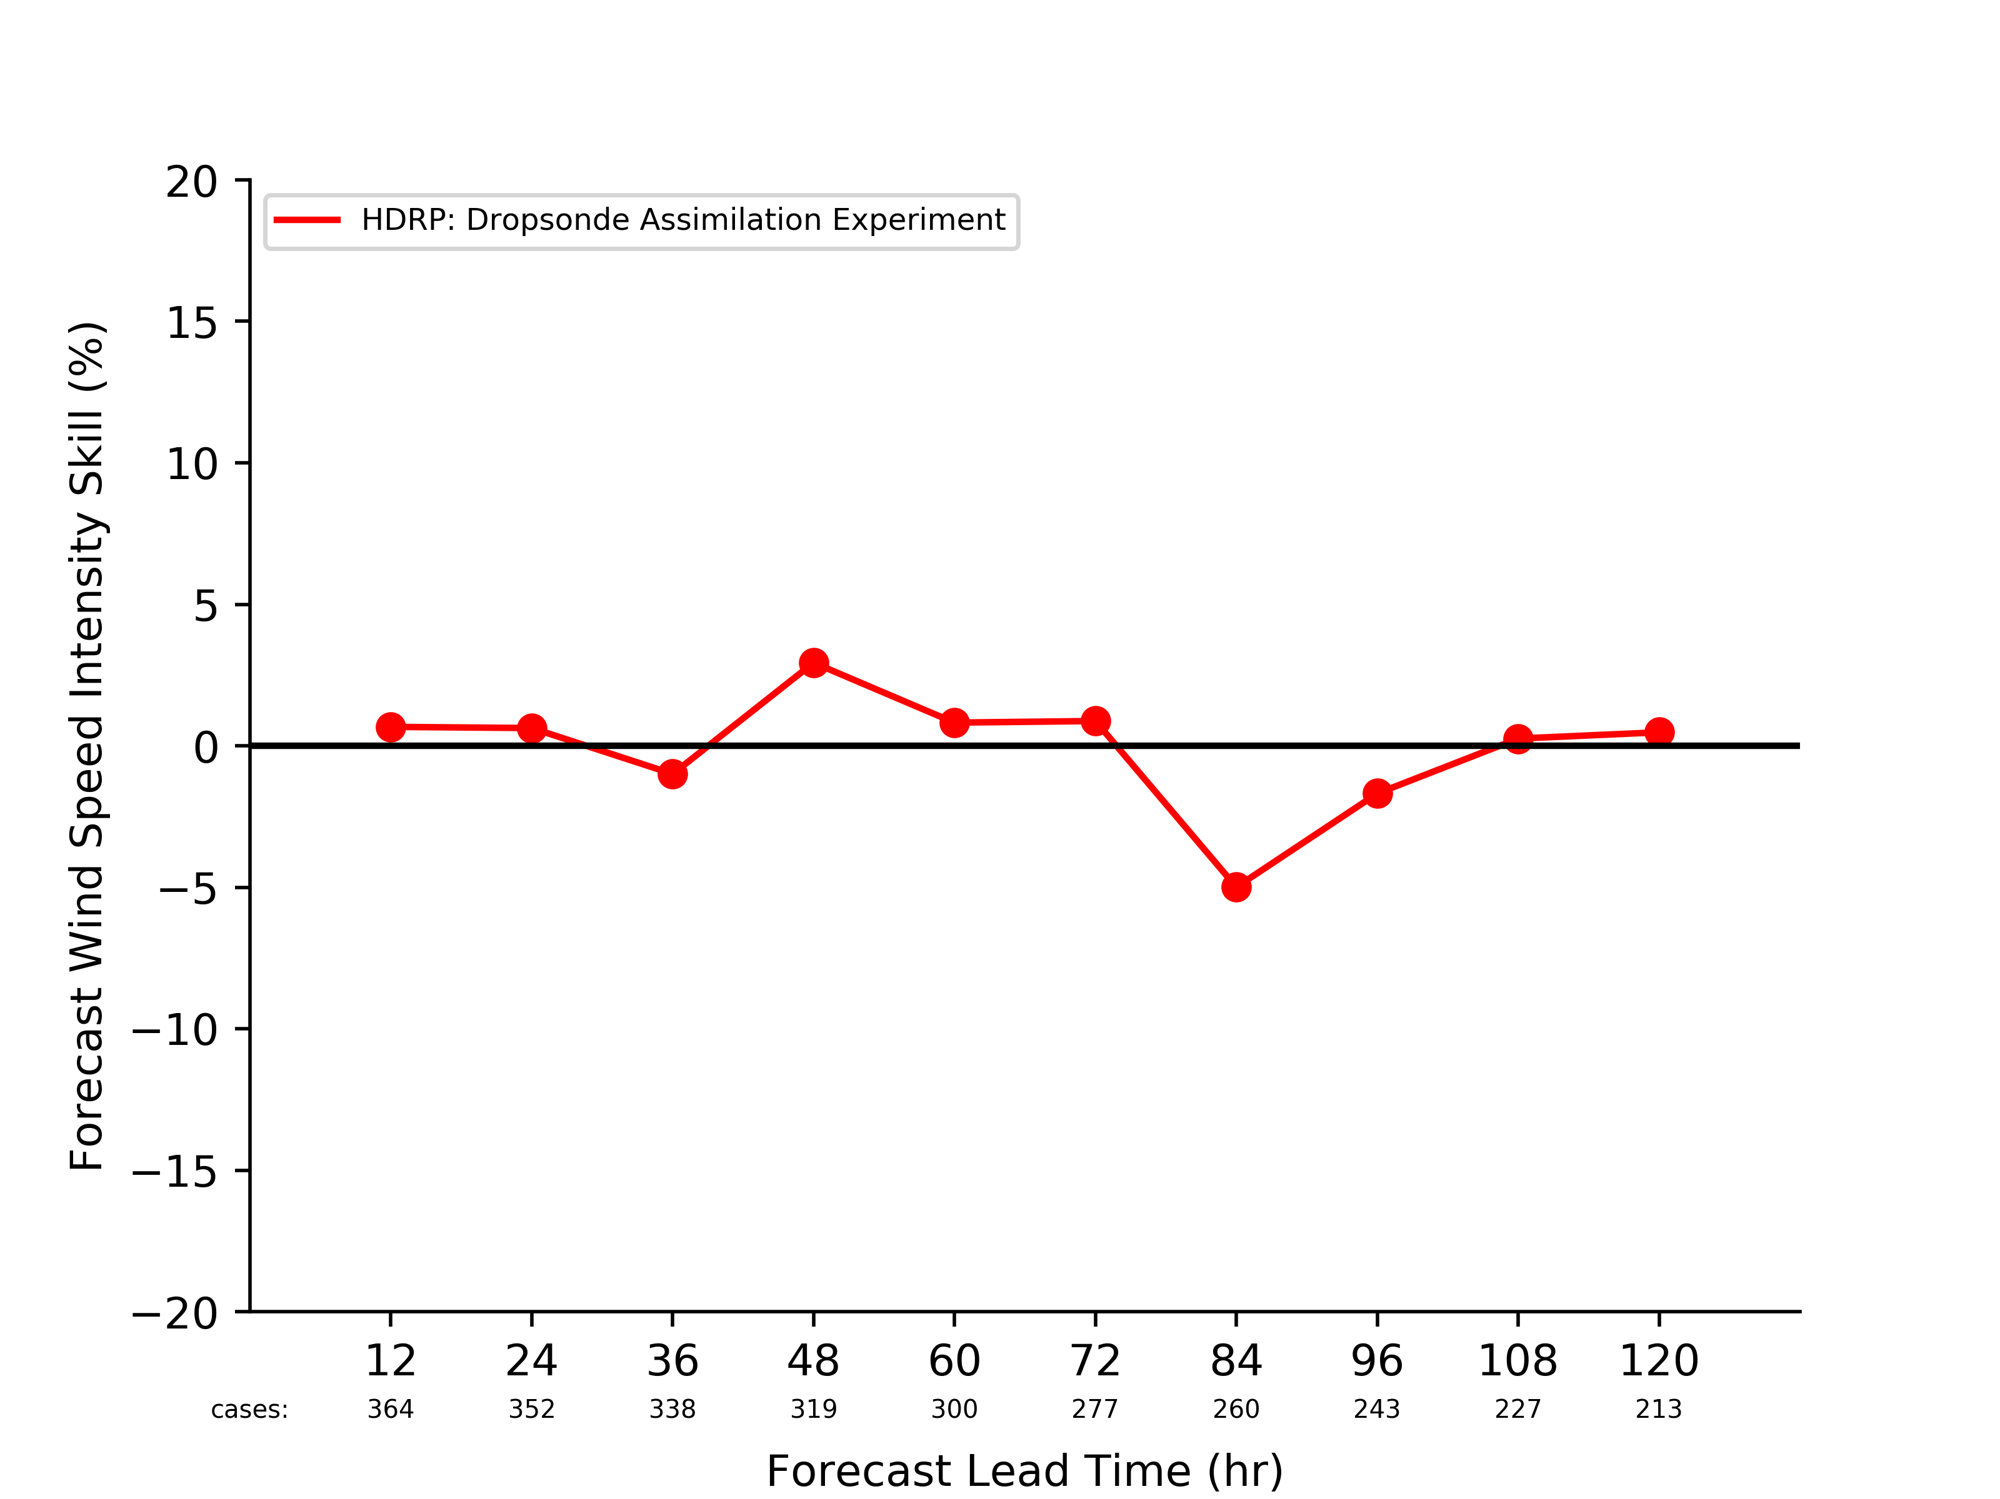
Milestones for 2017-2018:
Testing New Observation Types for HWRF 2018
All Global Positioning System (GPS) dropsondes, launched by reconnaissance aircraft, are assimilated – including TC inner-core; GPS dropsonde advection is estimated as discussed in Aberson et al., [2017]
The inclusion of GPS dropsonde advection illustrates significant track forecast improvement
Control Experiment
Control Experiment
Data Assimilation Experiment
Data Assimilation Experiment
Track Forecast Skill Relative to Control Experiment
Intensity Forecast Skill Relative to Control Experiment
The details of the employed methodology will be presented in a poster, tomorrow.

Slide 18
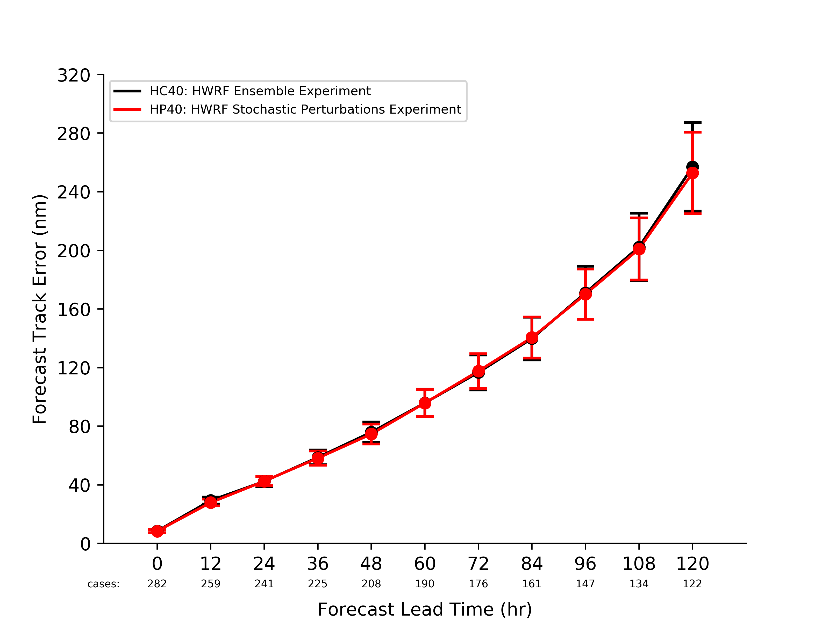
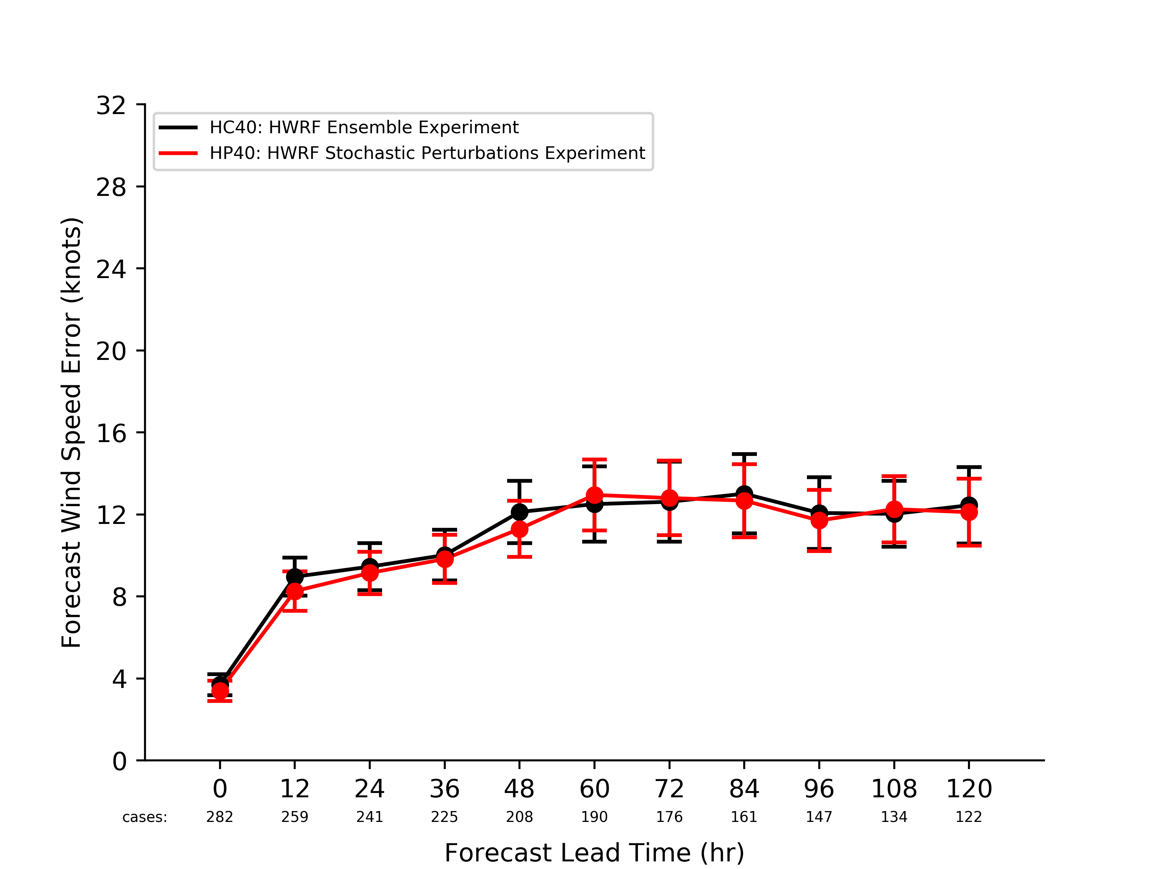
Milestones for 2017-2018:
Data Assimilation System Tuning
Stochastic physics perturbations are added to a 40-member HWRF ensemble
Track Forecast Errors Relative to Observations
Maximum Wind Speed Forecast Errors Relative to Observations
Ensemble Experiment
Ensemble Experiment
Perturbations Experiment
Perturbations Experiment

Slide 19
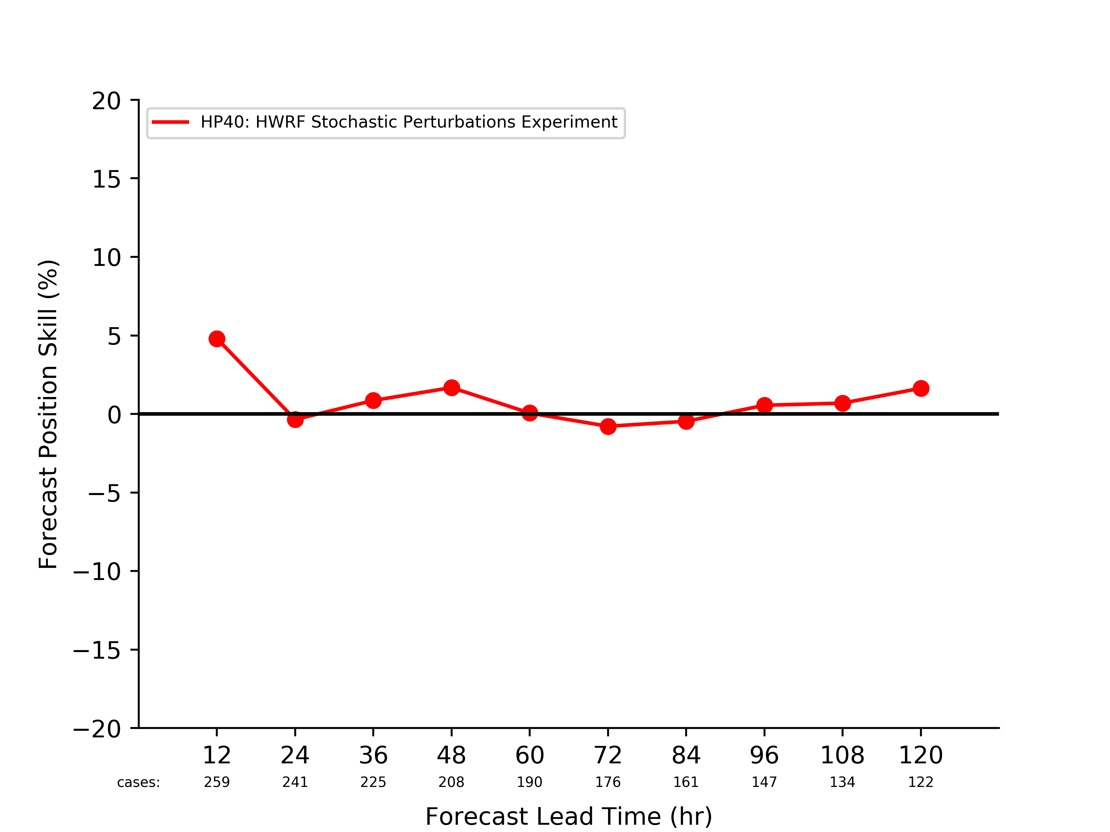
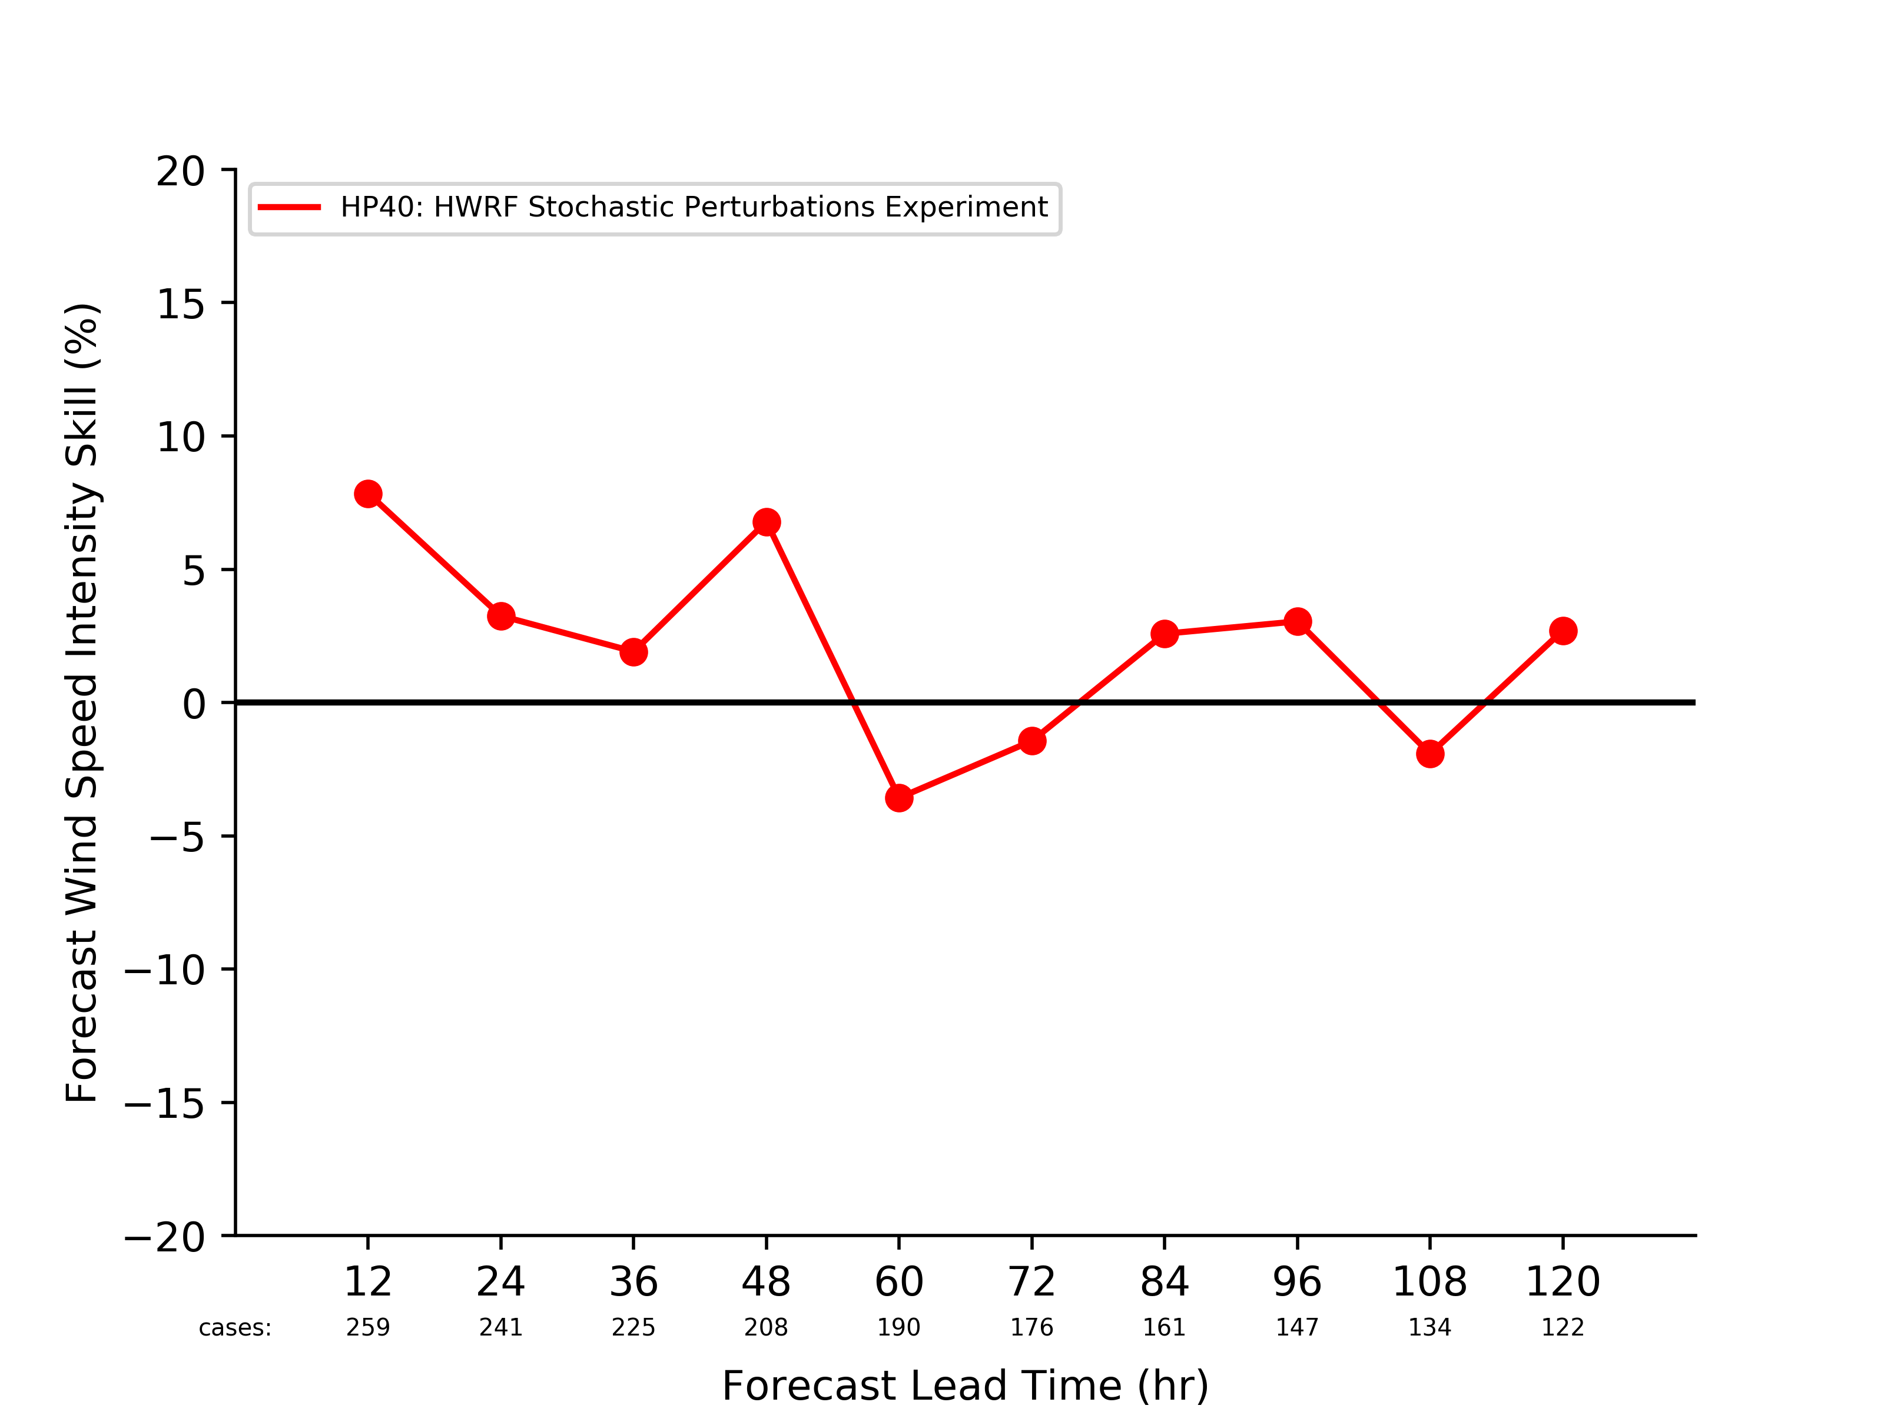
Milestones for 2017-2018:
Data Assimilation System Tuning
Stochastic physics perturbations are added to a 40-member HWRF ensemble
Perturbations are applied to the planetary boundary layer, convection and the surface drag coefficient ( )
Ensemble Experiment
Ensemble Experiment
Perturbations Experiment
Perturbations Experiment
Track Forecast Skill Relative to Control Experiment
Intensity Forecast Skill Relative to Control Experiment

Slide 20
Milestones for 2017-2018:
Data Assimilation System Tuning
Stochastic physics perturbations are added to a 40-member HWRF ensemble
Perturbations are applied to the planetary boundary layer, convection and the surface drag coefficient ( )
Largely positive TC forecast improvements relative to 40-member HWRF ensemble control experiment
Ensemble Experiment
Ensemble Experiment
Perturbations Experiment
Perturbations Experiment
Track Forecast Skill Relative to Control Experiment
Intensity Forecast Skill Relative to Control Experiment

Slide 21
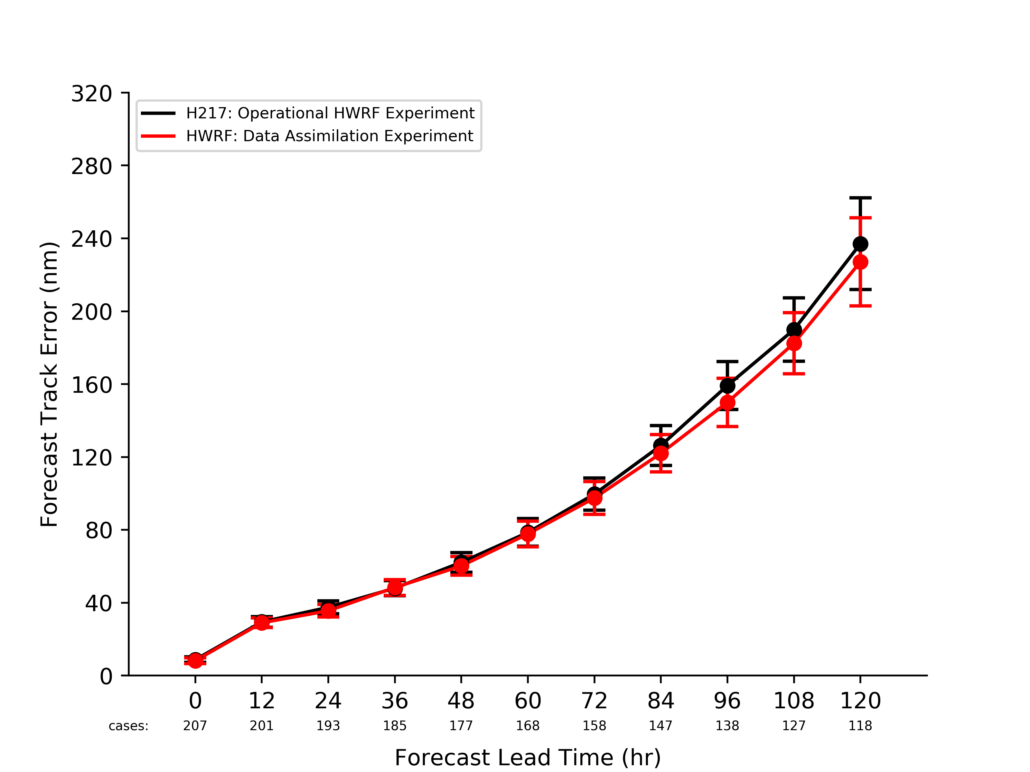
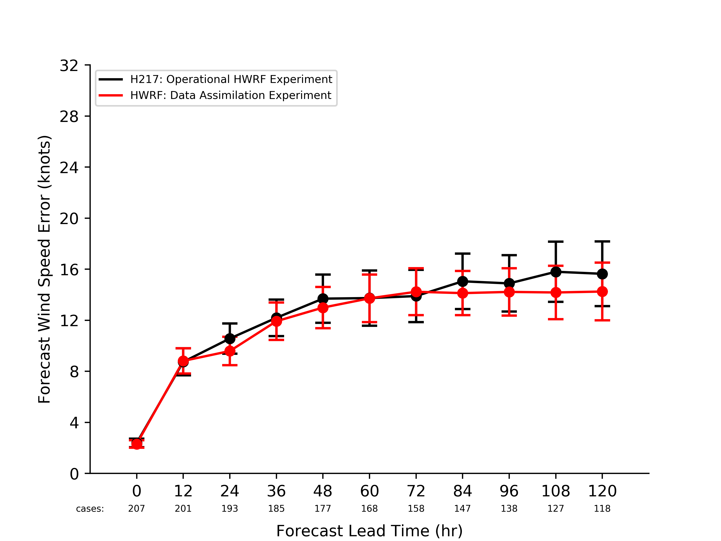
Planned Data Assimilation Testing:
(Further) Data Assimilation System Tuning
Currently, the HWRF ensemble-hybrid data assimilation method applies a 20% weighting to the static GFS derived background-error covariance
Track Forecast Errors Relative to Observations
Maximum Wind Speed Forecast Errors Relative to Observations
Static Covariance Experiment
Static Covariance Experiment
Covariance Experiment
Covariance Experiment

Slide 22
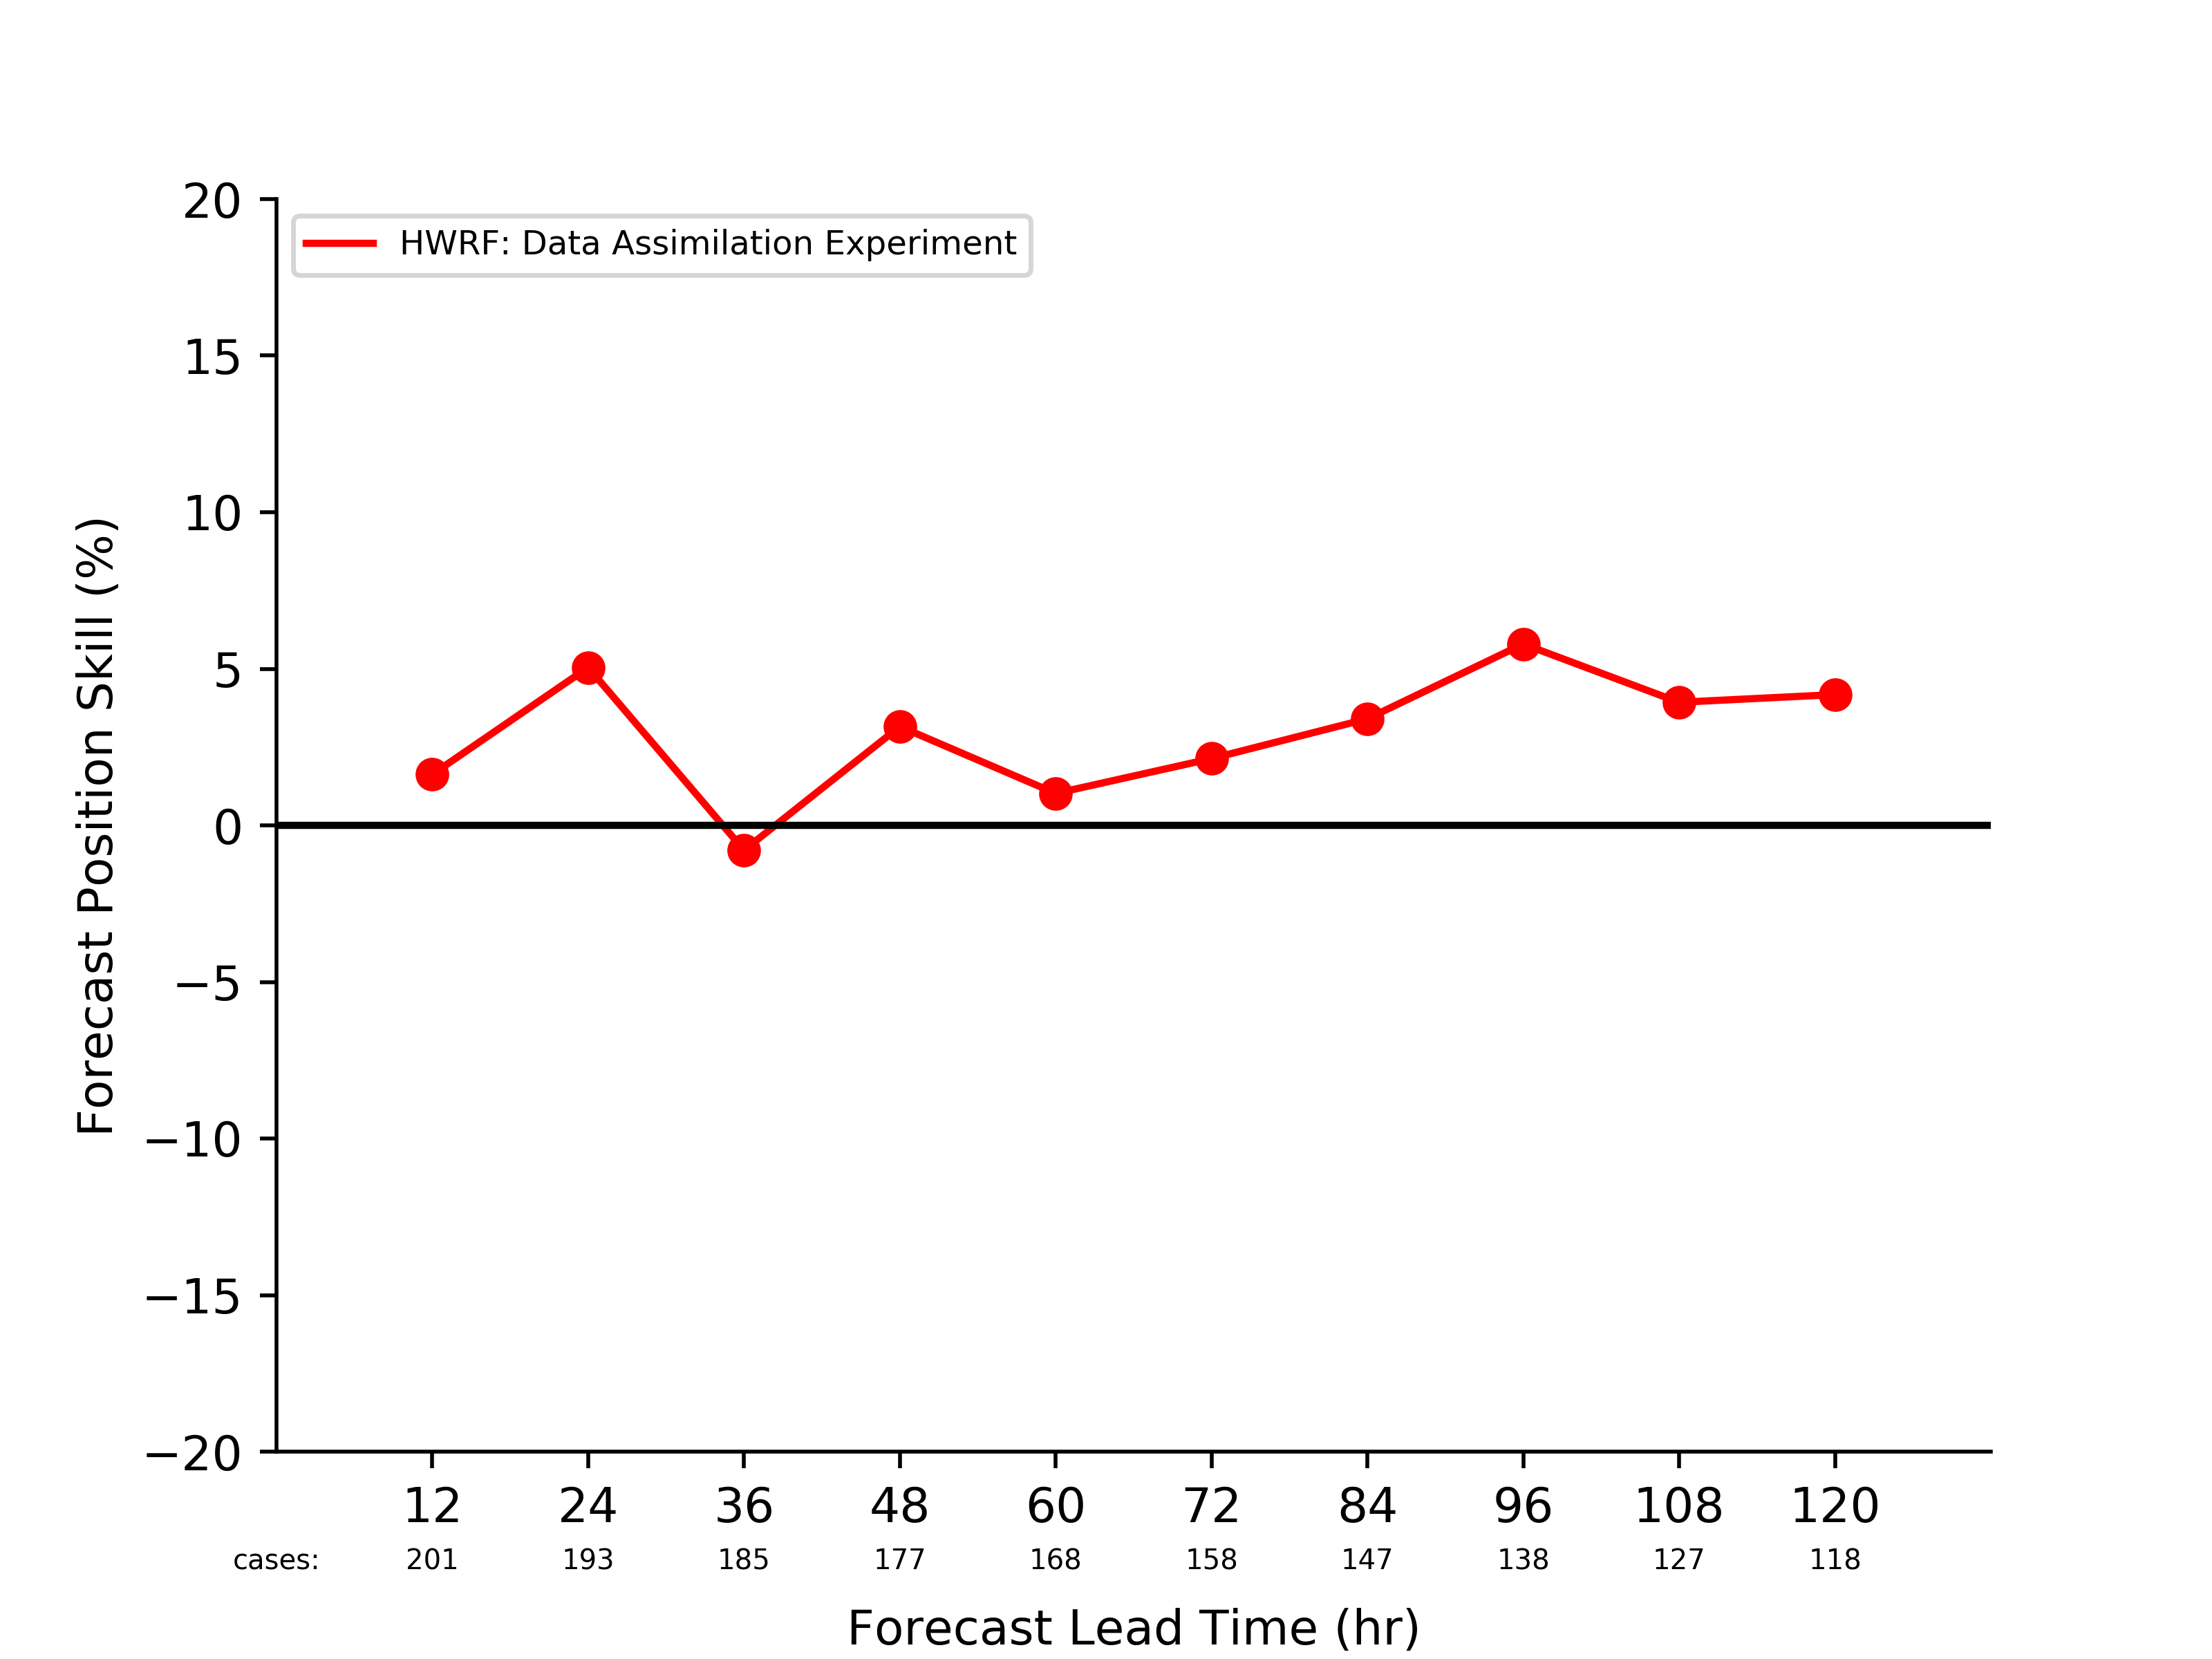
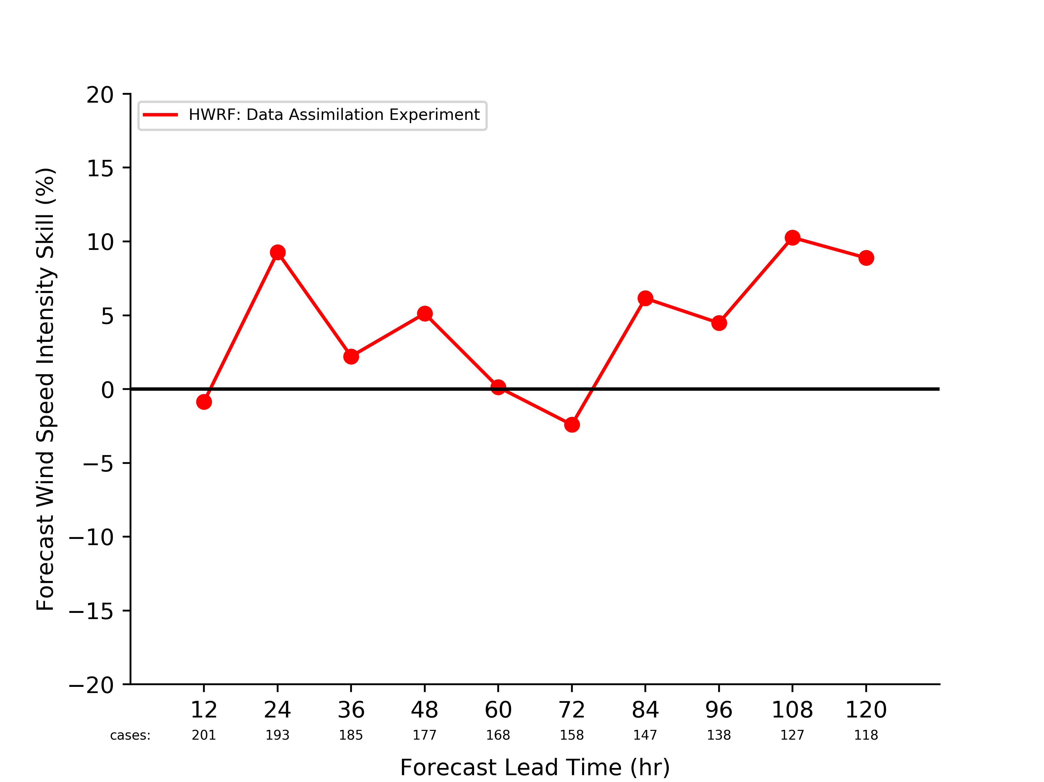
Planned Data Assimilation Testing:
(Further) Data Assimilation System Tuning
Currently, the HWRF ensemble-hybrid data assimilation method applies a 20% weighting to the static GFS derived background-error covariance
The impacts of the stochastic perturbations may be inhibited by inclusion of the GFS climatology
Static Covariance Experiment
Static Covariance Experiment
Covariance Experiment
Covariance Experiment
Track Forecast Skill Relative to Control Experiment
Intensity Forecast Skill Relative to Control Experiment

Slide 23
Planned Data Assimilation Testing:
Considering alternatives to the current vortex initialization (VI) strategy:

Slide 24
Planned Data Assimilation Testing:
Considering alternatives to the current vortex initialization (VI) strategy:
Improvements in the relocation of the TC within the background forecasts

Slide 25
Planned Data Assimilation Testing:
Considering alternatives to the current vortex initialization (VI) strategy:
Improvements in the relocation of the TC within the background forecasts
Assimilation of synthetic and diagnostic-type observations

Slide 26
Planned Data Assimilation Testing:
Considering alternatives to the current vortex initialization (VI) strategy:
Improvements in the relocation of the TC within the background forecasts
Assimilation of synthetic and diagnostic-type observations
Super-obing TC relative wind analyses (i.e., NHC gridded TCM)

Slide 27
Planned Data Assimilation Testing:
Considering alternatives to the current vortex initialization (VI) strategy:
Improvements in the relocation of the TC within the background forecasts
Assimilation of synthetic and diagnostic-type observations
Super-obing TC relative wind analyses (i.e., NHC gridded TCM)
Investigating the impacts of cycling the inner (e.g., 6- and 2-km) HWRF moving nests

Slide 28
Planned Data Assimilation Testing:
Considering alternatives to the current vortex initialization (VI) strategy:
Improvements in the relocation of the TC within the background forecasts
Assimilation of synthetic and diagnostic-type observations
Super-obing TC relative wind analyses (i.e., NHC gridded TCM)
Investigating the impacts of cycling the inner (e.g., 6- and 2-km) HWRF moving nests
Tuning the thinning mechanisms and better specifying the observation errors and localization characteristics for the more recently added platforms (i.e., SFMR, TDR, GPS dropsondes, etc.)

Slide 29
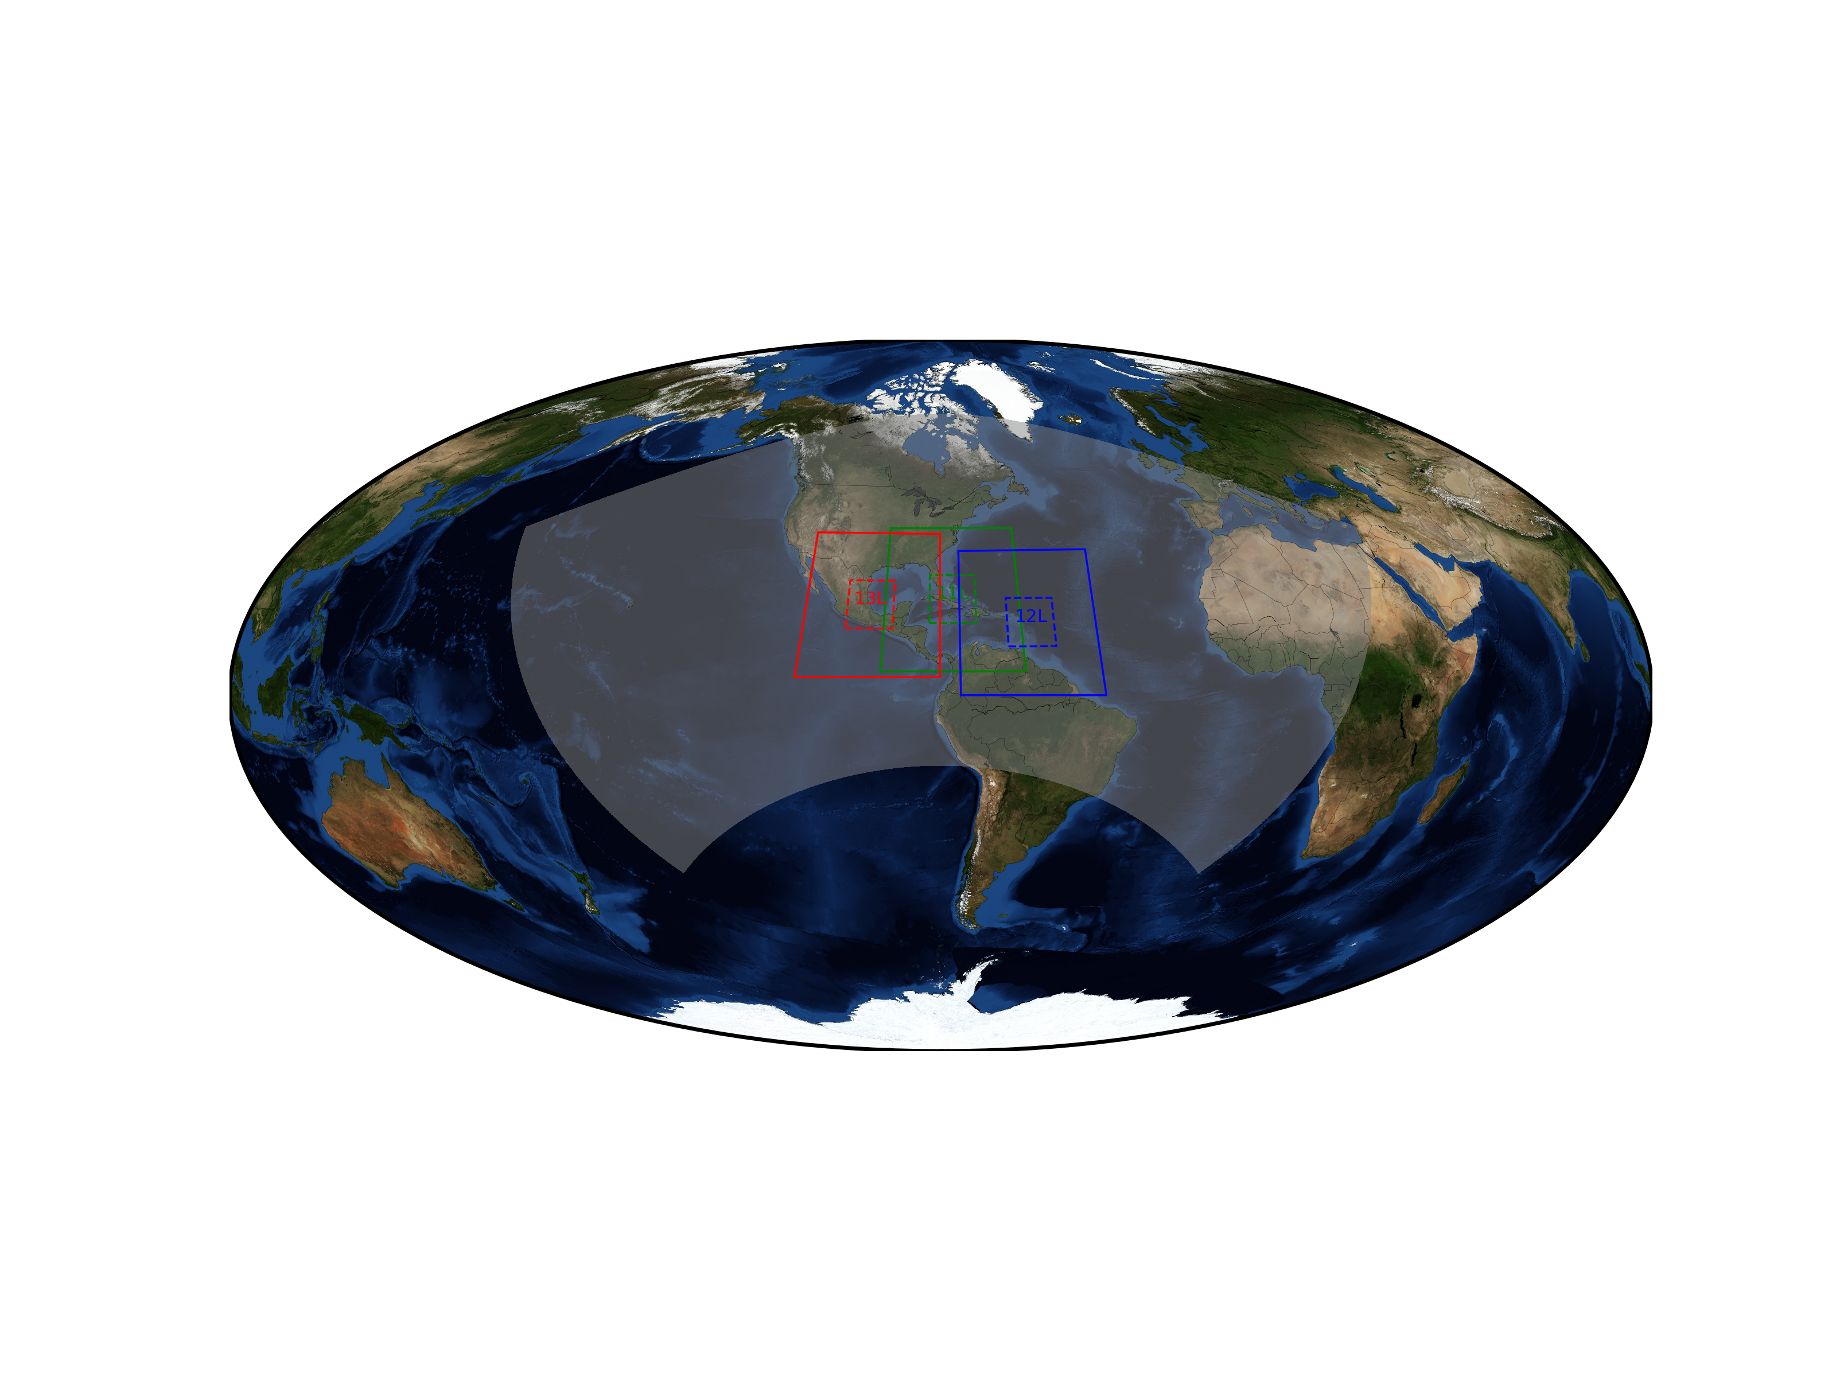
Planned Activities During the Next 2-3 Years:
Exploration of a fixed, basin-scale, continuous cycling (data-assimilation), parent domain
Basin-scale Parent Domain :: Valid 0000 UTC 08 September
Irma (2017)
Katia (2017)
Jose (2017)
HWRF basin-scale domain

Slide 30
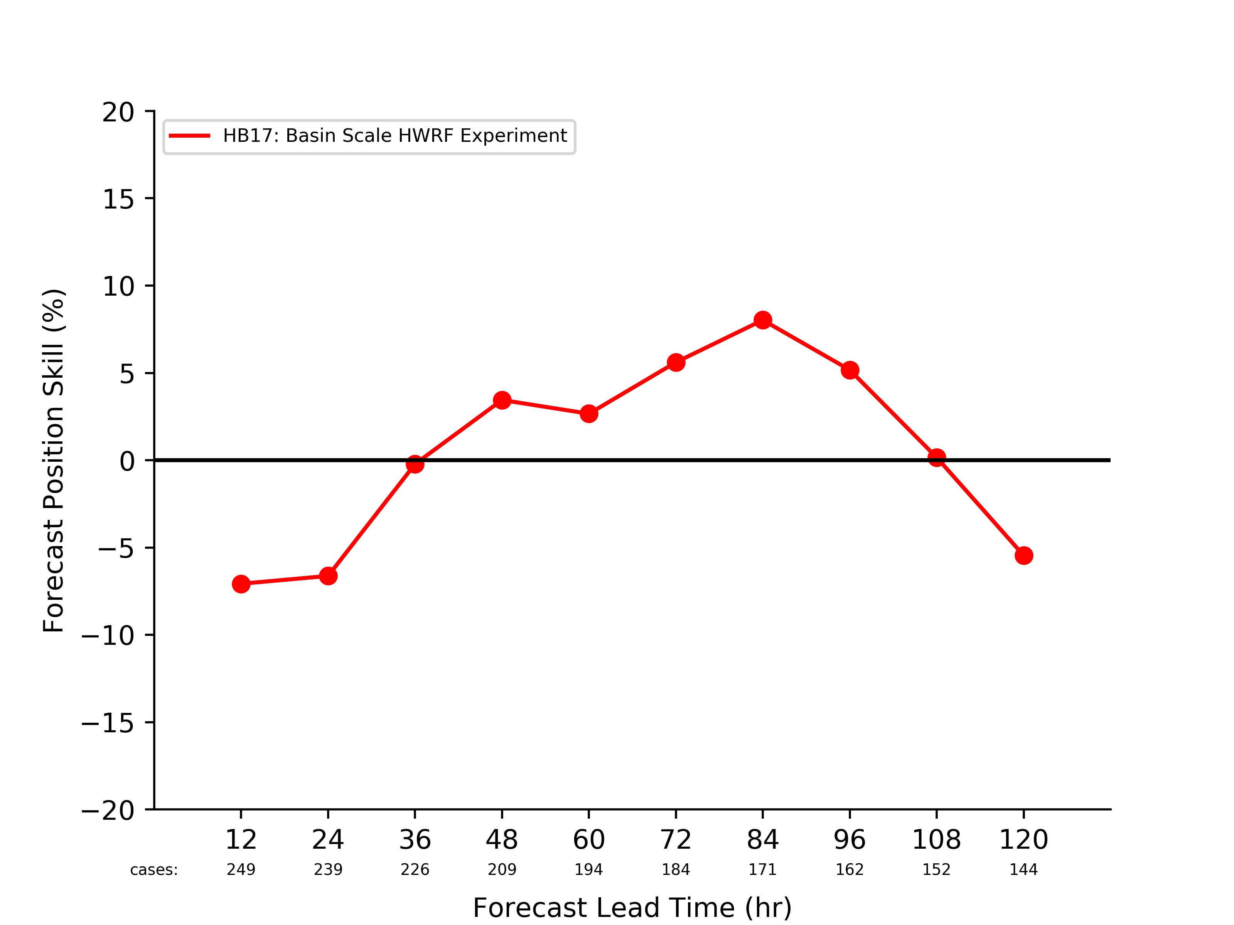
Planned Activities During the Next 2-3 Years:
Exploration of a fixed, basin-scale, continuous cycling (data-assimilation), parent domain
The current AOML/HRD basin-scale produces skillful track forecasts at medium range lead times
The fixed, cycling data-assimilation will enable better usage of satellite radiance observations
Operational HWRF Experiment
Basin-scale HWRF Experiment
Irma (2017)
Katia (2017)
Jose (2017)
Track Forecast Skill Relative to Control Experiment

Slide 31
Planned Activities During the Next 2-3 Years:
Adding data assimilation capabilities such as:
A more frequently cycled (e.g., hourly) 3D ensemble-hybrid system

Slide 32
Planned Activities During the Next 2-3 Years:
Adding data assimilation capabilities such as:
A more frequently cycled (e.g., hourly) 3D ensemble-hybrid system
Full 4D ensemble-hybrid data assimilation system

Slide 33
Planned Activities During the Next 2-3 Years:
Adding data assimilation capabilities such as:
A more frequently cycled (e.g., hourly) 3D ensemble-hybrid system
Full 4D ensemble-hybrid data assimilation system
Both will provide benefits toward spin-down alleviation and making better use of the available inner-core observations

Slide 34
Planned Activities During the Next 2-3 Years:
Adding data assimilation capabilities such as:
A more frequently cycled (e.g., hourly) 3D ensemble-hybrid system
Full 4D ensemble-hybrid data assimilation system
Both will provide benefits toward spin-down alleviation and making better use of the available inner-core observations
Incorporating cycling capabilities for the moving (e.g., d02/03) HWRF nests, including ensemble members

Slide 35
Planned Activities During the Next 2-3 Years:
Adding data assimilation capabilities such as:
A more frequently cycled (e.g., hourly) 3D ensemble-hybrid system
Full 4D ensemble-hybrid data assimilation system
Both will provide benefits toward spin-down alleviation and making better use of the available inner-core observations
Incorporating cycling capabilities for the moving (e.g., d02/03) HWRF nests, including ensemble members
Working closely with HFIP DTC partners to improve the HWRF scripting structure, particularly as it applies to data-assimilation

Slide 36
Planned Activities During the Next 2-3 Years:
Adding data assimilation capabilities such as:
A more frequently cycled (e.g., hourly) 3D ensemble-hybrid system
Full 4D ensemble-hybrid data assimilation system
Both will provide benefits toward spin-down alleviation and making better use of the available inner-core observations
Incorporating cycling capabilities for the moving (e.g., d02/03) HWRF nests, including ensemble members
Moving nest positions
Blending of inner-nest with parent domain
Ensemble cycling example

Slide 37
Summary and Conclusions:
The 2017 HWRF had significant improvements for both data usage and data assimilation

Slide 38
Summary and Conclusions:
The 2017 HWRF had significant improvements for both data usage and data assimilation
The implementation experiments for the 2018 HWRF suggests that intensity forecast improvements on the order of 10% are attainable

Slide 39
Summary and Conclusions:
The 2017 HWRF had significant improvements for both data usage and data assimilation
The implementation experiments for the 2018 HWRF suggests that intensity forecast improvements on the order of 10% are attainable
Planned short- and long(er)-term experiments, as well as other upgrades will further improve data usage and data assimilation capabilities

Slide 40
Summary and Conclusions:
The 2017 HWRF had significant improvements for both data usage and data assimilation
The implementation experiments for the 2018 HWRF suggests that intensity forecast improvements on the order of 10% are attainable
Planned short- and long(er)-term experiments, as well as other upgrades will further improve data usage and data assimilation capabilities
Working closely with HFIP partners will enable acceleration of research to operations implementations with the HWRF workflow

Slide 41
Summary and Conclusions:
The 2017 HWRF had significant improvements for both data usage and data assimilation
The implementation experiments for the 2018 HWRF suggests that intensity forecast improvements on the order of 10% are attainable
Planned short- and long(er)-term experiments, as well as other upgrades will further improve data usage and data assimilation capabilities
Working closely with HFIP partners will enable acceleration of research to operations implementations with the HWRF workflow
Contributions from other HFIP partners, namely: Evan Kalida (DTC), Bin Liu (EMC), Ghassan Alaka (AOML/HRD), Jonathan Poterjoy (AOML/HRD), and Xuguang Wang (OU)

