Slide 1
Outlier analysis
1. H215 vs. H15Z

Slide 2
1. H215 vs. H15Z

Slide 3
Improvement/Degradation of H215 over H15Z (AL+EP)
Improvement
Degradation
Track error
Intensity error
24h
48h
72h
96h

Slide 4
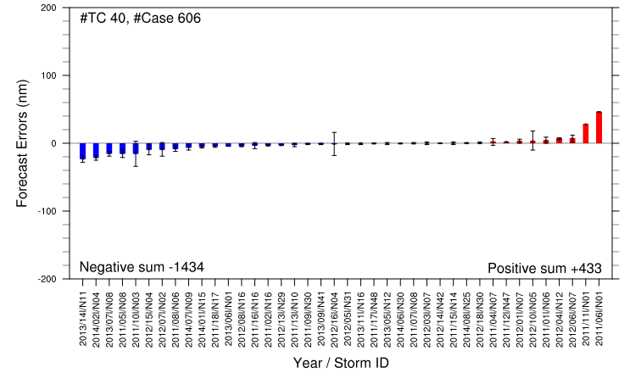
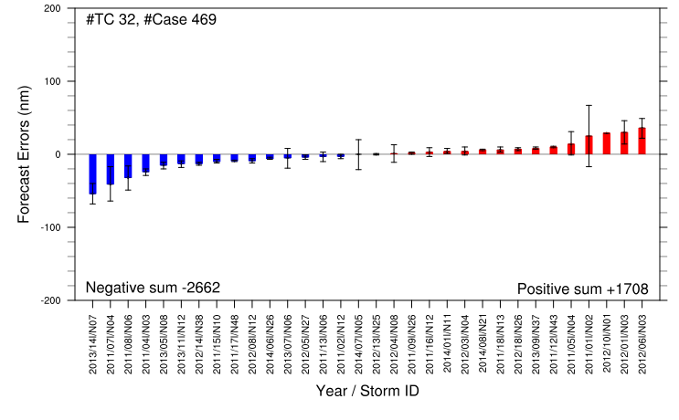
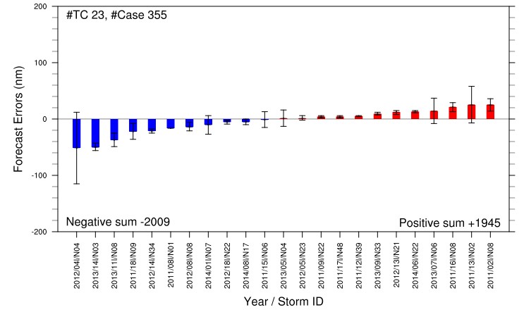
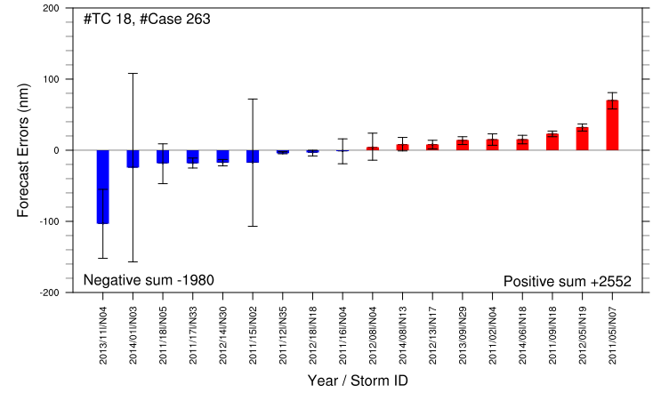
Improvement/Degradation of H215 over H15Z : Track error (AL)
H215 Total #Case=1455, #TC=94
Improvement (< 25th PCTL)
Degradation (>75th PCTL)
24h
25th PCTL
75th PCTL
48h
72h
96h

Slide 5
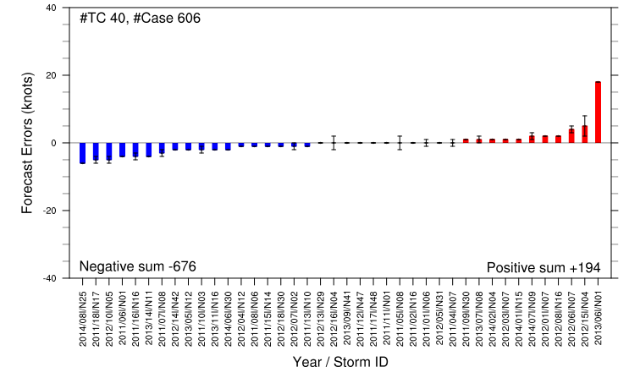
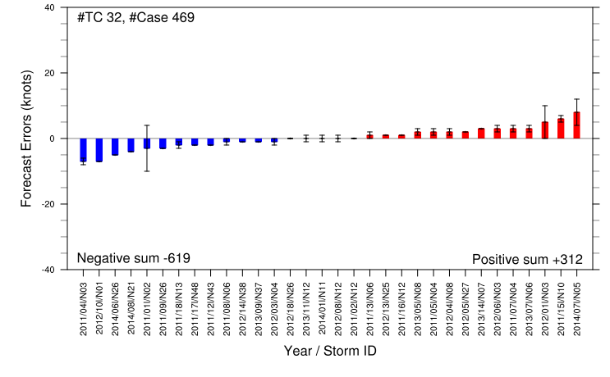
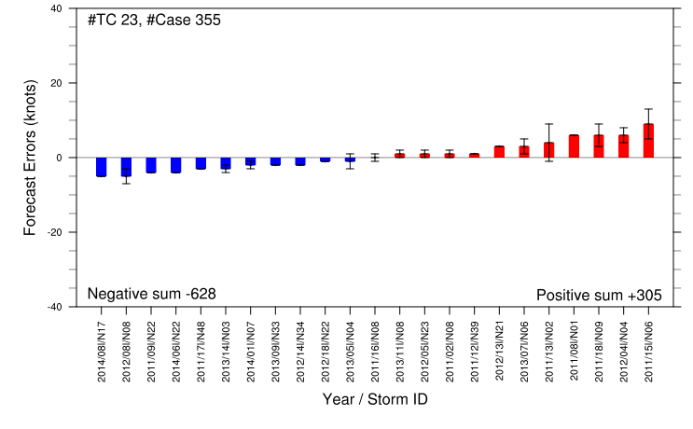
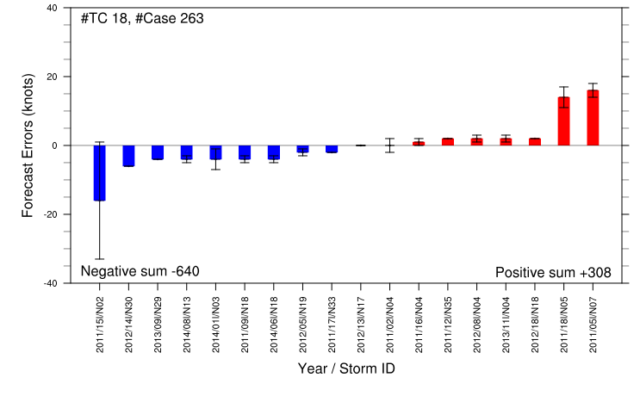
Improvement/Degradation of H215 over H15Z : Intensity error (AL)
H215 Total #Case=1455, #TC=94
Improvement (< 25th PCTL)
Degradation (>75th PCTL)
24h
25th PCTL
75th PCTL
48h
72h
96h

Slide 6
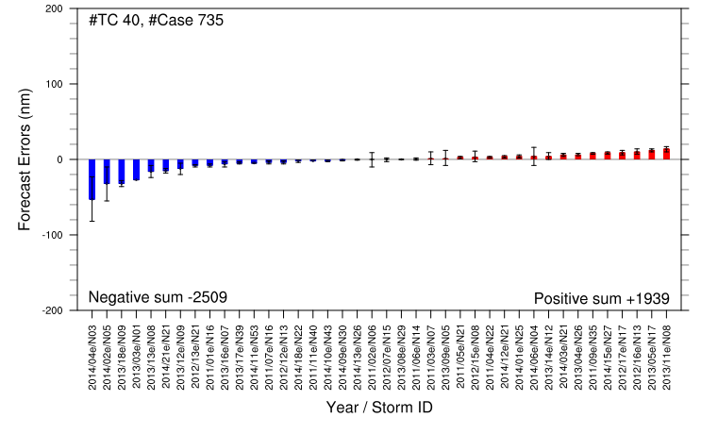
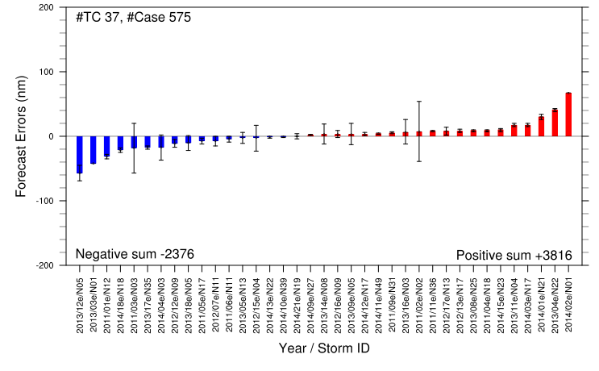
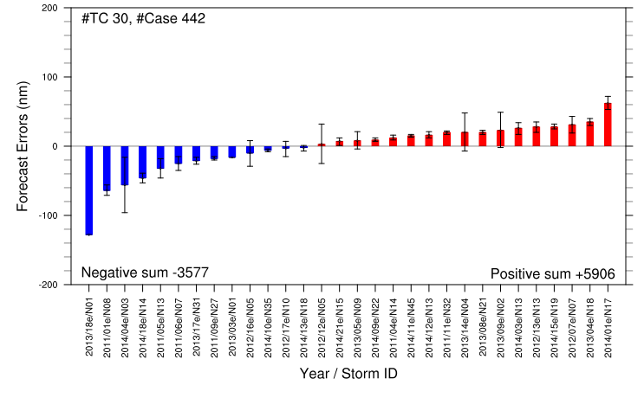
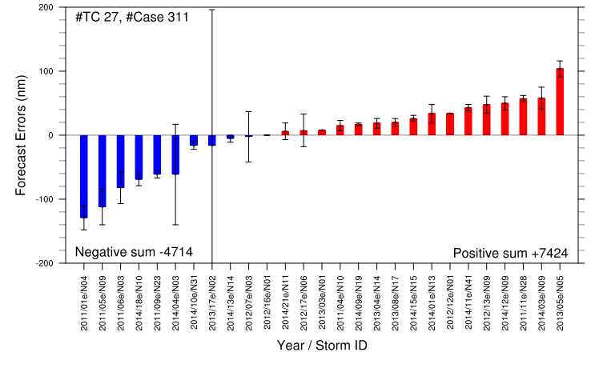
Improvement/Degradation of H215 over H15Z : Track error (EP)
H215 Total #Case=1640, #TC=107
Improvement (< 25th PCTL)
Degradation (>75th PCTL)
24h
25th PCTL
75th PCTL
48h
72h
96h

Slide 7
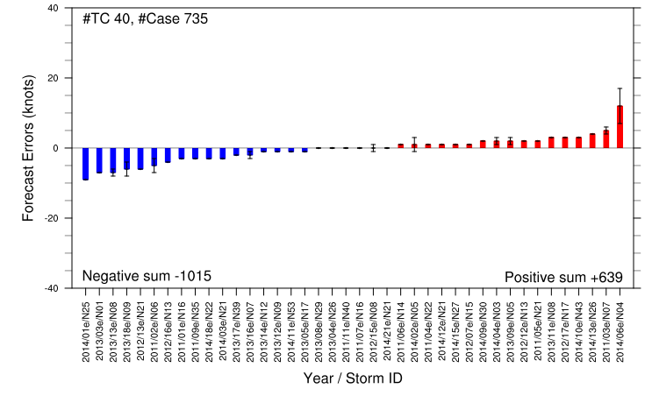
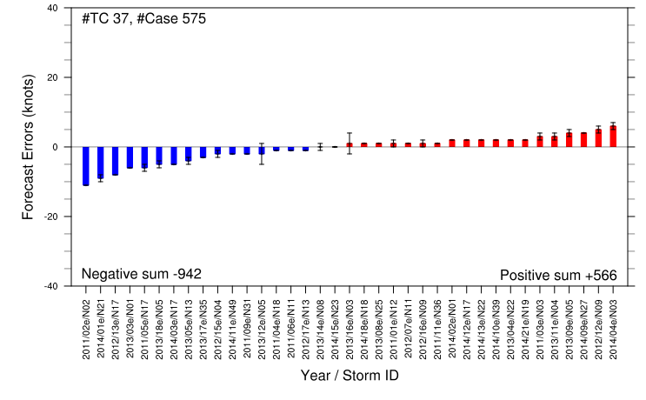
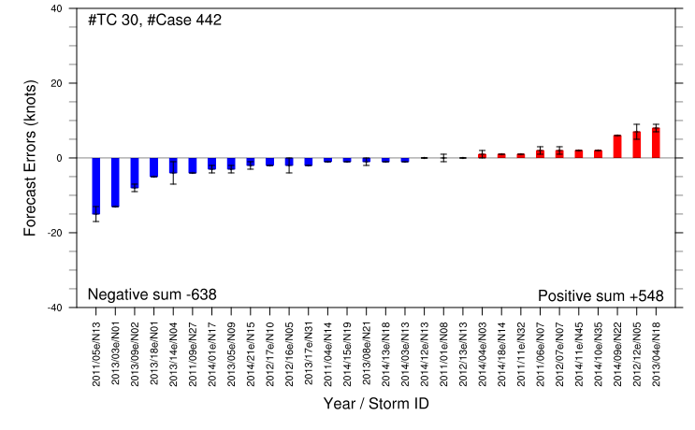
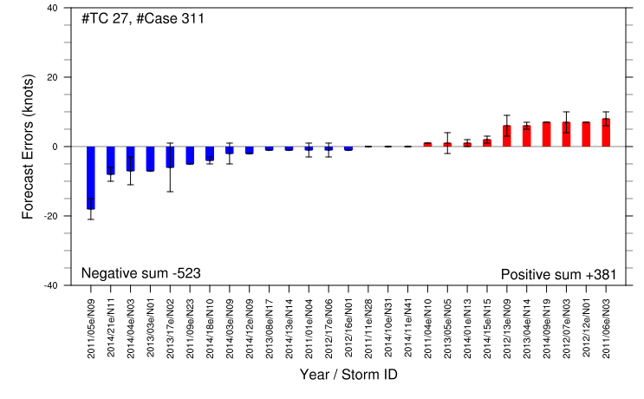
Improvement/Degradation of H215 over H15Z : Intensity error (EP)
H215 Total #Case=1640, #TC=107
Improvement (< 25th PCTL)
Degradation (>75th PCTL)
24h
25th PCTL
75th PCTL
48h
72h
96h

Slide 8
Case: 201401 ARTHUR (H214, H15Z and H215)
Improved track error (24h) of H215 over H15Z

Slide 9
Case: 201218 SANDY (H214, H15Z and H215)
Degraded track error (24, 48h) of H215 over H15Z

Slide 10
Case: 201112 KATIA (H214, H15Z and H215)
Degraded track error (24, 48h) of H215 over H15Z

Slide 11
Case: 201109 IRENE (H214, H15Z and H215)
Improved intensity (48, 72h) of H215 over H15Z

Slide 12
Case: 201115 NATE (H214, H15Z and H215)
Degraded intensity (48, 72h) of H215 over H15Z

