Slide 1
Outlier analysis
H214 vs. H215: Impact of New GFS, Physics, and Resolution
Chun-Sil Jin

Slide 2
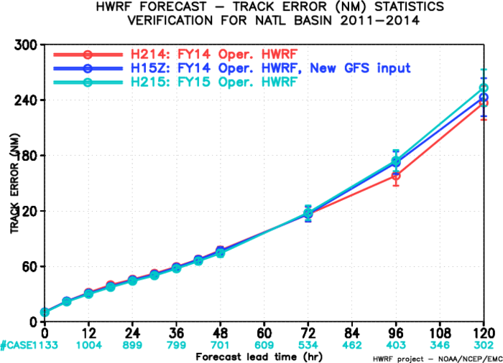
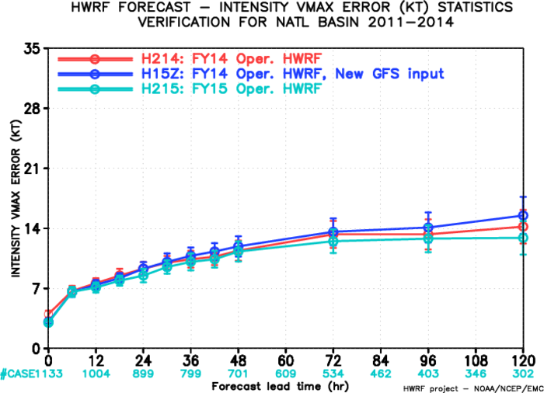
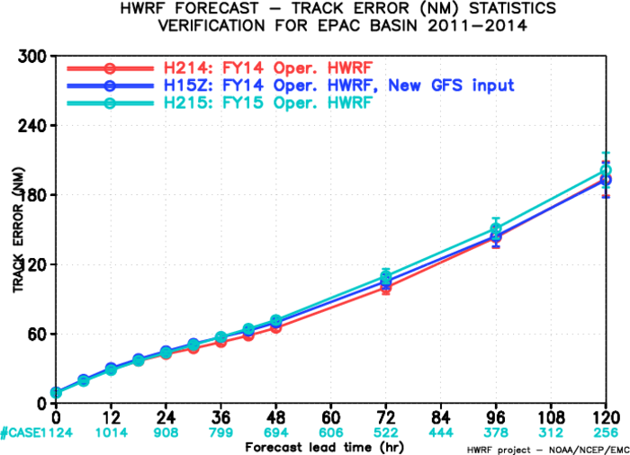
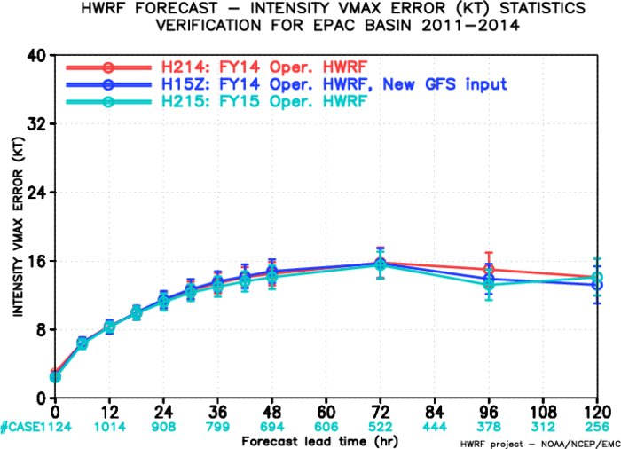
In NHC briefing..
H214 vs. H15Z
:Impact of New GFS
H214 vs. H215
: Impact of Physics, Resolution, and New GFS
Track error
Intensity error
Track error
Intensity error
AL
10
3
3
4
4
10
10
7
4
EP
8
8
6
6
10
10
5
3
12
#
Relative improvement (%)
#
Relative degradation (%)
For the AL, track forecast performance from H215 showed neutral impact (slightly better (~5%) at 24 and 48 hrs and slightly worse (~5%) at 72 and 96 hrs compared to H214 as well as H15Z. Intensity forecast performance from H215 showed significant improvements (~10% at 24, 72 and 96 hrs). H15Z indicated significant degradations due to use of new GFS.
For the EP, H215 were able to recover the loss of track forecast skill due to new GFS through 24 hrs, but remained largely negative 48 hrs and beyond, and modest improvements (~5%) in intensity forecasts through 96 hrs.
However, these results indicate mean value of forecast error. So, we need to perform outlier analysis.

Slide 3
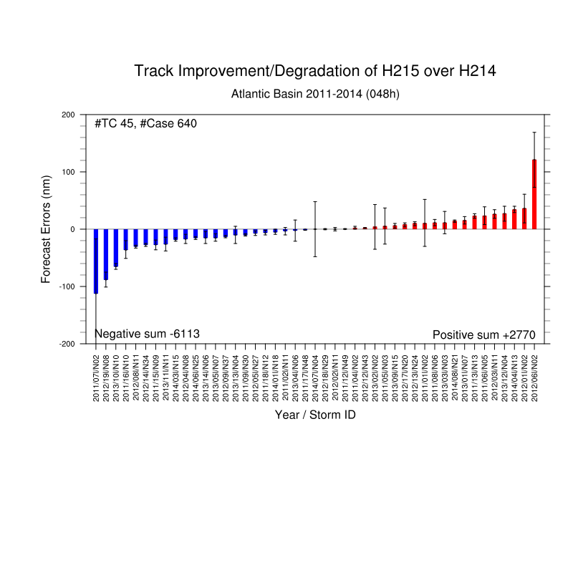
Methodology
Example - Individual storm track forecast: improvement/degradation (AL, 48h)
Individual storm track forecast (Zhan)
Individual storm track forecast
Mean
+ 95% CI
Mean
Mean
– 95% CI
Negative: Improved
Positive: Degraded
Error density
Improved storms
(< 25th PCTL)
Degraded storms
(>75th PCTL)
Err < -25
-25 < Err < 0
0 < Err < 25
25 < Err (nm)
Based on previous outlier analysis by Zhan, error bar, improved/degraded storm, total error density, and notable storm case are investigated error distribution.
Improvement
Degradation

Slide 4
H214 vs. H215
: Impact of New GFS/Physics/Resolution

Slide 5
Improve/Degrade of H215 over H214 : Track error (AL)
4
4
10
Error density
Improvement/degradation
Improved (< 25th PCTL)
Degraded (>75th PCTL)
24h
201218
SANDY
48h
201115
NATE
72h
201406
EDOUARD
96h
Err < -25
-25 < Err < 0
0 < Err < 25
25 < Err (nm)
Over the open sea, track errors tend to be improved at 24 and 48 hrs and degraded at 96 hr compared to H214.
Notable cases: 201115 NATE and 201406 EDOUARD

Slide 6
Case: 201115 NATE (H214, H15Z and H215)
Improved track error (24, 48, 72h) and degraded intensity error (24, 48, 72h) of H215 over H214

Slide 7
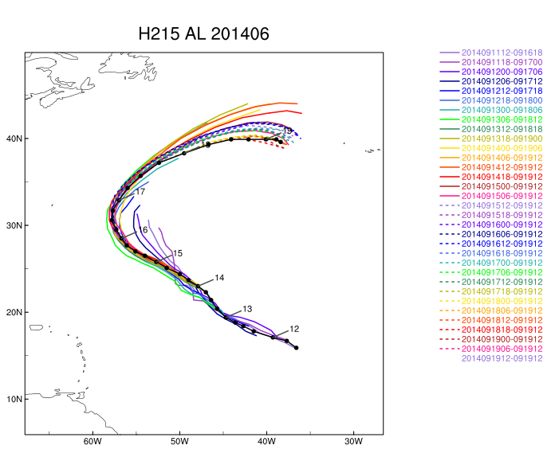
Case: 201406 EDOUARD (H214, H15Z and H215)
Degraded track error (72, 96h) and intensity error (48 h) of H215 over H214

Slide 8
Improve/Degrade of H215 over H214 : Intensity error (AL)
10
7
4
Error density
Improvement/degradation
Improved (< 25th PCTL)
Degraded (>75th PCTL)
24h
48h
72h
201109
IRENE
96h
Err < -5
-5 < Err < 0
0 < Err < 5
5 < Err (knots)
Over the southeastern Bahamans, intensity errors tend to be improved at 24, 72, and 96 hrs compared to H214.
Notable case: 201109 IRENE

Slide 9
Case: 201109 IRENE (H214, H15Z and H215)
Improved intensity (48, 72, 96h) of H215 over H214

Slide 10
Case: 201218 SANDY (H214, H15Z and H215)
Degraded track error (24h) and slightly improved intensity error (24, 48, 72 hrs) of H215 over H214

Slide 11
Improve/Degrade of H215 over H214 : Track error (EP)
10
10
5
Error density
Improvement/degradation
Improved (< 25th PCTL)
Degraded (>75th PCTL)
24h
48h
72h
96h
Err < -25
-25 < Err < 0
0 < Err < 25
25 < Err (nm)
Over the west coast of Mexico, track errors tend to be degraded at 48, 72, and 96 hrs compared to H214.

Slide 12
Improve/Degrade of H215 over H214 : Intensity error (EP)
3
12
Error density
Improvement/degradation
Improved (< 25th PCTL)
Degraded (>75th PCTL)
24h
48h
72h
96h
Err < -5
-5 < Err < 0
0 < Err < 5
5 < Err (knots)
Over the southwestern coast of Mexico, intensity errors tend to be improved at 48 and 96 hrs compared to H214.

Slide 13
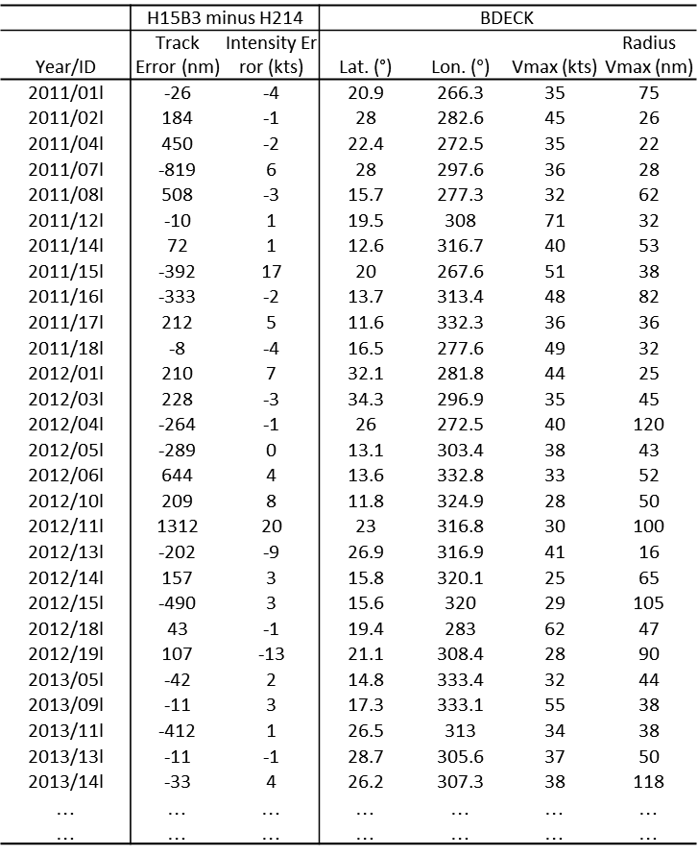
Further work
H215-H214
BDECK
It needs to find relationship between difference and observed characteristics (intensity, moving speed, radius of maximum wind, etc).
Relationship between difference and observed large-scale circulation (ENSO, AMM, ..)
Cluster analysis

