Slide 1
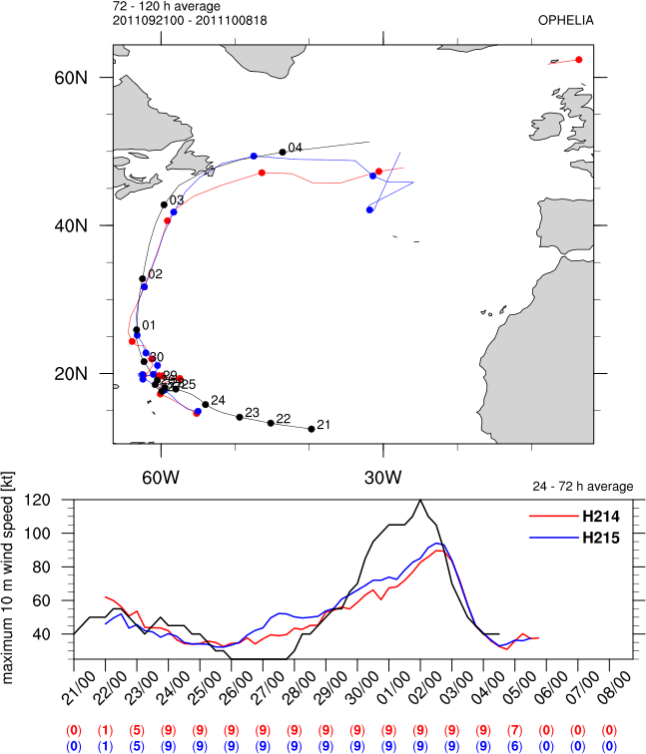
Ophelia 16L 2011
largest average
intensity error

Slide 2
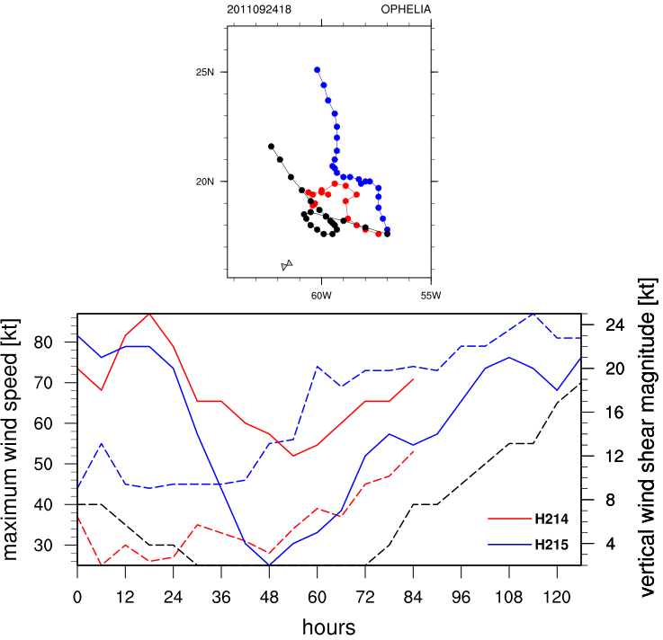
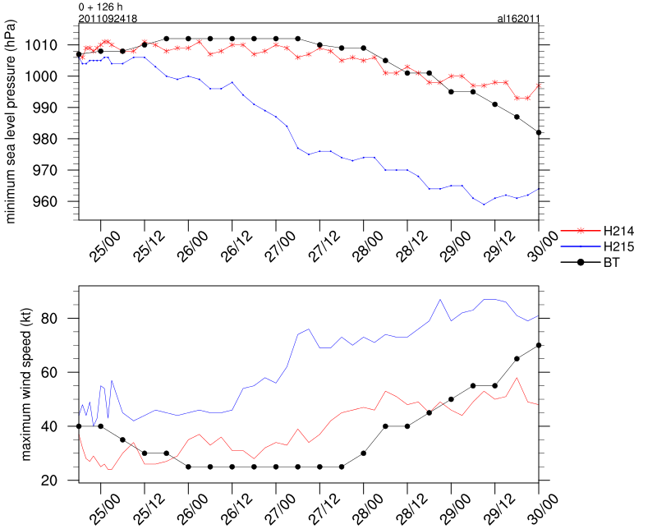
Ophelia 16L 2011
H215: track displacement → favorable location
for over-development
2011-09-24 1800
less vertical wind shear for H215

Slide 3
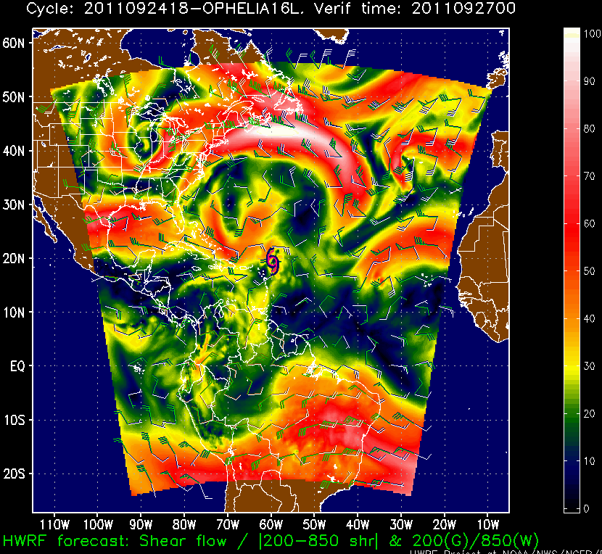
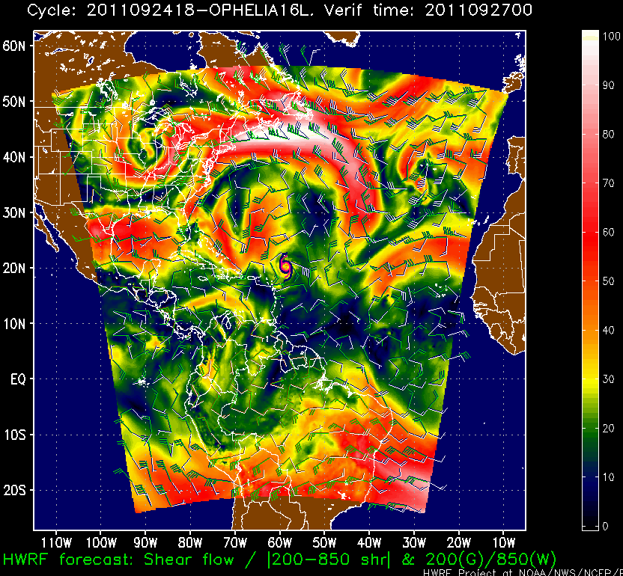
Ophelia 16L 2011
vertical wind shear
2011-09-24 1800
H214
H215

Slide 4
PW (mm)
(0- 200 km average)
averaged by forecast hour
averaged by valid time
Ophelia 16L 2011
Leslie 12L 2012
Katia 12L 2011
Isaac 09L 2012
number of forecasts averaged

Slide 5
temperature difference (H214-H215 °C)
(200-800 km average)
Isaac 09L 2012
Leslie 12L 2012
Katia 12L 2011
Ophelia 16L 2011

Slide 6
rh difference (H214-H215 %)
(200-800 km average)
Isaac 09L 2012
Leslie 12L 2012
Katia 12L 2011
Ophelia 16L 2011

Slide 7
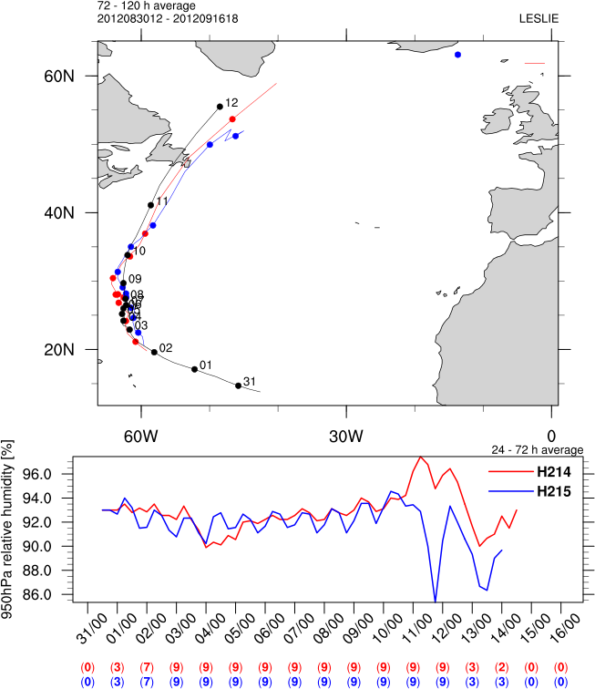
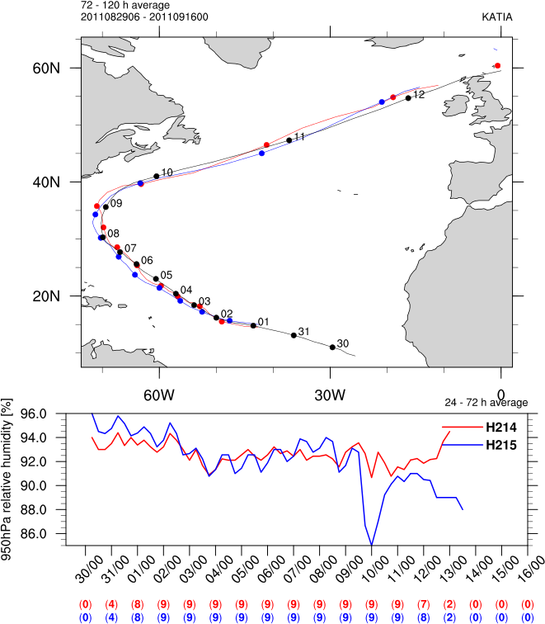
950 hPa RH (%)
(200-800 km average)
H215 amplified diurnal variation in RH (and temperature) near the surface relative to H214

