Slide 1
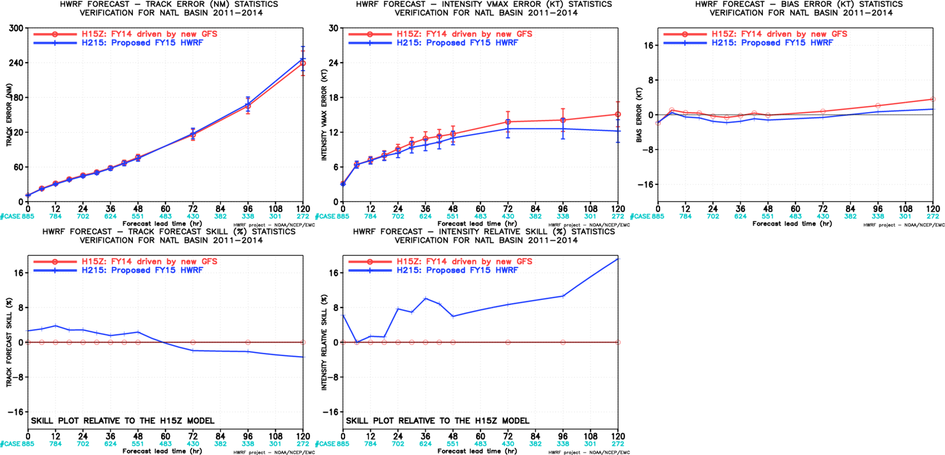
H215 Verification for AL

Slide 2
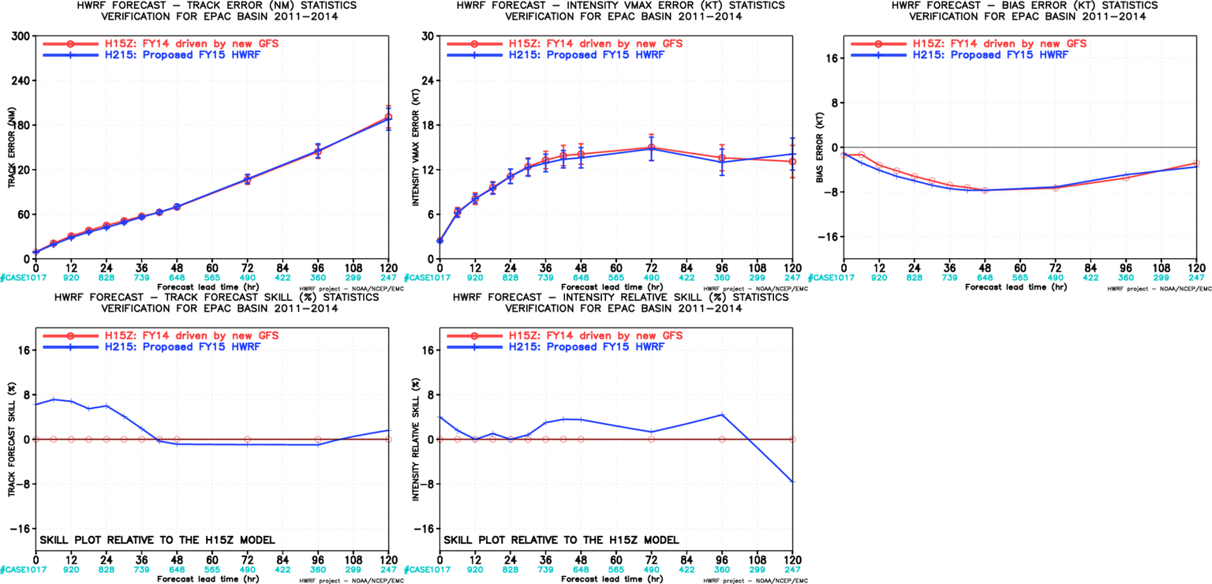
H215 Verification for EP

Slide 3
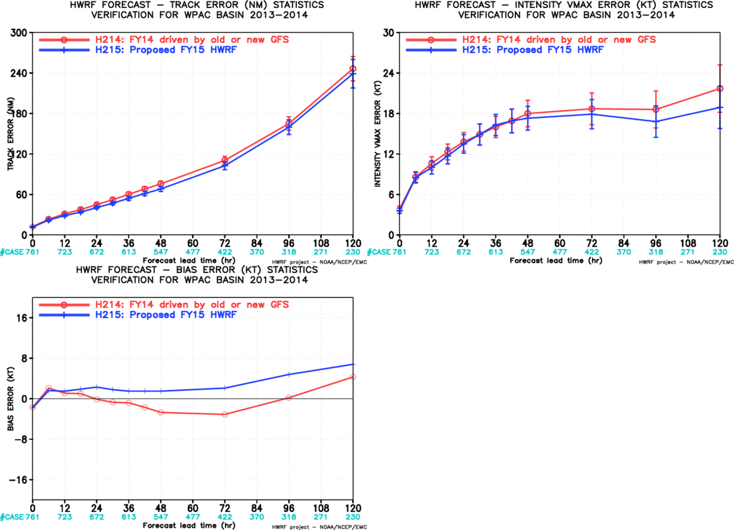
H215 Verification for WP

Slide 4
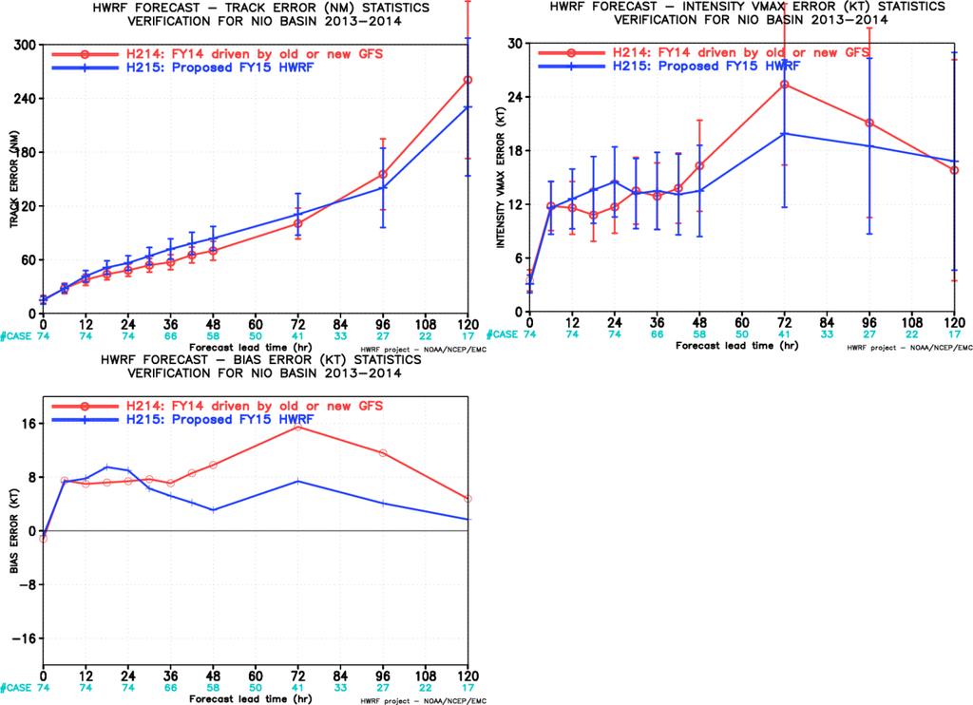
H215 Verification for IO

Slide 5
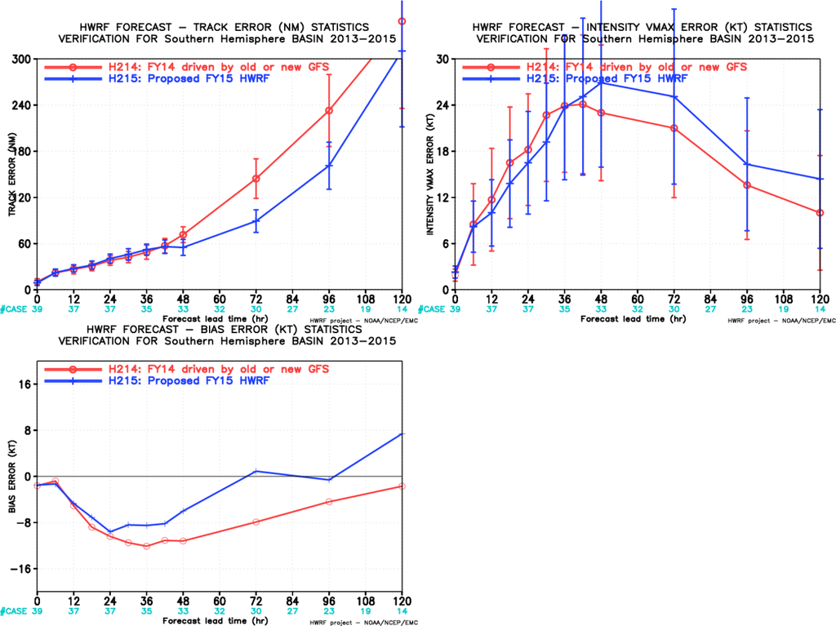
H215 Verification for SH

Slide 6
List of missing or partial finished AL Storms
Year | AL ID | H214 | H215
2011 | 17l | 60 | Missing
2011 | 18l | 21 | Missing
2012 | 01l | 13 | Missing
2012 | 02l | 32 | Missing
2012 | 03l | 18 | Missing
2012 | 04l | 31 | 2012063000 27
2012 | 05l | 41 | 38
2012 | 08l | 26 | 2012081812 14
2012 | 09l | 56 | 2012083000 39
2012 | 10l | 17 | 2012082412 10
2012 | 12l | 54 | 2012090800 38
2012 | 13l | 37 | 34
2012 | 15l | 20 | 2012100512 12
2012 | 19l | 18 | 15
2013 | 01l | 12 | Missing
2013 | 02l | 19 | Missing
2013 | 03l | 21 | 18
2013 | 04l | 32 | 21
2013 | 05l | 21 | Missing
2013 | 06l | 10 | 6
2013 | 07l | 54 | 32
2013 | 09l | 50 | 46
2013 | 10l | 27 | Missing
2013 | 12l | 30 | 2013100506 12
2014 | 01l | 18 | 2014070206 8
2014 | 02l | 8 | Missing
2014 | 03l | 22 | Missing
2014 | 04l | 21 | Missing
2014 | 08l | 28 | 2014101406 12

Slide 7
List of missing or partial finished EP Storms
Year | EP ID | H214 | H215
2012 | 01e | 25 | Missing
2012 | 02e | 29 | Missing
2012 | 03e | 18 | Missing
2012 | 04e | 39 | Missing
2012 | 05e | 39 | Missing
2012 | 17e | 28 | Missing
2013 | 01e | 5 | Missing
2013 | 02e | 19 | 1
2013 | 03e | 26 | 21
2013 | 05e | 30 | 2013070912 22
2013 | 06e | 29 | 24
2013 | 07e | 39 | 32
2013 | 08e | 49 | 19
2013 | 12e | 24 | 2013090806 14
2013 | 13e | 31 | 27
2013 | 15e | 29 | 12
2013 | 16e | 17 | 9
2013 | 18e | 20 | 6
2014 | 01e | 28 | 1
2014 | 02e | 8 | 1
2014 | 03e | 23 | 2
2014 | 06e | 6 | 2

Slide 8
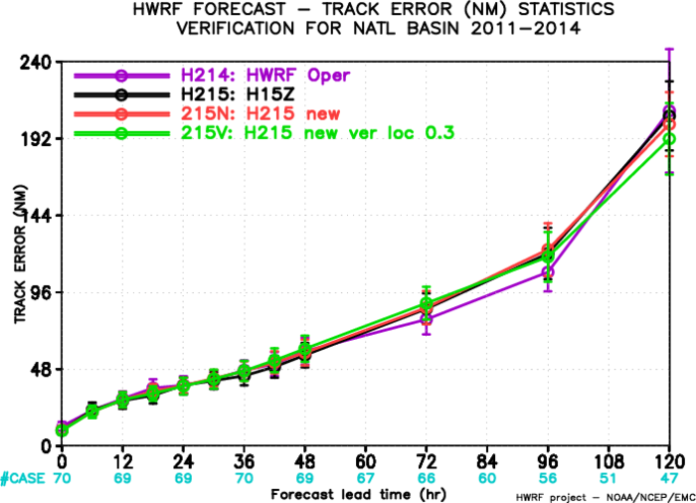
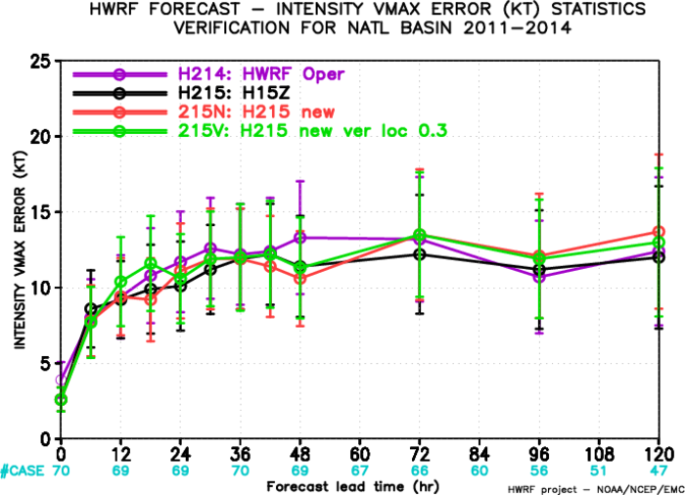
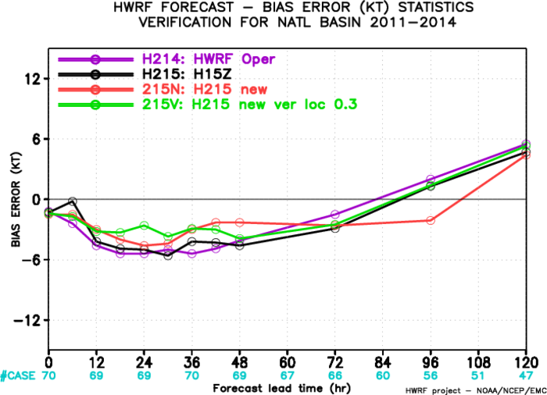
H215 w/ TDR Verification for AL

