Slide 1

H215 Verification at DTC
Christina Holt
Ligia Bernardet
Weekly EMC HWRF Meeting
04/09/2015

Slide 2
H215 vs H15Z
 | H15Z | H215
 | Control | Experiment
Model | 2014 HWRF | Configuration & Physics Upgrades
Input data | New GFS | New GFS
HWRF File Locations | hpss:/2year/NCEPDEV/emc-hwrf/H15Z | hpss:/2year/NCEPDEV/emc-hwrf/H215
Verified Against | H15Z Analysis | H215 Analysis
Model Evaluation Tools (MET) was used to perform large scale analysis
All hwrfprs_p Grib2 files were regridded onto a 0.25°×0.25° Mega Domain (see next slide)

Slide 3
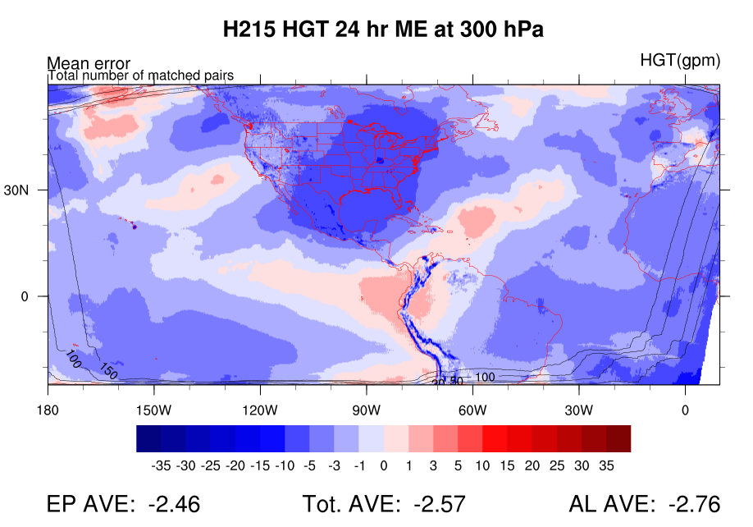
Mega Domain
0.25°× 0.25°
Areal averages do not extend to edge to exclude areas with fewer matched pairs

Slide 4
H15Z vs. H215
EP Cases Only, Homogeneous Comparison
FHR | # Cases
24 | 783
48 | 586
72 | 434
96 | 308
120 | 204
Each configuration is verified against it’s own analysis
Sources of differences in analyses:
  GFS interpolated to different resolution HWRF d01
  Merge differences from d01/d02 (same locations in each comparison)

Slide 5
EP Domain
EP Domain
H15Z Bias
H215 Bias
HGT
Pressure Level (hPa)
Large reduction in biases in H215 for all variables at nearly all times & levels
TMP
Pressure Level (hPa)
Pressure Level (hPa)
SPFH
Notes:
Large reduction in biases overall!
H215 Warming in mid-levels
H215 Cools drastically (over H15Z) at lower levels

Slide 6
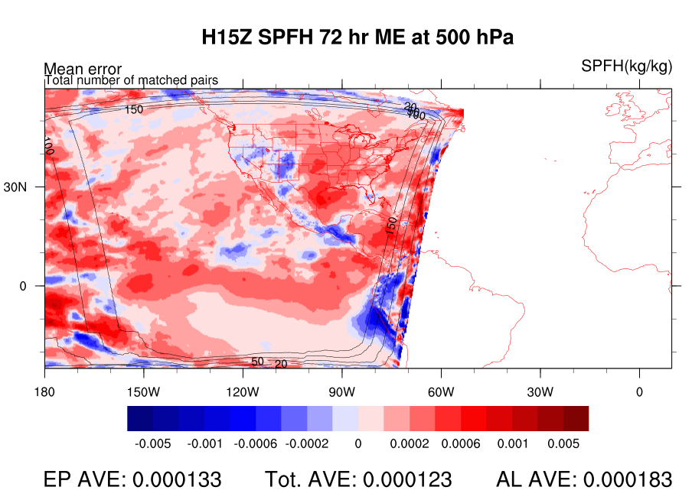
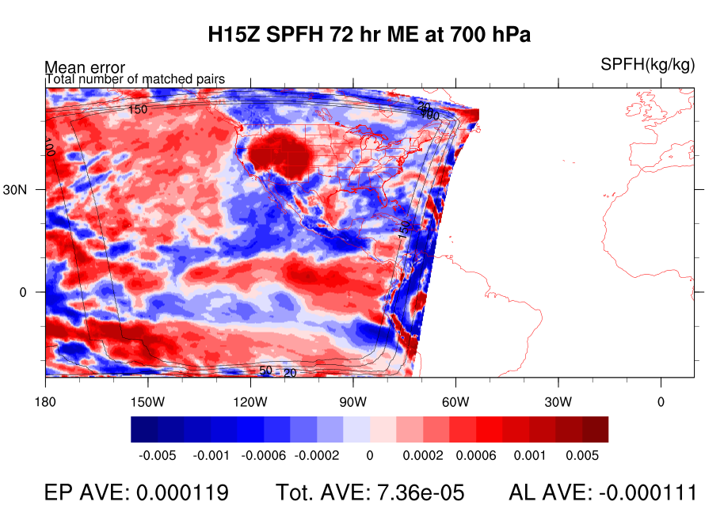
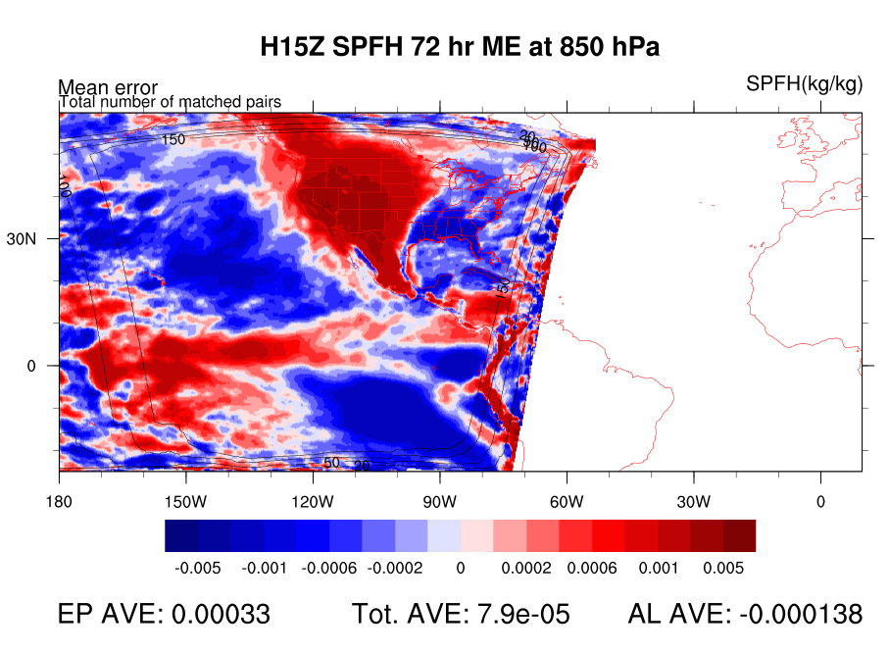
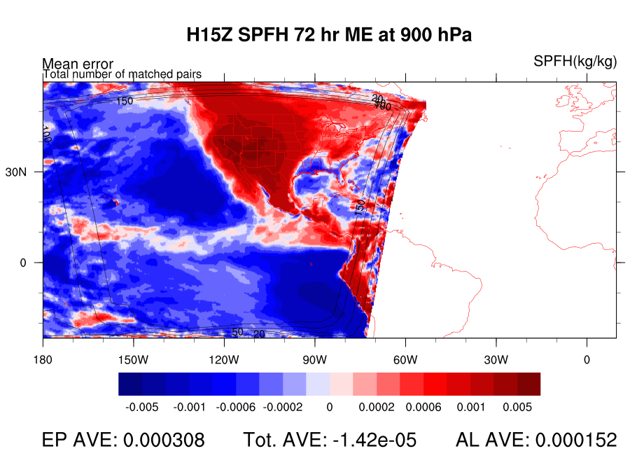
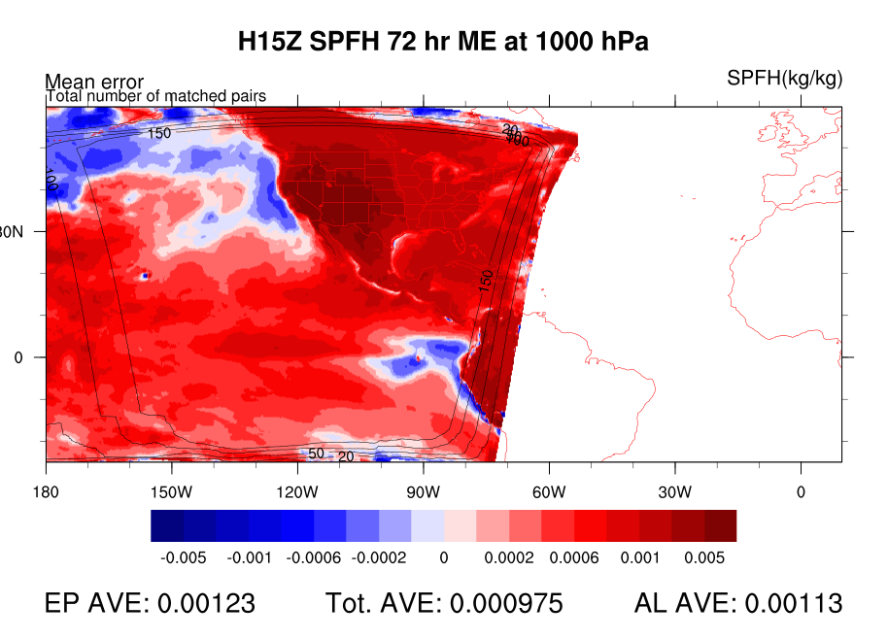
!!! CAUTION !!!
EP Domain
H15Z Bias
500 hPa
72 Hr Fcst
SPFH
700 hPa
850 hPa
900 hPa
1000 hPa
Averages may be dominated by a smaller area of extreme errors, NOT representative of the larger area

Slide 7
H15Z Bias
EP Domain
H215 Bias
EP Domain
VGRD
Pressure Level (hPa)
UGRD
Pressure Level (hPa)
Positive U Wind Bias Reduced (flipped)
Notes:
Flip in bias of midlevel U wind, and low level but opposite way.

Slide 8
EP Domain
EP Domain
H15Z RMSE
H215 RMSE
HGT
TMP
SPFH

Slide 9
H15Z RMSE
EP Domain
H215 RMSE
EP Domain
VGRD
Pressure Level (hPa)
UGRD
Pressure Level (hPa)

Slide 10
EP Domain
Percent Error
EP Domain
HGT
VGRD
TMP
UGRD
SPFH
Red: H215 % Improvement
Blue: H215 % Degradation

Slide 11
Shelter Level Variables
EP Domain
H15Z Bias
H215 Bias

Slide 12
Shelter Level Variables
EP Domain
H15Z RMSE
H215 RMSE

Slide 13
EP Domain
H215 – H15Z Bias*
EP Domain
HGT
H215: stronger V in lower half of tropo
VGRD
TMP
UGRD
H215 is warmer/moister in lower tropo.
H215: weaker mid-level U & stronger low-lev U
SPFH
*Diff in bias is an indicator of “warmer/cooler”, etc. It provides no indication of “better/worse”

Slide 14
Summary
Hovmoller diagrams provide concise way to look at experiment errors, but caution must be used when drawing conclusions
H215 drastically reduces biases in HGT, TMP, SPFH, improving fields by as much as 30%
H215 is warmer and moister in lower troposphere
H215 has stronger U & V components in lower troposphere
Adding ATL cases can change CONUS area statistics significantly

Slide 15
H215 Only
The following slides verify a larger set of AL and EP storms for H215
FHR | # Cases
24 | 1585
48 | 1202
72 | 927
96 | 700
120 | 521

Slide 16
EP Domain
Mega Domain
AL Domain
H215 Bias
HGT
TMP
SPFH
Notes:
ATL does not warm as much in 700-850 layer.
ATL and EP domains are moister in low levels than rest of domain

Slide 17
H215 Bias
EP Domain
Mega Domain
AL Domain
VGRD
UGRD
Notes:
Atlantic doesn’t have same wind profile

Slide 18
EP Domain
Mega Domain
AL Domain
H215 RMSE
HGT
TMP
SPFH

Slide 19
H215 RMSE
EP Domain
Mega Domain
AL Domain
VGRD
UGRD

Slide 20
H215 Bias
EP Domain
Mega Domain
AL Domain
Shelter Level Variables

Slide 21
H215 RMSE
EP Domain
Mega Domain
AL Domain
Shelter Level Variables
Notes:
ATL does not warm as much in 700-850 layer.
ATL and EP domains are moister in low levels than rest of domain

Slide 22
Summary
ATL doesn’t have same vertical/temporal distribution of errors as EP and Mega for TMP, SPFH, U/V wind
Comparison with baseline is needed for the full set of EP and ATL cases
Considering separating cases in each basin for verification

